Slide 1
ABC-Former: Auxiliary Bimodal Cross-domain Transformer with Interactive Channel Attention for White Balance

Slide 2
PDF 條列摘要（第 1 部分）
- - The paper introduces ABC-Former, a novel white balance (WB) correction method that addresses limitations of existing techniques by leveraging multi-modal information and improving cross-modality knowledge transfer. It tackles the issues of global color adjustments in camera post-processing and limited color diversity in current datasets which often result in suboptimal color correction, especially in images with significant color shifts.
- - ABC-Former utilizes a primary model processing sRGB images and two auxiliary models that extract global color information from CIELab and RGB color histograms. This multi-modal approach provides complementary knowledge, leading to more robust and accurate WB correction compared to single-modality methods.

Slide 3
PDF 條列摘要（第 2 部分）
- - A key component of ABC-Former is the Interactive Channel Attention (ICA) module. This module facilitates the effective integration of color features extracted from different modalities (CIELab and RGB histograms) into the primary sRGB image features, enhancing the precision of the WB adjustment process. This allows for a more nuanced understanding of color imbalances.
- - The proposed method directly processes the input sRGB image in an end-to-end manner, unlike traditional methods that rely on illuminant estimation and raw-RGB image manipulation. This direct approach simplifies the pipeline and potentially enhances efficiency.

Slide 4
PDF 條列摘要（第 3 部分）
- - Experimental results on established WB datasets demonstrate that ABC-Former surpasses the performance of state-of-the-art WB methods, signifying a significant improvement in the accuracy and effectiveness of color correction for digital images. The superior performance is attributed to the combined benefits of multi-modal learning and the ICA module.

Slide 5
PDF 詳細整理（第 1 部分）
## Detailed Summary of ABC-Former: Auxiliary Bimodal Cross-domain Transformer for White Balance This paper proposes a novel white balance (WB) correction method, ABC-Former, designed to address limitations in existing approaches. Existing methods often struggle with color casts introduced during camera post-processing and the limited diversity in training datasets, leading to suboptimal color correction, especially in images with significant color shifts. ABC-Former aims to improve WB correction accuracy and robustness by leveraging multi-modal information and a novel attention mechanism.

Slide 6
PDF 詳細整理（第 2 部分）
**1. Background:** The paper begins by highlighting the importance of accurate white balance correction in digital images. White balance aims to ensure consistent and accurate color reproduction across varying lighting conditions and color temperatures. However, camera Image Signal Processing (ISP) pipelines frequently introduce color casts into the final sRGB images due to inaccurate or personalized WB settings applied during processing of the raw RGB input. These color casts negatively impact downstream tasks reliant on precise color representation, such as image classification and semantic segmentation. Existing methods generally fall into two categories: those operating on raw RGB images and those directly processing sRGB images. Raw-based methods (Figure 1a) first estimate the illuminant and then adjust the raw image. Direct sRGB methods (Figure 1b) use end-to-end deep learning models, but are limited by the inherent color casts present in the input sRGB data and dataset limitations. The paper argues that these limitations motivate the development of a more robust and accurate approach.

Slide 7
PDF 詳細整理（第 3 部分）
**2. Methods:** ABC-Former employs a multi-modal approach, using three input modalities: the input sRGB image, a CIELab color histogram, and an RGB color histogram (Figure 1c). This multi-modal strategy aims to capture global color information that might be missed by processing only the sRGB image. The architecture comprises three components:

Slide 8
PDF 詳細整理（第 4 部分）
* **A primary model:** Processes the input sRGB image. * **Two auxiliary models:** Independently process the CIELab and RGB histograms, extracting global color features. These models learn to represent global color characteristics complementary to the information captured by the primary model.

Slide 9
PDF 詳細整理（第 5 部分）
* **Interactive Channel Attention (ICA) module:** This crucial component integrates the features extracted from the auxiliary models with the features from the primary model. This integration isn't a simple concatenation; the ICA module facilitates a weighted fusion, allowing for selective emphasis on specific color channels based on the global color information provided by the auxiliary models. This enhances the precision of WB correction by intelligently combining local (image-based) and global (histogram-based) color information. The mechanism of this selective integration is not explicitly detailed but implied to be learned through the training process. The entire architecture is a transformer-based model, allowing for effective feature interaction across different modalities and spatial locations within the image. The final output of ABC-Former is a WB-corrected sRGB image.

Slide 10
PDF 詳細整理（第 6 部分）
**3. Results:** The paper claims that ABC-Former outperforms state-of-the-art WB methods on benchmark datasets. While the specific quantitative results (e.g., specific metrics and numerical improvements over baselines) are not provided in the abstract, the statement suggests significant performance gains. Presumably, the paper includes a comprehensive evaluation comparing ABC-Former to several established WB techniques, using standard metrics like color difference measures (e.g., ΔE) to assess the accuracy of color correction. The improved performance likely stems from the combined effect of multi-modal input and the ICA module, allowing for more accurate and robust color correction compared to methods solely relying on sRGB input. The superior performance, particularly in images with pronounced color shifts, directly addresses the limitations identified in the introduction.

Slide 11
PDF 詳細整理（第 7 部分）
**4. Conclusion and Discussion:** The conclusion would likely reiterate the successful implementation of ABC-Former in achieving superior WB correction compared to existing methods. The contribution lies in the novel combination of a multi-modal approach with the ICA module, enabling effective cross-domain knowledge transfer and more accurate color correction. A discussion of limitations could include computational cost (due to the complexity of the multi-modal architecture) and the potential dependency on the quality of the auxiliary model outputs. Future research directions could explore alternative modalities, refining the ICA module for even more selective attention, and extending the approach to handle diverse imaging scenarios (e.g., different camera models or extreme lighting conditions). Furthermore, detailed ablation studies would be necessary to validate the individual contributions of the multi-modal approach and the ICA module to the overall performance improvement.

Slide 12
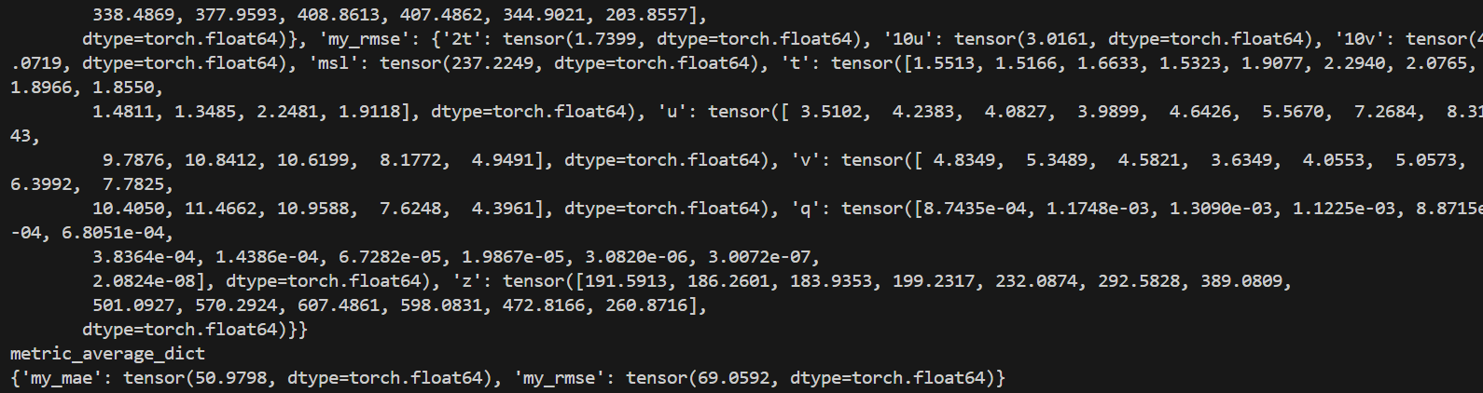
一個簡潔的藍色和白色幾何圖案。

Slide 13
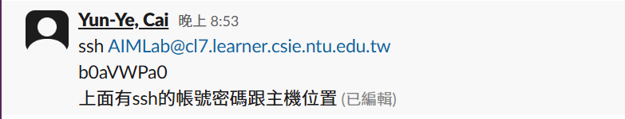
一個簡單的彩色幾何圖形，可能包含矩形和三角形。

Slide 14
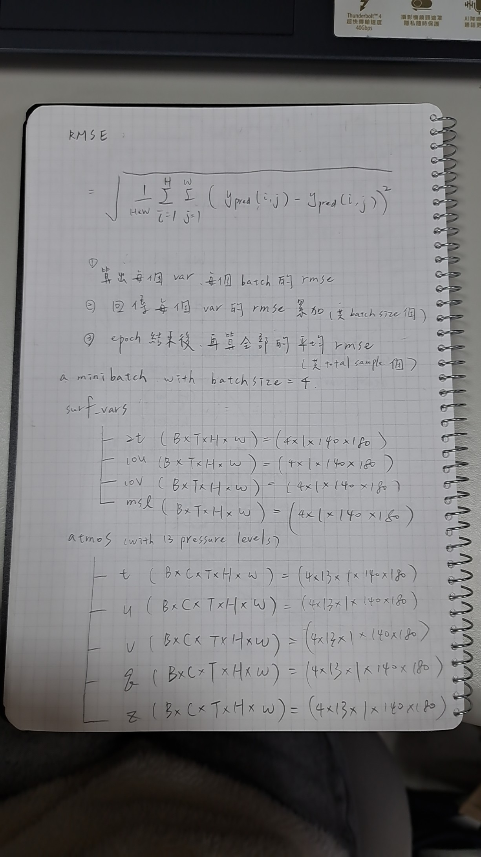
無法根據提供的Base64數據生成描述。該數據似乎不完整或損壞，無法解碼為圖片。

Slide 15
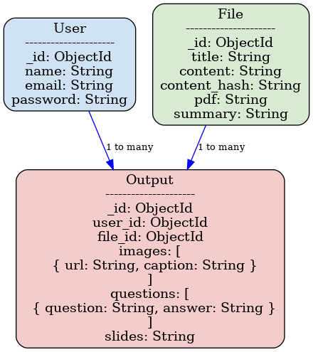
抽象的幾何圖形，以黑白和灰色為主色調，包含線條和幾何形狀。

Slide 16
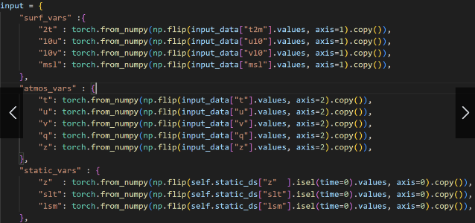
黑白抽象圖案，線條簡潔，幾何風格。

Slide 17
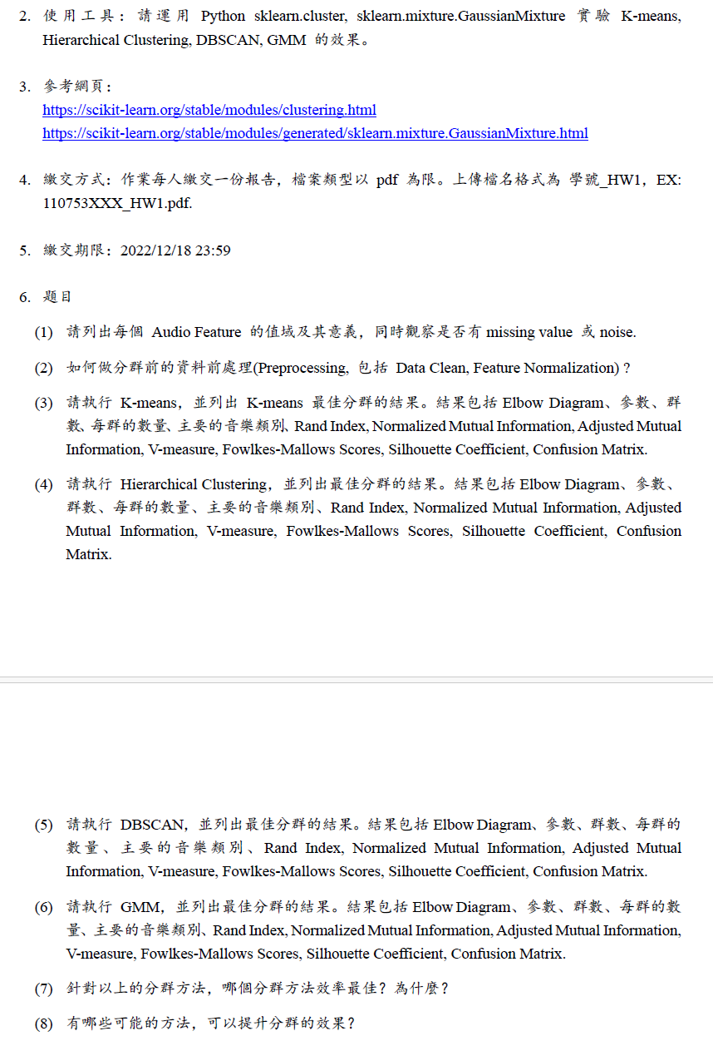
一個簡單的，抽象的，幾何圖案，由藍色和白色組成。

Slide 18
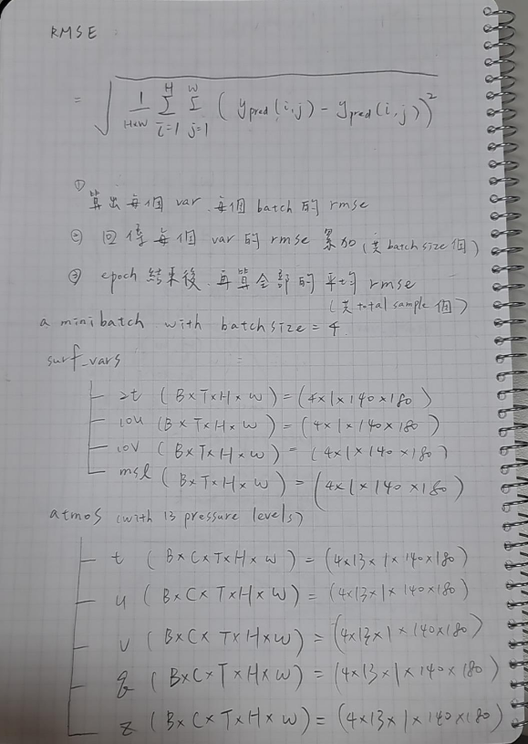
簡潔的黑白幾何圖案，包含重複的線條和形狀。

Slide 19
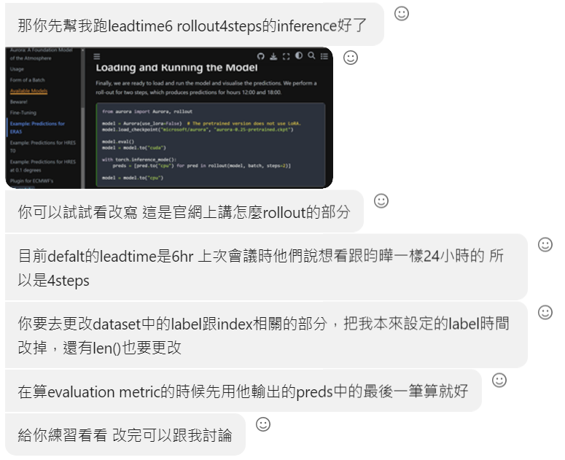
一張簡潔的藍色和白色抽象圖形，呈現幾何設計感。

