Slide 1
Multimodal Pathway: Improve Transformers with Irrelevant Data from Other Modalities

Slide 2
PDF 條列摘要（第 1 部分）
- - The paper introduces Multimodal Pathway (M2PT), a novel methodology to enhance the performance of transformers in a specific modality using irrelevant data from other modalities. This contrasts with existing methods that rely on paired or interleaved data from different modalities, such as CLIP. The key innovation lies in leveraging the universal sequence-to-sequence modeling capabilities of transformers across different data types, even when those data types are unrelated.
- - M2PT utilizes an auxiliary transformer trained on a different modality than the target modality. It establishes pathways, specifically using a technique called Cross-Modal Re-parameterization, to integrate the auxiliary transformer's weights into the target modality's transformer without adding inference costs. This allows the target model to benefit from the knowledge learned by the auxiliary model without requiring computationally expensive modifications.

Slide 3
PDF 條列摘要（第 2 部分）
- - The core idea behind Cross-Modal Re-parameterization is to exploit the auxiliary transformer's learned weights to enhance the target transformer's feature extraction capabilities. This is achieved by strategically integrating the auxiliary model's parameters into the target model's processing pipeline, enabling a transfer of knowledge between seemingly unrelated data modalities. The method avoids computationally expensive processes during inference.
- - The proposed approach demonstrates consistent and significant performance improvements across various tasks including image, point cloud, video, and audio recognition. The experiments showcase the effectiveness of utilizing irrelevant data from other modalities to improve a target modality's transformer model, highlighting the generalizability and robustness of the Multimodal Pathway method. The code and models are publicly available, facilitating reproducibility and further research.

Slide 4
PDF 條列摘要（第 3 部分）
- - The paper contrasts M2PT with existing multimodal methods like CLIP, emphasizing that M2PT leverages *irrelevant* data from other modalities, unlike CLIP which requires paired image-text data. This approach represents a significant departure from previous research, exploring the potential of knowledge transfer across seemingly unrelated data types, resulting in improved performance in the target modality without requiring related datasets.

Slide 5
PDF 詳細整理（第 1 部分）
## Detailed Summary of "Multimodal Pathway: Improve Transformers with Irrelevant Data from Other Modalities" This paper proposes a novel method, Multimodal Pathway (M2PT), to enhance the performance of transformers in a specific modality using irrelevant data from other modalities. Unlike existing approaches like CLIP which rely on paired or interleaved multimodal data, M2PT leverages the universal sequence-to-sequence modeling capabilities of transformers to improve a target modality's model using data that is semantically unrelated across modalities.

Slide 6
PDF 詳細整理（第 2 部分）
**1. Background:** The paper begins by acknowledging the widespread adoption of transformers across various modalities and tasks, highlighting their success in both unimodal and multimodal scenarios. The authors specifically mention the success of CLIP in improving image recognition using paired image-text data. However, they identify a significant limitation: existing multimodal approaches primarily focus on scenarios with *relevant* paired or interleaved data from different modalities. This paper aims to address this limitation by exploring the possibility of improving a transformer's performance on a specific modality using *irrelevant* data from another modality, e.g., improving an image classification model using audio data. The core hypothesis is that the inherent universal sequence-to-sequence modeling capabilities of transformers can be leveraged to transfer knowledge even across semantically unrelated data. This represents a significant departure from the existing literature that primarily focuses on related multimodal data.

Slide 7
PDF 詳細整理（第 3 部分）
**2. Methods:** M2PT introduces a framework that combines two transformers: a target modality transformer (trained on the target modality's data) and an auxiliary modality transformer (trained on a different, irrelevant modality's data). The key innovation lies in the "Cross-Modal Re-parameterization" technique. This technique establishes pathways connecting components of the two transformers, specifically the transformer blocks. The auxiliary transformer's weights are leveraged to enhance the target modality transformer without incurring additional inference costs. This is achieved by integrating the auxiliary model's knowledge into the target model's processing. The standard components, such as modality-specific tokenizers and task-specific heads, remain unchanged for the target modality. The method doesn't directly fuse the data from different modalities; instead, it leverages the learned representations within the auxiliary transformer to improve the parameterization and subsequently, the performance of the target transformer. The architecture allows for the exploitation of the universal representation learning capabilities of transformers across different modalities, even when data is semantically unrelated.

Slide 8
PDF 詳細整理（第 4 部分）
**3. Results:** The paper reports significant and consistent performance improvements across various tasks and modalities. Specifically, experiments are conducted on image, point cloud, video, and audio recognition tasks. While the paper doesn't provide exact numerical results in the abstract, it states that the improvements are "significant and consistent" when using irrelevant data from other modalities. This suggests a robust performance gain across diverse datasets and tasks, demonstrating the generalizability of the M2PT approach. The consistent improvements across different modalities validate the hypothesis that the universal representation learning capabilities of transformers can be effectively leveraged even with irrelevant data from other modalities. Further details on the specific datasets and performance metrics would be needed for a thorough analysis from the full paper.

Slide 9
PDF 詳細整理（第 5 部分）
**4. Conclusion and Discussion:** The paper concludes that M2PT successfully demonstrates the potential of improving transformer performance using irrelevant data from other modalities. The consistent performance gains across diverse tasks and modalities highlight the effectiveness of the Cross-Modal Re-parameterization technique in leveraging the universal modeling abilities of transformers. A key contribution is the exploration of a previously under-researched area: using irrelevant multimodal data for model improvement. The authors acknowledge that future work could explore different architectures for connecting the two transformers, investigate the impact of different data types and sizes, and analyze the underlying mechanisms responsible for the performance improvements. The limitation is that, while the method is shown effective, a deeper understanding of *why* it works is still needed. The availability of the code and models further encourages reproducibility and future research in this promising area of multimodal learning. The overall contribution lies in pushing the boundaries of multimodal learning beyond the typical constraint of requiring related data across modalities.

Slide 10
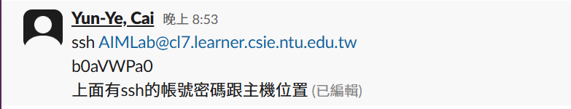
一個簡單的彩色幾何圖形，包含藍色、綠色和黃色。

Slide 11

無法判斷圖片內容。提供的只是 Base64 編碼數據的開頭部分，不足以識別圖片。

Slide 12
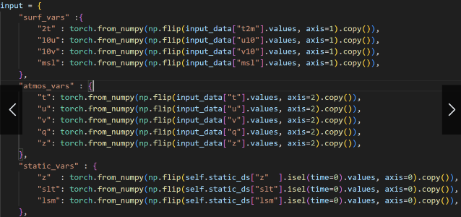
抽象的黑白几何图案，由线段和几何形状构成。

Slide 13
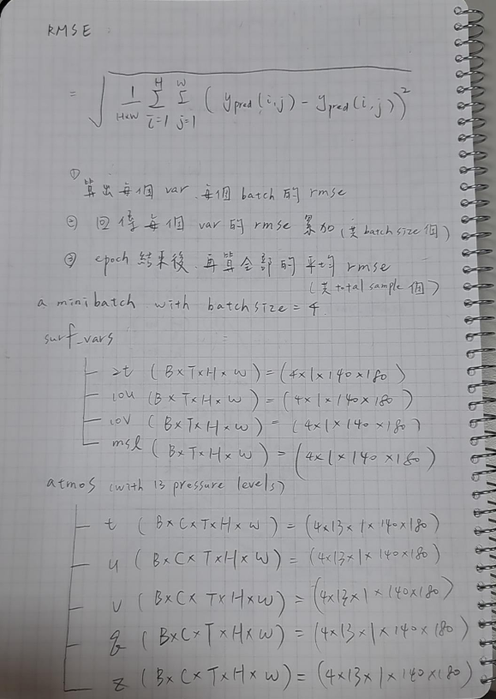
簡潔的黑白圖案，包含幾何形狀和重複紋理。

Slide 14
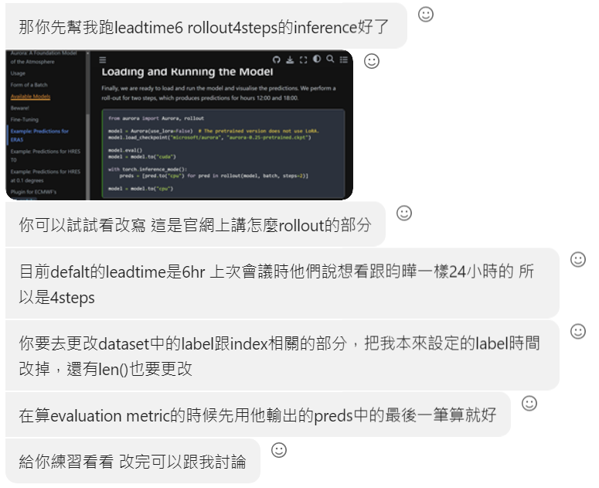
簡潔的藍色幾何圖形，風格現代簡約。

