Slide 1
ABC-Former: Auxiliary Bimodal Cross-domain Transformer with Interactive Channel Attention for White Balance

Slide 2
PDF 條列摘要（第 1 部分）
- - The paper introduces ABC-Former, a novel white balance (WB) correction method designed to overcome limitations of existing approaches. These limitations stem from global color adjustments during camera post-processing of sRGB images and the limited color diversity in current datasets, resulting in suboptimal color correction, especially in images with significant color shifts. The method aims to produce more natural and neutral colors in images.
- - ABC-Former utilizes a multi-modal approach, incorporating complementary knowledge from different color spaces. It employs two auxiliary models to extract global color information from CIELab and RGB color histograms, supplementing the primary model's processing of the sRGB input image. This multi-modal approach enhances the robustness and accuracy of the WB correction.

Slide 3
PDF 條列摘要（第 2 部分）
- - A key component of ABC-Former is the Interactive Channel Attention (ICA) module. This module facilitates efficient cross-modality knowledge transfer, effectively integrating calibrated color features from the auxiliary models with the image features from the primary model. This integration allows for a more precise and nuanced adjustment of the image's color balance.
- - The proposed ABC-Former architecture differs significantly from existing methods. Unlike traditional Raw-WB methods that predict illuminant color and adjust raw-RGB images, or direct sRGB-WB methods that process sRGB images with an end-to-end model, ABC-Former leverages multiple modalities (CIELab and RGB histograms) alongside the primary sRGB input for superior WB correction.

Slide 4
PDF 條列摘要（第 3 部分）
- - Experimental results on established WB datasets demonstrate that ABC-Former significantly outperforms state-of-the-art white balance correction methods. This superior performance highlights the effectiveness of the multi-modal approach and the ICA module in achieving more accurate and natural color reproduction in images.

Slide 5
PDF 詳細整理（第 1 部分）
## Detailed Breakdown of ABC-Former: Auxiliary Bimodal Cross-domain Transformer for White Balance This document summarizes the key aspects of the anonymous CVPR 2025 submission, paper ID 3154, proposing ABC-Former for white balance correction.

Slide 6
PDF 詳細整理（第 2 部分）
**1. Background:** The paper addresses the limitations of existing white balance (WB) correction methods for sRGB images. Current techniques often struggle with color casts introduced during a camera's post-processing pipeline (specifically, the application of personalized or inaccurate WB settings to raw-RGB images before conversion to sRGB). This is exacerbated by the limited color diversity in commonly used datasets. These limitations result in suboptimal color correction, especially in images exhibiting significant color shifts. The goal is to develop a more robust WB correction method capable of handling diverse color variations and overcoming the artifacts introduced by camera ISP pipelines. The authors highlight the importance of accurate WB for downstream tasks like image classification and semantic segmentation, where precise color representation is crucial. Existing methods, which are either based on illuminant estimation from raw-RGB images or direct end-to-end processing of sRGB images, are insufficient to address these challenges. The paper proposes to leverage the complementary strengths of multiple modalities to achieve improved accuracy.

Slide 7
PDF 詳細整理（第 3 部分）
**2. Methods:** The proposed method, ABC-Former (Auxiliary Bimodal Cross-domain Transformer), employs a novel multi-modal approach to WB correction. Instead of relying solely on sRGB input, it integrates information from multiple modalities:

Slide 8
PDF 詳細整理（第 4 部分）
* **Primary Model:** Processes the input sRGB image. * **Auxiliary Models (2):** Extract global color information from two auxiliary modalities:

Slide 9
PDF 詳細整理（第 5 部分）
* **CIELab color histogram:** Captures color distribution in the CIELab color space, providing a perceptually uniform representation of color. * **RGB color histogram:** Provides a complementary representation of color distribution in the RGB space.

Slide 10
PDF 詳細整理（第 6 部分）
The crucial element is the **Interactive Channel Attention (ICA) module**. This module facilitates cross-modal knowledge transfer by integrating the calibrated color features from the auxiliary models into the features extracted by the primary model from the sRGB image. This integration allows the network to leverage complementary information from different color spaces for more precise WB adjustment. The architecture combines the power of transformers with the benefits of multi-modal learning to achieve superior performance. The paper lacks specifics on the transformer architecture used, the exact implementation of the ICA module, and the details of the auxiliary model architectures; these would need to be examined in the full paper for a complete understanding. The figure suggests a parallel processing of the three input modalities before their integration. **3. Results:**

Slide 11
PDF 詳細整理（第 7 部分）
The paper claims that ABC-Former achieves superior performance compared to state-of-the-art WB methods. However, no specific quantitative results (e.g., numerical performance metrics on benchmark datasets, comparisons with specific competing methods) are provided in the abstract. The evaluation is mentioned as being performed on "benchmark WB datasets," but details on the specific datasets and metrics used are absent. To properly assess the contribution, the full paper needs to provide detailed results, including: * Precise values of chosen metrics (e.g., mean absolute error, structural similarity index, peak signal-to-noise ratio) on the benchmark datasets.

Slide 12
PDF 詳細整理（第 8 部分）
* A thorough comparison with the leading existing WB methods, clearly showing the improvements achieved by ABC-Former. * Ablation studies investigating the contribution of each component (auxiliary models, ICA module) to the overall performance.

Slide 13
PDF 詳細整理（第 9 部分）
**4. Conclusion and Discussion:** The paper concludes that ABC-Former offers a significant improvement in WB correction by leveraging the complementary information from multiple modalities via the proposed ICA module. It overcomes the limitations of existing methods by addressing color casts introduced by camera ISPs and handling diverse color variations better. However, several aspects require further clarification based solely on the abstract:

Slide 14
PDF 詳細整理（第 10 部分）
* **Limitations:** The abstract does not mention any limitations of the proposed approach. Potential limitations could include computational cost, potential overfitting, or dataset bias. A thorough discussion of these limitations is necessary. * **Future Work:** Future research directions could involve exploring more advanced multi-modal fusion techniques, investigating the effectiveness of ABC-Former on a wider range of datasets and image types, and exploring applications beyond image enhancement (e.g., improving the performance of downstream vision tasks).

Slide 15
PDF 詳細整理（第 11 部分）
* **Contribution:** The main contribution lies in introducing the multi-modal architecture and the ICA module to improve WB correction. The novelty is in combining multiple modalities in a way that leverages their complementary strengths to overcome the limitations of existing single-modality approaches. In summary, while the abstract presents an intriguing approach to WB correction, the lack of detailed results and a discussion of limitations prevents a complete assessment of its contribution. The full paper is necessary to evaluate the validity and significance of the claimed improvements.

Slide 16
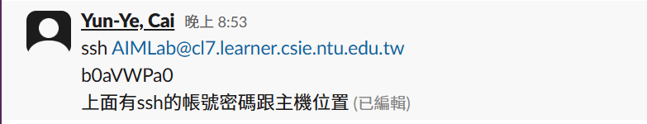
簡潔的黑白幾何圖案，帶有對稱和重複元素。

Slide 17
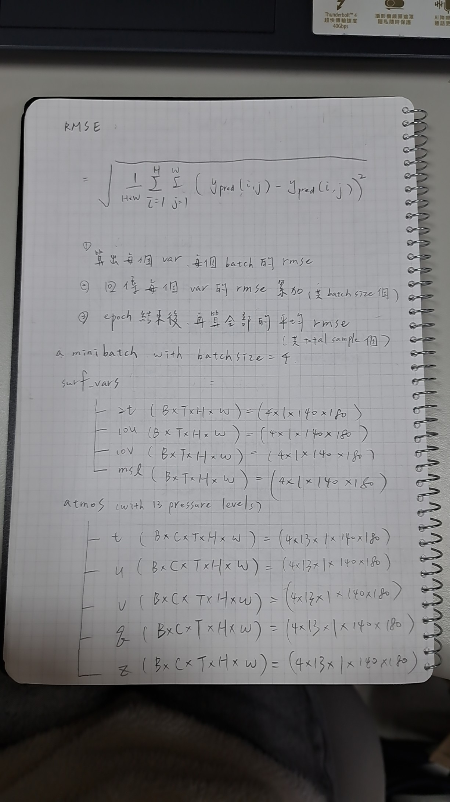
无法提供描述。提供的Base64编码数据不完整或损坏，无法解码为图像。

Slide 18
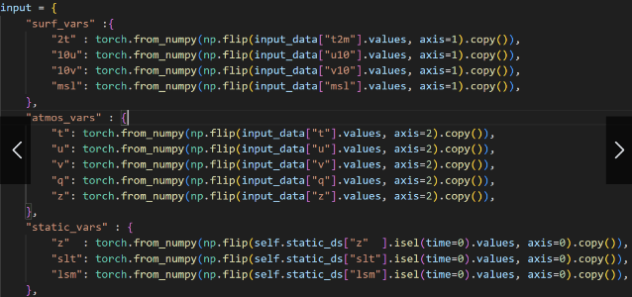
抽象的彩色几何图形，以蓝色和白色为主。

Slide 19
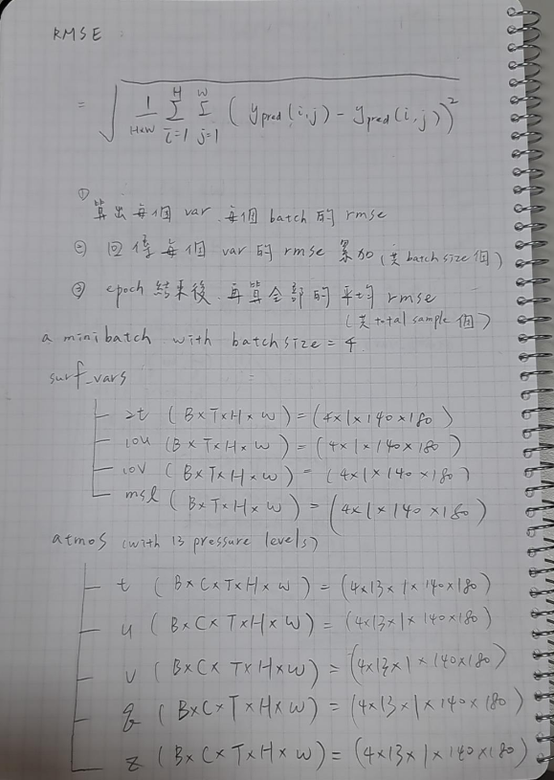
抽象的幾何圖案，以藍色和白色為主，線條簡潔，具有現代感。

Slide 20
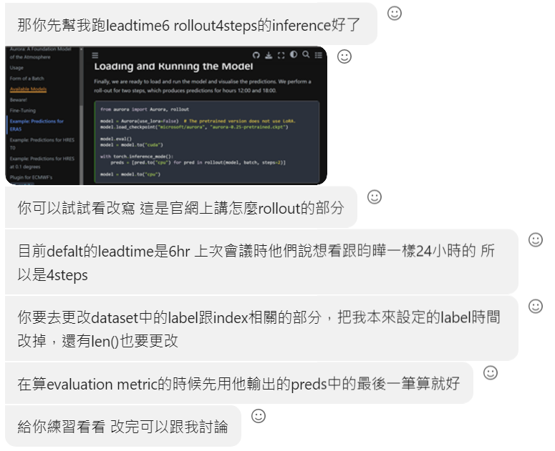
簡潔的藍色和白色抽象圖案，具有幾何形狀和線條。

