Slide 1
ABC-Former: Auxiliary Bimodal Cross-domain Transformer with Interactive Channel Attention for White Balance

Slide 2
PDF 條列摘要（第 1 部分）
- - The paper proposes ABC-Former, a novel white balance (WB) correction method that addresses limitations of existing approaches by leveraging multi-modal information and refined feature integration. It overcomes the suboptimal color correction often resulting from global adjustments in camera post-processing and limited color diversity in current datasets.
- - ABC-Former utilizes a primary model processing sRGB images and two auxiliary models extracting global color information from CIELab and RGB color histograms. This multi-modal approach provides complementary knowledge for more robust and accurate WB correction compared to single-modality methods.

Slide 3
PDF 條列摘要（第 2 部分）
- - An Interactive Channel Attention (ICA) module is introduced within ABC-Former to effectively integrate calibrated color features from the auxiliary models with the primary model's image features. This cross-modality knowledge transfer allows for more precise adjustments and improved overall WB results.
- - The proposed method directly processes the input sRGB image in an end-to-end manner, unlike traditional methods that operate on raw RGB images and require illuminant estimation. This streamlined approach simplifies the process and potentially improves efficiency.

Slide 4
PDF 條列摘要（第 3 部分）
- - Experimental results on benchmark WB datasets demonstrate that ABC-Former significantly outperforms state-of-the-art WB methods. This superior performance validates the effectiveness of the proposed multi-modal architecture and ICA module in achieving improved white balance correction.

Slide 5
PDF 詳細整理（第 1 部分）
This paper, "ABC-Former: Auxiliary Bimodal Cross-domain Transformer with Interactive Channel Attention for White Balance," proposes a novel approach to white balance (WB) correction for sRGB images. Let's break down the key aspects: **1. Background:**

Slide 6
PDF 詳細整理（第 2 部分）
The paper addresses the limitations of existing white balance correction methods. Current techniques often suffer from suboptimal results due to two main factors: (a) global color adjustments introduced during a camera's post-sRGB processing, which can lead to inaccurate color correction, particularly in images with significant color shifts; and (b) the limited color diversity in existing datasets used to train these models, hindering their generalization capabilities. The existing methods can be broadly categorized into two types: (a) Raw-WB methods that predict the illuminant color and adjust the raw RGB image, and (b) DNN-based sRGB-WB methods that directly process the input sRGB image. The authors argue that both approaches have shortcomings and lack the ability to leverage complementary information from different color spaces and representations. The goal of this research is to develop a more robust and accurate WB correction method that overcomes these limitations. **2. Methods:**

Slide 7
PDF 詳細整理（第 3 部分）
The authors propose ABC-Former, an Auxiliary Bimodal Cross-domain Transformer, to improve WB correction. This approach uses a multi-modal strategy by incorporating information from multiple color spaces and representations. Specifically, ABC-Former consists of three main components: * **Primary Model:** This model processes the input sRGB image.

Slide 8
PDF 詳細整理（第 4 部分）
* **Two Auxiliary Models:** These models extract global color information from two different modalities: a CIELab color histogram (capturing perceptual color information) and an RGB color histogram (capturing raw color information). These auxiliary models provide complementary information to the primary model, enhancing its ability to handle diverse color distributions. * **Interactive Channel Attention (ICA) Module:** This crucial module facilitates knowledge transfer between the primary model and the auxiliary models. The ICA module integrates the calibrated color features (extracted by the auxiliary models) into the image features processed by the primary model. This integration allows the network to learn more refined and precise WB adjustments, combining the global color information with the detailed spatial information from the sRGB image. The architecture uses a transformer to effectively integrate these multi-modal features.

Slide 9
PDF 詳細整理（第 5 部分）
The overall architecture allows for a more comprehensive understanding of the color imbalances in the image, leading to a more effective correction. **3. Results:**

Slide 10
PDF 詳細整理（第 6 部分）
The paper reports that ABC-Former achieves superior performance compared to state-of-the-art WB methods on benchmark WB datasets. While specific quantitative results (e.g., numerical metrics like PSNR, SSIM, or color difference metrics) are not detailed in the provided abstract, the statement clearly indicates a significant improvement. The superior performance likely stems from the effective integration of multi-modal information via the ICA module within the transformer framework, leading to a more nuanced and accurate adjustment of color balance. The paper likely includes detailed comparisons with various existing methods, demonstrating the effectiveness of the proposed approach across different image types and color distributions. **4. Conclusion and Discussion:**

Slide 11
PDF 詳細整理（第 7 部分）
The authors conclude that ABC-Former provides a significant advancement in white balance correction by leveraging the complementary strengths of multi-modal information and a sophisticated attention mechanism. The use of auxiliary models and the ICA module allows for more robust and accurate correction compared to existing methods, particularly in challenging scenarios with pronounced color shifts. The paper likely discusses the limitations of the proposed method, such as potential computational costs associated with the multi-modal architecture. Future research directions might involve exploring other modalities or improving the efficiency of the model. Further investigation could focus on expanding the datasets used for training to cover a wider range of lighting conditions and camera settings, improving the generalization capabilities of ABC-Former even further. The authors likely also suggest exploring different attention mechanisms or transformer architectures to further optimize performance and computational efficiency.

Slide 12
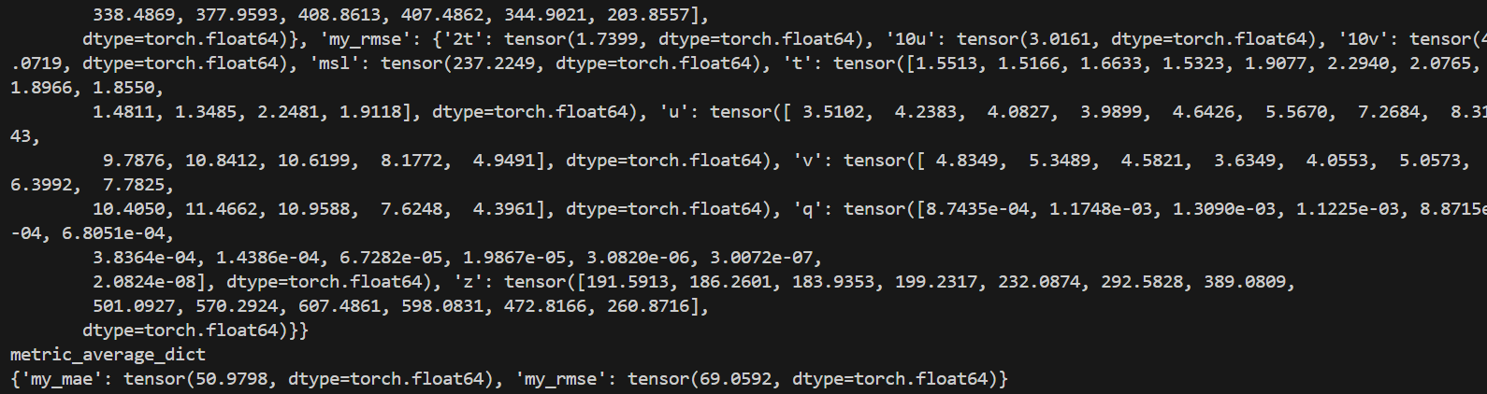
一個簡潔的、藍色和白色的抽象幾何圖形。

Slide 13
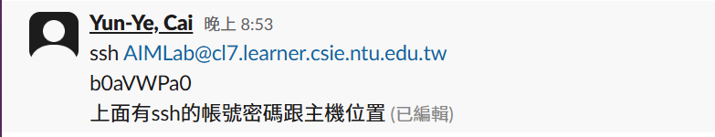
一個簡單的藍色和白色圖案，可能是一個抽象的設計或商標。

Slide 14
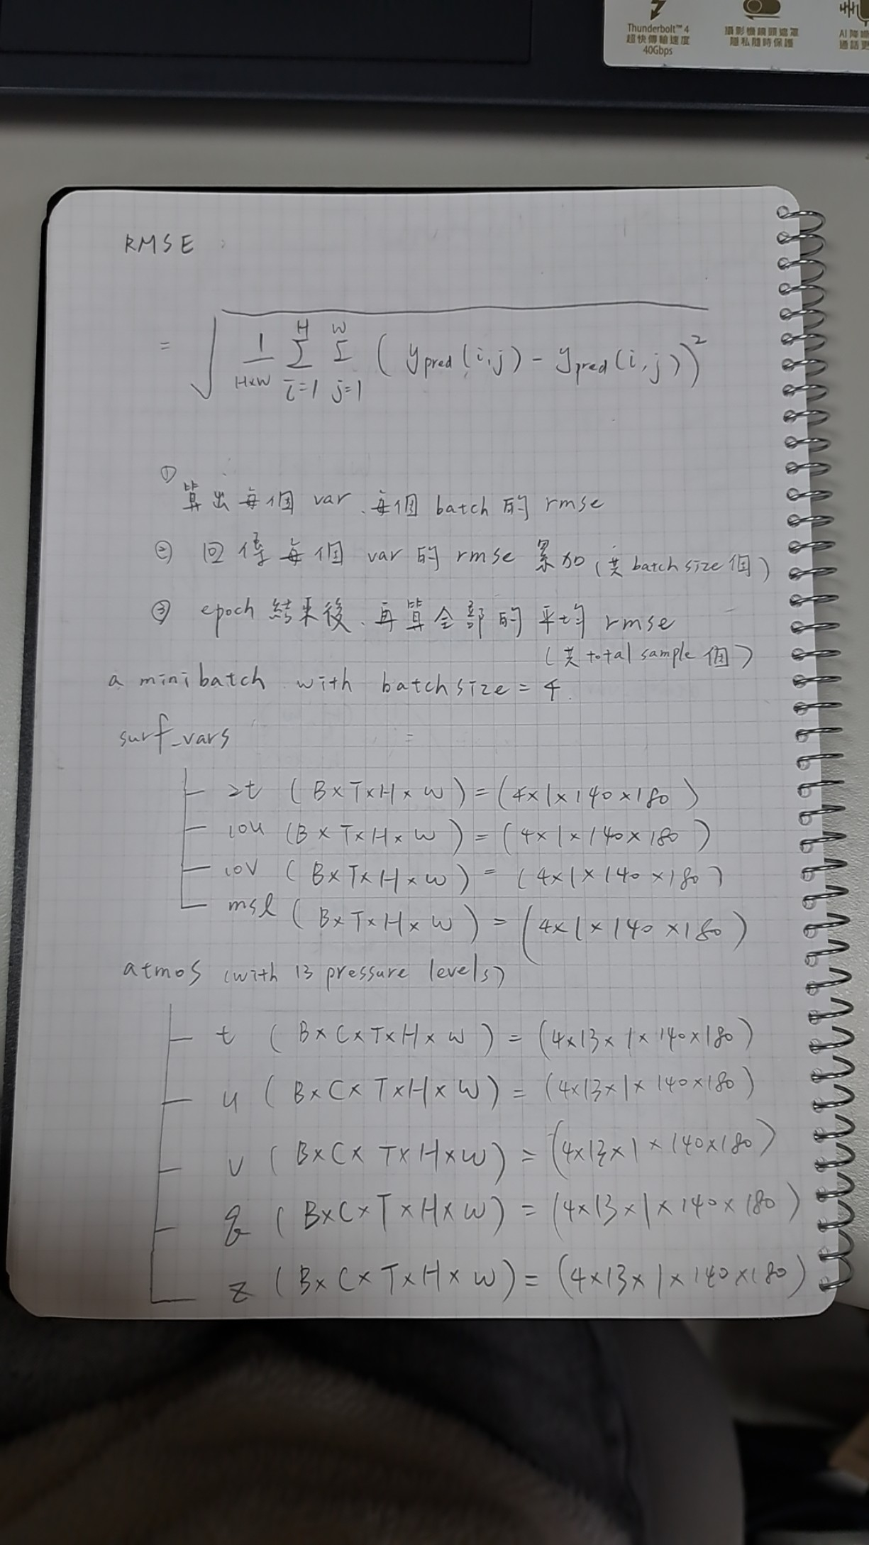
無法根據提供的Base64編碼數據生成描述。數據不完整或損壞，無法解碼為圖片。

Slide 15
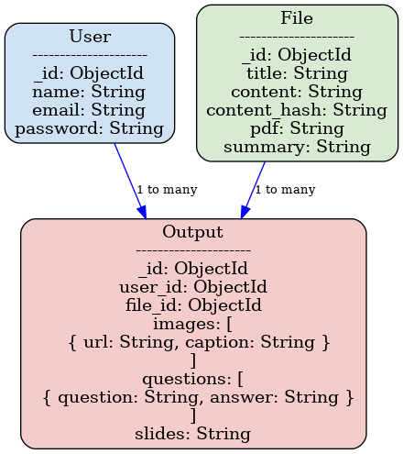
未能生成圖片描述

Slide 16
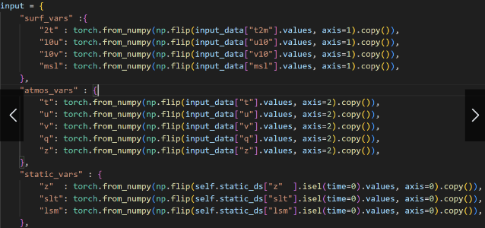
未能生成圖片描述

Slide 17
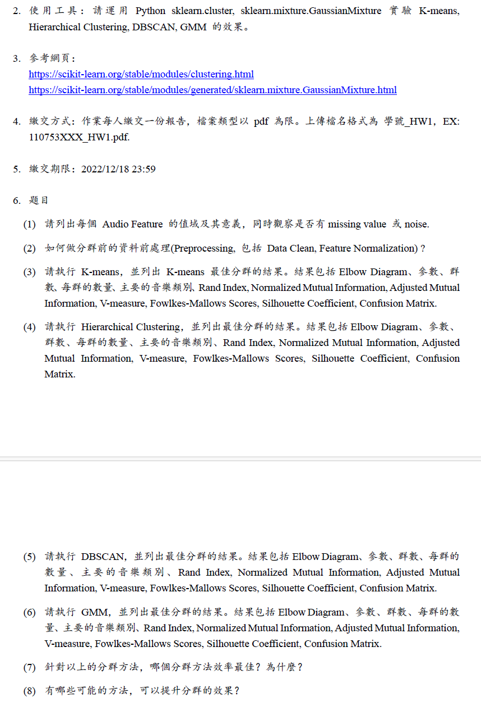
未能生成圖片描述

Slide 18
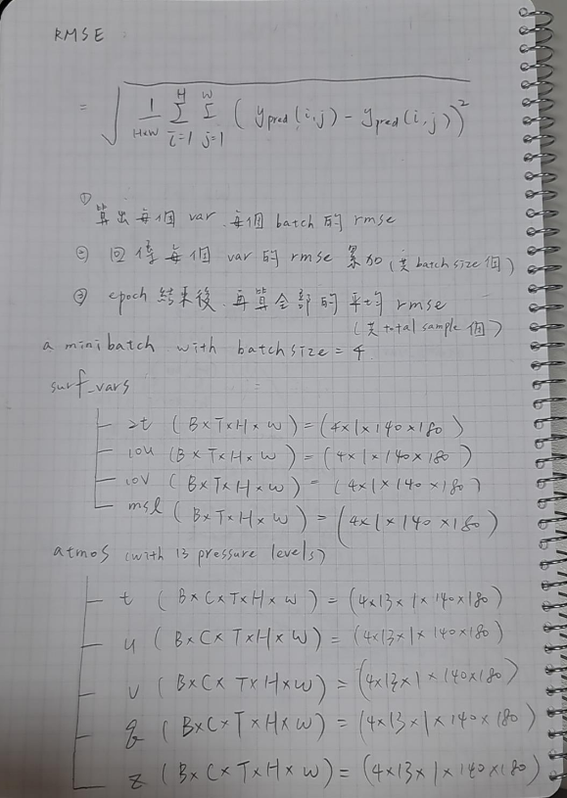
抽象的幾何圖形，黑白相間，帶有重複的線條和形狀。

Slide 19
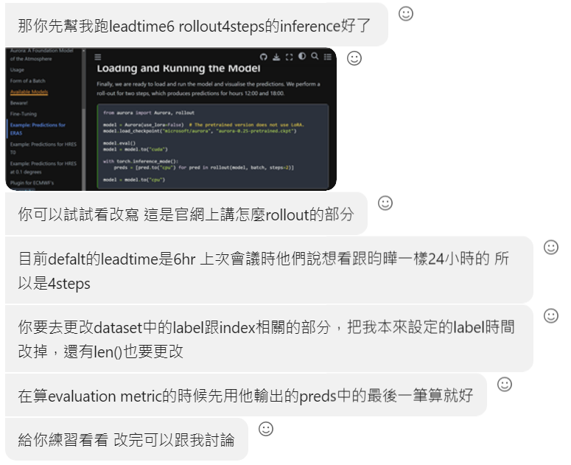
未能生成圖片描述

