Slide 1
Death,
Birth,
The
Ressurection
and
Languages
of

Slide 2
The “birth” of Languages
Diachronic change
The change of
languages’ form through time
Bifurcation
Division of a language into multiple different languages
Old Enlish
Middle English
Indo-European
Modern English
Germanic
Italic
Language Contact
Languages created when different languages come into contact with each other
Artifitial language
Languages can be created artificially
Some are spoken by many people
English
African languages
Esperanto
Toki pona
Patois

Slide 3
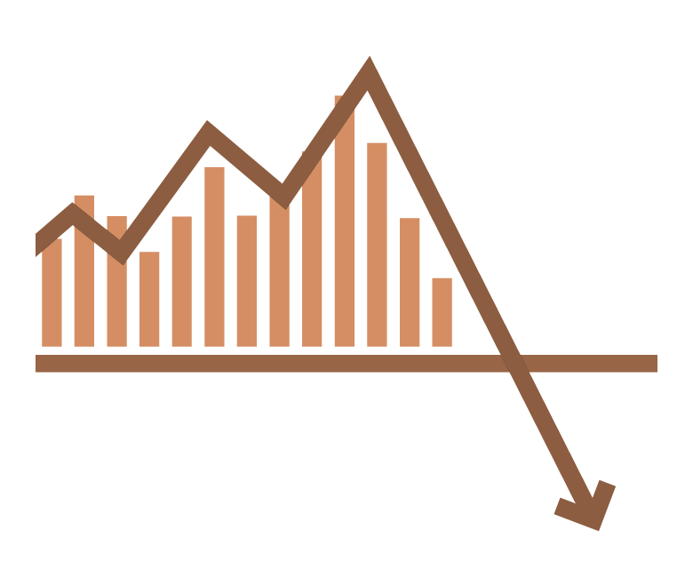
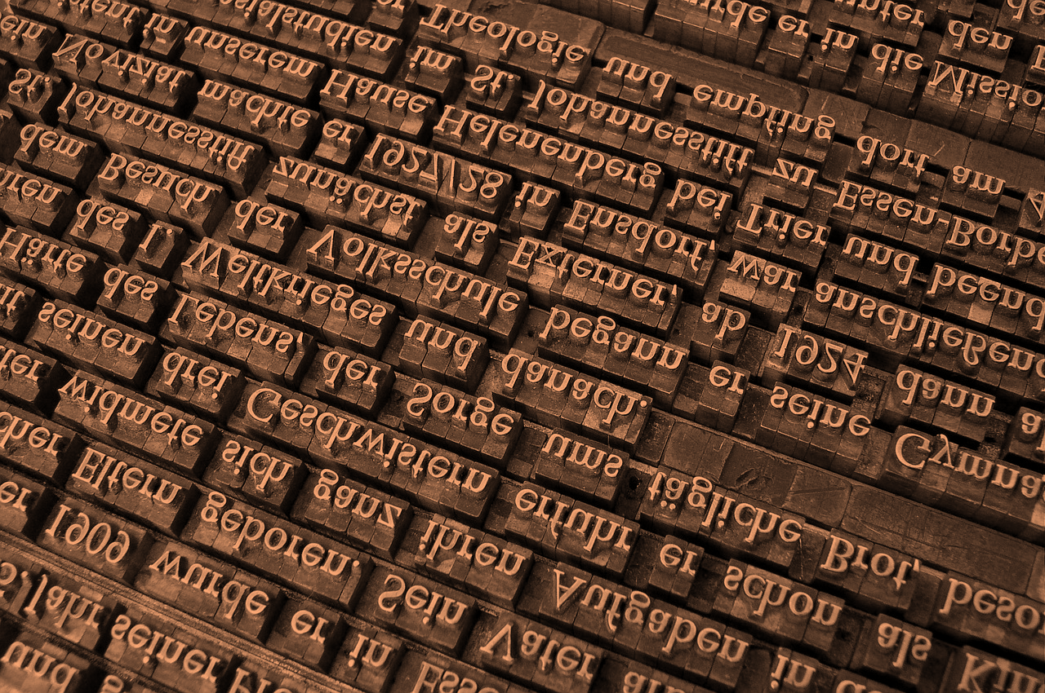
The “death” of Languages
The loss of a language and the absence of people who speak that language.
That all the speakers die without inheriting their language
The speakers no longer
speak the language
The number of speakers
is rapidly reduced by
Language is not passed on to the next generation due to politically forced use of another language.
disaster,
epidemic,
or genocide

Slide 4
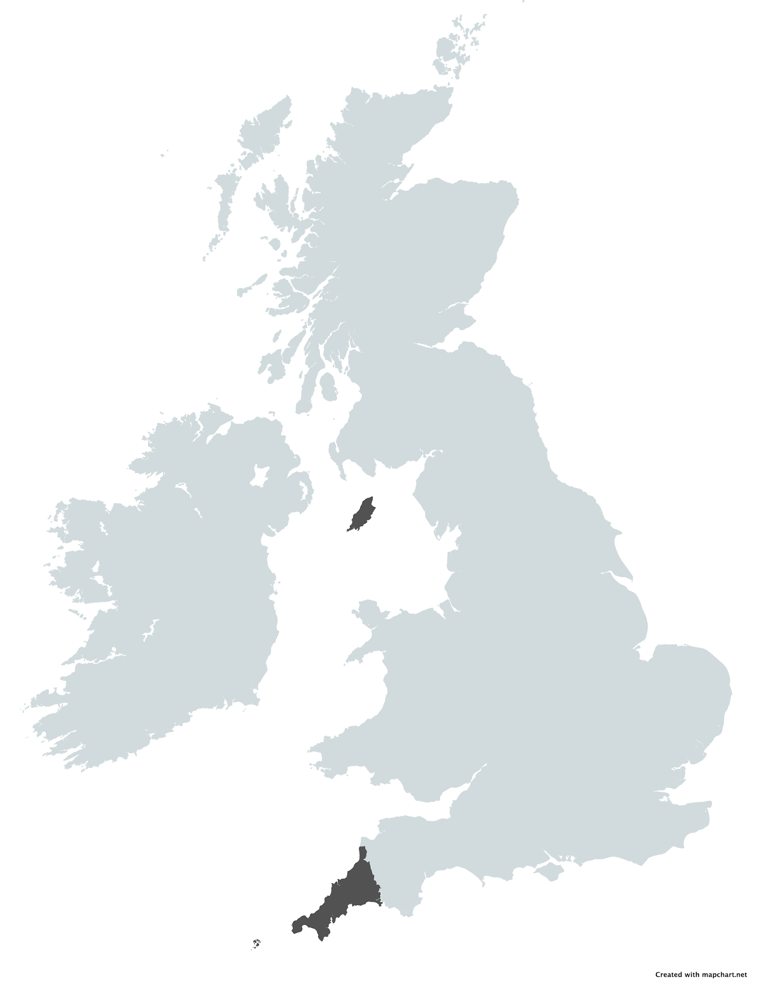
The “Ressurection” of Languages
Even a dead language can be revived if there are people who use it based on the materials.
Manx language
Cornish language

Slide 5
Matsuura Yoshihiro
Presented by
Founder and former head of
Handai Language Circle GGC,
Spanish Major Sophomore

