Slide 1
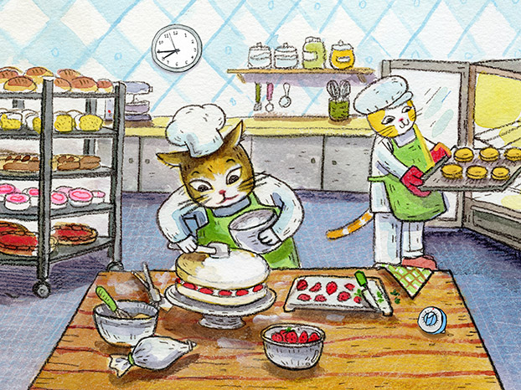



PROS and CONS of Technology
+
Production
-
Manual labor
+
Easy access information
-
False information
+
Cheap / free
-
Exposed to predators/
scammers

