Slide 1
Clean and Elegant Portfolio
Here is where your presentation begins

Slide 2
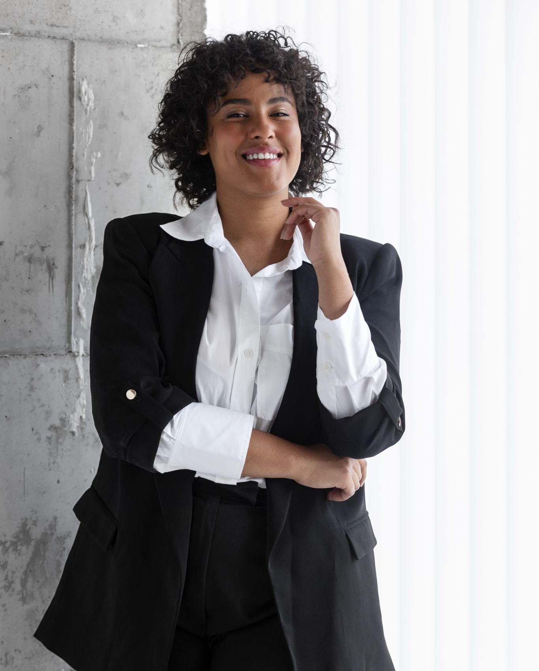
Contents of a portfolio
A portfolio is composed of three main elements:
Content: this includes the actual work you want to showcase and can be anything from writing samples to photographs or videos
Design: the design should reflect your personality and style while remaining professional. It should also make it easy to navigate the portfolio
Summary: a brief summary at the beginning of the portfolio will help provide an introduction to your work and give visitors a better understanding of yourself and what you have created

