Slide 1

ROBOT RETURN TO ORIGIN
Leetcode No.657
001

Slide 2
ORDER
START
PLOTS
THOUGHTS
01
02
03
04
TOPIC
SOLUTION CODE
END

Slide 3
01
TOPIC
Leetcode topics No.657 -> Robot return to origin

Slide 4
There is a robot starting at the position (0, 0), the origin, on a 2D plane. Given a sequence of its moves, judge if this robot ends up at (0, 0) after it completes its moves.
You are given a string moves that represents the move sequence of the robot where moves[i] represents its i^{th} move. Valid moves are 'R' (right), 'L' (left), 'U' (up), and 'D' (down).
Return true if the robot returns to the origin after it finishes all of its moves, or false otherwise.
Note: The way that the robot is "facing" is irrelevant. 'R' will always make the robot move to the right once, 'L' will always make it move left, etc. Also, assume that the magnitude of the robot's movement is the same for each move.

Slide 5
02
PLOTS
Plots for explaining solution

Slide 6
UP
(horizontal , vertical)
(0 , 1)
vertical += 1
‘U’
LEFT
ORIGIN
RIGHT
‘L’
‘R’
horizontal -= 1
(-1 , 0)
(0 , 0)
(1 , 0)
horizontal += 1
‘D’
DOWN
(0 , -1)
vertical -= 1

Slide 7
Example
moves = “UD”
moves = “LL”
moves = “ULDR”
moves = “URL”
True
False
The robot moves up once, and then down once. All moves have the same magnitude. (0 , 0)
The robot moves left twice. It ends up two moves to the left of the origin. (-2 , 0)
The robot moves up once, left once, down once, and then right once. (0 , 0)
The number of moves is an odd number. It can’t be return to the origin. (1 , 0)

Slide 8
03
SOLUTION CODE
Language -> C++

Slide 9
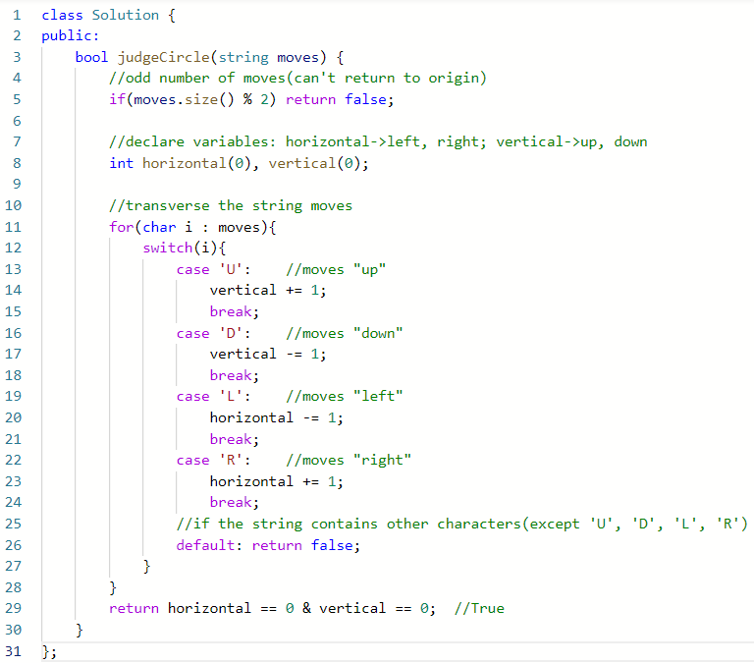
V1. switch case

Slide 10
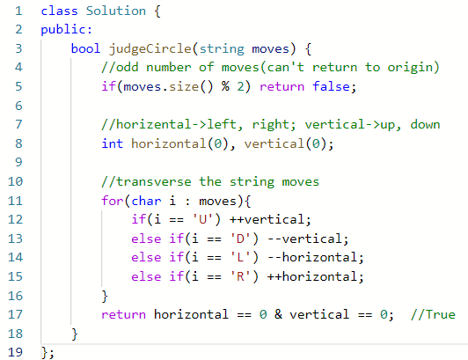
V2. if - else

Slide 11
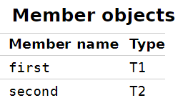
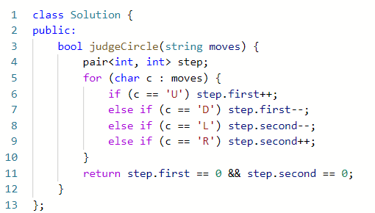
V3. std::pair
https://en.cppreference.com/w/cpp/utility/pair

Slide 12
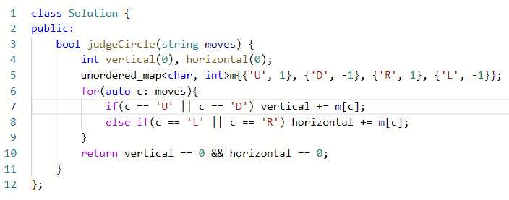
V4. std::unordered_map / map -1
like dictionary in Python??? {key, value}
https://en.cppreference.com/w/cpp/container/unordered_map
https://en.cppreference.com/w/cpp/container/map

Slide 13
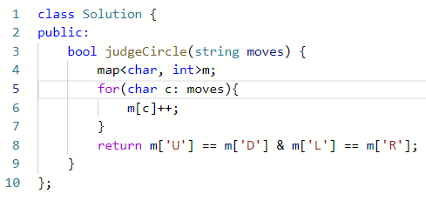
V4. std::unordered_map / map -2
like dictionary in Python??? {key, value}
https://en.cppreference.com/w/cpp/container/unordered_map
https://en.cppreference.com/w/cpp/container/map

Slide 14

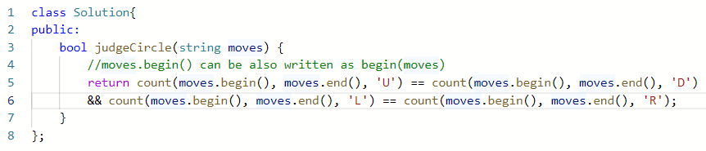
V5. std::count
https://en.cppreference.com/w/cpp/algorithm/count

Slide 15
04
THOUGHTS
Some thoughts on problem solving ;)

Slide 16
Which is more faster?
Review before?
- switch
- if-else
What else???
- unordered_map
- map
- pair
- count
Assignment
operator
(+=、-=)
v.s.
Increment / decrement operator
(++、--)
Time complexity?
Space complexity?
Notes:
記憶體朝向大儲存量與低廉價格發展，使得空間複雜度變成次要，時間複雜度成為主要關注的重點。最典型的運用便是各式各樣的網頁，使用者不能忍受3秒以上的等待，於是瀏覽器們著重在使用記憶體，好帶給使用者快速的體驗。
那有著重空間複雜度的場合嗎？有的，在部分伺服器、嵌入式系統等，提供的是有限的記憶體，此時該思考如何在有限的記憶體下，爭取到多少時間？
當然，目前各大公司提到演算法時，仍舊著重在時間複雜度，記憶體的問題在特定產業才有可能遇到，因此，寫出能夠快速執行的程式碼幾乎是各大公司要求的基本功。

Slide 17
THANKS FOR LISTENING

