Slide 1
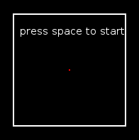
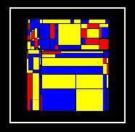
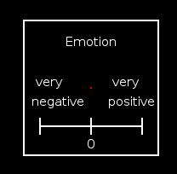
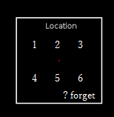
Instructions
During the whole period of a trial, please keep focusing on the little red dot in the middle.
@ Please make sure a proper fusion before every trial begins.
@ Please feel free to take a short break in-between trial @ Please try to utilize the full scale and respond as accurately as possible to the emotion of target face.

