Slide 1


ANNA UNIVERSITY PROJECT VIVA VOCE
NEXT-GEN AD BLOCKING AND DYNAMIC AD-LIST GENERATION IN RASPBERRY PI
(COMPUTER SCIENCE AND ENGINEERING)
FINAL YEAR - R17
BATCH - 2020-24
SRI MUTHUKUMARAN INSTITUE OF TECHNOLOGY
CHENNAI - 69
PRESENTED BY –
M VISHAL(212620104024)
R YUNESHWARAN (212620104026)
GUIDANCE -
Mrs.B.ASHRAF YASHMIN, M.E, Ph.D.,
ASSISTANT PROFESSOR

Slide 2
Next-Gen Ad Blocking and Dynamic Ad-list Generation in Raspberry Pi
By
M.VISHAL
R.YUNESHWARAN

Slide 3
Agenda
Introduction
Abstract
Objective
Literature Survey
Problem Statement
Proposed System
Base Paper
Modules
System Architecture
Module Diagram
Result
Implementation
Future Enhancements
References

Slide 4
INTRODUCTION

Slide 5
In today's online landscape, advertisements are ubiquitous, often intrusive, and can significantly impact user experience.
Traditional ad blocking methods, such as browser extensions and host file manipulation, offer users some control over the ads they see while browsing the web.
However, these methods have limitations, including their inability to provide network-wide ad blocking and their reliance on individual device configurations.

Slide 6

To address these limitations, network-level ad blocking solutions have emerged, offering users a more comprehensive approach to ad blocking. One such solution is Pi-hole.
Pi-hole provides users with a faster, cleaner, and more private browsing experience across all their devices. In this presentation,
We'll explore how Pi-hole, along with other tools like Unbound and dynamic ad-list generation, offering users greater control over their online experience and enhancing privacy and security in the process.

Slide 7
ABSTRACT

Slide 8
This project proposes the development of a comprehensive ad-blocking and network security solution using Raspberry Pi, Pi-hole, Unbound DNS, and Suricata rules.
The integrated system offers an efficient approach to block ads at the network level while simultaneously enhancing network security through real-time monitoring and blocking of malicious activities.
Pi-hole is deployed to block ads network-wide, ensuring all connected devices benefit from ad blocking without requiring individual configurations.

Slide 9
The integration of Pi-hole with Unbound DNS provides secure and private DNS resolution, enhancing user privacy and network security.
Additionally, Suricata rules are implemented to strengthen network security by monitoring and blocking malicious activities in real-time.
To ensure the system remains up-to-date with the latest security measures, a Python script automates the process of updating ad lists and Suricata rules.
This project aims to provide an effective solution for ad blocking and network security needs within the local network, offering improved ad blocking, enhanced network security, and more efficient DNS resolution.

Slide 10
OBJECTIVE

Slide 11
Develop an Integrated Solution: Create a comprehensive ad-blocking and network security system using Raspberry Pi, Pi-hole, Unbound DNS, and Suricata rules to address the limitations of existing ad-blocking solutions.
Network-wide Ad Blocking: Implement Pi-hole to block ads network-wide, ensuring all devices connected to the local network benefit from ad blocking without requiring individual configurations.
Enhance Network Security: Integrate Unbound DNS and Suricata rules to enhance network security by providing secure and private DNS resolution and real-time monitoring and blocking of malicious activities.

Slide 12
Automation of Update Process: Develop a Python script to automate the process of updating ad lists and Suricata rules, ensuring the system remains up-to-date with the latest security measures.
Provide Improved Ad Blocking and Network Security: Offer an efficient and effective solution for ad blocking and network security needs within the local network, ensuring improved ad blocking, enhanced network security, and more efficient DNS resolution

Slide 13
LITERATURE SURVEY

Slide 14
"Ad Blocking and Counter-Ad Blocking Ad Blocking and Counter-Ad Blocking: Analysis of Online Ad Blocker Usage “
Authors: Shuai Zhao , Chong Wang, Achir Kalra, Leon Vaks.
Published in: May 2018 Americas Conference on Information Systems (Research Gate)
Summary: This study investigates the factors influencing ad blocker usage within the context of the online advertising industry. Given the rapid increase in ad blocker adoption and its adverse effects on publishers and advertisers, many companies have implemented counter-ad blocking strategies. However, some have discontinued these strategies due to a lack of understanding of user ad blocking behavior.

Slide 15
"Securing the Home Network with Raspberry Pi and Pi-Hole"
Authors: Alex Dib, Andrew Bechard, Jesse Johnston, Anthony R. Curtis
Published in: 2019 IEEE MIT Undergraduate Research Technology Conference (URTC)
Summary: This paper discusses the implementation of Pi-hole on Raspberry Pi for ad blocking and network security. It explores the effectiveness of Pi-hole in blocking ads and reducing network traffic, as well as its role in enhancing network security by blocking malicious domains.

Slide 16
"Enhancing Network Security using Raspberry Pi based IDS/IPS"
Authors: Akshay Agarwal, Gaurav Trivedi
Published in: 2019 International Conference on Vision Towards Emerging Trends in Communication and Networking
Summary: This paper presents a Raspberry Pi-based Intrusion Detection System (IDS) and Intrusion Prevention System (IPS) using Suricata. It discusses the implementation of Suricata rules for real-time monitoring and blocking of malicious activities, thereby enhancing network security.

Slide 17
PROBLEM STATEMENT

Slide 18
Content Blocking: Despite their name, ad blockers often block more than just ads. For example, some ad-blocking software unintentionally blocks access to desired content unrelated to advertising. Users may need to whitelist specific sites to access certain features.
Data Privacy Risks: Some ad blockers send users’ browsing behavior to third-party servers, which then pay for this information. This means your browsing history could be tracked without your knowledge.

Slide 19
False Positives: Ad blockers sometimes mistakenly block legitimate content. For instance, they might flag essential scripts or interactive elements as ads, disrupting the functionality of websites.
Dependency on Updates: Ad blockers need regular updates to stay effective. If not updated, they might fail to block new ad formats or tracking techniques.
Complexity and Compatibility: Ad blockers can be complex to configure, especially for non-technical users. Additionally, they may not work seamlessly with all browsers or platforms.

Slide 20
PROPOSED SYSTEM

Slide 21
The proposed system addresses the limitations of the existing ad-blocking and network security setup by implementing a comprehensive solution using
RaspberryPi - Pi-hole - Unbound DNS - Suricata rules.
With Pi-hole, we establish a powerful ad-blocking solution at the network level, ensuring that all devices connected to the network benefit from ad blocking without the need for individual configurations. Integrating Pi-hole with Unbound DNS provides secure and private DNS resolution, enhancing user privacy and security

Slide 22
Raspberry Pi: Utilized as the hardware platform to host the ad-blocking and network security solution.
Pi-hole: Implemented as the ad-blocking solution, filtering out ads at the network level for all connected devices.
Unbound DNS: Configured for secure and private DNS resolution, enhancing user privacy and network security.
Suricata rules: Implemented to enhance network security by monitoring and blocking malicious activities in real-time.

Slide 23
BASE PAPER

Slide 24
"Securing Network Using Raspberry Pi by Implementing
VPN, Pi-Hole “
Authors: Shuai Zhao , Chong Wang, Achir Kalra, Leon Vaks.
Published in: May 2018 Americas Conference on Information Systems (Research Gate)
Summary: The paper examines security risks inherent in internet-connected devices, including data exposure to ISPs and third-party entities for targeted advertising. It proposes VPiSec, a protective device that conceals users' IP addresses via an OpenVPN server in another country and blocks DNS requests for tracking domains using Pi-Hole. OSSEC IPS is implemented to thwart internal network brute force attacks. Network performance is assessed pre- and post-VPiSec deployment, with no discernible difference in upload/download speeds, suggesting users can secure network activities without performance compromise.

Slide 25
MODULES

Slide 26
Raspberry Pi Module:
  Installation of Raspbian OS
  Installation of necessary software (Git, Python, etc.)
  Configuration of Raspberry Pi
Pi-hole Module:
  Installation and configuration of Pi-hole
  Configuration of blacklists and whitelists
  Integration with Unbound DNS
Unbound DNS Module:
  Installation and configuration of Unbound DNS
  Configuration for secure and private DNS resolution
Python Script Module:
  Development of Python script to generate latest ad lists .
  Explanation of the script's functionality
Suricata Module:
  Installation and configuration of Suricata
  Configuration of Suricata rules for IDS/IPS

Slide 27
SYSTEM ARCHITECTURE

Slide 28
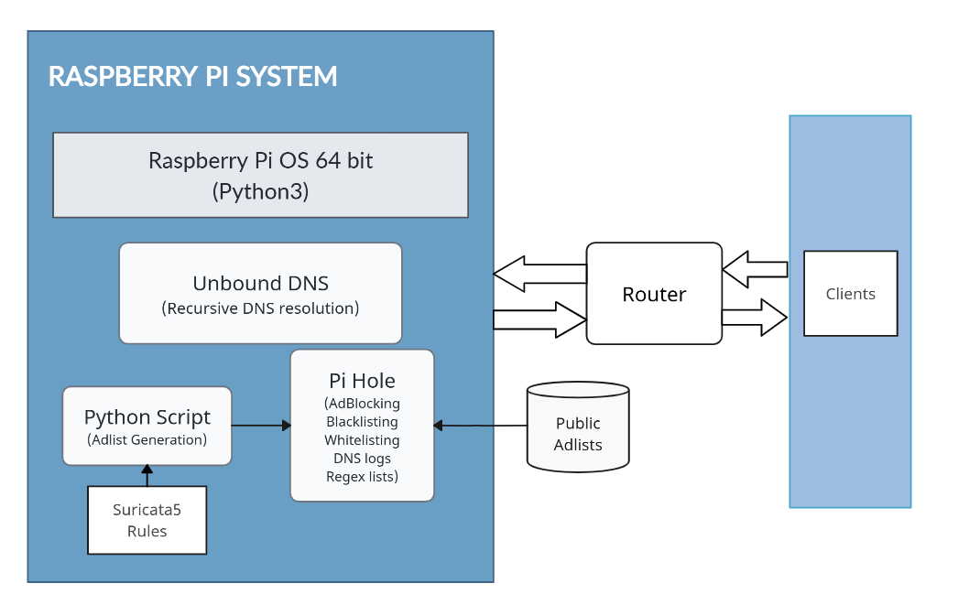

Slide 29
MODULE DIAGRAM

Slide 30
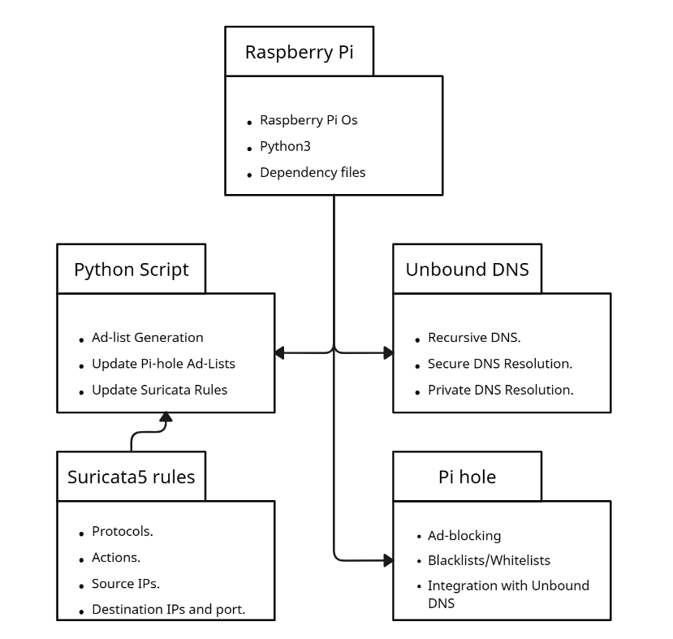

Slide 31
RESULT

Slide 32
Effective Ad Blocking and Enhanced Network Security:
  Ads are effectively blocked at the network level, providing an ad-free browsing experience, while network security is enhanced through real-time monitoring and blocking of malicious activities.
Improved Privacy and Automated Updates:
  Privacy is improved through secure and private DNS resolution, and the system remains up-to-date with the latest security measures through automated updates of ad lists and Suricata rules.

Slide 33
Customizability and Network Traffic Analysis:
  Users have the option to customize blocklists, whitelists, and other configuration settings, and detailed reports and analytics on network traffic allow for thorough analysis and detection of potential security threats.
Real-time Threat Detection and Scalability:
  Suricata IDS/IPS provides real-time monitoring and detection of malicious activities, helping to prevent security breaches, and the system is scalable and flexible, allowing for easy integration with additional security tools and services.

Slide 34
IMPLEMENTAION

Slide 35
Prerequisites
Hardware Requirements: Raspberry Pi (any model), microSD card (8GB or larger), power adapter, Ethernet cable, and a compatible router.
Software Requirements: Raspbian OS, Pi-hole, Unbound DNS, Suricata, Python 3.x, Git, and a text editor (e.g., nano or Vim).
Network Requirements: Access to the local network, administrative access to the router for DNS configuration, and internet access for downloading software and updates.

Slide 36
Raspberry Pi Installtion
Download Raspberry Pi Imager:
Go to the official Raspberry Pi Downloads page and download Raspberry Pi Imager for your operating system .
Write the Image to Your SD Card.
Select your microSD card and click on the WRITE button.
Click WRITE to start the process. It takes a few minutes to format the microSD card and write the files, followed by a verification step.
Remove the microSD card from your computer when prompted.
Insert the microSD card into your Raspberry Pi.
Power on your Raspberry Pi to start the fresh install of Raspbian.

Slide 37
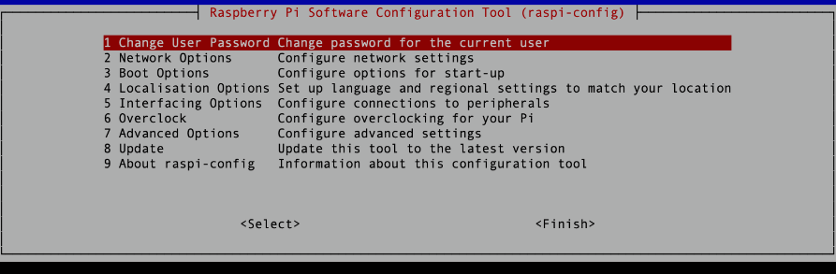
Setup
To login to your freshly baked Raspberry Pi, use the default username/password pair of pi and raspberry.
Enable SSH VNC and set static IP address for your PI (cmd– “raspi config”)

Slide 38
RUN : ‘ifconfig’ to know your IP address and update it as static in your network router
Update Raspbian and Packages: Run the commands :
  sudo apt update
  sudo apt-get upgrade -y
Install :
  Python : sudo apt install python3
  Unboud : sudo apt install unbound

Slide 39
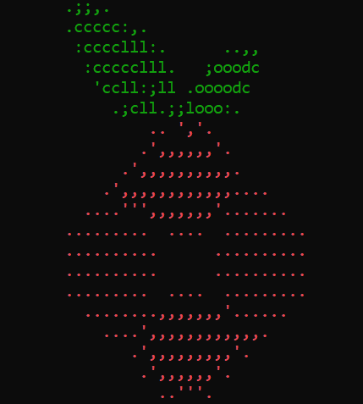
Pi-hole Installation
To install run : curl -sSL https://install.pi-hole.net | bash
Follow the installion specified by the installer and complete the installation.
After installation run : pihole -a –p
Then in the web interface login with the password.
Set PI hole as DNS ,if internet connection faults as result run : “echo "nameserver 8.8.8.8" | sudo tee /etc/resolv.conf > /dev/null” (a temperory fix till completion).

Slide 40
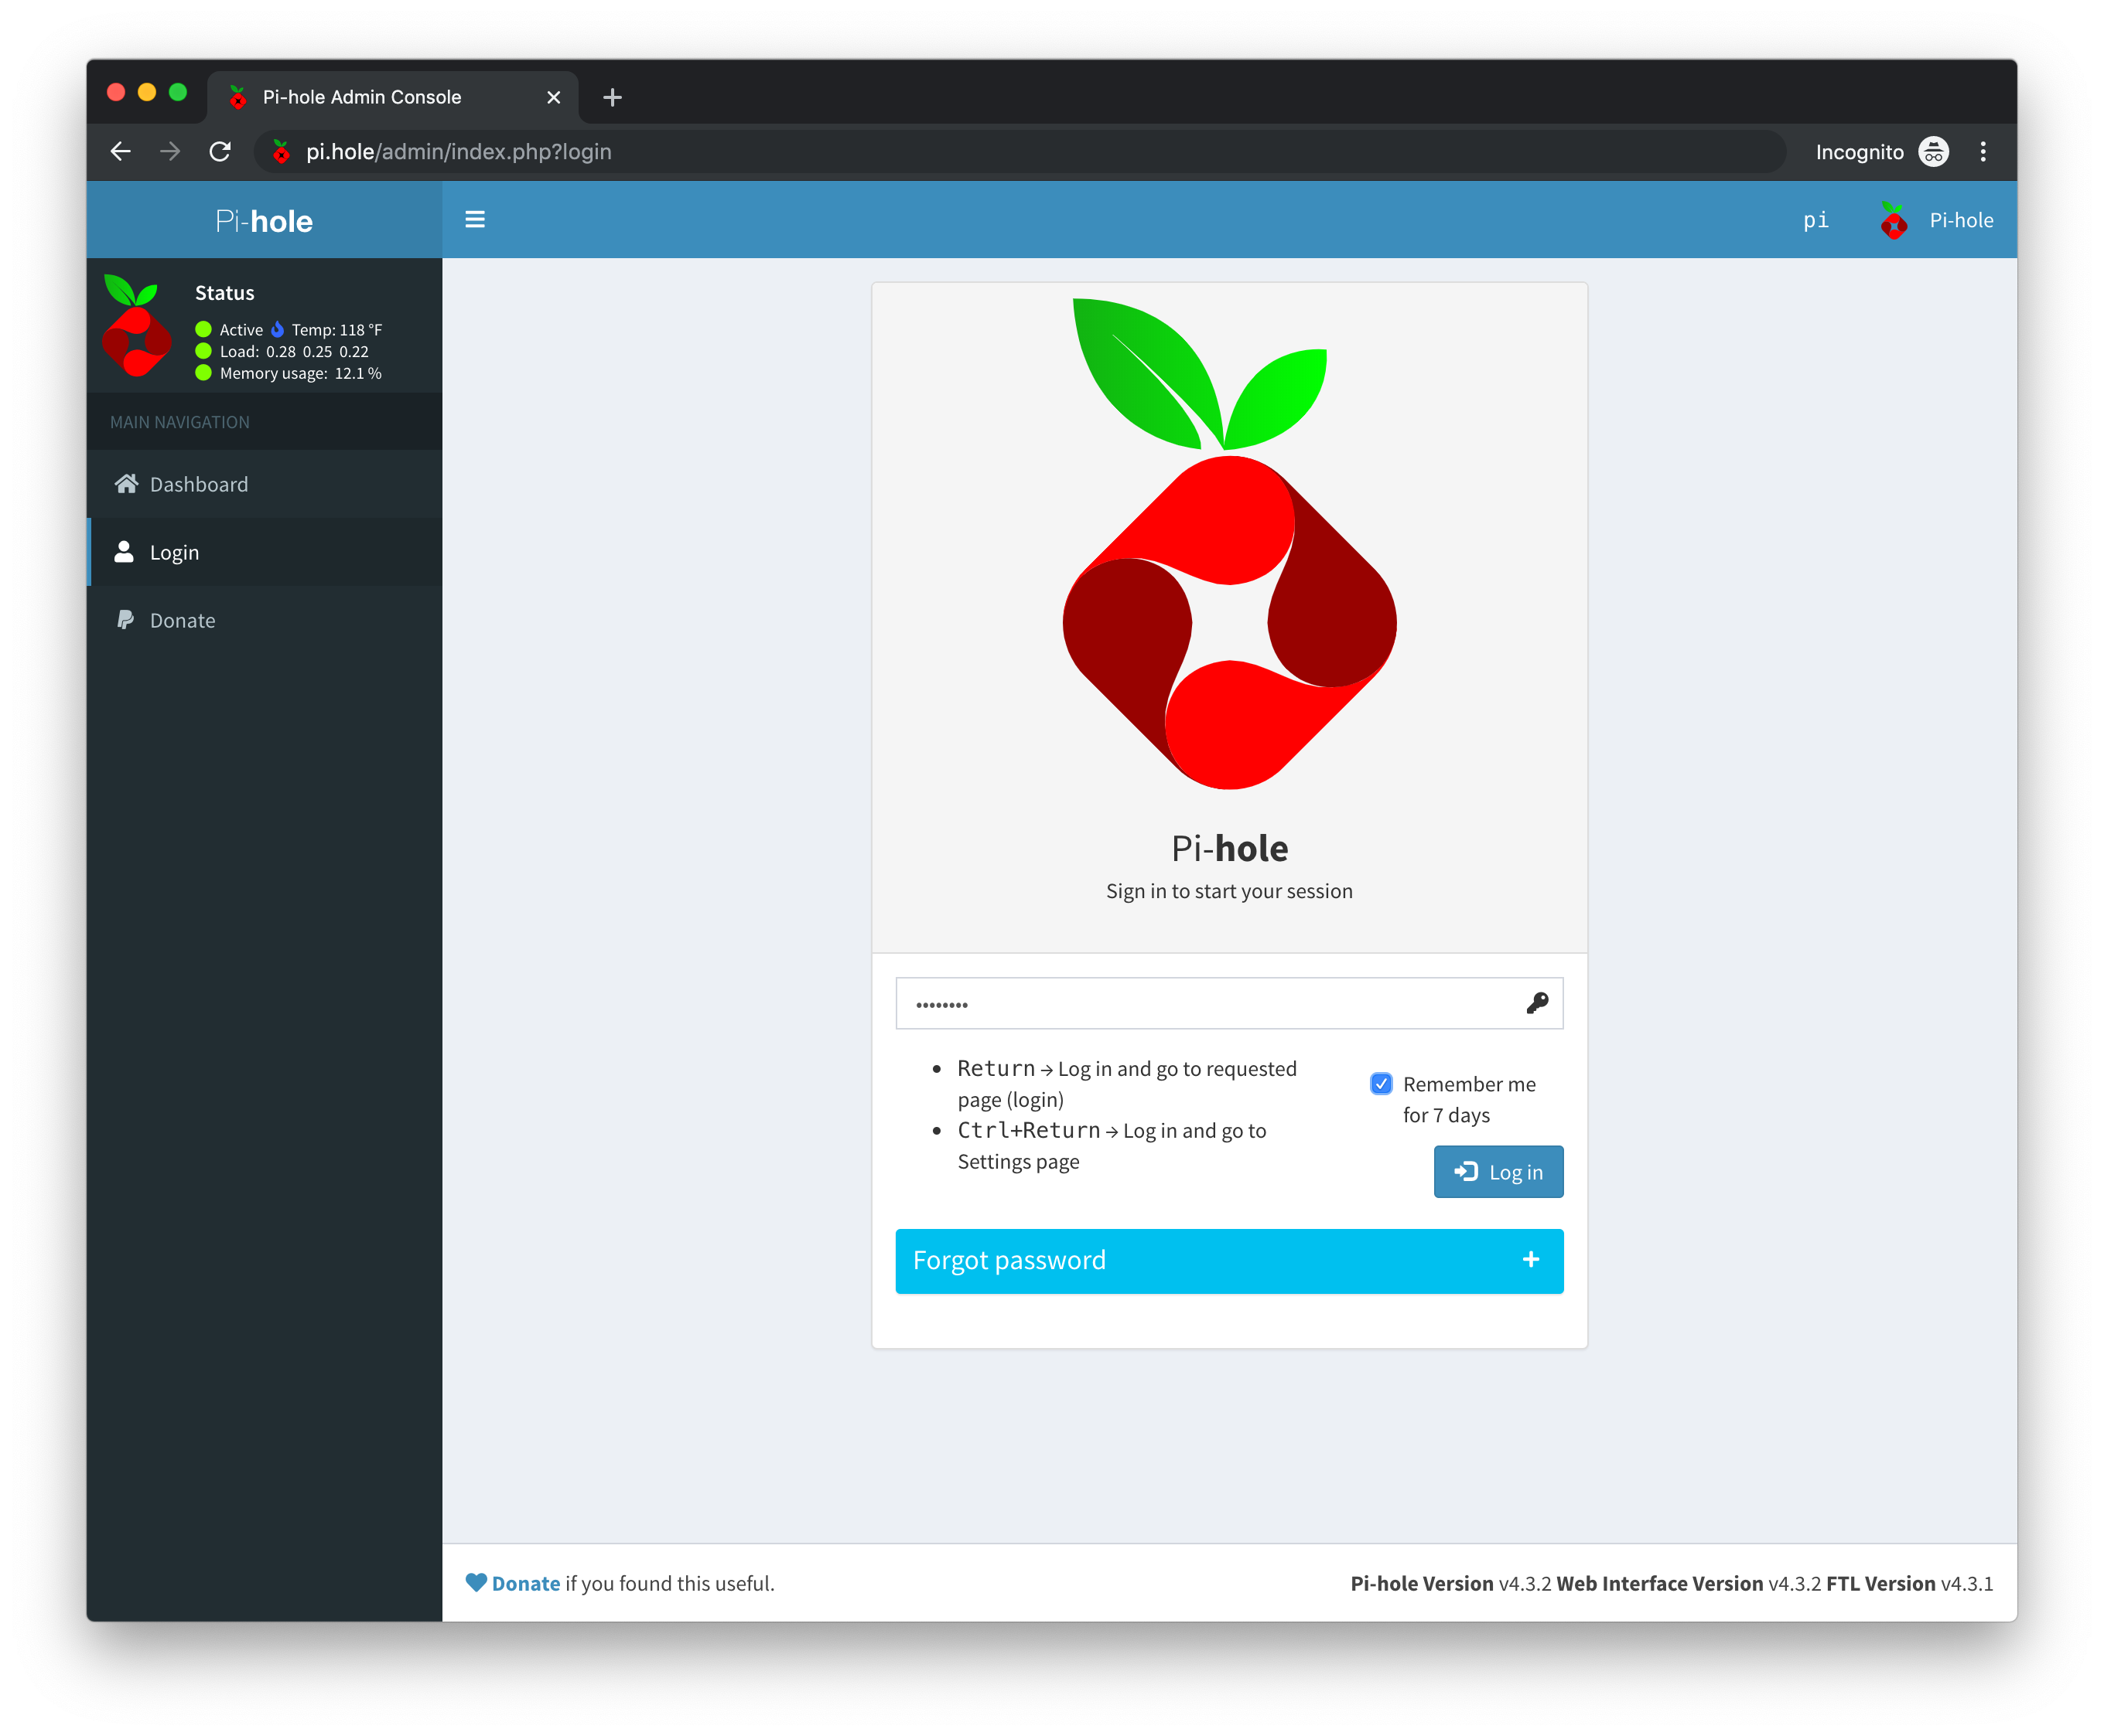
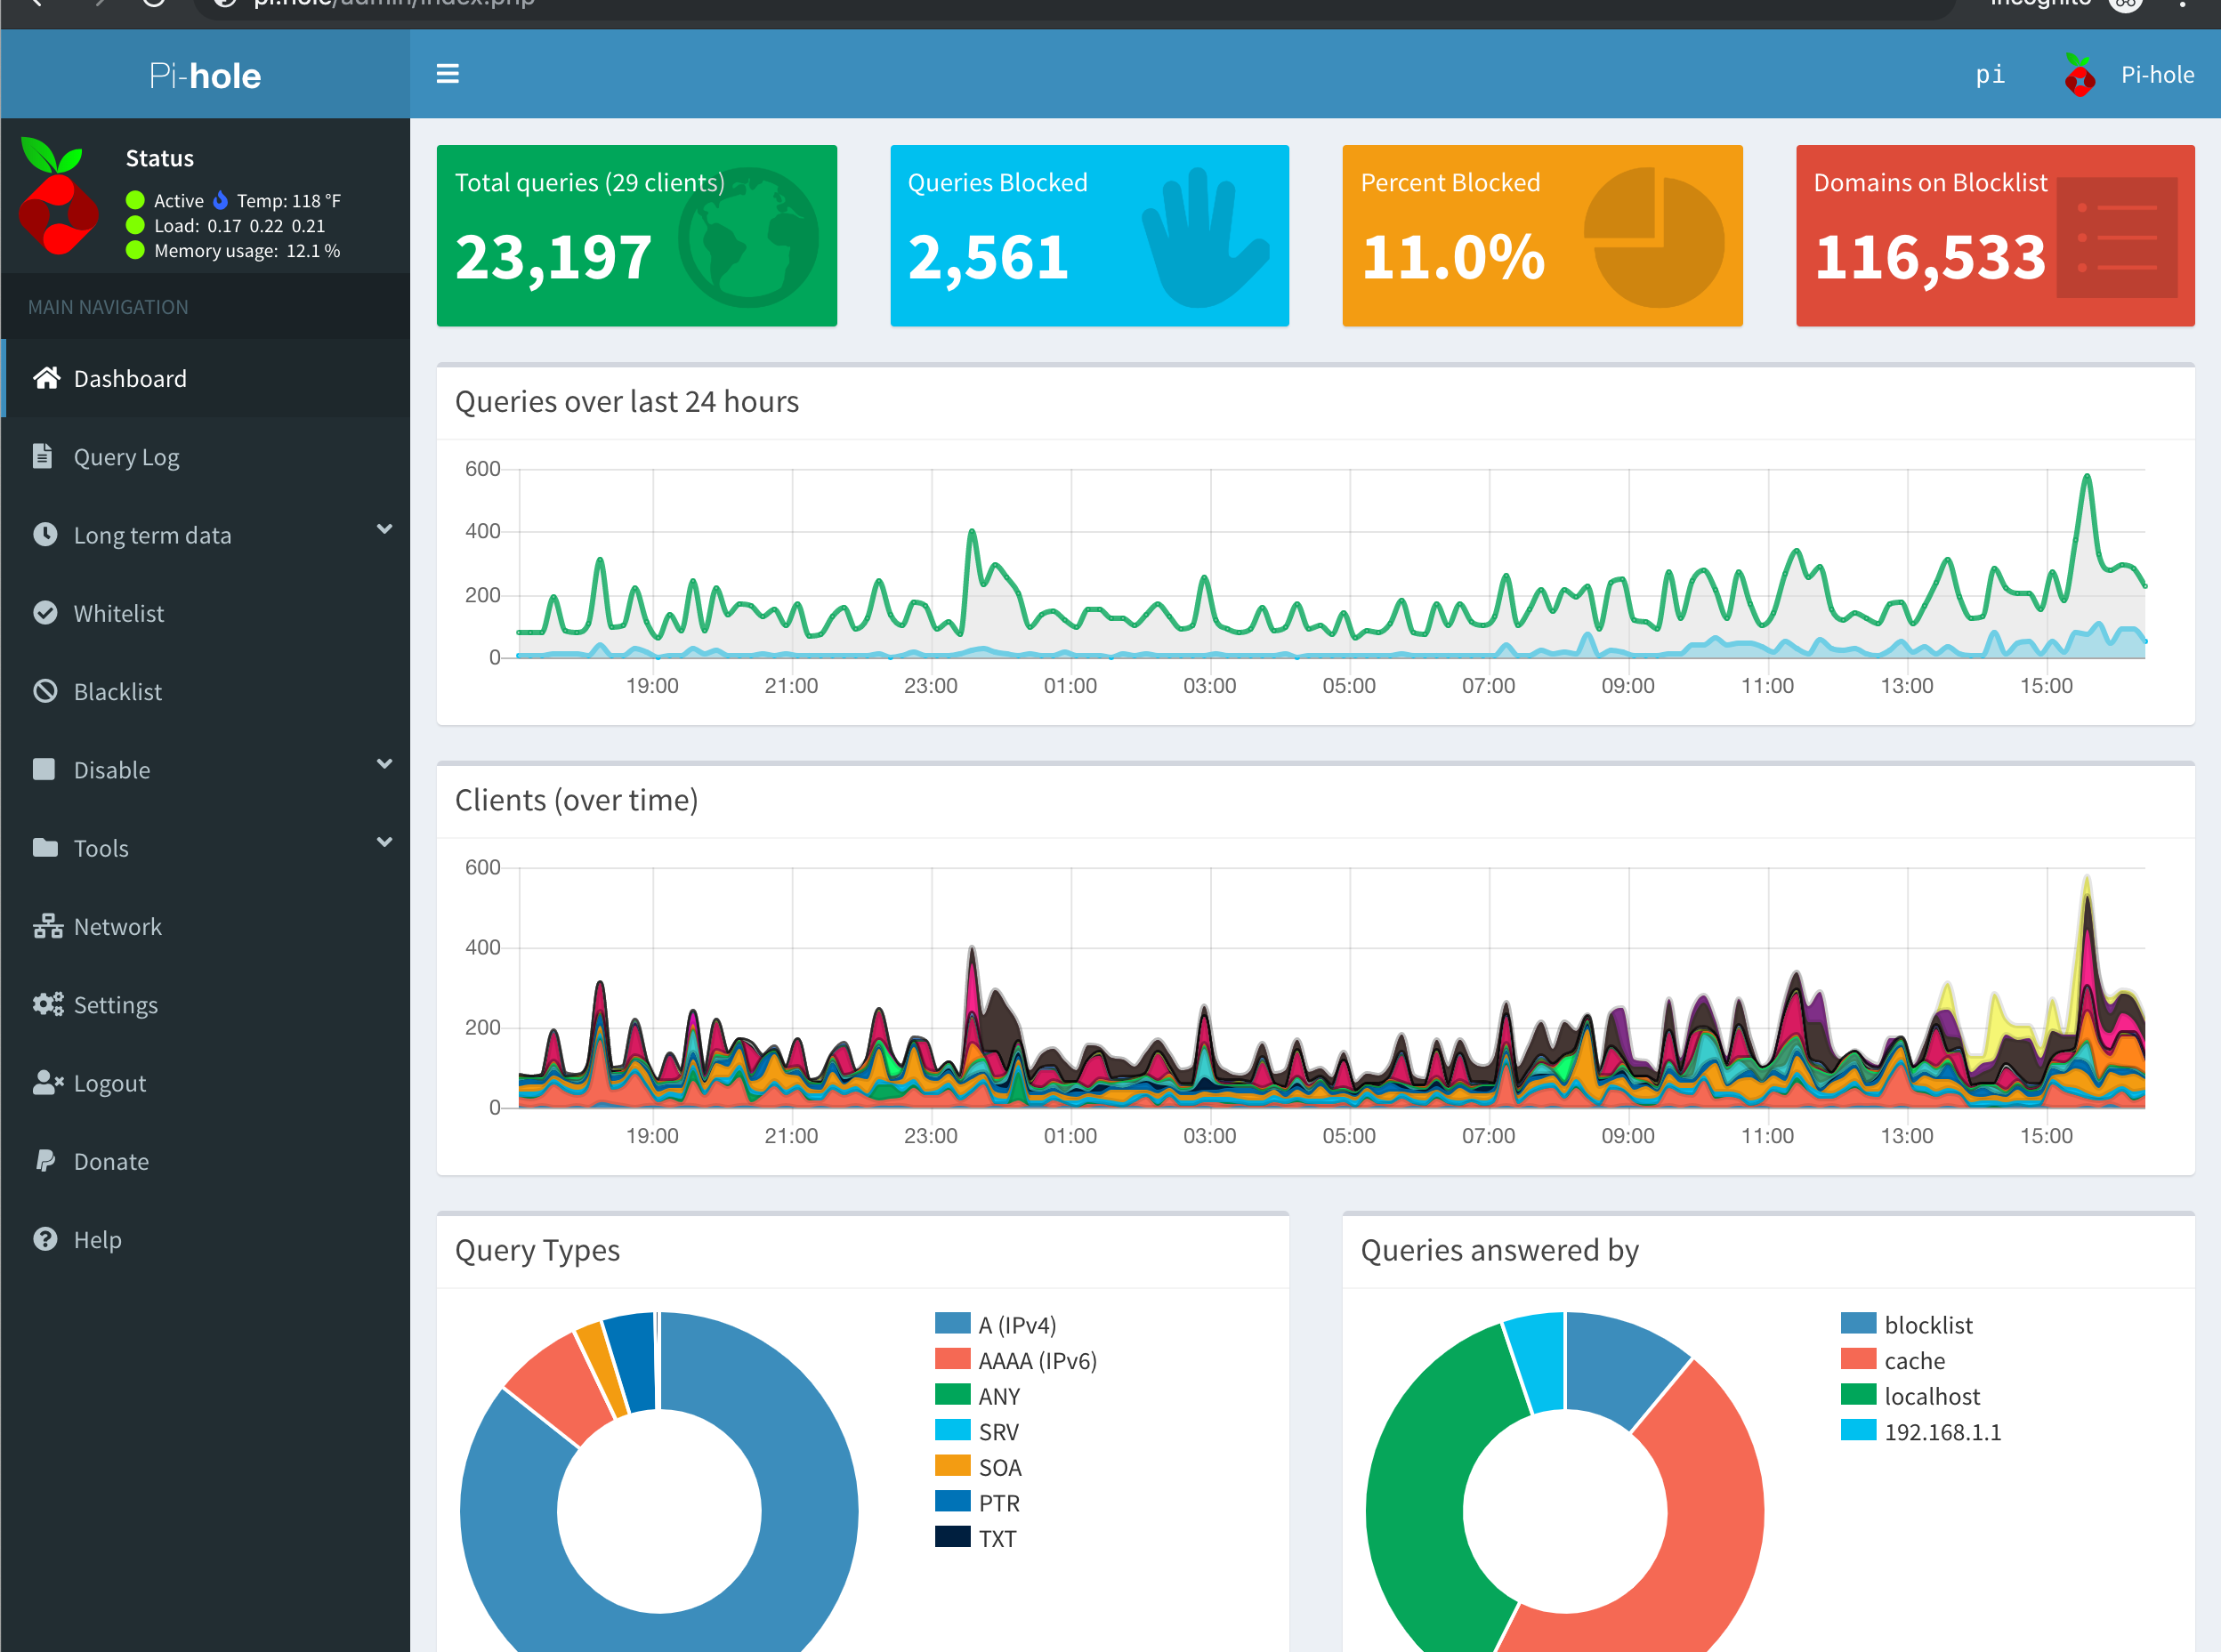
After the installation head to http://pi.hole/admin you can use the password provided during the process to login to land at the Dashboard

Slide 41
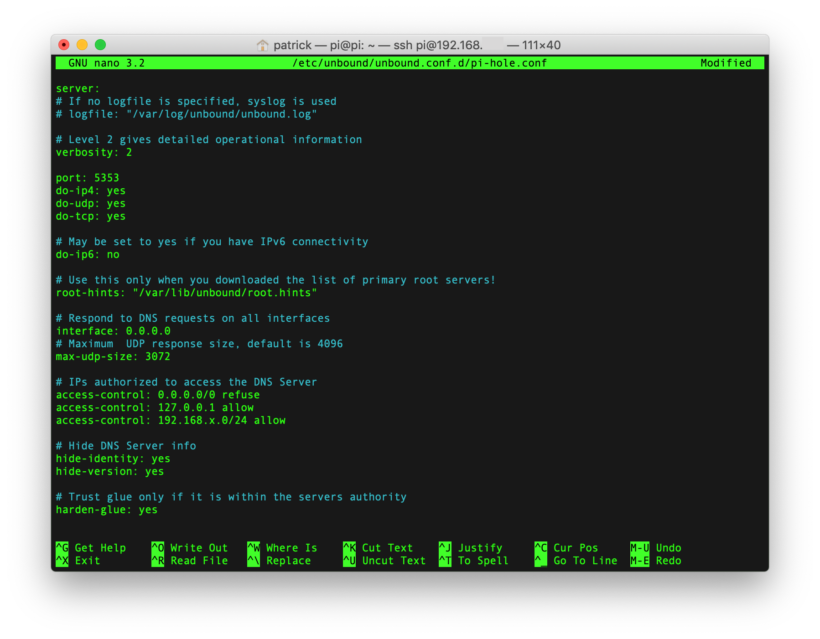
Unboud DNS Installation
To install Unbound on the Raspberry Pi: sudo apt install unbound
Afterwards we'll need to download a root.hints file to replace the built-in hints:
‘wget -O root.hints https://www.internic.net/domain/named.root’
‘sudo mv root.hints /var/lib/unbound/’
‘sudo nano /etc/unbound/unbound.conf.d/pi-hole.conf’
Then copy paste the contents of dns.conf file from repository and change the ip and dns according to you r network.
Then run this command to conclude this installation
sudo service unbound start

Slide 42
Python Script – Adlist Generation
Download the latest Suricata5 rules by running bash file
“./fetch_et_open.sh“
Then run the python script to generate Adlists by running the command
“ python3 et2dns.py “
Now a new folder output will be generated in the same directory.
Upload the files to pihole AdBlock lists , and update gravity nby running
“ pihole –g“

Slide 43
FUTURE ENHANCEMENTS

Slide 44
Easy Installation and Configuration:
  The project is designed for plug and play functionality, ensuring that users can set up the system with minimal effort and without the need for complex installation steps.
Machine Learning-based Threat Detection:
  Implement machine learning algorithms to improve the detection and prevention of network threats and malicious activities.
Support for IPv6:
  Extend support for IPv6 to ensure compatibility with the latest networking protocols and standards.

Slide 45
Containerization and Microservices Architecture:
  Refactor the system architecture using containerization and microservices to improve scalability, flexibility, and maintainability.
Community-driven Development and Support:
  Establish a community-driven development model to encourage contributions, feedback, and support from the user community.
Enhanced Reporting and Analytics:
  Develop a dashboard to provide detailed reports and analytics on network traffic, ad blocking statistics, and security alerts.

Slide 46
Thank You

Slide 47



Traditional ad blocking methods offer users a variety of options to control the display of ads while browsing the web.
Browser extensions like AdBlock and uBlock Origin are popular choices, as they allow users to block ads directly within their web browsers.
These extensions work by analyzing web page content and blocking requests to known ad-serving domains, effectively preventing ads from being displayed.

Slide 48

Another method of ad blocking involves manipulating the host file of the operating system to block access to known ad-serving domains. By redirecting requests to these domains to a local host address, ads are effectively blocked at the system level. While this method can be effective, it requires manual configuration on each device and does not provide centralized control or monitoring.

