Slide 1
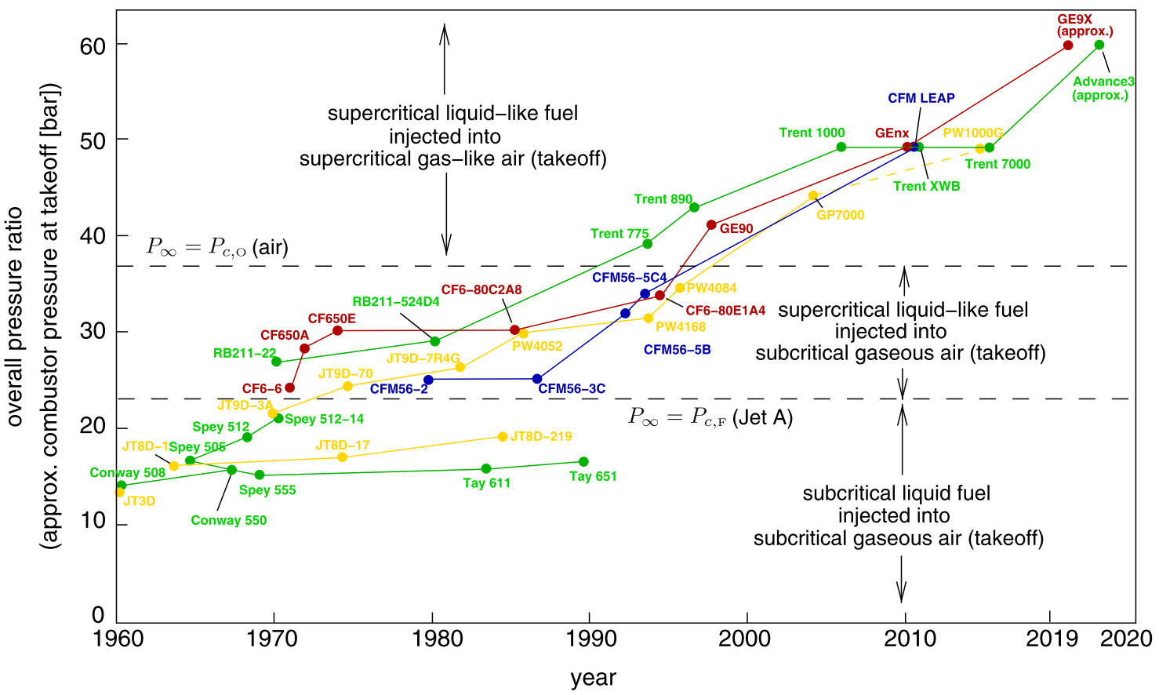
combustor pressure at takeoff (bar)

