Slide 1

EECS 542: Advanced topics in computer vision Programming Assignment 1
Abhishek Venkataraman
abhven@umich.edu

Slide 2

Buffy Stickmen dataset
We will be using S5e2 data (76 images)
Data available for upper body
Considered a hard dataset since persons appear at a variety of scales, against highly cluttered background in varying clothes
buffy_s5e2_sticks.txt contains annotation for all images
http://www.robots.ox.ac.uk/~vgg/data/stickmen/

Slide 3
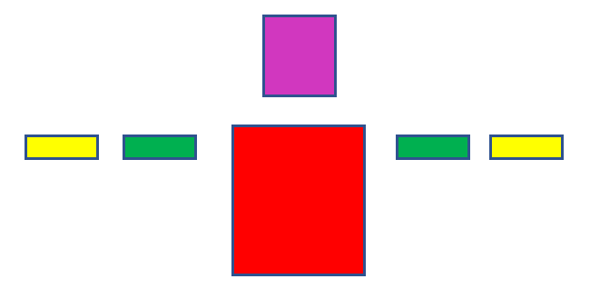
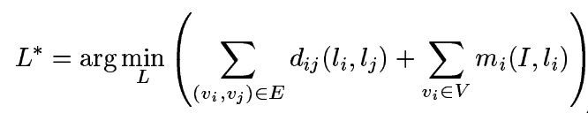
Problem details
head
Pose estimation: Using model and best configuration of each part
Each part is a vertex
Each connection (edge) has a deformation cost function
Each vertex has match cost function
Left lower arm
Right upper arm
Right lower arm
Left upper arm
torso

Slide 4
Problem formulation
Use person model (revolute joints)
Each part is specified by location l= {x, y, θ, scale}
Implement deformation cost function
Search for best configuration (minimum cost)
Match cost function is provided. Should use this for base problem
2 Bonus points Problems
Use annotation data only for bonus prob #2
(0,-45)
(-127.5,20)
(127.5,20)
(-47.5,20)
(47.5,20)
(0,80)
θ =0, scale=1 for all parts above
θ in radians

Slide 5
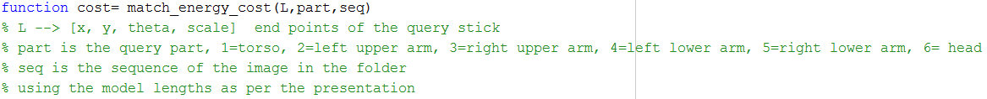
Useful functions
Do not rename the images/ Change folder structures

