Slide 1
Lecture 1: Intro to Game Theory

Slide 2
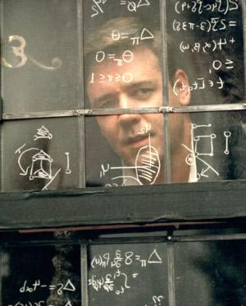
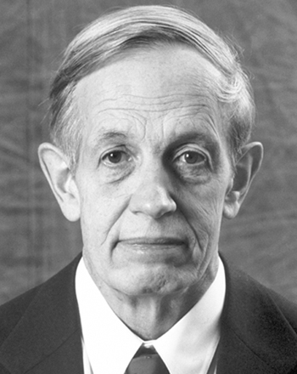
“A Beautiful Mind” (2001)

Slide 3
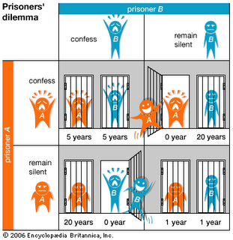
Sneak Peek: Prisoner’s Dilemma

Slide 4


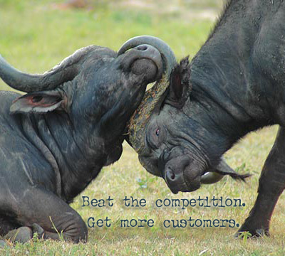
What is Game Theory?
(Distributed) Optimization Theory
Optimize a single objective over a design variable x,
Game theory
Study of multi-person decision problems
Competition and cooperation among agents
Role of threats/punishments in long-term relations
Models of adversarial behavior

Slide 5
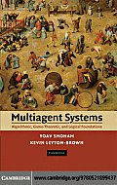

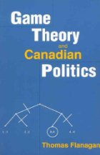
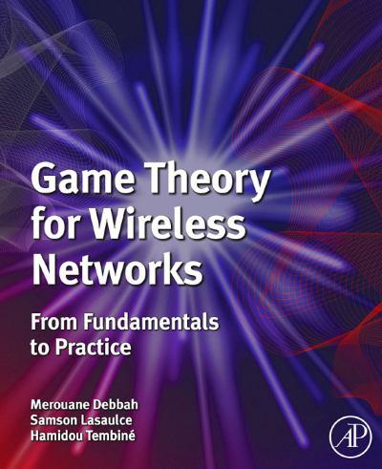
Applications of Game Theory
Theory developed mainly by mathematicians and economists
contributions from biologists
Widely applied in many disciplines
from economics to philosophy, including computer science (Systems, Theory and AI)
goal is often to understand some phenomena

Slide 6
Limitations of Game Theory
No unified solution to general conflict resolution
Real-world conflicts are complex
models can at best capture important aspects
Players are (usually) considered rational
determine what is best for them given that others are doing the same
No unique prescription
not clear what players should do
But it can provide intuitions, suggestions and partial prescriptions
best mathematical tool we currently have

Slide 7
What is a Game?
A Game consists of
at least two players
a set of strategies for each player
a preference relation over possible outcomes
Player is general entity
individual, company, nation, protocol, animal, etc
Strategies
actions which a player chooses to follow
Outcome
determined by mutual choice of strategies
Preference relation
modeled as utility (payoff) over set of outcomes

Slide 8
Classification of Games
Many, many types of games
Two major categories
Non-Cooperative Games
individualized play, no bindings among players
What strategies do I have to take when other strategic (rational) people interact with me?
Cooperative Games
play as a group, possible bindings
What advantages are given to me if I cooperate with others in the group?
Whom do I have to make a coalition with in order to maximize the gain given to me?

Slide 9
Example 1: WiFi MAC Access
Access Point
Nodes are required to follow Medium Access Control (MAC) rules
Wireless channel
A
B
Misbehaving nodes may violate MAC rules
: access probability, different backoff times

Slide 10

Example 2: Uplink Power Control
Network with a single point of interest
Uplink transmission
My power will make significant impact on the throughputs of other mobiles at the BS
Strategic situation
How can we model and analyze this system?

Slide 11
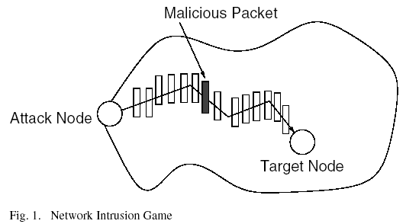
Example 3: Security
An intruder who sends a malicious packet to a node in the network
A defender who uses packet sampling on links in an attempt to detect this intrusion

Slide 12
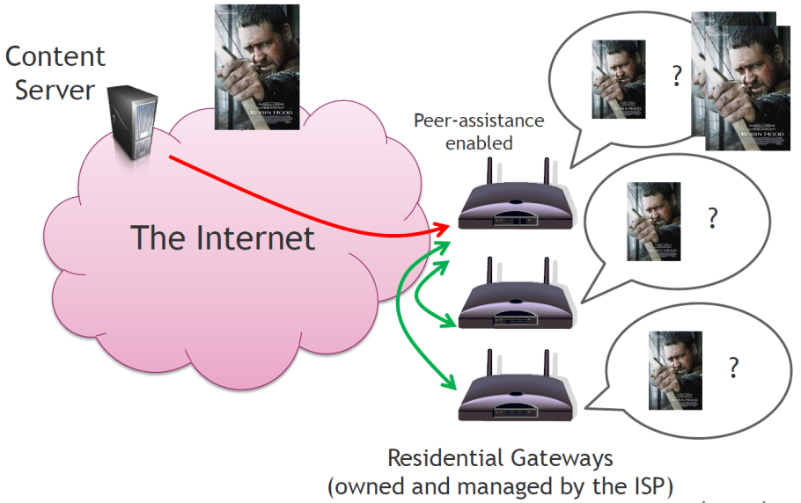
Example 4: Peer-Assisted Service
Client-Server
Limited by server side’s capability: access bandwidth and computing power
P2P
Exponential capacity growth and significant reduction of delivery cost
Too much copyright violation
Peer-assisted Services
Peers legally assist CP by commitment
Examples deployed: Nano data center and IPTV
Question:
How to incentivize peers?
What kind of viable revenue sharing principle among CP and peers?

Slide 13
Two Views of Game Theory
As an analysis tool
Model of a strategic situation and study what situation we will end up with having
Example: Analysis of Coke market (Coca Cola and Pepsi)
As a control tool
Development of a control mechanism that leads to a “good” conclusion
Inverse game theory or often called mechanism design
Example: Auction

