Slide 1
Lecture 5: Potential Game

Slide 2
Contents
There exists some special games with “beautiful” properties
One great example is “Potential Game”
What “beautiful” properties?
What is Potential Game?

Slide 3
Potential games

Slide 4
Potential Game: Summary
A special class of non-cooperative games having a special structure
The variations of the users’ utilities can be captured by a single function known as the potential function
Potential games are characterized by their simplicity and the existence or uniqueness of a Nash equilibrium solution
Often, potential games are useful when dealing with continuous-kernel games

Slide 5
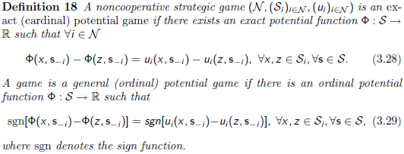
Potential Game
Formally,
In exact potential games, the difference in individual utilities achieved by each player when changing unilaterally its strategy has the same value as the difference in values of the potential function. In ordinal potential games, only the signs of the differences have to be the same.

Slide 6
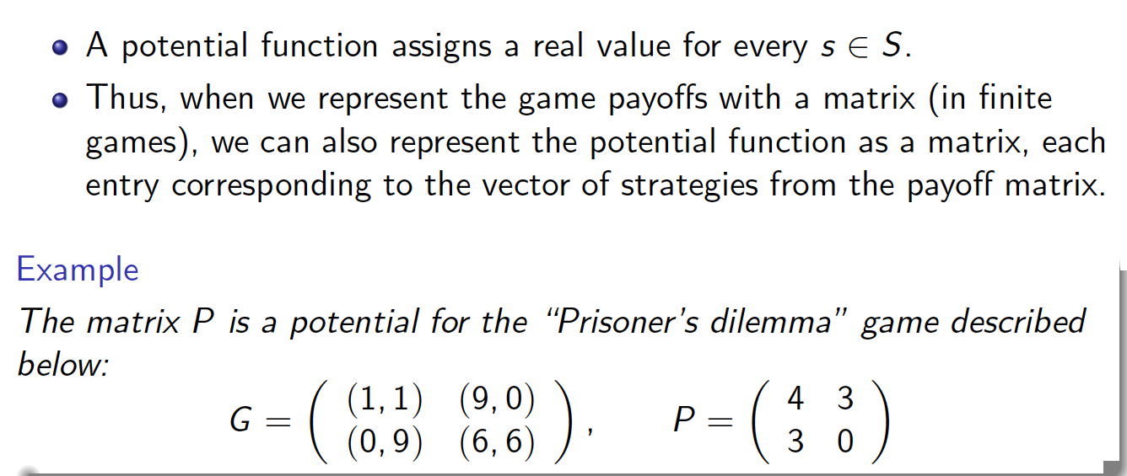
Example: Prisoner’s Dilemma

Slide 7
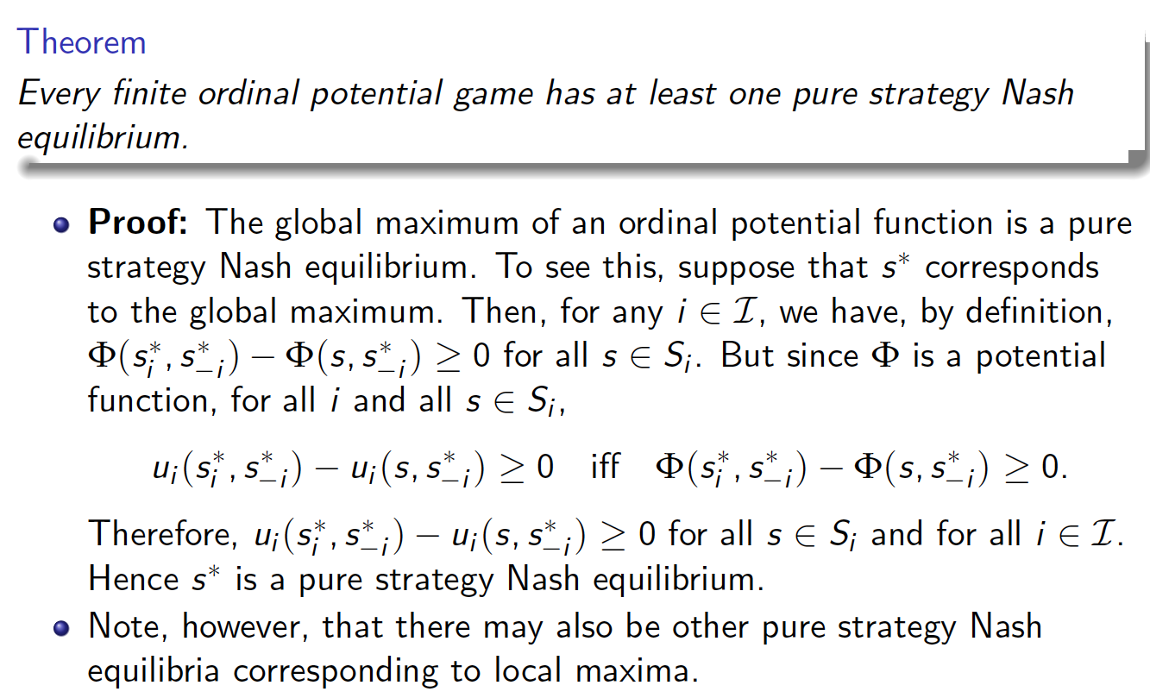
Pure Strategy NE: Existence
Intuition?

Slide 11
Does there exist a famous and
representative potential game?
Yes! Congestion Game
But, you will see more surprising
result soon!

Slide 12
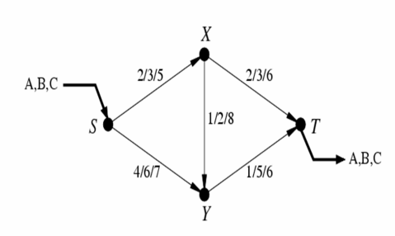
Congestion Game: Example
Three players from S to T
a/b/c: cost when one/two/three players use that road
Total cost of each player is the aggregate link cost over its path

Slide 13
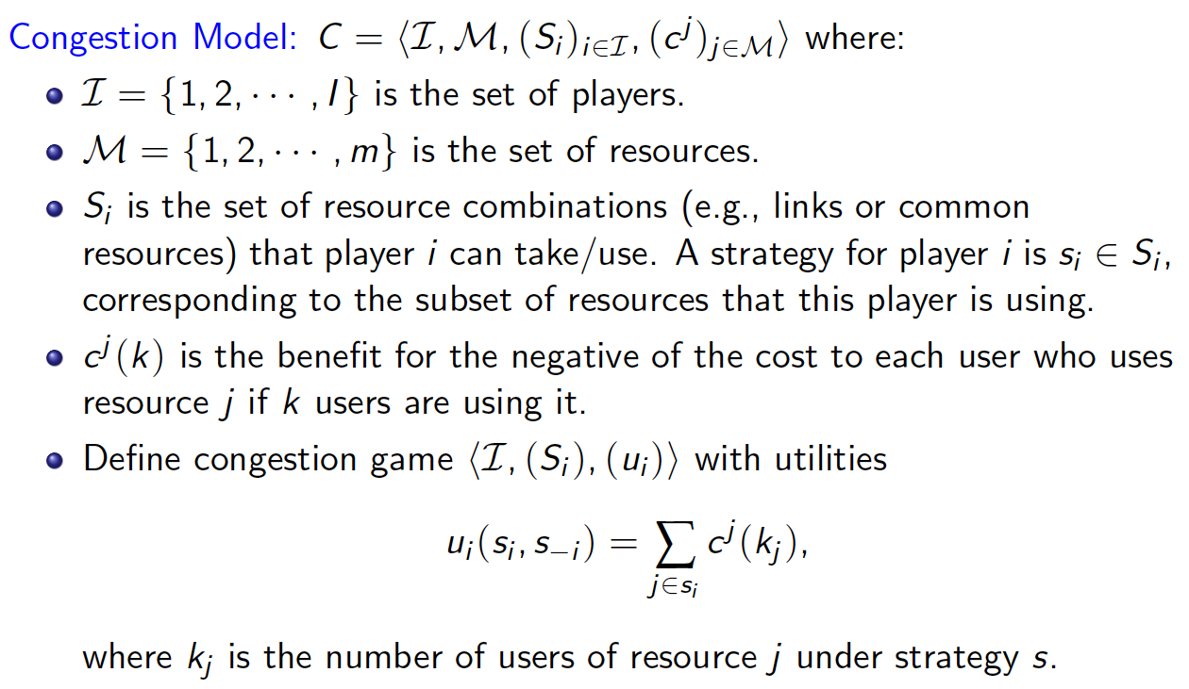
Congestion Game: Formal Model

Slide 14
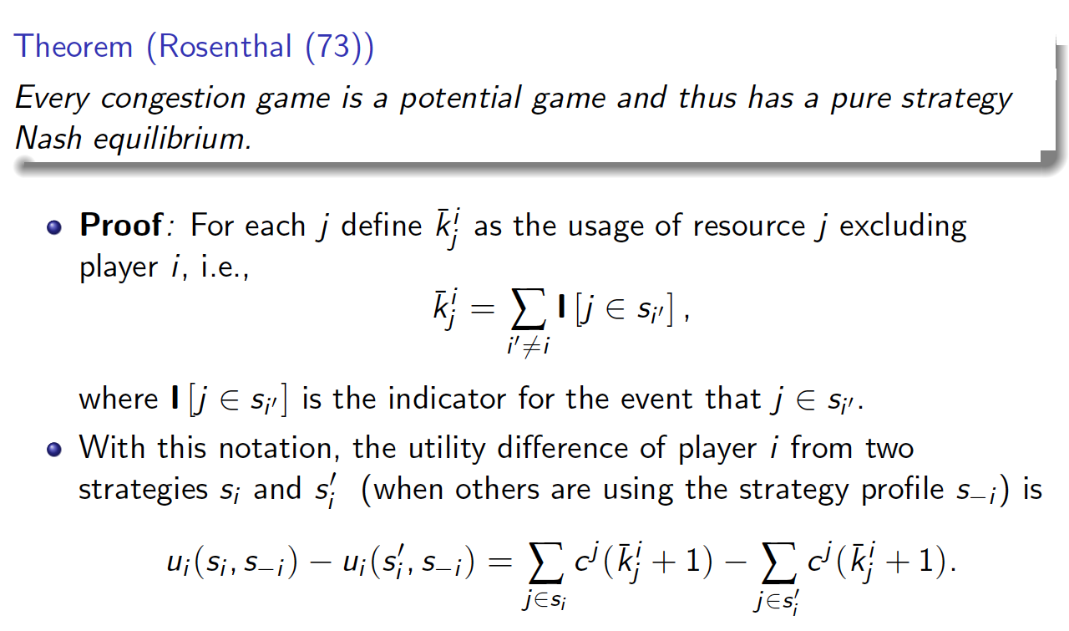
Congestion Game is a Potential Game

Slide 18
Congestion game is not just an example
Theorem
Each exact potential game has its equivalent congestion game.
Hmm…

Slide 19
Potential game for continuous strategy set
In the earlier slides,
Mainly, discrete, finite number of strategies
Clearly, we can apply almost the similar principle to continuous strategy cases.
Example?
Conditions under which NE exists or even it is unqiue?
How can we see some game is a potential game or not?
We will see them later …

Slide 20
Summary

Slide 21
Pure Strategy NE: Existence

Slide 23
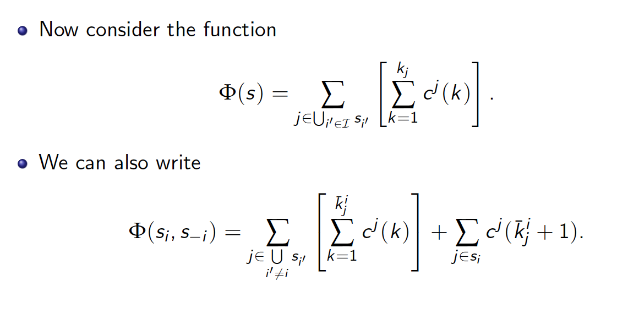

Slide 24
