Slide 1
Lecture 6: Playing with Equilibrium

Slide 2
Existence and Uniqueness
Sufficient conditions for existence and uniqueness
This lecture
A little bit mathematical
But, we focus on just intuitions and results, rather than rigorous proofs
Note
Many NE existence and uniqueness proofs do NOT directly follow these sufficient conditions, but they sometimes use other techniques (e.g., directly follow the definition of NE, etc).
But, it’s useful to know that there exist these sufficient conditions.

Slide 3


Existence
Mathematically,
Existence of NE: a fixed-point problem
Why?

Slide 4
Existence
Many sufficient conditions for existence based on the existence of the solution of FPT (fixed point theorems).
In the previous homework,
Pricing-congestion game
Infinitely many pure strategy space
Depending on the situation, pure strategy NEs may or may not exist.

Slide 5
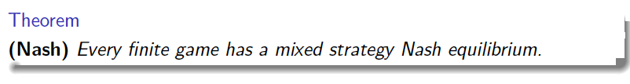
Finite Game
Pure strategy (Prisoner’s Dilemma, Matching Pennies etc)
NE may exists
NE can be unique
No NE
Mixed Strategy
What about infinite games?
P2
 | Head | Tail
Head | 1,-1 | -1,1
Tail | -1,1 | 1,-1
P1

Slide 6
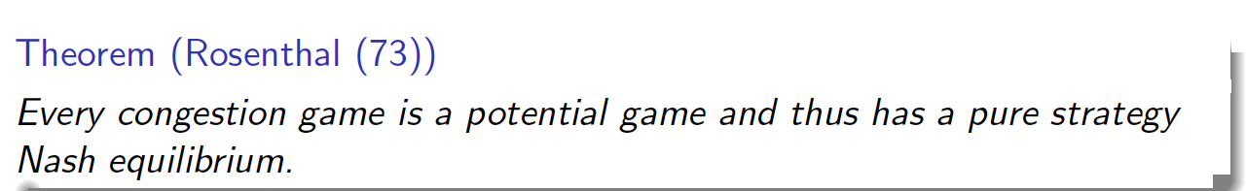
Finite Potential Game
Do you remember?

Slide 7
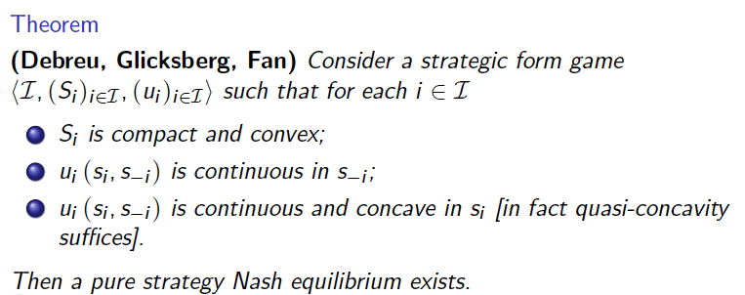
Pure NE Existence for Infinite Game

Slide 8
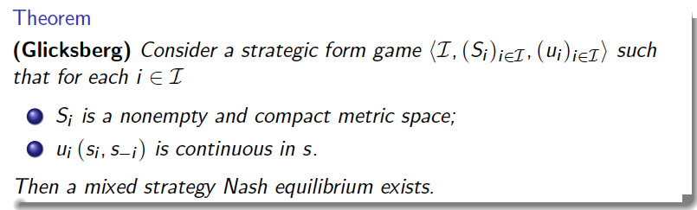
Existence of Mixed NE for Infinite Game

Slide 9
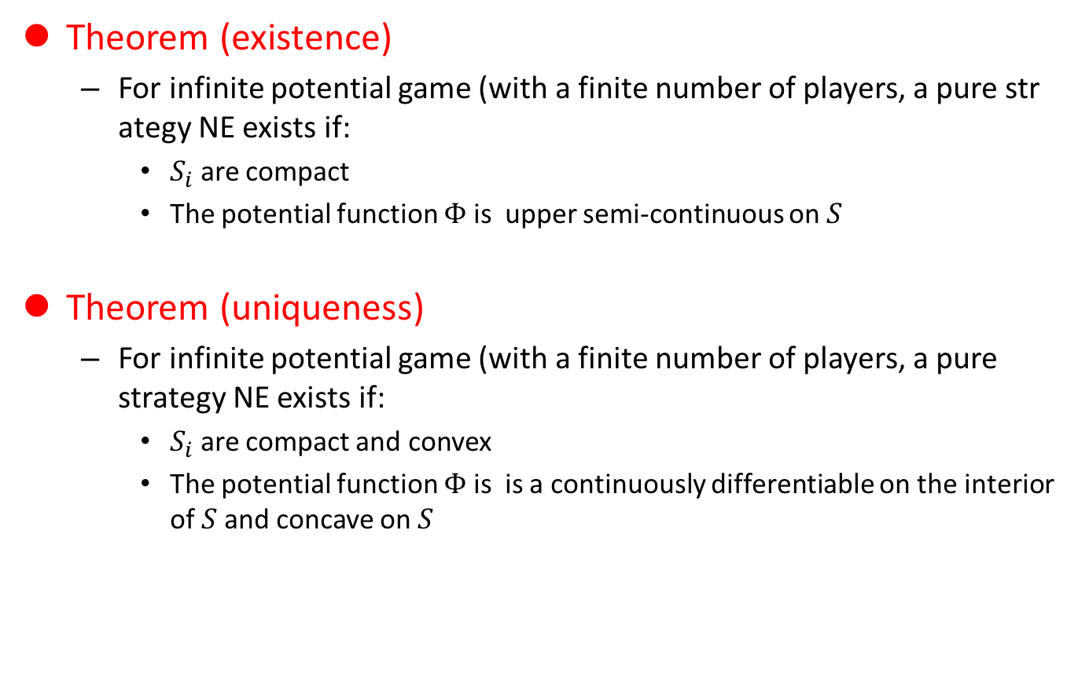
Infinite Potential Game
Theorem (existence)
For infinite potential game (with a finite number of players, a pure strategy NE exists if:
$S_{i}$ are compact
The potential function $Φ$ is upper semi-continuous on $S$
Theorem (uniqueness)
For infinite potential game (with a finite number of players, a pure strategy NE exists if:
$S_{i}$ are compact and convex
The potential function $Φ$ is is a continuously differentiable on the interior of $S$and concave on $S$

Slide 10
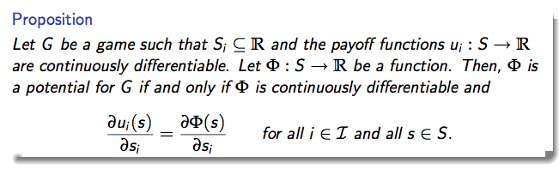
Aside: For infinite potential games
What is the condition for a game to be a potential game?

Slide 11
Uniqueness of NE for General Games
If the best response can be computed with a closed form
When players’ utilities are concave, Rosen [1965]
If the best responses are known with a closed form
Find the intersection points (generally applied in many cases)
Just do it and try to prove from your gut feeling
For example, suppose that we have two NEPs.
Assume they are different → find a contradiction

Slide 12
Summary

Slide 13
Better-reply Secure (BRS) [Reny 1999]
Generally, the FPT conditions are well known for the case when the utility functions are continuous w.r.t. the strategy profiles
This condition is a generalized version of those.
BRS

Slide 14
Recursive Diagonally Transferable Continuous (RDTC) Games
This is necessary & sufficient condition
[Tian 2009] Very recently developed
Very nice to prove that there does not exist NE
Sufficiency: much more complex than, for example, quasi-concavity, may not be very, very useful, but we don’t know

Slide 15
Potential and Supermodular games
Do you remember that we have already talked some existence and uniqueness conditions?

