Slide 1
Lecture 9: Repeated Game

Slide 2
Basic Terminologies
Dynamic/Static Game
Game in which we have sequence of moves or not
Complete/Incomplete Information
Games in which the strategy space and player’s payoff functions are common knowledge, or not
Perfect/Imperfect Information
Each move in the game the player with the move knows the full history of the game thus far.
At some move the player with the move does not know the history of the game.
Typically used for dynamic games

Slide 3
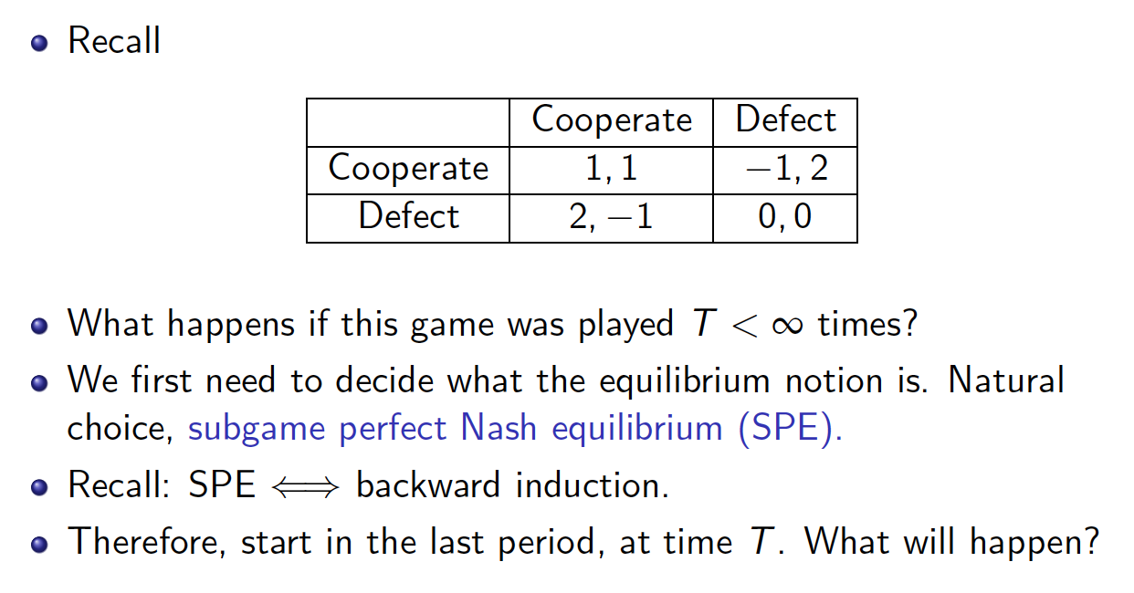
Prisoner’s Dilemma
What about playing this game iteratively?
Iterative Prisoner’s Dilemma
A special form of dynamic games
Difference from the earlier extensive form game, or stackelberg game?

Slide 4
Motivation
Consider this strategy S:
Start with C, and choose C as long as the other player chooses C
If in any period the other player chooses D, then choose D in every subsequent period
Outcome example
(C,C), (C,C), (C,C) … (C,D) (D,D) (D,D) …
Why player 2 can choose D in (C,D)? For a short-term gain
The strategy S means that I will punish you if you defect!
If a player value the present more highly than the future, she may or may not choose defect.
How patient is a player?

Slide 5


What is Repeated Game?
………
A game is repeated multiple times, say 10 times.
한번만 할 것이라면, $L_{i}$를 선택하겠지만, 여러 번 할 것이라면, $R_{i}$를 선택하여서, “협조”를 구해보는 것도…
만약, 협조하다가 배신하면, 내가 너를 “응징”하리…

Slide 6
What is Repeated Game?
………
In ongoing relationships, the promise of future rewards and the threat of future punishments may sometimes provide incentives for good behavior (i.e., cooperation) today. (Nobel prize!)
T: Period of a repeated game
Finite case
Infinite case

Slide 7
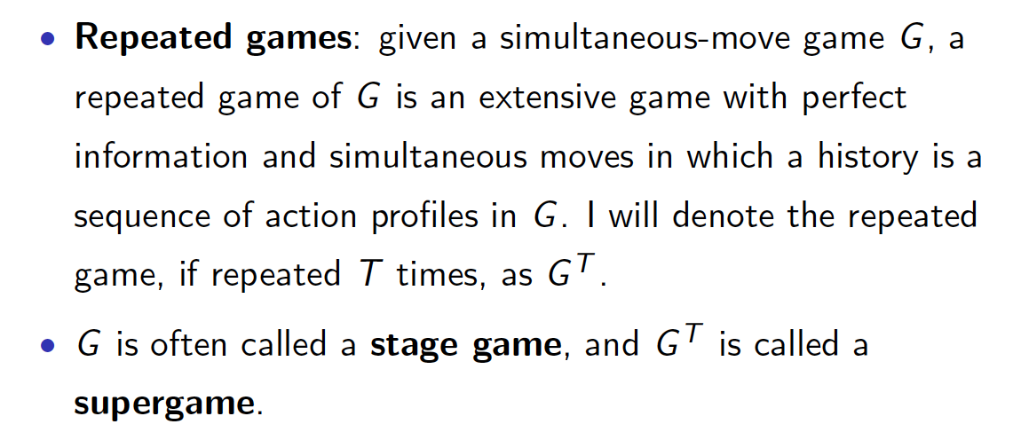
Terminologies

Slide 8
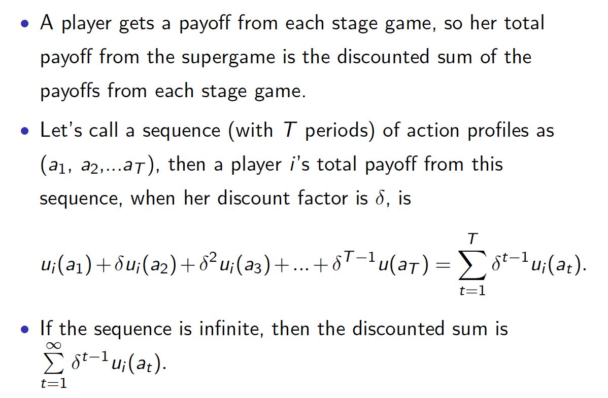
Payoffs of a repeated game

Slide 9
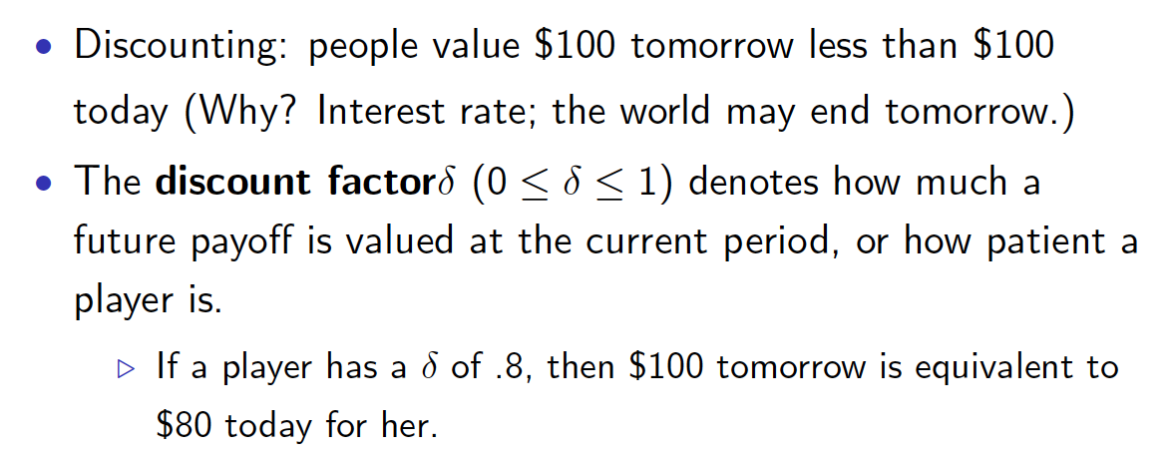
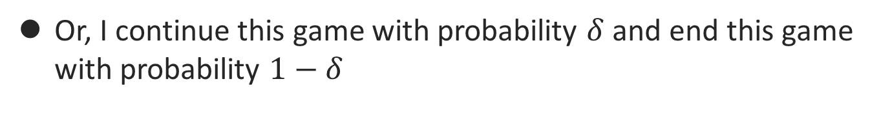
Discounting: Rationale
Or, I continue this game with probability $δ$ and end this game with probability $1−δ$

Slide 10
Dividing Cases
Finite repeated game
(Case 1) A stage game has unique NE
(Case 2) A stage game has multiple NEs
(Case 3) Infinite repeated game
In this lecture, in most of examples,
Use Prisoner’s dilemma as a stage game
Assumptions
Perfect monitoring: At each period, the outcomes of all past periods are observed by all players

Slide 11
Finite Repeated Game:
Unique NE in the stage game

Slide 12
Finitely-repeated PD
 | C | D
C | 2,2 | 0,3
D | 3,0 | 1,1

Slide 13
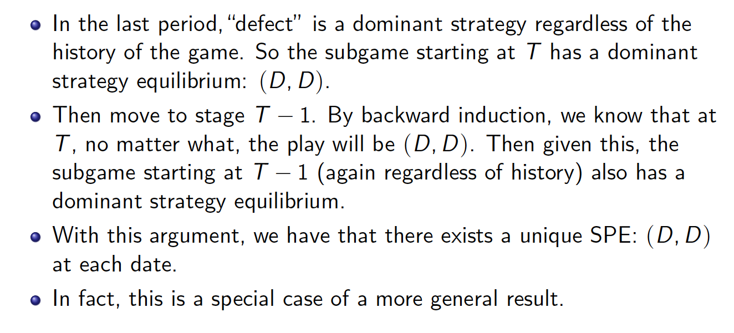
Cont’d

Slide 14
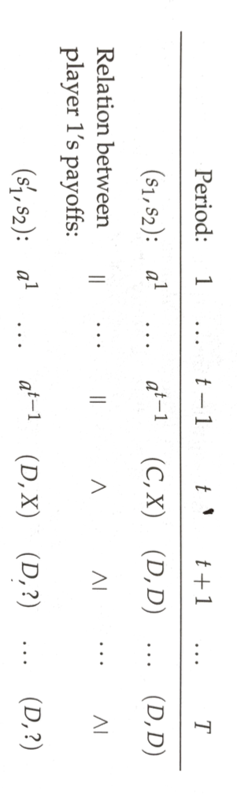
(D,D,D,D): SPNE Checking
 | C | D
C | 2,2 | 0,3
D | 3,0 | 1,1

Slide 15
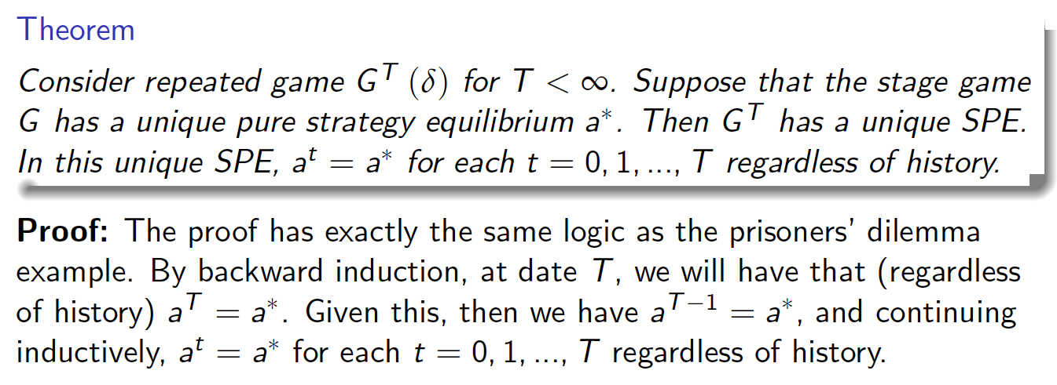
Thus, we have …
In this case, no cooperation appear even if we repeat the game.

Slide 16
Infinite Repeated Game:
What happens if we don’t know when the game would end?

Slide 17
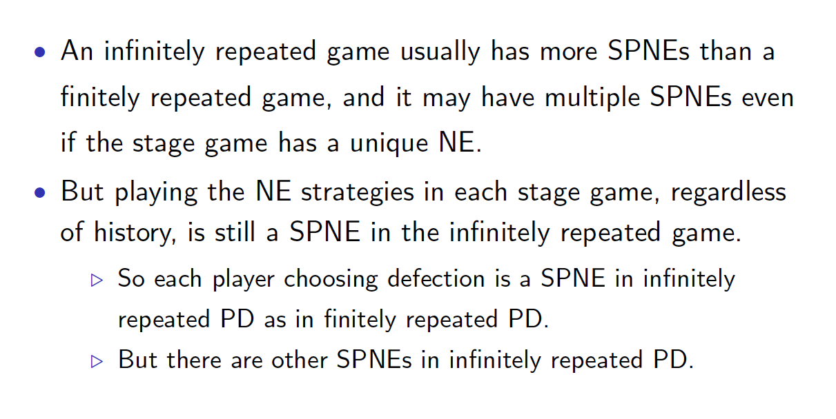
Intro
Our interest: Strategies inducing cooperation is SPNE or not

Slide 18
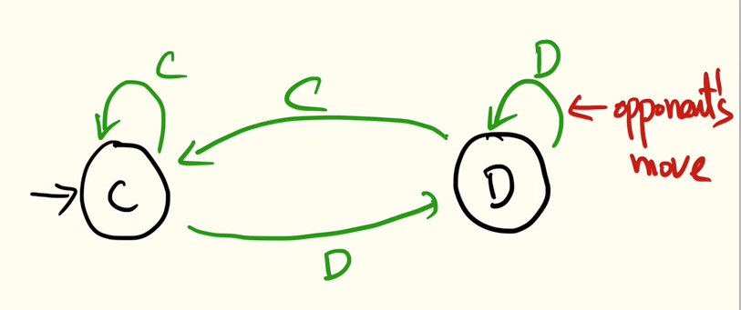
Strategy: Tit-for-tat
 | C | D
C | 2,2 | 0,3
D | 3,0 | 1,1
TFT strategy
Play C first,
Then, do whatever the other play did in the previous period

Slide 19
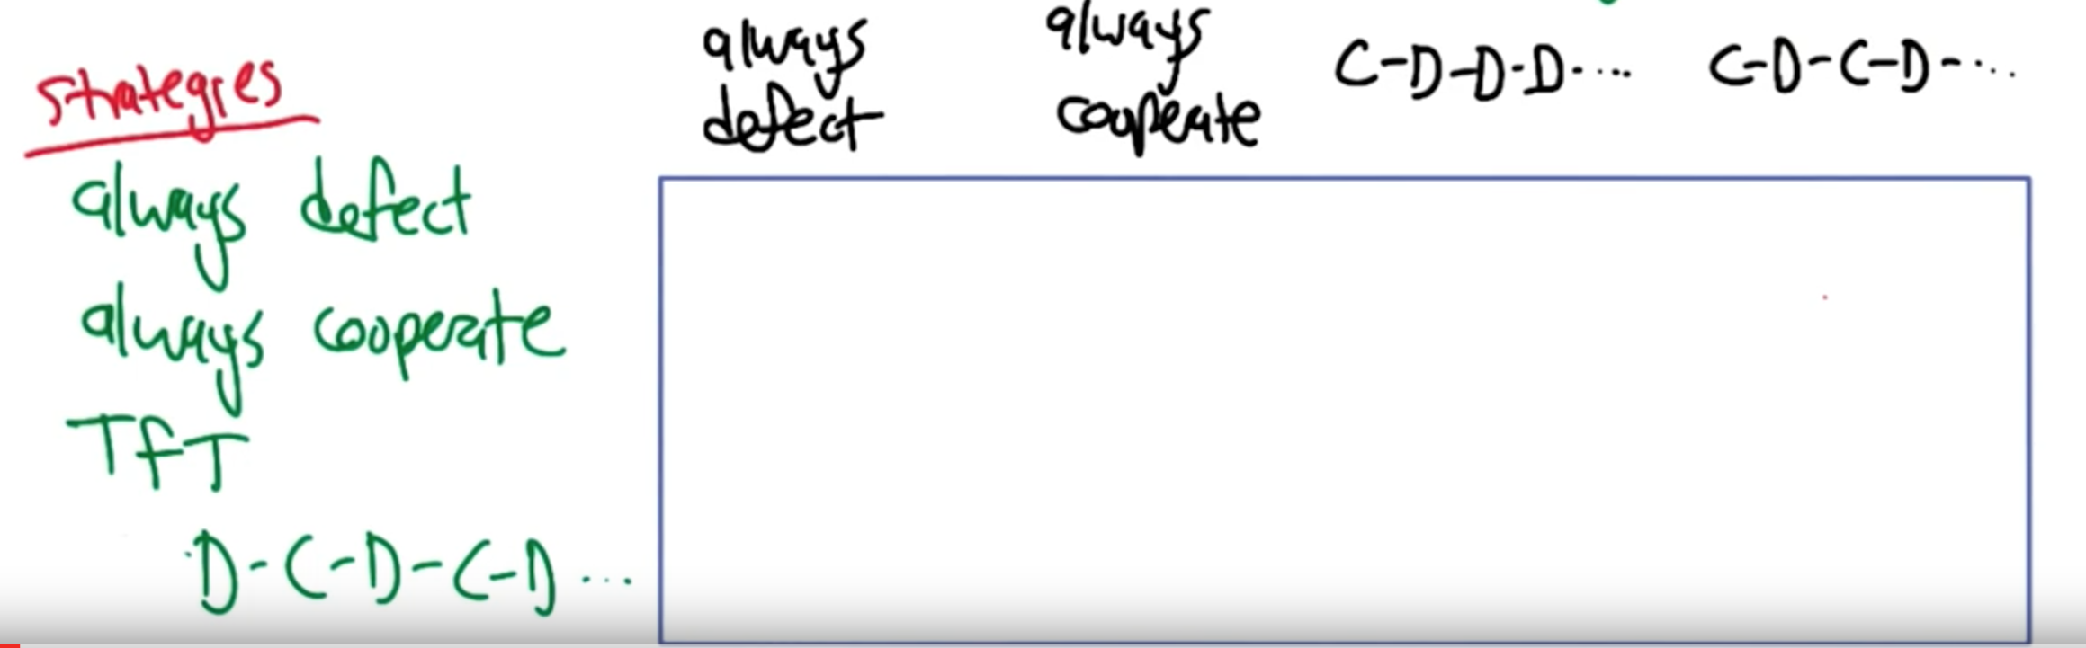
What does TFT do when playing against these strategies?
 | C | D
C | 2,2 | 0,3
D | 3,0 | 1,1

Slide 20
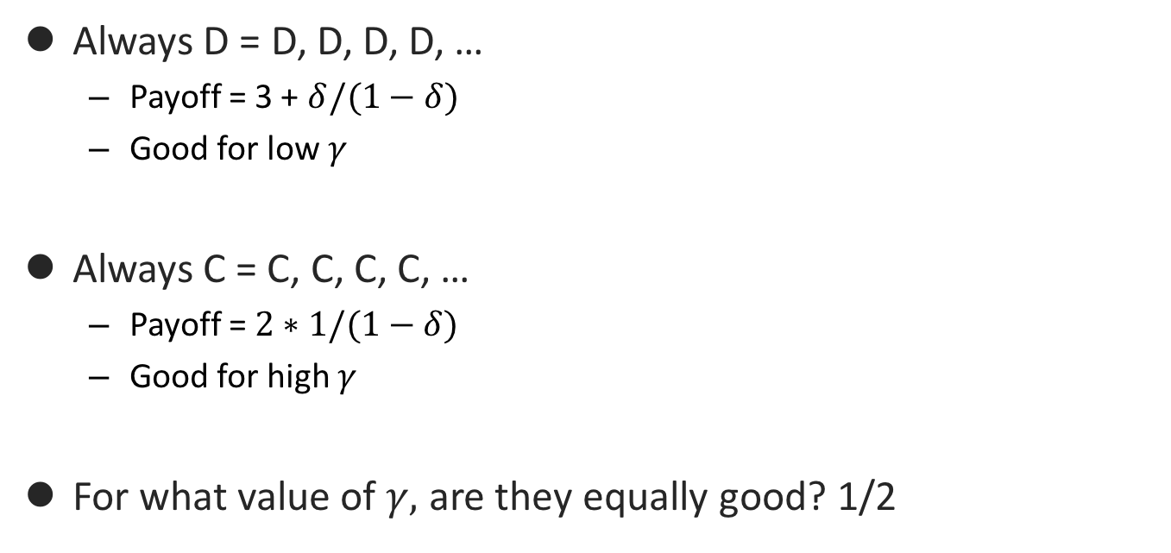
Which is better response to TFT?
 | C | D
C | 2,2 | 0,3
D | 3,0 | 1,1
Always D = D, D, D, D, …
Payoff = 3 + $δ/(1−δ)$
Good for low $γ$
Always C = C, C, C, C, …
Payoff = $2∗1/(1−δ)$
Good for high $γ$
For what value of $γ,$ are they equally good? 1/2

Slide 21
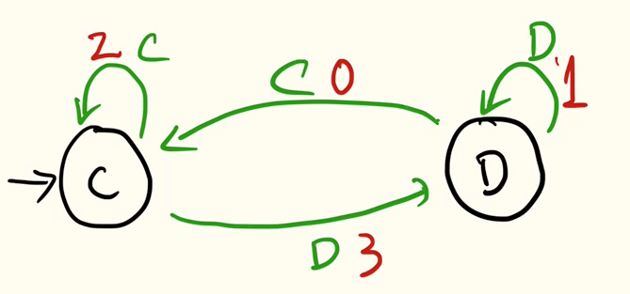
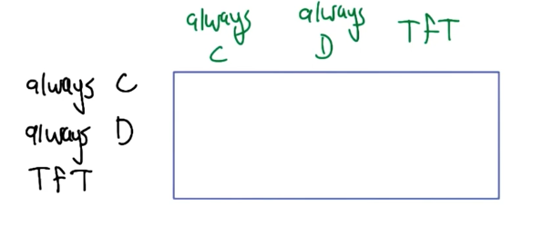
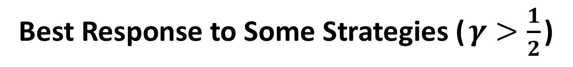
Best Response to Some Strategies ($γ>\frac{1}{2}$)
State: opponent choice
Edge: my choice
Edge label: my payoff
Given strategies
What are NEPs? Is there cooperation in some NEP?

Slide 22
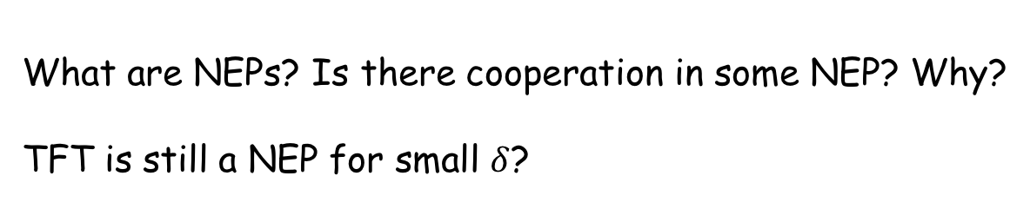
Cooperation in Infinite Repeated Game
Given strategies
What are NEPs? Is there cooperation in some NEP? Why?
TFT is still a NEP for small $δ$?

Slide 23
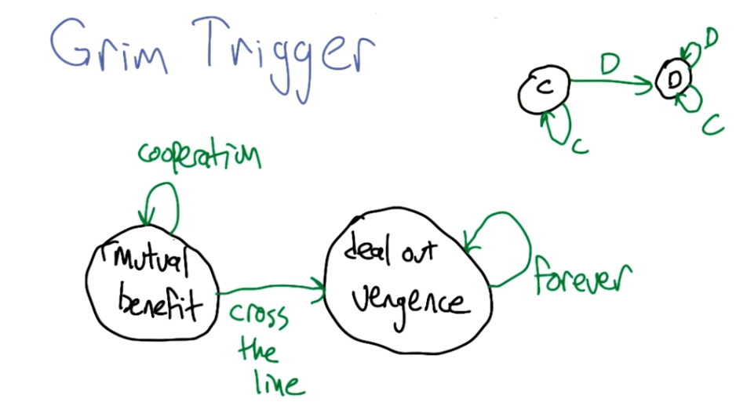
Strategy: Grim Trigger (GT)
Start with C
Then, play C if opponent has played D, and play D otherwise
Draconian policy

Slide 24

Grim Trigger: NEP
Under what conditions of $δ$, (GT,GT) is a NEP?

Slide 25
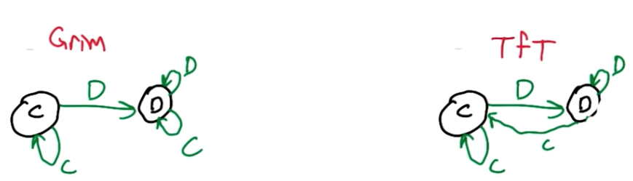
Incredible Threat (NE but not SPNE)
Consider a strategy (GT, TFT) as follows:
Is this NE?
Is this SPNE?
vs.

Slide 26
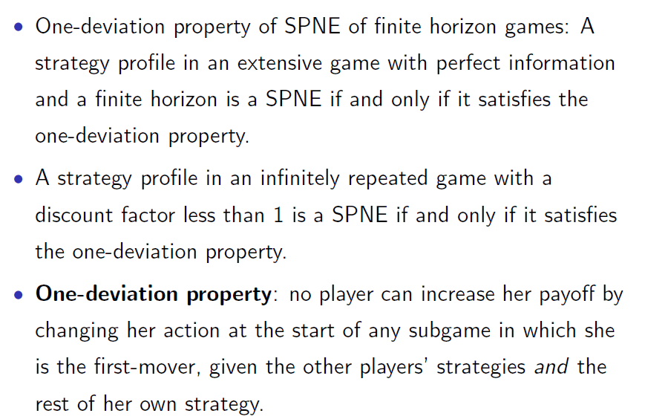
Checking SPNE Easily: One Deviation Property

Slide 27

TFT: SPNE
 | C | D
C | 2,2 | 0,3
D | 3,0 | 1,1
Under what $δ$, (TFT,TFT) is a SPNE?

Slide 29

Grim Trigger Strategy: SPNE
 | C | D
C | 2,2 | 0,3
D | 3,0 | 1,1
Under what $δ$, (GT,GT) is a SPNE?

Slide 30
Summary

Slide 31
Finite Repeated Game:
Multiple NEs in the stage game

Slide 32
Message
SPNE can include a strategy (at some stage game) that is NOT NE of the associated stage game.
Generally, many SPNEs

Slide 33
Example: Extended PD
 | Cooperate | Defect | Punish
Cooperate | 4,4 | 0,5 | 0,0
Defect | 5,0 | 1,1 | 0,0
Punish | 0,0 | 0,0 | 3,3
Cooperate = Quiet (묵비권),
Defect (배반) = Fink (고자질)
What are the NEs? (D,D) and (P,P)
Play twice, i.e., T=2
We will see
Even for the known ends, still cooperation helps
“Like to sustain (C,C)”, which is not an NE of the one-shot game

Slide 34
Strategy “Yung” that is SPNE
Strategy “Yung”
Play C and then
Play P if (C,C), and Play D otherwise
Is “Yung” a strategy?
Is “Yung” a SPNE? Yes!

Slide 35
How to check a strategy is SPNE?
One deviation principle, i.e.,
“Assuming that other players are playing Yung, what happens if I deviate?”
If I get a larger payoff (by deviation), than Yung is not an SPNE.
If I get a smaller payoff (by deviation), than Yung is an SPNE.

Slide 36
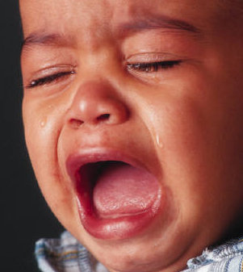
What happens if I deviate?
I deviate?
In other words, I don’t play C, but D (no reason to play P)
Why? Temptation to cheat because of an increasing payoff present (현실에 눈이 어두워서…)
If I play C (i.e., playing Yung)
C → 4 (C,C) + 3 (P,P) = 7
If I deviate and play D (i.e., playing some other strategy)
D → 5 (D,C) + 1 (D,D) = 6
Temptation to cheat (5-4 = 1) < reward – punishment (3-1 = 2) → I should not have deviated
(C,C) is reward, and (B,B) is punishment
Yung is a SPNE
C,P,P,P,P….

Slide 37
One Deviation Property

Slide 38
One Deviation Property

