Slide 1
Complex Network 보충자료
Yung Yi

Slide 2
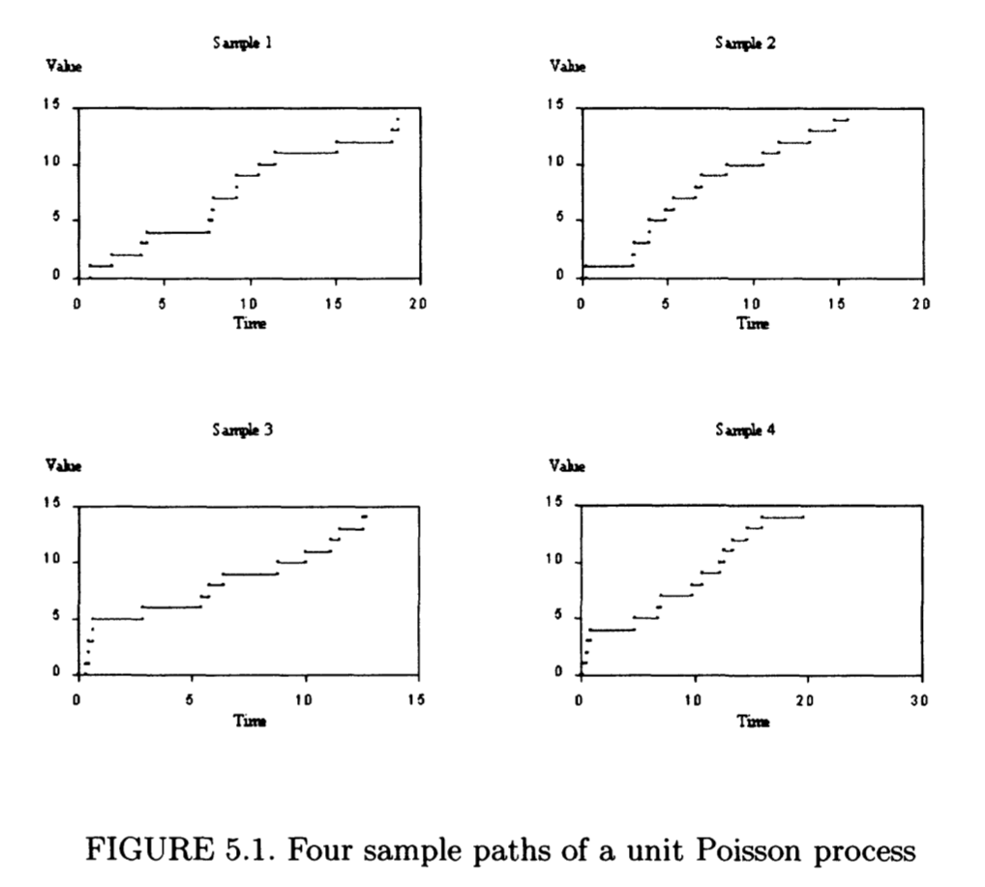

Slide 3
