Slide 1
Viral Marketing & Influence Maximization

Slide 2
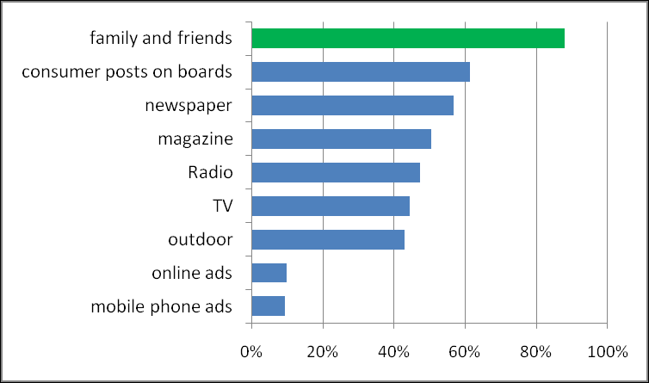
Word-of-mouth
Social network plays a fundamental role as a medium for the spread of influence among its members.
Level of trust on different types of ads*
“발 없는 말이 천리 간다.”
*source from Forrester Research and Intelliseek

Slide 3
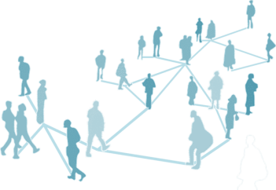
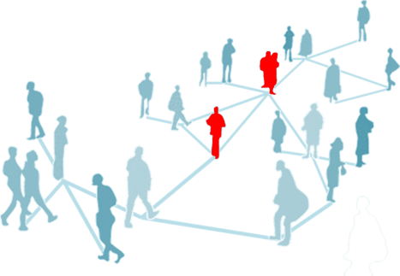
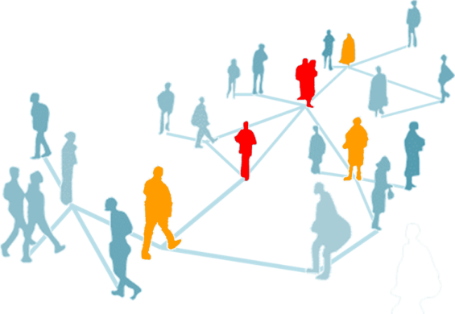
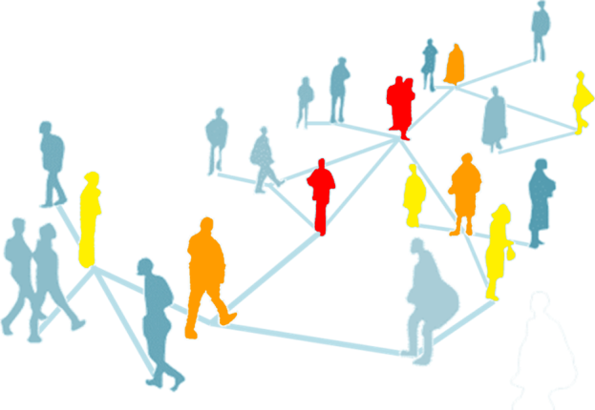
Viral Marketing
Interests
Budget: Who?
Influence: How many?
Diffusion Efficiency (or marketing efficiency)
Diffusion Time: How long?
Diffusion Number: How many?
Influence Maximization
Given graph G (V,E), select “k” vertices to maximize (expected) diffusion efficiency
t=0
t=1
t=2

Slide 4
Diffusion Model
&
Objective

Slide 5
Independent Cascade Model
When node v becomes active, it has a single chance of activating each currently inactive neighbor w.
The activation attempt succeeds with probability p_{vw} .
Notes:
We again start with an initial set of active nodes A0, and the process unfolds in discrete steps according to
the following randomized rule. When node v first becomes active
in step t, it is given a single chance to activate each currently inactive
neighbor w; it succeeds with a probability pv;w —a parameter
of the system — independently of the history thus far. (If w has
multiple newly activated neighbors, their attempts are sequenced in
an arbitrary order.) If v succeeds, then w will become active in step
t+1; but whether or not v succeeds, it cannot make any further attempts
to activate w in subsequent rounds. Again, the process runs
until no more activations are possible.

Slide 6

Example
0.6
Inactive node
0.3
0.2
0.2
Active node
X
U
Newly active
node
0.1
0.4
Successful
attempt
0.5
0.3
0.2
Unsuccessful
attempt
w
0.5
v
Stop!

Slide 7
Independent Cascade Model
Let U(C) denote the corresponding (random) set of ultimately activated nodes by active seed set C.
U(C) is a random variable thus we want to maximize F(C) = E(|U(C)|) subject to |C| < k.
IF-MAX Problem
Maximize F(C) := E(|U(C)|)
Subject to |C| < k
Notes:
We again start with an initial set of active nodes A0, and the process unfolds in discrete steps according to
the following randomized rule. When node v first becomes active
in step t, it is given a single chance to activate each currently inactive
neighbor w; it succeeds with a probability pv;w —a parameter
of the system — independently of the history thus far. (If w has
multiple newly activated neighbors, their attempts are sequenced in
an arbitrary order.) If v succeeds, then w will become active in step
t+1; but whether or not v succeeds, it cannot make any further attempts
to activate w in subsequent rounds. Again, the process runs
until no more activations are possible.

Slide 8
Problem Hardness
&
Efficient Approximation

Slide 9
Solving IF_MAX is NP-hard
Theorem NP-hard. IF_MAX is NP-hard for the Independent Cascade model.
(sketch of proof) A simplified version of influence maximization problem in IC model is equivalent to NP-hard Set Cover problem. Thus, the original influence maximization problem is NP-hard problem as its simplified version. The simplified version of influence maximization problem:
Consider seed set C with cardinality k.
p_{ij} is 1 if i and j are connected. (or consider a sample path)
Define C_{i} as coverage by node i in C.

Slide 10
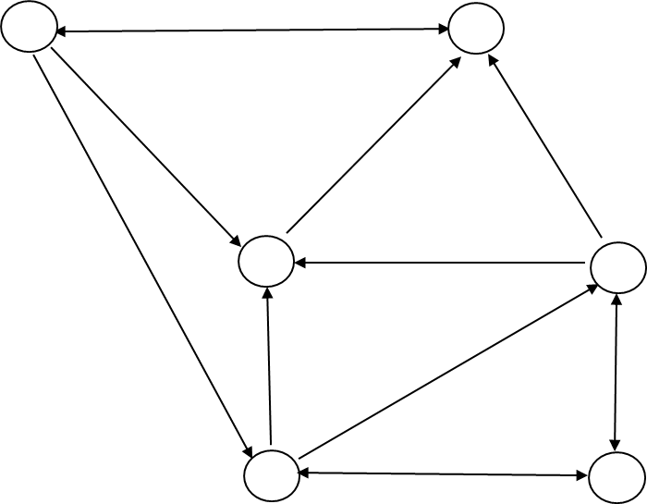
#P-hard to Estimate Influence
Theorem #P-hard. Computing the influence F(C) given seed set C is #P-hard.
sketch of proof)
A simplified version of computation of F(C) is equivalent to counting problem of s-t connectness in a directed graph. (Consider a path between s (in C) and t (in G\C) as propagation path.)
Since the s-t connectness is #P-complete, and thus the influence computation problem is #P-hard.
t
s

Slide 11
Outline
Introduction
Word-of-mouth and viral marketing [9.1]
Basic Models for Influence Maximization
General diffusion models
Independent Cascade (IC)
Complexity of Influence Maximization
NP-hard to maximize influence [9.2]
#P-hard to estimate influence
Influence Maximization and PTAS
Monotonicity and Submodularity at “in-advance” view point
Submodularity and (ε, δ)-greedy algorithm [9.3]
Handling incorrectness in influence estimation [9.4]
Related Works
Networked coordination game and linear threshold model [Klein07]
Other influence maximization formulations [GoyalMin12, Dead12]
More on scalability issue [MIA10]

Slide 12
Bad News and Possible Solutions
#P-hard to estimate influence
Allow shortfalls (ε, δ) to measure influence
NP-hard to maximize influence
Greedy algorithm under submodular and monotone structure
(ε, δ) – greedy algorithm under submodular and monotone structure guarantees (1-e^{-ε})-optimal minus kδ/ε.
(1, 0) – greedy algorithm guarantee 63% optimality. (with perfect influence estimation)
Maximize F(C) := E(|U(C)|)
Subject to |C| < k
00

Slide 13
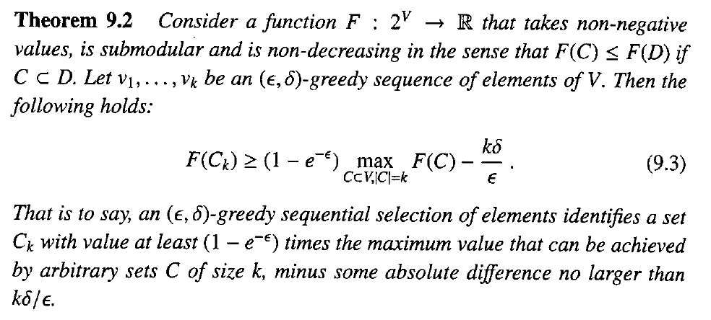
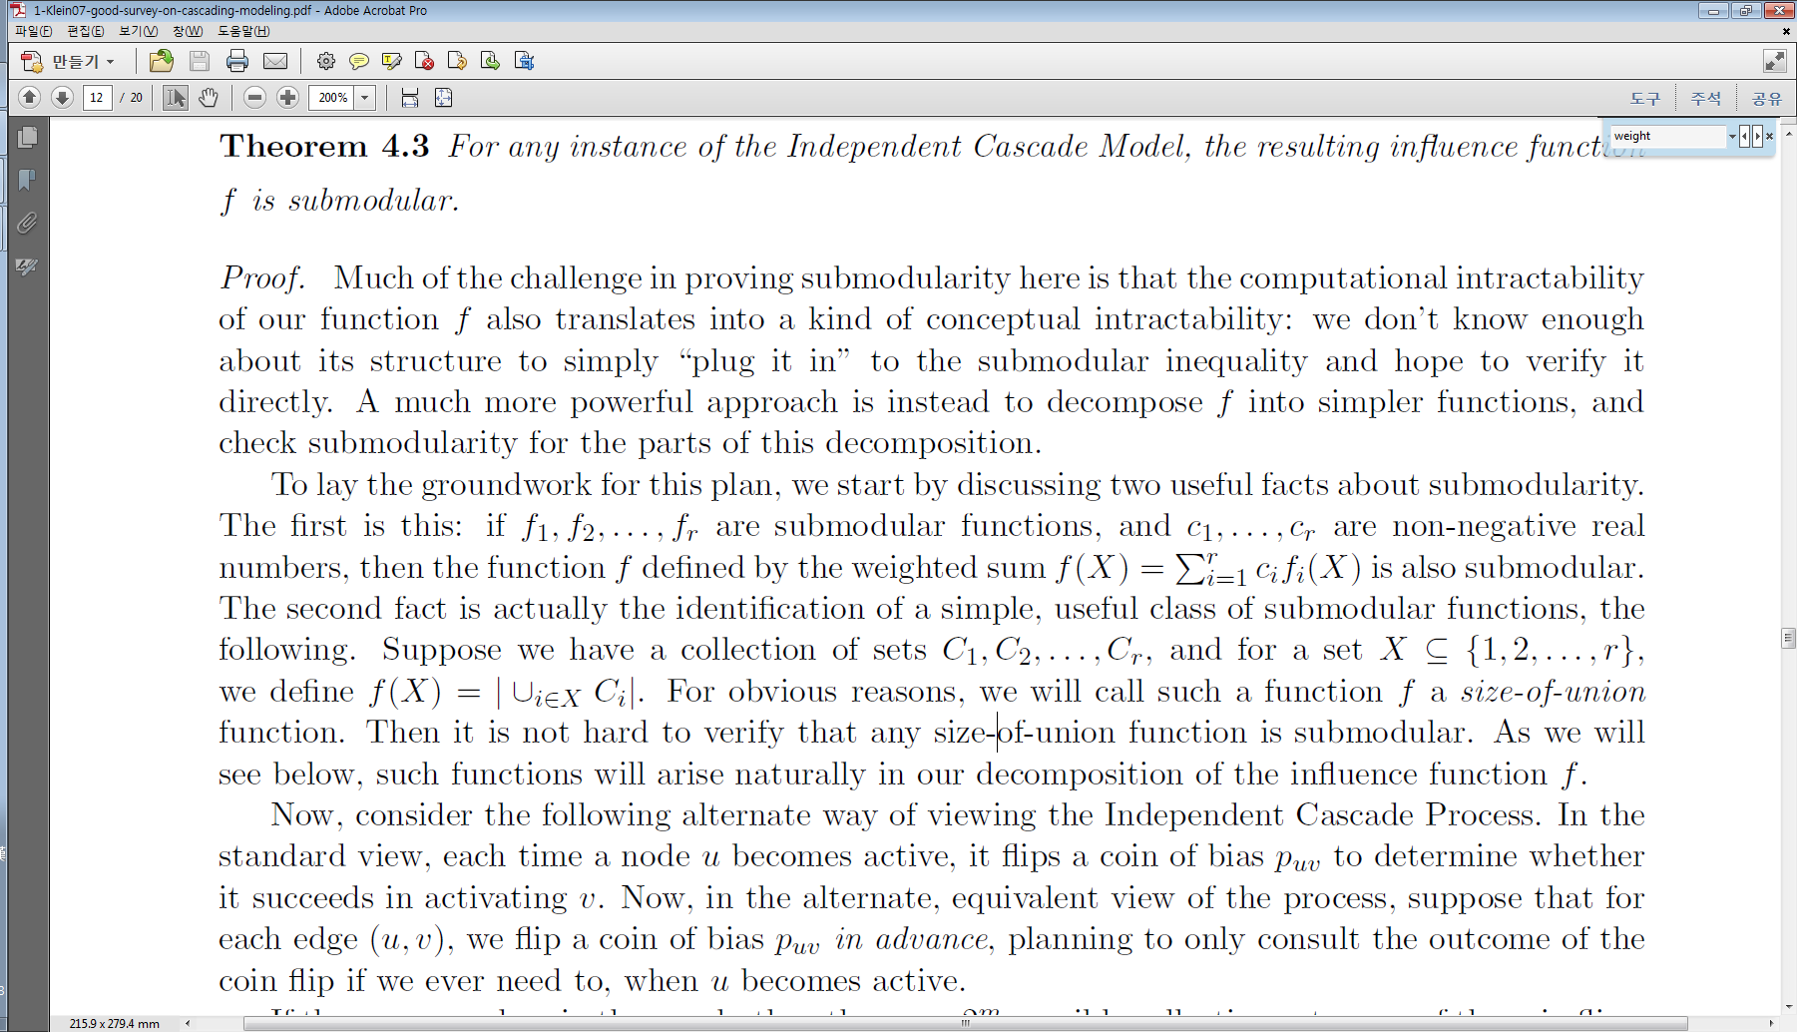
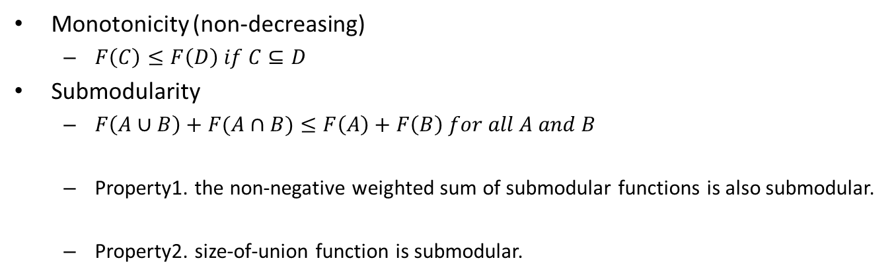
Handling NP-hardness in Maximizing Set Function
Monotonicity (non-decreasing)
$F\left(C\right)≤F\left(D\right) if C⊆D$
Submodularity
$F\left(A∪B\right)+F(A∩B)≤F\left(A\right)+F\left(B\right) for all A and B$
Property1. the non-negative weighted sum of submodular functions is also submodular.
Property2. size-of-union function is submodular.

Slide 14
Monotonicity
It’s trivial.
More seed nodes make more infected nodes.
Thus, F(C) is non-decreasing (monotone).

Slide 15
Submodularity (1)
In actual model, coins for edges are flipped during activation attempts.
0.6
0.3
0.2
0.2
0.1
0.4
0.5
0.3
0.5

Slide 16
Submodularity (2)
In equivalent model, pre-flip all coins and reveal results immediately. And then consider reachable nodes.
0.6
0.6
0.3
0.2
0.2
0.3
0.2
0.2
0.1
0.1
0.4
0.4
0.5
0.3
0.5
0.3
v
v
0.5
0.5
Live edges
are decided by head of biased coin
start at active nodes
biased (p_{vw}) coin flip in advance

Slide 17
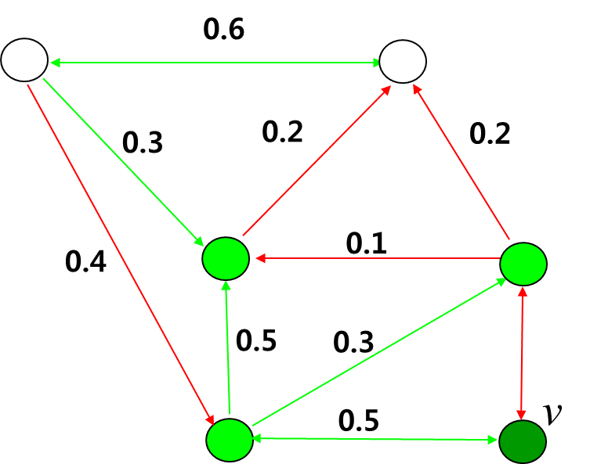
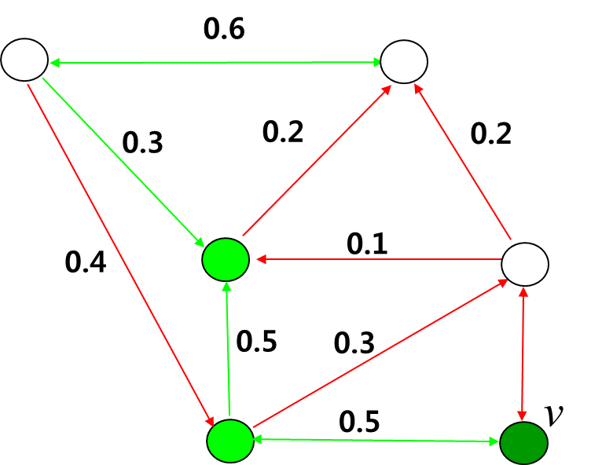
Submodularty (3)
A node x ends up active if and only if there is a path from some node in A to x consisting entirely of live edges. (We will call such a path a live-edge path and the node x is in R(v, X) where v is a seed node.)
Thus, two models have same probability space where each sample point is an outcome of coin flip.
Let X denote a in-advance outcome, then, F_{X}(C) = |∪_{v in C} R(v, X)| is submodular since it’s a size of union function.
Thus, F(C) = ∑_{X in Ω} Prob[X] · F_{X}(C) is submodular, too.
…
R(v, X)
R(v, X’)

Slide 18
Outline
Introduction
Word-of-mouth and viral marketing [9.1]
Basic Models for Influence Maximization
General diffusion models
Independent Cascade (IC)
Complexity of Influence Maximization
NP-hard to maximize influence [9.2]
#P-hard to estimate influence
Influence Maximization and Polynomial Algorithm
Monotonicity and Submodularity at “in-advance” view point
Submodularity and (ε, δ)-greedy algorithm [9.3]
Handling incorrectness in influence estimation [9.4]
Related Works
Networked coordination game and linear threshold model [Klein07]
Other influence maximization formulations [GoyalMin12, Dead12]
More on scalability issue [MIA10]

Slide 19
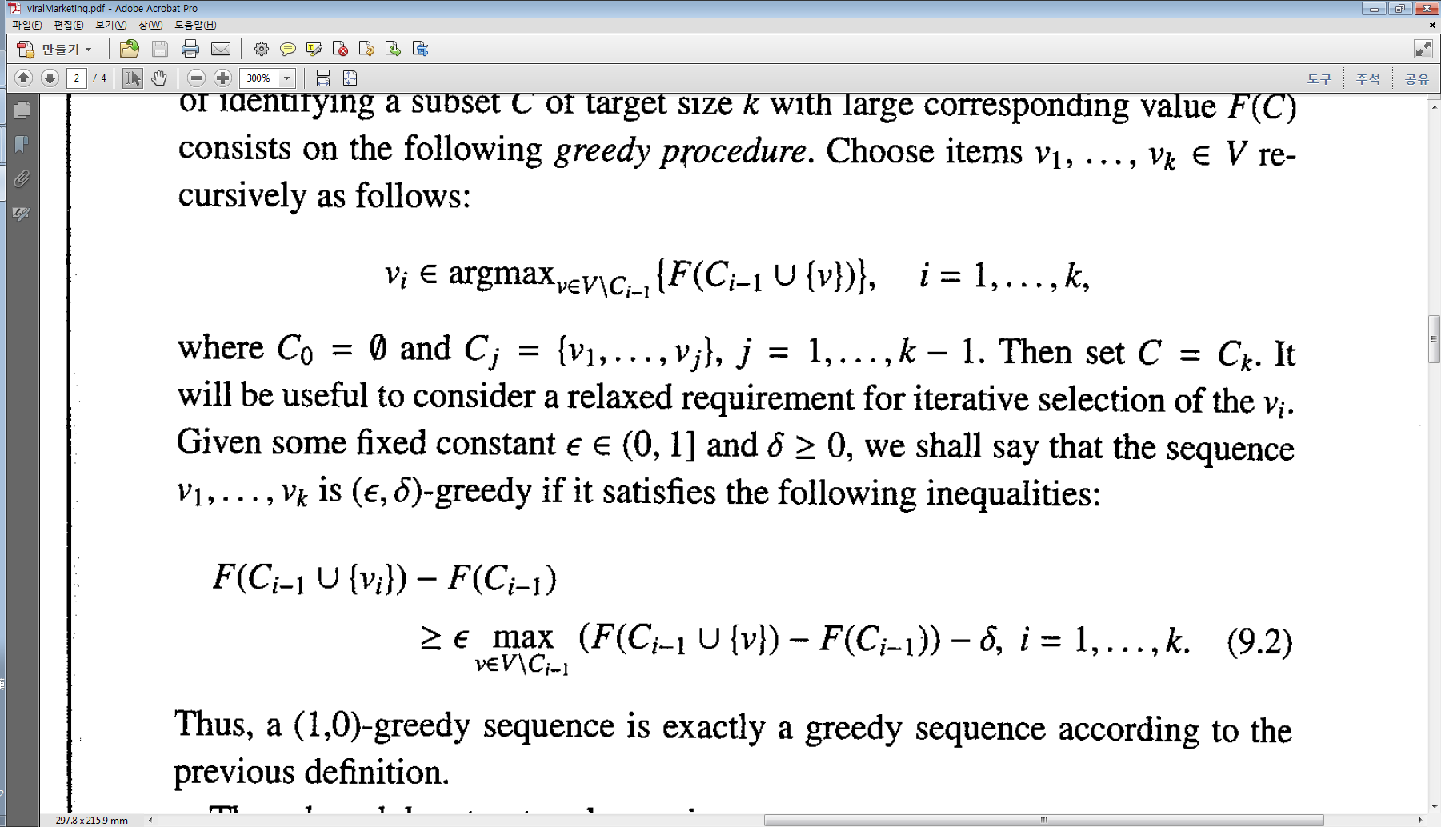
(ε, δ)-Greedy Algorithm
Greedy Algorithm for Influence Maximization
Greedy algorithm collects k vertices one by one as following:
(ε, δ)-Greedy Algorithm
Since estimation of F(C_{i-1}) could be incorrect (#P-hard for exact estimation), we consider greedy algorithm which allows shortfalls (ε, δ).

Slide 20
Performance Guarantee

Slide 21
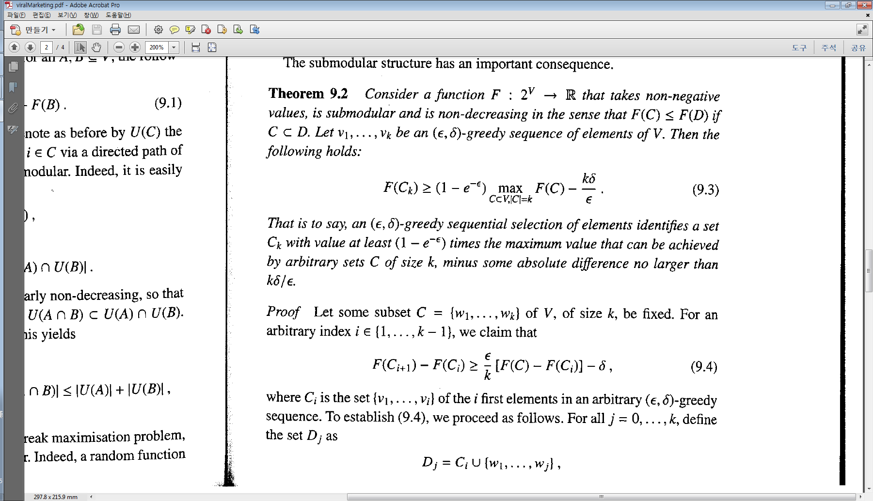
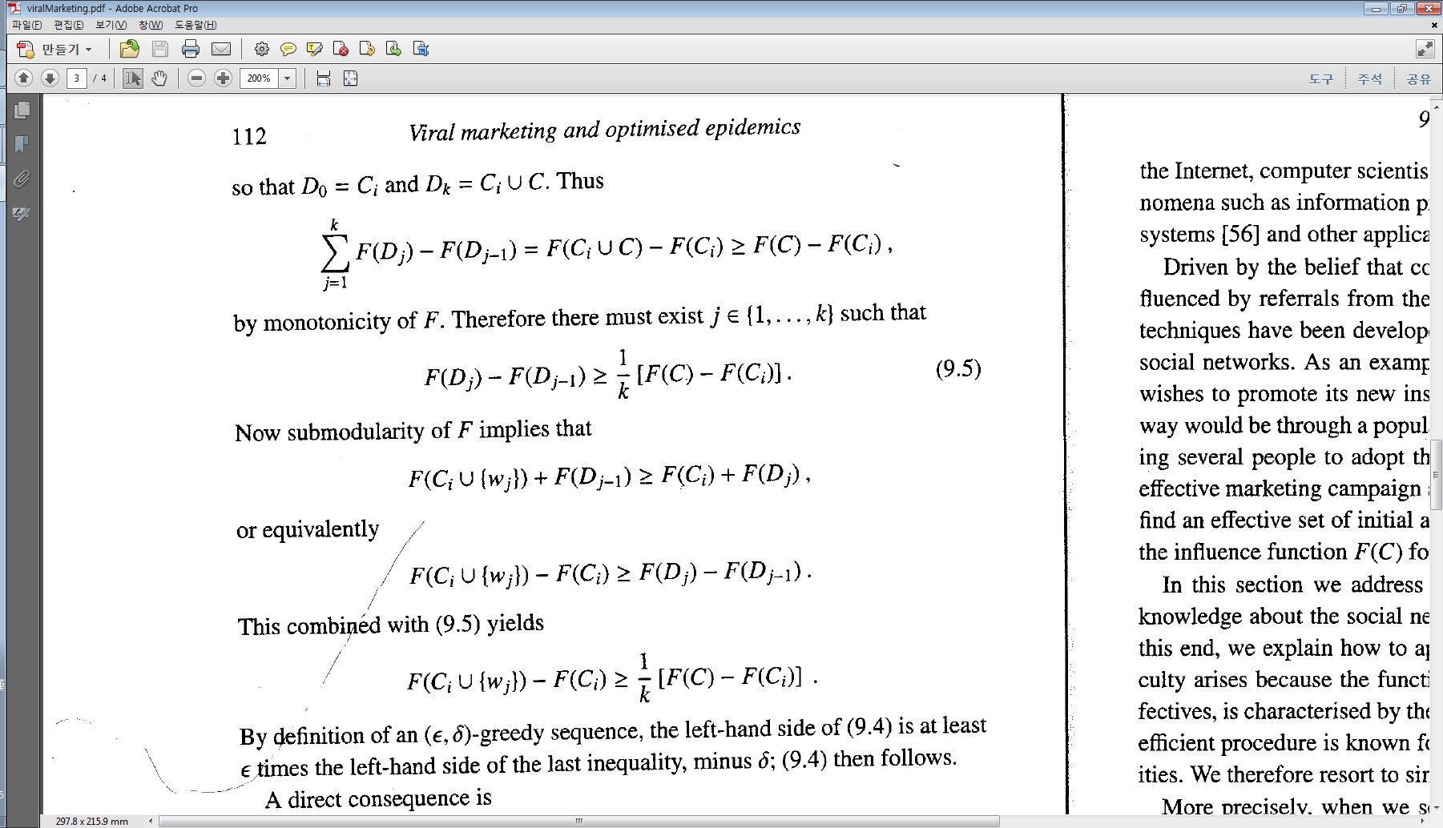
Proof of Theorem 9.2 (1)
∵

Slide 22
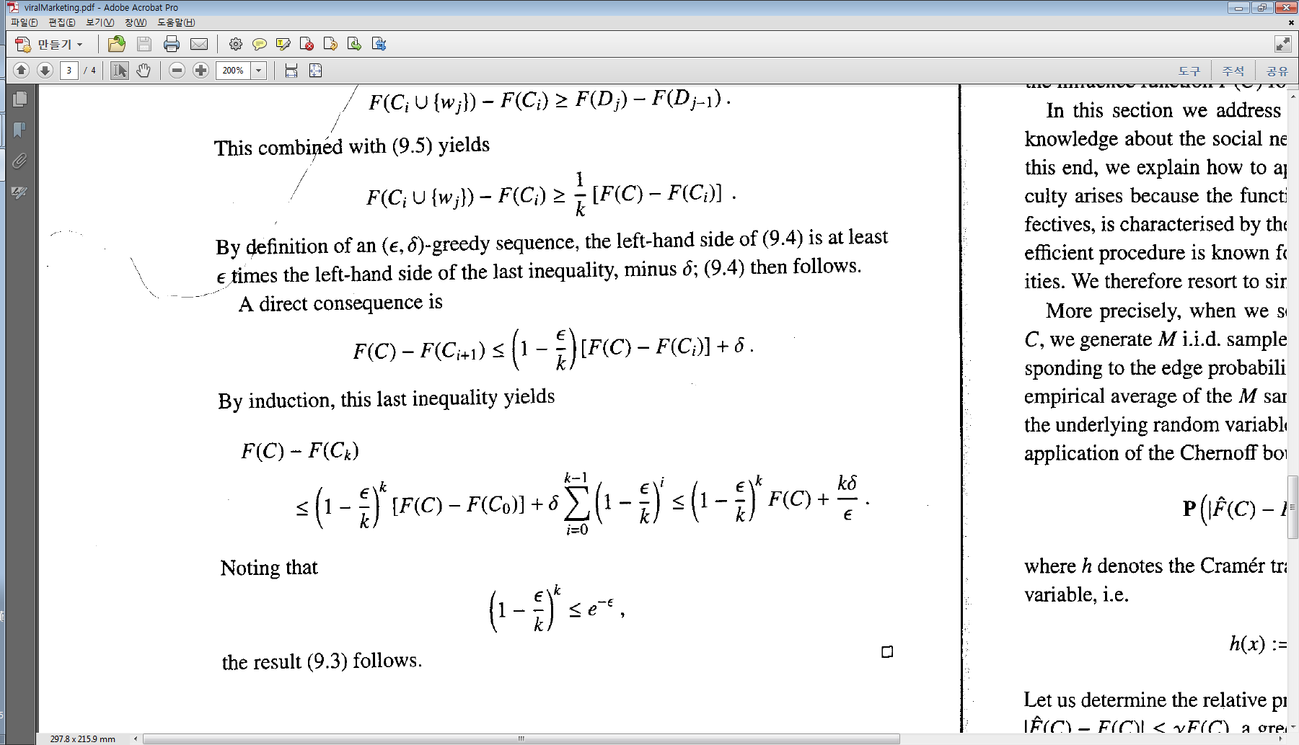
Proof of Theorem 9.2 (2)
Recall (9.4)
Recall (ε, δ)

Slide 23
Proof of Theorem 9.2 (3)
Recall (9.4)

Slide 24
Outline
Introduction
Word-of-mouth and viral marketing [9.1]
Basic Models for Influence Maximization
General diffusion models
Independent Cascade (IC)
Complexity of Influence Maximization
NP-hard to maximize influence [9.2]
#P-hard to estimate influence
Influence Maximization and Polynomial Algorithm
Monotonicity and Submodularity at “in-advance” view point
Submodularity and (ε, δ)-greedy algorithm [9.3]
Handling incorrectness in influence estimation [9.4]
Related Works
Networked coordination game and linear threshold model [Klein07]
Other influence maximization formulations [GoyalMin12, Dead12]
More on scalability issue [MIA10]

Slide 25
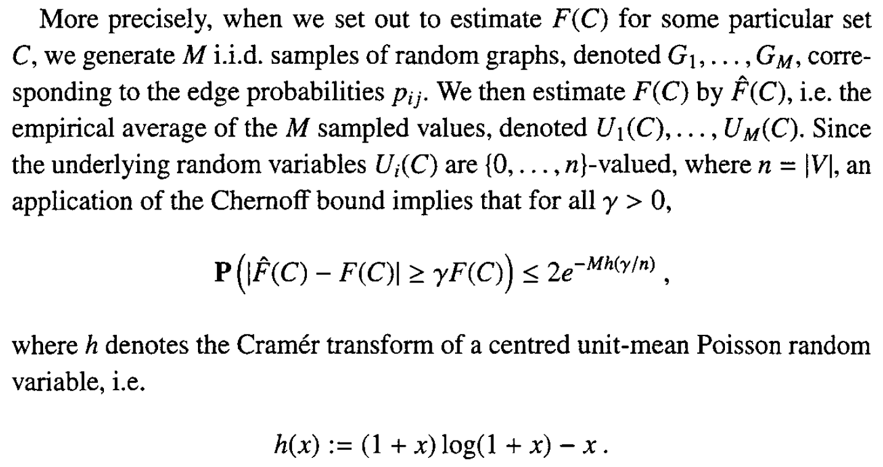
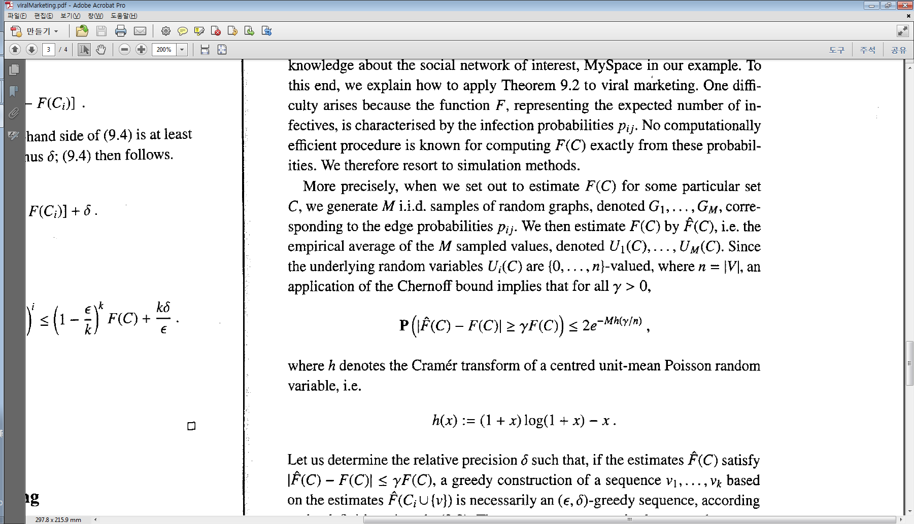
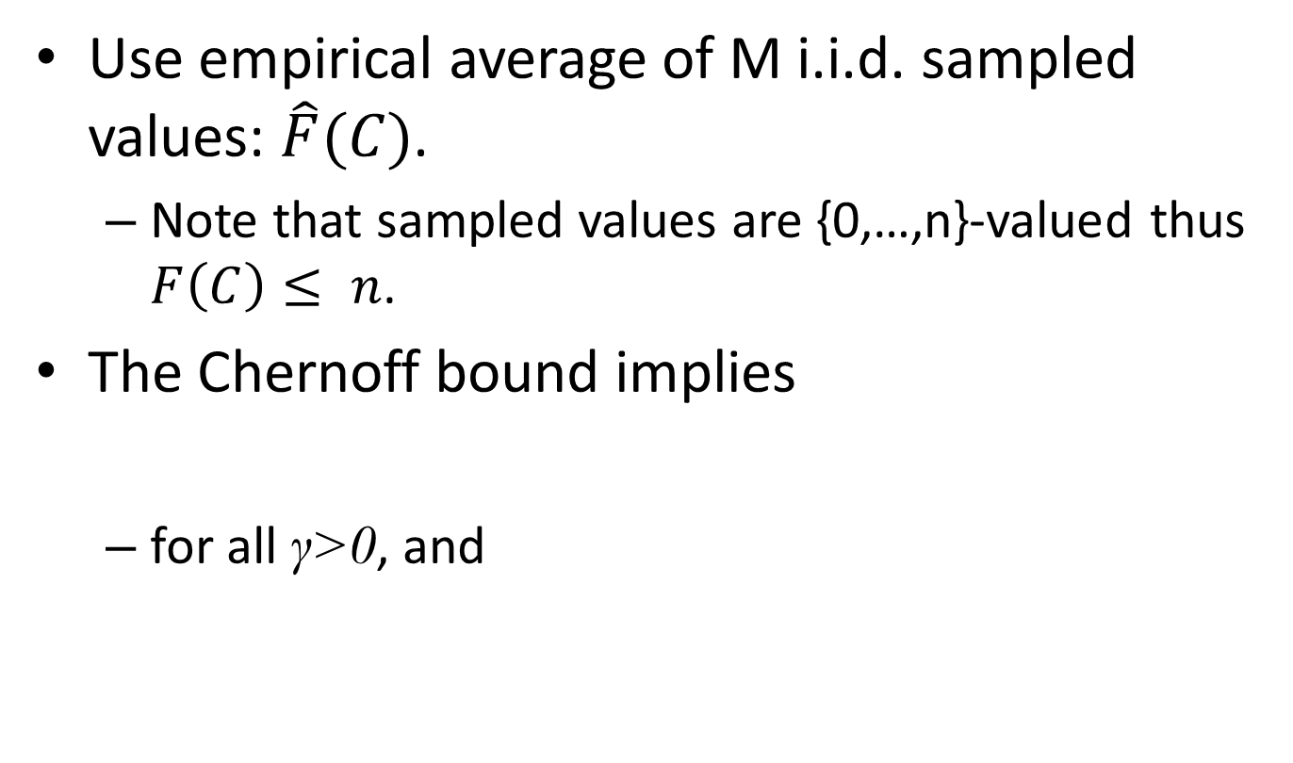
Incorrectness of Influence Estimation
Use empirical average of M i.i.d. sampled values: $\hat{F}(C)$.
Note that sampled values are {0,…,n}-valued thus $F\left(C\right)≤ n$.
The Chernoff bound implies
for all γ>0, and

Slide 26
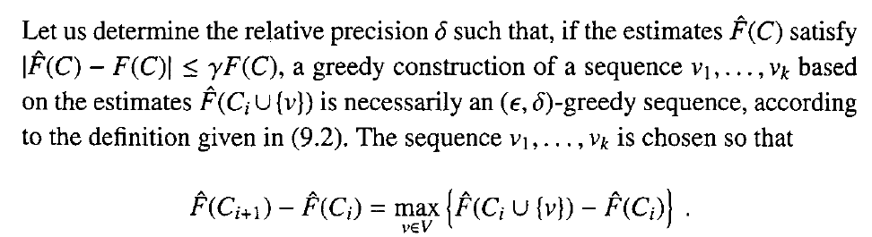
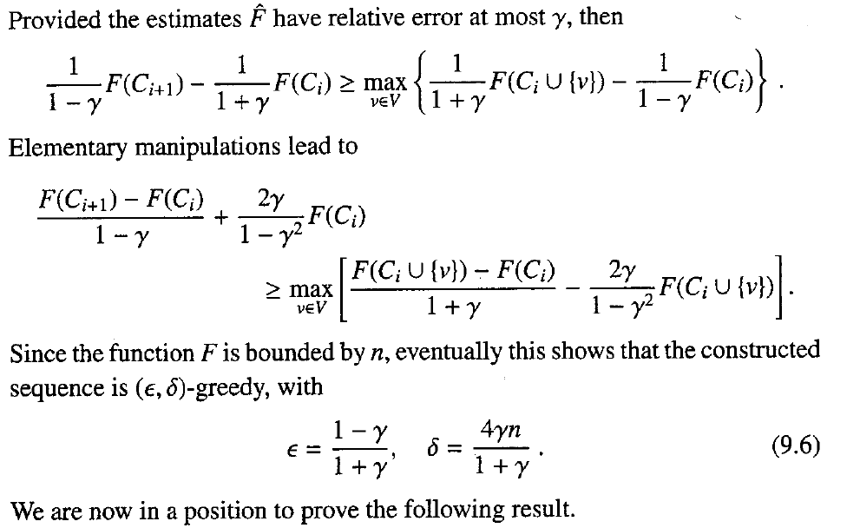
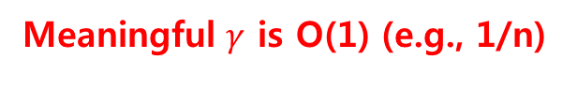
Connection between Thm 9.2 and the Incorrectness
Simple Math
Meaningful $γ$ is O(1) (e.g., 1/n)

Slide 27
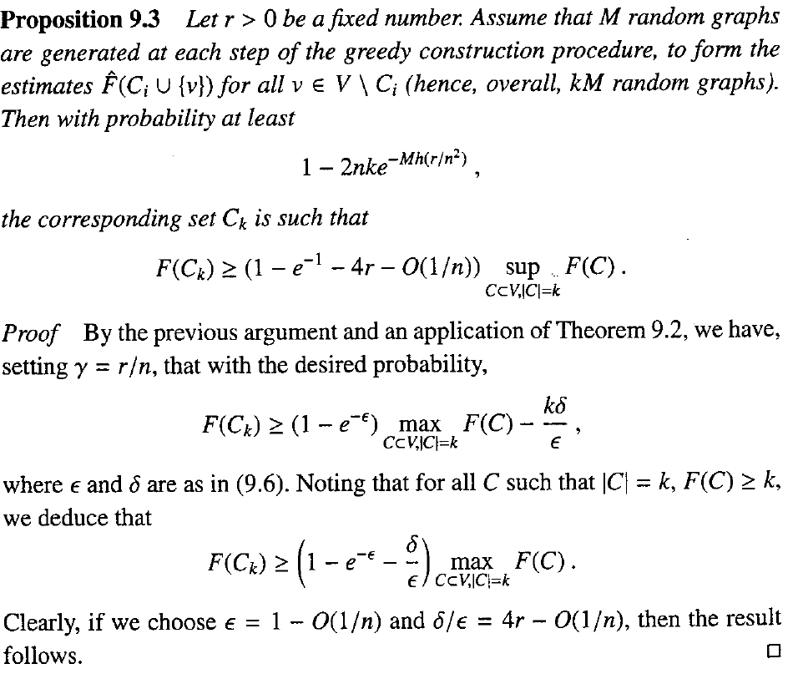

How Many Samples Needed?
There are k times seed selections.
At each selection, we test at most n nodes as candidate (v).
Note) Since $h\left(\frac{r}{n^{2}}\right)=Θ\left(\frac{r^{2}}{n^{4}}\right)$, take M of order $n^{4}\log{n}$, then $2nke^{−Mh\left(\frac{r}{n^{2}}\right)}=o(1)$

Slide 28
Outline
Introduction
Word-of-mouth and viral marketing [9.1]
Basic Models for Influence Maximization
General diffusion models
Independent Cascade (IC)
Complexity of Influence Maximization
NP-hard to maximize influence [9.2]
#P-hard to estimate influence
Influence Maximization and Polynomial Algorithm
Monotonicity and Submodularity at “in-advance” view point
Submodularity and (ε, δ)-greedy algorithm [9.3]
Handling incorrectness in influence estimation [9.4]
Related Works
Networked coordination game and linear threshold model [Klein07]
Other influence maximization formulations [GoyalMin12, Dead12]
More on scalability issue [MIA10]

