Slide 1
Martingales & Azuma-Hoeffding Inequality
Yung Yi

Slide 2
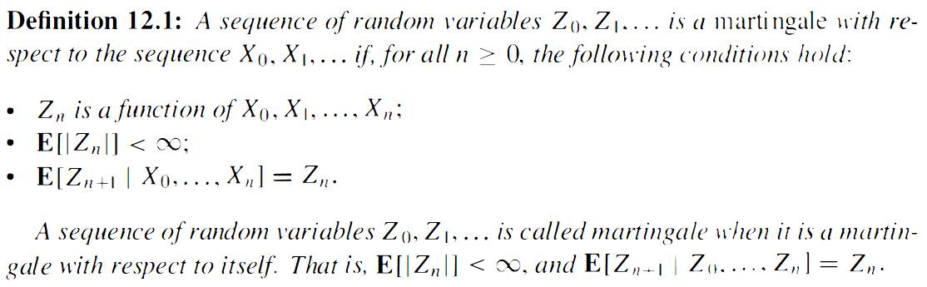
Martingales
Conditional expected value of next observation, given all past observations, is equal to the last observation
Submartingale (>=), Supermartingale (<=)

Slide 3
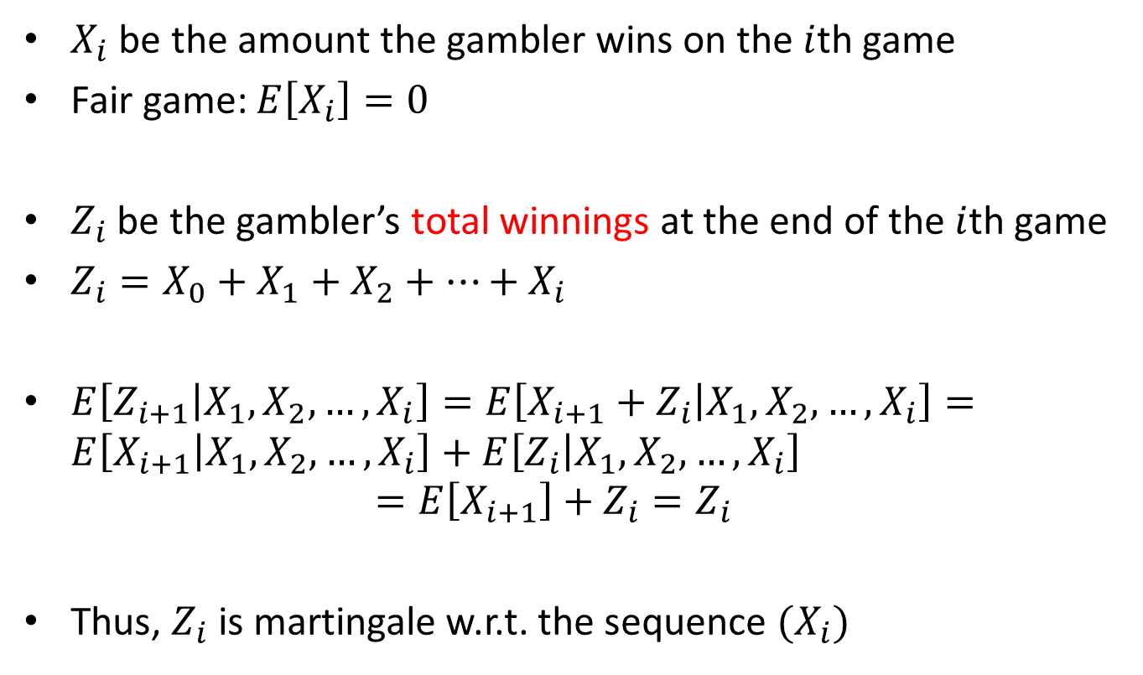
Example: Sequential fair games, martingale
$X_{i}$ be the amount the gambler wins on the $i$th game
Fair game: $E\left[X_{i}\right]=0$
$Z_{i}$ be the gambler’s total winnings at the end of the $i$th game
$Z_{i}=X_{0}+X_{1}+X_{2}+…+X_{i}$
$E\left[Z_{i+1} | X_{1},X_{2},…,X_{i}\right]=E\left[X_{i+1}+Z_{i} | X_{1},X_{2},…,X_{i}\right]=E\left[X_{i+1} | X_{1},X_{2},…,X_{i}\right]+E\left[Z_{i} | X_{1},X_{2},…,X_{i}\right]$ $=E\left[X_{i+1}\right]+Z_{i}=Z_{i}$
Thus, $Z_{i}$ is martingale w.r.t. the sequence $(X_{i})$

Slide 4
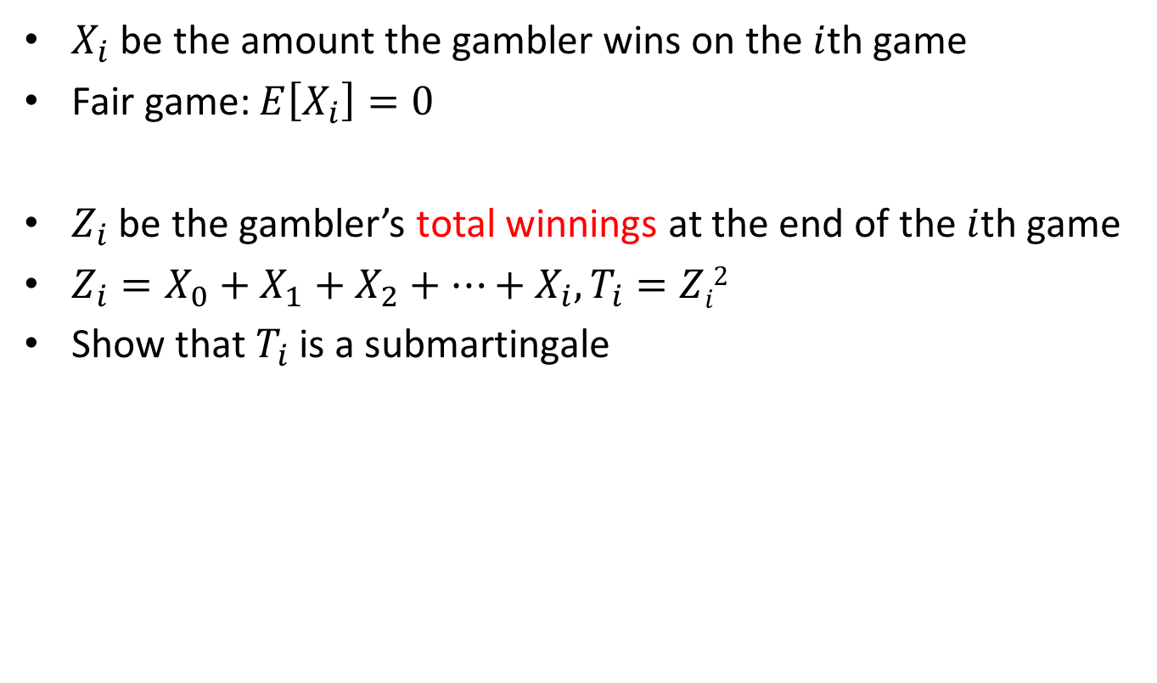
Example: Sequential fair games, submartingale
$X_{i}$ be the amount the gambler wins on the $i$th game
Fair game: $E\left[X_{i}\right]=0$
$Z_{i}$ be the gambler’s total winnings at the end of the $i$th game
$Z_{i}=X_{0}+X_{1}+X_{2}+…+X_{i}, T_{i}=Zi2$
Show that $T_{i}$ is a submartingale

Slide 5
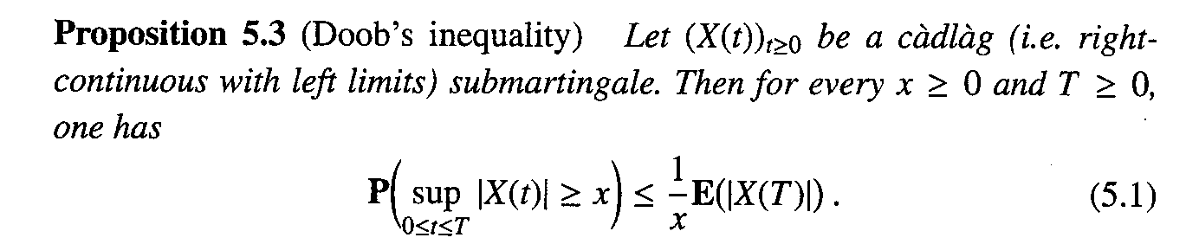
Doob’s inequality
Analogy to Markov inequality for a single random variable
Used for proving Proposition 5.2, but used in many context
Submartingale은 “커지는 경향”이 있다는 것을 intuition으로.

Slide 6
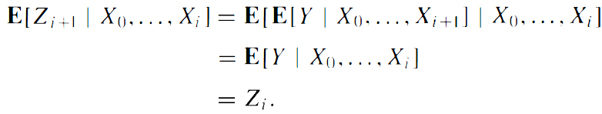
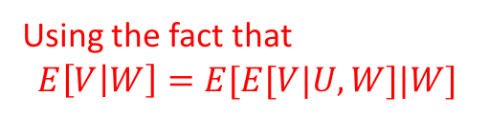

Doob martingale
A special martingale
$X_{0},X_{1},…,X_{n}$ be a sequence of RVs
$Y$ be a RV with $E\left[\left|Y\right|\right]<∞$ ($Y$ depends on $X_{0},…,X_{n}$)
$Z_{i}=E\left[Y | X_{0},…,X_{i}\right], i=0,1,…,n$
$Z_{i}$ is indeed martingale since
Using the fact that
$$E\left[V | W\right]=E[E[V|U,W]|W]$$

Slide 7
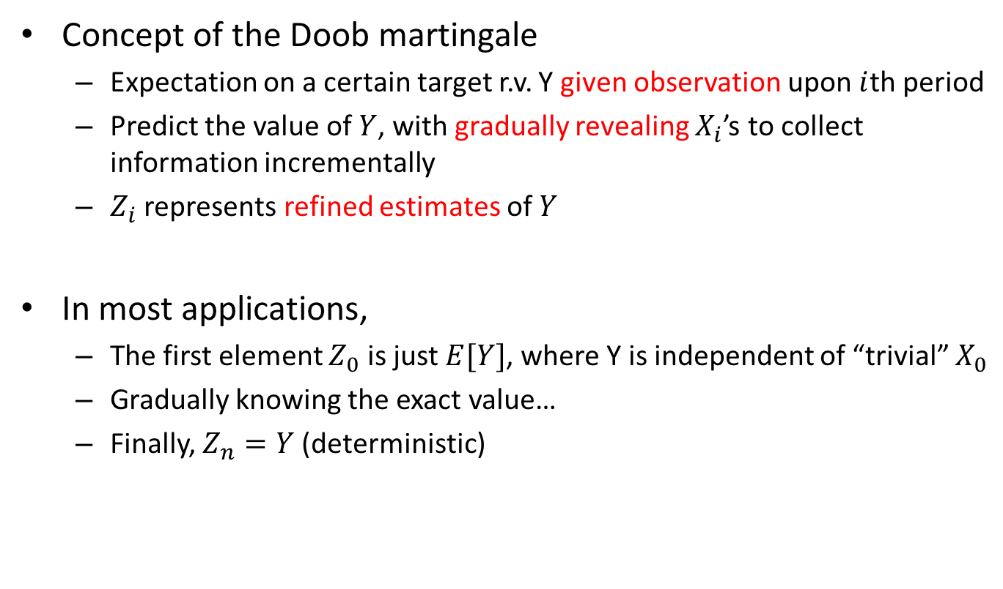
Doob martingale
Concept of the Doob martingale
Expectation on a certain target r.v. Y given observation upon $i$th period
Predict the value of $Y$, with gradually revealing $X_{i}$’s to collect information incrementally
$Z_{i}$ represents refined estimates of $Y$
In most applications,
The first element $Z_{0}$ is just $E[Y]$, where Y is independent of “trivial” $X_{0}$
Gradually knowing the exact value…
Finally, $Z_{n}=Y$ (deterministic)

Slide 8
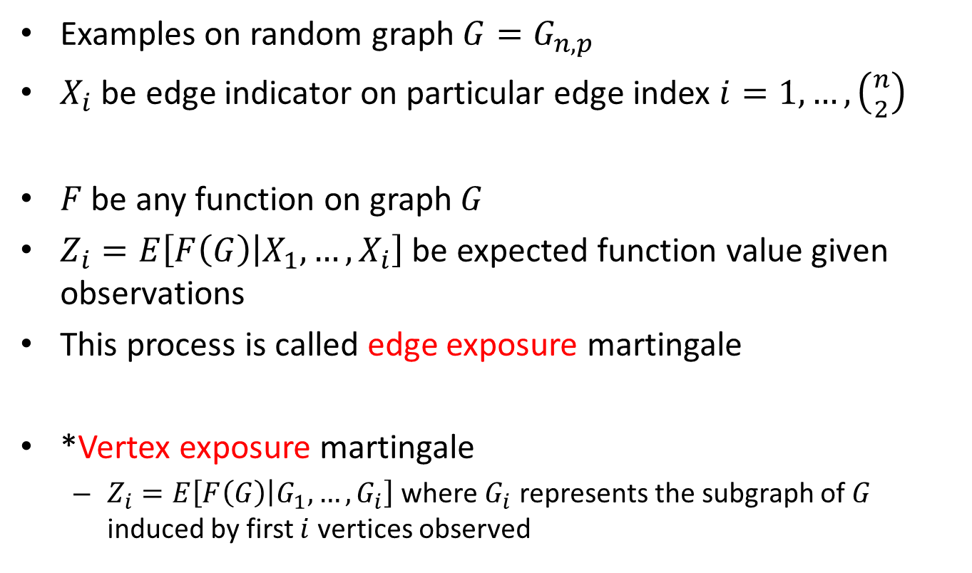
Doob martingale
Examples on random graph $G=G_{n,p}$
$X_{i}$ be edge indicator on particular edge index $i=1,…,\left({n \atop 2}\right)$
$F$ be any function on graph $G$
$Z_{i}=E\left[F\left(G\right) | X_{1},…,X_{i}\right]$ be expected function value given observations
This process is called edge exposure martingale
*Vertex exposure martingale
$Z_{i}=E\left[F\left(G\right) | G_{1},…,G_{i}\right]$ where $G_{i}$ represents the subgraph of $G$ induced by first $i$ vertices observed

Slide 9
Tail Inequalities for Maringales

Slide 10
Azuma-Hoeffding inequality
Chernoff-like tail bounds of martingales
Even when the underlying random variables are not independent
NOTE: Chernoff bound for Poisson trials: independent, but not indentical

Slide 11

Azuma-Hoeffding inequality
Chernoff-like tail bounds of martingales
Theorem 12.4 [Azuma-Hoeffding Inequality]: Let $X_{0},…,X_{n}$ be a martingale such that $\left|X_{k}−X_{k−1}\right|≤c_{k}$ Then, for all $t≥0$ and any $λ>0$, $\operatorname{Pr}\left(\left|X_{t}−X_{0}\right|\right)≥λ)≤2e^{−λ^{2}/(2\sum_{k=1}^{t}{c_{k}^{2}})}$

Slide 12

Azuma-Hoeffding inequality
Proof) Similarly to Chernoff bounds, first derive an upper bound for $E\left[e^{α\left(X_{t}−X_{0}\right)}\right]$ Define $Y_{i}≜X_{i}−X_{i−1}, i=1,…,t$, since $X_{0},…$ is martingale, $E\left[Y_{i} | X_{0},…,X_{i−1}\right]=E\left[X_{i}−X_{i−1} | X_{0},…,X_{i−1}\right]$ $=E[X_{i}|X_{0},…,X_{i−1}]−X_{i−1}=0$

Slide 13




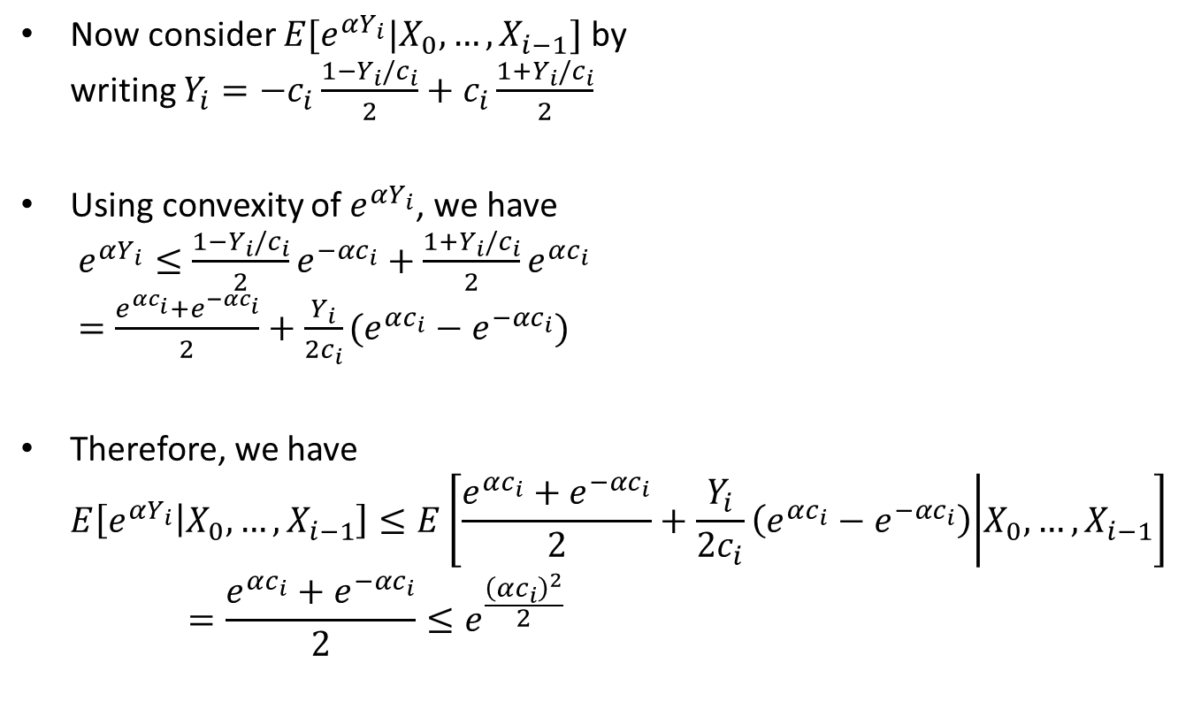
Azuma-Hoeffding inequality
Now consider $E[e^{αY_{i}}|X_{0},…,X_{i−1}]$ by writing $Y_{i}=−c_{i}\frac{1−Y_{i}/c_{i}}{2}+c_{i}\frac{1+Y_{i}/c_{i}}{2}$
Using convexity of $e^{αY_{i}}$, we have $e^{αY_{i}}≤\frac{1−Y_{i}/c_{i}}{2}e^{−αc_{i}}+\frac{1+Y_{i}/c_{i}}{2}e^{αc_{i}}$ $=\frac{e^{αc_{i}}+e^{−αc_{i}}}{2}+\frac{Y_{i}}{2c_{i}}(e^{αc_{i}}−e^{−αc_{i}})$
Therefore, we have $E\left[e^{αY_{i}} | X_{0},…,X_{i−1}\right]≤E\left[\frac{e^{αc_{i}}+e^{−αc_{i}}}{2}+\frac{Y_{i}}{2c_{i}}\left(e^{αc_{i}}−e^{−αc_{i}}\right) | X_{0},…,X_{i−1}\right]=\frac{e^{αc_{i}}+e^{−αc_{i}}}{2}≤e^{\frac{{\left(αc_{i}\right)}^{2}}{2}}$
$$−c_{i}$$
$$Y_{i}$$
$$c_{i}$$
Derived by Taylor series expansion of $e^{x}$

Slide 14
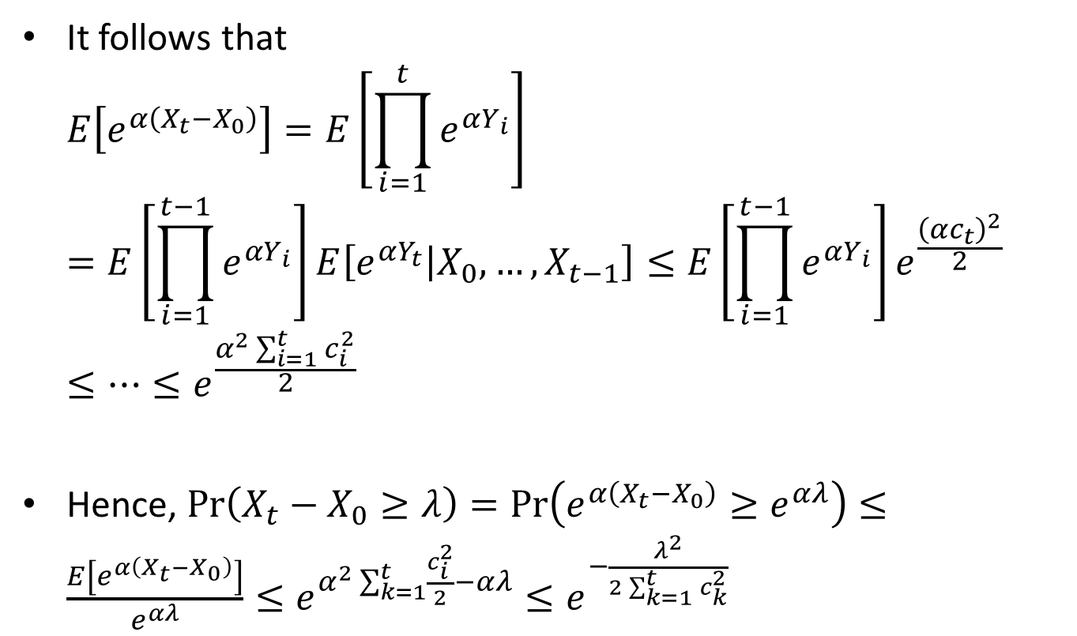
Azuma-Hoeffding inequality
It follows that $E\left[e^{α\left(X_{t}−X_{0}\right)}\right]=E\left[\prod_{i=1}^{t}{e^{αY_{i}}}\right]$ $=E\left[\prod_{i=1}^{t−1}{e^{αY_{i}}}\right]E\left[e^{αY_{t}} | X_{0},…,X_{t−1}\right]≤E\left[\prod_{i=1}^{t−1}{e^{αY_{i}}}\right]e^{\frac{{\left(αc_{t}\right)}^{2}}{2}}$ $≤…≤e^{\frac{α^{2}\sum_{i=1}^{t}{c_{i}^{2}}}{2}}$
Hence, $\operatorname{Pr}\left(X_{t}−X_{0}≥λ\right)=\operatorname{Pr}\left(e^{α\left(X_{t}−X_{0}\right)}≥e^{αλ}\right)≤\frac{E\left[e^{α\left(X_{t}−X_{0}\right)}\right]}{e^{αλ}}≤e^{α^{2}\sum_{k=1}^{t}{\frac{c_{i}^{2}}{2}}−αλ}≤e^{−\frac{λ^{2}}{2\sum_{k=1}^{t}{c_{k}^{2}}}}$
Markov inequality

Slide 15
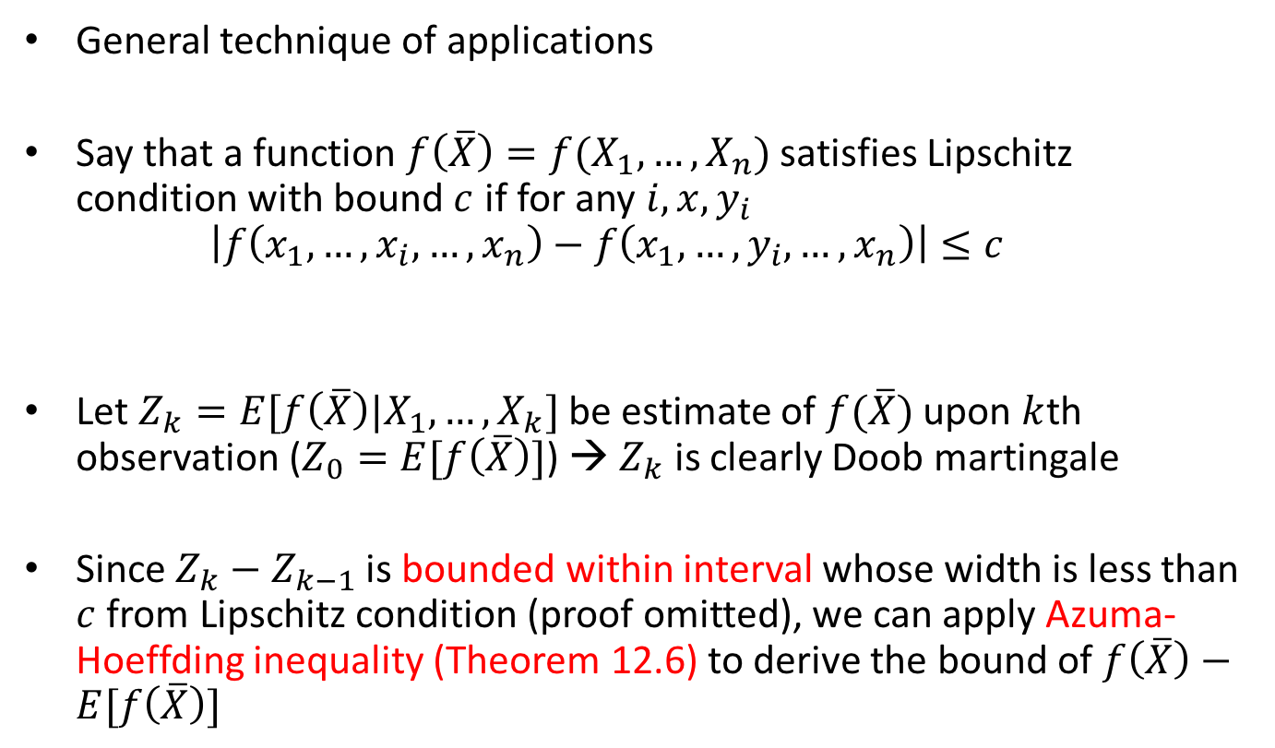
Applications of the Azuma-Hoeffding inequality
General technique of applications
Say that a function $f\left(\overline{X}\right)=f(X_{1},…,X_{n})$ satisfies Lipschitz condition with bound $c$ if for any $i, x, y_{i}$ $\left|f\left(x_{1},…,x_{i},…,x_{n}\right)−f\left(x_{1},…,y_{i},…,x_{n}\right)\right|≤c$
Let $Z_{k}=E[f\left(\overline{X}\right)|X_{1},…,X_{k}]$ be estimate of $f(\overline{X})$ upon $k$th observation ($Z_{0}=E[f\left(\overline{X}\right)]$) → $Z_{k}$ is clearly Doob martingale
Since $Z_{k}−Z_{k−1}$ is bounded within interval whose width is less than $c$ from Lipschitz condition (proof omitted), we can apply Azuma-Hoeffding inequality (Theorem 12.6) to derive the bound of $f\left(\overline{X}\right)−E[f\left(\overline{X}\right)]$
Changing single coordinate can change the function value by at most $c$

Slide 16
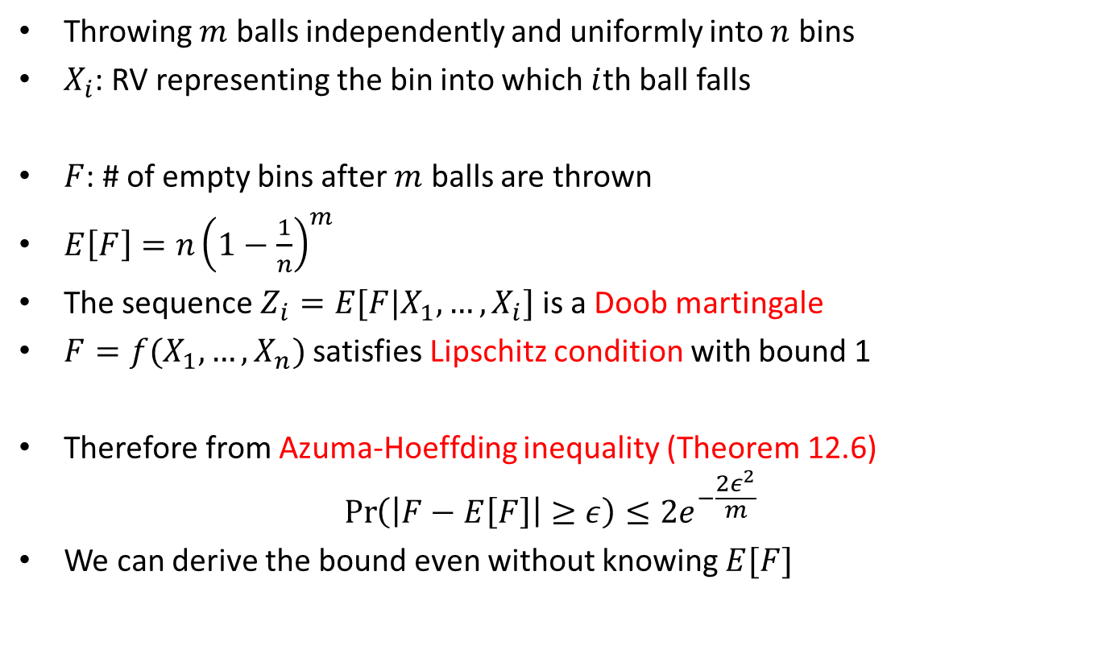
Applications: Balls and bins
Throwing $m$ balls independently and uniformly into $n$ bins
$X_{i}$: RV representing the bin into which $i$th ball falls
$F$: # of empty bins after $m$ balls are thrown
$E\left[F\right]=n{\left(1−\frac{1}{n}\right)}^{m}$
The sequence $Z_{i}=E[F|X_{1},…,X_{i}]$ is a Doob martingale
$F=f(X_{1},…,X_{n})$ satisfies Lipschitz condition with bound 1
Therefore from Azuma-Hoeffding inequality (Theorem 12.6) $\operatorname{Pr}\left(\left|F−E\left[F\right]\right|≥ε\right)≤2e^{−\frac{2ε^{2}}{m}}$
We can derive the bound even without knowing $E[F]$

