Slide 1
Lecture 2: Normal-form game (Strategic-form game) with pure strategies

Slide 2
Key Words
Normal-form (Strategic form) Game
Matrix game
Strategy spaces are discrete
Continuous-kernel game
Strategy spaces are continuous
Strictly dominated strategies
Pure/Mixed strategy
Saddle point, Nash equilibrium

Slide 3
Matrix Game:
Pure Strategy

Slide 4
Matrix Game
Representation of a game
Simultaneous play
players analyze the game and write their strategy on a paper
Combination of strategies determines payoff
Strategy set
for Player 2
Strategy set
for Player 1
Player 2
 | A | B | C
A | (2, 2) | (0, 0) | (-2, -1)
B | (-5, 1) | (3, 4) | (3, -1)
Player 1
Payoff to
Player 1
Payoff to
Player 2

Slide 5
More Formal Game Definition
Normal form (strategic) game
a finite set N of players
a set strategies for each player i
payoff function for each player
where is the set of strategies chosen by all players
A is the set of all possible outcomes
is a set of strategies chosen by players
defines an outcome

Slide 6
Two-person Zero-sum Games
One of the first games studied
most well understood type of game
Players interest are strictly opposed
what one player gains what the other loses
game matrix has single entry (gain to player 1)
Intuitive solution concept
players maximize gains
unique solution

Slide 7
Solution Concept
A formal rule for predicting how a game will be played
Describes which strategies will be adopted by palyers, and thus the result of the game
Many kinds of solution concepts
People’s perspectives are different
It does not talk about how players reach a solution concept
Thus, naturally, it is an “equilibrium concept”.

Slide 8
Analyzing the Game: Domination
Player 1 maximizes matrix entry, while player 2 minimizes
Player 2
(12,-12)
 | A | B | C | D
A | 12 | -1 | 1 | 0
B | 3 | 1 | 3 | -18
C | 5 | 2 | 4 | 3
D | -16 | 1 | 2 | -1
Player 1
Strictly
dominated
strategy
(dominated by C)
Strictly
dominated
strategy
(dominated by B)

Slide 9
Dominance
Strategy S strictly dominates a strategy T
if every possible outcome when S is chosen is better than the corresponding outcome when T is chosen
Dominance Principle
rational players never choose strictly dominated strategies
Idea: Solve the game by eliminating strictly dominated strategies!
iterated removal

Slide 10
Solving the Game
Iterated removal of strictly dominated strategies
Player 2
 | L | M | R
T | -2 | -1 | 4
B | 3 | 2 | 3
Player 1
Player 1 cannot remove any strategy (neither T or B dominates the other)
Player 2 can remove strategy R (dominated by M)
Player 1 can remove strategy T (dominated by B)
Player 2 can remove strategy L (dominated by M)
Solution: P₁ -> B, P₂ -> M
payoff of 2

Slide 11
Solving the Game
Removal of strictly dominates strategies does not always work
Consider the game
Player 2
 | A | B | D
A | 12 | -1 | 0
C | 5 | 2 | 3
D | -16 | 0 | -1
Player 1
Neither player has dominated strategies
Requires another solution concept

Slide 12
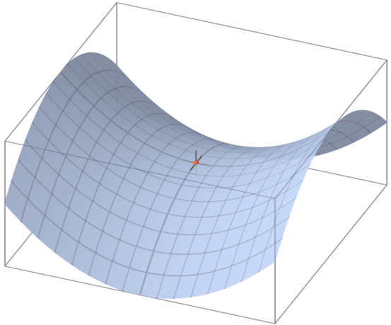
Analyzing the Game
Player 2
 | A | B | D
A | 12 | -1 | 0
C | 5 | 2 | 3
D | -16 | 0 | -1
Player 1
Outcome (C, B) seems “stable”
saddle point of game

Slide 13
Saddle Points
An outcome is a saddle point
if it is both less than or equal to any value in its row and greater than or equal to any value in its column
Saddle Point Principle
Players should choose outcomes that are saddle points of the game
Value of the game
value of saddle point outcome if it exists

Slide 14
Why Play Saddle Points?
Player 2
 | A | B | D
A | 12 | -1 | 0
C | 5 | 2 | 3
D | -16 | 0 | -1
Player 1
If player 1 believes player 2 will play B
player 1 should play best response to B (which is C)
If player 2 believes player 1 will play C
player 2 should play best response to C (which is B)

Slide 15
Why Play Saddle Points?
Player 2
 | A | B | D
A | 12 | -1 | 0
C | 5 | 2 | 3
D | -16 | 0 | -1
Player 1
Why should player 1 believe player 2 will play B?
playing B guarantees player 2 loses at most v (which is 2)
Why should player 2 believe player 1 will play C?
playing C guarantees player 1 wins at least v (which is 2)
Powerful arguments to play saddle point!

Slide 16
Solving the Game (min-max algorithm)
Player 2
 | A | B | C | D
A | 4 | 3 | 2 | 5
B | -10 | 2 | 0 | -1
C | 7 | 5 | 1 | 3
D | 0 | 8 | -4 | -5
2
-10
1
-5
Player 1
7 | 8 | 2 | 5
choose maximum entry in each column
choose the minimum among these
this is the minimax value
choose minimum entry in each row
choose the maximum among these
this is maximin value
if minimax == maximin, then this is the saddle point of game

Slide 17
Multiple Saddle Points
In general, game can have multiple saddle points
Player 2
 | A | B | C | D
A | 3 | 2 | 2 | 5
B | 2 | -10 | 0 | -1
C | 5 | 2 | 2 | 3
D | 8 | 0 | -4 | -5
2
-10
2
-5
Player 1
8 | 2 | 2 | 5

Slide 18
Multiple Saddle Points
In general, game can have multiple saddle points
Player 2
 | A | B | C | D
A | 3 | 2 | 2 | 5
B | 2 | -10 | 0 | -1
C | 5 | 2 | 2 | 3
D | 8 | 0 | -4 | -5
2
-10
2
-5
Player 1
8 | 2 | 2 | 5
Same payoff in every saddle point
unique value of the game
Strategies are interchangeable
Example: strategies (A, B) and (C, C) are saddle points
then (A, C) and (C, B) are also saddle points

Slide 19
Games With no Saddle Points
Player 2
 | A | B | C
A | 2 | 0 | -1
B | -5 | 3 | 1
Player 1

Slide 20
Two-person Non-zero Sum Games
Players are not strictly opposed
payoff sum is non-zero
Player 2
 | A | B
A | 3, 4 | 2, 0
B | 5, 1 | -1, 2
Player 1
Situations where interest is not directly opposed

Slide 21
What is the Solution?
Ideas of zero-sum game: saddle points
pure strategy equilibrium
no pure strategy eq.
Player 2
Player 2
 | A | B
A | 5, 4 | 2, 0
B | 3, 1 | -1, 2
 | A | B
A | 5, 0 | -1, 4
B | 3, 2 | 2, 1
Player 1
Player 1

Slide 22
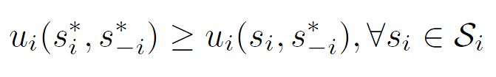
Nash equilibrium
A Nash equilibrium is a strategy profile s* with the property that no player i can do better by choosing a strategy different from s*, given that every other player j ≠ i .
In other words, for each player i with payoff function u_{i} ,
No user can change its payoff by unilaterally changing its strategy, i.e., changing its strategy while s_{-i} is fixed

Slide 23
Multiple Solution Problem
Games can have multiple equilibria
not equivalent:
payoff is different
not interchangeable:
playing an equilibrium strategy does not lead to equilibrium
Player 2
 | A | B
A | 1, 4 | 1, 1
B | 0, 1 | 2, 2
Player 1
equilibria

Slide 24
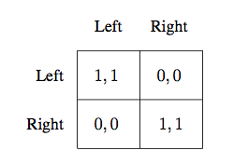
Ex 1: Coordination game
Two drivers, driving towards each other

Slide 25
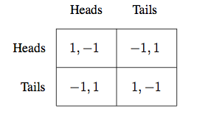
Ex 2: Matching Pennies game
Each player shows her coin.
Same side →Player 1 pockets both, and Player 2 does otherwise.

Slide 26
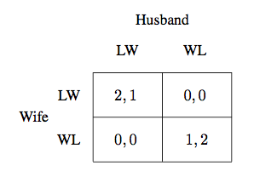
Ex 3: Battle of the Sexes Game
Tries to see a movie
Husband: “Lethal Weapon”, Wife: “Wondrous Love”

Slide 27
Summary

