Slide 1
Lecture 3: Normal-form game (Strategic-form game) with mixed strategies

Slide 2
Key Words
Normal-form (Strategic form) Game
Matrix game
Strategy spaces are discrete
Continuous-kernel game
Strategy spaces are continuous
Strictly dominated strategies
Pure/Mixed strategy
Saddle point, Nash equilibrium

Slide 3
Matrix Game:
Mixed Strategy

Slide 4
Pure vs. Mixed Strategies
Previous lecture
Players make deterministic choices from their strategy spaces
Strategies are pure if a player i selects, in a deterministic manner (probability 1), one strategy out of its strategy set S_{i}
Players can also select a probability distribution over their set of strategies, in which cases the strategies are called mixed

Slide 5
Mixed Strategies
Assume a zero-sum game, again.
Payoffs are computed as expectations
1/3 | 2/3
 | C | D
A | 4,-4 | 0,0
B | -5,5 | 3,-3
Player 1
Payoff to P1 when playing A = 1/3(4) + 2/3(0) = 4/3
Payoff to P1 when playing B = 1/3(-5) + 2/3(3) = 1/3
How should players choose prob. distribution?

Slide 6
Mixed Strategies
P2
No pure strategy NE
Claim 1
There exists a stochastic equilibrium with both playing (1/2,1/2) strategy
Why?
Need to argue that if P2 chooses (1/2,1/2) strategy, P1 optimally chooses (1/2,1/2) strategy, and vice versa
Suppose that P2(1/2,1/2) and P1(p,1-p)
Each outcome (H,H) and (H,T) occurs w.p. p/2.
Each outcome (H,T) and (T,H) occurs w.p. (1-p)2.
P1 gains 1 w.p. p/2 + (1-p)/2 = ½, and loses 1 w.p. ½.
P1’s payoff does not depend on p!. Thus, every p (including 1/2) is optimal.
Similarly, for P2.
 | Head | Tail
Head | 1,-1 | -1,1
Tail | -1,1 | 1,-1
P1

Slide 7
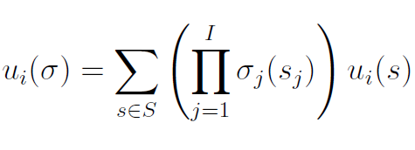

Mixed Nash Equilibrium
Define σ_{i} as a probability mass function over S_{i}, the set of actions of player i
When working with mixed strategies, each player i aim to maximize their expected payoff
Mixed strategies Nash equilibrium

Slide 8
Mixed Nash Equilibrium
Define σ_{i} as a probability mass function over S_{i}, the set of actions of player i
When working with mixed strategies, each player i aim to maximize their expected payoff

Slide 9

Aside: Best Response Function
Assume only pure strategy
Best response function is a set-valued function
Probably, we can define NE based on Best Response?

Slide 10

Aside: BR and NE
BR and NE can be similarly defined for mixed strategies

Slide 11
Computing NE using the BR concept
P2
 | Head | Tail
Head | 1,-1 | -1,1
Tail | -1,1 | 1,-1
P1
P1(p,1-p), P2(q,1-q)
Payoff to P1 when playing Head = q + (1-q)(-1) = 2q -1
Payoff to P1 when playing Tail = q(-1) + (1-q)1 = 1- 2q
If q < ½, P1’s payoff (Tail) > P1’s payoff (Head) → P1’s payoff (1,0) > P1’s payoff (p, 1-p) for p > 0.
Similarly, if q > ½, P1’s payoff (0,1) > P1’s payoff (p, 1-p) for p > 0.
If q = ½, P1’s payoff (1,0) = P1’s payoff (0,1) = P1’s payff (p,1-p).
Thus, P1’s best response to P2(q,1-q) is:

Slide 12


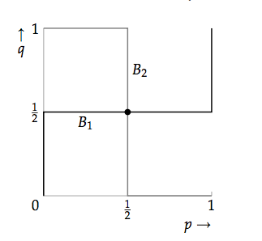
Thus, P1’s best response to P2(q,1-q) is:
Similarly, P2’s best response to P1(p,1-p) is:

Slide 13
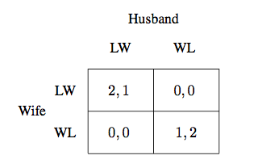
Exercise: Battle of Sexes
What is the mixed strategy NE?

Slide 14
Summary

