Slide 1
Lecture 4: Continuous Normal-form game and Equilibrium efficiency and selection

Slide 2
Key Words
Normal-form (Strategic form) Game
Matrix game
Strategy spaces are discrete
Continuous-kernel game
Strategy spaces are continuous
Strictly dominated strategies
Pure/Mixed strategy
Saddle point, Nash equilibrium

Slide 3
Continuous-kernel Game
Action (strategy) sets have uncountably many elements
For example, strategies are:
Amount of transmission powers, access probabilities in Wi-Fi
We will focus on pure strategies.

Slide 4
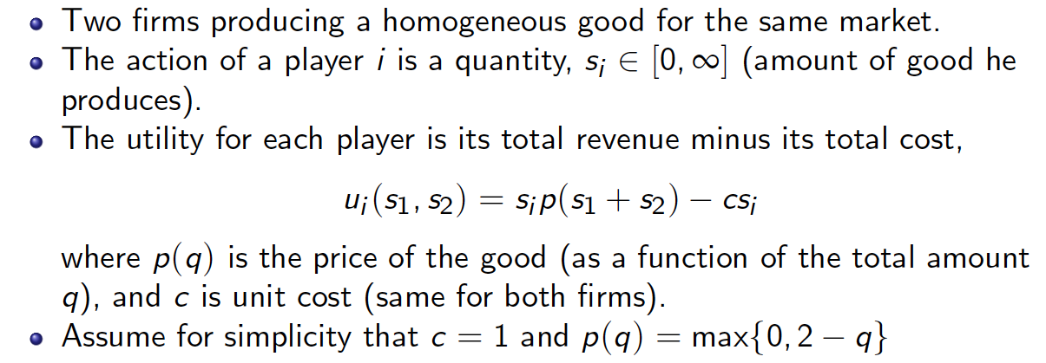
Example: Cournot Competition
A famous example from microeconomics

Slide 5


Recall: Best Response

Slide 6
Back to Cournot Competition

Slide 9
Efficiency and Equilibrium Selection

Slide 10
Nash equilibrium: Efficiency
Does the Nash equilibrium always exist?
If so, are they “efficient”? Which is more “efficient”?
Essentially, we need to compare two vectors

Slide 11
Pareto Optimality
One measure of efficiency is Pareto optimality
A payoff vector x is Pareto optimal if there does not exist any payoff vector y such that
y ≥ x
with at least one strict inequality for an element y_{i}

Slide 12
Example: Pareto Optimal
Player 2
 | A | B
A | 5, 5 | 1, 10
B | 10, 1 | 2, 2
Pareto Optimal
Player 1
Another type of solution concept: group rationality
Pareto optimal

Slide 13
The Prisoner’s Dilemma
One of the most studied and used games
proposed in 1950s
Player 2
 | A | B
A | 5, 5 | 1, 10
B | 10, 1 | 2, 2
Player 1
single NE
better
outcome

Slide 14
Price of Anarchy and Price of Stability
 | S | C
S | 5, 5 | 1, 10
C | 10, 1 | 2, 2
Price of Anarchy (PoA): (1+10)/(2+2)
Max aggregate payoff / min aggregate payoff at NE
Price of Stability (PoS):
Max aggregate payoff/ max aggregate payoff at NE

Slide 15
What is PoA and PoS here?

Slide 17
Summary

Slide 18
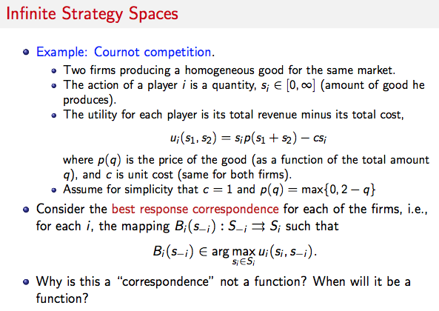

Slide 19
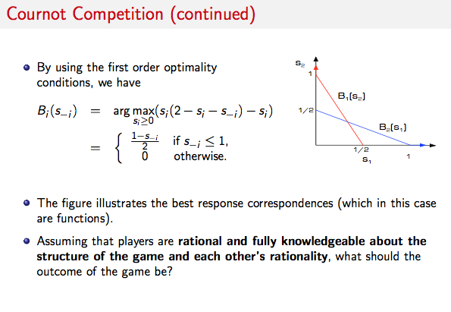

Slide 20
Homework
Congestion pricing game
나중에 NE의 existence에서 써먹을 것임.

Slide 21
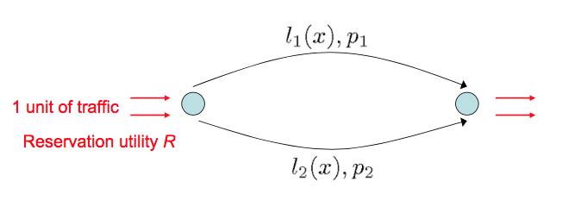
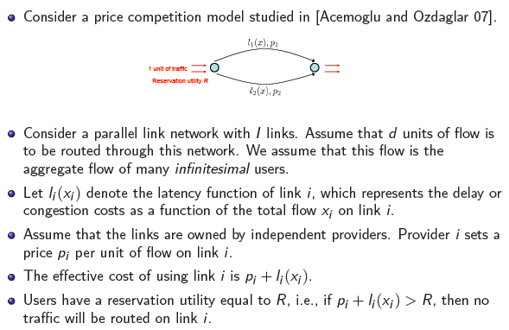
Congestion-Pricing Game (1)

Slide 22
Congestion-Pricing Game (2)

Slide 23
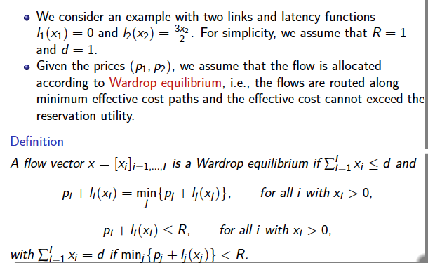
Example 1

Slide 24
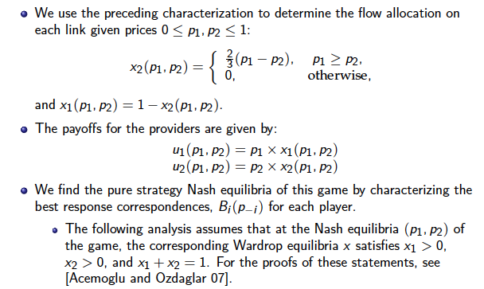

Slide 25
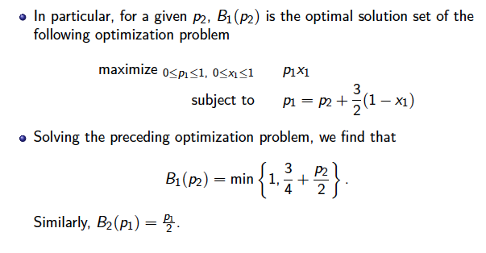

Slide 26
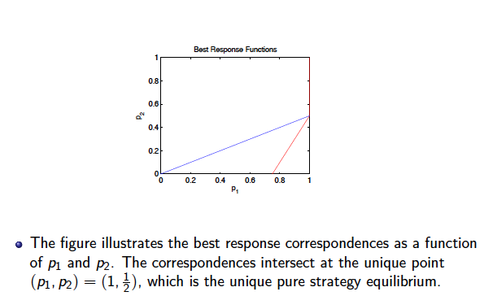

Slide 27
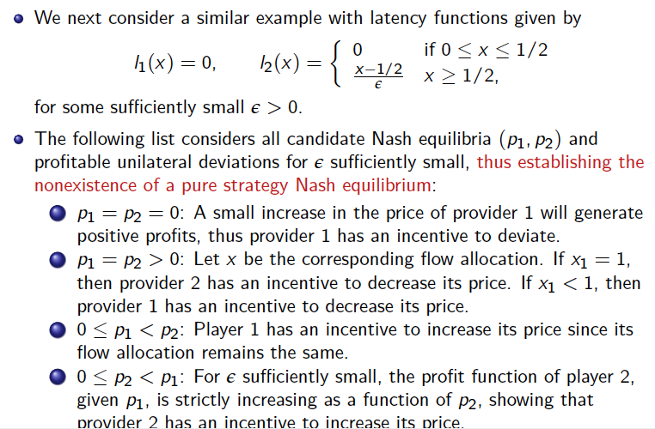
Example 2

