Slide 1
Lecture 8: Stackelberg game

Slide 2
Contents
Example of sequential game with continuous strategy space
Power of backward induction to find the equilibrium
Example: Stackelberg competition
Sequential version of Cournot dupoloy
Stackelberg game
One player (the “leader”) moves first, and all other players (the “followers”) move after him.

Slide 3
Competition between two firms: Model
Two firms (N = 2)
Each firm chooses a quantity s_{n} ≥ 0
Cost of producing s_{n} : c_{n} s_{n}
Demand (or Pricing) curve:
Price = P(s₁ + s₂) = a – b (s₁ + s₂)
Payoffs:
Profit = Π_{n}(s₁, s₂) = P(s₁ + s₂) s_{n} – c_{n} s_{n}

Slide 4
Simultaneous Play: Cournot Competition
(We’ve covered this earlier)

Slide 5

Best response
Assume $c_{1}=c_{2}=c$
Best response set for player n to s_{-n}:
Note: arg max_{x ∈ X} f(x) is the set of x that maximize f(x)
R_{n}(s_{-n}) = arg max_{s ∈ S} Π_{n}(s_{n}, s_{-n})
n n

Slide 6
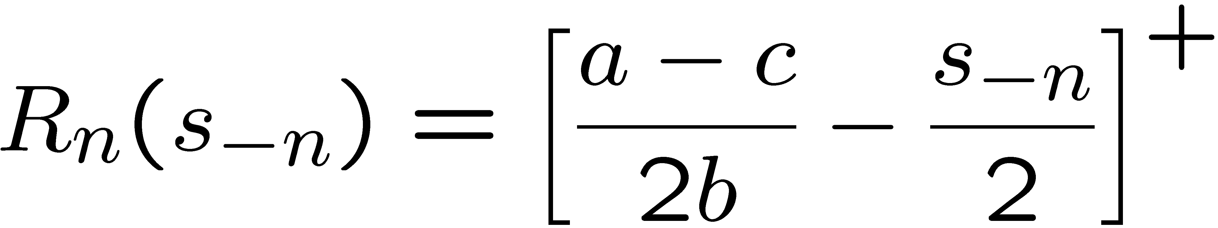
Example: Cournot duopoly
Calculating the best response given s_{-n}:
Differentiate and solve:
So the best response function is:

Slide 7
Example: Cournot duopoly
For simplicity, let t = (a - c)/b
t
R₁(s₂)
R₂(s₁)
s₂
0
0
t
s₁

Slide 8
Sequential Play:
Stackelberg Competition

Slide 9
Model Again
Two firms (N = 2)
Each firm chooses a quantity s_{n} ≥ 0
Cost of producing s_{n} : c_{n} s_{n}
Demand (or Pricing) curve:
Price = P(s₁ + s₂) = a – b (s₁ + s₂)
Payoffs:
Profit = Π_{n}(s₁, s₂) = P(s₁ + s₂) s_{n} – c_{n} s_{n}

Slide 10
Stackelberg Competition
Firm 1 moves before firm 2.
Firm 2 observes firm 1’s quantity choice s₁, then chooses s₂.
Interesting question
How does the equilibrium change in this case?
Advantageous for firm 1 or firm 2?

Slide 11
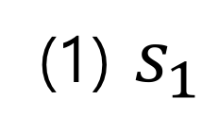
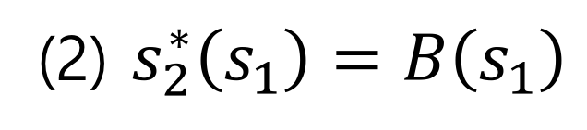
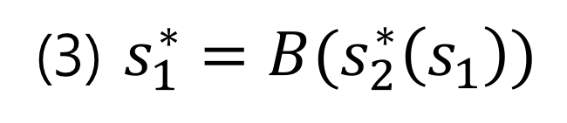
Finding the NE: Backward Induction
We solve the game using backward induction.
(3) $s_{1}^{∗}=B(s_{2}^{∗}\left(s_{1}\right))$
Firm 1
(1) $s_{1}$
Firm 2
(2) $s_{2}^{∗}\left(s_{1}\right)=B\left(s_{1}\right)$

Slide 12
Firm 2: Second Stage
We solve the game using backward induction.
Start with second stage:
Given s₁, firm 2 chooses s₂ as
s₂ = arg max_{s2 ∈ S2} Π₂(s₁, s₂)
This is the best response R₂(s₁)!

Slide 13
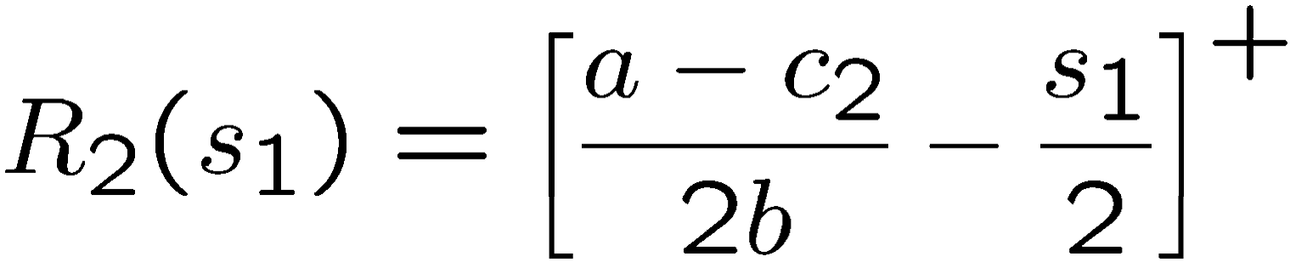
Best response for firm 2
Recall the best response given s₁:
Differentiate and solve:
So:

Slide 14
Firm 1’s decision
Backward induction:
Maximize firm 1’s decision, accounting for firm 2’s response at stage 2.
Thus firm 1 chooses s₁ as
s₁ = arg max_{s1 ∈ S1} Π₁(s₁, R₂(s₁))

Slide 15
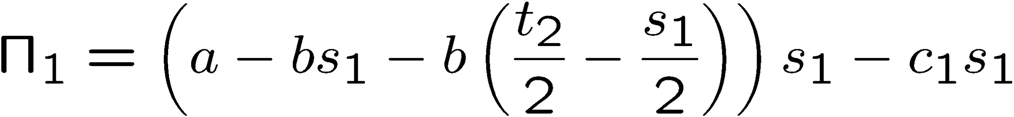
Firm 1’s decision
Define t_{n} = (a - c_{n})/b.
If s₁ ≤ t₂, then payoff to firm 1 is:
If s₁ > t₂, then payoff to firm 1 is:

Slide 16
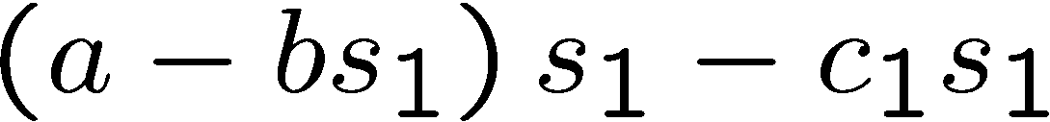
Firm 1’s decision
For simplicity, we assume that 2c₂ ≤ a+ c₁
This assumption ensures that
is strictly decreasing for s₁ > t₂.
Thus firm 1’s optimal s₁ must lie in [0, t₂].

Slide 17

Firm 1’s decision
If s₁ ≤ t₂, then payoff to firm 1 is:

Slide 18
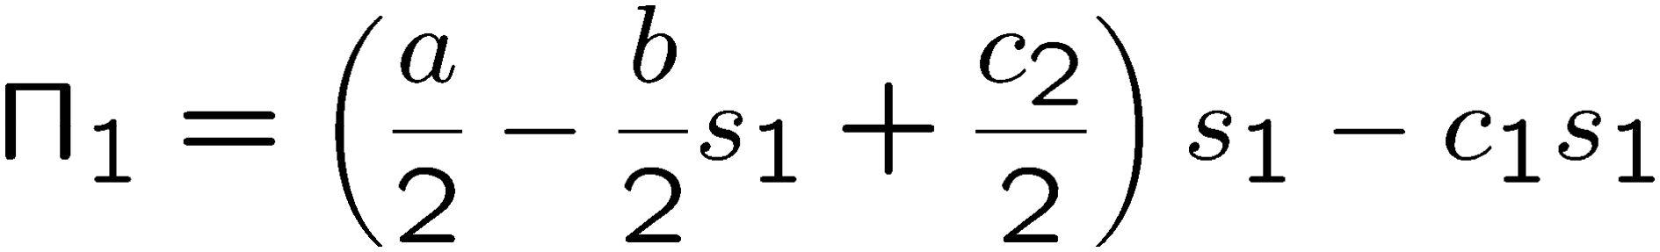
Firm 1’s decision
If s₁ ≤ t₂, then payoff to firm 1 is:

Slide 19
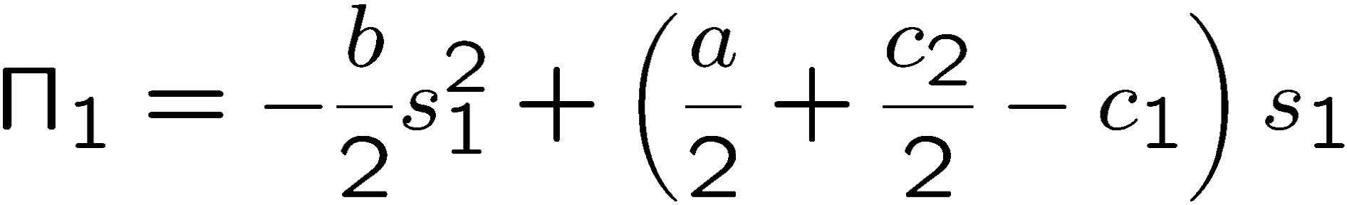
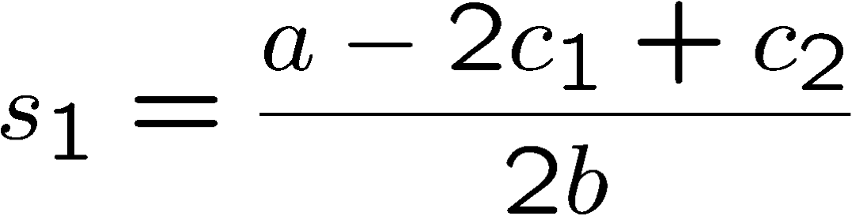
Firm 1’s decision
If s₁ ≤ t₂, then payoff to firm 1 is:
Thus optimal s₁ is:

Slide 20
Stackelberg equilibrium
So what is the Stackelberg equilibrium?
Must give complete strategies:
s₁* = (a - 2c₁ + c₂)/2b
s₂*(s₁) = (t₂/2 - s₁/2)⁺
The equilibrium outcome is that firm 1 plays s₁*, and firm 2 plays s₂*(s₁*).

Slide 21
Comparison:
Simultaneous Play vs. Sequential Play

Slide 22
Comparison to Cournot
Assume c₁ = c₂ = c.
In Cournot equilibrium:
(1) s₁ = s₂ = t/3.
(2) Π₁ = Π₂ = (a - c)²/(9b).
In Stackelberg equilibrium:
(1) s₁ = t/2, s₂ = t/4.
(2) Π₁ = (a - c)²/(8b), Π₂ = (a - c)²/(16b)

Slide 23
Comparison to Cournot
So in Stackelberg competition:
The leader has higher profits
The follower has lower profits
This is called a first mover advantage.

Slide 24
Stackelberg competition: moral
Moral:
Additional information available can lower a player’s payoff, if it is common knowledge that the player will have the additional information.
(Here: firm 1 takes advantage of knowing firm 2 knows s₁.)

Slide 25
Summary

Slide 26
Example: Cournot duopoly
Step 1: Remove strictly dominated s₁.
t
R₁(s₂)
All s > t/2 are strictly
1
dominated by s₁ = t/2
s₂
R₂(s₁)
0
0
t
s₁

Slide 27
Example: Cournot duopoly
Step 2: Remove strictly dominated s₂.
t
R₁(s₂)
All s > t/2 are strictly
2
dominated by s₂ = t/2…
s₂
R₂(s₁)
0
0
t
s₁

Slide 28
Example: Cournot duopoly
Step 2: Remove strictly dominated s₂.
t
R₁(s₂)
All s > t/2 are strictly
2
dominated by s₂ = t/2…
…and all s₂ < t/4 are strictly dominated by s₂ = t/4.
s₂
R₂(s₁)
0
0
t
s₁

Slide 29
Example: Cournot duopoly
Step 3: Remove strictly dominated s₁.
t
R₁(s₂)
s₂
R₂(s₁)
0
0
t
s₁

Slide 30
Example: Cournot duopoly
Step 4: Remove strictly dominated s₂.
t
R₁(s₂)
s₂
R₂(s₁)
0
0
t
s₁

Slide 31
Example: Cournot duopoly
The process converges to the intersection point: s₁ = t/3, s₂ = t/3
Step # | Undominated s₁
1 | [0, t/2]
3 | [t/4, 3t/8]
5 | [5t/16, 11t/32]
7 | [21t/64, 43t/128]

Slide 32
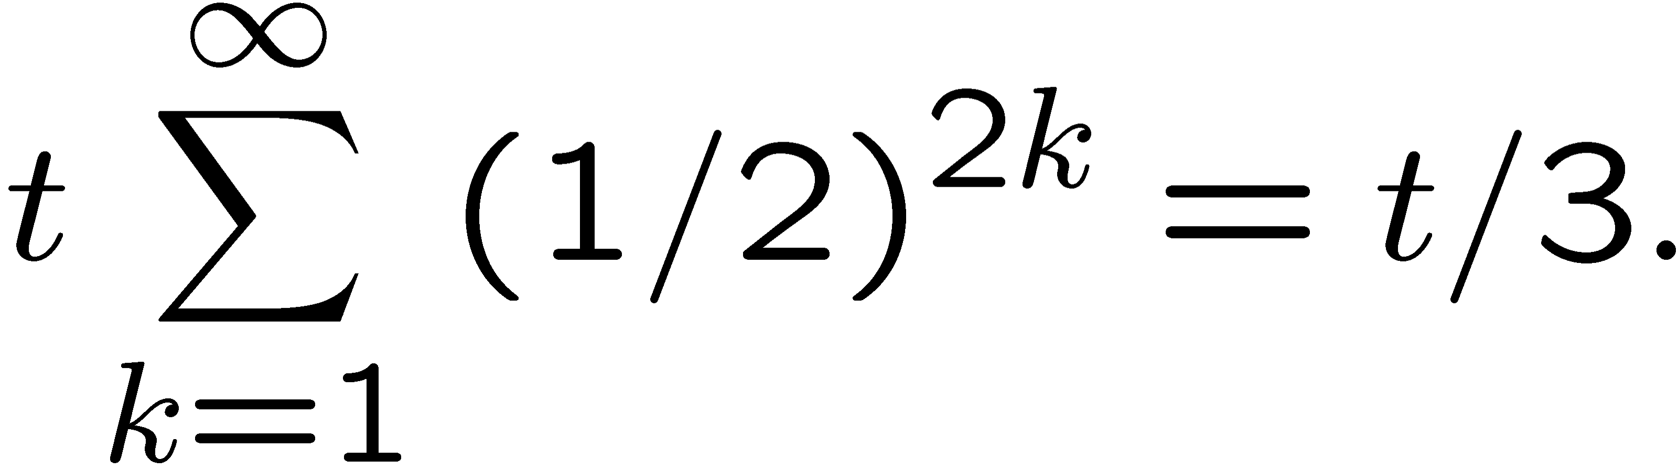
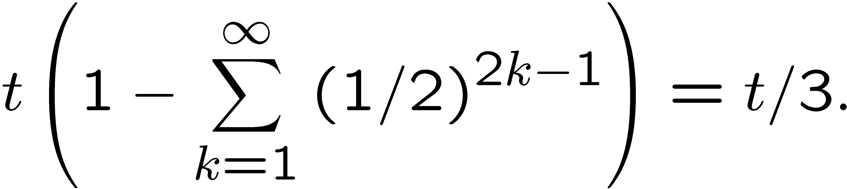
Example: Cournot duopoly
Lower bound =
Upper bound =

