Slide 1
Lecture 10: Bayesian Game

Slide 2
Overview of Bayesian Game
What happens I don’t know about you?
Incomplete information game
Static Bayesian Game
Example:
Battle of Sexes with incomplete information
Cournot Duopoly with incomplete information
Dynamic case (extensive form): Not covered in this lecture

Slide 3
What is Bayesian Game?

Slide 4
What is Bayesian Game?
Game in strategic form
Complete information (each player has perfect information
regarding the element of the game)
Iterated deletion of dominated strategy, Nash equilibrium:
solutions of the game in strategic form
Bayesian Game
A game with incomplete information
Each player has initial private information, type.
- Bayesian equilibrium: solution of the Bayesian game

Slide 5
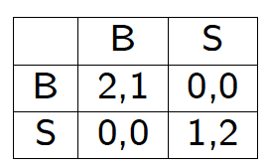
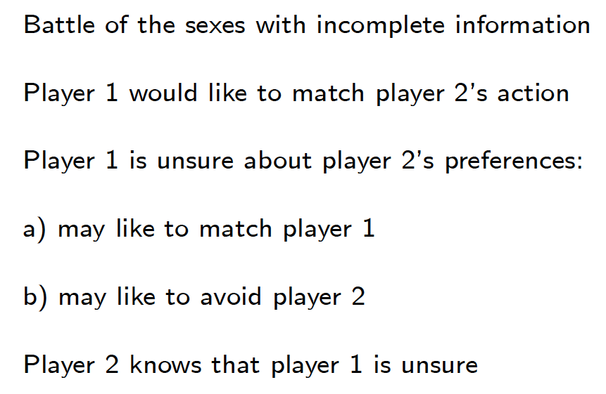
Battle of Sexes Game
player 1
player 1

Slide 6
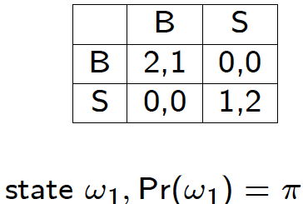
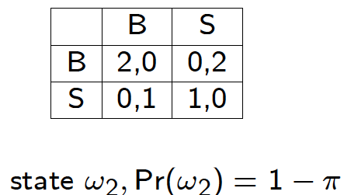
Player 1’s View of Player 2
Player 1’s unsure belief
Probabilistic distribution for each “type”
“A-ha, P2 has two types, but I cannot differentiate between them”
matching
avoiding

Slide 7
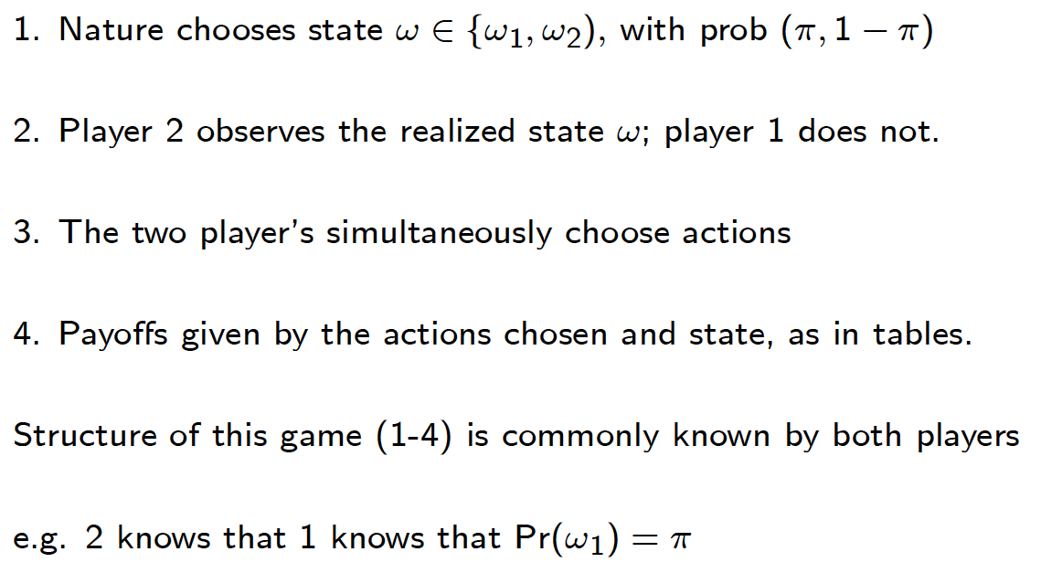
Bayesian Game Setup

Slide 8
What is a strategy?
Player 2 knows the state, but Player 1 does not
Thus, a strategy is a triple of actions
One for player 1
Two for player 2
Example: [B;(B,S)]
Player 1 chooses B
Player 2 chooses B for the state 1 and S for the state 2
Well, that’s “pure” strategy

Slide 9
Bayesian Game Setup: Interpretation
Player 2
Initially, P2 does not know the state; she is informed of the state by a signal that depends on the state
Before receiving the signal she carries out her planned action for that signal
Player 1
P1 also receives the signal, but it is uninformative: it must be the same in each state.
Given her signal, she is unsure of the state; when choosing an action she takes into account her belief about the likelihood of each state, given her signal.

Slide 10

What is a strategy? Pure? Mixed?
Mixed strategy
Example: [$p$;($q_{1},q_{2}$)]. It means …
Nash Equilibrium
Pure strategy NE
Mixed strategy NE
Study this for our particular example
Then, we will formalize this later.

Slide 11
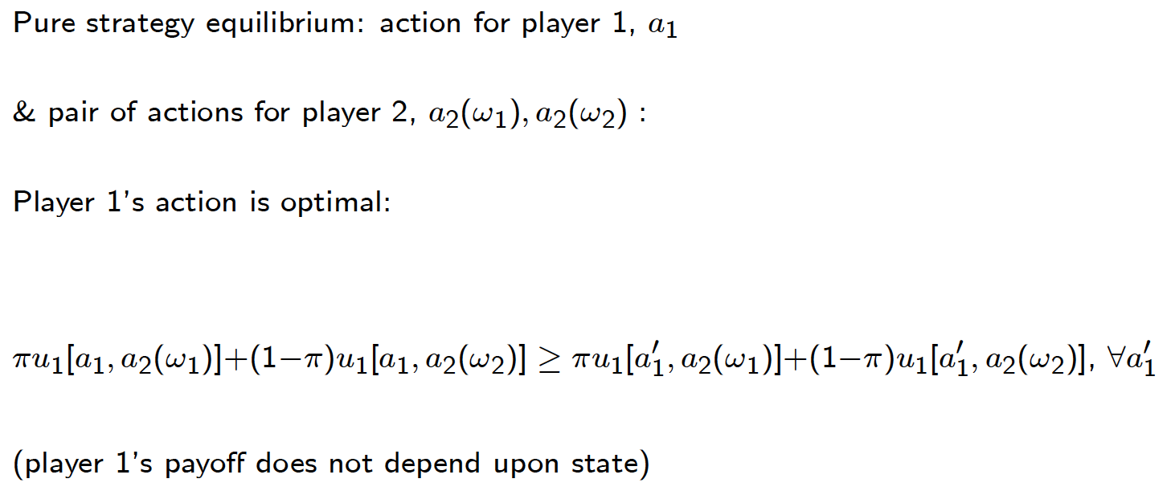
NE of BoS (1)

Slide 12
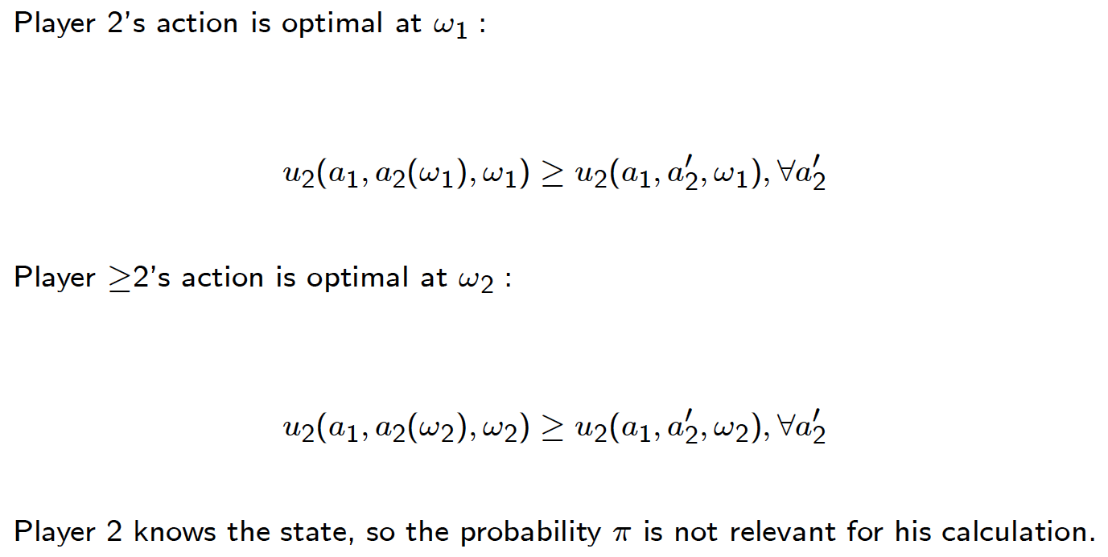
NE of BoS (2)

Slide 13
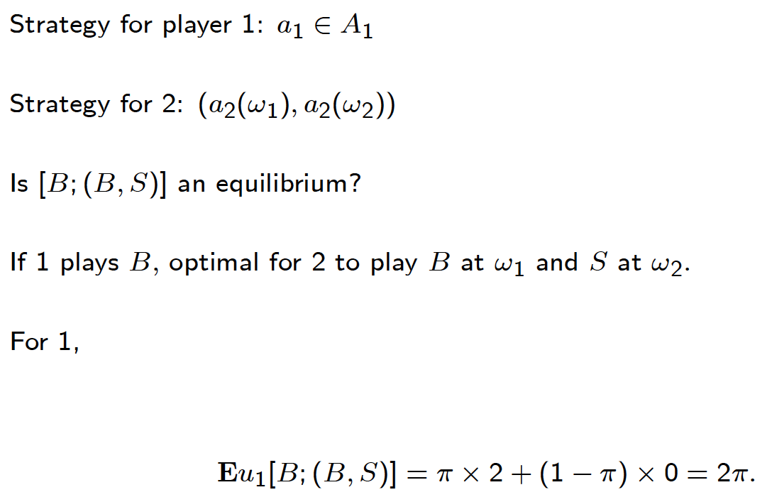
NE of BoS (3)

Slide 14
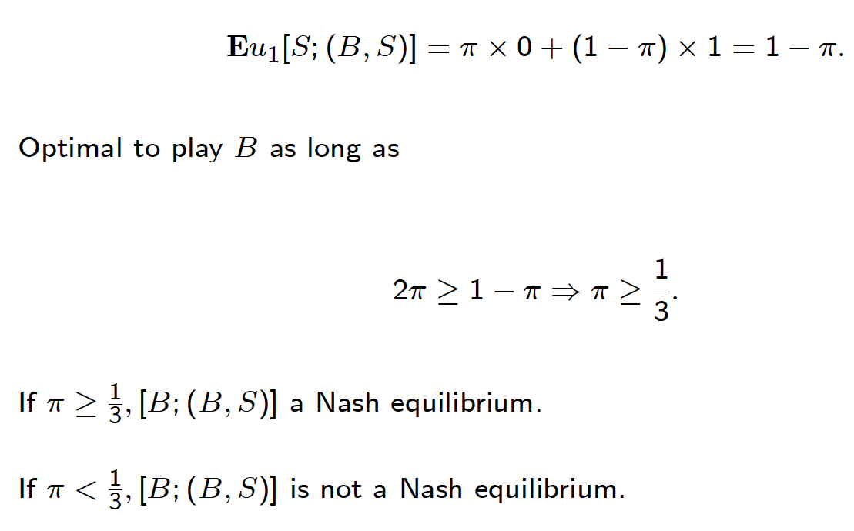
NE of BoS (3)

Slide 15
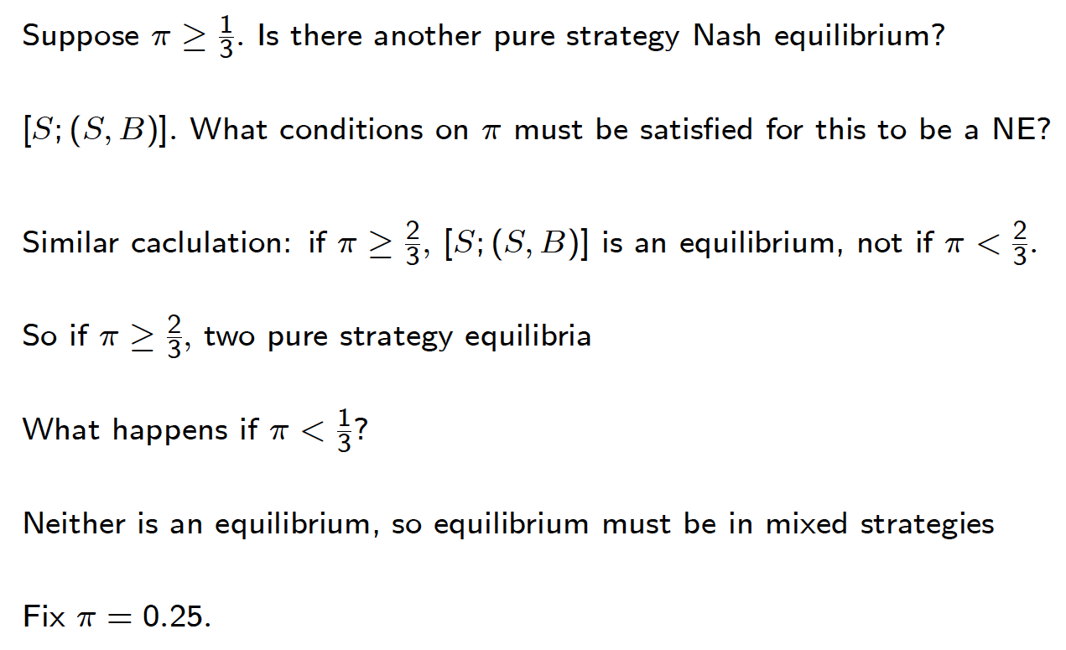
NE of BoS (3)

Slide 16
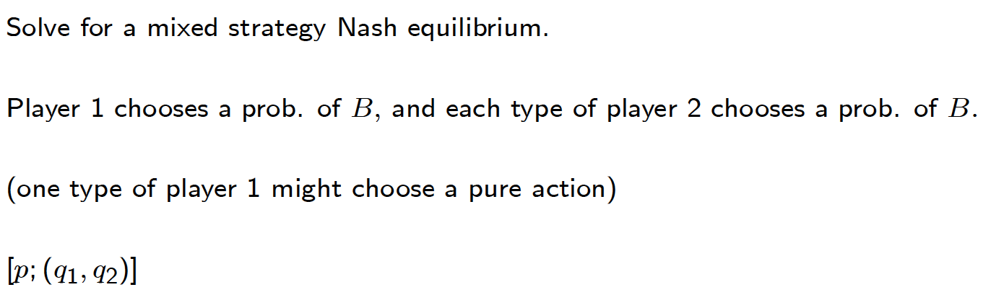
NE of BoS (3)

Slide 17
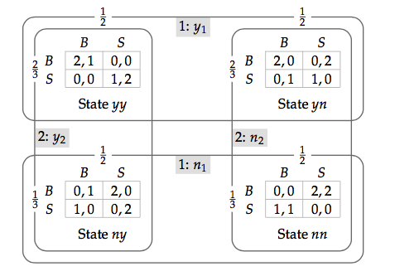
Another Example
P1: cannot differentiate between yy and yn
or between ny, nn
P2: cannot differentiate between yy and ny
or between yn and nn
Understanding:
P1 receives the same “signal” y1 for yy and yn
a different “signal” n1 for ny and nn
Similarly, for P2 for the signals y2 and n2

Slide 18
Expected Payoff
Player 1’s expected payoff
P2
 | (B,B) | (B,S) | (S,B) | (S,S)
(B,B)
(B,S)
(S,B)
(S,S)
P1
Player 2’s expected payoff
P2
 | (B,B) | (B,S) | (S,B) | (S,S)
(B,B)
(B,S)
(S,B)
(S,S)
P1

Slide 19
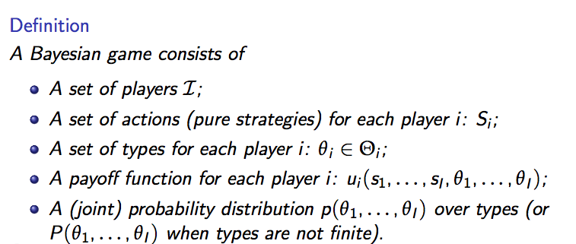
Bayesian Game
Note that the players’ types may not independent

Slide 20
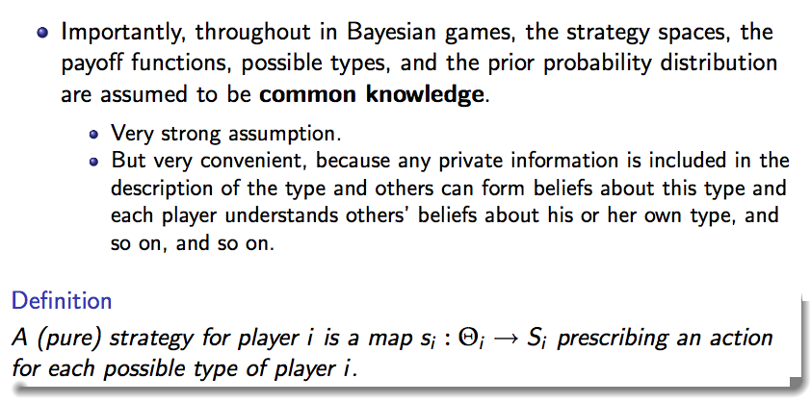
Bayesian Game

Slide 21
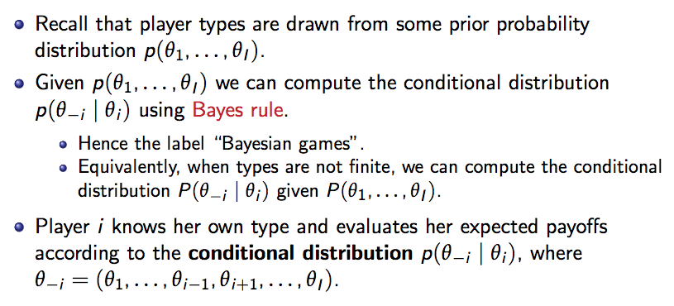
Bayesian Game

Slide 22
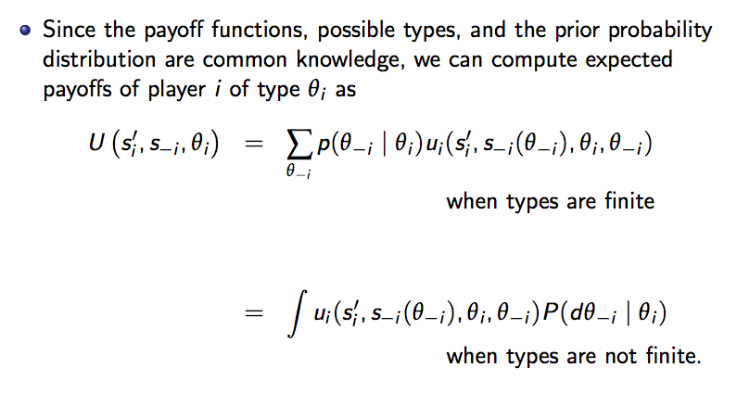
Bayesian Game

Slide 23
NEP Example
[(B,B), (B,S)] is a NEP?
[(S,B), (S,S)] is a NEP?

Slide 24
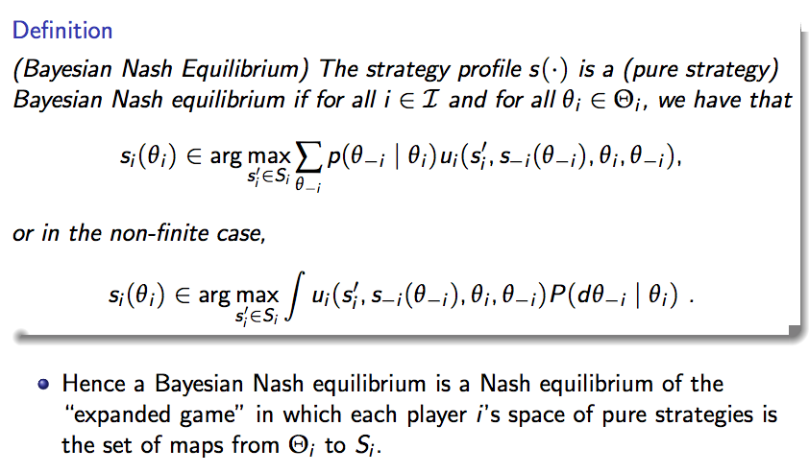
Bayesian Equilibrium

Slide 25
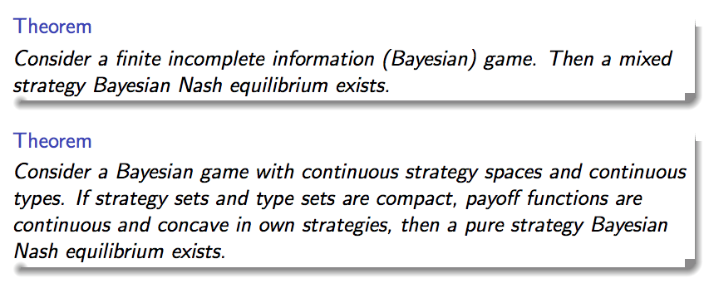
Bayesian Equilibrium: Existence

Slide 26
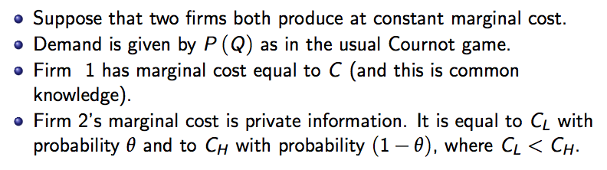
Example: Cournot Duopoly

Slide 30
Summary

