Slide 1
Lecture 12: Cooperative Game Theory Nash Bargaining Solution

Slide 2
Where We Are?
Non-cooperative game theory
Various games
Normal-form game
Extensive-form game
Repeated game
Bayesian game
…
Cooperative game theory
Bargaining (today)
Coalitional game

Slide 3
Introduction
Introduction to cooperative game
Bargaining solution
Nash Bargaining Solution
Kalai – Smorodinsky Bargaining Solution
Rubinstein Bargaining Process
Examples
Coalitional game

Slide 4
Cooperative Game Theory
Underlying situation
Players have mutual benefit to cooperate
Two categories
Bargaining problems
Coalitional game

Slide 5
Introduction to Bargaining
Bargaining situation
A number of individuals have a common interest to cooperate (e.g., trade or sharing of resource), but a conflicting interest on how to cooperate (terms of agreement, 계약조건)
Key tradeoff
Players wish to reach an agreement rather than disagree.
But, each player is self-interested

Slide 6
Introduction to Bargaining
What is bargaining?
Process through which the players on their own attempt to reach an agreement
Can be tedious, involving offers and counter-offers, negotiations, etc.
Bargaining theory studies these situations, their outcome, and the bargaining process

Slide 7
Examples
Painting
Seller: values at 1000$
Buyer: values at 1500$
What’s the final price?
Sharing Resource
Shared resource among nodes
How to share?
Every node wants to get larger portion of resource

Slide 8
Introduction
Key issues in bargaining
The players must inspect efficiency and the effect of delay and disagreement on it, i.e., jointly efficient
They seek a jointly efficient mutual agreement
Distribution of the gains from the agreement
Which point from the efficient set must the players select?
What are the joint strategies that the players must choose to get the desired outcome?
How to finally enforce the agreement?
Link to game theory
Issues 1 and 2 are tackled traditionally by cooperative game theory
Issues 3 and 4 are strongly linked to non-cooperative game theory

Slide 9

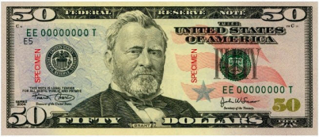

Motivating Example (1)
I can give you 100$ if and only if you agree on how to share it
Can be deemed unsatistifactory
Given each Man’s wealth!!!
Rich Man (Wealth = $${10}^{10}$)
Poor Man (Wealth = $10)

Slide 10
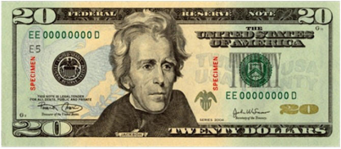
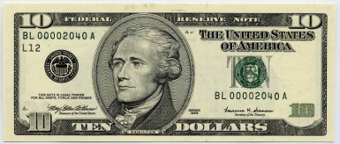
Motivating Example (2)
I can give you 100$ if and only if you agree on how to share it
Can be deemed unsatistifactory
Given each Man’s wealth!!!
Rich Man (Wealth = $${10}^{10}$)
Poor Man (Wealth = $10)

Slide 11
The Nash Bargaining Solution
John Nash’s approach
When presented with a bargaining problem such as the rich man – poor man case, how can we pick a reasonable outcome?
Interested in the outcome rather than the process
The Nash Bargaining Solution was proposed in 1950 using an axiomatic approach and is considered as one of the key foundations of bargaining problems

Slide 12
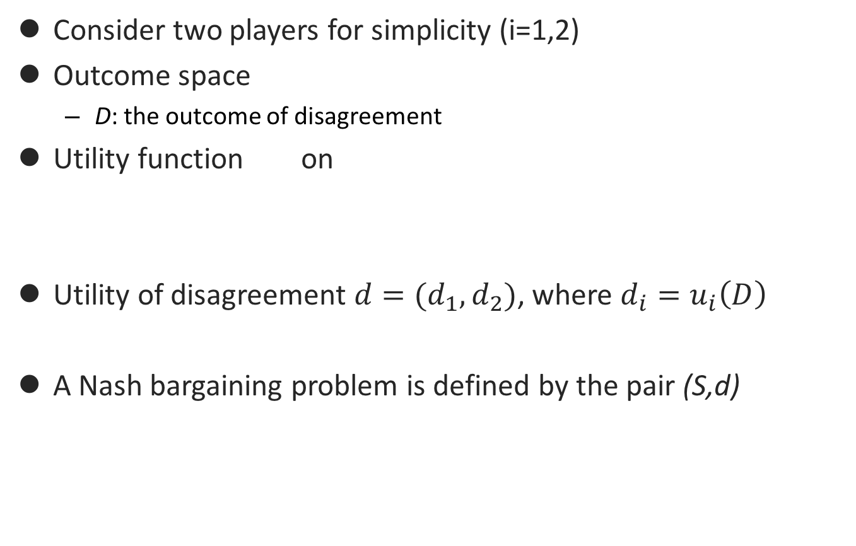
Setup
Consider two players for simplicity (i=1,2)
Outcome space
D: the outcome of disagreement
Utility function on
Utility of disagreement $d=(d_{1},d_{2})$, where $d_{i}=u_{i}\left(D\right)$
A Nash bargaining problem is defined by the pair (S,d)

Slide 13
The Nash Bargaining Solution
Can we find a bargaining solution, i.e., a function f that specifies a unique outcome f(S,d) ϵ S ?
Axiomatic approach proposed by Nash
Axiom 1: Feasibility
Axiom 2: Pareto efficiency
Axiom 3: Symmetry
Axiom 4: Invariance to linear transformation
Axiom 5: Independence of irrelevant alternatives

Slide 14
The Nash Bargaining Solution
Axiom 1: Feasibility
Feasibility implies that
The outcome of the bargaining process, denoted (u*,v*) cannot be worse than the disagreement point d = (d₁,d₂), i.e., (u*,v*) ≥ (d₁,d₂)
Strict inequality is sometimes defined
Trivial requirement but important: the disagreement point is a benchmark and its selection is very important in a problem!

Slide 15
The Nash Bargaining Solution
Axiom 2: Pareto efficiency
Players need to do as well as they can without hurting one another
At the bargaining outcome, no player can improve without decreasing the other player’s utility
Pareto boundary of the utility region
Formally, no point (u,v) ϵ S exists such that u > u* and v ≥ v* or u ≥ u* and v > v*

Slide 16
The Nash Bargaining Solution
Axiom 3: Symmetry
If the utility region is symmetric around a line with slope 45 degrees then the outcome will lie on the line of symmetry
Formally, if d₁ = d₂ and S is symmetric around u = v, then u*= v*
Axiom 4: Invariance to linear transformation
The bargaining outcome varies linearly if the utilities are scaled using an affine transformation

Slide 17
The Nash Bargaining Solution
Axiom 5: Independence of irrelevant alternatives
If the solution of the bargaining problem lies in a subset U of S, then the outcome does not vary if bargaining is performed on U instead of S
If the solution of a larger set is a member of a smaller set, then this solution is also the solution of the smaller set

Slide 18

The Nash Bargaining Solution
Theorem. Nash showed that there exists a unique solution f satisfying the axioms, and it takes the following form:
When d₁ = d₂ = 0, this is equivalent to the famous solution of telecommunication networks: Proportional fairness
Known as the Nash product

Slide 19
Rich man – poor man problem revisited
Considering logarithmic utilities and considering that what the men’s current wealth is as the disagreement point
The Nash solution dictates that the rich man receives a larger share of the 100$
Is it fair?
Fairness is subjective here, the rich man has more bargaining power so he can threaten more to stop the deal
The poor man also values little money big as he is already poor!
Variant of the problem considers the 100$ as a debt, and, in that case, the NBS becomes fair, the richer you are the more you pay!

Slide 20
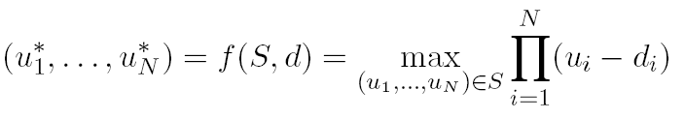
The Nash Bargaining Solution
The NBS is easily extended to the N-person case
The utility space becomes N-dimensional and the disagreement point as well
Computational complexity definitely increases and coordination on a larger scale is required
Solution to the following maximization problem

Slide 21
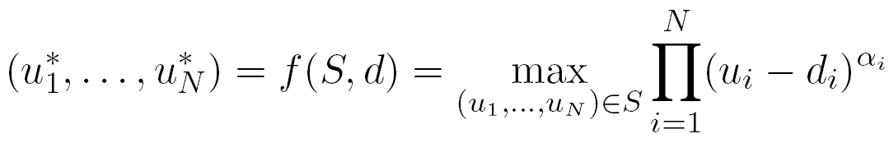
The Nash Bargaining Solution
If we drop the Symmetry axiom we define the Generalize Nash Bargaining Solution
Solution to the following maximization problem
Value between 0 and 1 representing the bargaining power of player i
If equal bargaining powers are used, this is equivalent to the NBS

Slide 22
Nash Bargaining Solution – Summary
The NBS/GNBS are a very interesting concept for allocating utilities in a bargaining problem
Provide Pareto optimality
Account for the bargaining power of the players but..
Can be unfair, e.g., the rich man – poor man problem
Require convexity of the utility region
Independence of irrelevant alternatives axiom
Provide only a static solution for the problem, i.e., no discussion of the bargaining process
Alternatives?
The Kalai – Smorodinsky solution
Dynamic bargaining and the Rubinstein process

Slide 23
Dynamic Bargaining
The NBS is the static solution in the sense that we only care about the outcome
How about the bargaining process?
Dynamic bargaining
Interested in the players interactions to reach an agreement
Broader than static bargaining, although linked to it
In this trial lecture, we cover the Rubinstein process although many others exists
Famous one: Rubinstein Bargaining Process
There are other bargaining processes (a hot research topic in game theory)

Slide 24
Summary

