Slide 1
Lecture 14: Learning in Games: Part I: Intro and Concept

Slide 2
Intro: Learning in Games

Slide 3
Learning and Dynamics in Games
Tension: Even though strategic form games model “one shot” interactions
NE: better motivated as the outcome of a dynamic process
Unclear how to interpret mixed strategies and Bernoulli payoffs as “one shot”.
Resolution
Define interactive processes that lead to NE
Sorry for the notations
Some notations are used with different mathematical symbols
Please understand that making slides takes a lot of time

Slide 4
Games with Complete/Incomplete Information
Complete Information
Every player knows the number of players and the strategy sets of all the players and their utility functions.
Every player knows that every player is rational.
Incomplete Information
A player knows some information about himself, but has partial (or no) information about the others.
Learning for Incomplete Information
Investigate ways in which players can optimize their own utility while simultaneously learning from experience or observations.
Notes:
Now I start to focus on the concepts that are related to learning.
But it does not mean that a player knows all information about himself,
As I’ll explain later, In some games, players don’t know their own utility functions.
If a incomplete information game is repeated several times, one of the main topic is

Slide 5
Taxonomy: Learning Algorithms
Fully distributed (or Uncoupled) learning algorithm
A player does not use information about the other players.
Builds his strategies and updates them by using own-actions and own-utilities.
Partially distributed learning algorithm
A player implements his updating rule after receiving some data about others.
The amount and the kind of data may depend on each algorithm (We will discuss this later)
Notes:
There are many ways of classifying learning algorithms
But I’ll divide them into 2 classes.

Slide 6
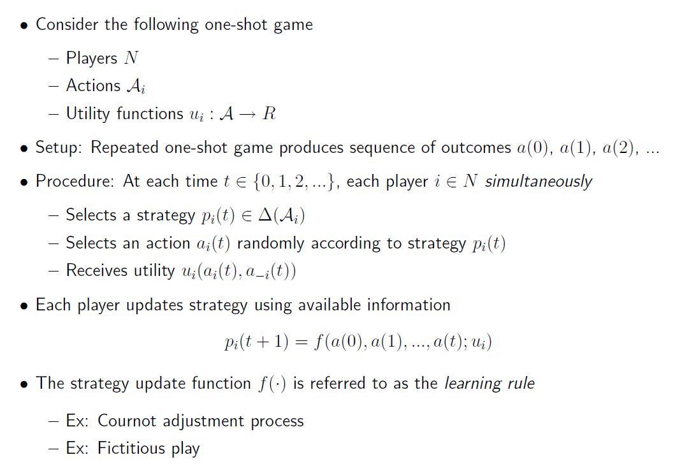
Framework: Learning in Games (1)

Slide 7
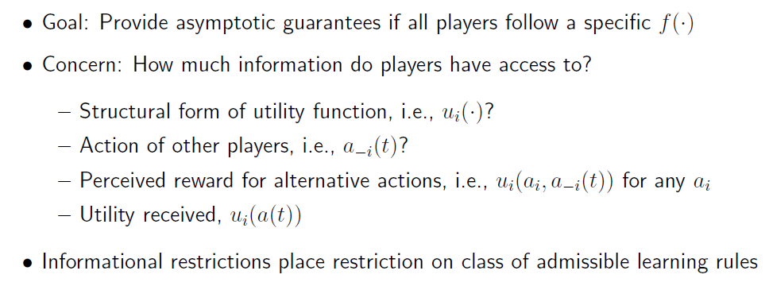
Framework: Learning in Games (2)

Slide 8
Some Concepts
Better Reply Graph
Finite Improvement Property
Weakly Acyclic Game
Correlated Equilibrium

Slide 9
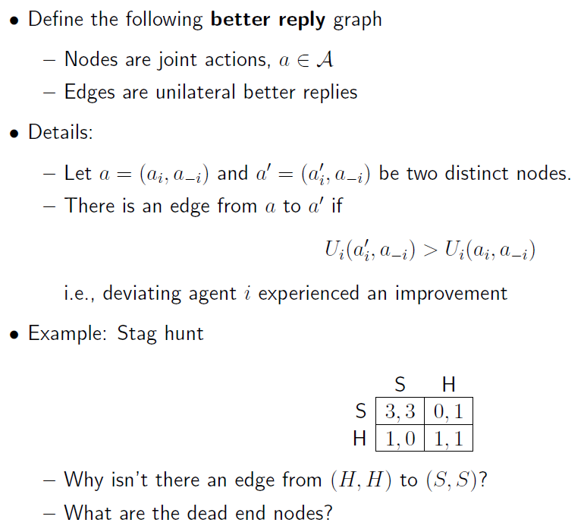
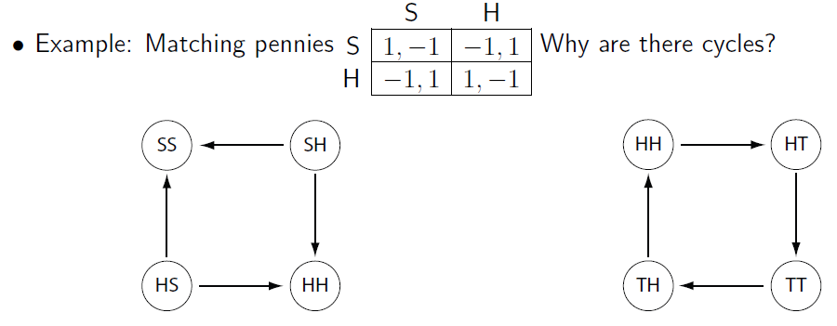
Better Reply Graph G*

Slide 10
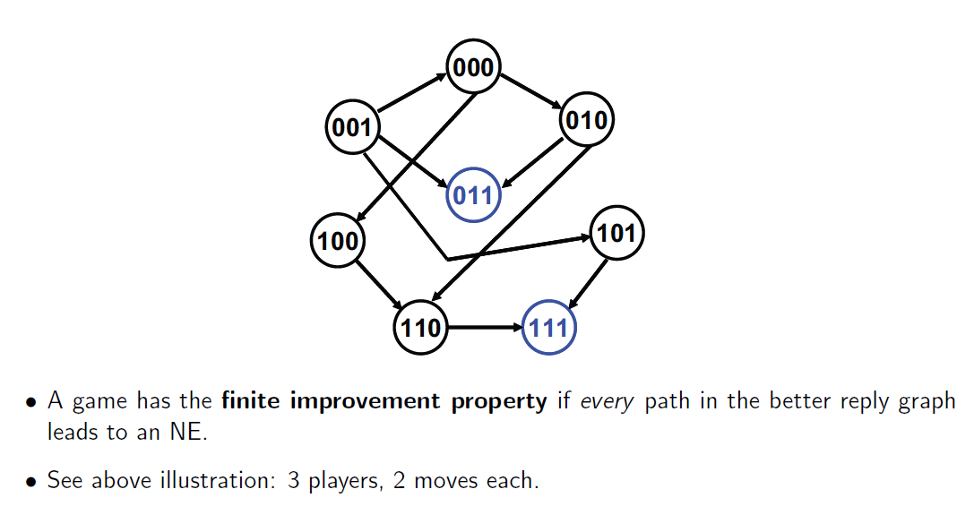
FIP (Finite Improvement Property)

Slide 11
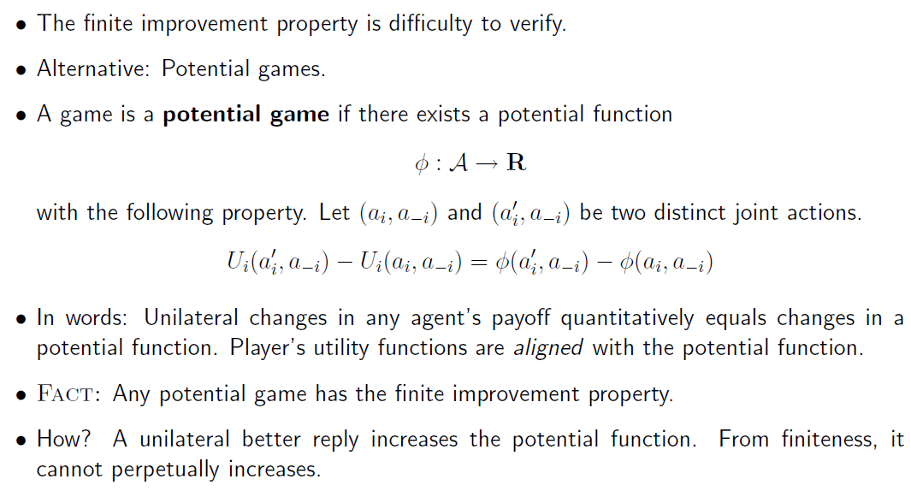
Potential game and FIP (1)

Slide 12
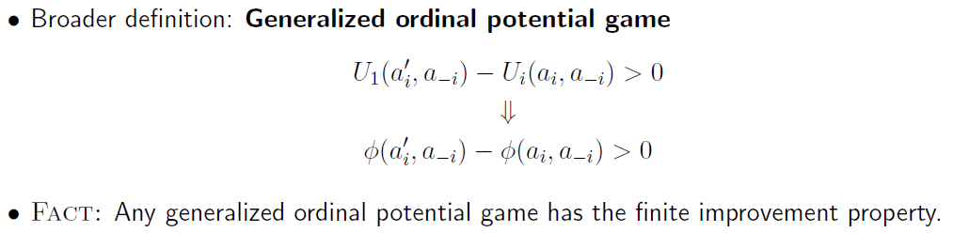
Potential Game and FIP (2)

Slide 13
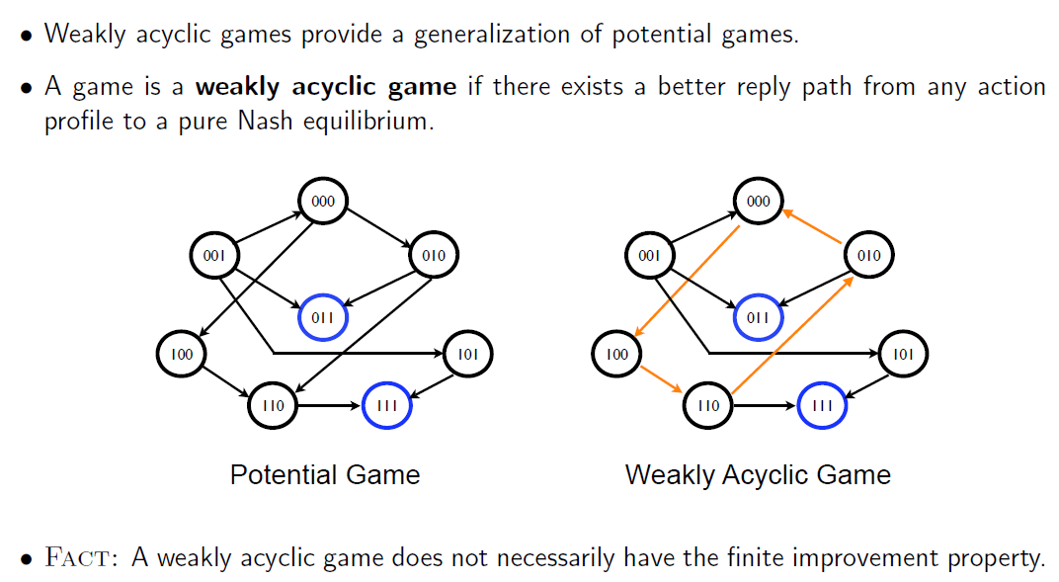
Weakly Acyclic Game (1)

Slide 14
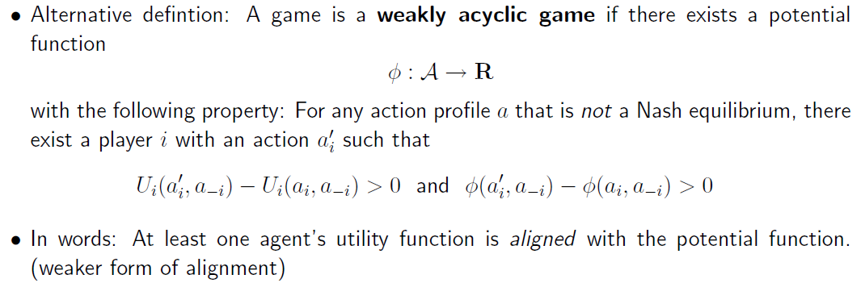
Weakly Acyclic Game (2)

Slide 15
Summary

Slide 16
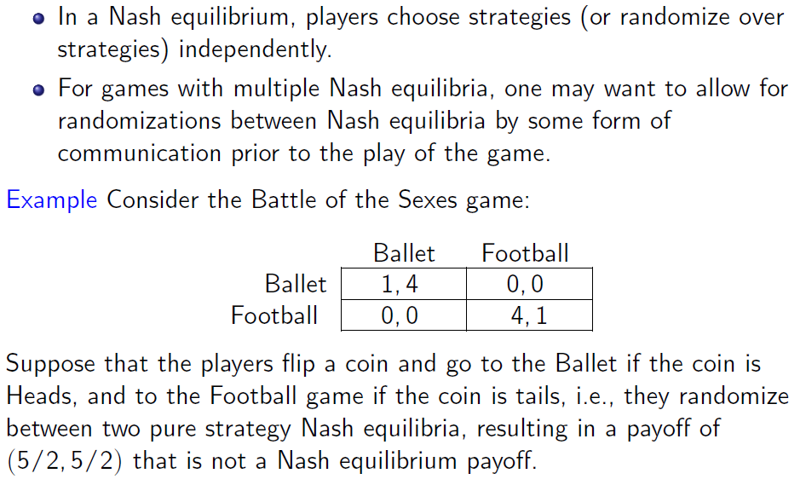
Correlated Strategies

Slide 17
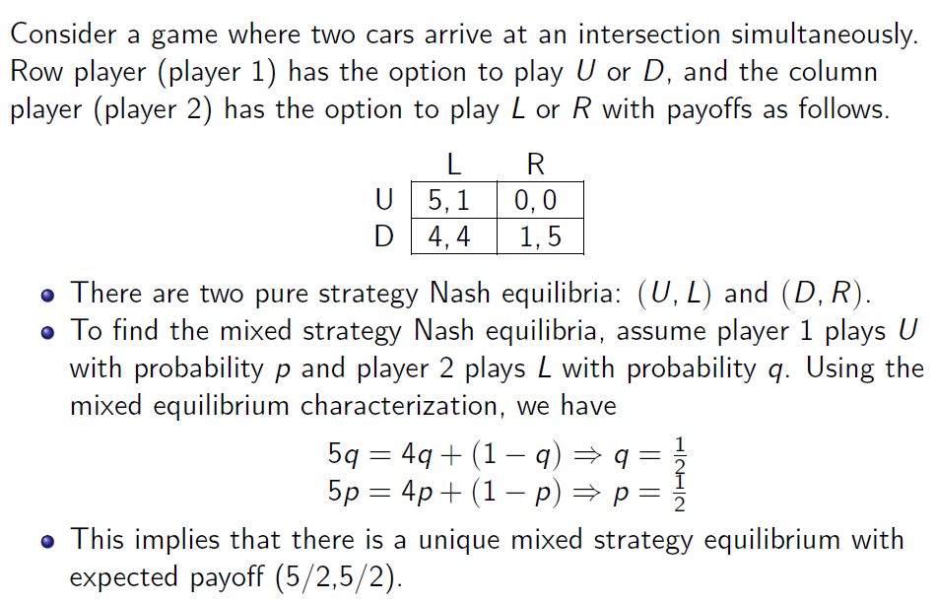
Traffic Intersection Game (1)

Slide 18
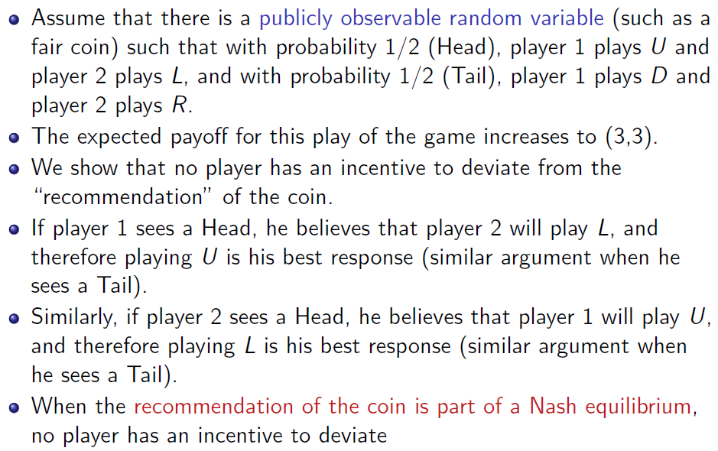
Traffic Intersection Game (2)

Slide 19
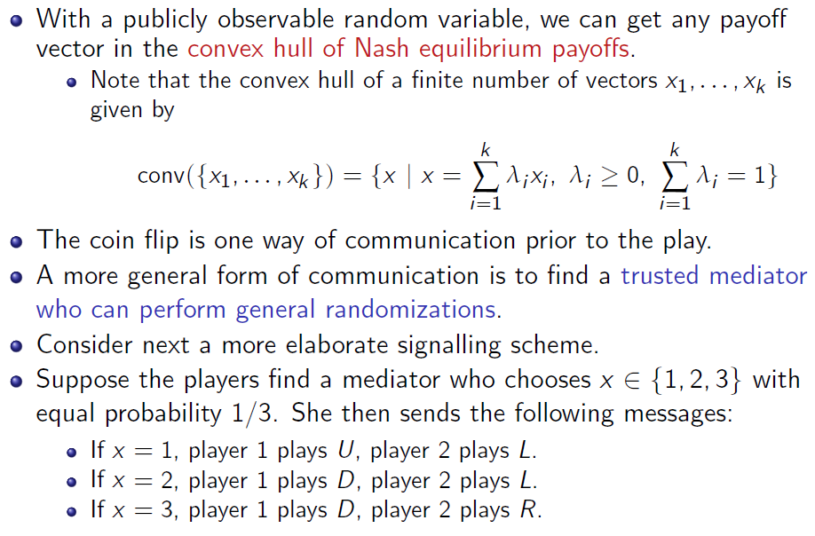
Traffic Intersection Game (3)

Slide 20
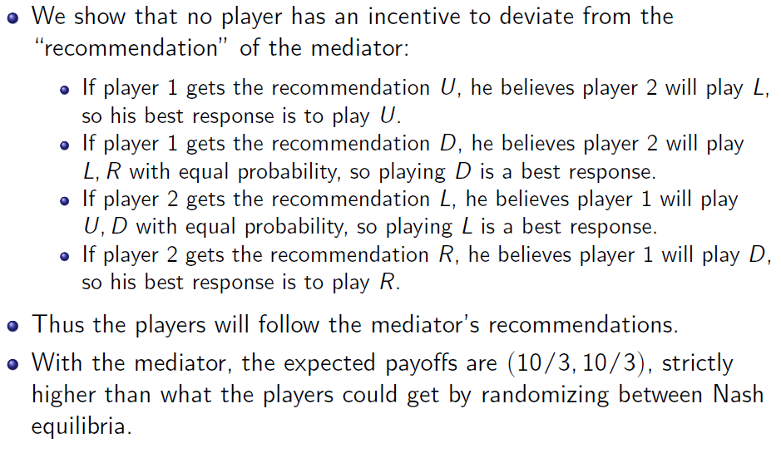
Traffic Intersection Game (4)

Slide 21
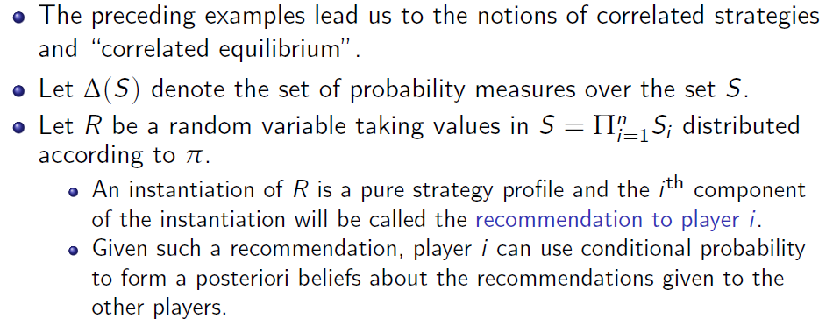
Correlated Equilibrium (1)

Slide 22
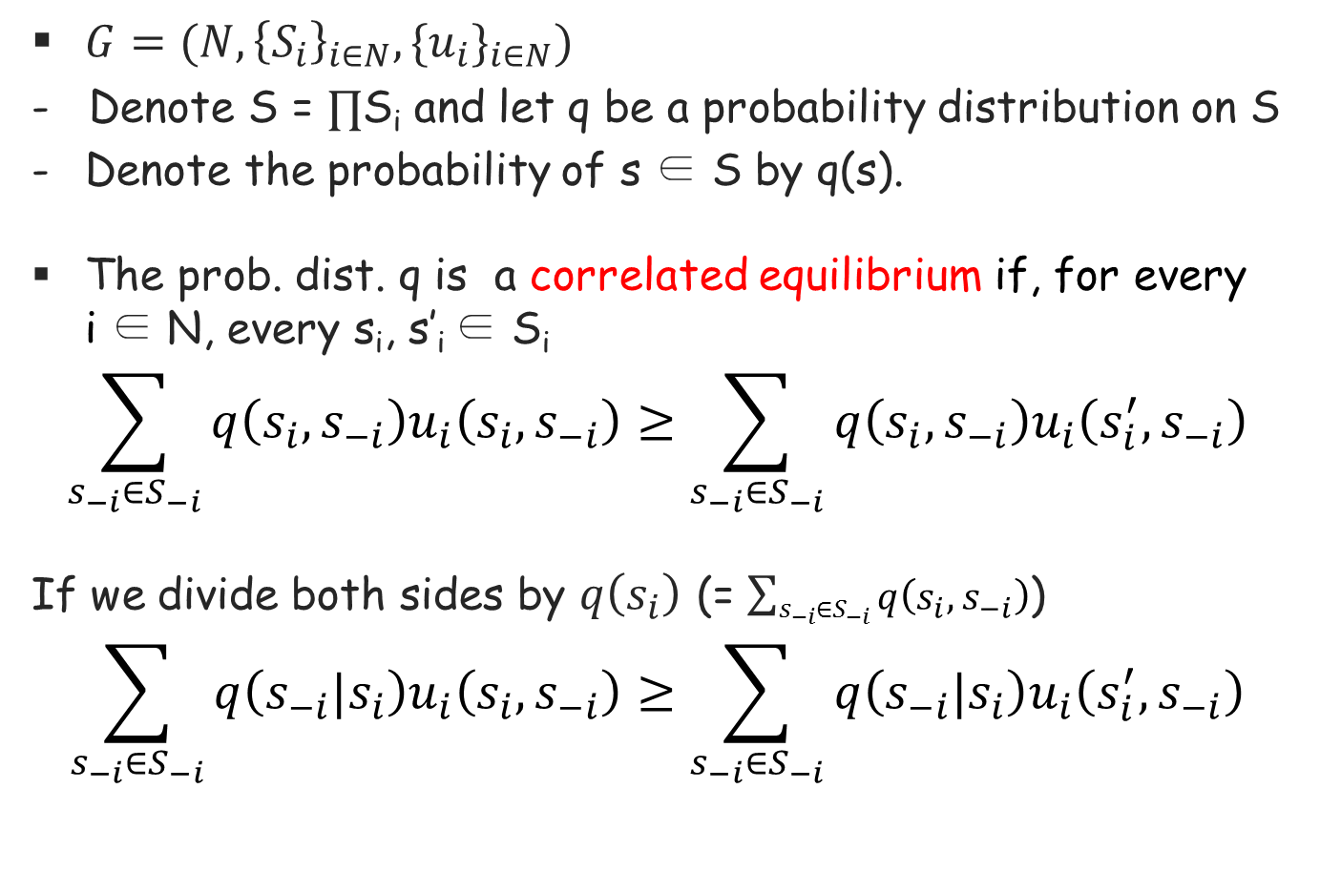
Correlated Equilibrium (2)
$G=(N, {\left\{S_{i}\right\}}_{i∈N},{{\{u}_{i}\}}_{i∈N})$
- Denote S = $∏$S_{i} and let q be a probability distribution on S
Denote the probability of s ∈ S by q(s).
The prob. dist. q is a correlated equilibrium if, for every i ∈ N, every s_{i}, s’_{i} ∈ S_{i}
$$\sum_{s_{−i}∈S_{−i}}{q\left(s_{i},s_{−i}\right)u_{i}\left(s_{i},s_{−i}\right)}≥\sum_{s_{−i}∈S_{−i}}{q\left(s_{i},s_{−i}\right)u_{i}\left(s_{i}^{′},s_{−i}\right)}$$
If we divide both sides by $q\left(s_{i}\right)$ (= $\sum_{s_{−i}∈S_{−i}}{q\left(s_{i},s_{−i}\right)}$)
$$\sum_{s_{−i}∈S_{−i}}{q\left(s_{−i}|s_{i}\right)u_{i}\left(s_{i},s_{−i}\right)}≥\sum_{s_{−i}∈S_{−i}}{q\left(s_{−i}|s_{i}\right)u_{i}\left(s_{i}^{′},s_{−i}\right)}$$
i‘th conditional expected payoff
from playing s_{i}
i‘th conditional expected payoff
from playing s’_{i}
Notes:
Besides Nash equilibrium, there are many popular solution concept.
A correlated equilibrium is one of the example, to which a regret matching converges.
The meaning of a correlated equilibrium becomes clearly if …

Slide 23
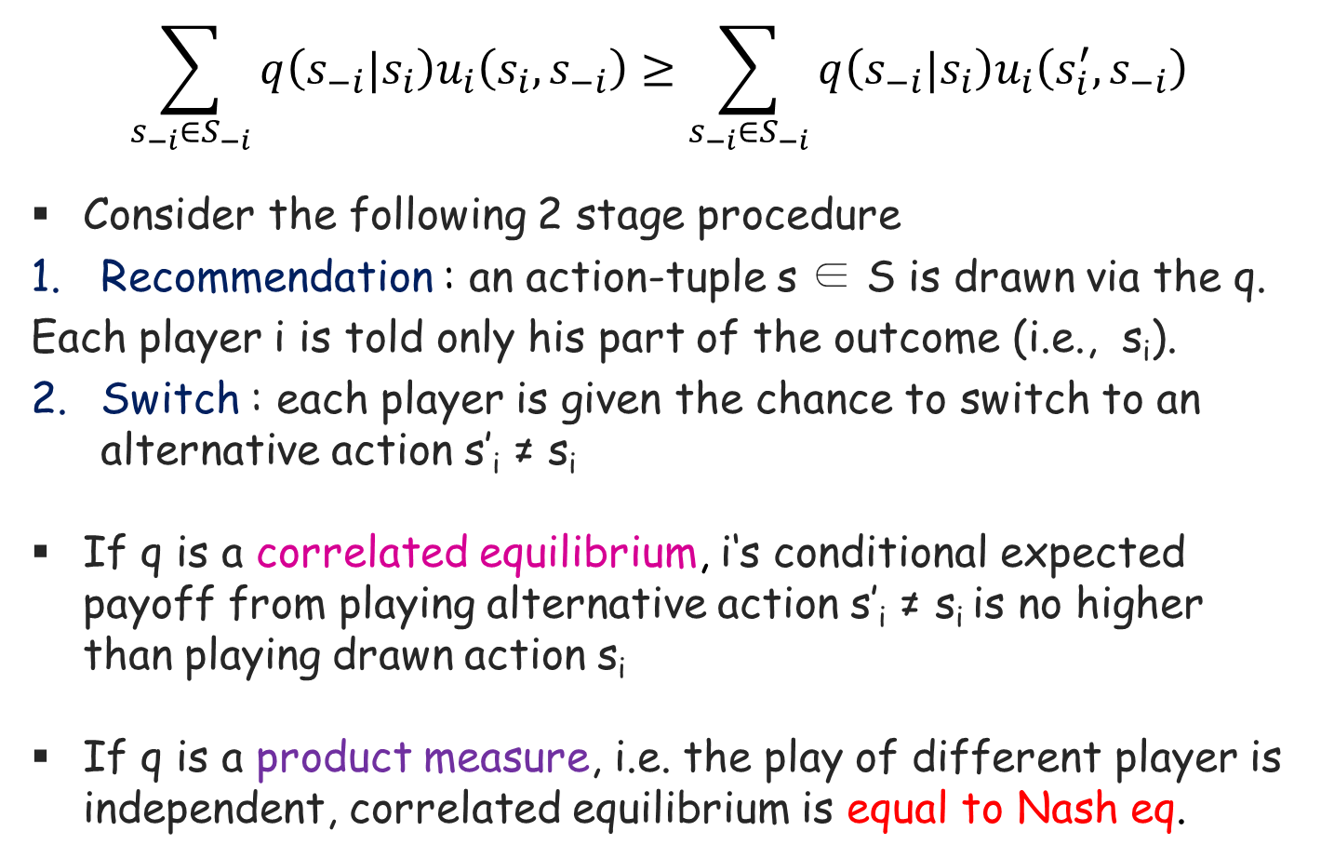
Interpretation of Correlated Equilibrium
$$\sum_{s_{−i}∈S_{−i}}{q\left(s_{−i}|s_{i}\right)u_{i}\left(s_{i},s_{−i}\right)}≥\sum_{s_{−i}∈S_{−i}}{q\left(s_{−i}|s_{i}\right)u_{i}\left(s_{i}^{′},s_{−i}\right)}$$
Consider the following 2 stage procedure
Recommendation : an action-tuple s ∈ S is drawn via the q.
Each player i is told only his part of the outcome (i.e., s_{i}).
Switch : each player is given the chance to switch to an alternative action s’_{i} ≠ s_{i}
If q is a correlated equilibrium, i‘s conditional expected payoff from playing alternative action s’_{i} ≠ s_{i} is no higher than playing drawn action s_{i}
If q is a product measure, i.e. the play of different player is independent, correlated equilibrium is equal to Nash eq.
Notes:
Here is an interpretation of correlated equilibrium

Slide 24
Lecture 15: Learning in Games: Part II: Partially Distributed

Slide 25
Contents
Environment
1. Best Response Dynamics
2. Fictitious Play Based Learning
3. Logit Equilibrium Learning (Logic Dynamics)
(smoothed fictitious play)
Notes:
Here, I introduce 3 algorithms.
…. ….
The last one can be interpreted as a variant of a fictitous play

Slide 26
Environment of 3 algorithms
Every player knows his utility function and can observe at each stage the actions played by others
They don’t know the other’s utility function.
⇒ Don’t know equilibria of game
Continuous/discrete action space (BRD, FPL)
Only discrete action space (LOGIT)
Notes:
The environment or game setting of the 3 learning algorithms are common.

Slide 27
How to define update time?
Discrete time
Synchronous: Each player updates simultaneously
Asynchronous: At each time, only one player updates.
For fair update chances, it is often assumed “sequential”
Continuous time
Often, assume that each player has its own Poisson clock with, say, unite rate
No simultaneous update
Long-term fair update chances
You can use your own update timing assumption, depending on the target applications

Slide 28
1. Best Response Dynamics

Slide 29
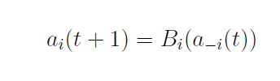
Best Response Dynamics (BRD)
Procedure (Asynchronous/Sequential Version)
Starting state, say a(0)=(a₁(0),a₂(0),…,a_{k}(0))
Player i updates his action to his best response to
a_{-i}(0).
Player j updates his action to his best response to the new action profile which only one action has been updated.
Another player updates his action to his best response to the new action profile which two actions have been updated. And so on.
There also exists a synchronous BRD

Slide 30
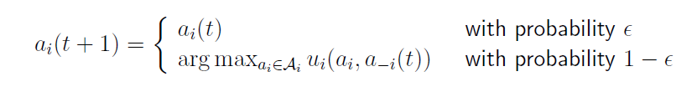
Synchronous BRD with or without inertia
Synchronous BRD
Often, experience oscillations
Synchronous BRD with inertia
Emulates “asynchronous” BRD
Helps in avoiding oscillations

Slide 31
Convergence of BRD
Not many general results on the convergence of BRD
Often, ad-hoc proof has to be done
Convergence for potential games
Young (2004)
In weakly acyclic games,
A-BRD converges with probability one to a pure Nash equilibrium
As discussed, weakly acyclic games is the superset of potential games
WAG is just a sufficient condition for the convergence
Need to check the convergence of BRD for the corresponding applications

Slide 32
2. Fictitious Play

Slide 33
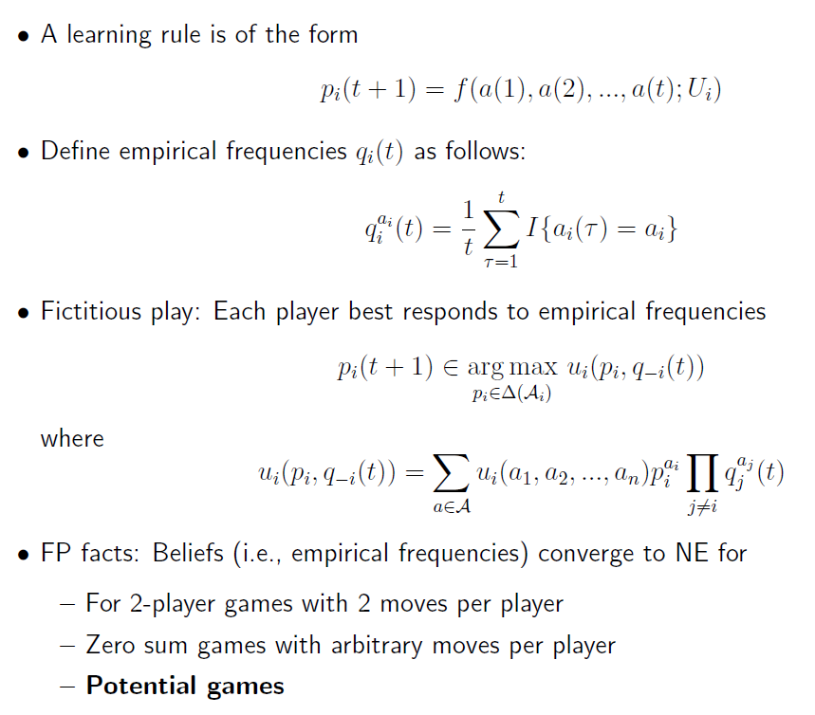
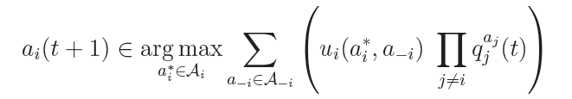
Fictitious Play (mixed strategy)
How many a_{i} are played until t
Difference from BRD?
Empirical distribution of a_{-i}

Slide 34
3. Logit Learning or Logit Dynamics

Slide 35
Logit Learning
Logit (or Boltzmann-Gibbs) learning can be interpreted as a variant of fictitious play or variant of best-response dynamics
A modification of fictitious play
Players’ responses are smoothed by small random trembles.
Let $x_{−i}(t)∈{Δ(A}_{−i})$ be i’s forecast for the opponents’ behavior at time t
$x_{−i}(t)$ can be: (i) (ii)
i chooses his action a_{i} with probability
$q^{i}\left(a_{i} | x_{−i}(t)\right)= \frac{e^{\frac{1}{γ_{i}}u_{i}^{}(a_{i}^{},x_{−i}(t))}}{\sum_{{a_{i}^{′}∈A}_{i}}{e^{\frac{1}{γ_{i}}u_{i}^{}(a_{i}^{′},x_{−i}(t))}}}$
Where $q^{i}(a_{i})$ is the prob. that i chooses action $a_{i}$
Logistic function
(or Bolzmann-Gibbs
Distribution)
Notes:
There have been a number of proposals for modifying fictitious play to reflect more realistic aspect.

Slide 36
Logit Learning (cont’d)
$q^{i}\left(a_{i} | x_{−i}(t)\right)= \frac{e^{\frac{1}{γ_{i}}u_{i}^{}(a_{i}^{},x_{−i}(t))}}{\sum_{{a_{i}^{′}∈A}_{i}}{e^{\frac{1}{γ_{i}}u_{i}^{}(a_{i}^{′},x_{−i}(t))}}}$
If $γ_{i}>0$ is close to 0,
the learning rule closely approximates a best response.
If $γ_{i}$ becomes larger,
the learning tends to a uniform distribution.
⇒ $γ_{i}$ : level of rationality of player i

Slide 37
Summary

Slide 38
Convergence of BRD
Young (2004)
In weakly acyclic games,
A-BRD converges with probability one to a pure Nash equilibrium
As discussed, weakly acyclic games is the superset of potential games
WAG is just a sufficient condition for the convergence
Things to do
We have to see some papers which use BRD and prove that it converges to pure NE.
Case-by-case
Are there such papers? Need to google
Notes:
I’ll skip what is acyclic games.
But I want to introduce a potential game which is a kind of acyclic game.
It is important because it allows several learning algorithms to converge to equilibria.

Slide 39
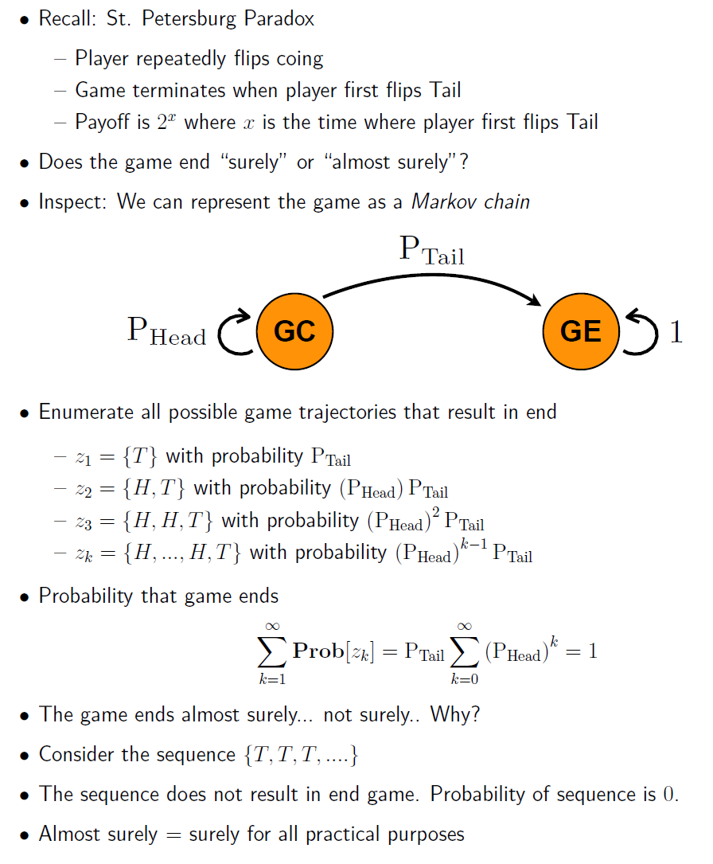
Almost sure

Slide 40
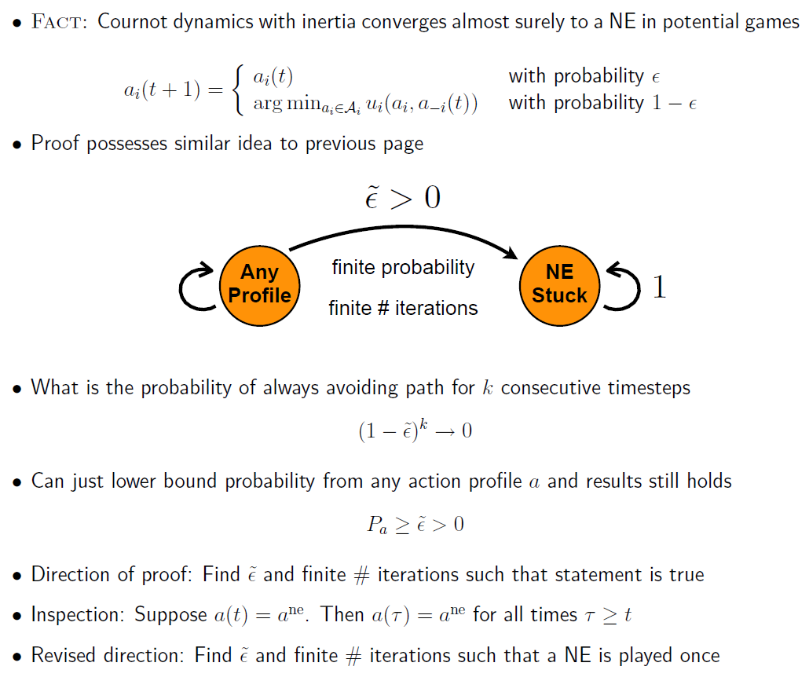
Proof of BR

Slide 41
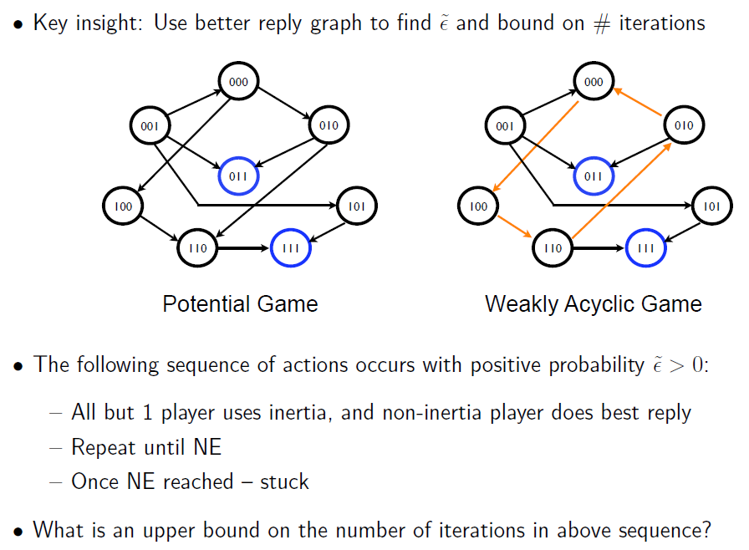

Slide 42
Summary of BRD (Conjecture)
Asynchronous (or sequential) BRD
Converges to NE (for a special class of the game mentioned earlier)
Synchronous
BRD with inertia: Similarly converges to NE
Pure BRD: May not converge due to possible oscillations (even in potential games?)
Basic idea on convergence
Asynchronous or inertia: 동시에 update를 해서, oscillation이 나지 않을 가능성 확보

Slide 43
Fictitious Play (pure strategy)
상대편마다, 특정 action을 얼마나 많이 play했는가에 대한 2차원 matrix를 유지하여, 그것을 가지고 자신의 action을 선택

Slide 44
Fictitious Play (mixed strategy)
How many a_{i} are played until t

Slide 45
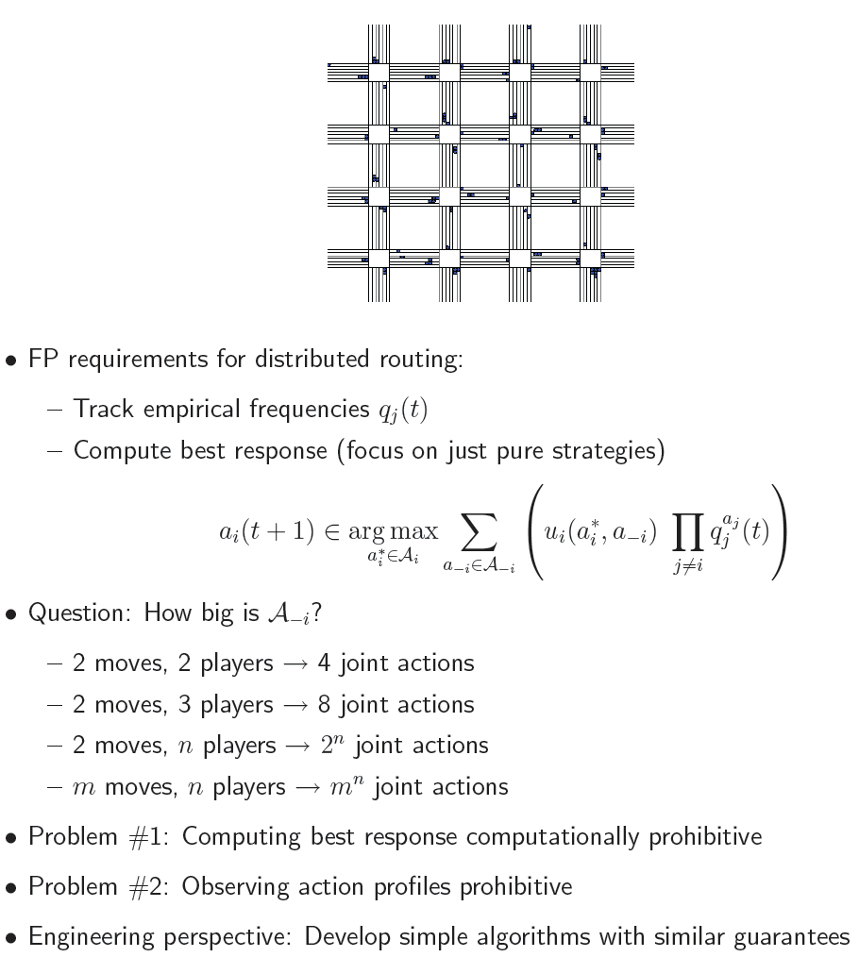
App of FP

Slide 46
Joint Strategy vs. Individual Strategy
관점
Player i의 입장에서 상대방의 strategy를 상대방마다 추적을 기록을 할 것인가, 아니면, 상대방 전체를 하나로 보고 할 것인가?
Individual
Fictitious play of the earlier slides
Sometimes, called Brown’s FP (1951)
Joint strategy
다음장에서 볼 것.
2개가 차이가 있기는 한 것인가? (곧 볼 것)

Slide 47
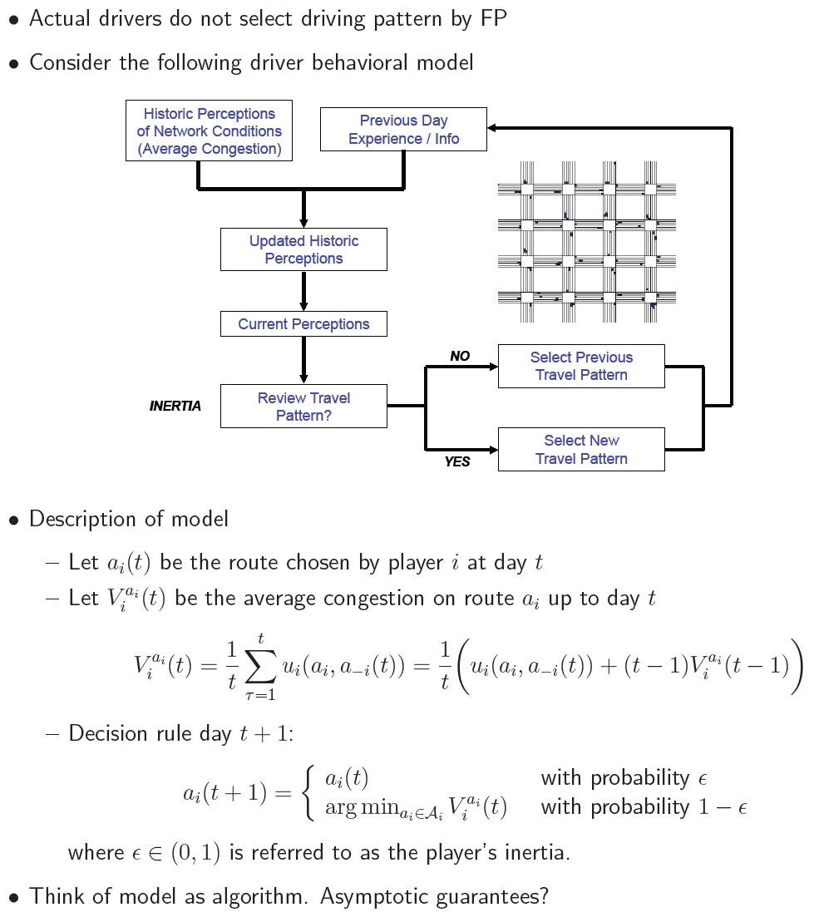
Models of Behavior

Slide 48
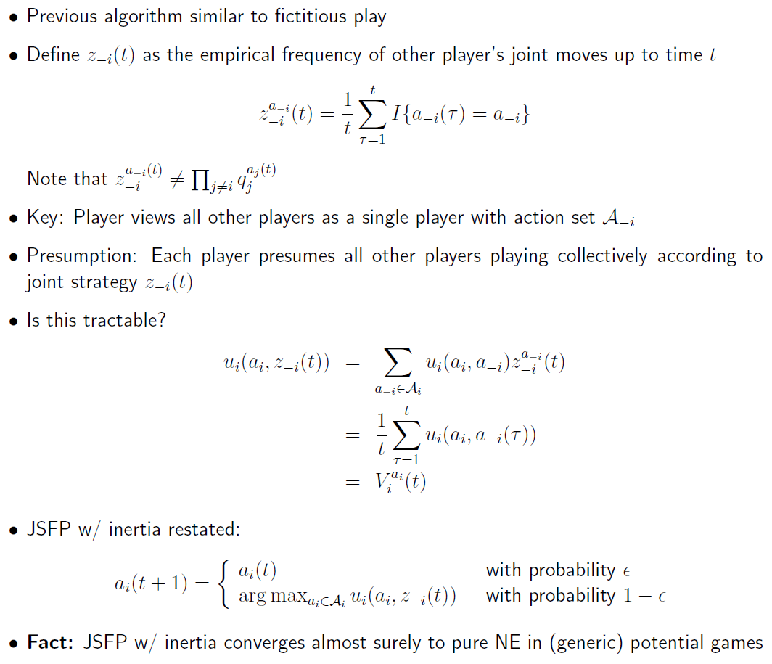
Joint Strategy FP

Slide 49
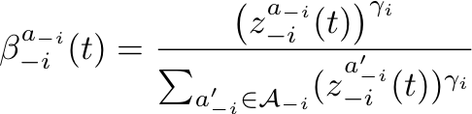
Generalized JSFP
If \gamma_i =1, then just a JSFP.
We are going to look at another variant of JSFP.

Slide 50
Logit Learning (cont’d)
$q^{i}\left(a_{i} | x_{−i}(t)\right)= \frac{e^{\frac{1}{γ_{i}}u_{i}^{}(a_{i}^{},x_{−i}(t))}}{\sum_{{a_{i}^{′}∈A}_{i}}{e^{\frac{1}{γ_{i}}u_{i}^{}(a_{i}^{′},x_{−i}(t))}}}$
If $γ_{i}>0$ is close to 0,
the learning rule closely approximates a best response.
If $γ_{i}$ becomes larger,
the learning tends to a uniform distribution.
⇒ $γ_{i}$ : level of rationality of player i
Logit equilibrium
the limit of the logit learning procedure if it converges.
ε-Nash equilibrium

Slide 51
Logit Equilibirum
Let $q_{j}^{i}$ be the prob. that player i chooses j’th action.
Given a distribution $q^{i}$ on $∆(A_{i})$, the amount of information
conveyed by $q^{i}$ : $−\sum_{j}{q_{j}^{i}\ln{q_{j}^{i}}}$ (Shannon entropy function)
Player i’s actual (or modified) utility U_{i}
$$U_{i}\left(q^{i},x_{−i}\right)=u_{i}\left(q^{i},x_{−i}\right)−γ_{i}\sum_{j}{q_{j}^{i}\ln{q_{j}^{i}}}$$
Optimal (or maximizer )${ q}^{i}$ is given by the Logistic function
Please check!
Current payoff
Information
Notes:
I will give you another important meaning of logit equilibrium

Slide 52
Convergence of Logit Learning
A potential game is a case the logit learning converges.
The convergence time to a η-Nash equilibrium under the logit learning is of order $K\log{\log{K}}+\log{\frac{1}{η}}$

Slide 53
Lecture 16: Learning in Games: Part III: Fully Distributed

Slide 54
Taxonomy: Learning Algorithms
Fully distributed (or Uncoupled) learning algorithm
A player does not use information about the other players.
Builds his strategies and updates them by using own-actions and own-utilities.
Can we even do something with this small information? Maybe
Partially distributed learning algorithm
A player implements his updating rule after receiving some data about others.
The amount and the kind of data may depend on each algorithm (We will discuss this later)
Notes:
There are many ways of classifying learning algorithms
But I’ll divide them into 2 classes.

Slide 55
Contents
Trial and error learning
Regret matching based learning
Reinforcement learning
Boltzmann-Gibbs learning

Slide 56
Contents
Trial and error learning
Regret matching based learning
Reinforcement learning
Boltzmann-Gibbs learning

Slide 57
Trial and Error Learning (TEL)
Also, called Learning by Experimenting
Environment
All players do not know their utility functions, only the value of the function at given stage is known.
Procedure
At time t,
Player i is in state $s_{i,t}=(a_{i,t},u_{i,t})$
At t+1,
Before choosing an action, each player i does experiment with probability $ε_{i}∈\left(0,1\right)$
If he does not experiment, $a_{i,t+1}$ = $a_{i,t}$
Otherwise, he plays${ a}_{i}^{′} ∈$ $A_{i}$ drawn uniformly at random. Only if received utility $u_{i,t+1}$ is greater than old $u_{i,t}$ he adopts the new state $s_{i,t+1}=\left(a_{i}^{′},u_{i,t+1}\right)$
Notes:
2. Here the experiment means that he will take other action at next time
3. If he does not experiment, the he keeps his action.

Slide 58
Convergence of TEL (Young 2009)
Let G_{A} be the set of all K-player games on the finite action space A that has at least one pure Nash eq.
[Theorem] If all players use interactive trial and learning and
the experimentation rate ε is sufficiently small, then
for games in G_{A} a Nash equilibrium is played at least
1- ε proportion of the time.
Notes:
Interactive trial and learning is one of the improved trial and learning scheme.

Slide 59
Contents
Trial and error learning
Regret matching based learning
Reinforcement learning
Boltzmann-Gibbs learning

Slide 60
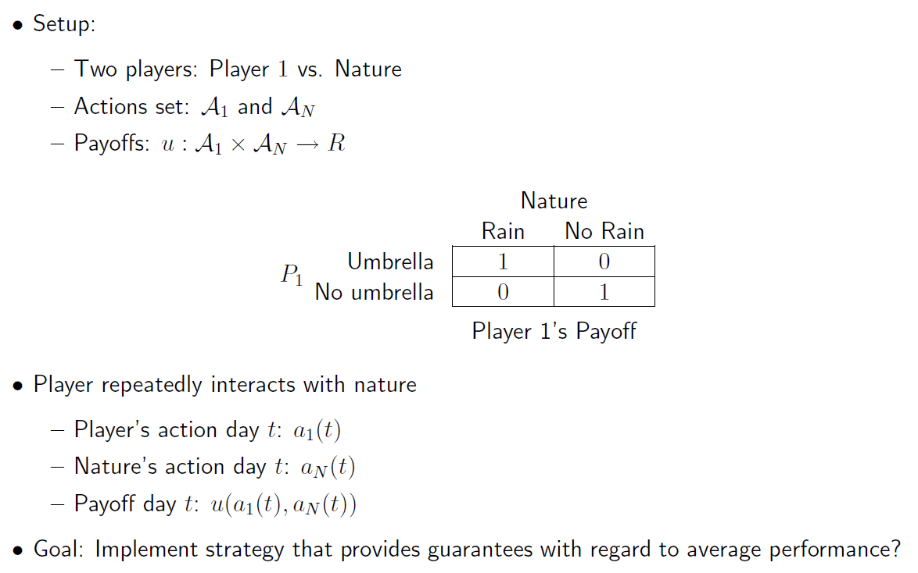
Regret-Matching (Young 2000)
Single-agent learning before multi-agent learning in game

Slide 61
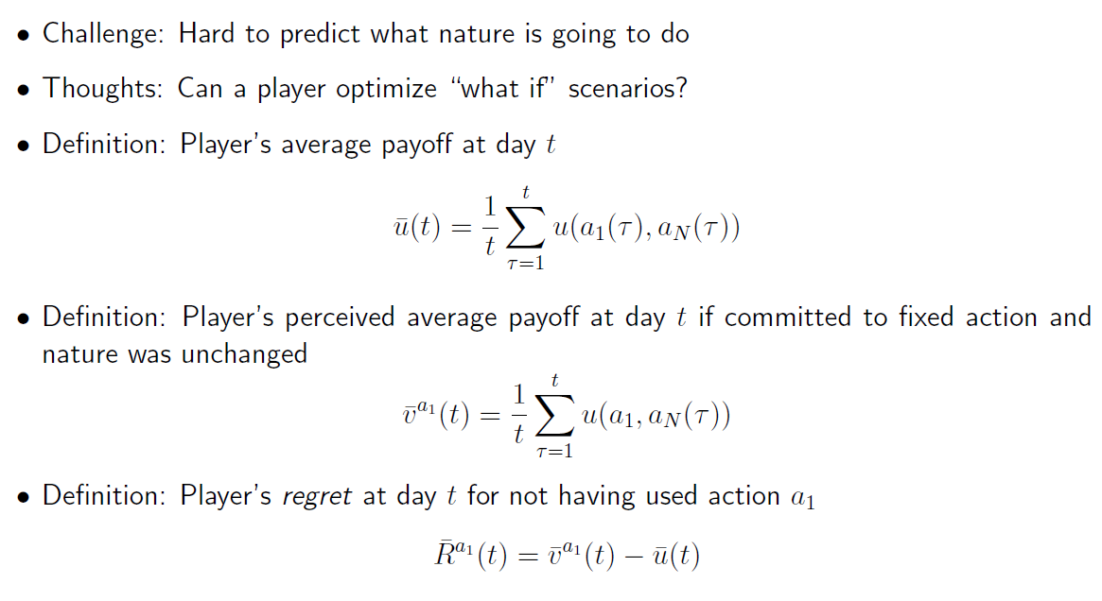
Regret
If this value is large, then I have to think “oh I have to choose a₁ more from now on”

Slide 62
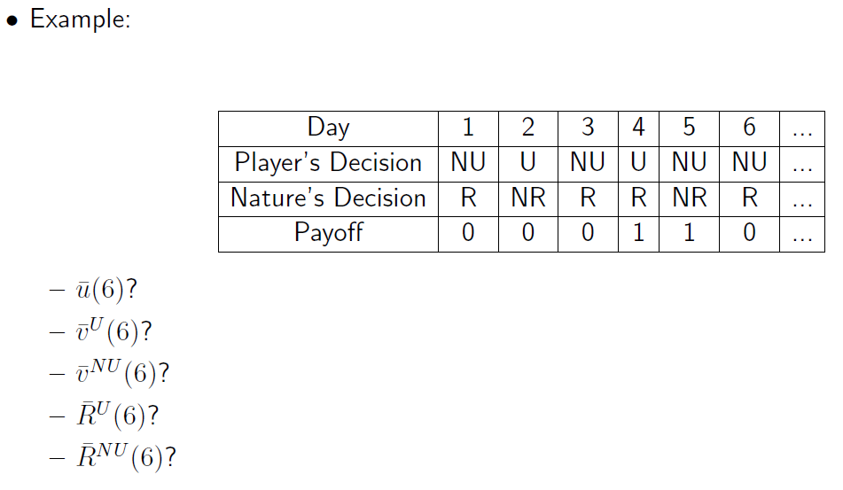

Slide 63
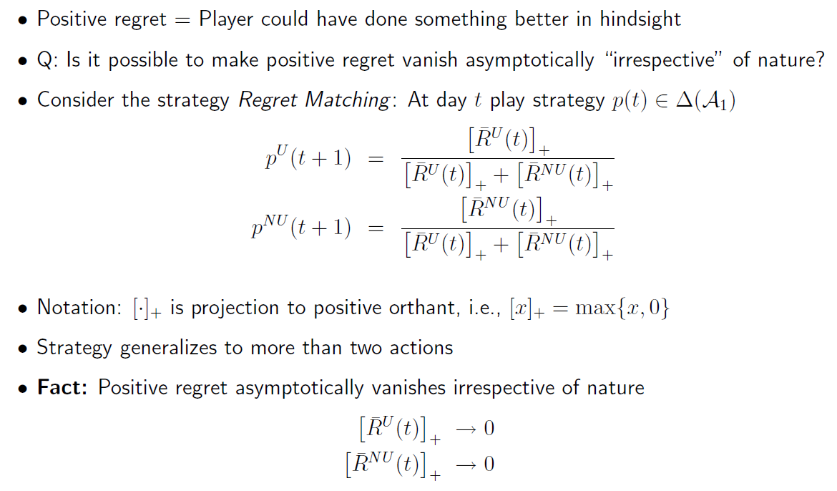
Regret-Matching Learning
A randomized strategy with more probability to the strategy with larger regret

Slide 64
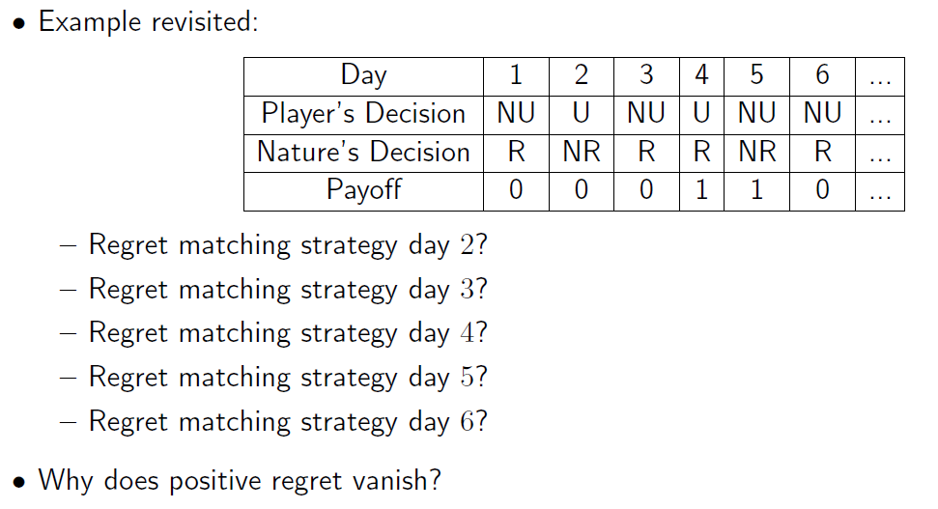

Slide 65

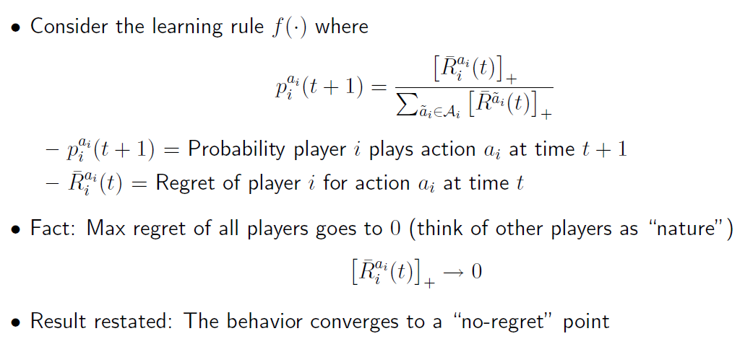
More formally
Learning rule

Slide 66
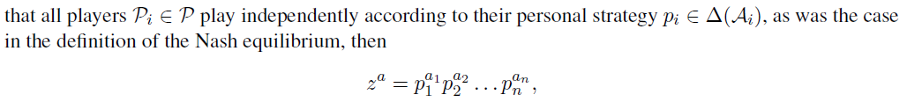
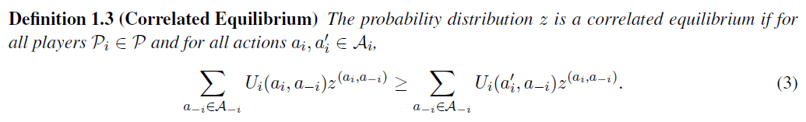
Correlated Equilibrium (Remind)
How to interpret?
Joint action a is randomly chosen by Nature according to z
Each player is informed of his action a_{i}
Each player has a chance to change his action a_{i}
Each player i’s conditional expected payoff for action a_{i} is at least as good as for other action a_{i}’

Slide 67
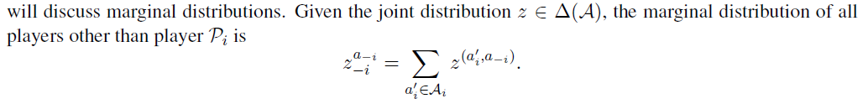
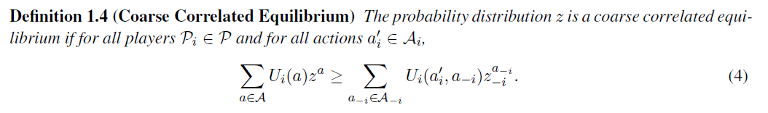
Coarse Correlated Equilibrium
How to interpret?
Before the joint action a is drawn, each player i is given the chance to opt out, in which case she chooses any action beforehand
If he does not opt out, then follow Nature’s suggestion
No player choose to opt out given that all other players opt to stay in

Slide 68
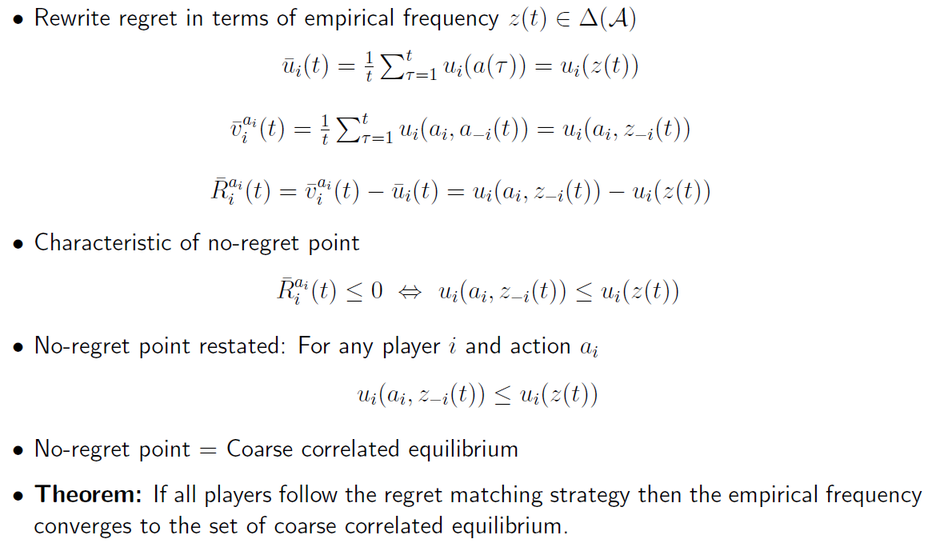
No-regret point? NE or what?

Slide 69
Contents
Trial and error learning
Regret matching based learning
Reinforcement learning
Boltzmann-Gibbs learning

Slide 70
Introduction for Reinforcement Learning
Basic idea: Reinforcement (재강화?)
The higher the payoff from taking an action in the past, the more likely it will be taken in the future.
Originally, developed for a single-agent situation (self-learning)
A classical machine learning topic
Supervised Learning
Unsupervised Learning
Reinforcement Learning
Player only knows his past choices and perceived utilities.
Using this information, each player tries to learn a strategy that maximizes expected future reward.
Notes:
The reinforcement learning is one of the most important field in learning theory.
It can be applied to diverse other theories and thus there have been many related works.
Before I introduce what reinforcement learning, I tell you some background about it.
The main challenge is know whether…

Slide 71
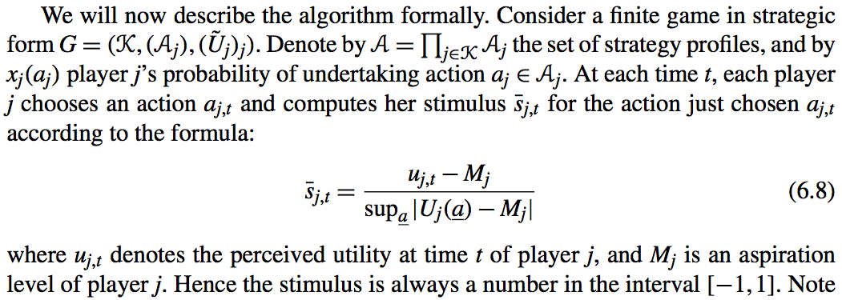
Bush & Mosteller Algorithm (1955) (1)
Stimulus
Stimulus: How am I satisfied about a particular action (measured by my aspiration level)?
Positive→ above aspiration, Negative→ below aspiration

Slide 72
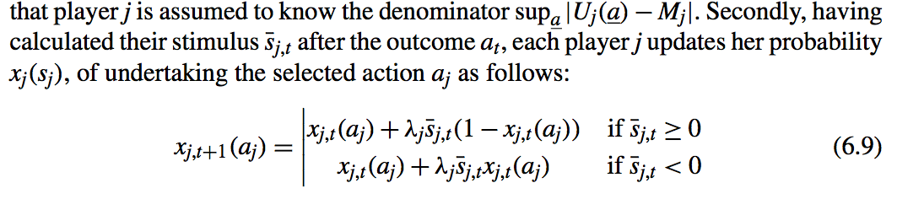
Bush & Mosteller Algorithm (2)
Learning rate
Larger stimulus → larger probability

Slide 73
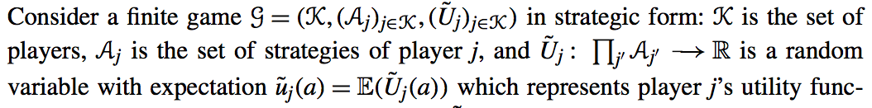
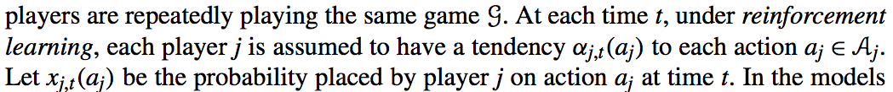
Arthur’s Algorithm (1993) (1)

Slide 74
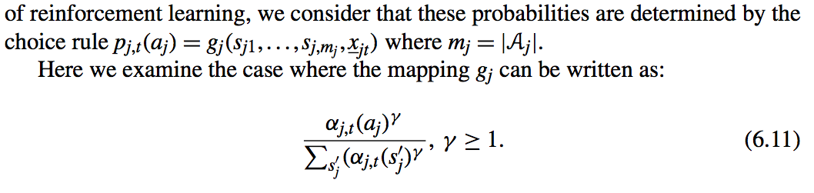
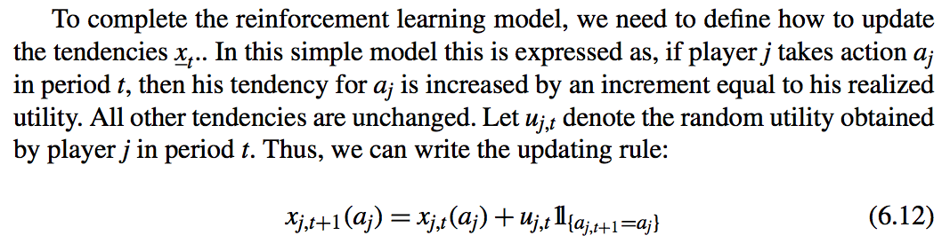
Arthur’s Algorithm (1993) (2)

Slide 75
Contents
Trial and error learning
Regret matching based learning
Reinforcement learning
Boltzmann-Gibbs learning

Slide 76
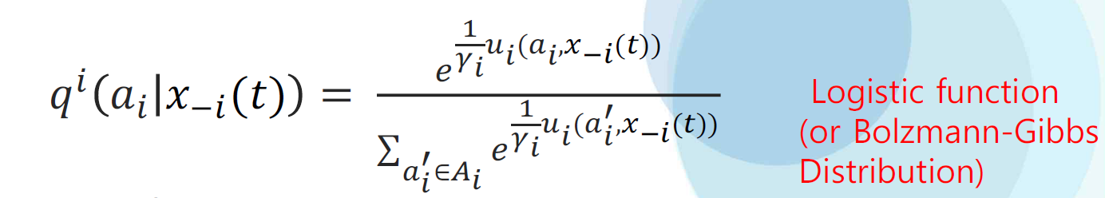
Boltzmann-Gibbs Learning (Partially Distributed)
Recall:
Compare the above with:

Slide 77
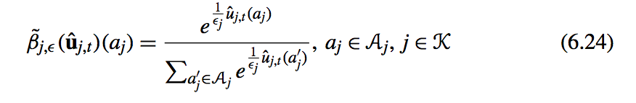
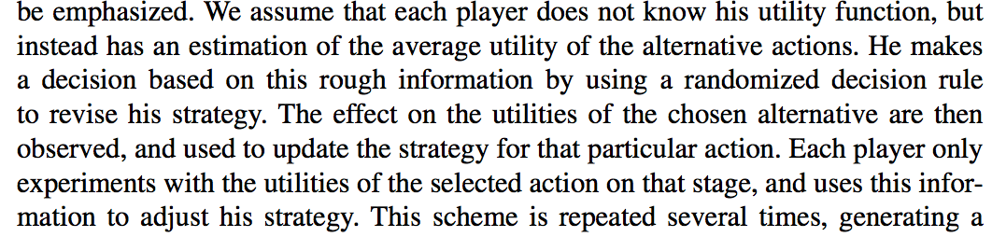
Boltzmann-Gibbs Learning (Fully Distributed)

