Slide 1
SOLID DESIGN PRINCIPLES
SEMINAR
2023

Slide 2
TABLE OF CONTENTS
01
02
03
OVERVIEW
S.O.L.I.D
CONCLUSION

Slide 3
01
OVERVIEW
SEMINAR
2023

Slide 4

Robert Cecil Martin
Robert C. Martin, commonly known as “Uncle Bob”, is an American software engineer, instructor, and best-selling author. He is most recognized for developing many software design principles and for being a founder of the influential Agile Manifesto.
Five of Martin's principles have become known collectively as the SOLID principles. Though he invented most of the principles he promotes, the Liskov substitution principle was invented by Barbara Liskov while the open-closed principle was invented by Bertrand Meyer.

Slide 5
—ROBERT C. MARTIN
“If our designs are failing due to the constant rain of changing requirements, it is our designs that are at fault. We must somehow find a way to make our designs resilient to such changes and protect them from rotting.”

Slide 6
02
S.O.L.I.D
SEMINAR
2023

Slide 7
SOLID Principles
S
O
L
I
D
Single Responsibility
Open/Closed
Liskov
Interface Segregation
Dependency Inversion
1
2
3
4
5

Slide 8
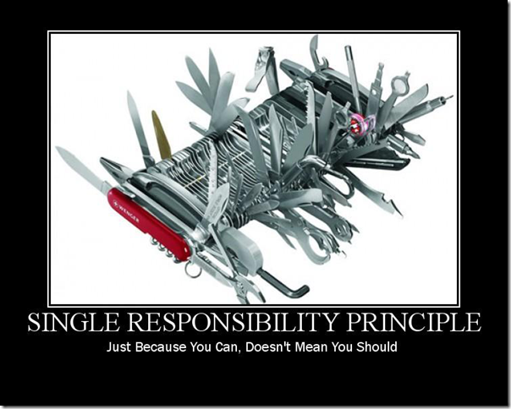
Single Responsibility Principle
The Single Responsibility Principle is all about responsibility, and which object in your system do what.
Historically, the SRP has been described as: “A module should have one, and only one, reason to change”.
Software systems are changed to satisfy users and stakeholders, those users and stakeholders are the “reason to change” that the principle is talking about.
What does the principle mean by the word “module”? The simplest definition is just a source file.

Slide 9

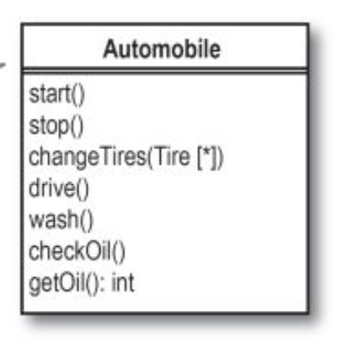
Have a look at this example

Slide 10
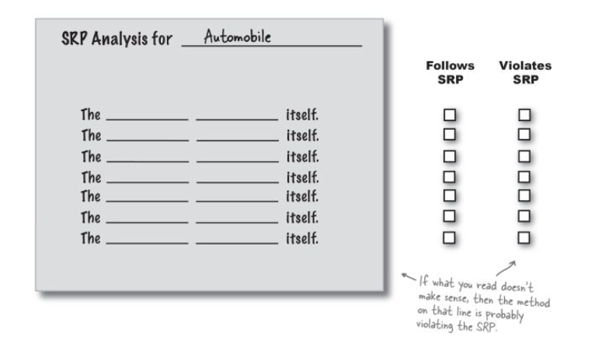
How to detect SRP violation

Slide 11
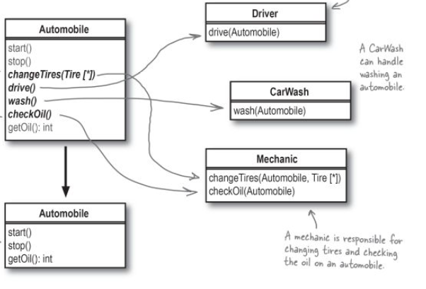
From multiple to single responsibility

Slide 12
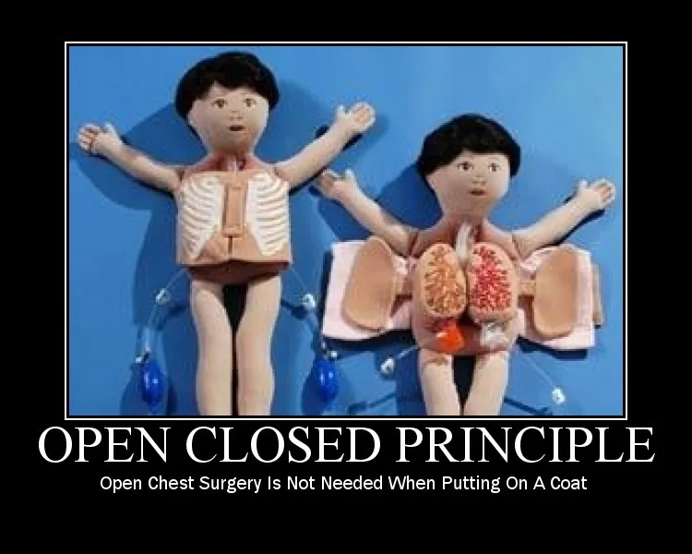
Open/Closed Principle
The Open-Closed Principle (OCP) was coined in 1988 by Bertrand Meyer. It says: “A software artifact should be open for extension but closed for modification.”
The OCP is all about allowing change, but doing it without requiring you to modify existing code.

Slide 13
Classes should be open for extension, and closed for modification
Closed for modification…
…but open for extension
Suppose you have a class with a particular behavior, and you’ve got that behavior coded up just the way you want it.
Make sure that nobody can change your class’s code, and you’ve made that particular piece of behavior closed for modification.
But then suppose someone else comes along, and they just have to change that behavior. You don’t want them messing with your perfect code, but you also want to make it possible for them to use your code, and extend it.
So you let them subclass your class, and then they can override your method to work like they want it.

Slide 14
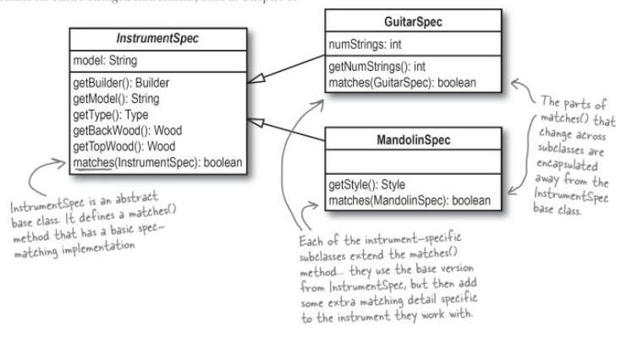
Example of the OCP

Slide 15
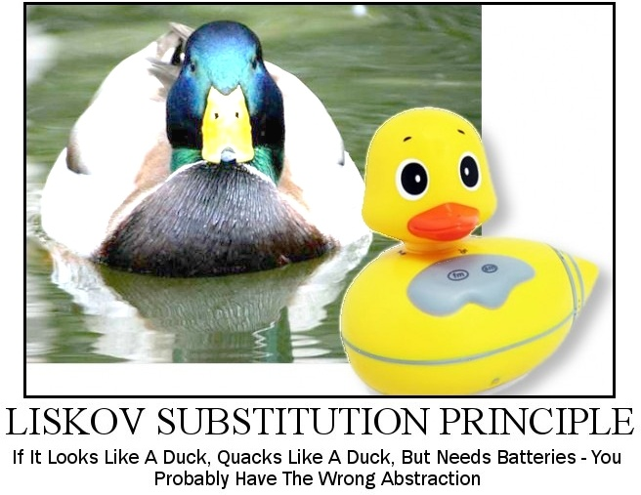
Liskov Substitution Principle
Subtypes must be substitutable for their base class
The LSP is all about well-designed inheritance. When you inherit from a base class, you must be able to substitute your subclass for that base class without things going terribly wrong. Otherwise, you’ve used inheritance incorrectly.

Slide 16
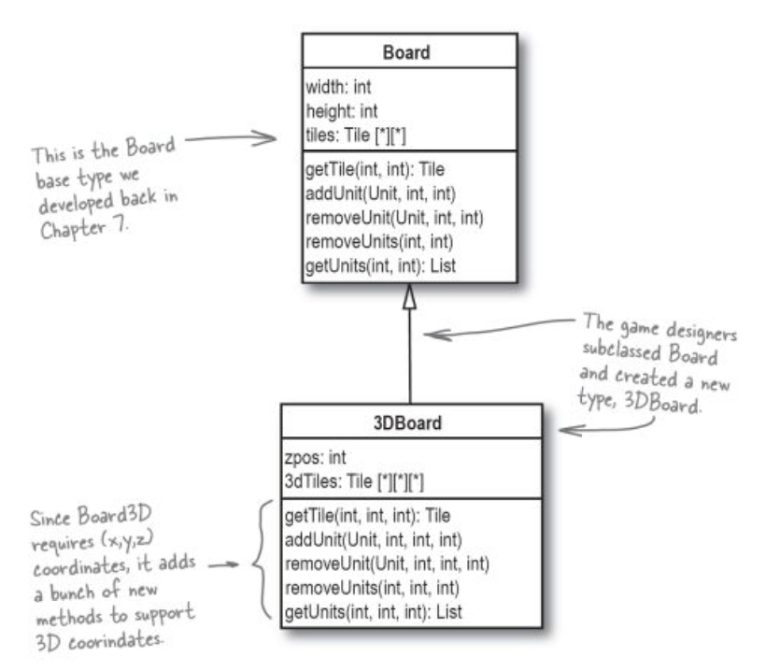
Case study
A game is using a 2D Board as in the Board class. Suppose someone want to use the game system framework to create their own game.
They need to take the basic Board base type, and extend it to support a 3D board to represent the sky.

Slide 17
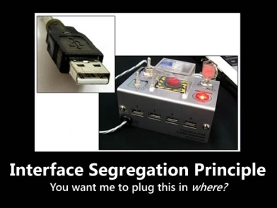
Interface Segregation
“Clients should not be forced to depend upon interfaces that they do not use.”
Similar to the Single Responsibility Principle, the goal of the Interface Segregation Principle is to reduce the side effects and frequency of required changes by splitting the software into multiple, independent parts.

Slide 18
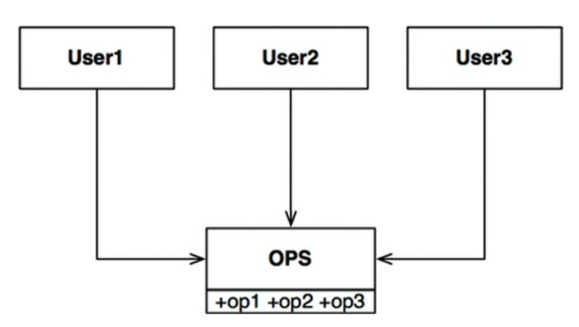
Example

Slide 19
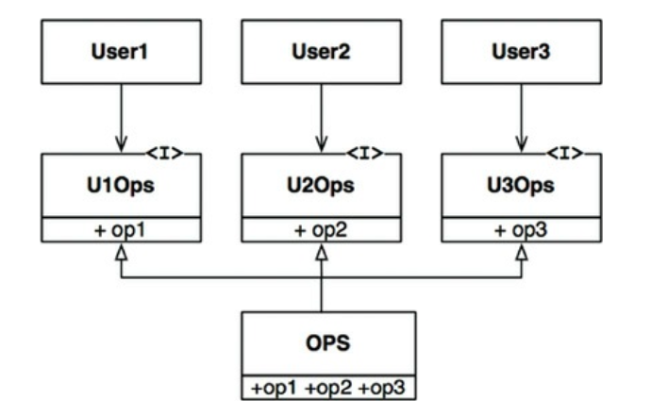
Example

Slide 20
ISP and Language
Clearly, the previously given description depends critically on language type. Statically typed languages like Java force programmers to create declarations that users must import, or use, or otherwise include. It is these included declarations in source code that create the source code dependencies that force recompilation and redeployment.
In dynamically typed languages like Ruby and Python, such declarations don’t exist in source code. Instead, they are inferred at runtime. Thus there are no source code dependencies to force recompilation and redeployment. This is the primary reason that dynamically typed languages create systems that are more flexible and less tightly coupled than statically typed languages.
This fact could lead you to conclude that the ISP is a language issue, rather than an architecture issue.

Slide 21
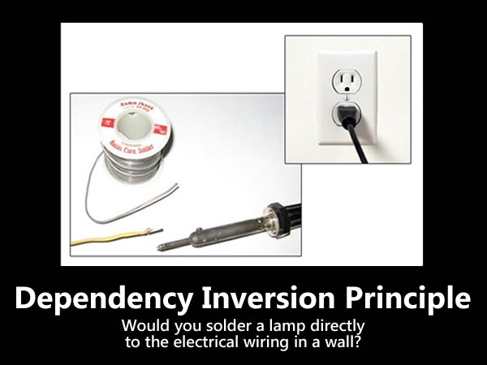
Dependency Inversion Principle
High-level modules should not depend on low-level modules. Both should depend on abstractions.
Abstractions should not depend on details. Details should depend on abstractions.

Slide 22
Dependency Inversion Principle
Don’t refer to volatile concrete classes. Refer to abstract interfaces instead. This rule applies in all languages, whether statically or dynamically typed.
Don’t derive from volatile concrete classes. This is a corollary to the previous rule, but it bears special mention.
Don’t override concrete functions. Concrete functions often require source code dependencies. When you override those functions, you do not eliminate those dependencies—indeed, you inherit them.
Never mention the name of anything concrete and volatile. This is really just a restatement of the principle itself.

Slide 23
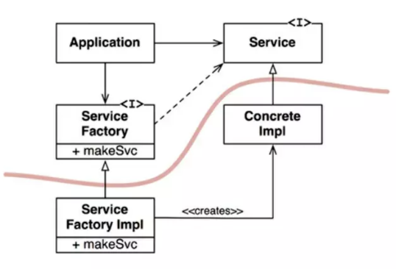
Example

Slide 24
03
CONCLUSION
SEMINAR
2023

Slide 25
RESOURCES
Head First Object-Oriented Analysis & Design – O’Reilly
Clean-Architecture: A Craftsman’s Guide to Software Structure and Design – Robert Cecil Martin
Pablo’s SOLID Software Development – LosTechies
Stackify.com

