Slide 1
Predicting Housing Prices in Ames Iowa through Machine Learning Techniques
Rajesh Arasada, Yung Chou, Nilesh Patel, Pankaj Sharma, Tim Waterman

Slide 2
Purpose
For Industry: Understand which housing aspects are valued by consumers, in order to accurately price assets, and evaluate undervalued/overvalued assets n the market.
For Consumers: Understand how much they might expect to pay for specific features/aspects of a new home.
Presentation Outline: Visualizing Data Missing Data Feature Selection Data Transformation Linear Models Tree Models KNN

Slide 3
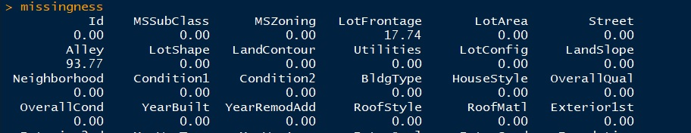
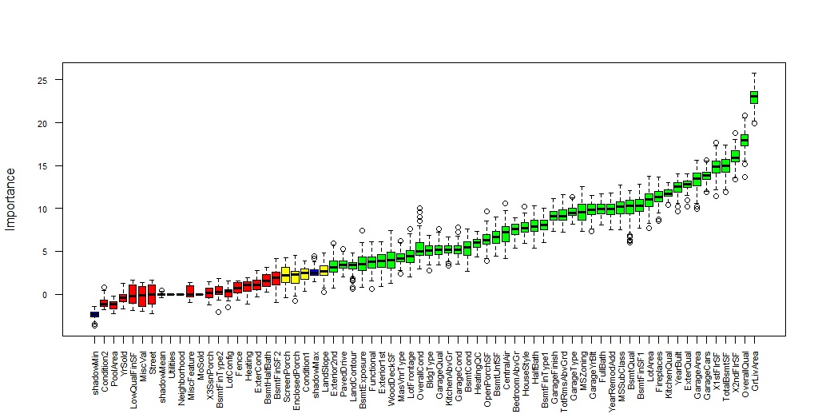
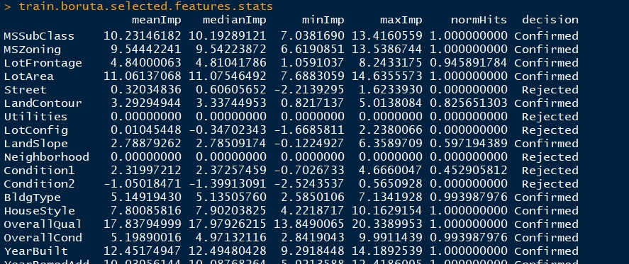
EDA: Understanding and Visualizing Data
Missing values
Boruta as starting point
Random Forest

Slide 4
Data Cleaning
we drop few unwanted columns, which don't have any impact on sale price. Then we change the data type of the ‘MSSubClass’ features from numeric to string.
Missing Values
Flagging as 'No':
BsmtFinType1, BsmtFinType2, GarageType, GarageFinish
Values are Missing, Because there is no Garage and Basement.
Impute the Mode:
Electrical,Exterior1st, GarageCars, MSZoning, KitchenQual, MasVnrType, SaleType
Impute Zero:
GarageQual, GarageCond, BsmtCond, BsmtExposure, BsmtQual, FireplaceQu
Changing categorical ranking into numerical scale values.
Dummify remaining categorical features.

Slide 5
Features Engineering
Derived Features
Feature:
TotalSF = TotalBsmtSF + GrLivArea + all other areas
TotalBaths = FullBath + BsmtFullBath + .5(HalfBath + BsmtHalfBath)
YearBuilt_Age = 2018 - YearBuilt
Dropping columns which are repeated:
TotalBsmtSF = sum of(BsmtFinSF1, BsmtFinSF2, BsmtUnfSF')
GrLivAre = sum of(1stFlrSF, 2ndFlrSF)
Taking log of ‘SalePrice’

Slide 6
EDA: Missing Data
Imputed zeros for most columns (i.e. those with less than 5% missingness)
Imputed zeros for variables
Deleted columns with high degree of missingness
Rajesh’s Heat Map

Slide 7
EDA: Feature Selection
Logical ‘committee’ assessment
Dropping variables with uneven distribution of values (i.e. utilities) as add more complexity than predictive value
List out the final selection of our features here

Slide 8
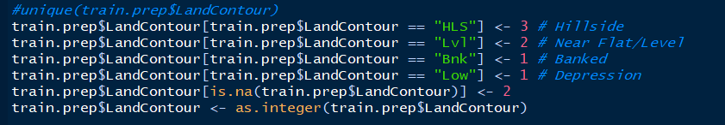
Feature Engineering: Transforming and Scaling Variables
-Dummification
-Ordinal Stratification (i.e. assigning 1-5 for quality variables)
-Transforming year to “age”
-Customized variables (i.e. “total area”)

Slide 9
Linear Models
Individual team models, best “crowdsourced” results selected
Multivariable linear models
Ridge
Lasso
Elastic
Plot different values for different attempts by different team members for different models

Slide 10
KNN
Rajesh Again!
Just basic details

Slide 11
Tree Based Models
This is Rajesh territory!
-best features as indicated by tree selection -- features to invest in

Slide 12
Conclusions and Lessons Learned
Feature selection is difficult and subjective!
Heart on common sense, mind on statistics

