Slide 1
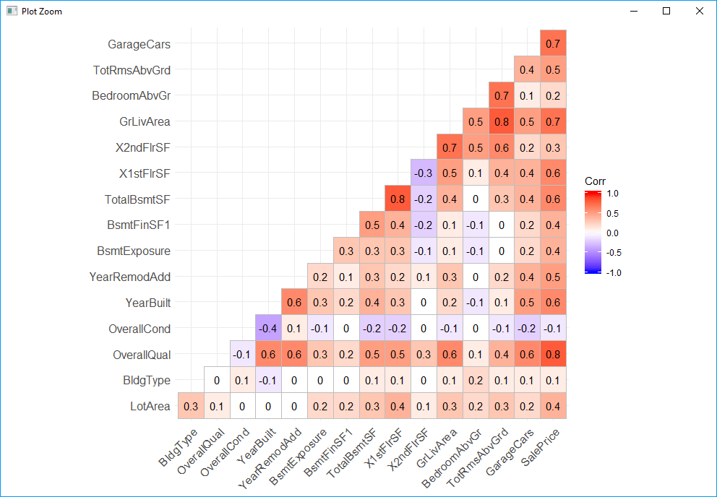

Slide 2



Elastic Net
lm
Ridge
Lasso

