Slide 1
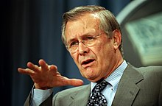
…as we know, there are known knowns; …and there are known unknowns…

Slide 2

unknown knowns
…and there are unknown unknowns; and…
which is what this project is about.

Slide 3
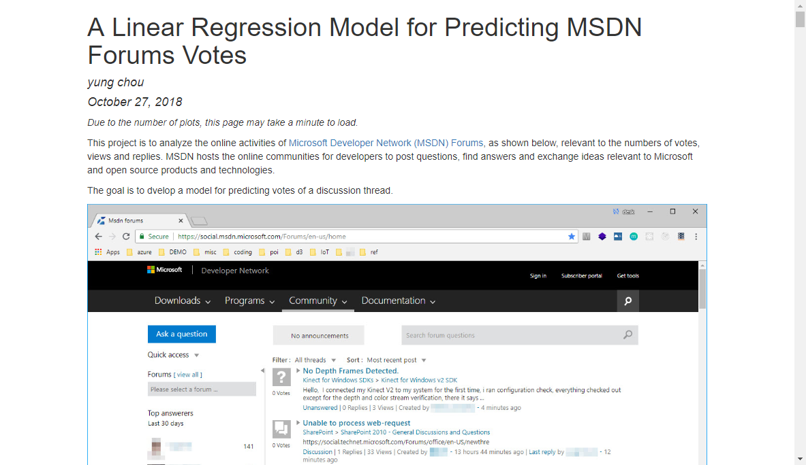
Notes:
https://1drv.ms/u/s!Ao6dvUl6xJZtdisI_DzCwAtMWPk

Slide 4
Lessons learned
To crawl, or die.
No data, no bread.
I’ll stick with csv.
So glad, I can fish now.
The more I learn, the less I know?
So many unknown unknowns unknown to an unknown person like me.
This world may as well a huge generalized linear regression model.
A newly developed multiple linear regression model from this project
Based on years’ observations in my household with high accuracy and low variance
Decisions = -yung’s saying + 2*Fluffy + 3*(kids want)^2 + exp(6) * wife’s saying^12 + err(yung)
Simple Linear Regression
As simple as driving in New York City
Need to give full respect and pay dues. What I have learned in kindergarten is true.
Enjoy the project very much, other than my brain hurts a lot lately.

Slide 5
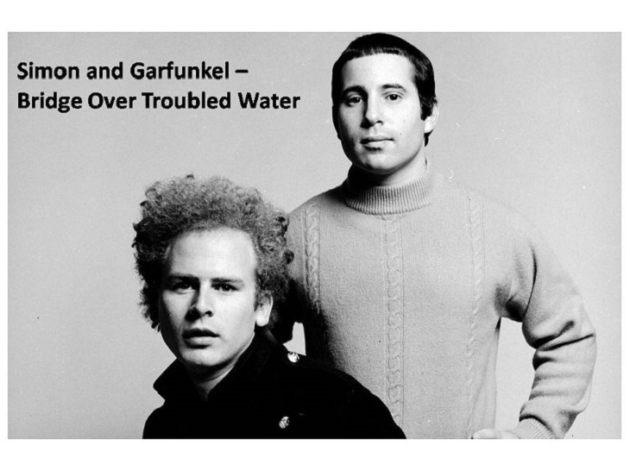
When you're weary, feeling small When tears are in your eyes…

Slide 6
Take RSS and divided by n-2 degrees of freedom,
then square-root it
And get yourself a hypothesis test and check the p-value

