Slide 1
LVM
Notes:
Configure LVM on a Linux VM in Azure
https://docs.microsoft.com/en-us/azure/virtual-machines/linux/configure-lvm#configure-lvm

Slide 2
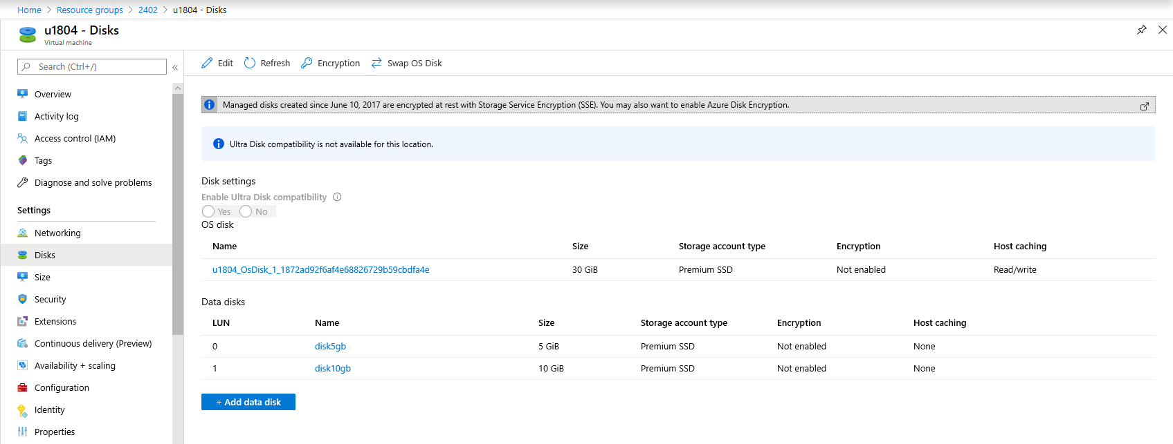

Slide 3


Slide 4
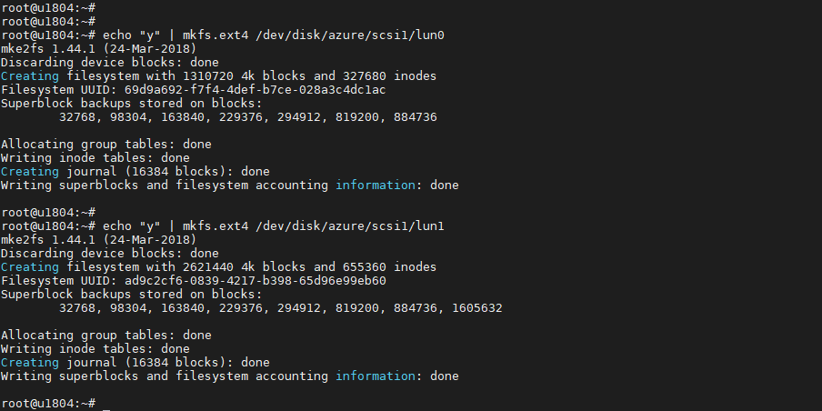

Slide 5


Slide 6


Slide 7


Slide 8
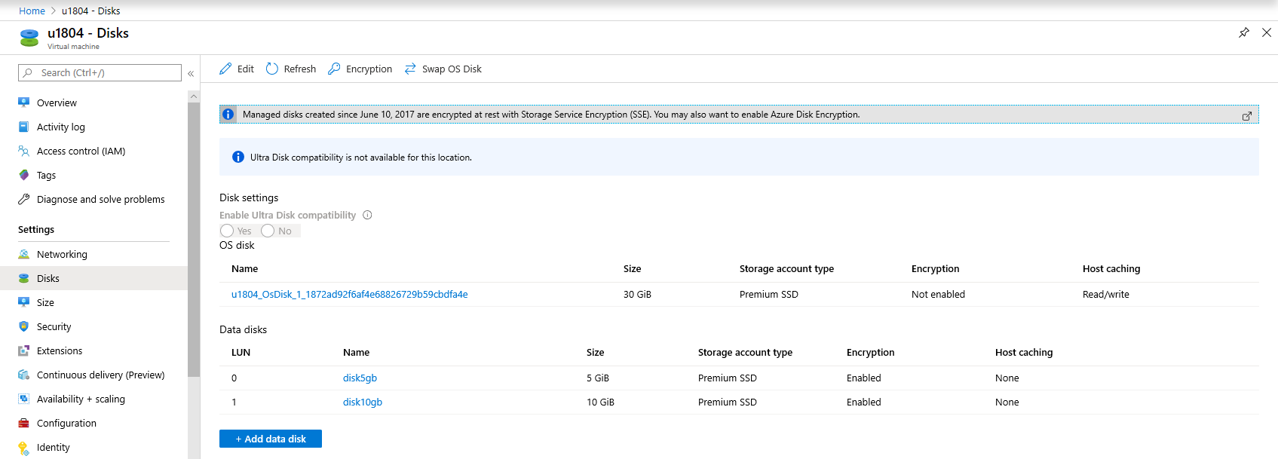

Slide 9
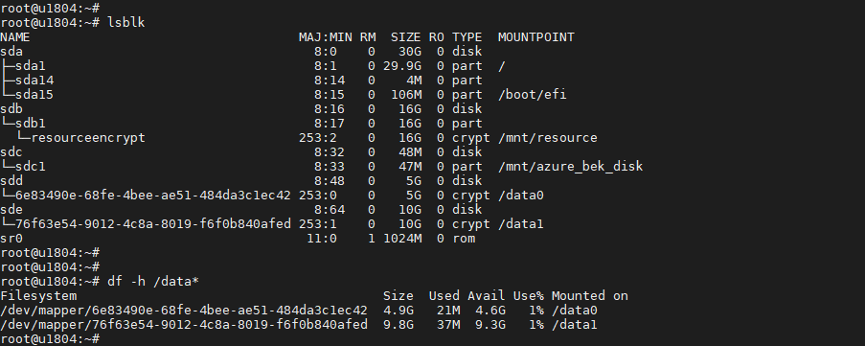

Slide 10


Slide 11
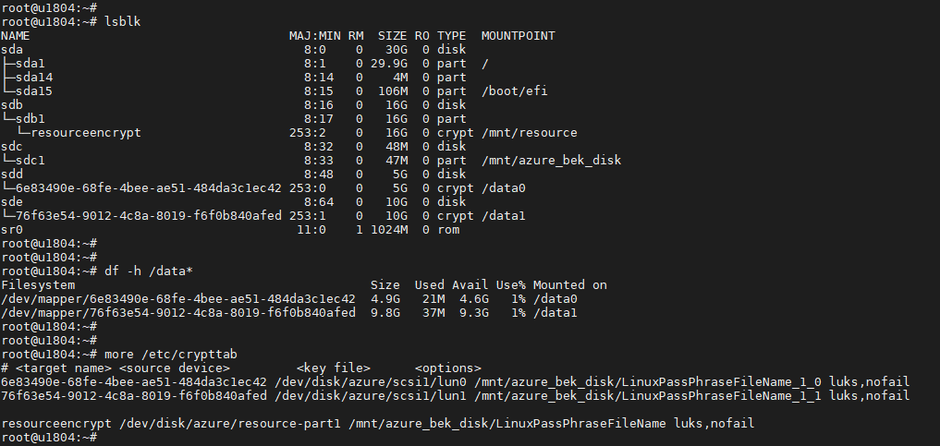


Slide 12


Slide 13
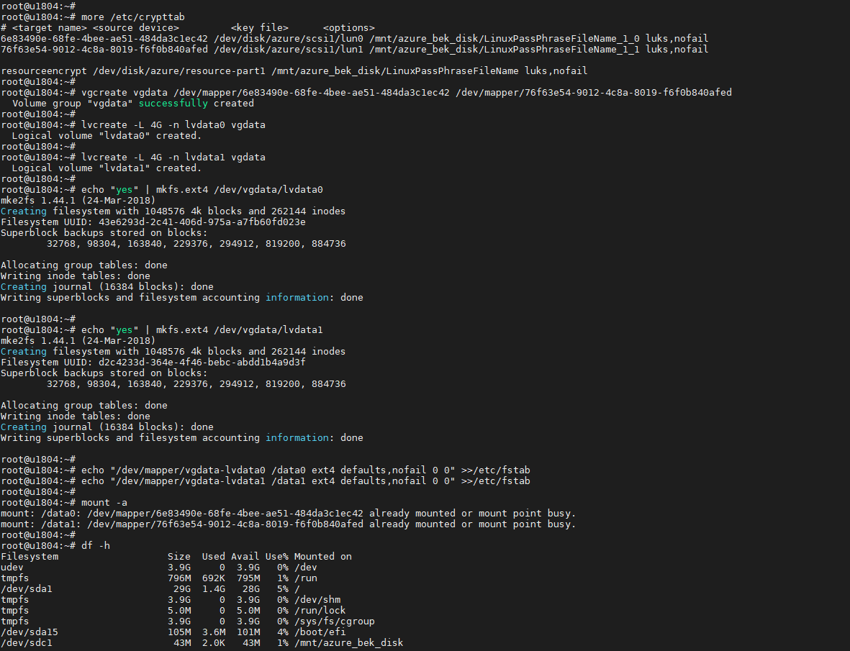

Slide 14
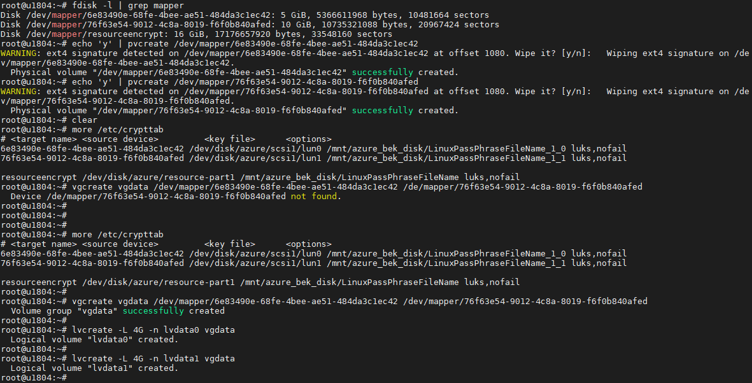

Slide 15
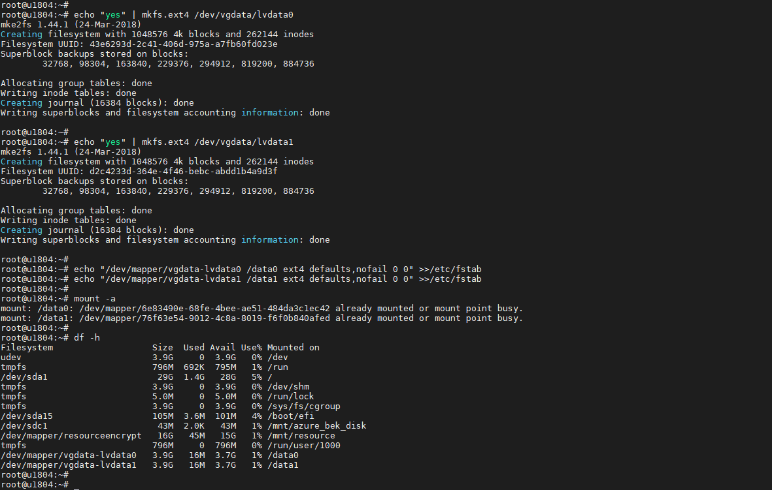

Slide 16


