Slide 1
SQL
Ray Lee

Slide 2
Schedule
Resources
Certificate (MTA98-364)
DBMS
Why?
Data Models
Quiz

Slide 3
Resources
Resources? Get better? Sign up and JUST DO IT.
Google
HackerRank / Leetcode
W3Schools
Udemy (limited time Black Friday Deal now! 10-15USD per course)

Slide 4
Certificate (MTA98-364)
Exam 98-364: Database Fundamentals
Exam skill outline
$127 USD*
Languages: English, Chinese (Simplified), Chinese (Traditional), French, German, Italian, Japanese, Korean, Portuguese (Brazil), Russian, Spanish, Spanish (Mexico)
Retirement date: 06/30/2022**
Skills measured
Understanding core database concepts (20–25%)
Create database objects (20–25%)
Manipulate data (25–30%)
Understand data storage (15–20%)
Administer a database (10–15%)

Slide 5
DBMS
Database
(n.) a structured set of data held in a computer, especially one that is accessible in various ways.
Analogy:
record > paper > section > chapter > book > shelf > library
record > file > folder > disk > computer > database > server
What's DBMS?
Database Management System

Slide 6
DBMS
Why ?
Convenient: predefined query
Integrity: Easy to maintain
Redundancy: Memory used to be expensive!
Information/ Cyber Security
Popular: 1974 first appearance of SQL
Applications: Facebook (MySQL), Bank transactions, e-Commerce

Slide 7
DBMS
Data Models
Relational Data Model
Entity-Relationship Model

Slide 8
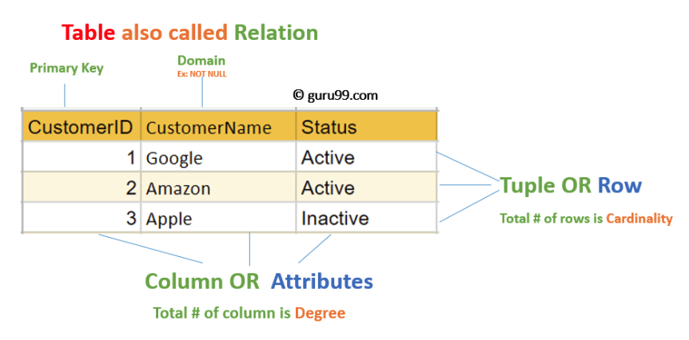
DBMS Relational Data Model
Schema
(n.) a representation of a plan or theory in the form of an outline or model

Slide 9
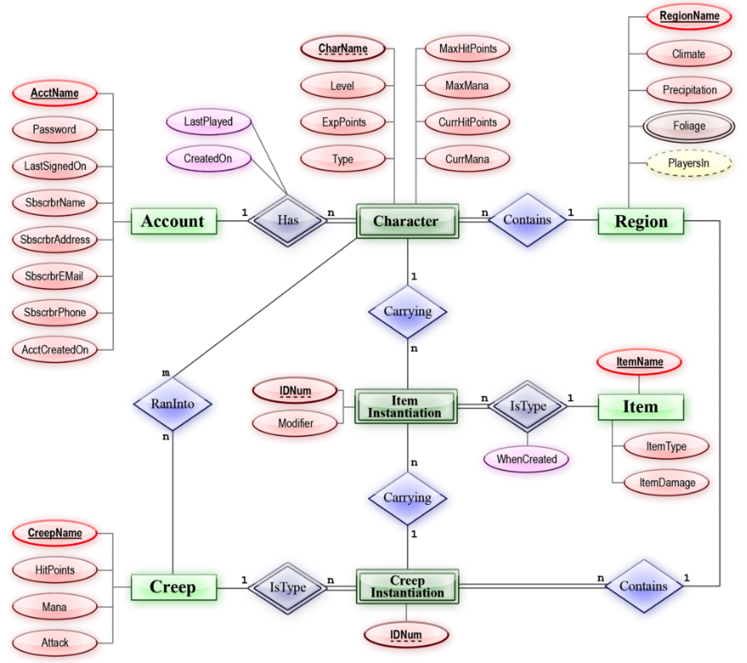
DBMS Entity-Relationship model

Slide 10
DBMS
Primary Key
(n.)The PRIMARY KEY constraint uniquely identifies each record in a table. Primary keys must contain UNIQUE values, and cannot contain NULL values.
Foreign Key
A foreign key is a column or group of columns in a relational database table that provides a link between data in two tables. It acts as a cross-reference between tables because it references the primary key of another table, thereby establishing a link between them.

Slide 11
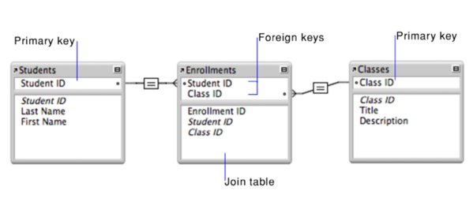
DBMS Primary Key & Foreign Key

Slide 12
Quiz
Can a table not have primary key?

Slide 13
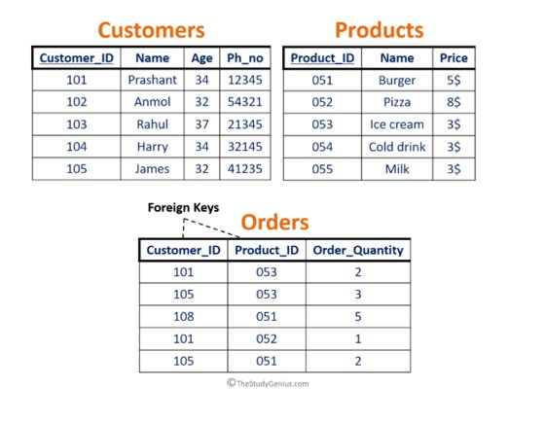
Quiz

