Slide 1
BCH Code
• a larger class of powerful random error-correcting cyclic codes
• a remarkable generalization of the Hamming codes for multiple-error
correction
Def : Let q and m be given and let α be any element of GF(q^{m}) of order n.
Then for any positive integer t and any integer j₀, the corresponding
BCH code is the cyclic code of block length n with the generator
polynomial
g(x) = LCM[f_{j0}(x), f_{j0+1}(x), … , f_{j0+2t-1}(x)]
where f_{j}(x) is the minimal polynomial at α^{j}
※ Let 1. n = q^{m} – 1 | n | q^{m} - 1
2. j₀ = 1 | α: non-primitive element (α^{n} = 1)
⇓ |
α: primitive element (α^{n} = 1) |
α, α², α³, … , α^{2t} |
primitive (or narrow-sense) BCH code|
2004/5/5
Yuh-Ming Huang, CSIE, NCNU

Slide 2
※ Let q = 2, j₀ = 1 ﹡取相鄰 power of
Block length : n = 2^{m} – 1 or n | 2^{m} – 1 α保證 d* ≥ 2t + 1
Number of parity-check digits : n – k ≤ mt ↑
Minimum distance : d* ≥ 2t + 1 (BCH bound)
⇓ ↑
t-error-correcting BCH code designed distance
g(x) = LCM [f₁(x), f₂(x), … , f_{2t}(x)]
2 = 1•2
4 = 1•2²
6 = 3•2
8 = 1•2³
10 = 5•2¹
∵ i (even) = I’•2^{l} where i’ is an odd number and l ≥ 1
∴ α^{i} = (α^{i’})^{2l} is a conjugate of α^{i’}
∴ α^{i} & α^{i’} have the same minimal polynomial i.e. f_{i}(x) = f_{i’}(x)
∴ g(x) = LCM [ f₁(x), f₃(x), … , f_{2t-1}(x) ]
∵ deg[ f_{i}(x) ] ≤ m ➔ n – k ≤ mt
Eg: t = 2 g(x) = LCM [f₁(x), f₂(x), f₃(x), f₄(x)]
q = 2 = LCM [x⁴+x+1, x⁴+x+1, x⁴+x³+x²+x+1, x⁴+x+1]
m = 4 = (x⁴+x+1)(x⁴+x³+x²+x+1)
n = q^{m} – 1 = 15 = x⁸+x⁷+x⁶+x⁴+1
n – k = 8 ⇒ BCH(15, 7, 5)
2t + 1 ≤ d* ≤ w(g(x))
(n, t) → k ! k is unknown until after g(x) is found
2004/5/5
Yuh-Ming Huang, CSIE, NCNU

Slide 3
Eg:
t = 2 g(x) = LCM [f₁(x), f₂(x), f₃(x), f₄(x)]
q = 4 = (x²+x+2)(x²+x+3)(x²+3x+1)
m = 2 = x⁶+3x⁵+x⁴+2x²+2x+1
n = q^{m} – 1 = 15 BCH(15, 9)
t = 6 g(x) = x¹⁴+x¹³+…+x²+x+1 Q:
BCH(15, 1) – it can actually correct 7 errors
↑simple repetition code
※ The single-error-correcting BCH code of length 2^{m} – 1 is a Hamming Code
2004/5/5
Yuh-Ming Huang, CSIE, NCNU

Slide 4
Table 7.1 Representations of GF(2⁴). p(z) = z⁴ + z + 1
Exponential Notation | Polynomial Notation | Binary Notation | Decimal Notation | Minimal Polynomial
0 | 0 | 0000 | 0 | x
α⁰ | 1 | 0001 | 1 | x + 1
α¹ | z | 0010 | 2 | x⁴ + x + 1
α² | z² | 0100 | 4 | x⁴ + x + 1
α³ | z³ | 1000 | 8 | x⁴ + x³ + x² + x + 1
α⁴ | z + 1 | 0011 | 3 | x⁴ + x + 1
α⁵ | z² + z | 0110 | 6 | x² + x + 1
α⁶ | z³ + z² | 1100 | 12 | x⁴ + x³ + x² + x + 1
α⁷ | z³ + z + 1 | 1011 | 11 | x⁴ + x³ + 1
α⁸ | z² + 1 | 0101 | 5 | x⁴ + x + 1
α⁹ | z³ + z | 1010 | 10 | x⁴ + x³ + x² + x + 1
α¹⁰ | z² + z + 1 | 0111 | 7 | x² + x + 1
α¹¹ | z³ + z² + z + 1 | 1110 | 14 | x⁴ + x³ + 1
α¹² | z³ + z² + z + 1 | 1111 | 15 | x⁴ + x³ + x² + x + 1
α¹³ | z³ + z² + 1 | 1101 | 13 | x⁴ + x³ + 1
Α¹⁴ | z³ + 1 | 1001 | 9 | x⁴ + x³ + 1
2004/5/5
Yuh-Ming Huang, CSIE, NCNU

Slide 5
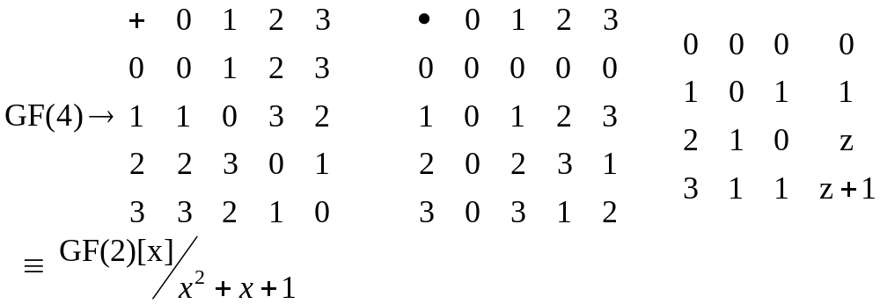
Table 7.2 GF(4²) ≡ GF(4)[x]/z²+z+2 p(z) = z²+z+2
α α² α⁴ α⁸ α¹⁶ ≡ α
α³ α⁶ α¹² α²⁴ α⁴⁸ ≡ α³
≡ α⁹
Exponential Notation | Polynomial Notation | Binary Notation | Decimal Notation | Minimal Polynomial
0 | 0 | 00 | 0
α⁰ | 1 | 01 | 1 | x + 1
α¹ | z | 10 | 4 | x² + x + 2
α² | z + 2 | 12 | 6 | x² + x + 3
α³ | 3z + 2 | 32 | 14 | x² + 3x + 1
α⁴ | z + 1 | 11 | 5 | x² + x + 2
α⁵ | 2 | 02 | 2 | x + 2
α⁶ | 2z | 20 | 8 | x² +2x + 1
α⁷ | 2z + 3 | 23 | 11 | x² + 2x + 2
α⁸ | z + 3 | 13 | 7 | x² + x + 3
α⁹ | 2z + 2 | 22 | 10 | x² + 2x + 1
α¹⁰ | 3 | 03 | 3 | x + 3
α¹¹ | 3z | 30 | 12 | x² + 3x + 3
α¹² | 3z + 1 | 31 | 13 | x² + 3x + 1
α¹³ | 2z + 1 | 21 | 9 | x² + 2x + 2
α¹⁴ | 3z + 3 | 33 | 15 | x² + 3x + 3
α = z
α¹⁵ = 1
2004/5/5
Yuh-Ming Huang, CSIE, NCNU

Slide 6
TABLE 6.1 BCH CODES GENERATED BY PRIMITIVE ELEMENTS OF ORDER LESS THAN 2¹⁰ (上)
m | n | k | t | m | n | k | t | m | n | k | t | n | k | t | n | k | t
3 | 7 | 4 | 1 |  | 63 | 24 | 7 |  | 127 | 50 | 13 | 255 | 187 | 9 | 255 | 71 | 29
4 | 15 | 11 | 1 |  |  | 18 | 10 |  |  | 43 | 14 |  | 179 | 10 |  | 63 | 30
 |  | 7 | 2 |  |  | 16 | 11 |  |  | 36 | 15 |  | 171 | 11 |  | 55 | 31
 |  | 5 | 3 |  |  | 10 | 13 |  |  | 29 | 21 |  | 163 | 12 |  | 47 | 42
5 | 31 | 26 | 1 |  |  | 7 | 15 |  |  | 22 | 23 |  | 155 | 13 |  | 45 | 43
 |  | 21 | 2 | 7 | 127 | 120 | 1 |  |  | 15 | 27 |  | 147 | 14 |  | 37 | 45
 |  | 16 | 3 |  |  | 113 | 2 |  |  | 8 | 31 |  | 139 | 15 |  | 29 | 47
 |  | 11 | 5 |  |  | 106 | 3 | 8 | 255 | 247 | 1 |  | 131 | 18 |  | 21 | 55
 |  | 6 | 7 |  |  | 99 | 4 |  |  | 239 | 2 |  | 123 | 19 |  | 13 | 59
6 | 63 | 57 | 1 |  |  | 92 | 5 |  |  | 231 | 3 |  | 115 | 21 |  | 9 | 63
 |  | 51 | 2 |  |  | 85 | 6 |  |  | 223 | 4 |  | 107 | 22 | 511 | 502 | 1
 |  | 45 | 3 |  |  | 78 | 7 |  |  | 215 | 5 |  | 99 | 23 |  | 493 | 2
 |  | 39 | 4 |  |  | 71 | 9 |  |  | 207 | 6 |  | 91 | 25 |  | 484 | 3
 |  | 36 | 5 |  |  | 64 | 10 |  |  | 199 | 7 |  | 87 | 26 |  | 475 | 4
 |  | 30 | 6 |  |  | 57 | 11 |  |  | 191 | 8 |  | 79 | 27 |  | 466 | 5
n = 2^{m} - 1
For t small
n – k = mt
2004/5/5
Yuh-Ming Huang, CSIE, NCNU

Slide 7
TABLE 6.1 BCH CODES GENERATED BY PRIMITIVE ELEMENTS OF ORDER LESS THAN 2¹⁰ (下)
n | k | t | n | k | t | n | k | t | n | k | t | n | k | t
511 | 457 | 6 | 511 | 322 | 22 | 511 | 193 | 43 | 511 | 58 | 91 | 1023 | 933 | 9
 | 448 | 7 |  | 313 | 23 |  | 184 | 45 |  | 49 | 93 |  | 923 | 10
 | 439 | 8 |  | 304 | 25 |  | 175 | 46 |  | 40 | 95 |  | 913 | 11
 | 430 | 9 |  | 295 | 26 |  | 166 | 47 |  | 31 | 109 |  | 903 | 12
 | 421 | 10 |  | 286 | 27 |  | 157 | 51 |  | 28 | 111 |  | 893 | 13
 | 412 | 11 |  | 277 | 28 |  | 148 | 53 |  | 19 | 119 |  | 883 | 14
 | 403 | 12 |  | 268 | 29 |  | 139 | 54 |  | 10 | 121 |  | 873 | 15
 | 394 | 13 |  | 259 | 30 |  | 130 | 55 |  | 1013 | 1 |  | 863 | 16
 | 385 | 14 |  | 250 | 31 |  | 121 | 58 | 1023 | 1003 | 2 |  | 858 | 17
 | 376 | 15 |  | 241 | 36 |  | 112 | 59 |  | 993 | 3
 | 367 | 16 |  | 238 | 37 |  | 103 | 61 |  | 983 | 4
 | 358 | 18 |  | 229 | 38 |  | 94 | 62 |  | 973 | 5
 | 349 | 19 |  | 220 | 39 |  | 85 | 63 |  | 963 | 6
 | 340 | 20 |  | 211 | 41 |  | 76 | 85 |  | 953 | 7
 | 331 | 21 |  | 202 | 42 |  | 67 | 87 |  | 943 | 8
2004/5/5
Yuh-Ming Huang, CSIE, NCNU

Slide 8
TABLE 6.2 GALOIS FIELD GF(2⁶) WITH ρ(α) = 1 + α +α⁶ = 0
0 | 0 | (0 0 0 0 0 0) | α¹⁵ | α³ +α⁵ | (0 0 0 1 0 1)
1 | 1 | (1 0 0 0 0 0) | α¹⁶ | 1+ α +α⁴ | (1 1 0 0 1 0)
α | α |  | α¹⁷ | α+α² +α⁵ | (0 1 1 0 0 1)
α² | α² | (0 1 0 0 0 0) | α¹⁸ | 1+α+α²+α³ | (1 1 1 1 0 0)
α³ | α³ | (0 0 1 0 0 0) | α¹⁹ | α+α²+α³+α⁴ | (0 1 1 1 1 0)
α⁴ | α⁴ | (0 0 0 1 0 0) | α²⁰ | α²+α³+α⁴+α⁵ | (0 0 1 1 1 1)
α⁵ | α⁵ | (0 0 0 0 0 1) | α²¹ | 1+α +α³+α⁴+α⁵ | (1 1 0 1 1 1)
α⁶ | 1+α | (1 1 0 0 0 0) | α²² | 1 +α² +α⁴+α⁵ | (1 0 1 0 1 1)
α⁷ | α+α² | (0 1 1 0 0 0) | α²³ | 1 +α³ +α⁵ | (1 0 0 1 0 1)
α⁸ | α²+α³ | (0 0 1 1 0 0) | α²⁴ | 1 +α⁴ | (1 0 0 0 1 0)
α⁹ | α³+α⁴ | (0 0 0 1 1 0) | α²⁵ | α +α⁵ | (0 1 0 0 0 1)
α¹⁰ | α⁴+α⁵ | (0 0 0 0 1 1) | α²⁶ | 1+α+α² | (1 1 1 0 0 0)
α¹¹ | 1+α | (1 1 0 0 0 1) | α²⁷ | α+α²+α³ | (0 1 1 1 0 0)
α¹² | 1 +α² | (1 0 1 0 0 0) | α²⁸ | α²+α³+α⁴ | (0 0 1 1 1 0)
α¹³ | α +α³ | (0 1 0 1 0 0) | α²⁹ | α³+α⁴ +α⁵ | (0 0 0 1 1 1)
α¹⁴ | α² +α⁴ | (0 0 1 0 1 0) | α³⁰ | 1+α +α⁴+α⁵ | (1 1 0 0 1 1)
2004/5/5
Yuh-Ming Huang, CSIE, NCNU

Slide 9
TABLE 6.4 GENERATOR POLYNOMIALS OF ALL THE BCH CODES OF LENGTH 63
n | k | t | g(X)
63 | 57 | 1 | g₁(X) = 1 + X + X⁶
 | 51 | 2 | g₂(X) = (1 + X + X⁶)(1 + X + X² + X⁴ + X⁶)
 | 45 | 3 | g₃(X) = (1 + X + X² + X⁵ + X⁶)g₂(X)
 | 39 | 4 | g₄(X) = (1 + X³ + X⁶)g₃(X)
 | 36 | 5 | g₅(X) = (1 + X² + X³)g₄(X)
 | 30 | 6 | g₆(X) = (1 + X² + X³ + X⁵ + X⁶)g₅(X)
 | 24 | 7 | g₇(X) = (1 + X + X³ + X⁴ + X⁶)g₆(X)
 | 18 | 10 | g₁₀(X) = (1 + X² + X⁴ + X⁵ + X⁶)g₇(X)
 | 16 | 11 | g₁₁(X) = (1 + X + X²)g₁₀(X)
 | 10 | 13 | g₁₃(X) = (1 + X + X⁴ + X⁵ + X⁶)g₁₁(X)
 | 7 | 15 | g₁₅(X) = (1 + X + X³)g₁₃(X)
2004/5/5
Yuh-Ming Huang, CSIE, NCNU

Slide 10
TABLE 6.2 Continued
α³¹ | 1 +α² +α⁵ | (1 0 1 0 0 1) | α⁴⁷ | 1+α+α² +α⁵ | (1 1 1 0 0 1)
α³² | 1 +α³ | (1 0 0 1 0 0) | α⁴⁸ | 1 +α²+α³ | (1 0 1 1 0 0)
α³³ | α +α⁴ | (0 1 0 0 1 0) | α⁴⁹ | α +α³+α⁴ | (0 1 0 1 1 0)
α³⁴ | α² +α⁵ | (0 0 1 0 0 1) | α⁵⁰ | α² +α⁴+α⁵ | (0 0 1 0 1 1)
α³⁵ | 1+ α +α³ | (1 1 0 1 0 0) | α⁵¹ | 1+α +α³ +α⁵ | (1 1 0 1 0 1)
α³⁶ | α+α² +α⁴ | (0 1 1 0 1 0) | α⁵² | 1 +α² +α⁴ | (1 0 1 0 1 0)
α³⁷ | α²+α³ +α⁵ | (0 0 1 1 0 1) | α⁵³ | α +α³ +α⁵ | (0 1 0 1 0 1)
α³⁸ | 1+α +α³+α⁴ | (1 1 0 1 1 0) | α⁵⁴ | 1+α+α² +α⁴ | (1 1 1 0 1 0)
α³⁹ | α+α² +α⁴+α⁵ | (0 1 1 0 1 1) | α⁵⁵ | α+α²+α³ +α⁵ | (0 1 1 1 0 1)
α⁴⁰ | 1+α+α²+α³ +α⁵ | (1 1 1 1 0 1) | α⁵⁶ | 1+α+α²+α³ +α⁴ | (1 1 1 1 1 0)
α⁴¹ | 1 +α²+α³+α⁴ | (1 0 1 1 1 0) | α⁵⁷ | α+α²+α³ +α⁴+α⁵ | (0 1 1 1 1 1)
α⁴² | α +α³+α⁴+α⁵ | (0 1 0 1 1 1) | α⁵⁸ | 1+α+α²+α³ +α⁴+α⁵ | (1 1 1 1 1 1)
α⁴³ | 1+α+α² +α⁴+α⁵ | (1 1 1 0 1 1) | α⁵⁹ | 1 +α²+α³ +α⁴+α⁵ | (1 0 1 1 1 1)
α⁴⁴ | 1 +α²+α³ +α⁵ | (1 0 1 1 0 1) | α⁶⁰ | 1 +α³ +α⁴+α⁵ | (1 0 0 1 1 1)
α⁴⁵ | 1 +α³ +α⁴ | (1 0 0 1 1 0) | α⁶¹ | 1 +α⁴ +α⁵ | (1 0 0 0 1 1)
α⁴⁶ | α +α⁴ +α⁵ | (0 1 0 0 1 1) | α⁶² | 1 +α⁵ | (1 0 0 0 0 1)
α⁶³ = 1
2004/5/5
Yuh-Ming Huang, CSIE, NCNU

Slide 11
TABLE 6.3 MINIMAL POLYNOMIALS OF THE ELEMENTS IN GF(2⁶)
Elements | Minimal polynomials
α, α², α⁴, α⁸, α¹⁶, α³² | 1 + X + X⁶
α³, α⁶, α¹², α²⁴, α⁴⁸, α³³ | 1 + X + X² + X⁴ + X⁶
α⁵, α¹⁰, α²⁰, α⁴⁰, α¹⁷, α³⁴ | 1 + X + X² + X⁵ + X⁶
α⁷, α¹⁴, α²⁸, α⁵⁶, α⁴⁹, α³⁵ | 1 + X³ + X⁶
α⁹, α¹⁸, α³⁶ | 1 + X² + X³
α¹¹, α²², α⁴⁴, α²⁵, α⁵⁰, α³⁷ | 1 + X² + X³ + X⁵ + X⁶
α¹³, α²⁶, α⁵², α⁴¹, α¹⁹, α³⁸ | 1 + X + X³ + X⁴ + X⁶
α¹⁵, α³⁰, α⁶⁰, α⁵⁷, α⁵¹, α³⁹ | 1 + X² + X⁴ + X⁵ + X⁶
α²¹, α⁴² | 1 + X + X²
α²³, α⁴⁶, α²⁹, α⁵⁸, α⁵³, α⁴³ | 1 + X + X⁴ + X⁵ + X⁶
α²⁷, α⁵⁴, α⁴⁵ | 1 + X + X⁶
α³¹, α⁶², α⁶¹, α⁵⁹, α⁵⁵, α⁴⁷ | 1 + X⁵ + X⁶
2004/5/5
Yuh-Ming Huang, CSIE, NCNU

Slide 12
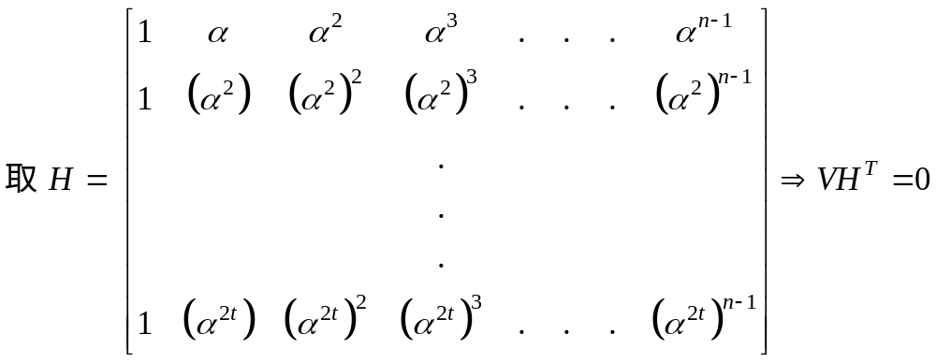
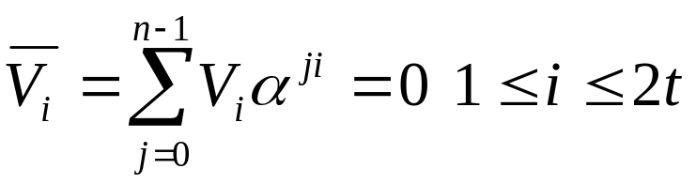
Def t-error-correcting BCH code of length n = 2^{m} – 1:
A binary n-tuple v = (v₀, v₁, … , v_{n-1}) is a code word iff the polynomial
v(x) = v₀ + v₁x + … + v_{n-1}x^{n-1} has α, α², α³, … , α^{2t} as roots.
v(α^{i}) = v₀ + v₁α^{i} + v₂α^{2i} + … + v_{n-1}α^{(n-1)i} = 0 1 ≤ i ≤ 2t
2004/5/5
Yuh-Ming Huang, CSIE, NCNU

Slide 13
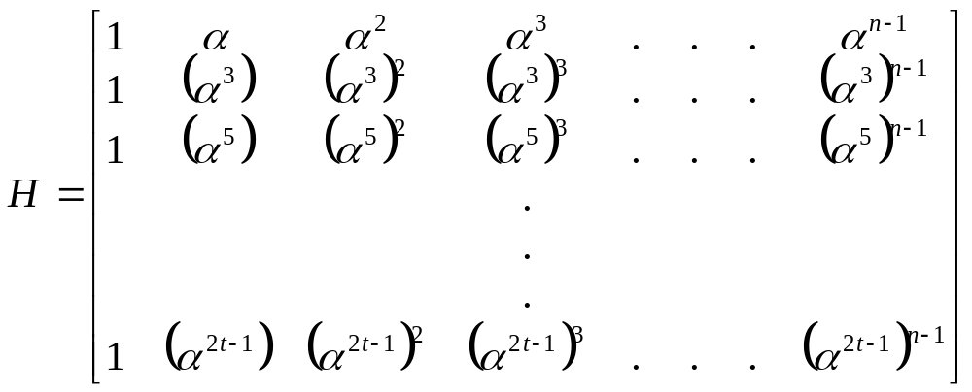
if x – α^{i} | v(x) α^{i} α^{j} 互為 conjuqate
then x – α^{j} | v(x)
By conjugate property
Ref: Block Codes – extended 4
Proof: d* ≥ 2t + 1 (BCH bound)
suppose code vector v = (v₀, v₁, … , v_{n-1}) with weight δ ≤ 2t
Let v_{j1}, v_{j2}, … , v_{jδ} be the nonzero components of v
2004/5/5
Yuh-Ming Huang, CSIE, NCNU

Slide 14
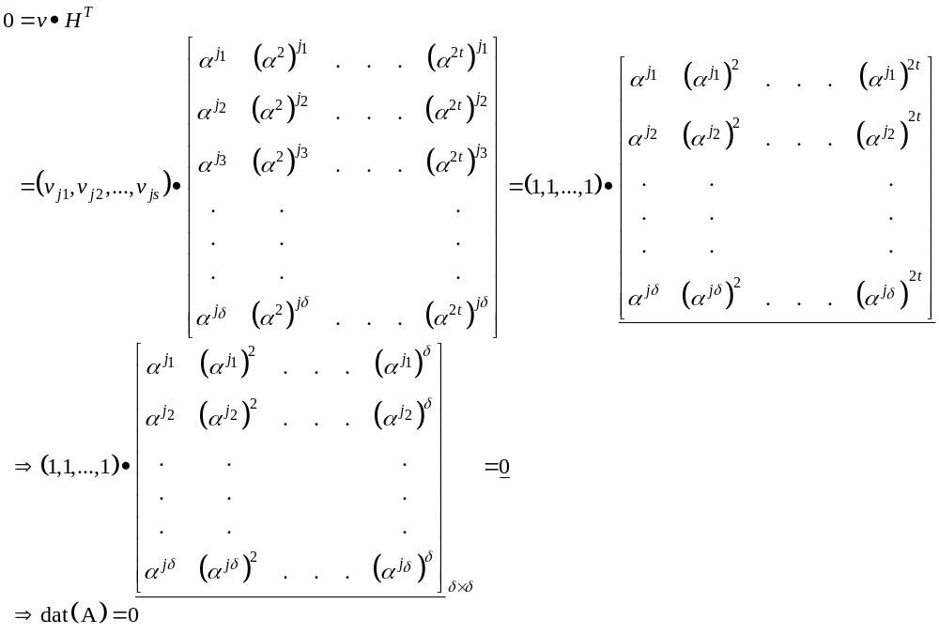
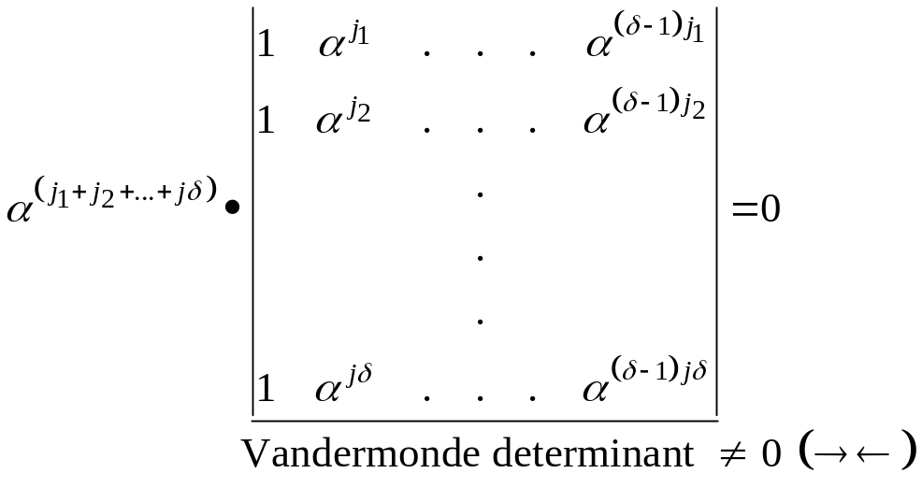
=
(1, 1, … ,1)
implies
2004/5/5
Yuh-Ming Huang, CSIE, NCNU

Slide 15
Syndrome
S = (S₁, S₂, … , S_{2t}) = r•H^{T} r = (r₀, r₁, … , r_{n-1})
S_{i} = r(α^{i}) r(x) = r₀ + r₁x + … + r_{n-1}x^{n-1}
r(x) = α_{i}(x)f_{i}(x) + b_{i}(x) f_{i}(x): minimal polynomial of α_{i}
∵ f_{i}(α_{i}) = 0
S_{i} = r(α_{i}) = b_{i}(α_{i})
Q: 與
s(x) = r(x)/g(x)
之關係
2004/5/5
Yuh-Ming Huang, CSIE, NCNU

Slide 16
Peterson-Gorenstein-Zierler Decoder
(1) e(X) = e₀ + e₁X + … + e_{n-1}X^{n-1} where at most t coefficients are nonzero
(2) Suppose v errors actually occur, 0 ≤ v ≤ t, in unknown locations
i₁, i₂, … ,i_{v}
∴ e(X) = e_{i1}X^{i1} + e_{i2}X^{i2} + … + e_{iv}X^{iv}
(3) S₁ = v(α) = c(α) + e(α) = e(α)
= e_{i1}α^{i1} + e_{i2}α^{i2} + … + e_{iv}α^{iv}
Let Y_{l} = e_{il} : error magnitude 1 ≤ l ≤ v
X_{l} = α^{il} : error-location number
Note : all X_{l} are different (∵α^{n} = 1)
S₁ = Y₁X₁ + Y₂X₂ + … + Y_{v}X_{v}
i_{j}, e_{ij}, v are unknown !
Q
2004/5/5
Yuh-Ming Huang, CSIE, NCNU

Slide 17
(4) For α α² α³ … α^{2t}
S₁ = Y₁X₁ + Y₂X₂ + … + Y_{v}X_{v} Y_{l} ∈ GF(q)
S₂ = Y₁X₁² + Y₂X₂² + … + Y_{v}X_{v}² X_{l} ∈ GF(q^{m})
S₂ = Y₁X₁³ + Y₂X₂³ + … + Y_{v}X_{v}³
.
.
,
S_{2t} = Y₁X₁^{2t} + Y₂X₂^{2t} + … + Y_{v}X_{v}^{2t}
1.(＊)至少有一解 ∵Syndrome S_{i} is defined in such way
2.證明此解unique
(＊)
nonlinear
equations
2004/5/5
Yuh-Ming Huang, CSIE, NCNU

Slide 18
Consider the polynomial Λ(x) ≡ (1-X₁x)(1-X₂x)…(1-X_{v}x)
= 1 + Λ₁x + Λ₂x² + … + Λ_{v}x^{v} – (1)
error-locator polynomial
If we knew the coefficients Λ_{l} of Λ(x)
we could find the zeros of Λ(x) to obtain the error locations X_{l}
S_{i} ↔ Λ_{l}
1≤i≤2t 1≤l≤v
Multiply both sides of (1) by Y_{l}X_{l}^{j+v} and set x = X_{l}⁻¹
2004/5/5
Yuh-Ming Huang, CSIE, NCNU

Slide 19
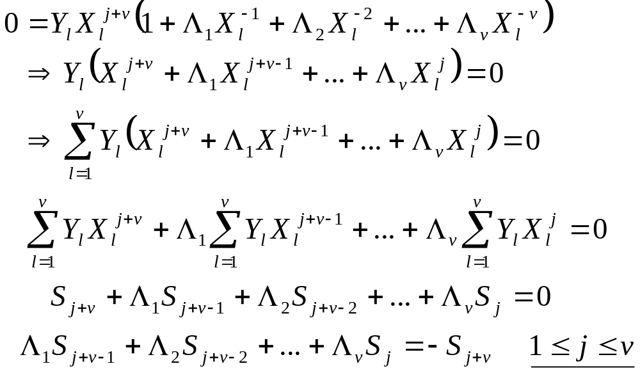
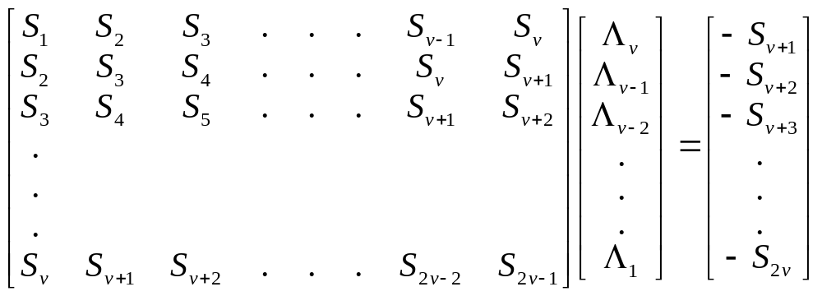
∵v ≤ t
∴S₁ ~ S_{2v}
all known
2004/5/5
Yuh-Ming Huang, CSIE, NCNU

Slide 20
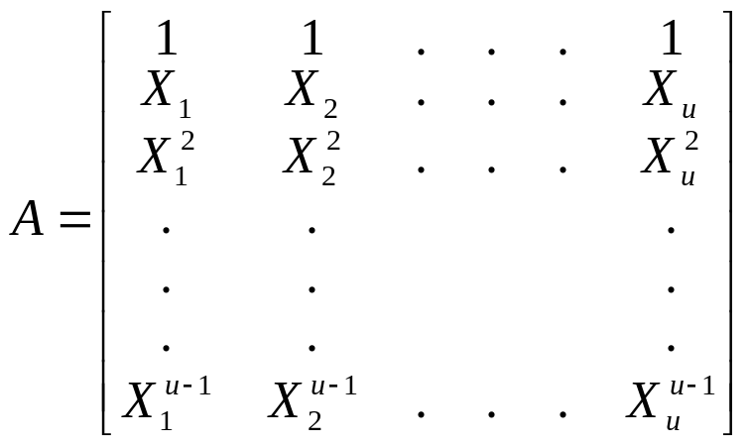
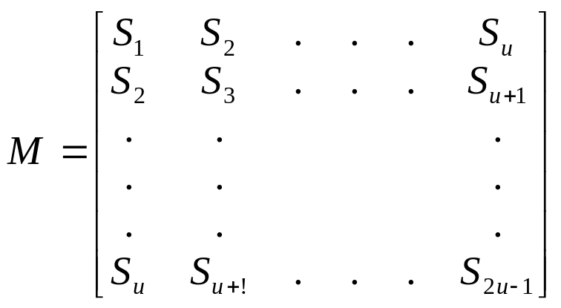
Thm : The Vandermonde matrix has a nonzero determinant
iff all of X_{i} 1 ≤ i ≤ u are distinct
Thm : The matrix of syndromes M is nonsingular if u is equal to v, the number
of errors that actually occurred. The matrix is singular if u > v.
If v > t
i.e. u < v時
det(M) = ?
2004/5/5
Yuh-Ming Huang, CSIE, NCNU

Slide 21
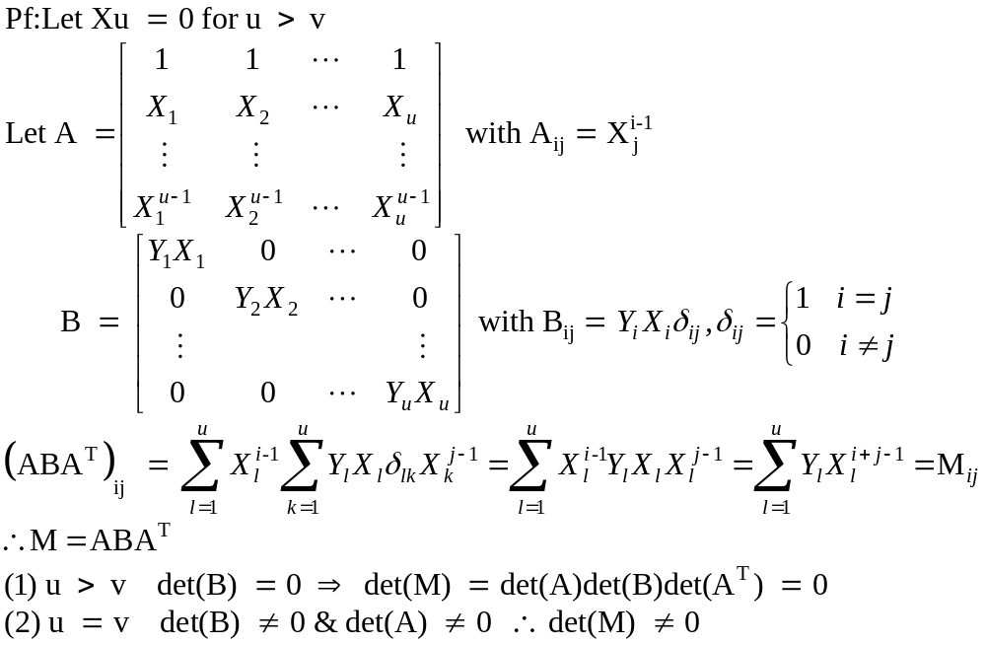
2004/5/5
Yuh-Ming Huang, CSIE, NCNU

Slide 22
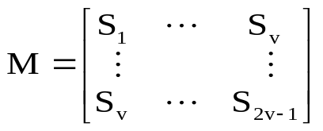
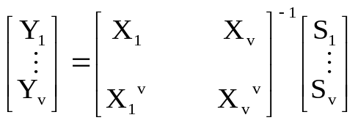
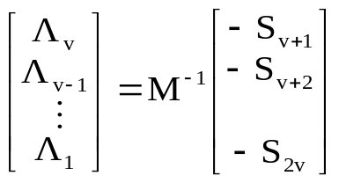
Enter υ(x)
special case
j₀ = 1
α α² … α^{2t}
Compute syndromes
S_{j} = υ(α^{j+j}₀⁻¹) j = 1 … 2t
v = t
Find error location
X_{l} (l = 1…..v)
by finding zeros of Λ(x)
det(M) = 0
Yes
v←v-1
No
Halt
Figure 7.1 The Peterson-Gorenstein-Zierler decoder.
2004/5/5
Yuh-Ming Huang, CSIE, NCNU

Slide 23
Eg:
BCH(15,5) triple-error-correcting code.
g(X) = X¹⁰ + X⁸ + X⁵ + X⁴ + X² + X + 1
received code polynomial
⇒ V(X) = X⁷ + X²
In GF(2⁴) S₁ = α⁷ + α² = α¹²
S₂ = α¹⁴ + α⁴ = α⁹
S₃ = α²¹ + α⁶ = 0
S₄ = α²⁸ + α⁸ = α³
S₅ = α³⁵ + α¹⁰ = α⁰
S₆ = α⁴² + α¹² = 0
2004/5/5
Yuh-Ming Huang, CSIE, NCNU

Slide 24
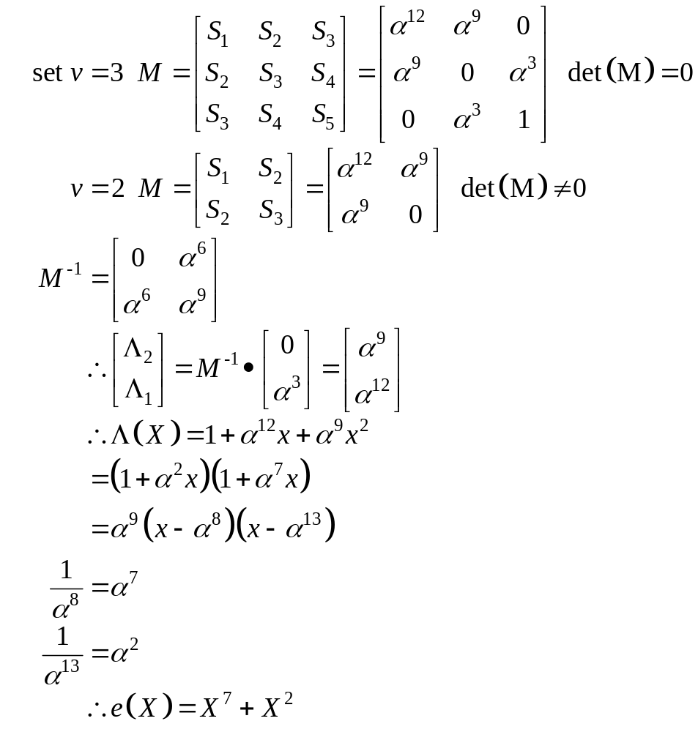
2004/5/5
Yuh-Ming Huang, CSIE, NCNU

Slide 25
Reed-Solomon Code (maximum-distance code)
The symbol field GF(q) and the error-locator field GF(q^{m}) are the same
(Y_{l}) (X_{l})
(i.e. m = 1)
Take α as primitive n = q^{m} – 1 = q – 1
The minimal polynomial over GF(q) of an element β in the same GF(q) is f_{β}(X) = X – β
Take j₀ = 1 g(X) = (X – α)(X – α²)… (X – α^{2t}) ∴ n – k = 2t
eg1. (15,11) t = 2 GF(16) j₀ = 1
g(X) = (X – α)(X – α²) (X – α³)(X – α⁴)
= X⁴ + (Z³ + Z² + 1)X³ + (Z³ + Z²)X² + Z³X + (Z² + Z + 1)
= X⁴ + α¹³X³ + α⁶X² + α³X + α¹⁰
n – k = 4 ⇒ k = 11 (11 16-ary symbols ≈ 44 bits)
2004/5/5
Yuh-Ming Huang, CSIE, NCNU

Slide 26
eg2. (7,3) t = 2 GF(8) j₀ = 4
g(X) = (X – α⁴)(X – α⁵) (X – α⁶)(X – α⁰)
= X⁴ + (Z² + 1)X³ + (Z² + 1)X² + (Z + 1)X + Z
n – k = 4 ⇒ k = 3 (3 8-ary symbols ≈ 9 bits)
If i(X) = (Z² + Z)X² + X + (Z + 1)
c(X) = i(X)g(X) = (α⁴X² + X + α³)(X⁴ + α⁶X³ + α⁶X² + α³X + α)
= α⁴X⁶ + αX⁵ + α⁶X⁴ + 0X³ + 0X² + α⁵X + α⁵
※ 1. n – k + 1 = 2t + 1 ≤ d* ≤ 1 + n – k
∴ d* = 1 + n – k
2. R-S codes always have relatively short block-length as compared
to other cyclic codes over the same alphabet !
2004/5/5
Yuh-Ming Huang, CSIE, NCNU

