Slide 1

Classical Physics
Introduction to Physics
Textbook: Physics for Computer Science Students, by N. Garcia, A. Damask, and S. Schwarz, 2nd, 1998.

Slide 2
Chapter One
Physical Quantities

Slide 3

Physical Quantities
In physics two fundamental processes are involved:
1. the description of natural phenomena based on experiments, which control variables;
2. mathematical manipulation or theorizing, which is a predictive process.

Slide 4
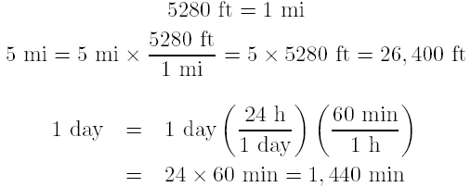
Quantities and Units
In classical physics the fundamental parameters in the measurement system are length, mass, and time.
There are two versions of the metric system in use, the cgs (centimeter, gram, second) and the mks (meter, kilogram, second).
Conversion of units
In square or cubic units, all measurements must be in the same units.

Slide 5
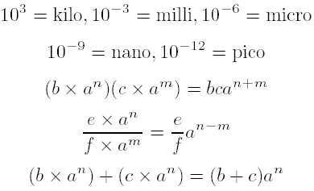
Powers of 10

Slide 6
Accuracy of Numbers
Suppose we wish to find the area of a rectangular surface.
See Figure 1-1.
Our measurement of widths is as
and The largest area is
and the smallest is

Slide 7
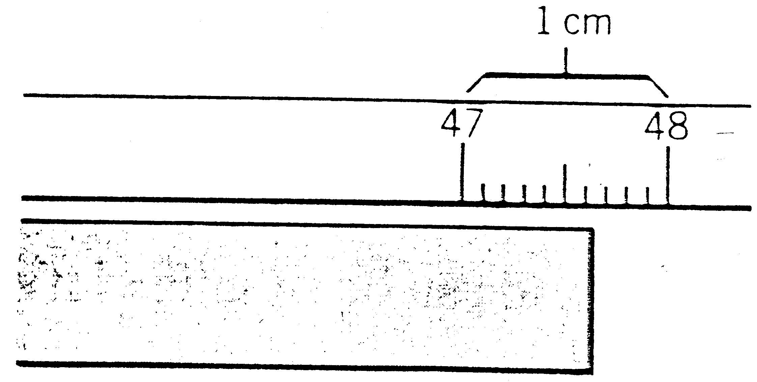

Slide 8

We can write the answer as
The accuracy of the product cannot exceed the accuracy of any of the components in the product.
No matter how accurately a given parameter is measured, when is combined arithmetically with another measurement the result is only as accurate as the least-accurate measurement.

