Slide 1
Chapter Ten
Oscillatory Motion

Slide 2

Oscillatory Motion
When a block attached to a spring is set into motion, its position is a periodic function of time.
When we considered the motion of a particle in a circle, the components of a position vector r making an angle θ with the x axis were

Slide 3

Characterization of Springs
The Hook's law states that the extension or compression x of an elastic body is proportional to the applied force F. That is
where k is called the force constant or spring constant.
In the case of a spring, the value of the constant k characterize the strength of the spring.
The extension of the spring is within its elastic limit if the spring returns to its original length when the weight attached to it is removed.

Slide 4

Frequency and Period
Suppose we have a periodic event, that is, one that occurs regularly with time. Its frequency v is one event per time. The time between periodic events is the period, denoted as T. Thus,
One event per second is called one hertz, abbreviated Hz.

Slide 5


See Fig. 10-1.
In every rotation θ changes by 2¼ rad. If the particle performs v rotations in 1 sec, then θ will change by 2¼ rad every second.

Slide 6
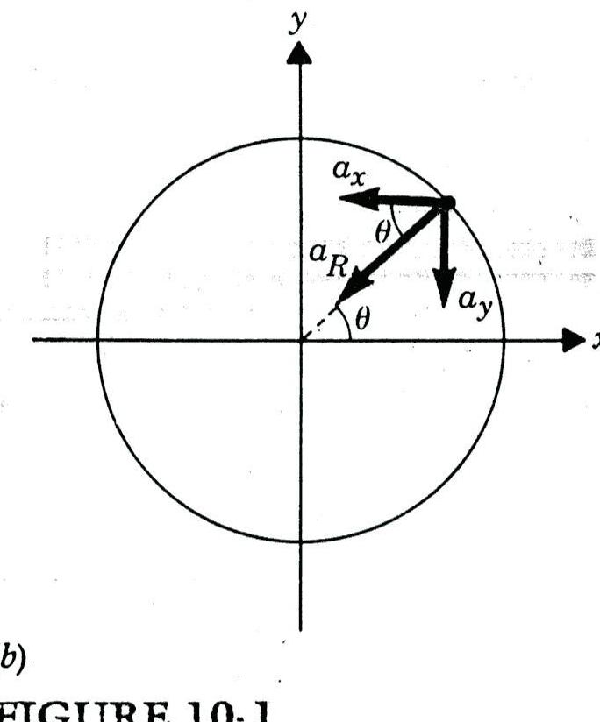
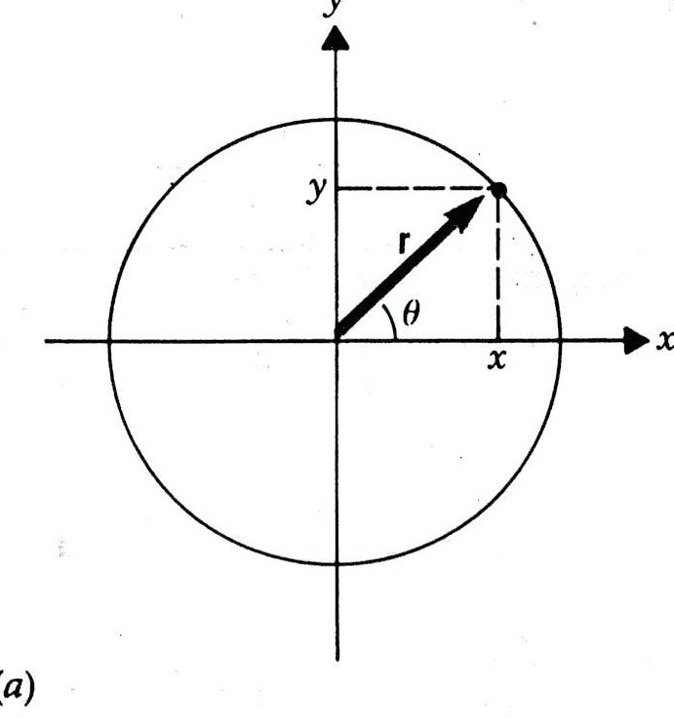

Slide 7

Amplitude and Phase Angle
Fig. 10-2 shows a plot of sin θ versus θ.
The maximum value of the magnitude of this oscillation is called the amplitude.
See Fig. 10-3. When θ = 0 the function has the value of sin ¼ / and thereafter attains all values of sinθ at an angle ¼/ earlier.
The general form for a function to describe a body undergoing sinusoidal oscillations is
where Φ is called the phase angle and its sign may be positive or negative.

Slide 8
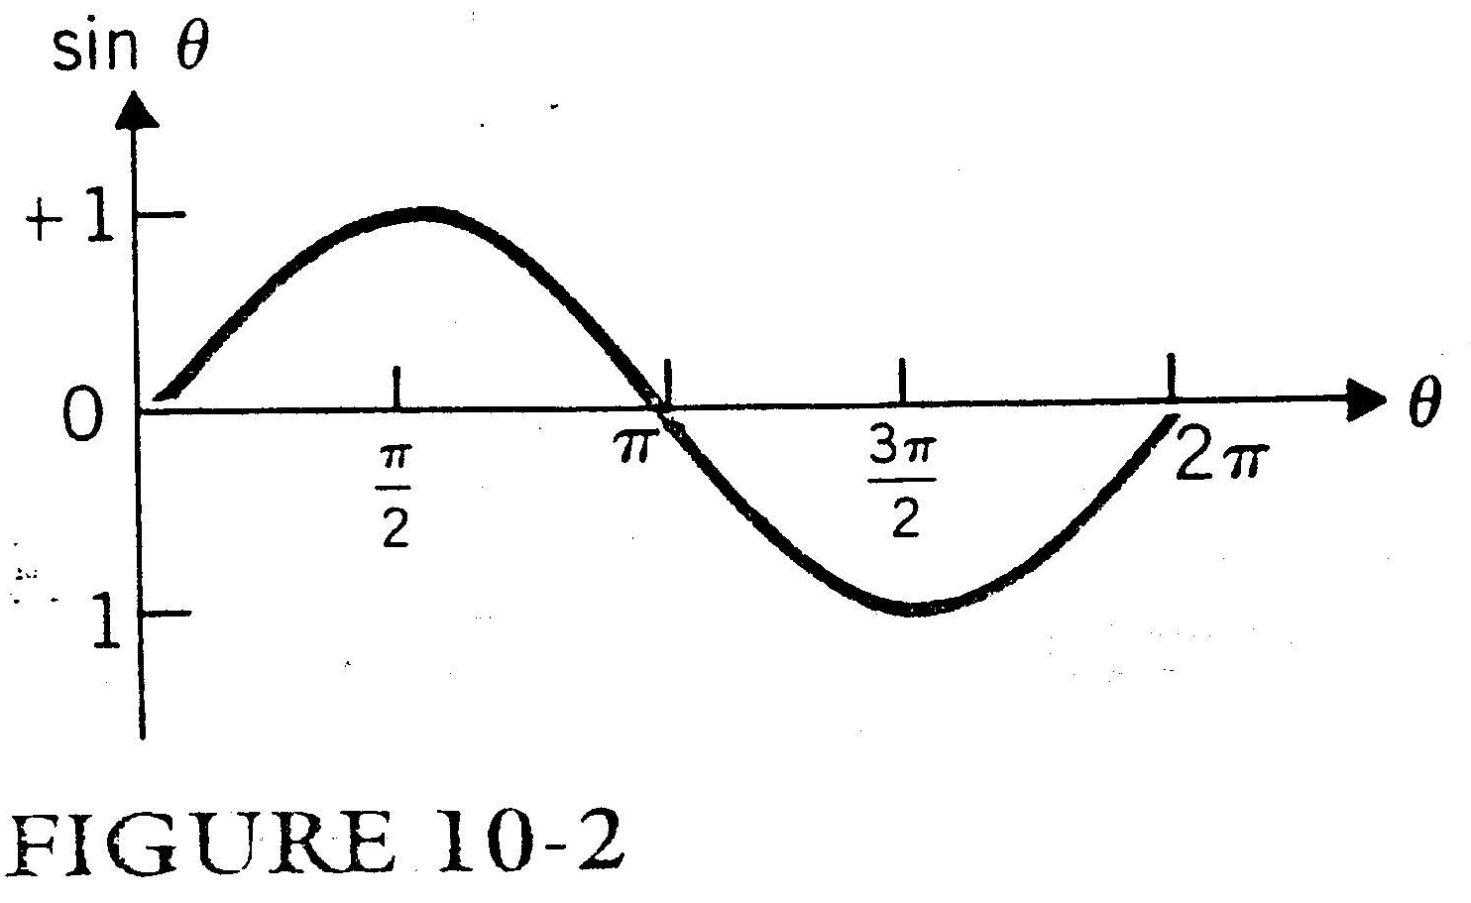

Slide 9
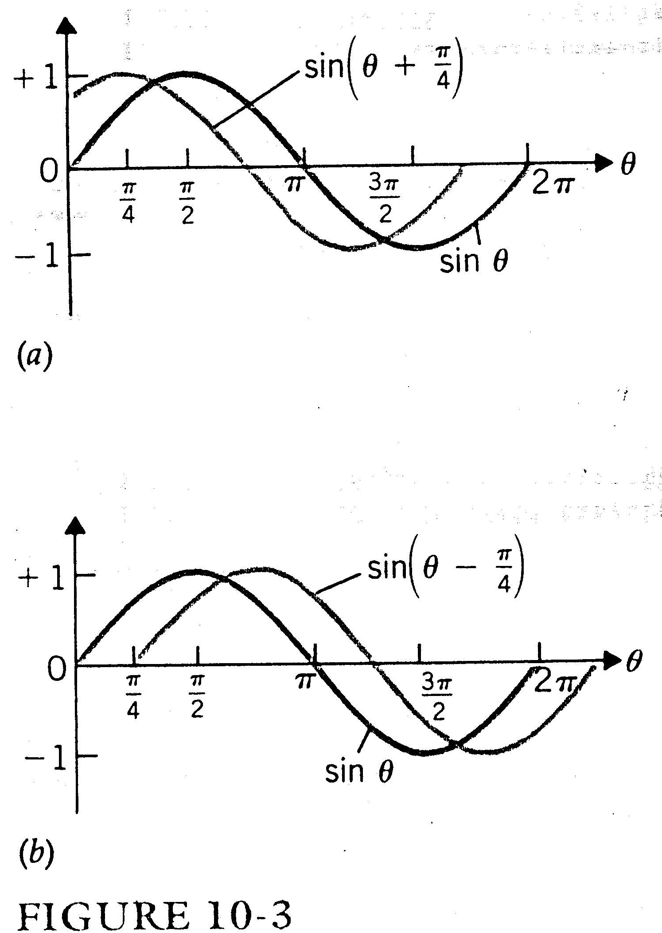

Slide 10

Oscillation of a Spring
See Fig. 10-4. By Newton's third law of action and reaction, if you pull on a spring with force F it pulls in the opposite direction with force -F. Thus, the force that the spring exerts on the body is -kx according to the Hooke's law.

Slide 11
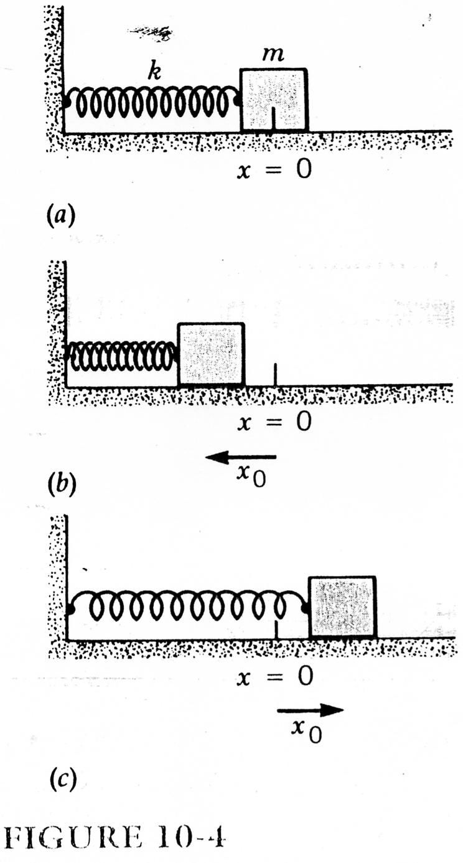

Slide 12



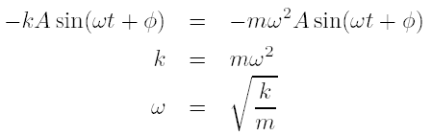
The above is a second-order differential equation. Our guess at a solution will be

Slide 13
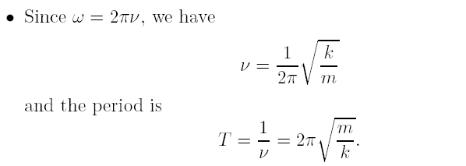
To complete the solution of the problem, we must determine the value of the amplitude A and of the phase angle Ф. This is done by specifying the boundary conditions, that is, the behavior of the body at some time such as, t = 0.

Slide 14



At t = 0,
Let x = x₀ and t = 0, we have
Since v_{x} = 0 and t = 0, we have

Slide 15
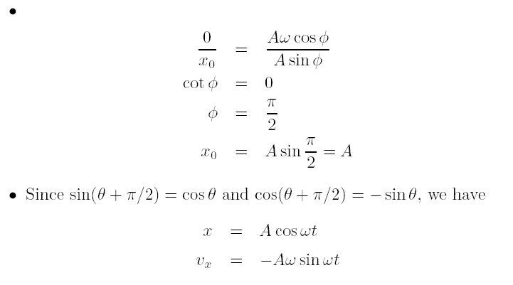

Slide 16

The maximum value of the velocity occurs when x = 0 or at the midpoint of oscillation.
The amplitude of the displacement A and the maximum value of the velocity Aω are not the same because ω may be equal to or greater or smaller than unity. See Fig. 10-5.

Slide 17
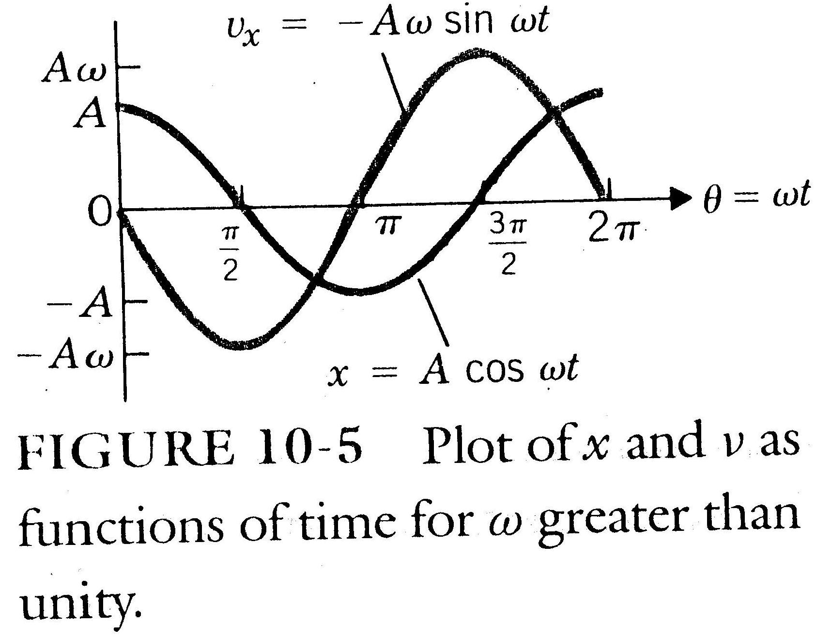

Slide 18

See Fig. 10-6.
When the displacement is maximum in the positive direction, the acceleration is maximum in the negative direction.
When the displacement is zero, so is the acceleration. See Fig. 10-6.
Since F = ma and F = -kx, -kx = ma and a is maximum when x is maximum and x and a have opposite signs.

Slide 19
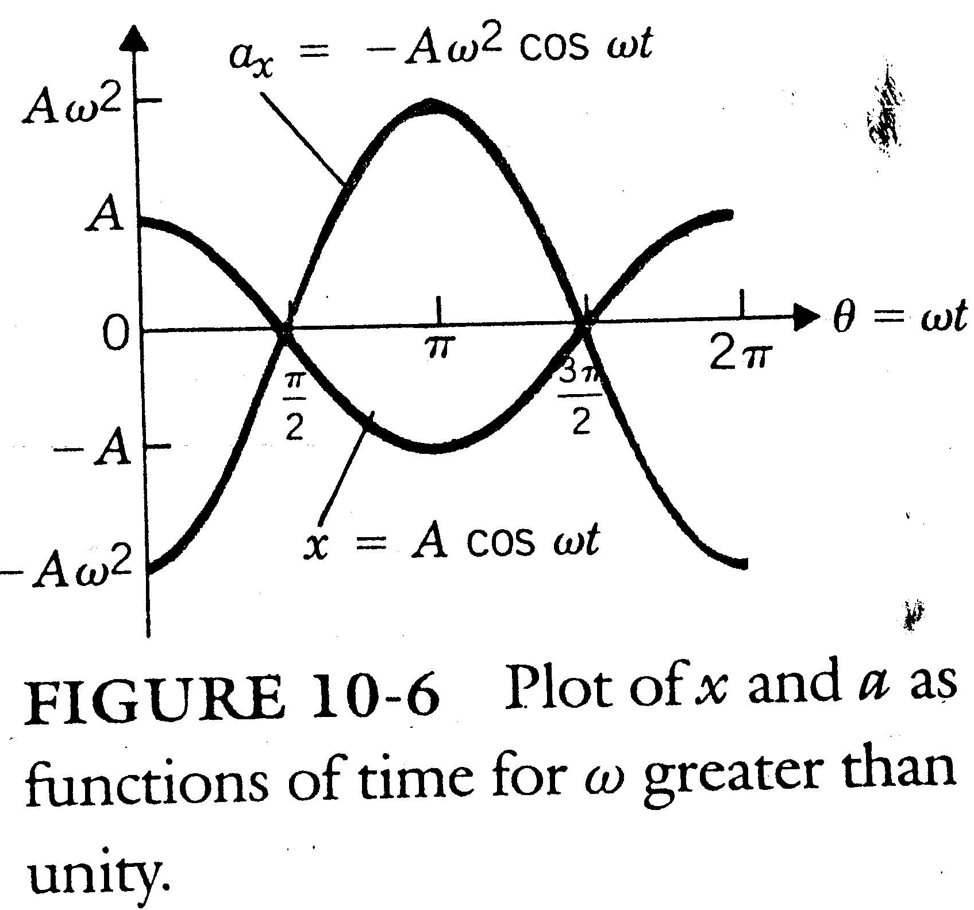

Slide 20
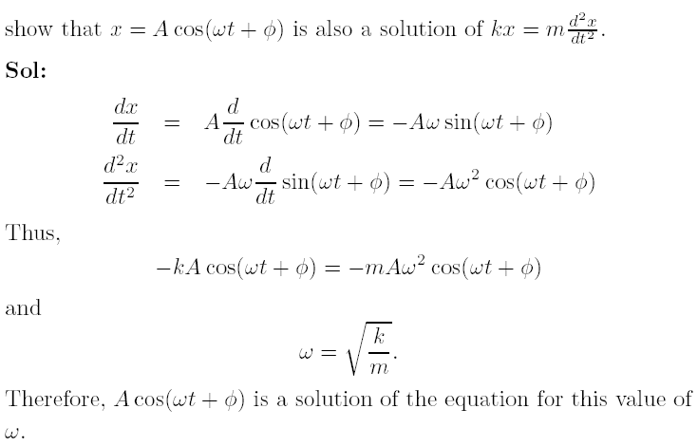
Example 10-1
Show

Slide 21
Example 10-2
A given spring stretches 0.1 m when a force of 20 N pulls on it. A 2-kg block attached to it on a frictionless surface as in Fig. 10-4 is pulled to the right 0.2 m and released. (a) What is the frequency of oscillation of the block? (b) What is its velocity at the midpoint? (c) What is its acceleration at either end? (d) What are the velocity and acceleration when x = 0.12 m, on the block's first passing this point?

Slide 23


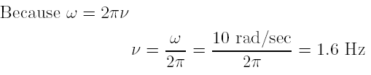
Sol
(a)

Slide 24


(b) The velocity is a maximum when x = 0, that is, at the midpoint. Thus,
(c) The acceleration is a maximum at the two extremes of the motion. Therefore,

Slide 25
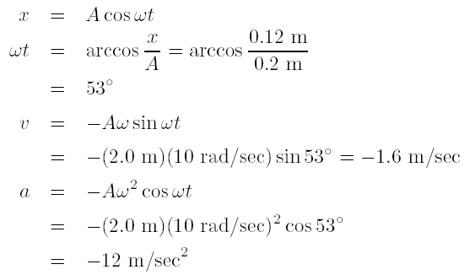
(d) To determine the block's velocity and acceleration at some arbitrary value of x, we need to know the angle ωt at that position.

Slide 26

Energy of Oscillation
When a body attached to a spring is displaced from its equilibrium position (x = 0), the spring is potentially capable, on the release of the body, to do work on the body. We can therefore associate with the spring-body system a potential energy E_{p}.
This potential energy will be the work done in stretching or compressing the spring.
When the force F and the displacement dx are in the same direction,

Slide 27
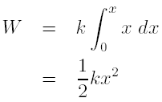

From Hooke's law,
The potential energy of the spring-body system, when the body is displaced a distance x from its equilibrium position is

Slide 28
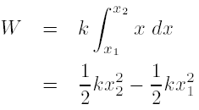
If the spring is initially in a position x₁ and is compressed or stretched to position x₂, the work done is as before
Because the displacement is squared the potential energy of a spring is the same whether it is stretched or compressed an equal distance x from its related position.

Slide 29

By the work-energy theorem, the work done by the spring, as the body moves between two arbitrary displacements x₁ and x₂, is equal to the change in the kinetic energy of the body; that is,
where v₁ and v₂ are the velocities of the body at x₁ and x₂, respectively. Since F_{spring} = -kx,

Slide 30
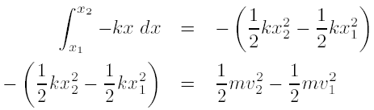
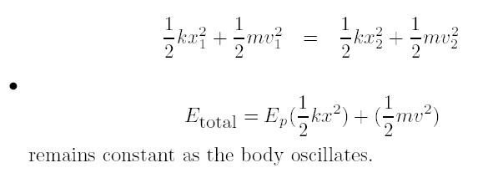

Slide 31

Example 10-3
The block of Example 10-2 is released from a position of x₁ = A = 0.2 m as before. (a) What is its velocity at x₂ = 0.1 m? (b) What is its acceleration at this position?
Sol: (a) The velocity at x₂ can be found with the conservation of energy equation,

Slide 32
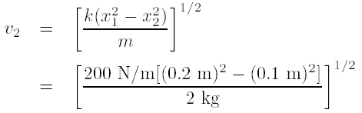

Since v₁ = 0, we have

Slide 33
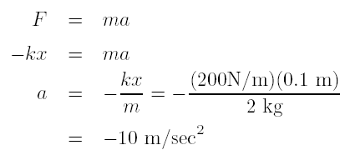
(b) We may find the acceleration at this position by using Newton's second law

Slide 34
Homework
Homework: 10.4, 10.9, 10.10, 10.11, 10.12, 10.13, 10.14, 10.16, 10.17, 10.18.

