Slide 1
Chapter Eleven
Wave Motion

Slide 2
Wave Motion
Light can be considered wavelike by experimental analogies to the behavior of water waves.
Experiments with fundamental particles, such as electrons, demonstrate that they also have wave characteristics.
Travelling waves can transmit energy along a medium without any net translation of the particles in the medium through which the wave travels.
Because of the nature of the light wave, no medium is necessary for its propagation.

Slide 3

Wavelength, Velocity, Frequency, and Amplitude
The time between successive risings on the waves is called the period, with symbol T.
The number of risings that we experience per unit time is called the frequency, with symbol v.

Slide 4

See Fig. 11-1. The distance between two successive risings on the waves is called the wavelength, with symbol λ.
The speed of the wave is the wavelength divided by the period, that is,
The amplitude of a wave is the maximum value of the displacement it produces.

Slide 5
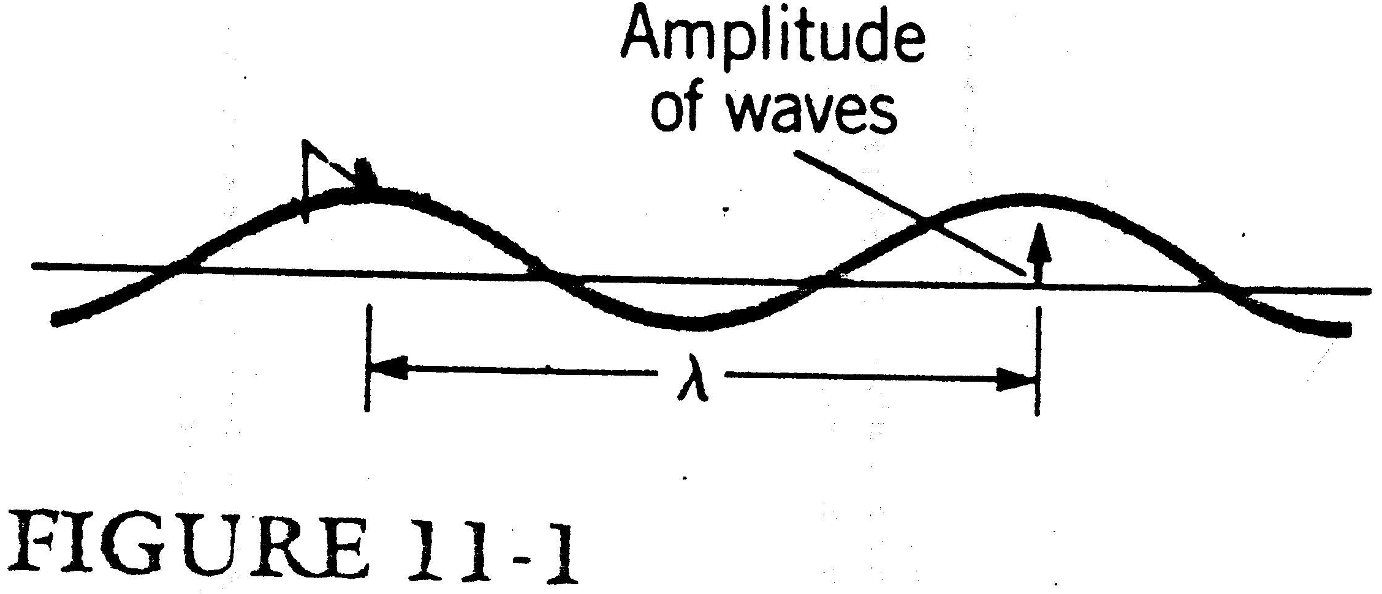

Slide 6

Travelling Waves in a String
See Fig. 10-2. We may say the wave pulse, y, is a function of x and the time t; that is, y = f(x, t).
One of the most important and most commonly found types of travelling waves is the sinusoidal travelling wave, a wave consisting of a series of consecutive sinusoidal pulses.
Considering the system shown in Fig. 11-3. See Fig. 11-4.

Slide 7
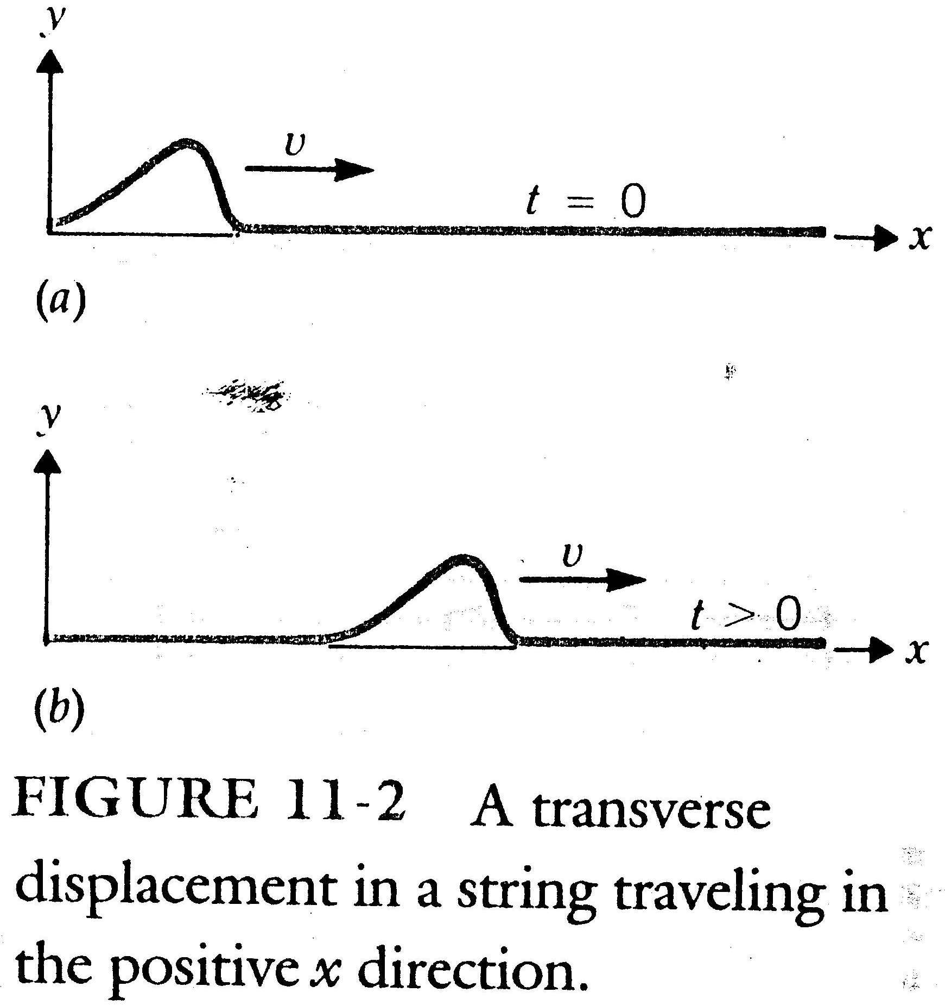

Slide 8
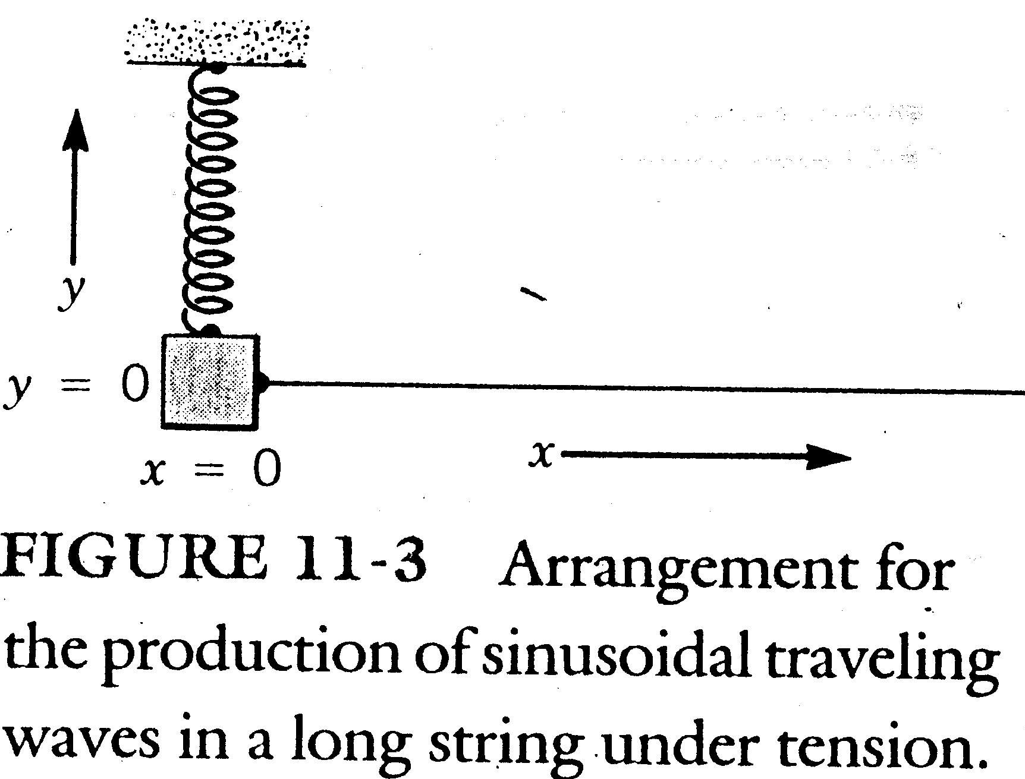

Slide 9
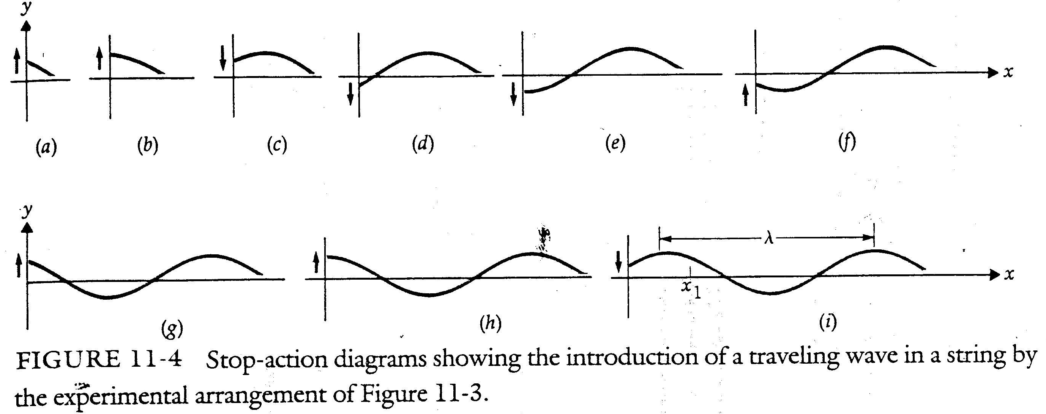

Slide 10


If the velocity of the wave in the string is v, then the time it takes to travel a distance x along the string is x/v. Let t₀ = x/v. We obtain

Slide 11


If we limit ourselves to waves such that y = 0 when both x = 0 and t = 0, then Φ = 0 or π. Thus,
where
and is called the propagation constant.

Slide 12


For a wave travelling toward the left,
To pick a particular, fixed value of y, the argument of the sine function in the above equation must be kept constant, that is,
Thus, as t increases, x must decrease.
Set t equal to an instantaneous value t₁ we have
where θ₁ = ωt₁ is a phase shift at t₁. See Fig. 11-5.

Slide 13
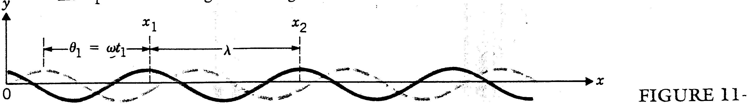

Slide 14


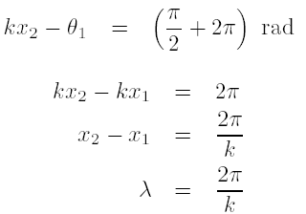
From Fig. 11-5,
We identify x₁ and x₂ as two successive values of x for which the sine function equals +1; that is,

Slide 15

Set x equal to a constant value x₁, we have
where θ’₁ = kx₁ is a constant phase shift that depends on the point chosen in contrast to the previous analysis, which showed that the phase shift depended on the time of the snapshot.
The above equation is similar to the one described the oscillatory motion of the body attached to a spring.

Slide 16


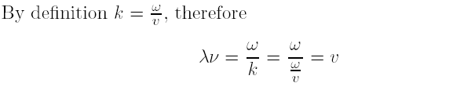
With the position x fixed, y will vary with sin ωt and
An alterative demonstration of the relation between frequency and wavelength:

Slide 17
Example 11-1
A mass of 0.2 kg suspended from a spring of force constant 1000 N/m is attached to a long string as shown in Fig. 11-3. The mass is set into vertical oscillation, and the distance between successive crests of the waves in the string is measured to be 12 cm. What is the velocity of waves in the string?

Slide 19
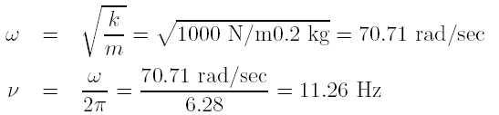

Sol
The frequency of oscillation is
The velocity of waves in a medium is

Slide 20
Energy Transfer of a Wave
The wave has given energy to the particle because the wave carries energy with it.
Wave motion is one of the two general mechanisms available to transport energy from one point to another. The other occurs when one or more particles move from one point to another and in so doing bring their kinetic energy with them.

Slide 21
There are two differences between these two mechanisms:
1. Waves transfer energy without transfer
of matter, unlike the motion of particles.
2.The energy of a beam of particles is
localized. In a wave the energy is
distributed over the entire space occupied
at a given instant by the wave.

Slide 22

We can obtain the power P of a wave by calculating the energy crossing a given point in a string in 1 sec. See Fig. 11-6.
Each particle in the string is oscillating with the same amplitude A. Because the total energy of an oscillating particle is proportional to the square of the amplitude oscillation, we conclude that all the particles in the vibrating string have the same energy.

Slide 23
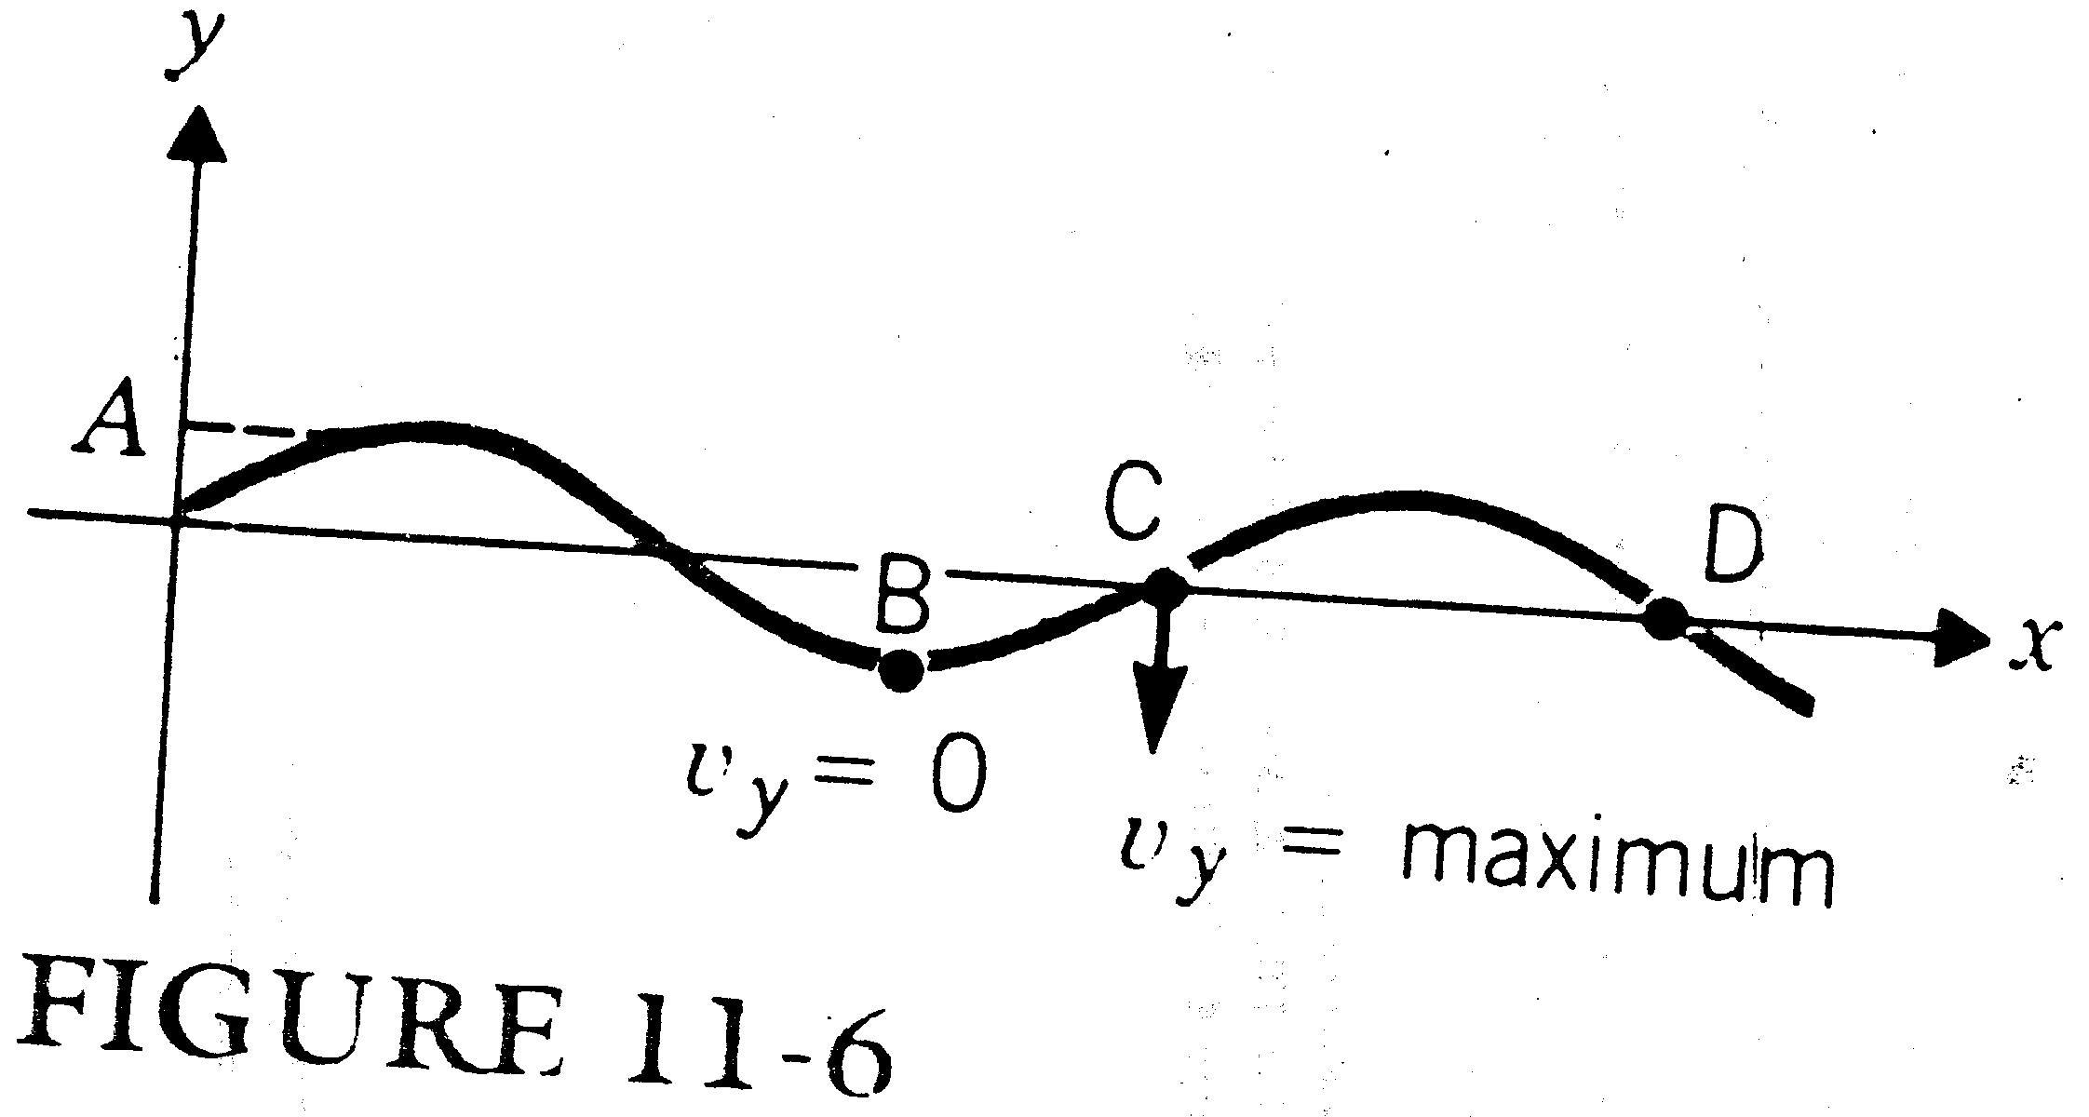

Slide 24


At any given time, the energy of a particular particle may be all kinetic or all potential or a mixture.
To obtain the kinetic energy of the particles in the string we need an expression for the transverse velocity v_{y}.

Slide 25


We now calculate the energy of particle C of mass ¢m.
If the amplitude of the wave is small compared with the wavelength, then the mass in one wavelength is μλ, where μ is the mass per unit length of the string. Therefore,

Slide 26
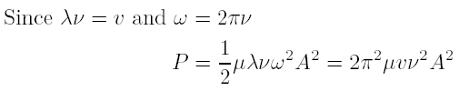
The power transported by a wave is proportional to the square of the amplitude and to the velocity of propagation of the wave.

Slide 27
When considering waves that propagate in three dimensions, such as sound waves or light waves, it is convenient to talk about the energy flowing through a given area of the medium traversed by the wave.
The intensity, with symbol I, is defined as the power transmitted per unit area perpendicular to the direction of propagation of the wave.
The intensity of the wave is also proportional to the square of the amplitude.

Slide 28
Homework
Homework: 11.4, 11.7, 11.9, 11.13, 11.14, 11.15, 11.16, 11.17, 11.20, 11.21.

