Slide 1
Introduction to Physics ---
Modern Physics
Textbook: Physics for Computer Science Students, by N. Garcia, A. Damask, and S. Schwarz, 2nd, 1998.

Slide 2
Chapter Thirteen: Electrostatics
The interaction of charges at rest is called electrostatics.
Superposition principle: The behavior of multiple charges on one another is a simple sum of the one-to-one interactions (pairwise).

Slide 3
Charges
There are two different types of charges called positive and negative.
Metals have been known as electrical conductors and nonmetals as insulators.

Slide 4

Coulomb's Law
Attraction and repulsion of charges: see Fig. 13-2.
Coulomb's experiments concerning the forces between charges :see Fig. 13-3. The force diagram for q₂ is shown in Fig. 13-3b and the system is in the equilibrium state. Thus,

Slide 5
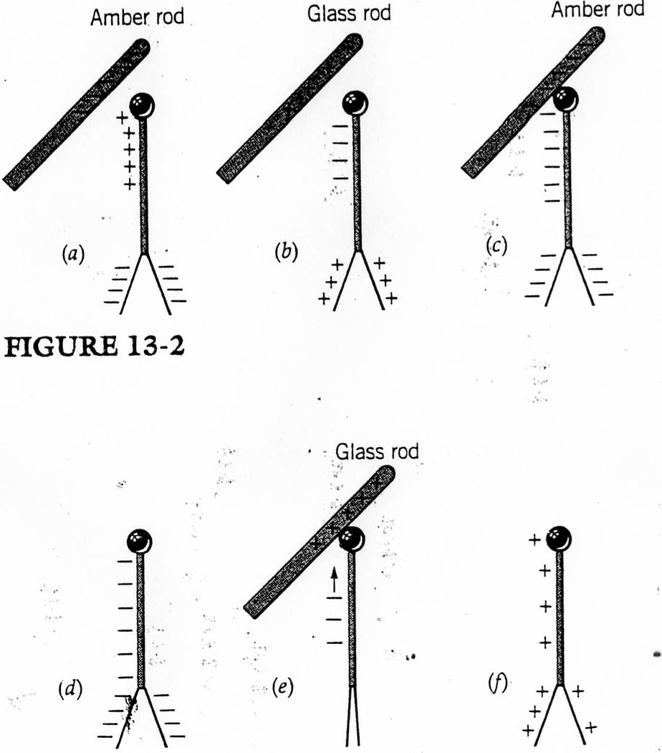

Slide 6
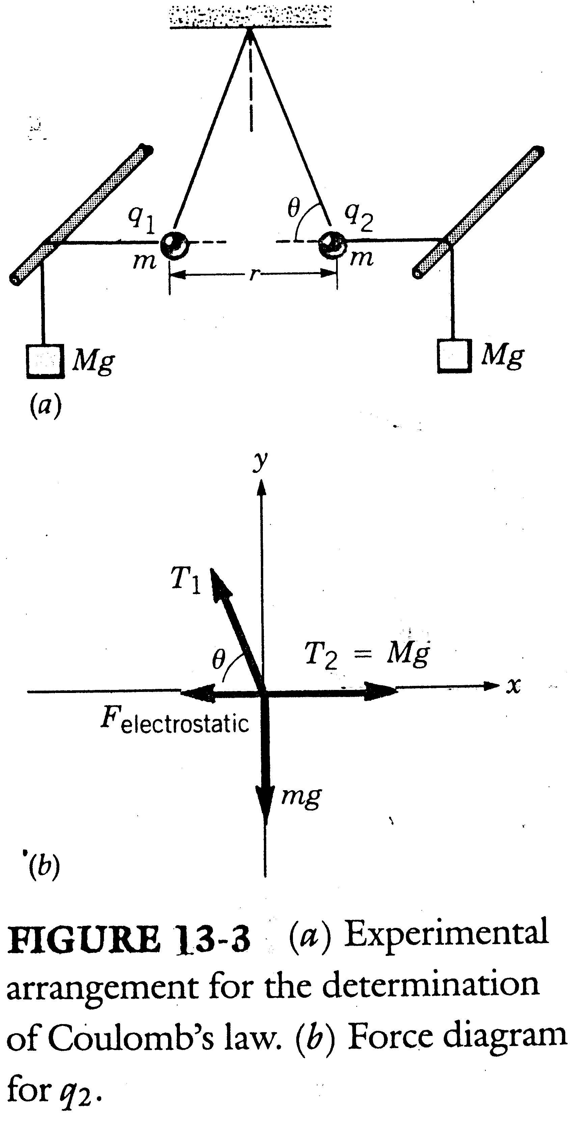

Slide 7


Coulomb's law:
where the sign of q₁ and q₂ may be either plus or minus, and r is the distance between q₁ and q₂.
In the SI system the constant in Coulomb's law is taken as

Slide 8

The symbol C stands for Coulomb and is the unit of charge.
The charge of the electron in coulombs is
Coulomb's law:
The direction of the force that q₁ exerts on q₂ is along the line joining the two charges, pointing away from q₁ if the force is repulsive or toward q₁ if the force is attractive.

Slide 9
Example 13-1
Two pith balls of mass 0.1g each are suspended on 50-cm threads. They are given equal charges and assume a position in which each makes an angle of with vertical, as in Fig. 13-4a. What is the charge on each?

Slide 10
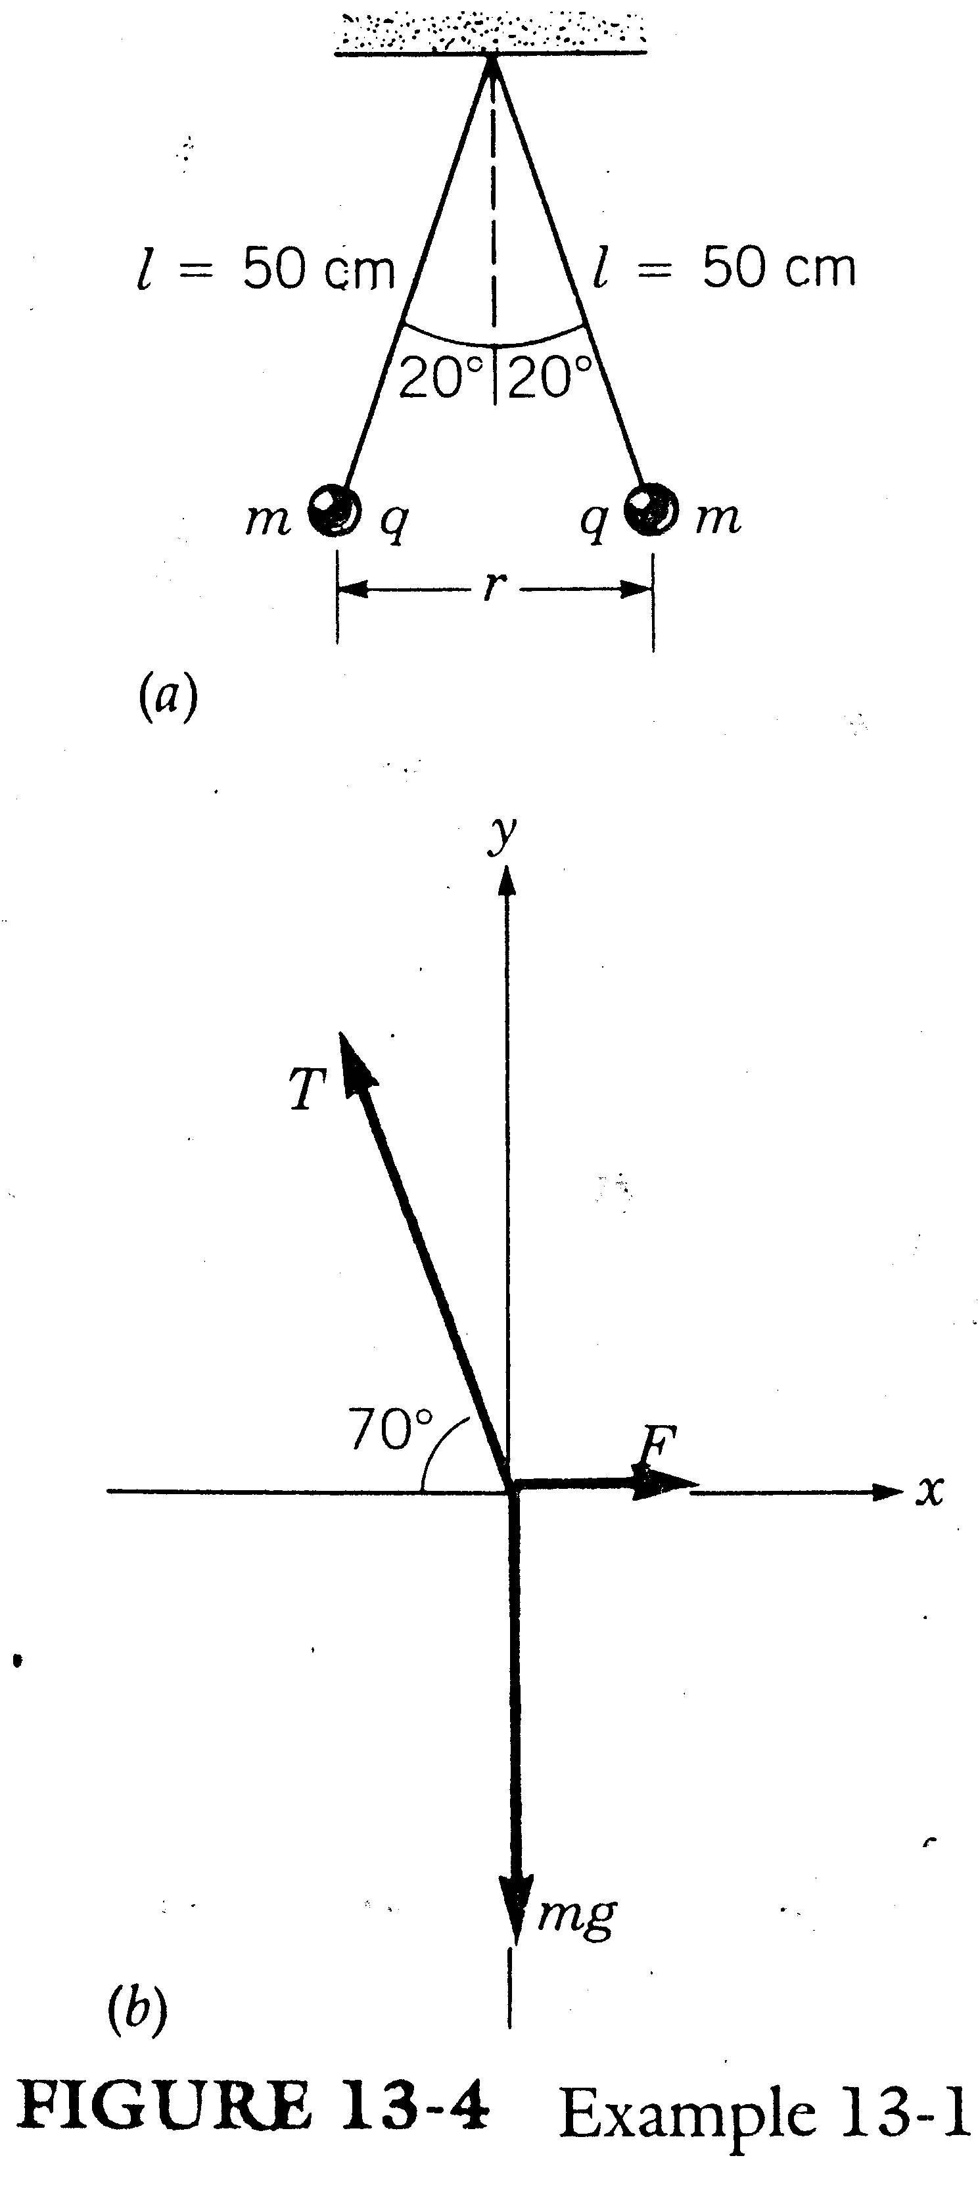

Slide 11
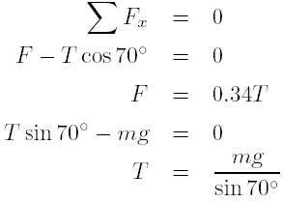
Sol
The vector diagram of the forces on the right-hand ball is shown in Fig. 13-4b, where F is the coulombic force of repulsion between the two charged pith balls.

Slide 12

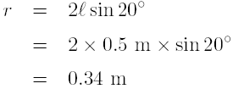
Substituting this value of T in the equation for F, we have

Slide 13



Using Coulomb's law,
Because q₁ = q₂ and substituting for F and r we have

Slide 14
Charge of an Electron
In the years 1909 through 1913 R. Millikan measured the charge on an electron by the system shown in Fig. 13-5.
With a spray he introduced fine oil drops between two parallel metal plates and observed the motion of a single drop through a telescope.
He found the drops usually acquired a negative charge.

Slide 15
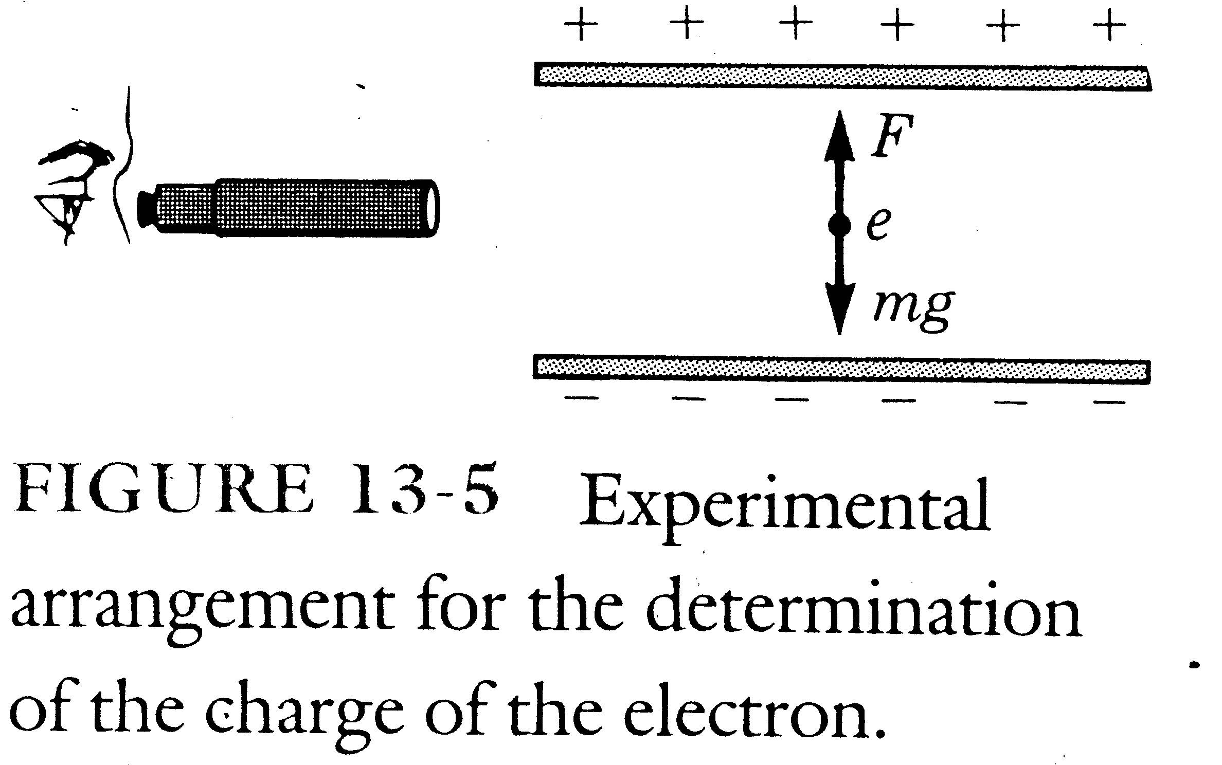

Slide 16
He also found that the smallest charge that was ever acquired by the drop had a magnitude of C and that larger charges were always integral multiples of this quantity.

Slide 17
Superposition Principle
If one selects a given charge in a group and asks for the total force on it, this force would be the resultant of the individual vector forces on it from each of the charges. This is called the superposition principle of charges.

Slide 18
Example 13-2
Three charges are arranged in a triangle as shown in Fig. 13-6a. What is the direction and the magnitude of the resultant force on the C charge?

Slide 19
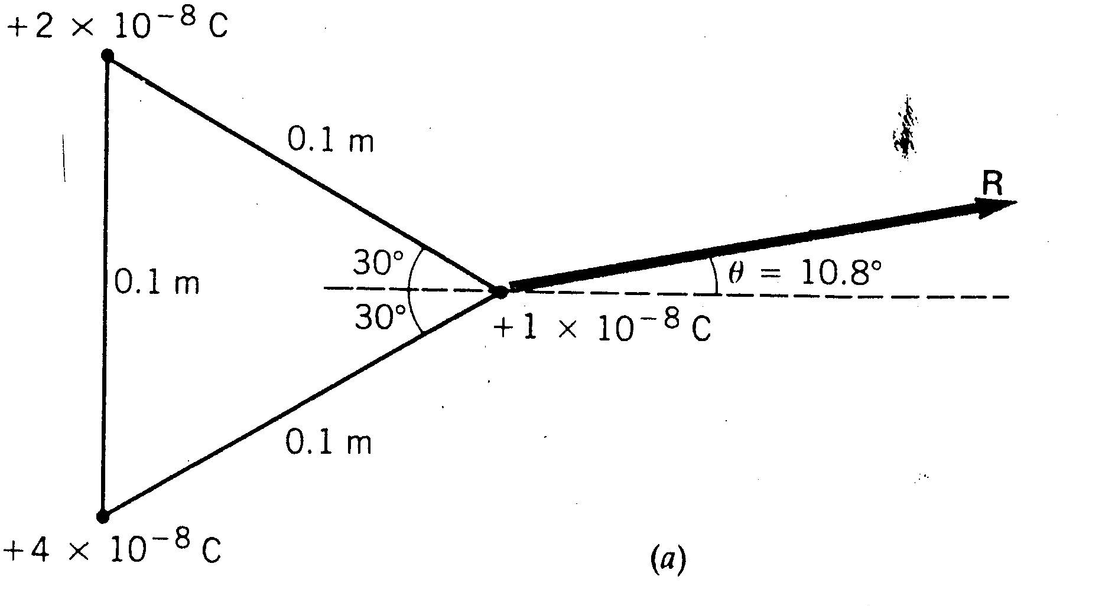

Slide 20


Sol
at above the positive x axis.
at below the positive x axis.

Slide 21
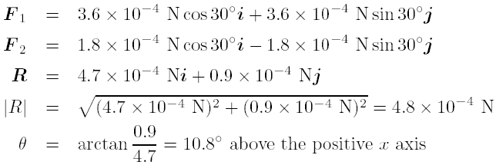
We now use the vector diagram of these two forces and find the resultant by the component method of Chapter 2. We have

Slide 22
Homework
13.4, 13.9, 13.10, 13.11, 13.12, 13.13, 13.14.

