Slide 1
Chapter Fourteen
The Electric Field and the Electric Potential

Slide 2
The Electric Field and the Electric Potential
The idea of an electric field is introduced to describe the effect in all space around a charge so that if another charge is present we can predict the effect on it.
The concept of separating the calculation into the formation of an electric field and the response to the electric field by a given charge placed in it greatly simplifies the calculations.

Slide 3


The Electric Field
The electric field, with symbol , at a point in space as the vector resultant force experienced by a positive test charge of magnitude 1 C placed at that point.
If an arbitrary test charge is placed at that point, the charge experience a force
The magnitude of the force between two charges, and , is

Slide 4


The magnitude of the electric field produced by q at P is given by
The electric field produced by a positive charge q at a point P is along the line joining the charge q and the point P and directed away from q. See Fig. 14-1.

Slide 5
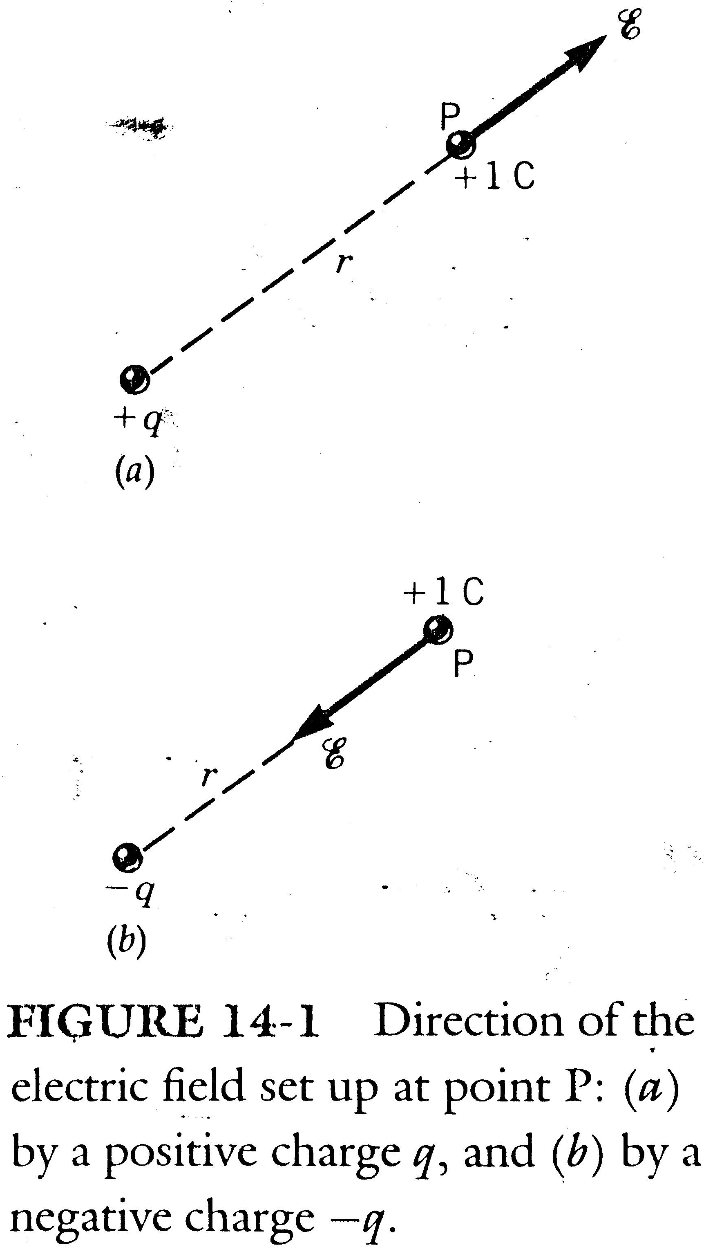

Slide 6
On the other hand, for a negative point charge q, the electric field that it produces is directed radially toward it.
The electric field obeys the superposition principle.
Not only is there no electric field when there no charges, but there is no electric field at a point when the force from an assembly of charges on a test charge is zero at that point.

Slide 7
Example 14-1
A charge C is located at the origin of the x axis. A second charge C is also on the x axis 4 m from the origin in the positive x direction (see Fig. 14-2).
(a) Calculate the electric field at the midpoint P of the line joining the two charges.
(b) At what point on that line is the resultant field zero?

Slide 8
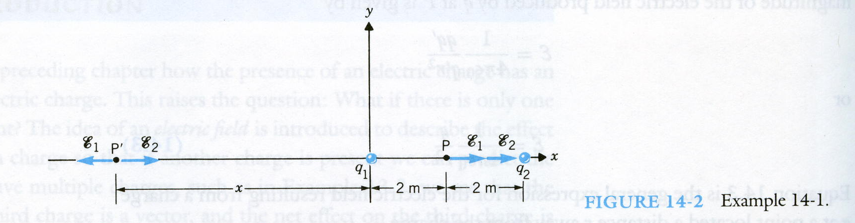

Slide 9


Sol
(a) Since q₁ is positive and q₂ is negative, at any point between them, both electric fields produced by them are the same direction which is toward to q₂. Thus,
The resultant electric field E at P is

Slide 10
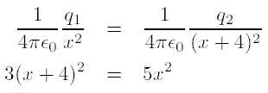

(b) It is clear that the resultant can not be zero at any point between q₁ and q₂ because both and are in the same direction. Similarly can not be zero to the right of q₂ because the magnitude of q₂ is greater then q1 and the distance r is smaller for q₂ than q₁. Thus, can only be zero to the left of q₁ at some point to be found. Let the distance from to q₁ be x.
Apparently, we need to take x which is positive.

Slide 11
Electrical Potential Energy
The magnitude of the electric field at a point P resulting from a point charge is independent of the angular position of the point P.
The direction of the electric field is radially away from the charge producing the field if the charge is positive or radially toward it if the charge is negative. See Fig. 14-3.
By definition work involves the dot product of the force vector F and displacement vector ¢s , that is, .

Slide 12
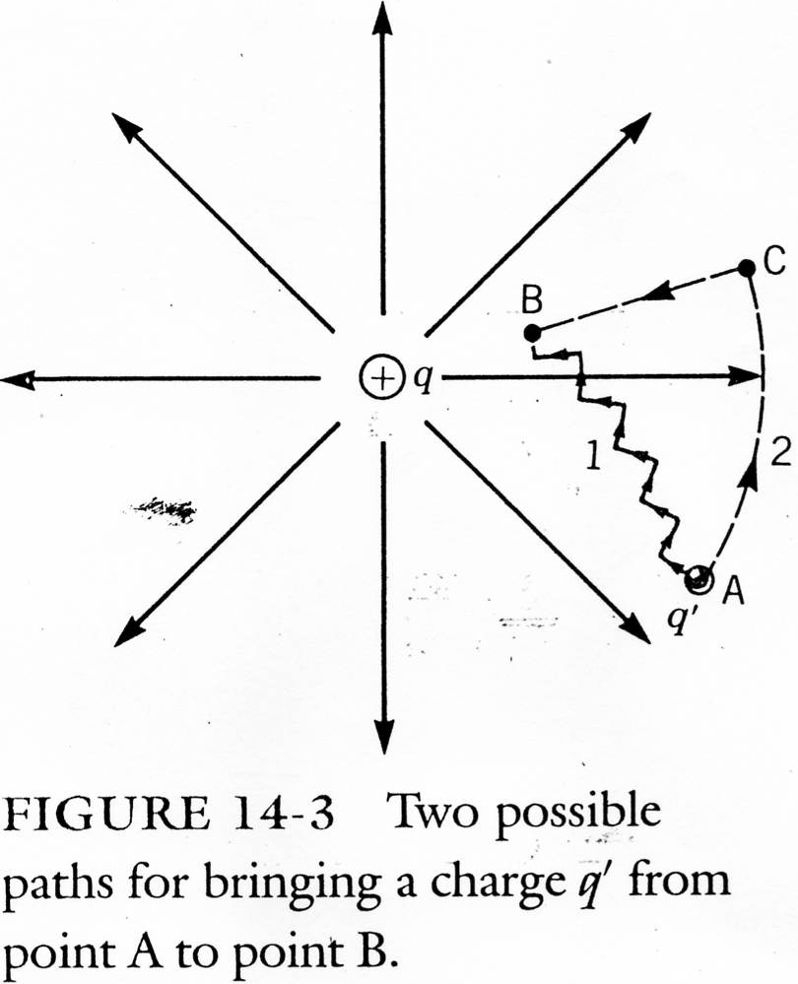

Slide 13

In Fig. 14-3 the same amount of work is done in moving a charge from point A to point B either by path 1 or by path 2 or by any other path.
The work done in moving the test charge q0 from point A to point B is

Slide 14


The force F needed to move 0 at constant velocity must be equal and opposite to the force exerted by the electric field of q.
See Fig. 14-4. We may evaluate by moving tangentially from point A to C and then radially from point C to point B.
since

Slide 15
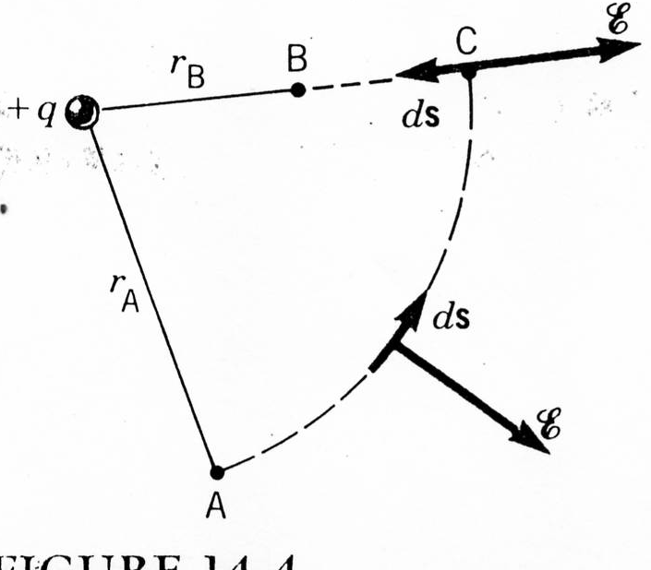

Slide 16
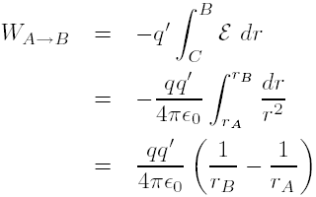
As we move a distance ds toward B from point C, the radius r decreases, that is, ds = -dr.

Slide 17

By definition, the work done in moving an object between two points in a force is equal to the difference in the potential energy E_{p} between the two points, that is
The reference point at which the potential energy is chosen to be zero is r = .

Slide 18

The potential energy of our two charges system q and q when they are separated by a distance r is simply the work done in bringing one of them from infinity to r. That is,
This potential energy is called electric potential energy.

Slide 19
If both q and q are positive, then E_{p} is also positive. To move q from infinity to r we have to do positive work, we have to overcome the repulsive force between the two charges. The same is true if both charges are negative.
If the charges are of unlike sign, they will attract each other and, consequently, to move q0 at constant velocity, we will have to hold it back. We will then do negative work and the potential energy will be negative.

Slide 20

By the superposition principle, the total energy of the three-charge system shown in Fig. 14-5 is obtained as
Thus, for a system of charges, the procedure to follow is to calculate the potential energy separately for the pairs and then to add these algebraically.

Slide 21
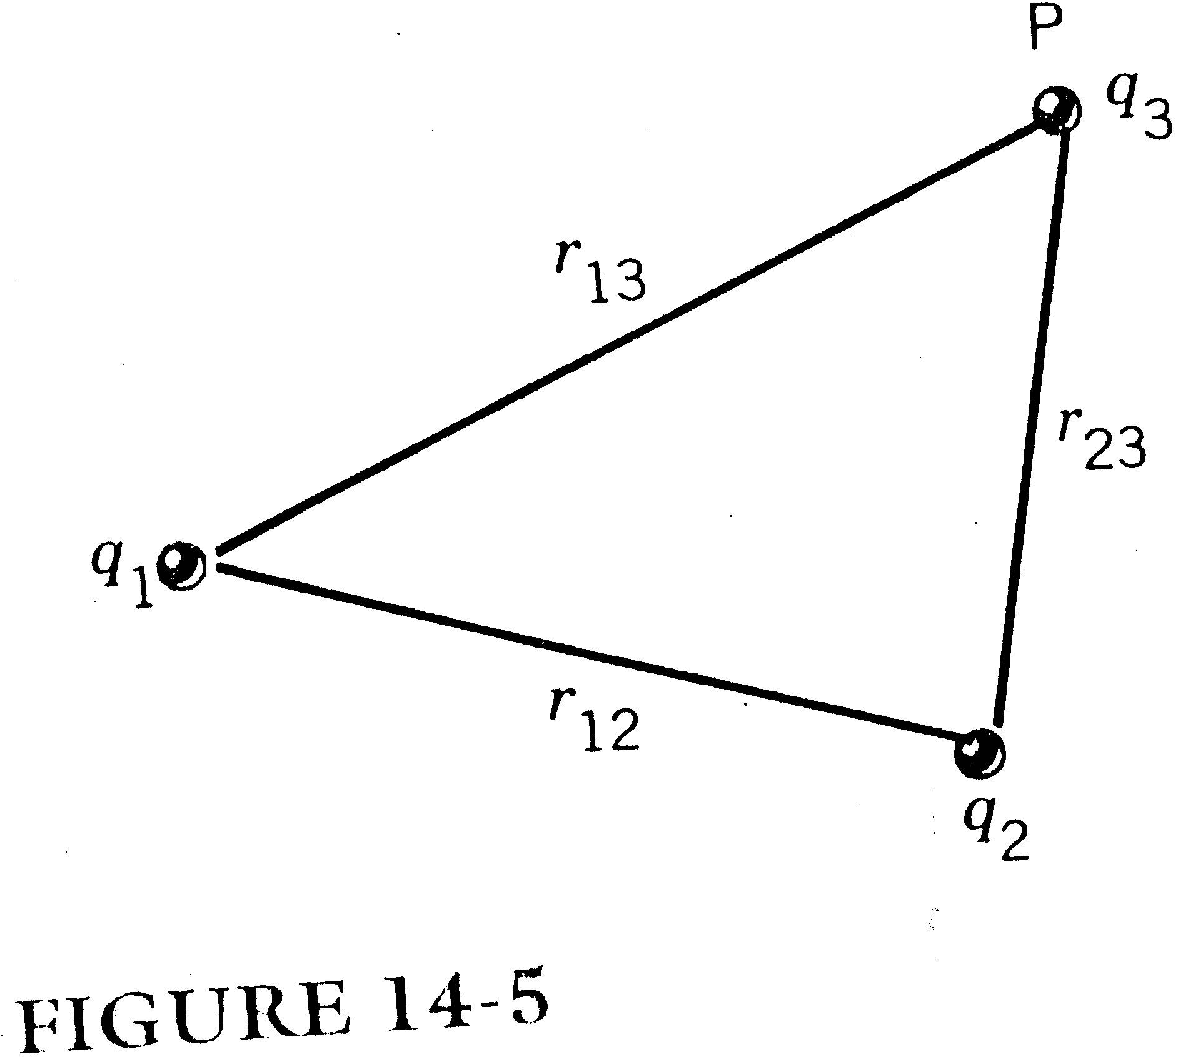

Slide 22
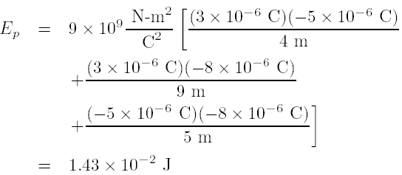
Example 14-2
Three charges and are positioned on a straight line as shown in Fig.14-6. Find the potential energy of the charges.
Sol:

Slide 23
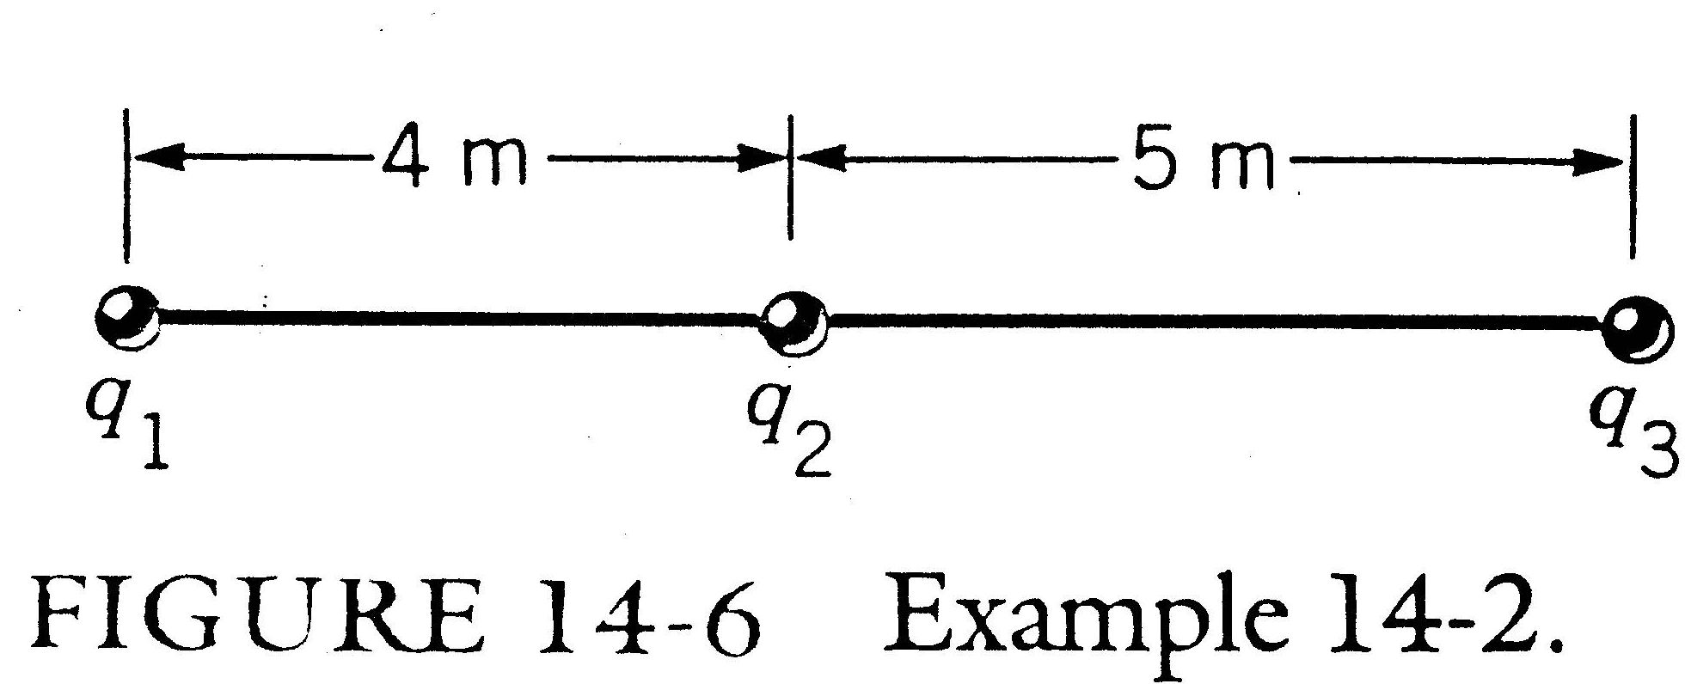

Slide 24


Electric Potential
The electric potential at a point P is defined as the work done in bringing a unit positive charge from infinity to the point. That is,
The work done in bringing a charge of arbitrary magnitude or sign to P is
and we have

Slide 25


The SI unit of potential is volt and one volt can be defined as one joule per coulomb.
The potential resulting from a point charge q at a distance r away from it is
The potential resulting from several point charges is simply equal to the algebraic sum.
where r₁, r₂… are the distances from q₁ and q₂, respectively, to the point where the potential is being evaluated.

Slide 26

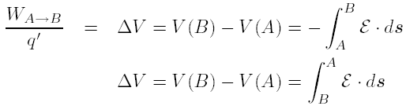
A potential difference between two points is commonly referred to as a voltage difference or simply voltage.
The potential difference can be calculated directly from the electric field.

Slide 27

Consider two plates, B which is positively charged and A which is negatively charged (see Fig. 14-7). The electric field is directed away from the positive charges and toward the negative charges.
A unit of positive charge placed at B will be accelerated toward A. Objects are accelerated when they move from a point to another of lower potential energy. Thus,

Slide 28
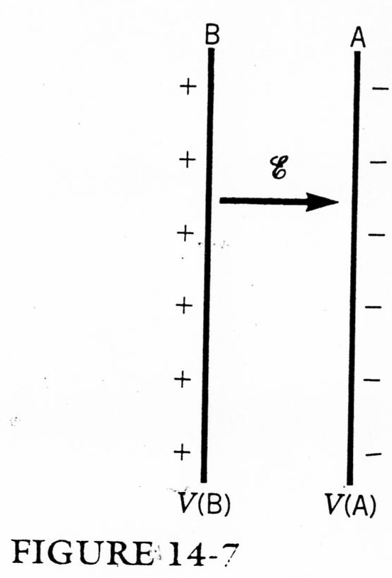

Slide 29
The electric field is directed from high potential points to low potential points, and that positive charges, if free to move, do so from high potential points to low potential points.
By using the conservation of total mechanical energy, we have

Slide 30
Example 14-3
A potential difference of 100 V is established between the two plates of Fig. 14-7, B being the high potential plate. A proton of charge C is released from plate B. What will be the velocity of the proton when it reaches plate A? The mass of the proton is

Slide 31


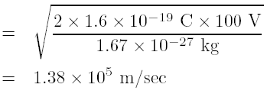
Sol
Because the proton is released with no initial velocity, E_{k}(B) is zero. Thus,
or
Solving for v_{A} ,

Slide 32
The Electron Volt and Capacitance
The charge of the electron is
If an electron is moved through a potential difference of 1 V (1J/C) the energy change is
We define 1 electron volt (eV) as
The battery maintaining a constant potential difference between plates connected to it is called an electromotive force, or simply emf.

Slide 33

Suppose we connect the terminals of a battery to two parallel metal plates, as Fig. 14-8. The plate on the left will quickly attain a negative charge of -q and the one on the right a positive charge of +q.
Experiments show that the charge is proportional to the potential difference, ,
where V actually means or voltage difference between the two terminals of the battery.

Slide 34
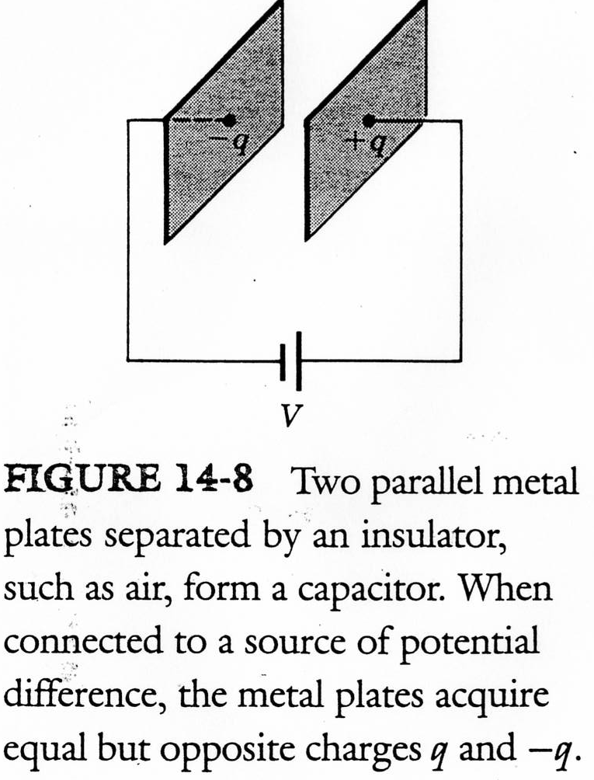

Slide 35
The arrangement of such a set of plates as in Fig. 14-8 is called a capacitor, and the constant is called the capacitance. The constant has unit farad where
The material placed between the plates is called a dielectric and
where the factor k is called the dielectric constant and it is dependent on the dielectric. For example, for air or vacuum the k is 1 and for paper it is 3.5.

Slide 36
Homework
14.2, 14.3, 14.4. 14.5, 14.6, 14.7, 14.9, 14.10, 14.20, 14.22, 14.23.

