Slide 1
Chapter Seventeen:
The Beginning of the Quantum Story

Slide 2
The Beginning of the Quantum Story
The principle of relativity seemed to fail when applied to electromagnetism.
The principle states that the laws of physics should be the same in all inertial frames of reference.
This mathematical invariance was shown to be preserved with the laws of mechanics, but it broke down with the laws of electricity and magnetism.
This problem eventually led to development of Einstein's special theory of relativity.

Slide 3
Another problem that baffled physicists at the beginning of the twentieth century was the nature of the spectrum emitted by a class of objects called blackbodies.
The predictions of classical ideas did not fit the experimental results. This problem led to the development of what we now call quantum mechanics.
We will address only the quantum mechanical part of modern physics in the remainder of the class.

Slide 4
Blackbody Radiation
All substances at finite temperatures radiate electromagnetic waves.
Isolated atoms emit discrete frequencies, molecules emit bands of frequencies, and solids radiate a continuous spectrum of frequencies.
The details of the spectrum emitted by a solid depend on its temperature and to some extent on its composition.
Most of the radiation emitted lies in the infrared part of electromagnetic spectrum.
As the temperature of the solid increases, more and more of the emitted radiation is in the visible.

Slide 5
Objects that emit a spectrum of universal character, one that does not depend on the composition of the object, are called blackbodies.
A type of blackbody is a metallic cavity with a small hole (Fig.17-1).
After multiple partial reflections by the inner walls of the cavity, the radiation is eventually absorbed by the atoms in the walls of the cavity.
These atoms, in turn, will reradiate electromagnetic waves into the cavity and some of it will leak out through the hole.

Slide 6
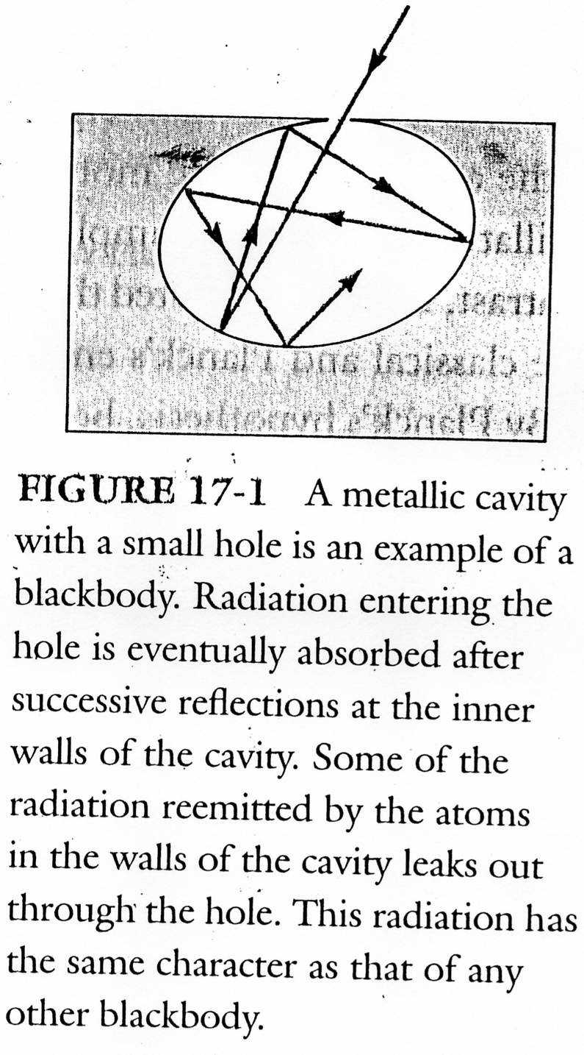

Slide 7

The main features of the spectrum emitted by a blackbody are:
1. The spectrum is continuous with a broad maximum. See Fig.17-2.
2. The integral of I(v) over all v, which we call I_{T} , represents the energy emitted per unit time per unit area, regardless of the frequency, and it is found to increase with the fourth power of the temperature. That is ( Stefan-Boltzmann law)
where the constant
3. The spectrum shifts toward higher frequencies as the temperature increases. That is,

Slide 8
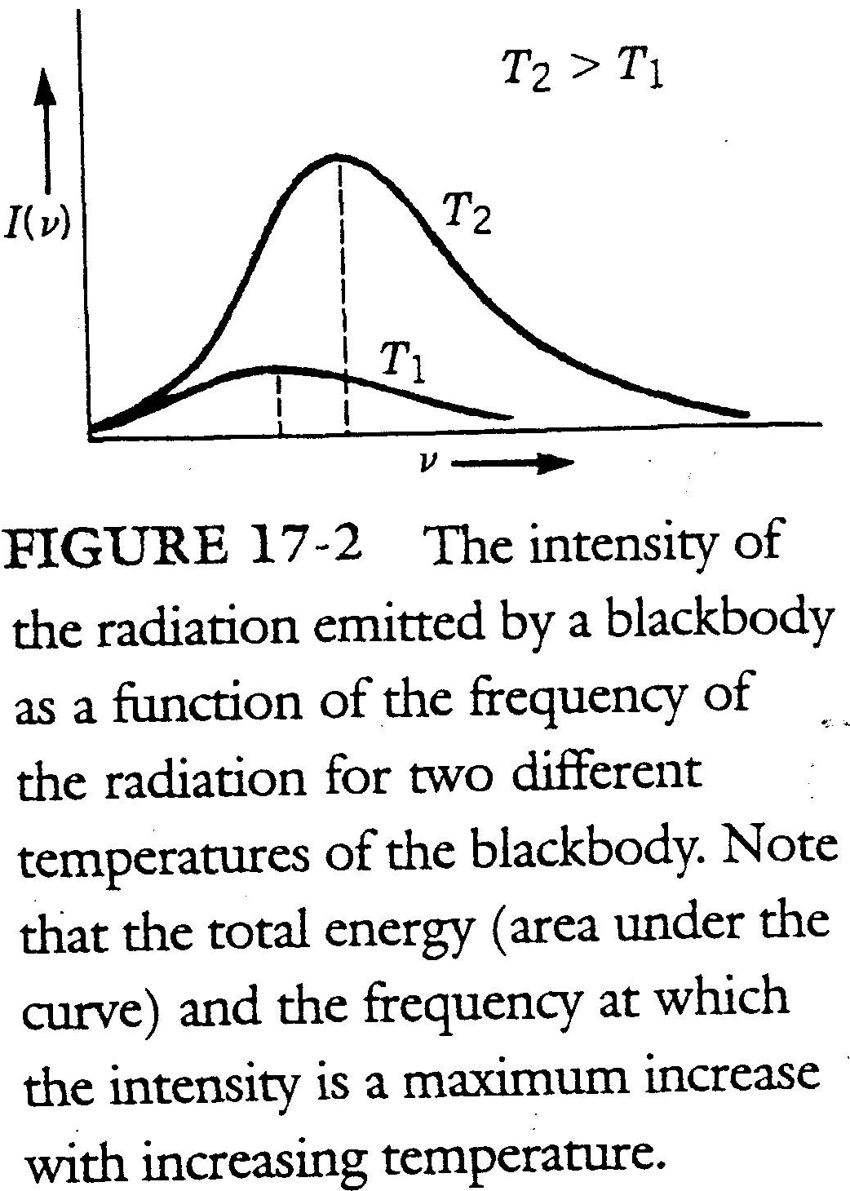

Slide 9

Attempts by physicists to explain the blackbody spectrum using the laws of classical electromagnetism and thermodynamics proved unsuccessful.
Planck presented a paper entitled, "On the Theory of the Energy Distribution Law of the Normal Spectrum," which is considered the birthday of quantum mechanics.
The revolutionary physical hypothesis Plank made: A system undergoing simple harmonic motion with frequency v can only have and therefore can only emit energies given by E = nhv, where n = 1; 2; 3; : : : and h is a constant known as Planck's constant.
Joule second (J-sec).

Slide 10

Plank postulated that atomic oscillators can have only discrete energy values. See Fig. 17-3.
An oscillator can take only certain values for the energy, when they lose that energy; they lose it in multiples of hv. these small quantities of energy are called quanta (singular, quantum).
Plank derived a rather complicated expression for I(v) that matched the experimental data:
where c is the velocity of light, kB is the Boltzmann constant, v is the frequency of the electromagnetic wave, and T is the absolute temperature of the black body.

Slide 11
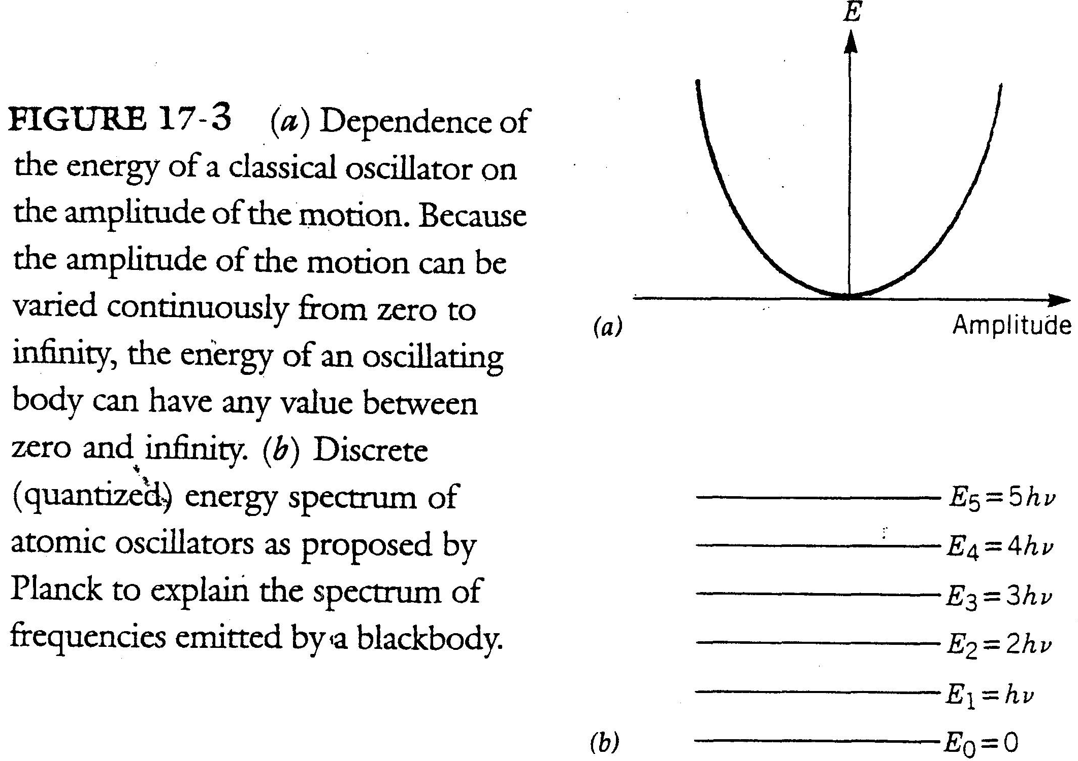

Slide 12


Example 17-s1
Let us consider a mass m = 10 kg, attached to a spring of force constant k = 10³ N/m. Let the initial amplitude of the motion be A = 0.1 m. What is the separation between adjacent energy levels?
Sol: We know that
and
By Plank's hypothesis

Slide 13
The Photoelectric Effect
The quantum idea was further expanded by Albert Einstein in connection with the photoelectric effect.
Under certain conditions, light incident on a metal will cause electrons to be ejected from the surface of the metal. This is known as the photoelectric effect.
An experimental arrangement that can be used to study some of the properties of the photoelectric effect is shown in Fig. 17-4.
Because the anode is at a negative potential V with respect to the cathode, the electrons, on being emitted by the incident light striking the cathode, face a retarding voltage V .

Slide 14
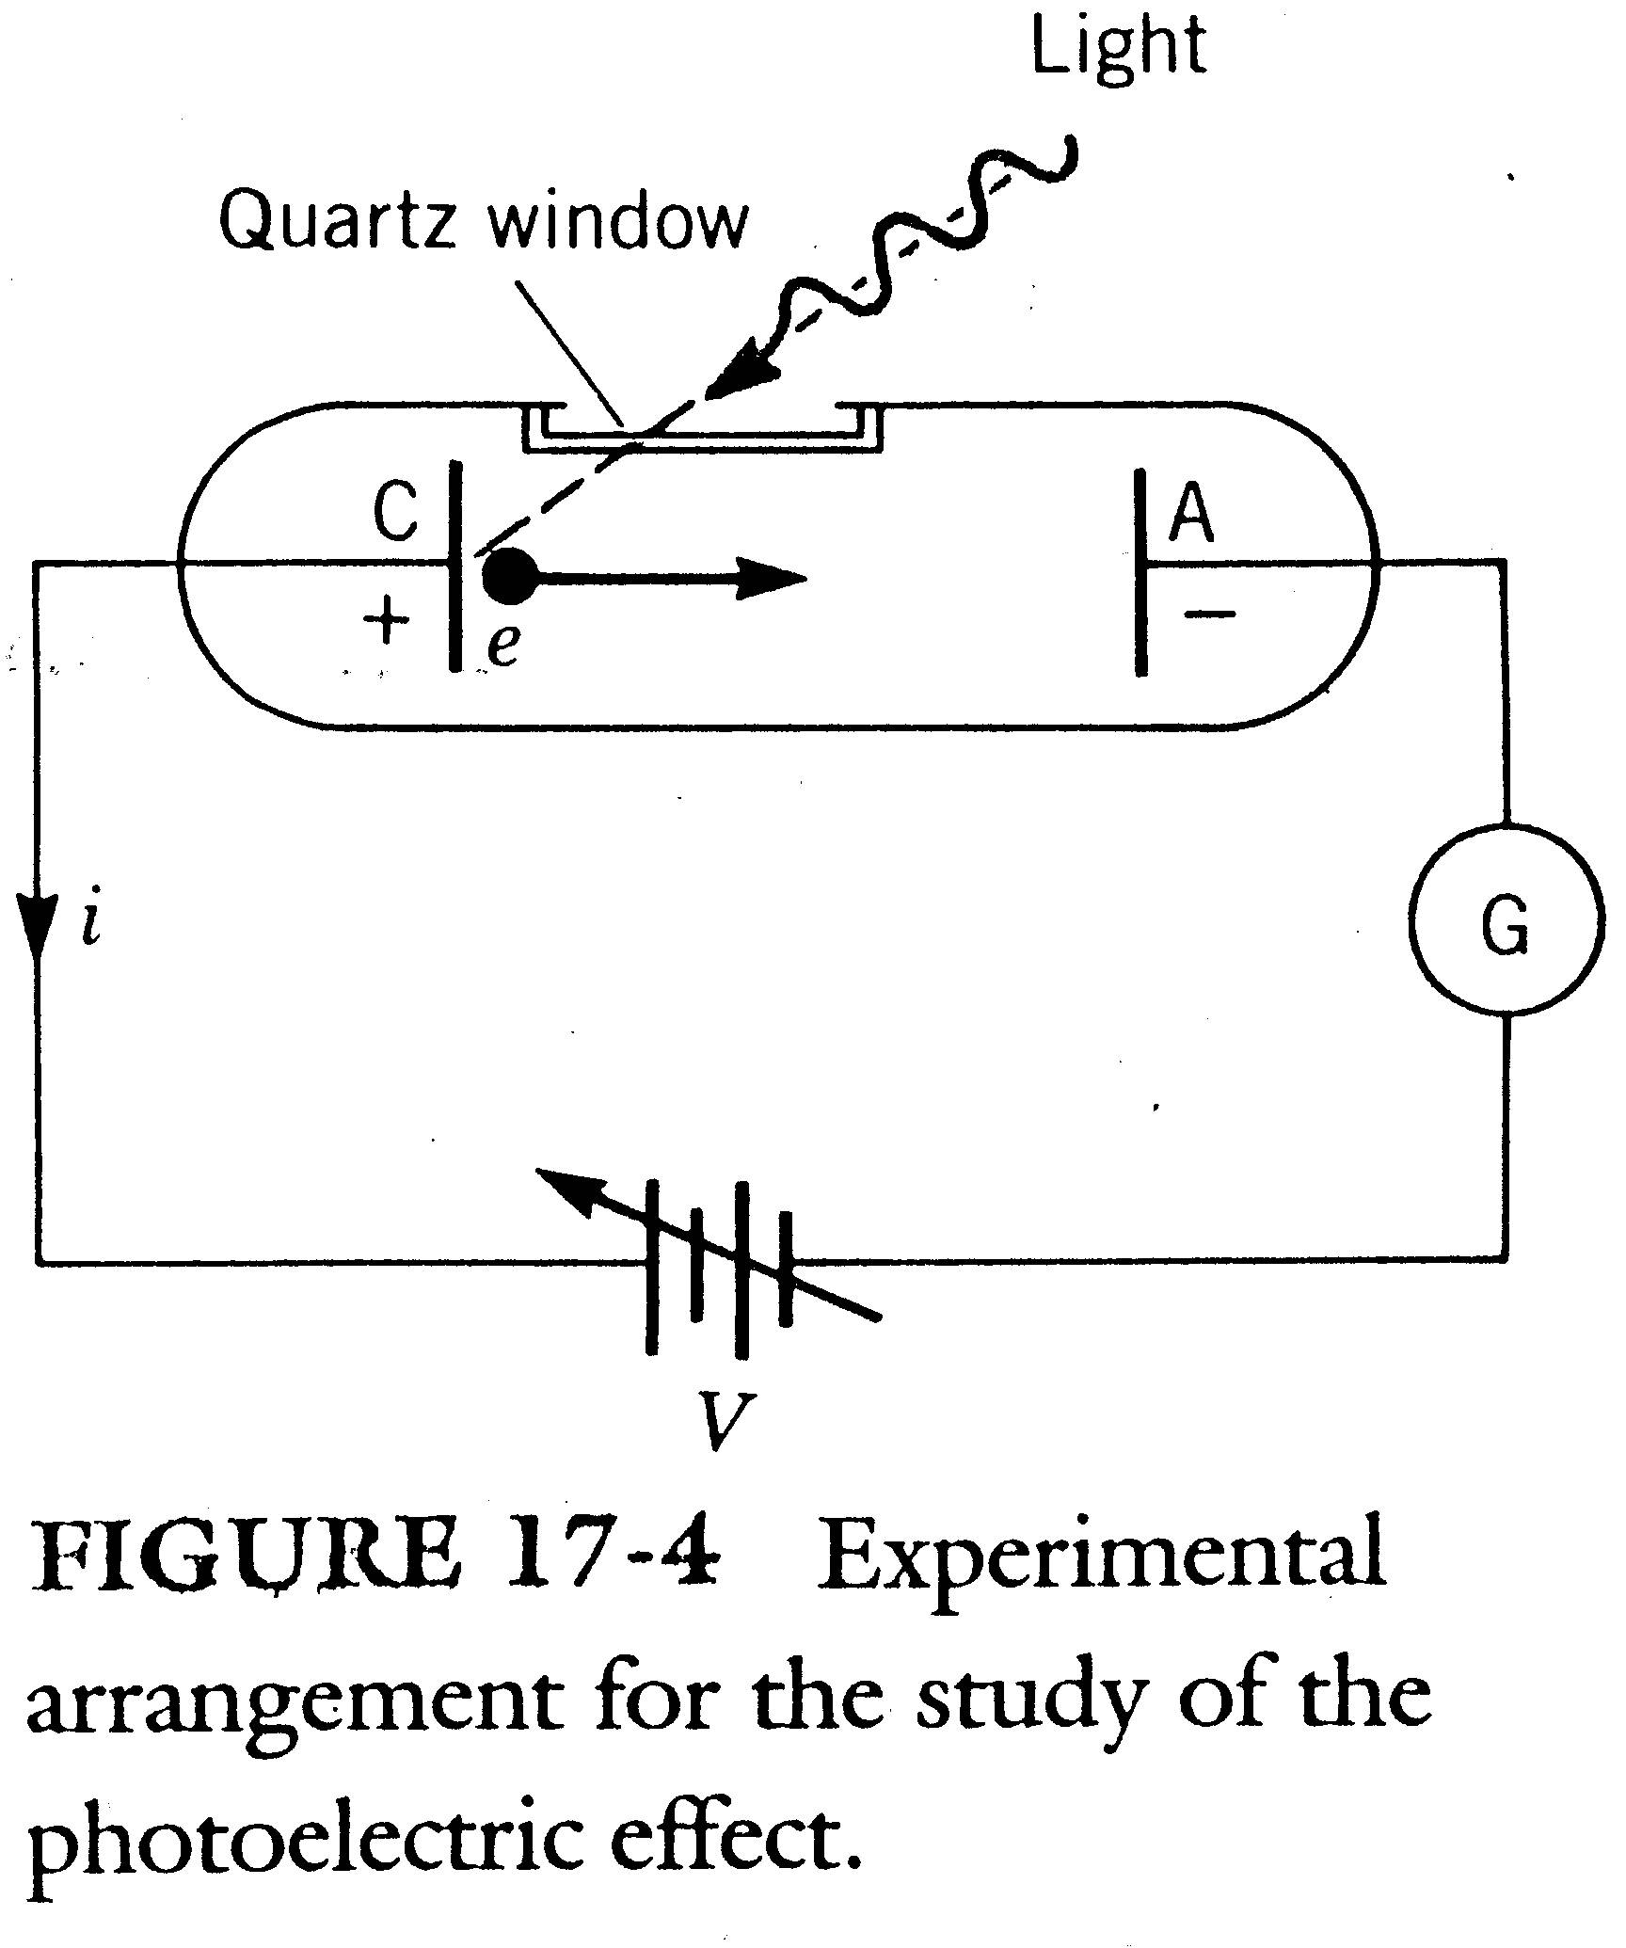

Slide 15

To reach the anode the photoelectron must be ejected with a kinetic energy E_{k} that is greater than the difference in potential energy, , between the anode and the cathode.
A summary of the experimental results is shown in Fig. 17-5.
When V = V₀ (V₀ is called the stopping potential), all the electrons, including the most energetic ones, are turned back and the current drops to zero.
V₀ is a measure of the maximum energy with which the electrons are ejected from the cathode,

Slide 16
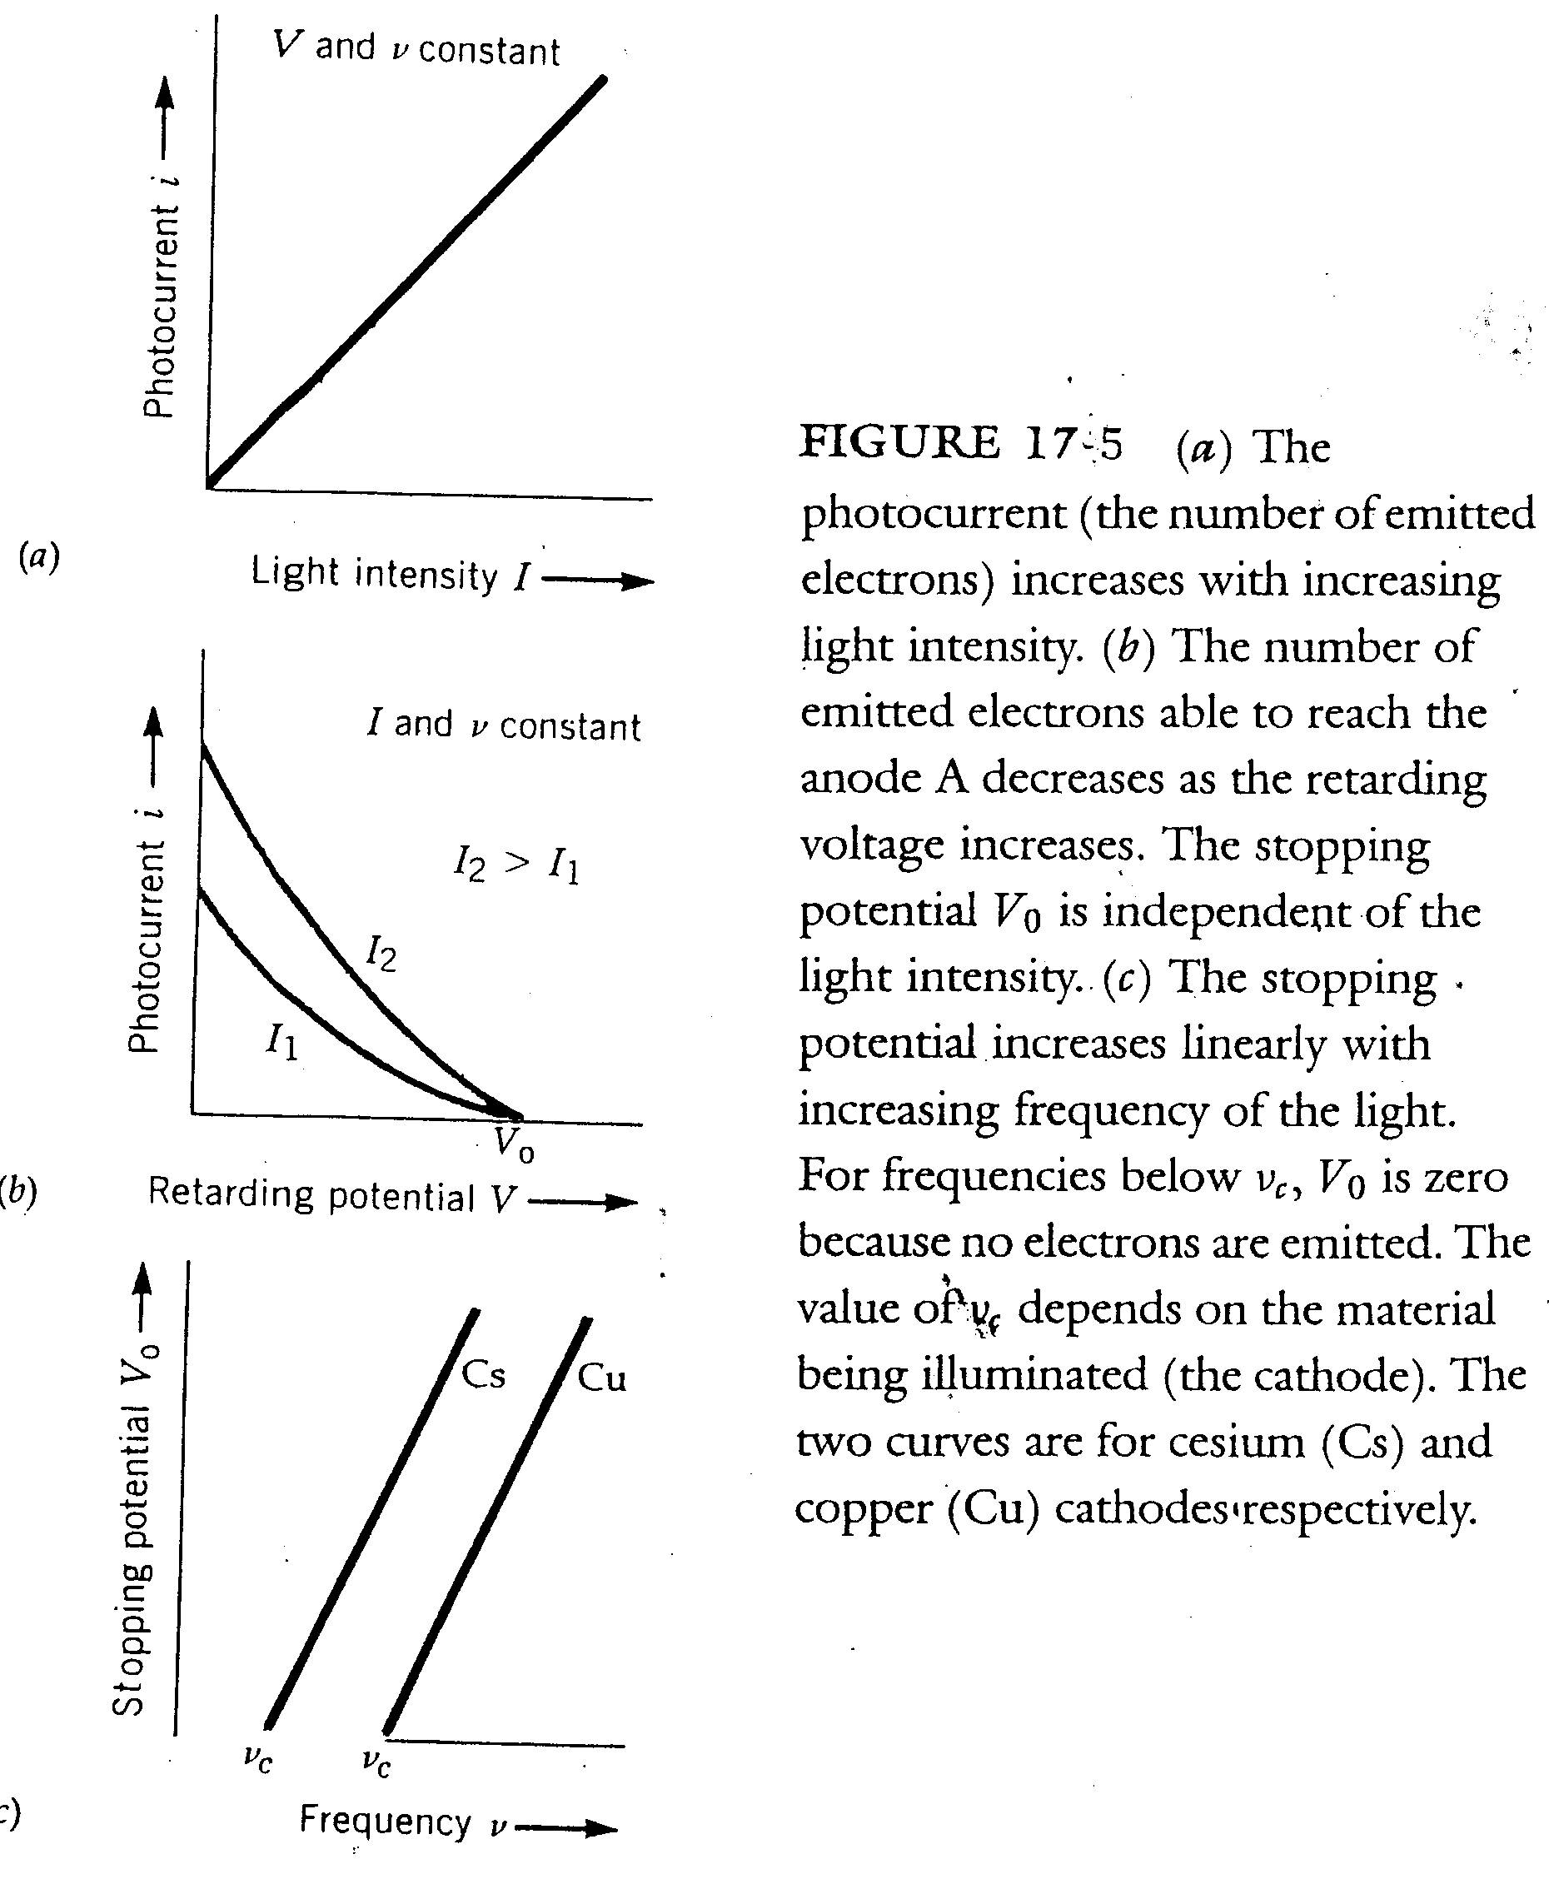

Slide 17
Figure 17-5b shows that V₀ is independent of the intensity of the light.
Fig 17-5c also shows that for frequencies V₀ is zero.
When the conditions for photoemission are favorable (high enough v, low enough V ), the emission is almost instantaneous (within 10⁻⁹ sec). This instantaneous emission has been observed to take place with extremely low intensities of light, as low as 10⁻¹⁰ W/m2.

Slide 18

According to classical physics, light is an electromagnetic wave. Two facts about waves are:
1. The energy of a wave is continuously distributed over the entire space traversed by the wave.
2. The intensity of a wave, which represents the energy carries by the wave per unit area perpendicular to the direction of propagation of the wave per unit time is proportional to the direction of the amplitude of the wave. In the case of electromagnetic waves,
where is the permittivity of free space, c is the velocity of light, and is the amplitude of the electric field of the wave.

Slide 19
The results of Fig. 17-5a can be explained in terms of classical concepts.
The fact that E_{k max} is independent of the intensity is difficult to explain by classical theory.
The fact that E_{k max} increases with v can not be accounted for by classical physics. Since the energy of the electromagnetic wave depends on its intensity, not on its frequency, V₀ should not depend on v.
The fact that the emission is almost instantaneous plays a key role in teh rejection of the classical ideas about the nature of electromagnetic radiation. See the next example.

Slide 20

Example 17-s2
Let us consider a sheet of some metal with an area of 1 m², as shown in Fig. 17-6. Assume that light of intensity I = 10⁻¹⁰ W/m² shines on it. By the classical physics, how long that an electron will be emitted? Assume that the interatomic separation d in a metal is about .

Slide 21
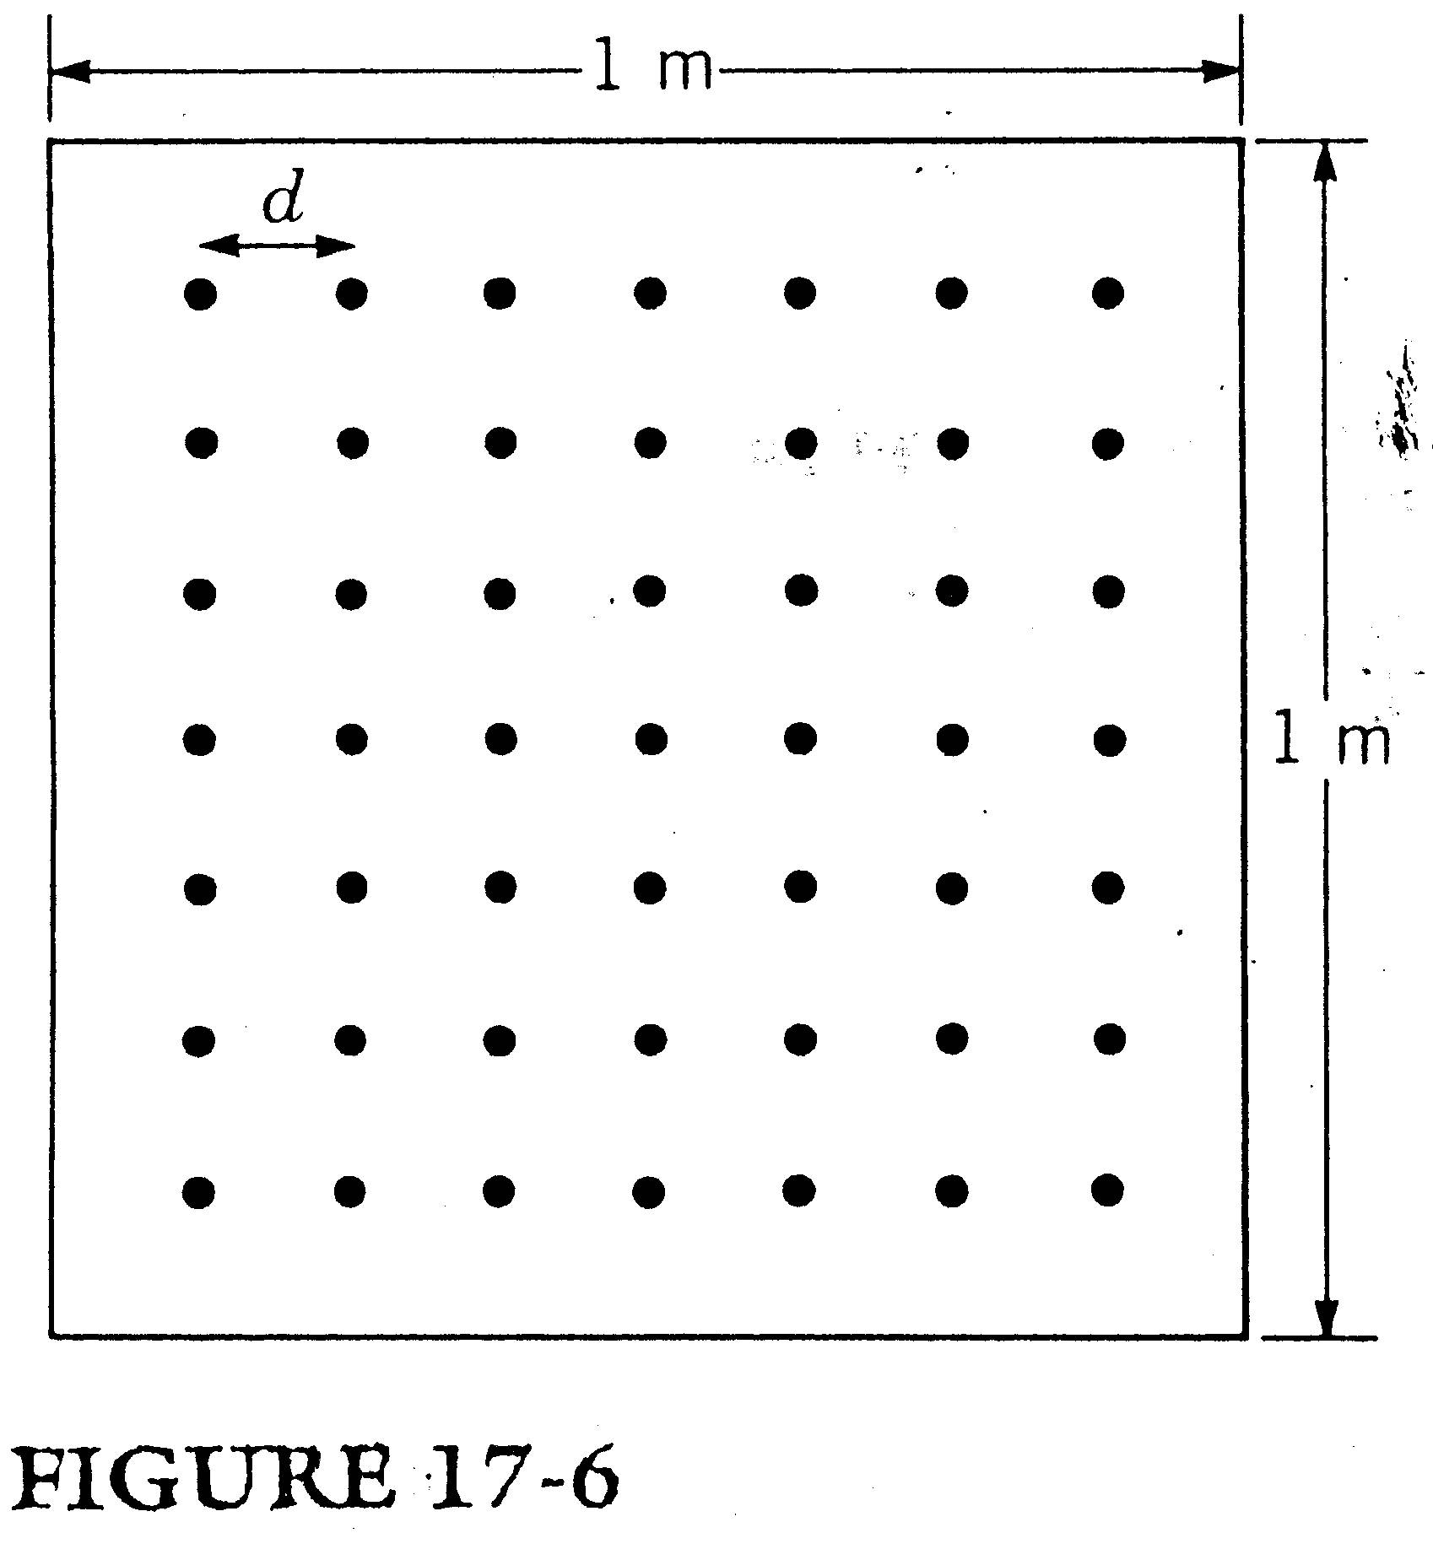

Slide 22

Sol
Let us be optimistic and assume that all the energy falling on a certain atomic site of the metal sheet is absorbed by only one of the electrons of the atom, the most loosely bound. The number of atoms in a 1-m-long row is
For simplicity, let the metal has cubic structure. Consequently, the number of atoms in the first layer of the metal sheet is
atoms/layer. That is,

Slide 23

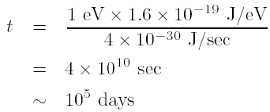
Assume that the minimum binding energy of an electron in a metal is 1 eV. The time required for an electron to collect 1 eV from the electromagnetic wave is
We see that classical physics also fails to explain the short time release of electrons in the photoelectric effect.

Slide 24
Einstein's Theory
According to Einstein, the energy of an electromagnetic wave of frequency v is not continuously distributed over the entire wave front, but instead it is localized in small bundles called photons.
The energy of each photon is E_{photon} = hv.
Basically a beam of electromagnetic radiation carries energy like a beam of particles, not like a wave.
Einstein visualized the photoelectric effect as a particle-particle collision in which a photon of energy hv collides with an electron in the metal and imparts all its energy to the electron.

Slide 25


where E_{b} is the energy with which the particular electron is bound to the metal and E_{k} is the kinetic energy with which that electron is ejected.
where Φ is the minimum binding energy and is called the work function of the metal.
E_{k max} is measured by determining the stopping potential V₀ and E_{k max} = eV₀. Thus,
is equal to the observed value.
If , then no photoemission will take place.
The emission is instantaneous because the process is not one in which the electrons progressively gather energy until they have enough to come out. It is a particle-particle collision.

Slide 26
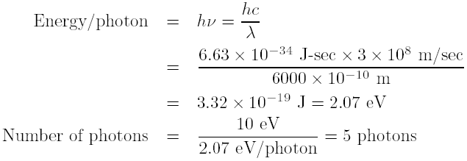
Example 17-1
The eye is capable of detecting 10 eV of light energy. If we take as the average wavelength of light 6000ºA, how many photons is the eye capable of detecting.
Sol: We obtain

Slide 27
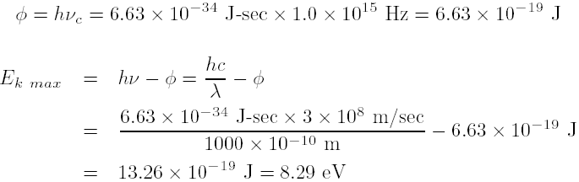
Example 17-2
The cut-off frequency for photoemission in copper is Hz. What is the maximum kinetic energy of the photoelectrons emitted when light of wavelength is shone on a copper surface?
Sol: The work function is

Slide 28






Supplement 17-0: Mass-Energy Equivalence
Einstein proposed that the mass of a particle can be treated as total energy of it dividing by c², where c is the speed of the light.
Let E be the total energy of a particle and m be mass of this particle when the particle is of speed v. Thus,
Since F = d(m_{v}v)/dt, Equation 1 becomes
Multiplying 2m_{v} on both sizes of the above equation, we have

Slide 29





Equation 3 can be rewritten as
Integrating both sizes of Equation 4, we have
where C is a constant.
When v = 0, we have
where m₀ is the mass when the particle is at rest.
Substituting C into Equation 5, we have

Slide 30
Supplement 17-1: Momentum of the Photon
Momentum and energy for all possible speed from Einstein's theory of special relativity:
1. (momentum);
2. (kinetic energy);
3. (total energy, single particle);
4. (the relation between momentum and kinetic energy);

Slide 31

Where
v is the speed of the particle, m₀ is the rest mass of the particle, and c is the velocity of light.
E_{k} is the kinetic energy of the particle, E₀ = m₀c² is the rest energy (m₀ is the rest mass of the particle, that is, the mass of the particle when its velocity is zero).
For the photon, the rest energy and therefore the rest mass is zero.

Slide 32



By Einstein's postulate,
Thus
Therefore, the momentum p of the photon is

Slide 33
Compton Effect
In 1916 Einstein extended his photon concept by asserting that when light interacts with matter, not only energy but also linear momentum is transferred via photon.
Like energy, momentum is transferred in discrete amounts and at pointlike locations instead of broad regions.
A. Compton carried out an experiment that gave solid support to the view that both momentum and energy are transferred via photon. See Fig. 17-10.
Fig. 17-11 shows his results.

Slide 34
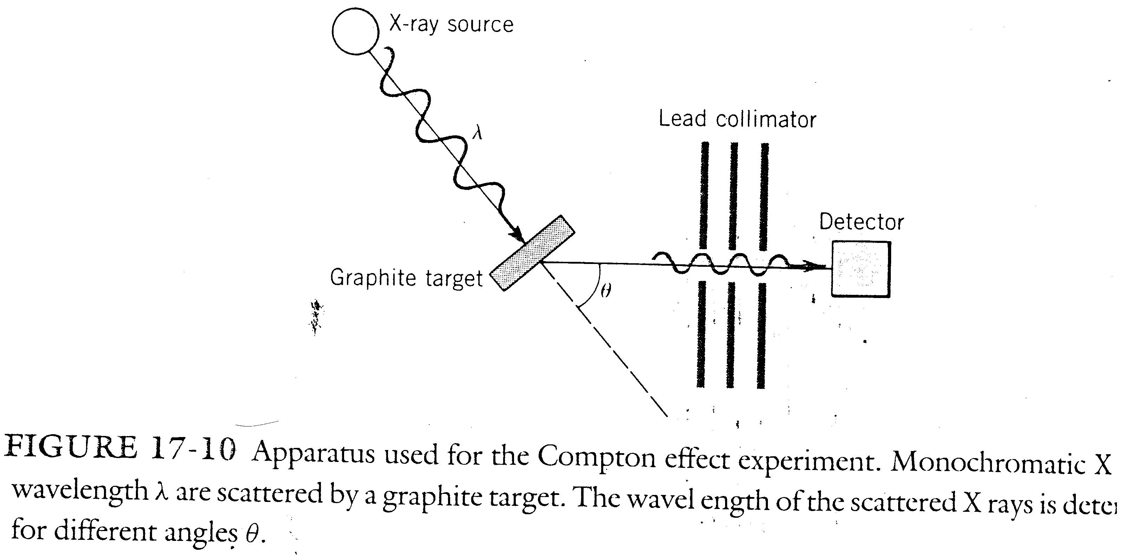

Slide 35
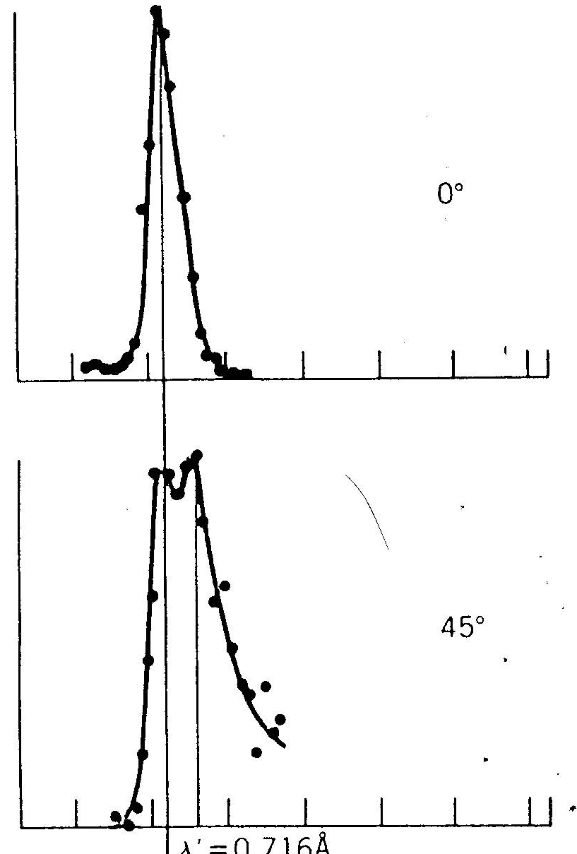
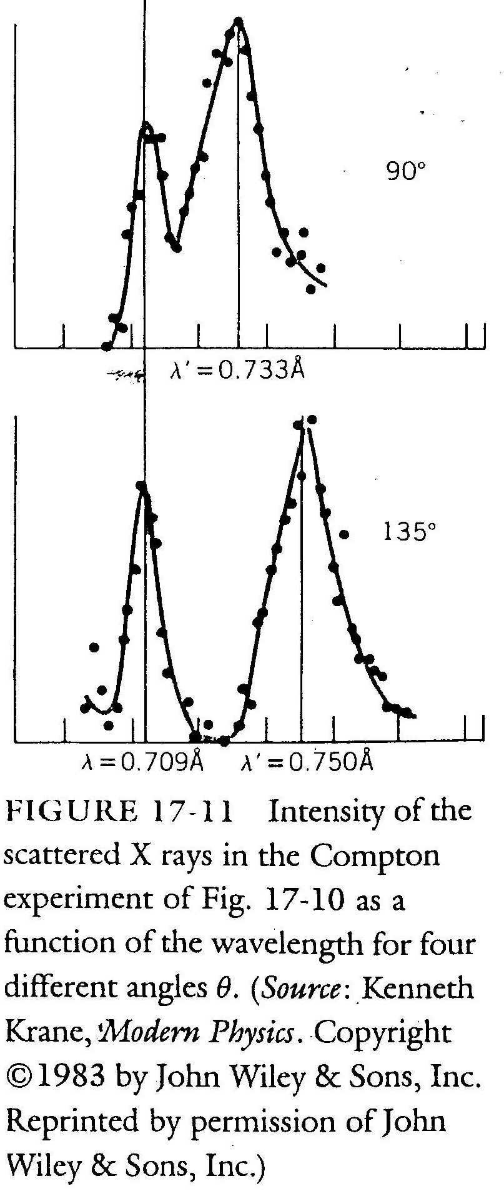

Slide 36
Although there is only a single wavelength in the incident x-ray beam, the scattered x-ray contain a range of wavelengths with two prominent intensity peaks.
One peak is centered about the incident wavelength , the other about a wavelength that is larger than by an amount , which is called the Compton shift.
The value of the Compton shift varies with the angle at which the scattered x-ray are detected.
Classical electromagnetic theory can not explain the presence of a longer wavelength in the scattered beam.

Slide 37

Compton interpreted the scattering of x-rays from carbon in terms of energy and momentum transfers, via photons, between the incident x-ray beam and loosely bound electrons in the carbon target. See Fig. 17-12.
As a result of collision, an x-ray of wavelength moves off at an angle θ and the electron moves off at an angle Φ.
The conservation of energy gives
where hv is the energy of the incident x-ray photon, is the energy of the scattered x-ray photon, and E_{k} is the kinetic energy of the recoiling electron.

Slide 38
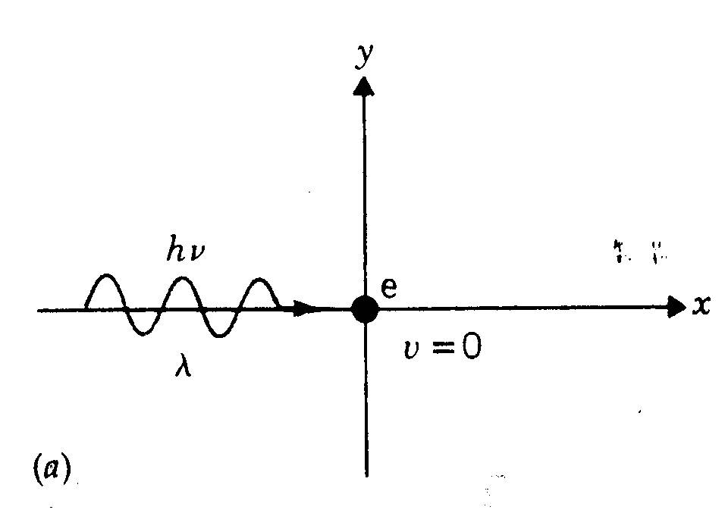
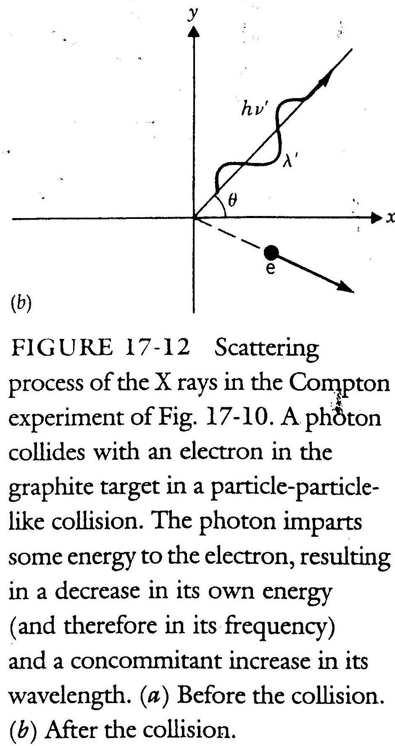

Slide 39


Because the electron may recoil with a speed comparable to that of light, we must use the relativistic expression of its kinetic energy. That is,
where m is the rest mass of an electron.
The momentum of the incident and scattered photons is p_{photon} = ¸ and that of the scattered electron is p_{e} = γmv.

Slide 40
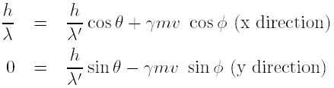

We need to apply the law of conservation of momentum to the x-ray-electron collision.
If we eliminate v and ψ which deal only with the recoiling electron, then

Slide 41


The photon can also collide with the atoms in the graphite. Since , for graphite,
We have
which is an unobservable amount when we compare it with

Slide 42
Example 17-3
X-rays of wavelength are Compton-scattered by the electrons in a graphite target.
(a) What is the wavelength of the X-rays scattered at an angle θ = 120º?
(b) What is the kinetic energy of the scattering electrons if they were originally at rest?
(c) What is the scattering angle of the electrons?

Slide 43
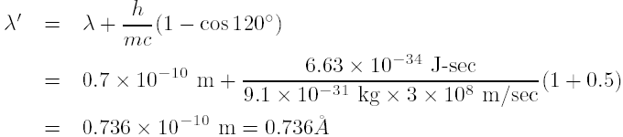
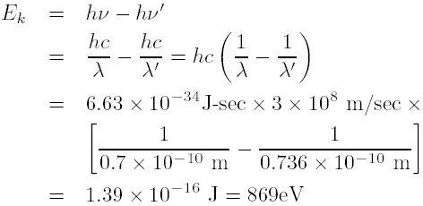
Sol
(a)
(b) From conservation of energy principles, the kinetic energy of the electron is equal to the energy lost by the photon, that is,

Slide 44


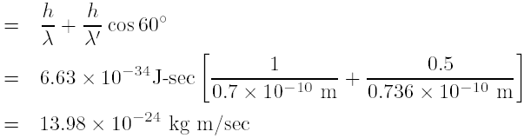
(c) From conservation of linear momentum principles on x direction we have
Therefore,

Slide 45

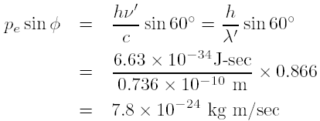
From conservation of linear momentum principles on y direction we have
Therefore,

Slide 46
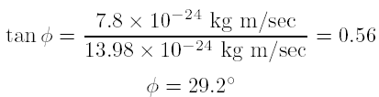
Thus,
Homework : 1, 3, 5, 6, 8, 9, 10, 12, 14, 15, 17, 18, 19.

