Slide 1
Chapter Eighteen:
Atomic Models

Slide 2
Atomic Models
The atom contains electrons. On the other hand, the atoms were known to be electrically neutral.
The atom carries an amount of positive charges equal in magnitude to the charge of its electrons.
The mass of the atom is thousands of times greater than that of the electron.
Most of the mass of the atom resides either with the positive charged matter or with neutral matter.

Slide 3
The Rutherford Model
In 1911, Rutherford and two co-workers did a series of experiments in which positively charged α particles, emitted by certain radioactive materials were sent through a collimator and then shot through thin metallic foils. See Fig. 18-1.
They studied the angular dependence of the scattered α particles, that is, what fraction of the α particles were scattered at a given angle θ.
Rutherford suggested that the experimentally observed large-angle scattering of α particles could be explained on the basis of a "nuclear planetary model".

Slide 4
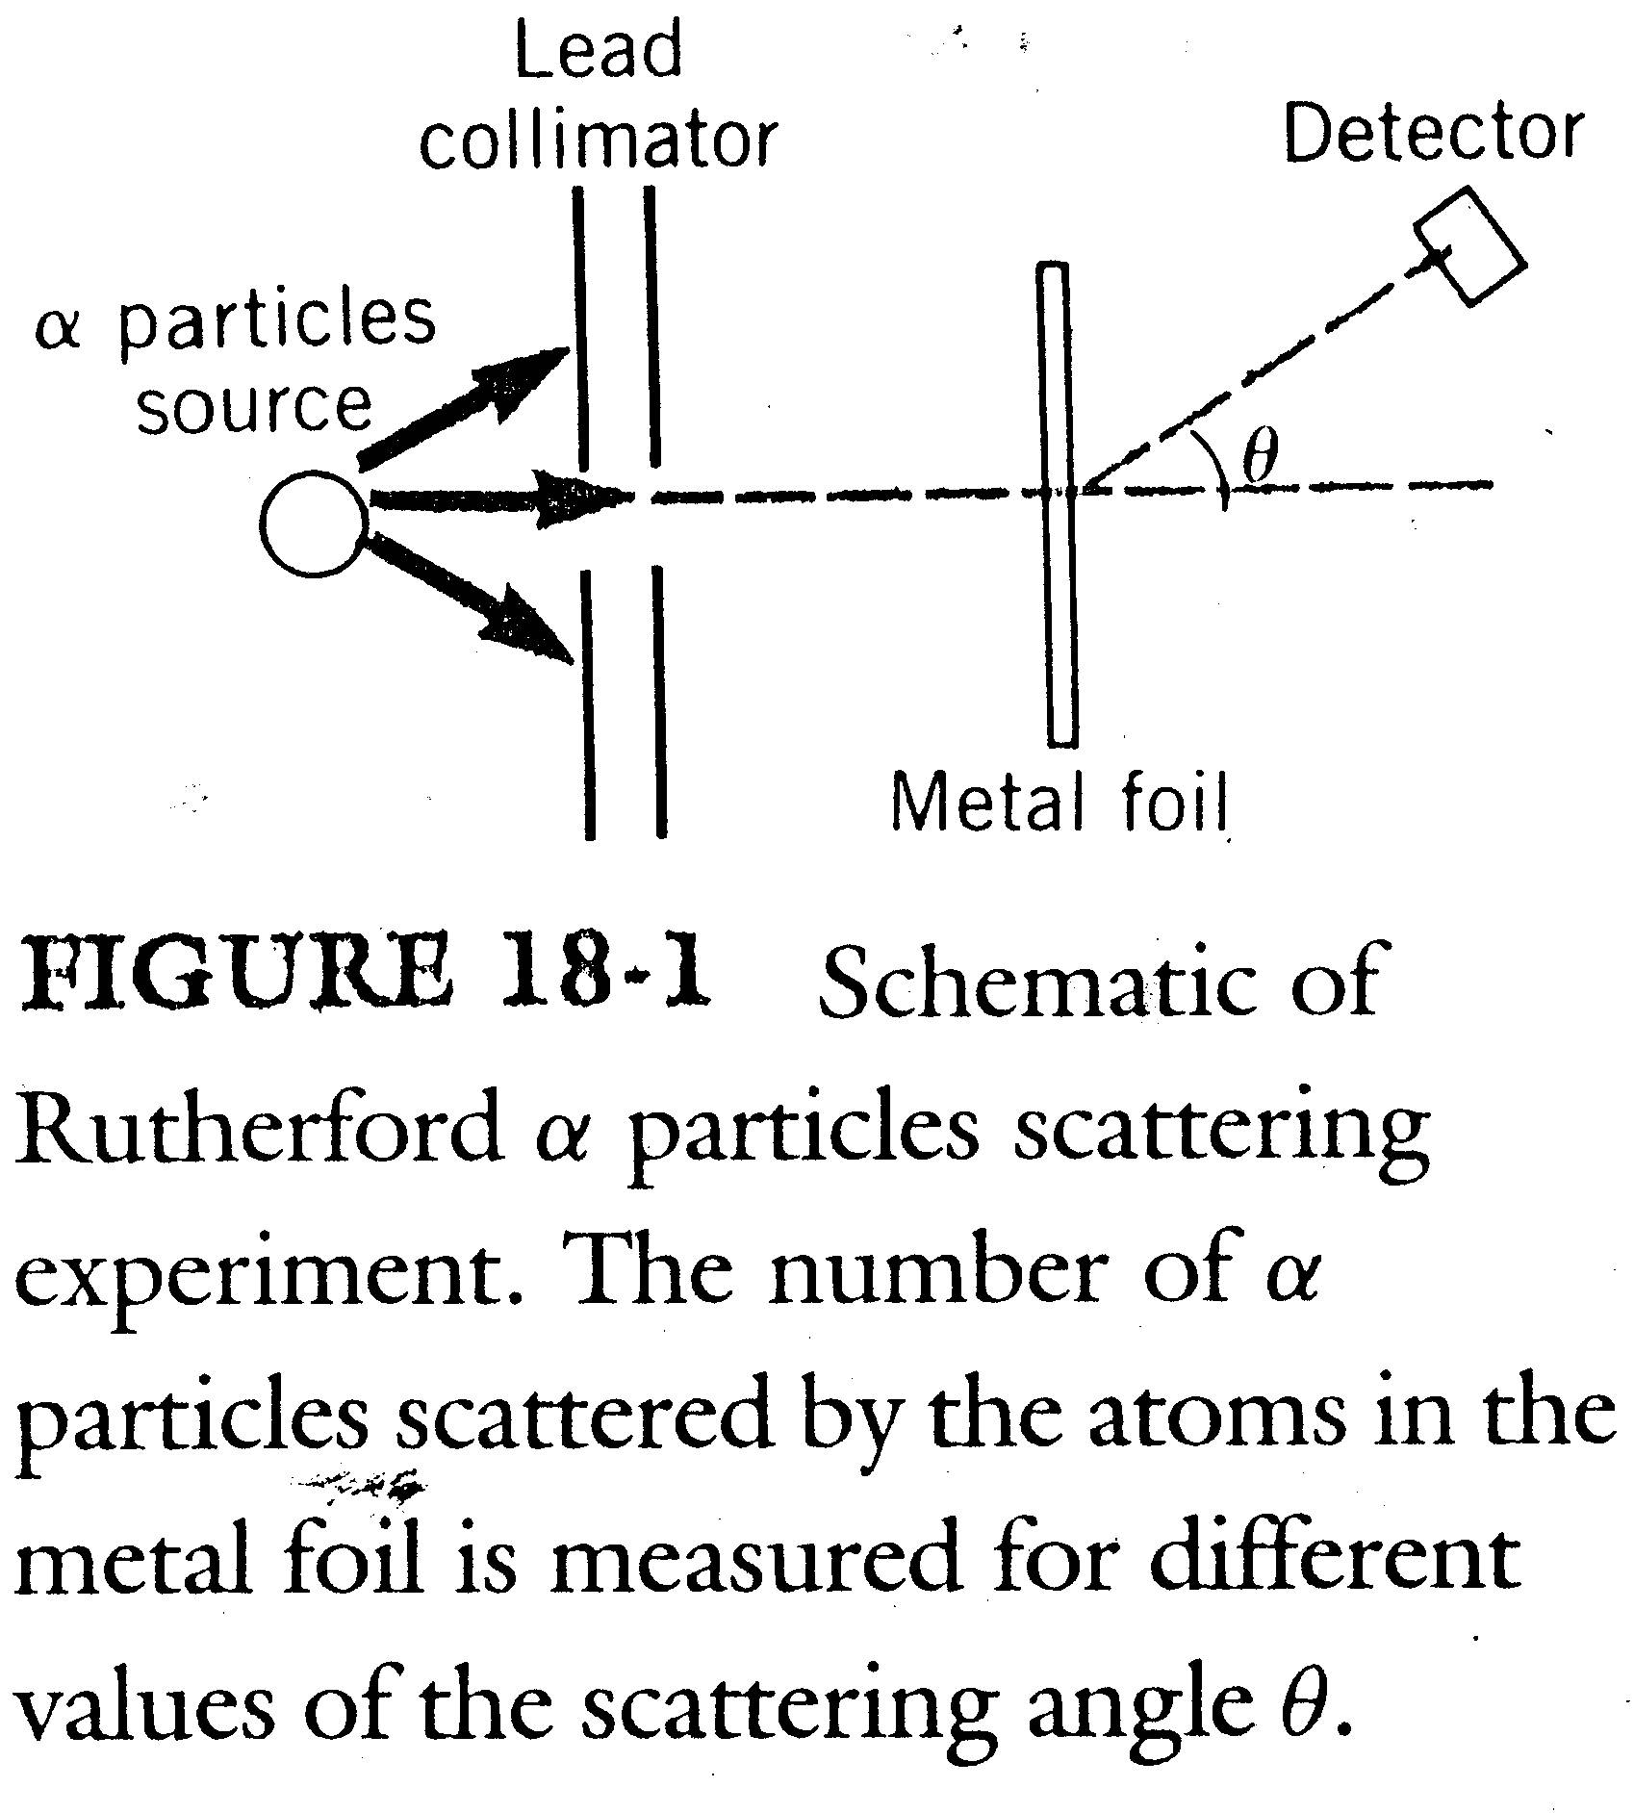

Slide 5

The problems caused by the model, such as stability of the model which can not be explained by classical physics, required a drastic modification of physical concepts and led to the first quantum mechanical model, the Bohr model.
Let us consider the simplest of atoms, the hydrogen atom. An electron of charge q = -e rotates in a circular orbit of radius r under the electrostatic attraction of the nucleus q = +e. See Fig. 18-2.

Slide 6
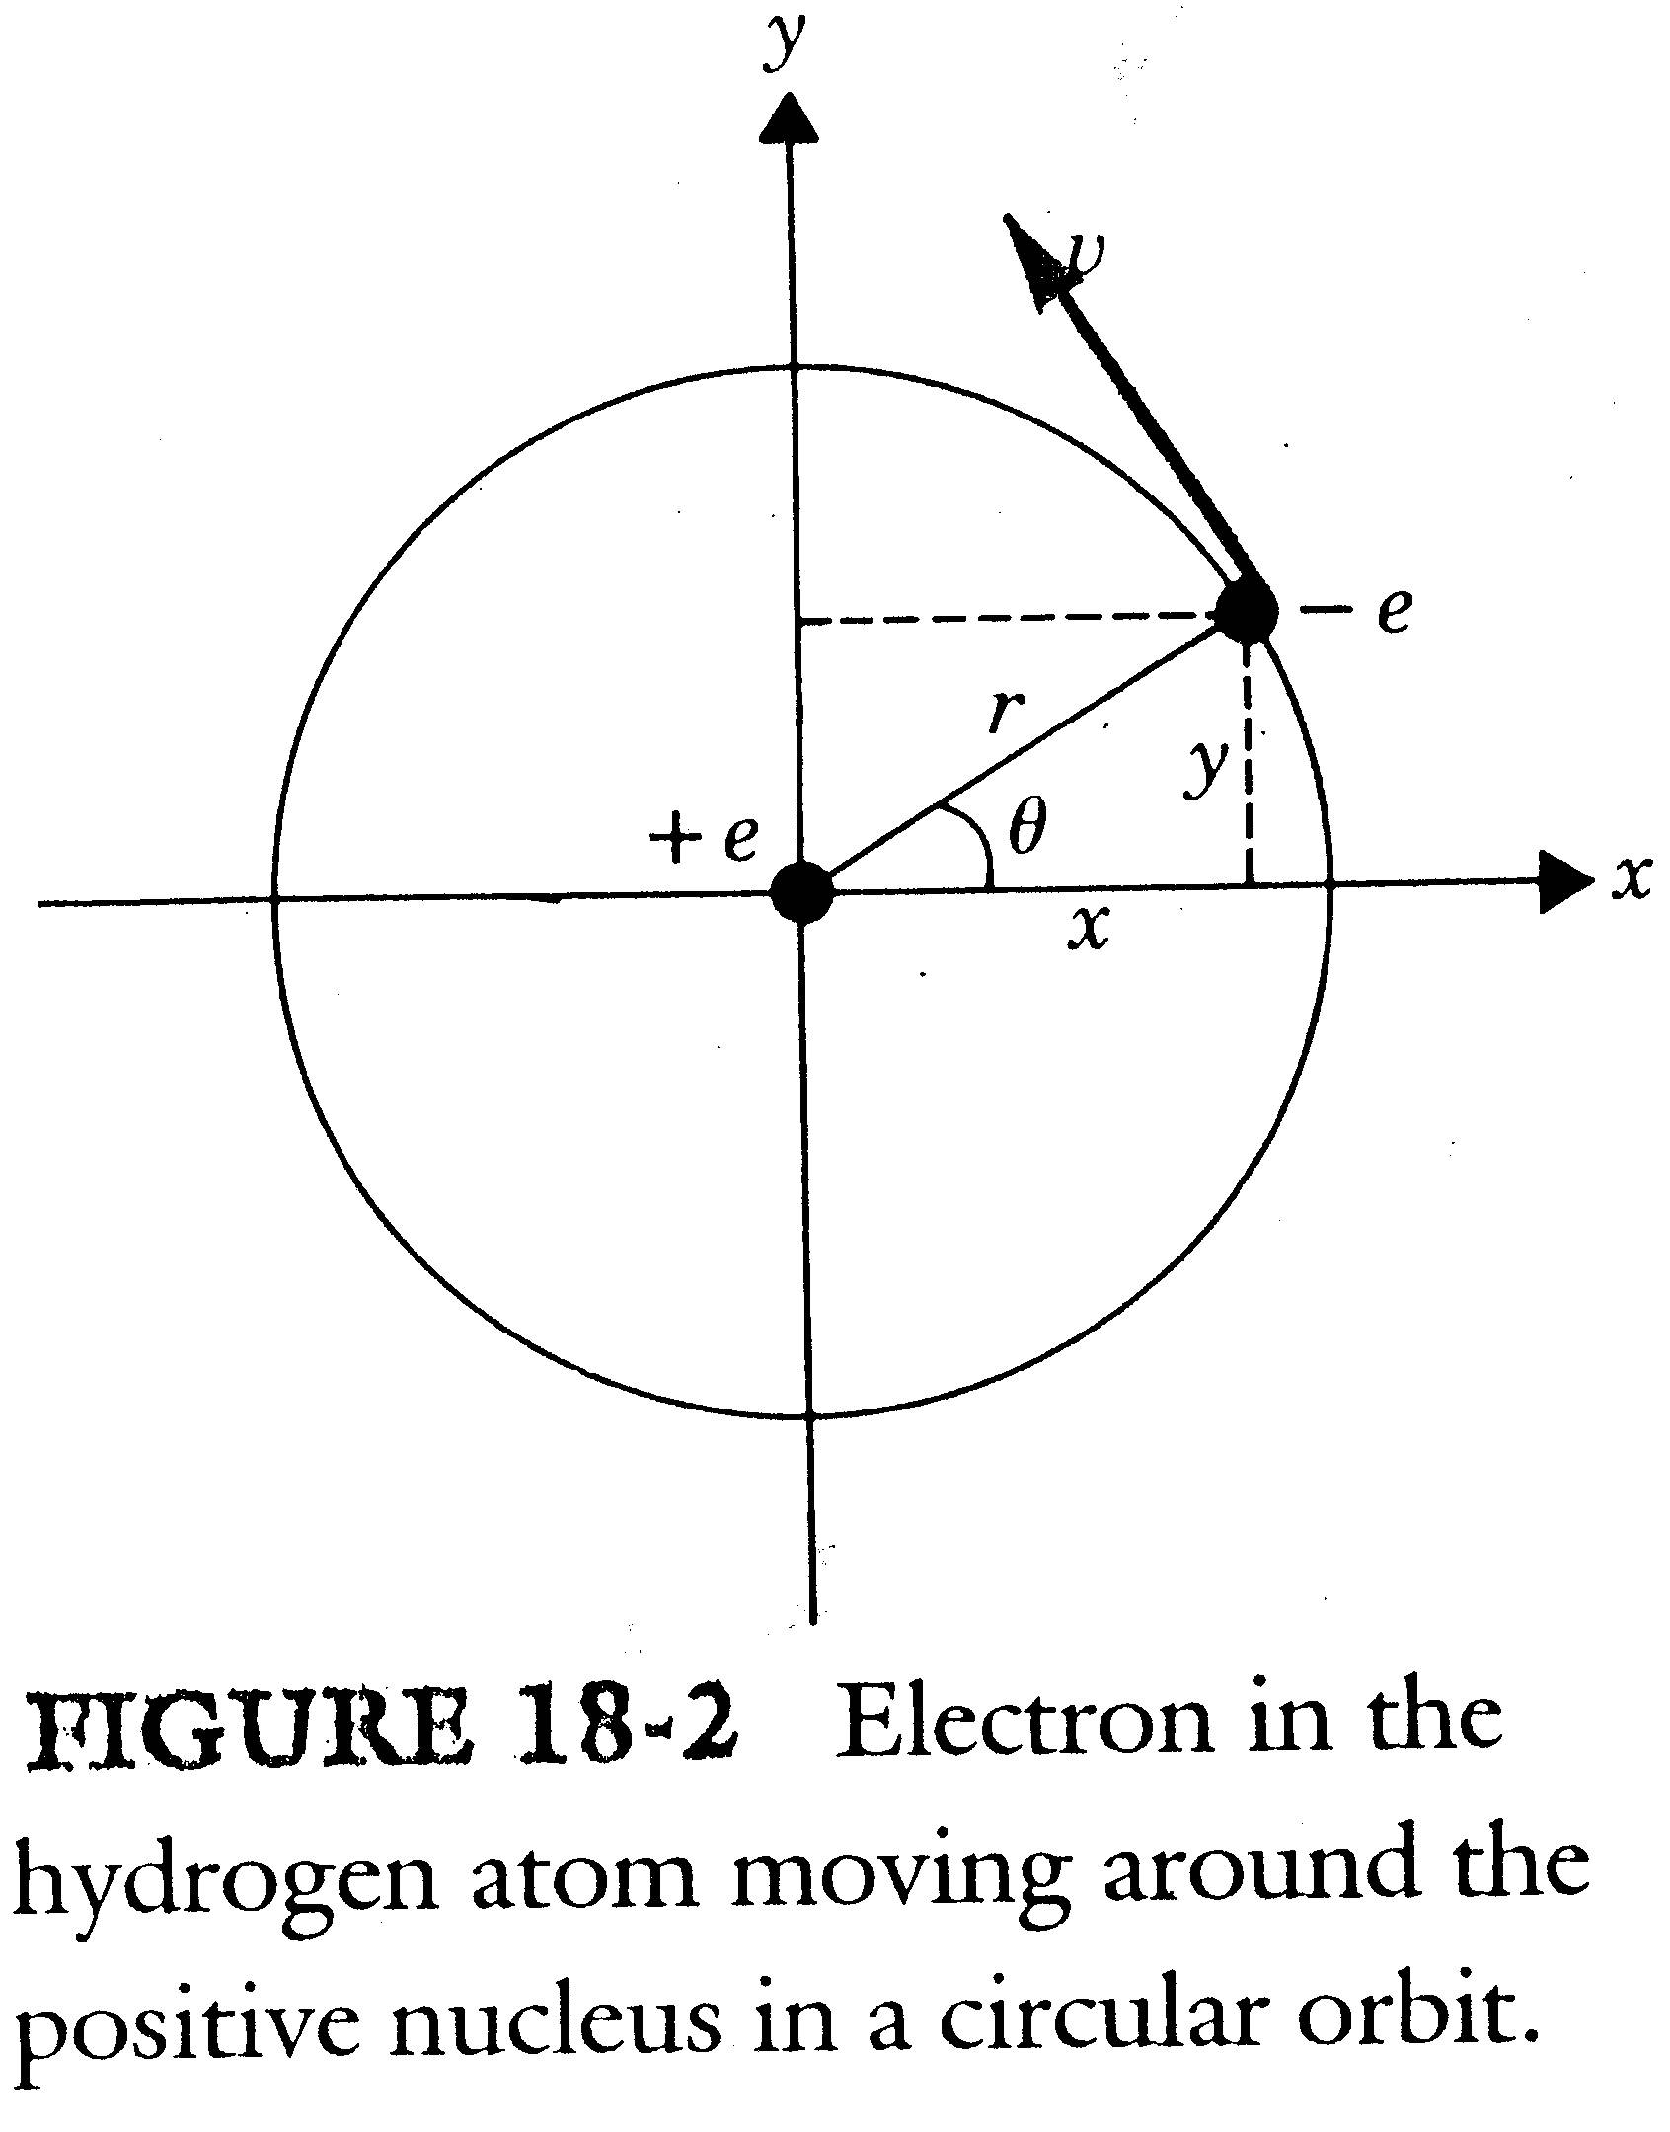

Slide 7

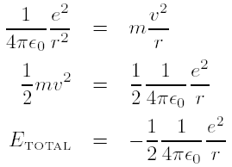
Since the electrostatic attraction of the nucleus supplies the centripetal force that causes the circular motion of the electron, we have

Slide 8
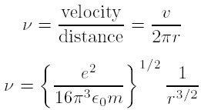
The frequency of rotation v can be expressed as
A particle moving in a circle with constant frequency
is equivalent to a particle simultaneously undergoing simple harmonic motion in two mutually perpendicular directions.

Slide 9
By classical electromagnetism, the electron moving in an orbit of radius r should radiate electromagnetic radiation.
Because this electromagnetic radiation carries away energy, the energy of the atom must decrease as energy is radiated from it.
According to principles of classical physics, the Rutherford model is unstable.
By the classical model the spectrum emitted by such an atom should be a continuous one.
The experimental facts are: The hydrogen atom is not unstable and the spectrum of hydrogen is not continuous.

Slide 10

The Spectrum of Hydrogen
A typical experimental arrangement used to study the electromagnetic spectrum emitted by an element is shown in Fig. 18-3.
The interference pattern of a grating is similar to that of a double slit. It consists of a central maximum that contains all the wavelengths present in the incident radiation. Secondary maxima will be observed on the screen where
and d is the separation between slits in the double slit condition.

Slide 11
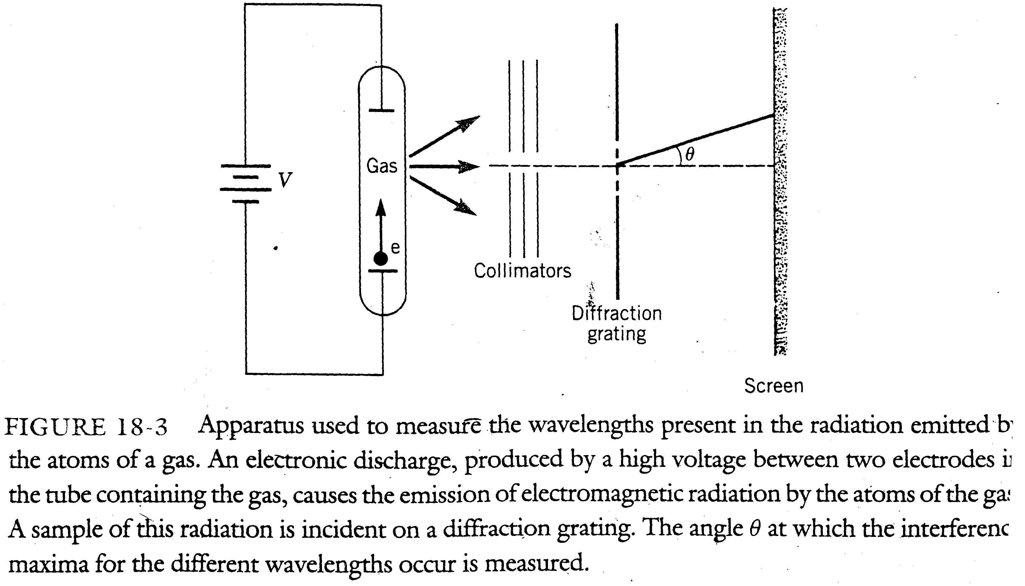

Slide 12

In the case of hydrogen, the spectrum consists of families of lines ; the lines of a given family could be fitted to a simple empirical relation known as the Rydberg-Ritz formula, which yields a series of lines

Slide 13
For a given For example, If n_{k} = 1, then n_{j} = 2, 3, 4, … This family is known as the Lyman series; If n_{k} = 2, then n_{j} = 3, 4, 5, … This family is known as the Balmer series; If n_{k} = 3, then n_{j} = 4, 5, 6, … This family is known as the Paschen series; If n_{k} = 4, then n_{j} = 5, 6, 7, … This family is known as the Brackett series;
The Lyman series corresponds to frequencies in the ultraviolet part of the spectrum, the Balmer series to frequencies in the visible, and the other series to those in the infrared.

Slide 14
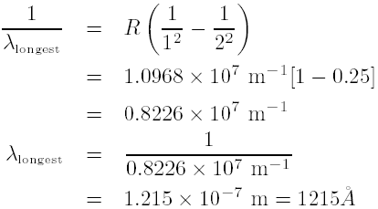
Example 18-1
What are the shortest and longest wavelengths of the Lyman series?
Sol: The longest wavelength corresponds to the smallest value of n_{j} , which for the Lyman series is 2.

Slide 15
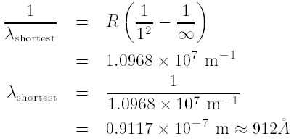
The shortest wavelength corresponds to the largest value of n_{j} that is

Slide 16

The Bohr Atom
To avoid the two problems encountered by the Rutherford model and to explain the spectral data that we have discussed before, Bohr proposed a model of the hydrogen atom that can be summarized in three postulates.
Postulate 1. The electron can taken only certain orbits for which the angular momentum L takes values given by
where is Plank's constant divided by 2π.
Postulate 2. An electron in one of the allowed orbits does not radiate electromagnetic radiation.

Slide 17

Postulate 3. If an electron is initially in an allowed orbit of energy E_{i} and goes into another orbit of lower energy E_{f} , electromagnetic radiation will be emitted with a precise frequency given by
Bohr quantizes the orbital angular momentum, not the energy; however, the energy will also be quantized.
The second postulate is needed to prevent the instability predicted by electromagnetic theory.
The third postulate is basically a reaffirmation of the photon concept.

Slide 18
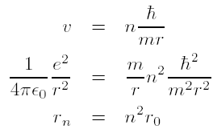

We see that only orbits with radius r₀, 4r₀, 9r₀, . . . are allowed.
Any system, if left alone, will tend to go to the lowest energy state available to it.

Slide 19
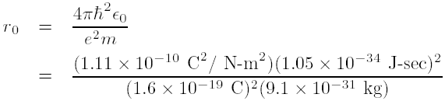

The lowest state corresponds to the orbit of smallest radius.
According to Bohr model, the normal state of the hydrogen atom is a circular orbit of radius r₀ , or (recall that

Slide 20
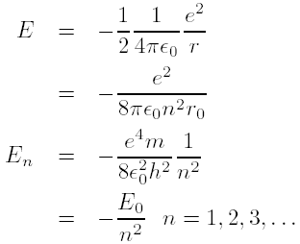
This result is in agreement with the experimentally known size of the atom.
The restriction on the allowed radius for the orbit leads immediately to the quantization of the energy spectrum.

Slide 21
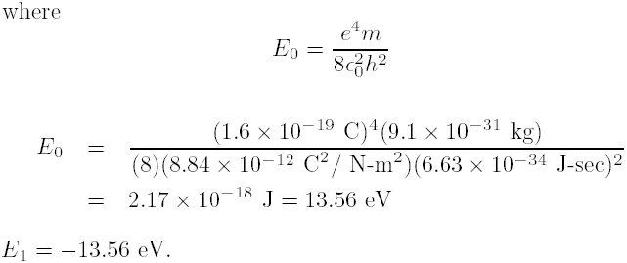
A few of the energy levels of the hydrogen spectrum are shown in Fig. 18-4.
The energy of n = 1 level is called ground state. The other levels, corresponding to higher values of n, are called the excited states.

Slide 22
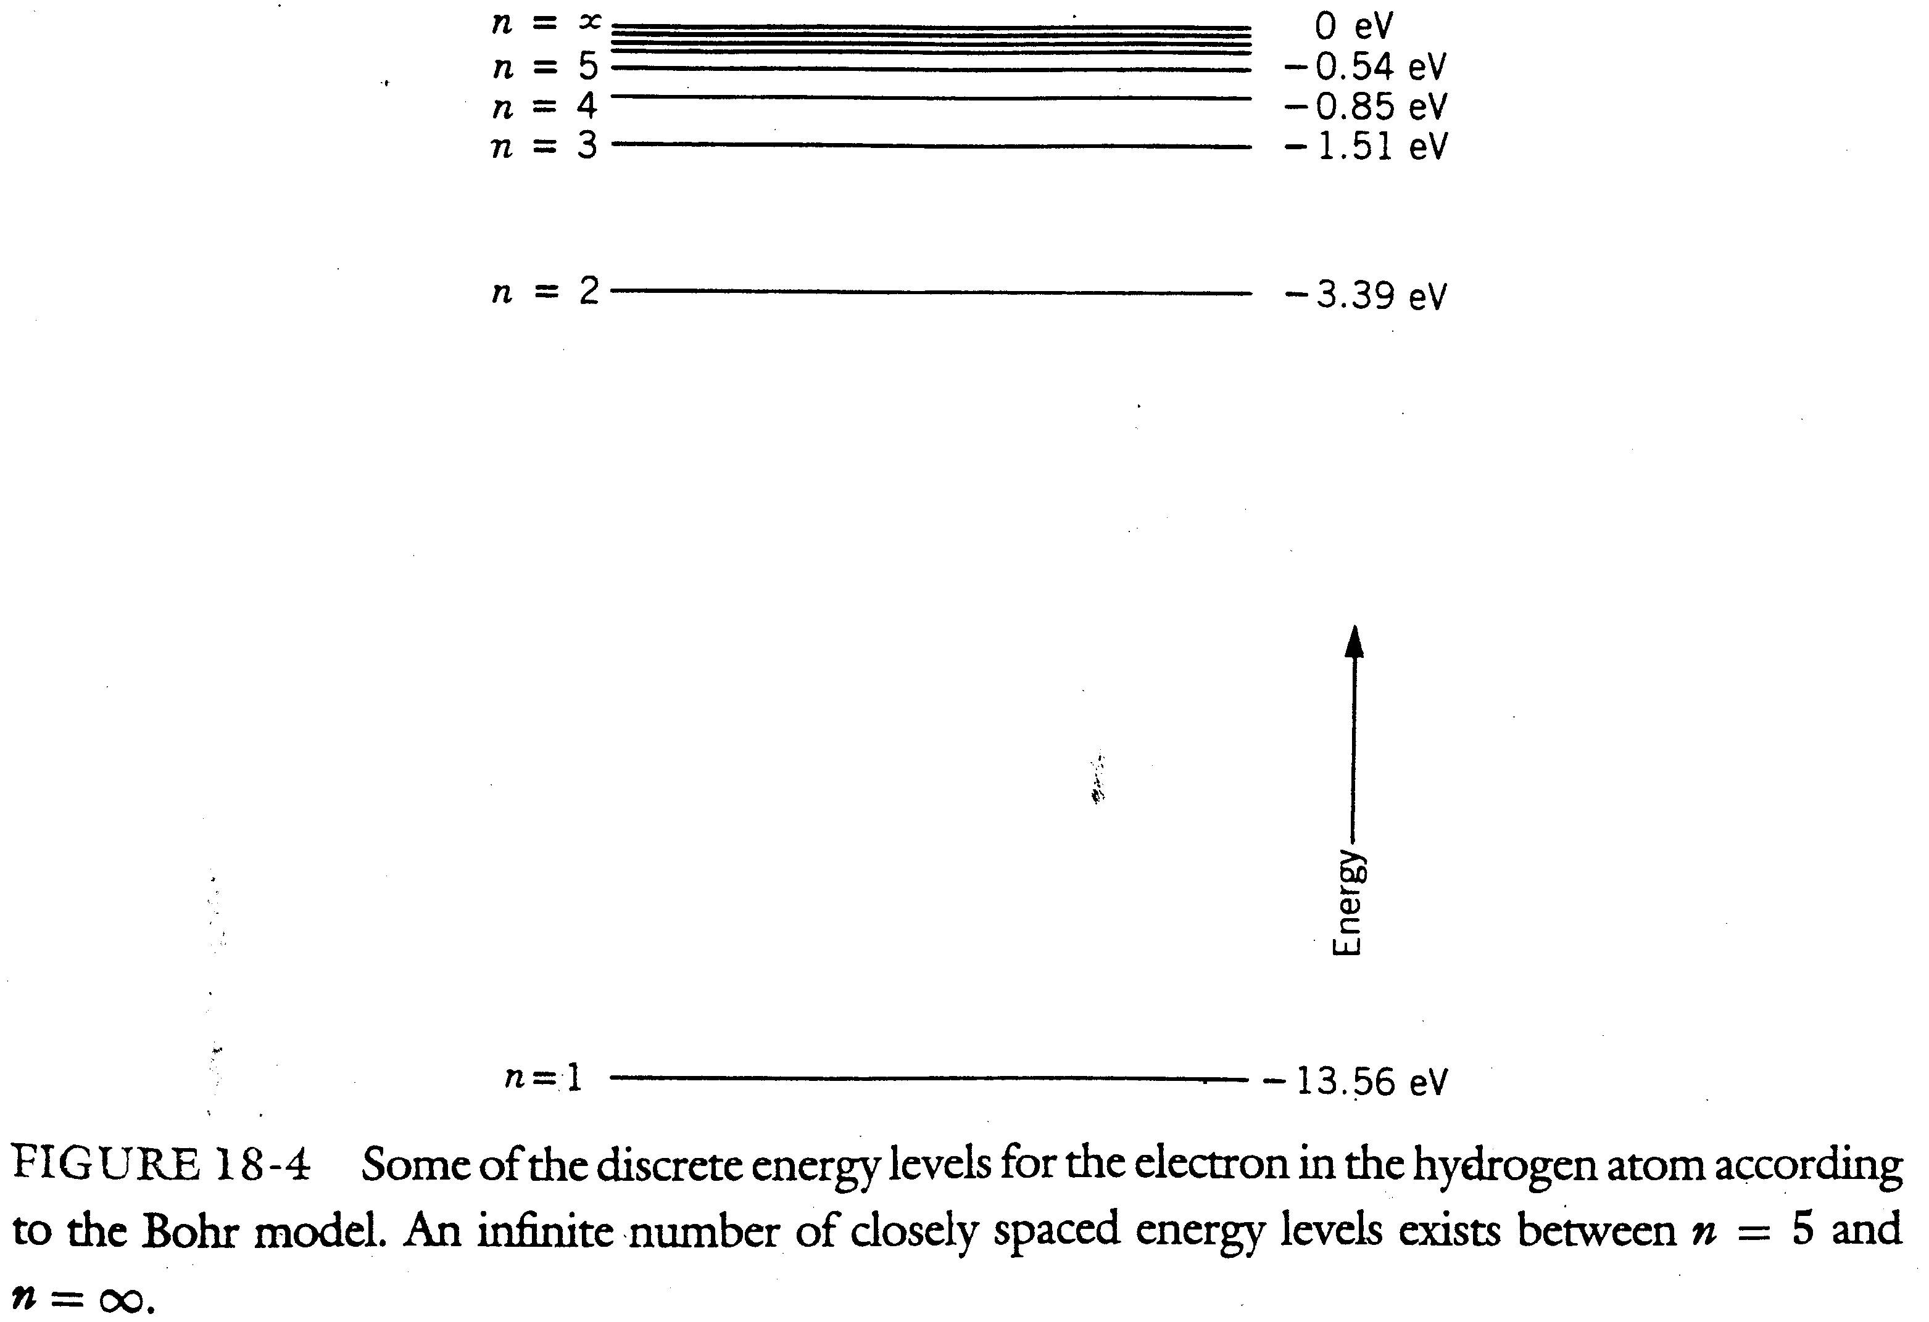

Slide 23
To ionize the atom (to separate the electron from the nucleus), 13.56 eV of energy must be given to it according to the model.
Once the atom has been ionized, a free electron near the nucleus can be captured by it. This capture can take place in one step-namely, the electron in one jump falls down to the ground state-or in a series of steps in which the electron fails into one or more excited states before it winds up in the ground state.
In each transition toward a lower energy state the electron loses a precise quantity of energy, called a quantum.

Slide 24



The energy will depend on the energy difference of the levels between which the transition takes place.
Because the energy difference between levels is not continuous, the frequency spectrum of the emitted photons will not be continuous either.
Suppose that an electron is initially in a state of energy and then makes a transition to a state of energy Thus, a photon of frequency
will be emitted. See Fig. 18-5.

Slide 25
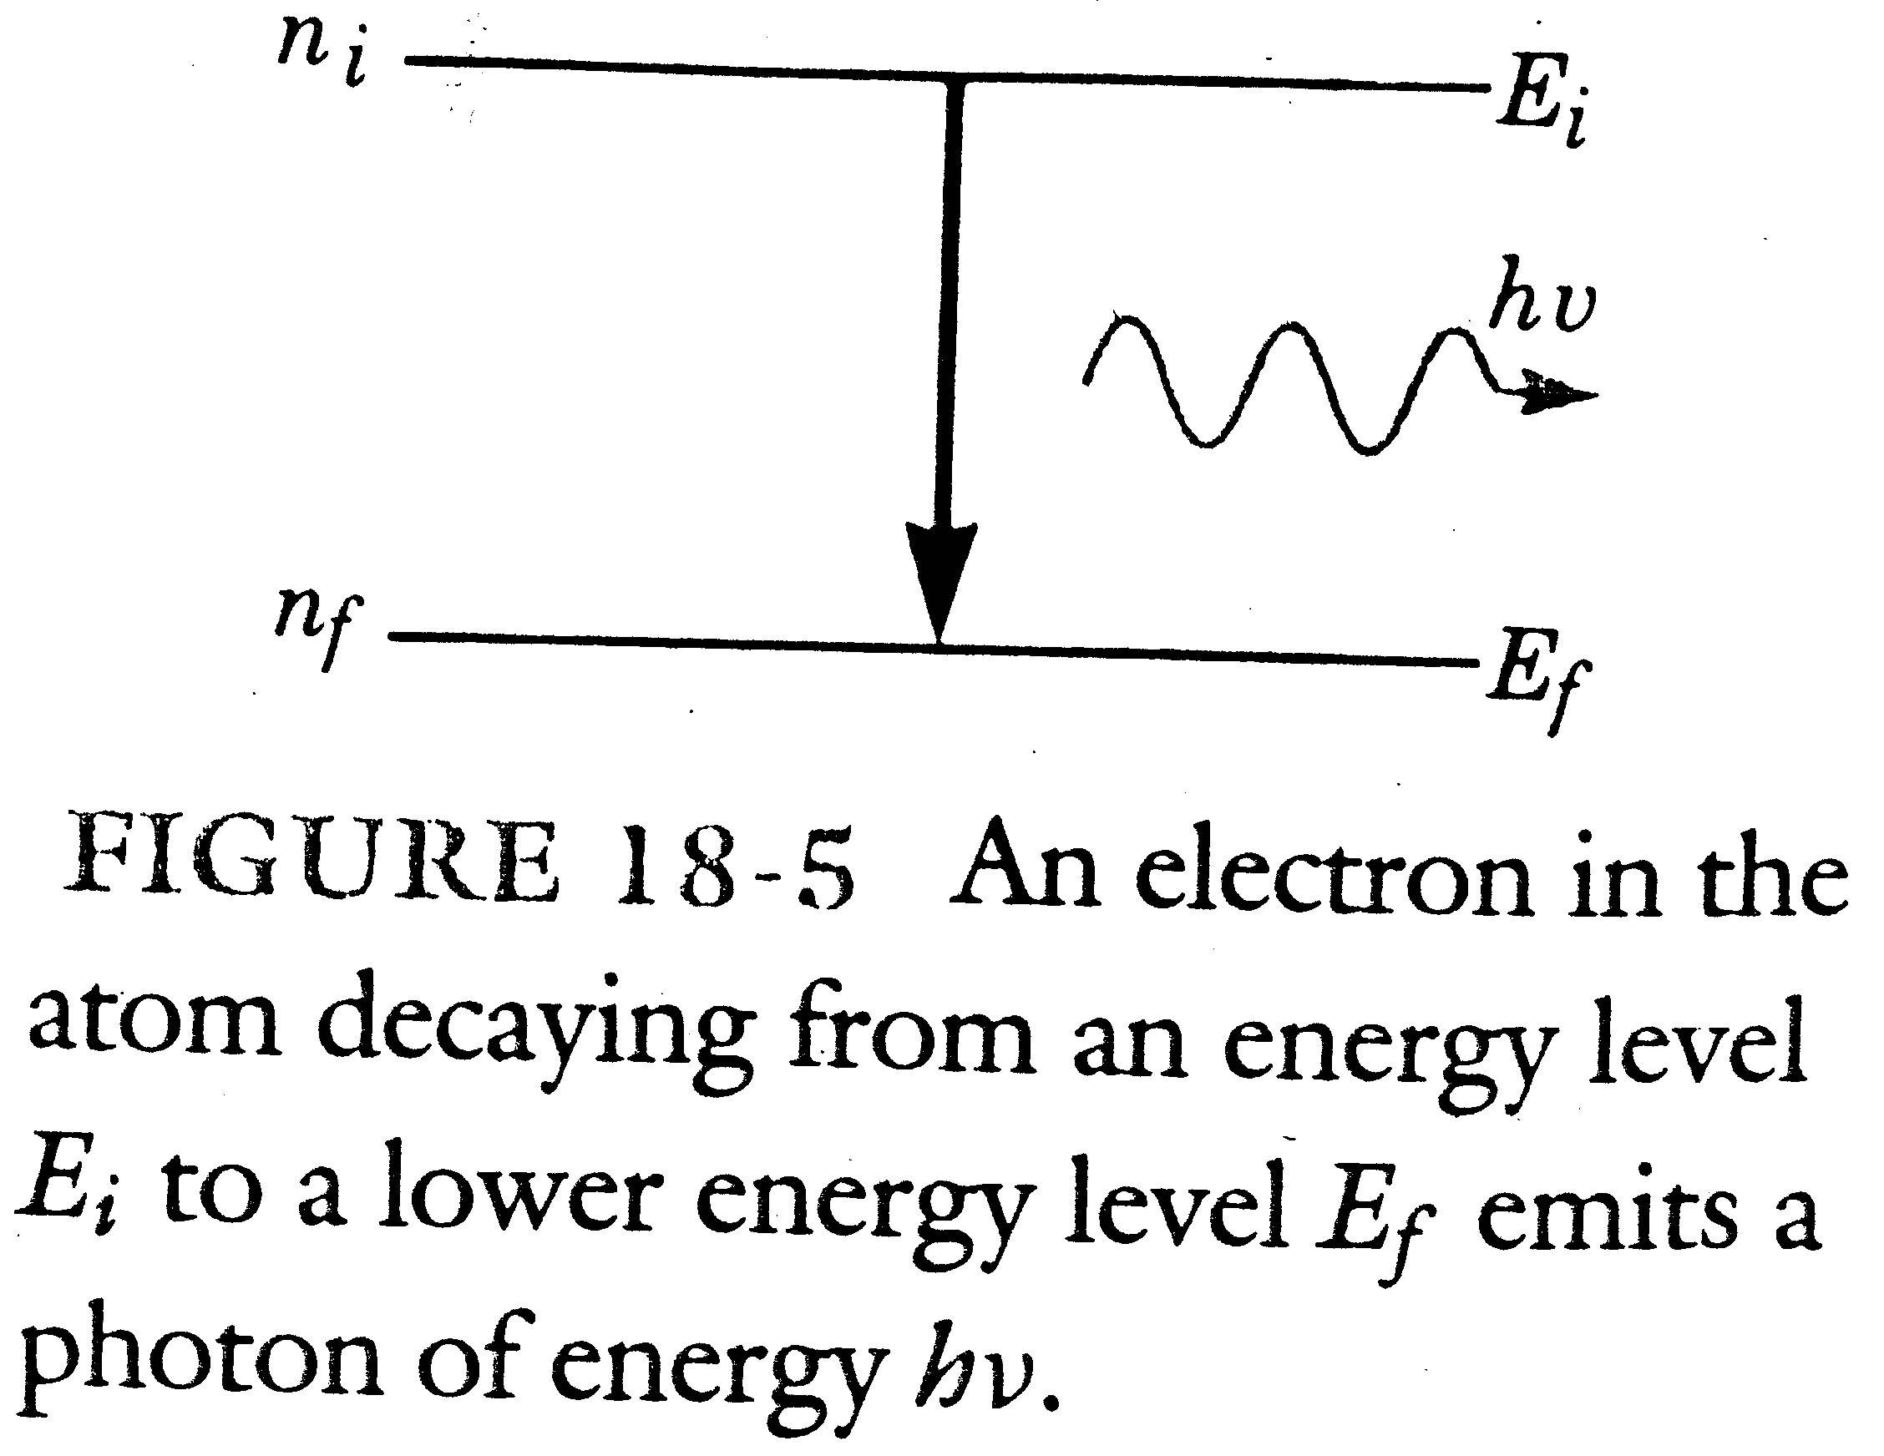

Slide 26

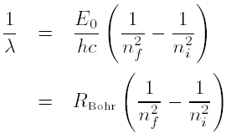
Since we have
where R_{Bohr} is a constant and R_{Bohr}

Slide 27
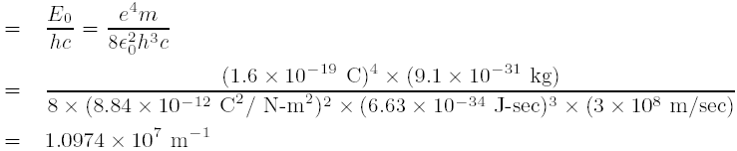
We see that above equation is similar to the Rydberg-Ritz formula and the constant R_{Bohr} is almost identical to the Rydberg constant R. See Fig. 18-6.

Slide 28
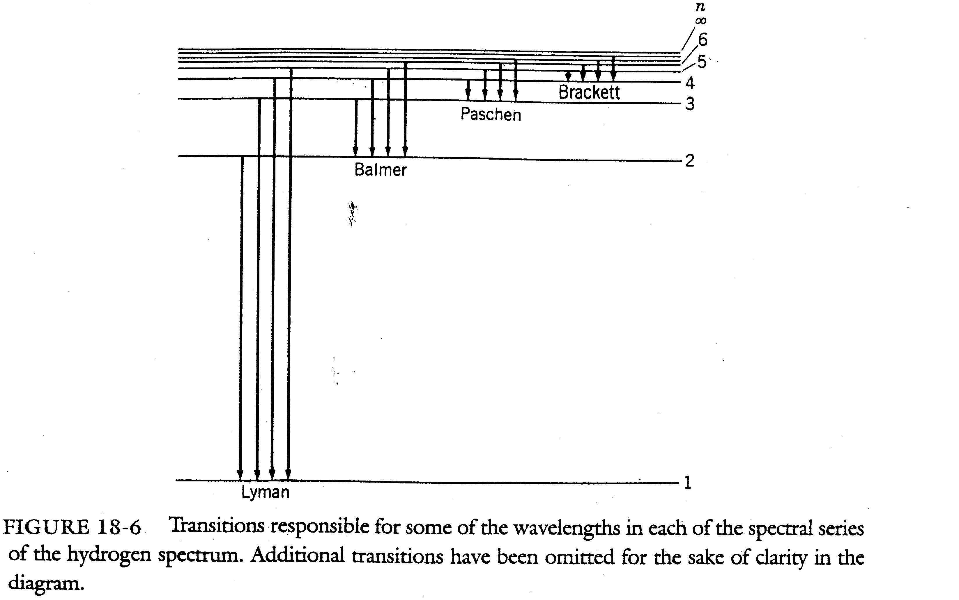

Slide 29
Example 18-2
After begin excited, the electron of a hydrogen atom eventually falls back to the ground state. This can take place in one jump or in a series of jumps, the electron falling into lower excited states before it ends up in the ground state. Consider a hydrogen atom that has been raised to the second excited state, that is, n = 3. Calculate the different photon energies that may be emitted as the atom returns to the ground state.

Slide 30
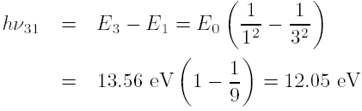
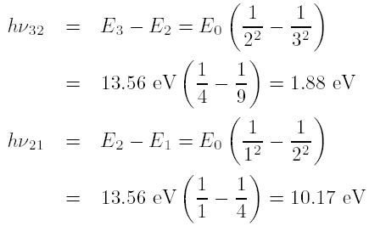
Sol
The possible transitions are shown in Fig. 18-7.

Slide 31
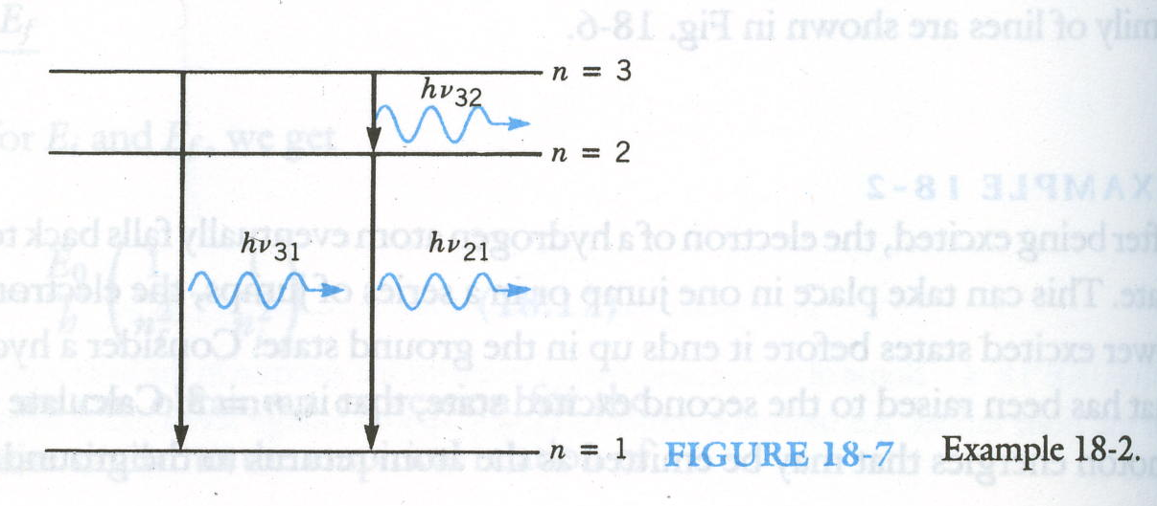

Slide 32
The Franck-Hertz Experiment
The existence of discrete energy levels in atoms was demonstrated directly by Franck and Hertz in 1914.
A schematic of the experimental set-up is shown in Fig. 18-8.
See Fig. 18-9 and 18-10.
The fact that there is no drop in the current until V₀ = 4.9 V indicates that the electrons do not lose energy through collisions until they have 4.9 eV of kinetic energy.
Homework: 2, 4, 5, 8, 9, 10, 11, 13, 14, 15, 16, 17, 18, 19.

Slide 33
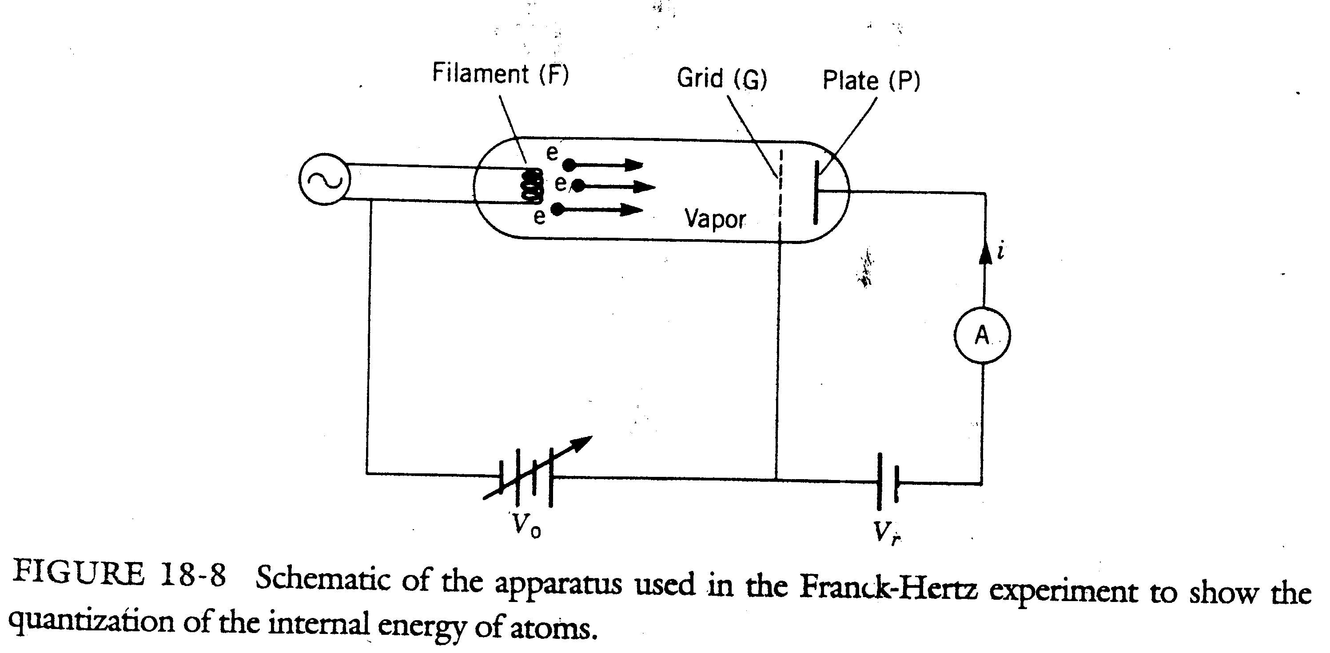

Slide 34
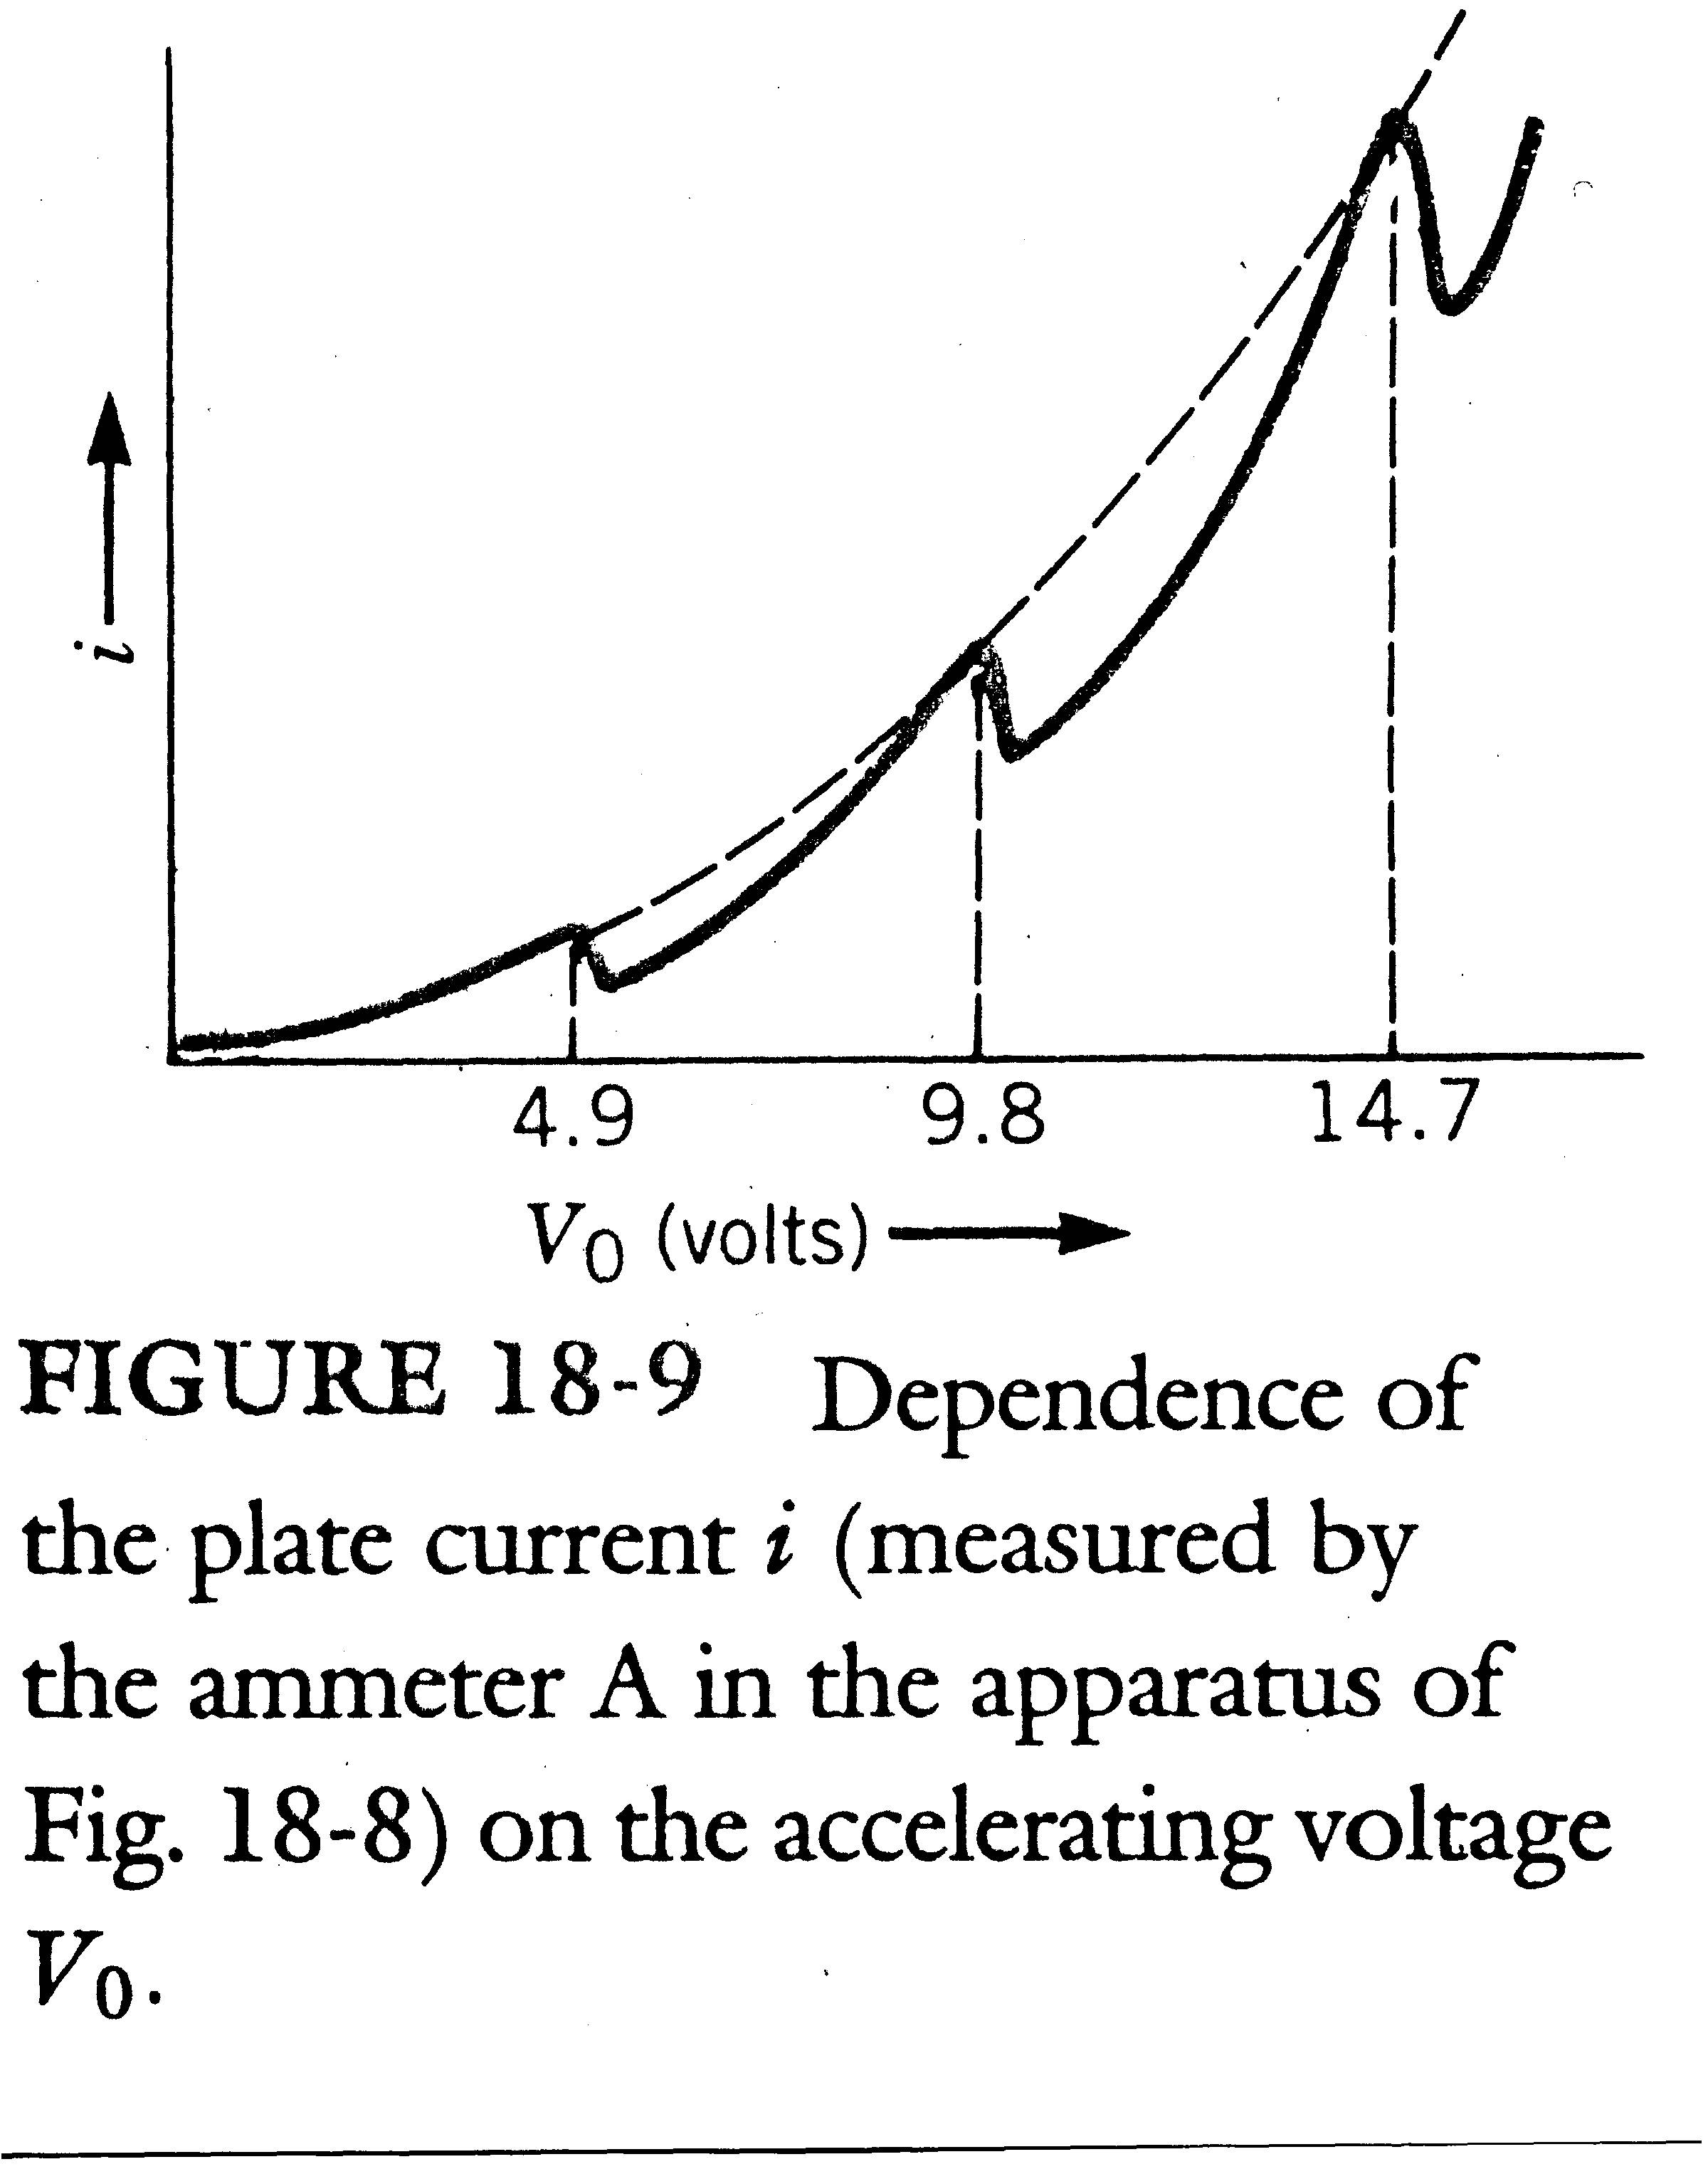

Slide 35
