Slide 1
Chapter Three
Uniformly Accelerated Motion

Slide 2
Uniformly Accelerated Motion
We introduce certain vector quantities -- position, displacement, velocity and acceleration -- used to describe the motion of a body.

Slide 3


Speed and Velocity
The average speed is the distance traveled in any direction. , divided by the time , or
where
The displacement vector is defined as the vector difference between the final and the initial position vectors, namely,
See Figure 3-1.

Slide 4
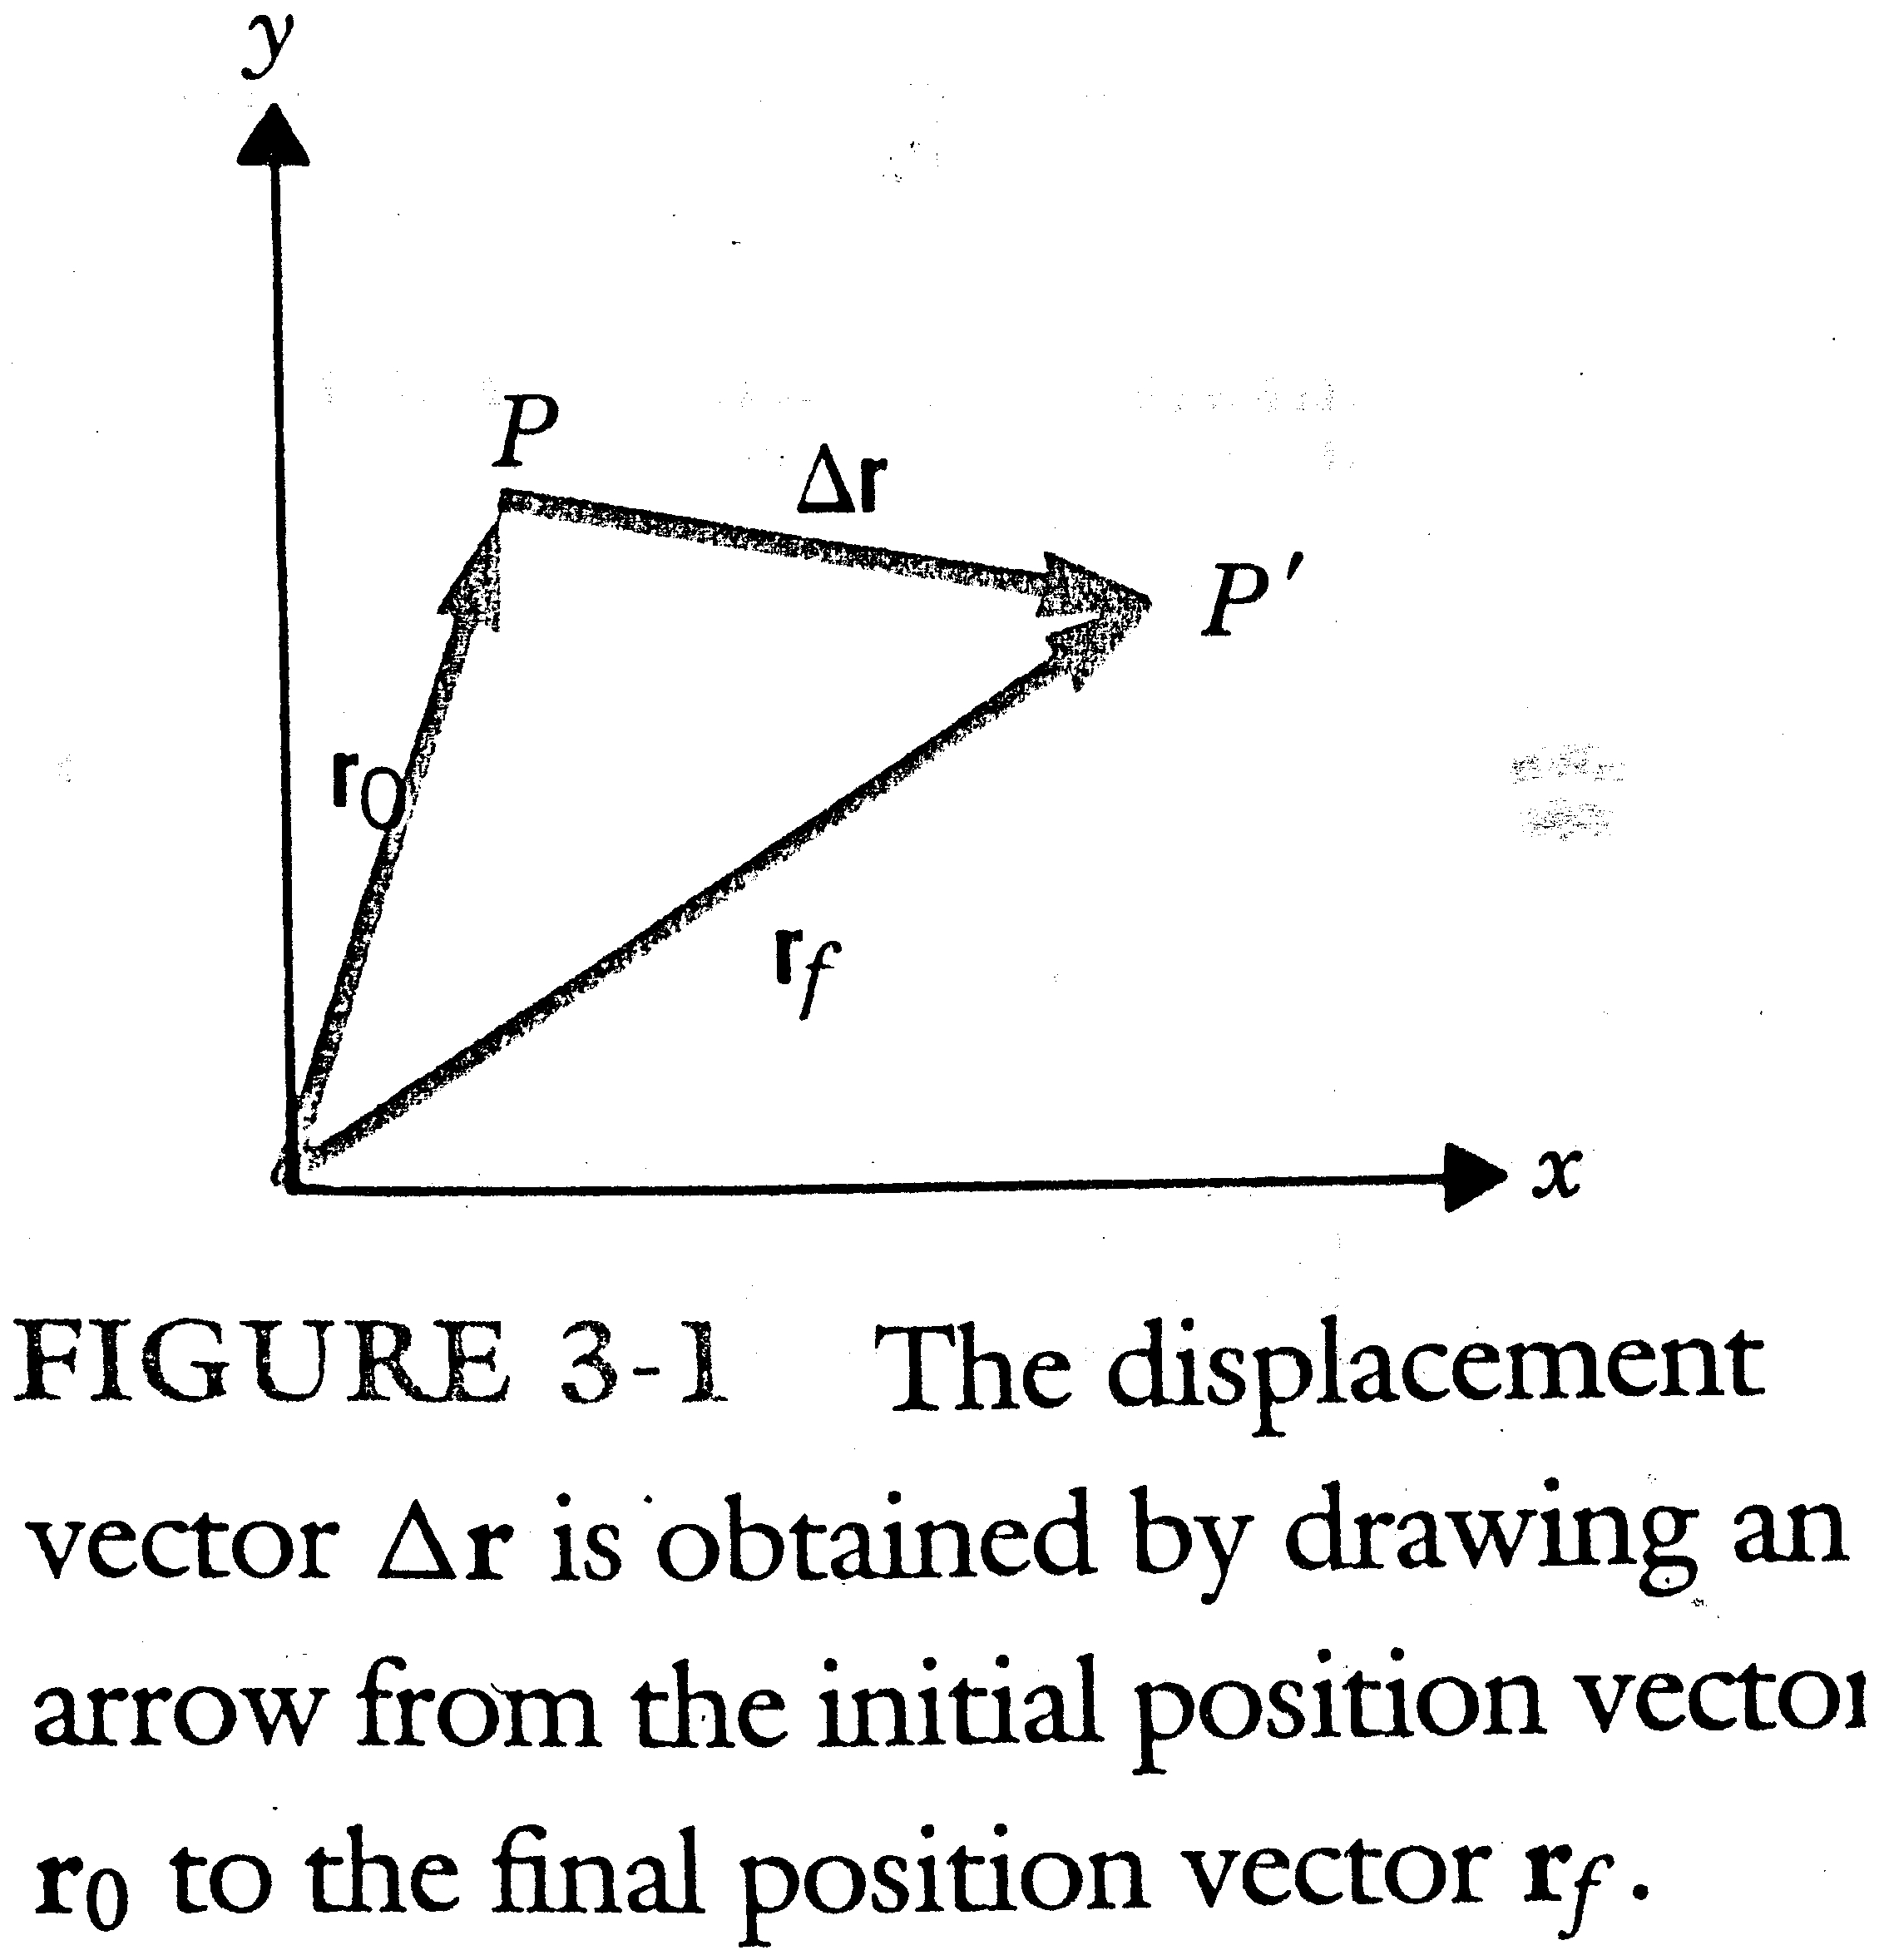

Slide 5


The average velocity is defined as the ratio of the displacement vector to the time taken for the displacement to occur, namely,
The instantaneous velocity is defined as
See Figure 3-2.

Slide 6
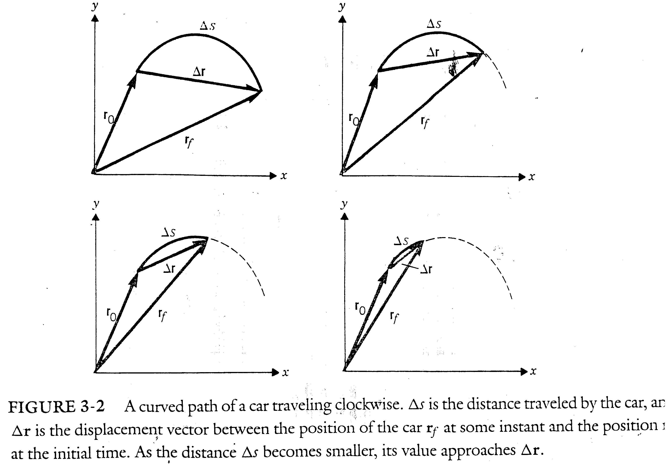

Slide 7

where v_{x}, v_{y}; and v_{z} are the Cartesian components of v and x, y, and z are those of r.

Slide 8

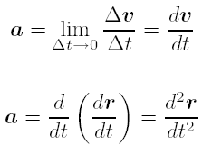
Acceleration
If there is a velocity change in a certain time , we define the average acceleration as
The instantaneous acceleration as

Slide 9

Example 3-1
The position of a body on the x axis varies as a function of time according to the following equation
Find its velocity and acceleration when t = 3 sec:

Slide 10
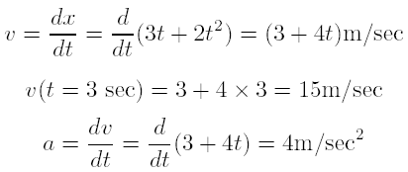
Sol
Since r = x,

Slide 11


Linear Motion -- Constant Acceleration
Because displacement, velocity, and acceleration are vectors, we may treat them by the method of Cartesian components.
Assume that the object moving in the x direction when it starts from or is passing the x = 0 point, and we have
or
The acceleration is the rate of change of the velocity with time. See Figure 3-3.

Slide 12
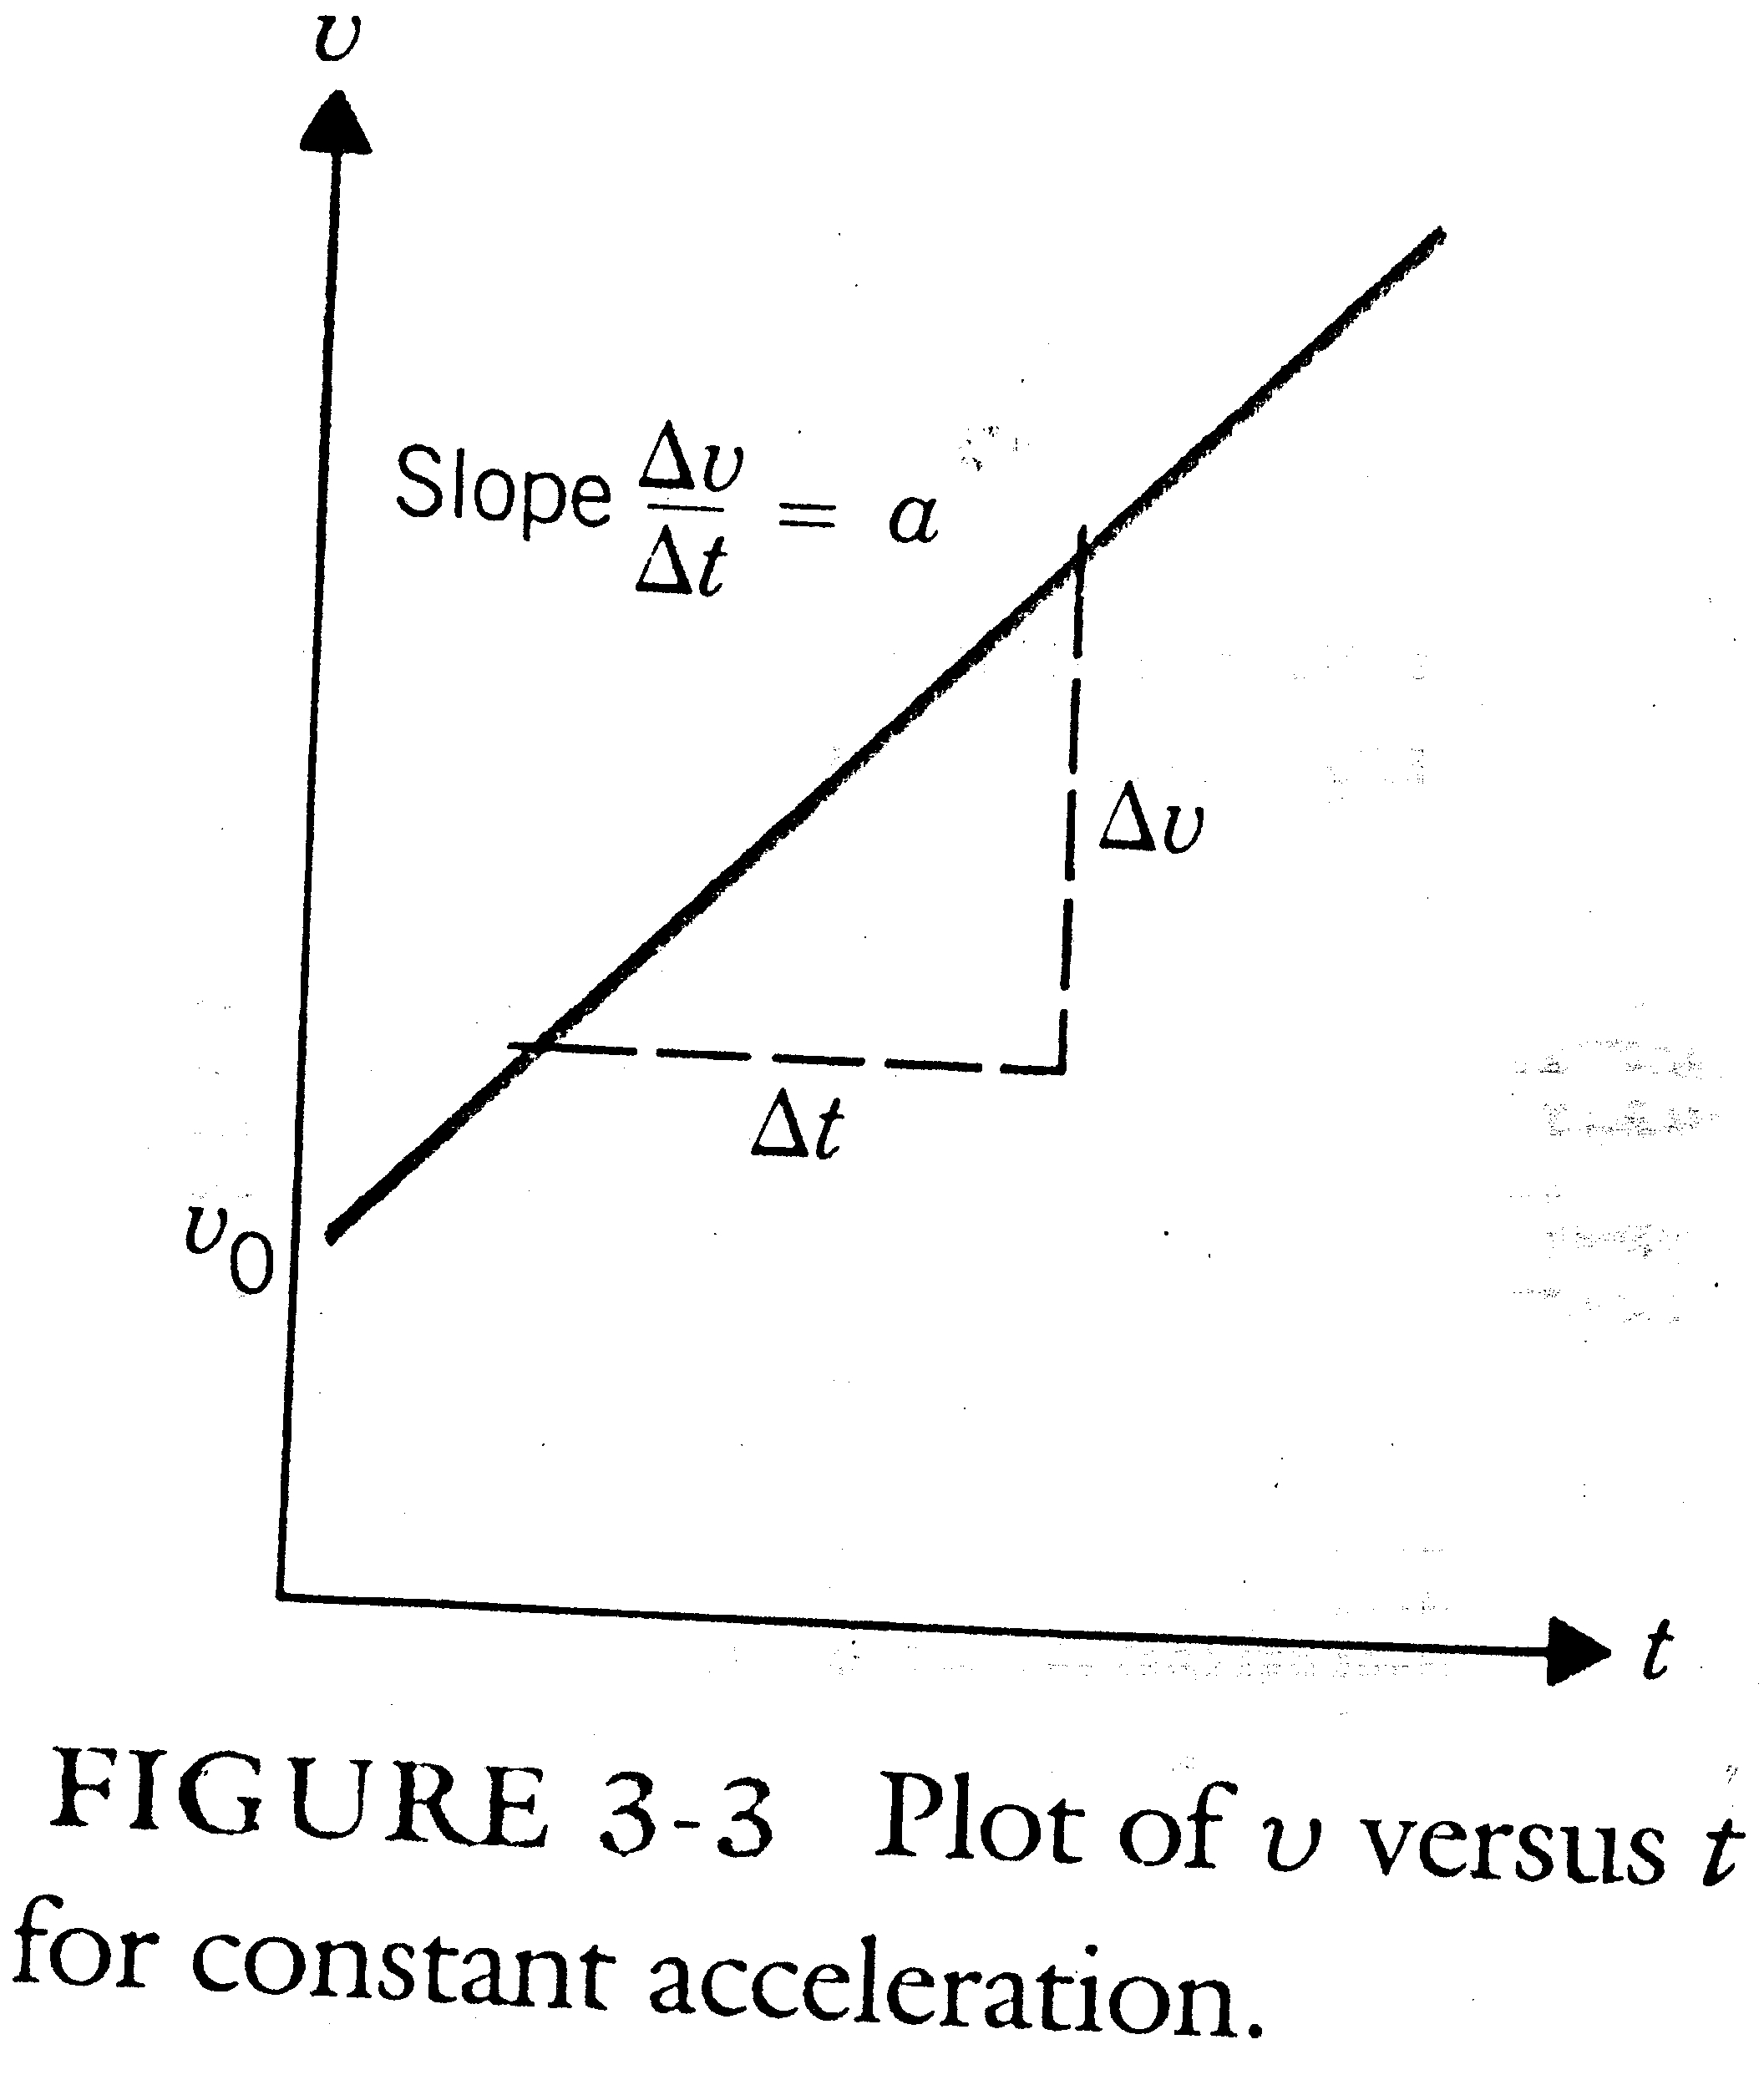

Slide 13
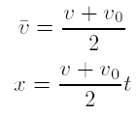
Informal derivation of equations associated with displacement, velocity, and acceleration.
1.

Slide 14
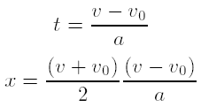



2.
and
3.

Slide 15
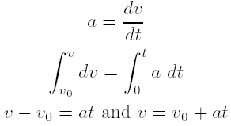
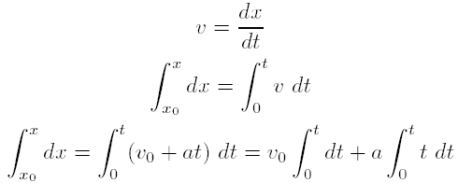
Formal derivation of the above equations:
1.
2.

Slide 16

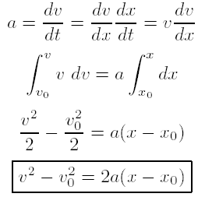
3.
The acceleration caused by gravity is usually written as the symbol g and has approximate sea-level value g= 9.8 m/sec².

Slide 17
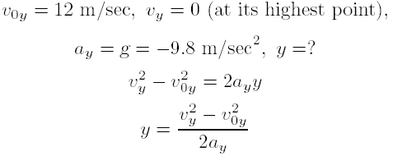
Example 3-2
A boy throws a ball upward with an initial velocity of 12 m/sec. How high does it go?
Sol:
We choose the starting point as the origin and the upward direction as positive.

Slide 18

Substituting the numerical value for the quantities in the equation,

Slide 19

Example 3-3
A boy throws a ball upward with an initial velocity of 12 m/sec and catches it when it returns. How long was it in the air?
Sol:
We choose the starting point as the origin and the upward direction as positive.

Slide 20

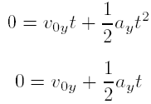

(vector displacement is zero because it returns to his hand),
Using the fact that y = 0, we have
and

Slide 21
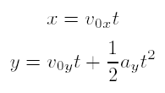
Projectile Motion (1)
The projectile motion is defined as follows: the object moves in the x direction with its constant initial x velocity but its y velocity is incereaing downward owing to the acceleration of gravity.
See multiflash photograph.

Slide 22
Example 3-4
A ball moving at 2 m/sec rolls off of a 1-m-high table, Fig. 3-4. How far horizontally from the edge of the table does it land?
Sol:
The ball will continue moving in the x direction as long as it is in the air.
where t_{f} is the time that the ball is in the air. We have

Slide 23
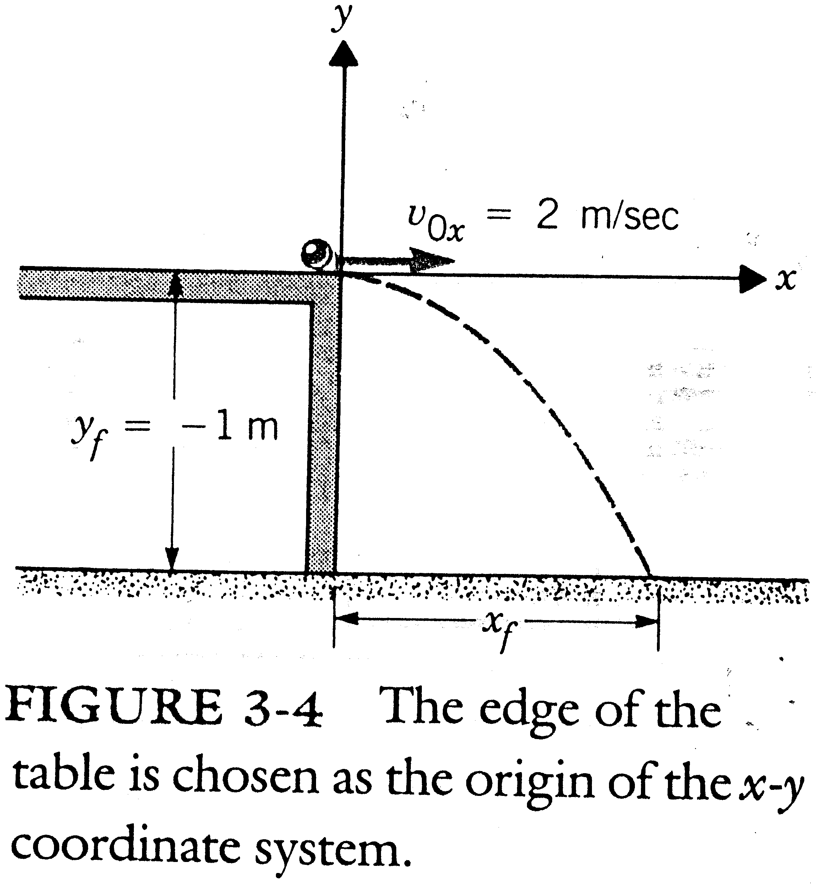

Slide 24
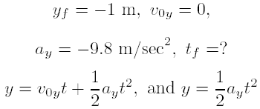
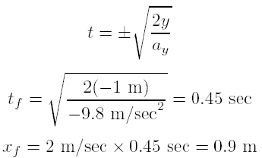
Thus,

Slide 25

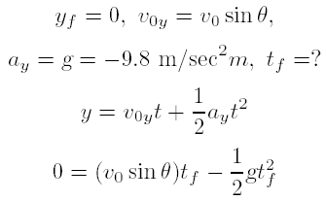
Projectile Motion (2)
The general formula for the distance that a person can throw a ball or that a gun can fire a projectile. See Figure 3-5.

Slide 26
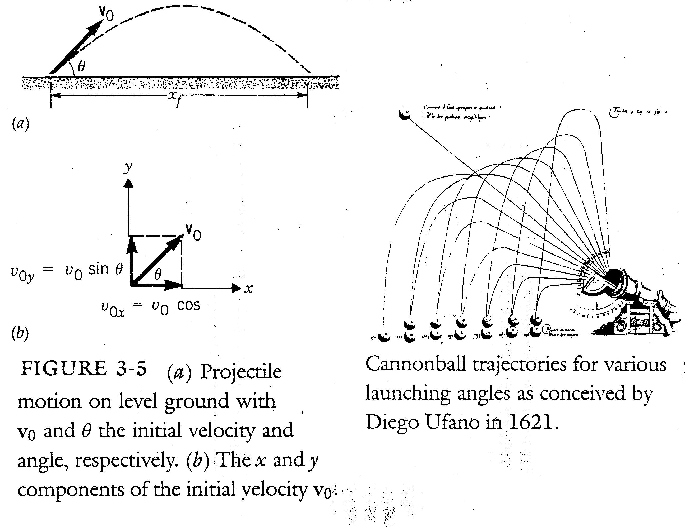

Slide 27
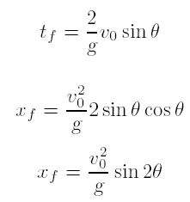
since

Slide 28
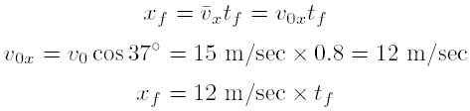
Example 3-5
A boy stands on the edge of a roof 10 m above the ground and throws a ball with a velocity of 15 m/sec at an angle of above the horizontal. How far from the building does it land? See Fig. 3-6.
Sol:
Let us choose the edge of the roof as the origin of the coordinate system.
1.

Slide 29
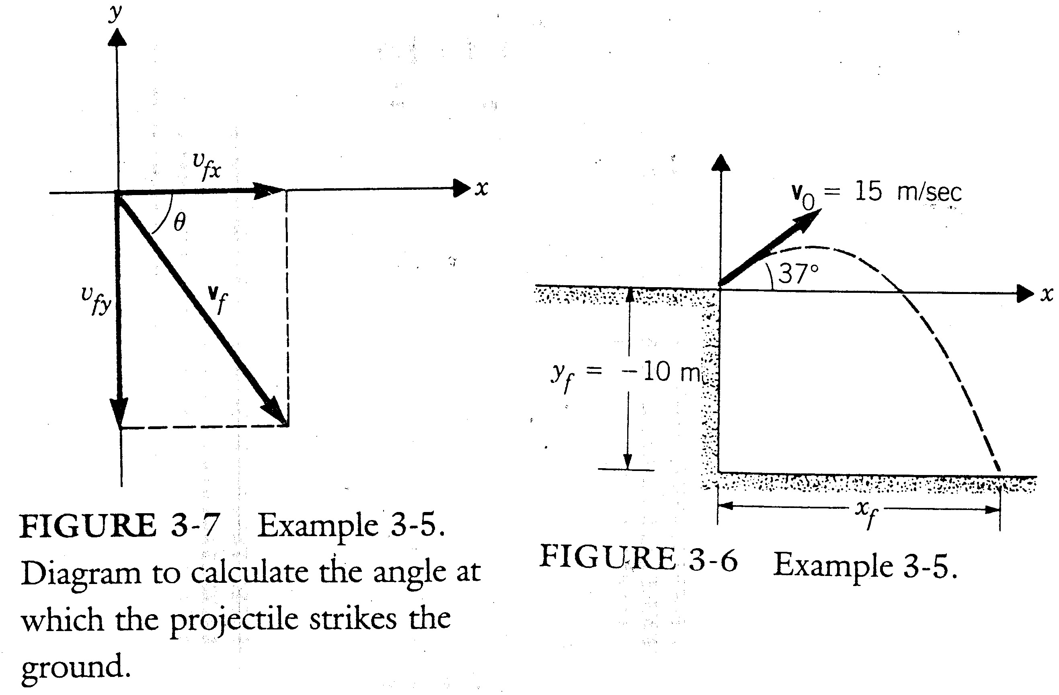

Slide 30

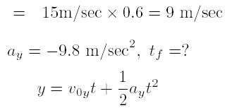
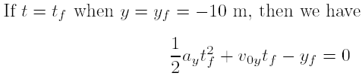
2.

Slide 31
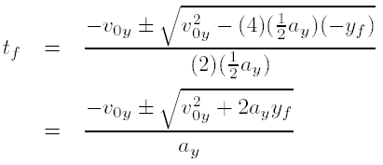

Subtituting the numerical values for y_{f} , v_{0y}, and a_{y}
3.
What is v_{f} ? DIY.

Slide 32
Homework
Homework : 6. 8. 10. 12. 14. 16. 18. 20.

