Slide 1
Chapter Six:
Momentum and Collisions

Slide 2
Momentum and Collisions
Momentum is the product of the mass of a body and its velocity.
A body may be an assembly of particles. Such an assembly can be mathematically represented by a point mass, called the center of mass.
The motion of the center of mass is that predicted by Newton's second law for a particle whose mass is the sum of the masses of the individual particles and is acted on by the resultant of the forces acting on the body.

Slide 3
Center of Mass
The weight of the stick supplies the downward force, and it appears to be located at the balance point , although we know that every segment of the stick has weight. We call this point the center of gravity of the stick.
The center of gravity of the stick behaves as a point mass in Newton's second law, F = ma, and that the center of gravity may also be considered as the center of mass.

Slide 4
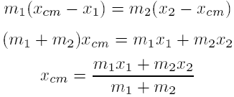

See Fig. 6-1. The center of mass is the point such that
From Fig. 6-1(b), we have
This relation holds true regardless of the number of masses placed on the balance, so we have
where M is the total mass.

Slide 5
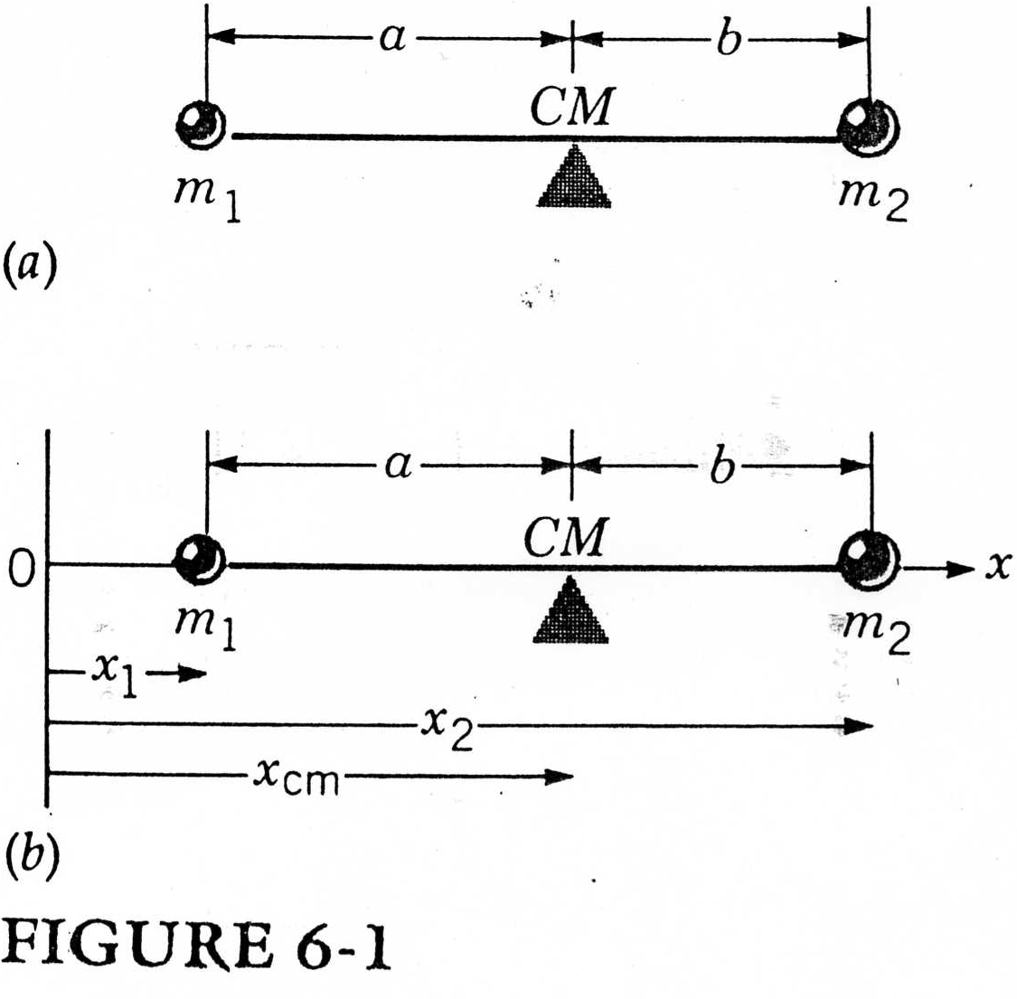

Slide 6


We define the center of mass as the point whose Cartesian coordinates are
and
where x_{i}; y_{i}; z_{i} are the coordinates of the ith particle, all measured from the same arbitrary origin.

Slide 7
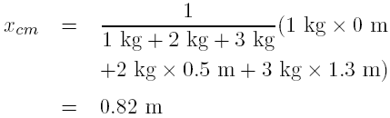
Example 6-1
Find the center of mass of the configuration in Fig. 6-2 when m₁ = 1 kg, m₂ = 2 kg, and m₃ = 3 kg.
Sol: If we take the position of m₁ as the origin, we have

Slide 8
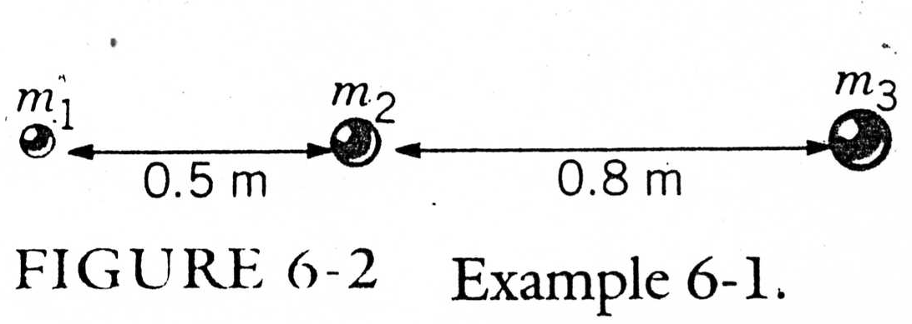

Slide 9
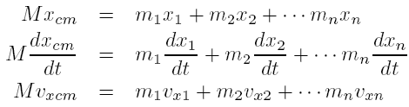
Motion of the Center of Mass
Similar expressions can be obtained for Mv_{ycm} and Mv_{zcm}.
Similarly, we have

Slide 10
If we apply Newton's second law to each individual particle, then we have
where F_{xi} is the x component of the resultant of the forces acting on the ith particle.
We only need to consider all the external forces acting on any particle.
F = Ma_{cm} where F is the resultant of the external forces acting on all the particles.

Slide 11
Example 6-3
Suppose a grenade is thrown that has the trajectory shown in Fig. 6-4. If it explodes in midair, only internal forces have acted on the fragments and the acceleration of the center of mass of the fragments, regardless of their subsequence dispersal, is unchanged by the explosion, and thus follows the original trajectory.

Slide 12
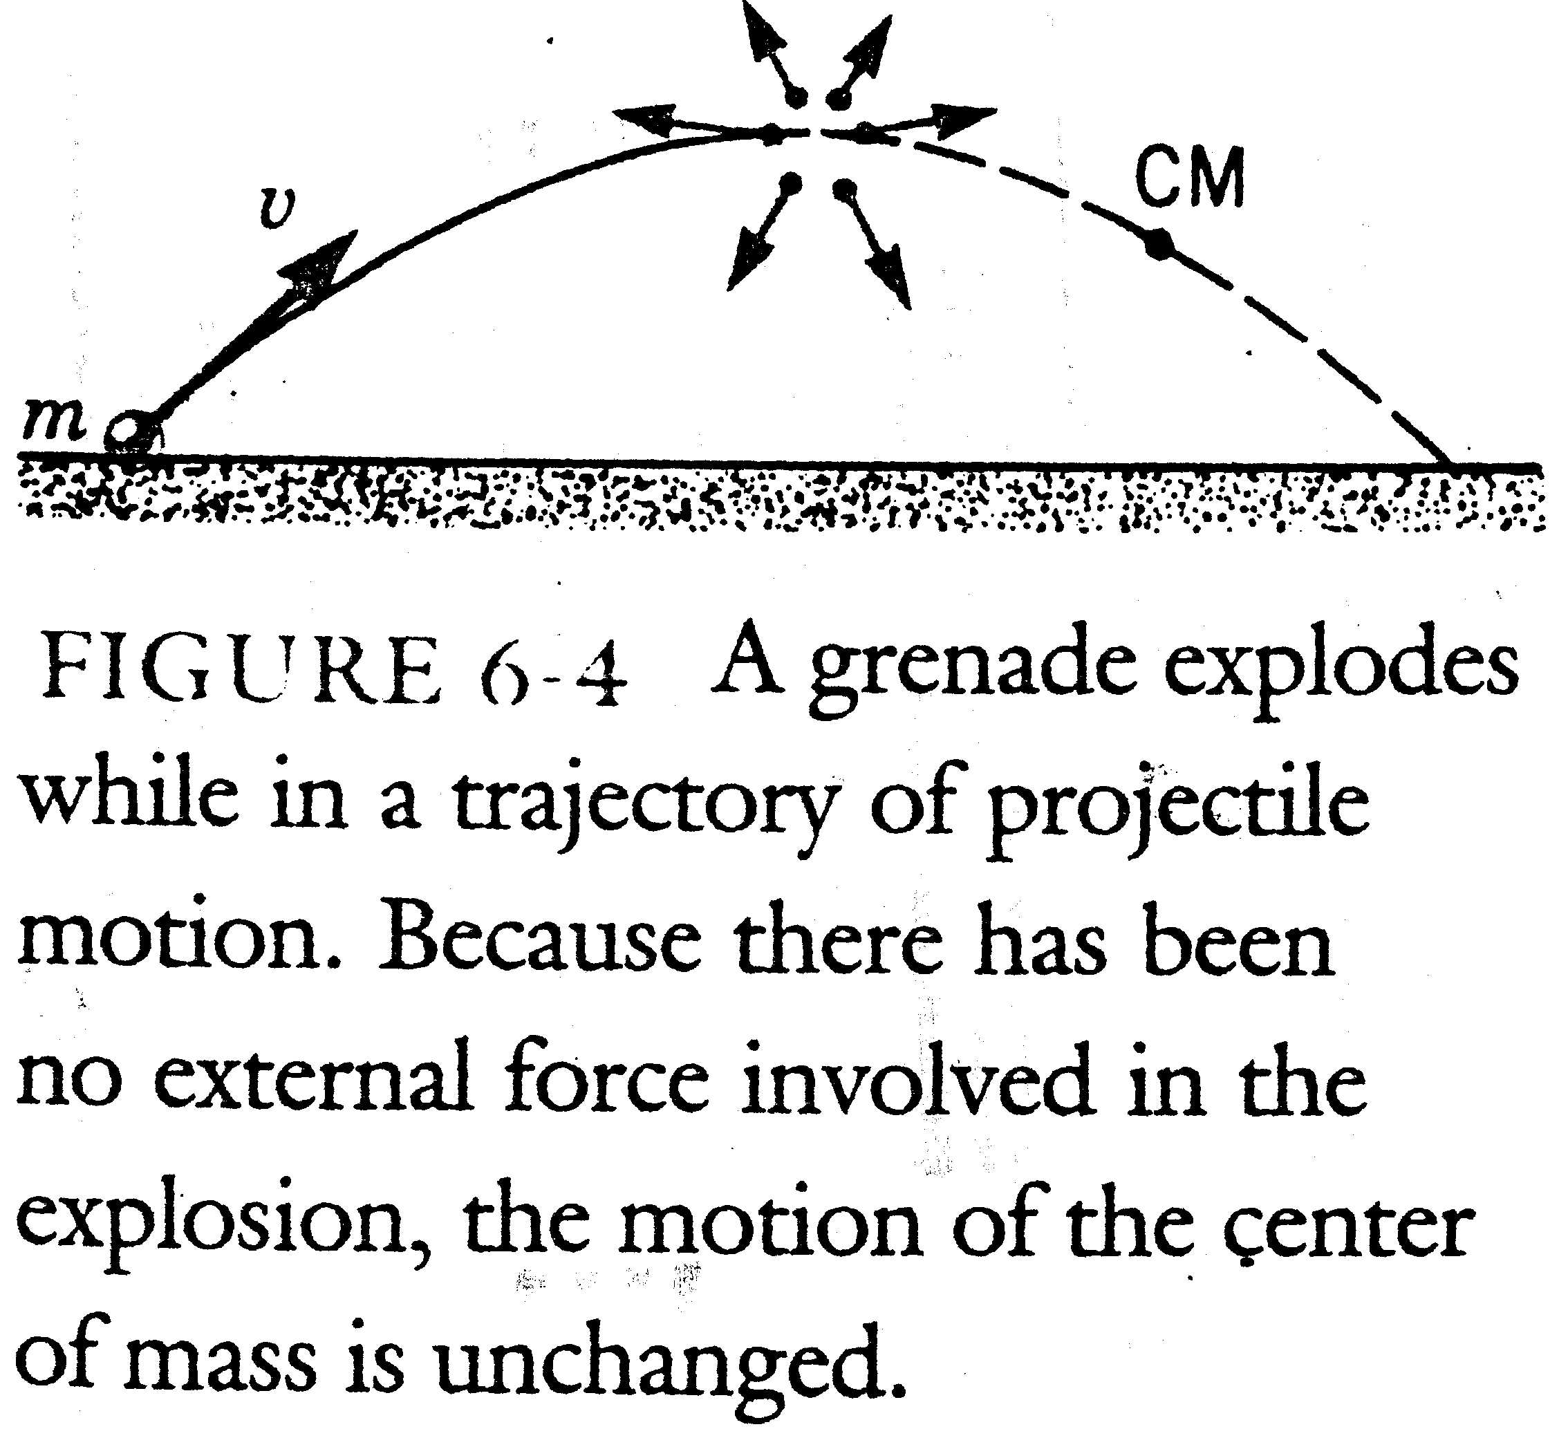

Slide 13


Momentum and Its Conservation
An impulse applied to a body will change its state of momentum.
where v₀ is the velocity of the body before the force begins to act on it and v_{f} is the velocity when the force stops acting on the body.
Momentum is often represented by the letter p,

Slide 14

If there is no external force exerted on a mass we have
which is the law of conservation of momentum.
If the resultant of the external forces acting on all the particles is zero, the total momentum of all the particles will not change, or

Slide 15

Momentum at very high speeds { Einstein's theory of special relativity} For the particles moving with speeds that are near the speed light, the formula F = dp/dt is correct, provided we define the momentum of a particle not as mv but as
where c is the speed of light.

Slide 16
Example 6-4
A cannon of mass 1000 kg fires a 100-kg projectile with a muzzle velocity of 400 m/sec (see Fig. 6-5). With what speed and in what direction does the cannon move?
Sol: Let M be the mass of the cannon, V ₀ its initial velocity, and V _{f} its final velocity. Let m be the mass of the projectile and v₀ and v_{f} its initial and final velocities, respectively. If we consider the cannon and projectile as our system of particles, no external force is involved in the firing of the projectile and we have

Slide 17
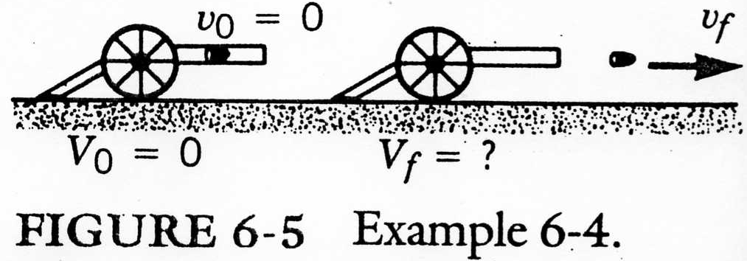

Slide 18



If we choose the direction of motion of the projectile as the positive direction, we get
or

Slide 19
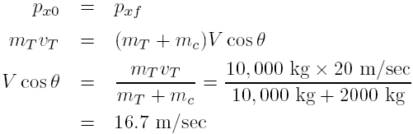
Example 6-5
A 10000-kg truck travelling east at 20 m/sec collides with a 2000-kg car travelling north at 30 m/sec. After the collision, they are locked together. With what velocity and at what angle do the locked vehicles move immediately after the collision? (See Fig. 6-6)
Sol: Because no external force is involved in the collision, momentum is conserved. In the x direction

Slide 20
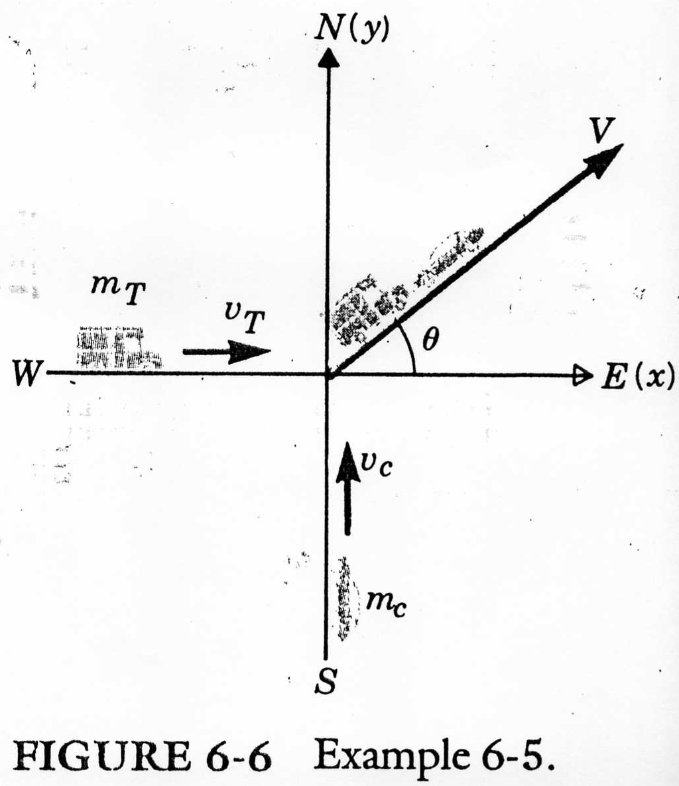

Slide 21
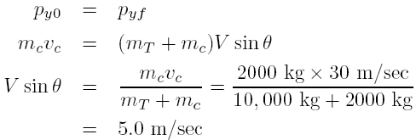
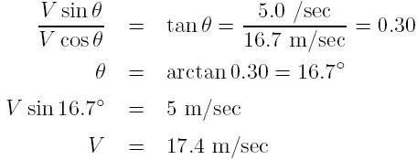
In the y direction,
Find the angle by dividing the two velocity components

Slide 22
Collisions
There are two types of collisions : elastic and inelastic.
In an elastic collision kinetic energy is conserved (i.e., no energy is lost from the system).
An inelastic collision is one in which kinetic energy is not conserved (e.g., some energy is lost to friction, crumpled fenders, or such).

Slide 23

Example 6-6 Elastic collisions
A neutron with a mass of m = 1 u (atomic mass unit) strikes a larger atom at rest and rebounds elastically along its original path with 0.9 of its initial forward velocity. What is the mass M, in atomic mass units, of the atom it struck?
Sol: Let v₀ be the initial velocity of the neutron and v_{f} = -0.9 v₀ its final velocity. Let M be the mass of the atom, V₀ its initial velocity, and V_{f} its velocity after collision. Both momentum and kinetic energy are conserved. From the conservation of momentum

Slide 24



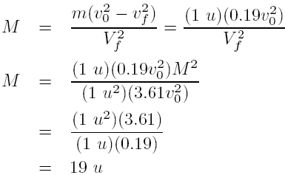
Since V₀ = 0
From the conservation of kinetic energy
Since V₀ = 0

Slide 25
Example 6-7 Elastic collisions
An important type of elastic collision at the atomic level, whose results we will use later, is the collision between a very small mass particle, such as an electron, with another particle of comparatively large mass, such as an atom. The mass of a copper atom, for example, is about 10⁵ times that of an electron. In this type of collision with the copper atom one is often interested in finding the velocity of the electron after the collision with the copper atom. To solve this type of collision, we follow the usual procedure of conserving momentum and kinetic energy. We will assume a one-dimensional collision.

Slide 26

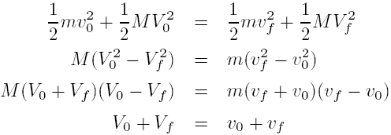
Sol: Let m, v₀, and v_{f} be the mass and the initial and the final velocity of the electron and M, V₀, and V_{f} those of the atom. From the conservation of momentum law
Conserving kinetic energy yields

Slide 27

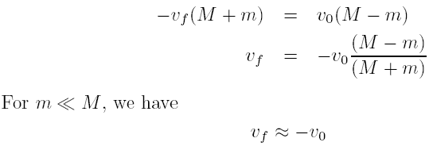
Let us have the atom initially at rest, V₀ = 0, we have

Slide 28
Example 6-8 Inelastic collisions
A ballistic pendulum is used to measure the velocity of a bullet. The bullet is shot into a wooden block suspended by strings. It lodges in the block, losing energy in its penetration, and the increase in the height of the swinging block and bullet is measured (see Fig. 6-7). If the bullet has a mass of 0.01 kg, the block has a mass of 0.5 kg, and the swing rises 0.1 m, what was the velocity of the incident bullet and what fraction of its energy was lost during penetration?

Slide 29
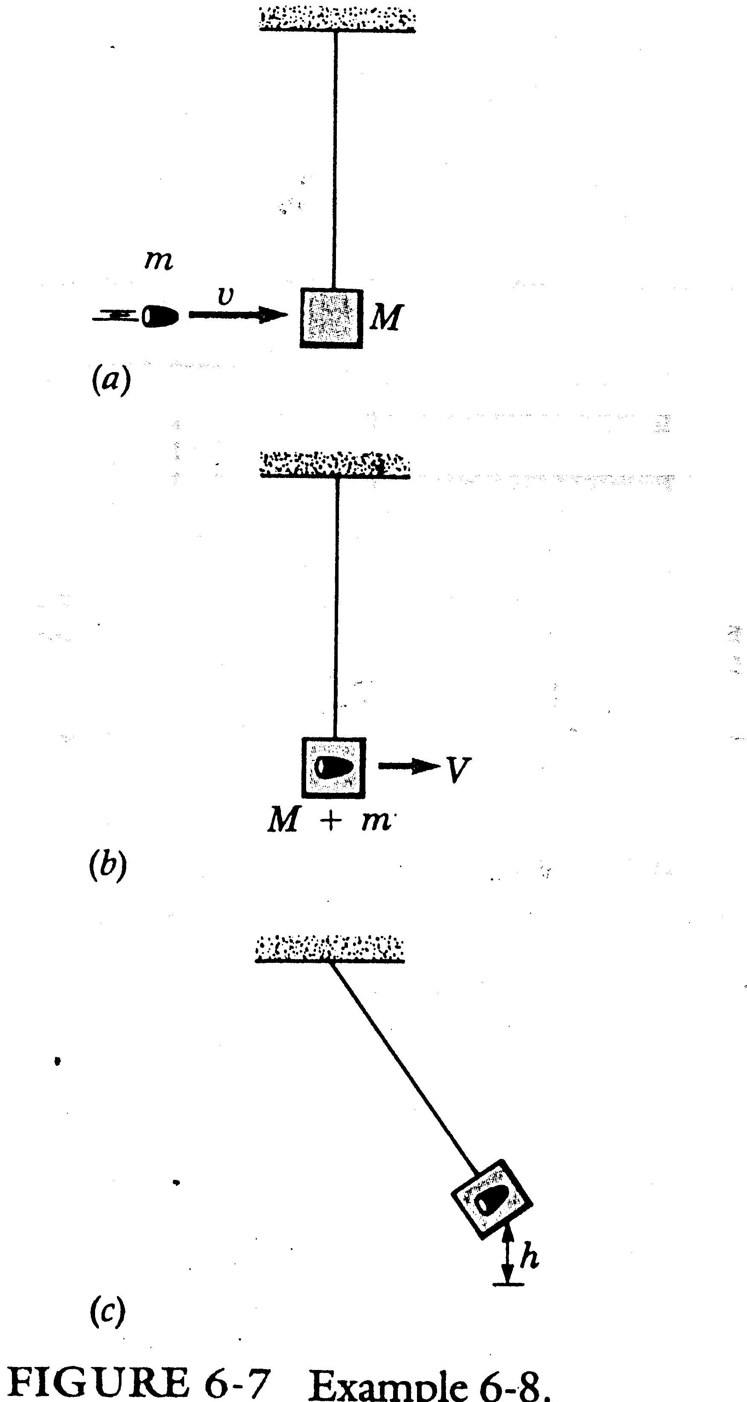

Slide 30
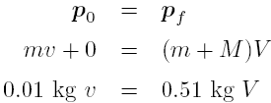
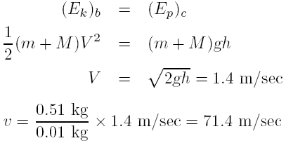
Sol: We first conserve momentum between situation (a) and (b) in Fig. 6-7.
Recall that the string does no work on the block in the pendulum.

Slide 31
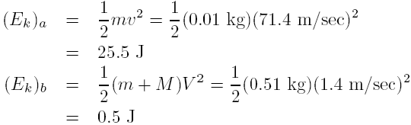
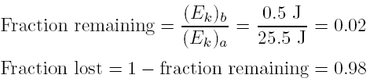
We find the fraction of the bullet's initial energy lost in penetration by calculating the energy of the system before and after the collision.

Slide 32
Homework
5, 7, 9, 12, 14, 18, 19, 22, 23, 24.

