Slide 1
Chapter Seven
Rotational Motion

Slide 2
Rotational Motion
A roulette wheel simply rotates, whereas a car wheel both rotates and translates.
Newton's laws and momentum and energy conservation still apply, but the formulation is somewhat different.

Slide 3
Measurement of Rotation
The most common measurement of rotation is a count of the number of revolutions about an axis of rotation.
We also use degrees as a measure, where 360º corresponds to one revolution.
In physics we mostly use radians since the formulation affords a quick and easy bridge between linear and rotational motion.

Slide 4



A measure of an angle in radians is the length of the circular are subtended by the angle divided by the radius of the circle (see Fig. 7-1).
where θ is dimensionless.

Slide 5
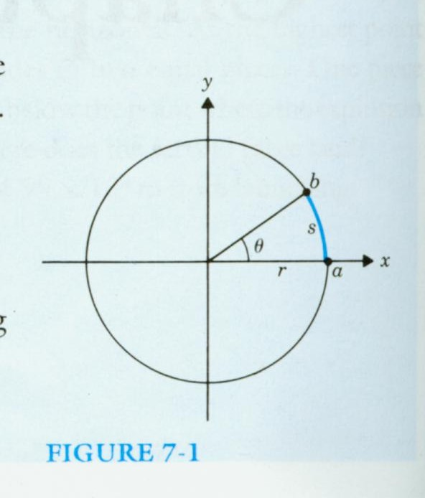

Slide 6
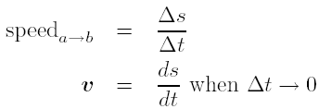
Rotational Motion
Suppose we have a reference marker a on the x axis of a coordinate system and a wheel whose center coincides with the origin (see Fig. 7-2).
The direction of the instantaneous velocity of the marker on the rotating wheel is the tangent to the circle of motion and is called the tangential velocity (v_{T}).

Slide 7
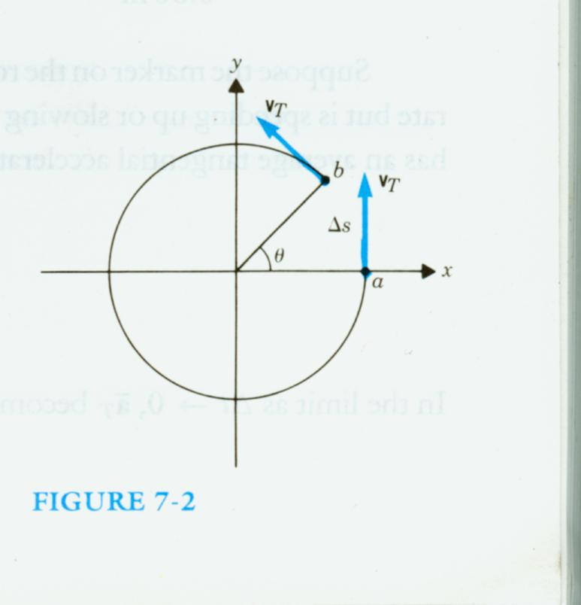

Slide 8

The velocity v_{T} is constantly changing. Here we have a vector whose magnitude may remain constant while its direction always changes.
The average rate of change of the angle θ with time is called the average angular or rotational velocity.
As the average angular velocity becomes the instantaneous angular velocity

Slide 9


Since
We have

Slide 10
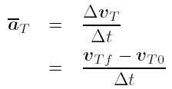

The average tangential acceleration is defined as
In the limit as , becomes the instantaneous acceleration ,

Slide 11


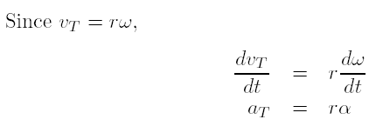
We call the rate of change of ω the average angular or rotational acceleration, so that
To find the instantaneous value we let
, and

Slide 12
Example 7-1
A car is traveling at a constant velocity of 24 m/sec. The radius of its wheels is r = 0.30 m. (a) How many revolutions have the wheels turned after the car has gone 120 m? (b) How many revolutions have the wheels turned after 60 sec?

Slide 13
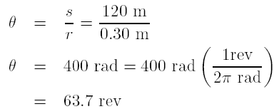
Sol
(a) If there is no slipping between the wheels of the car and the road, the arc length moved by a marker on the outermost radius of the wheel is equal to the distance traveled by the car.

Slide 14
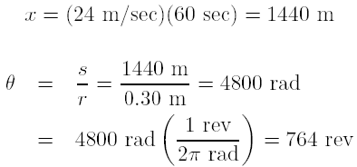
(b) Because the car travels at constant velocity,

Slide 15
Example 7-2
A driver of a car traveling at 24 m/sec applies the brakes, decelerates uniformly, and comes to a stop in 100 m. If the wheels have a radius of 0.30 m, what is the angular deceleration of the wheels in rev/sec²?

Slide 16
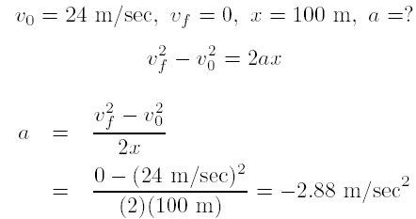
Sol
Because a is the acceleration of the car, it is also the tangential acceleration of every point on the rim of its wheels.

Slide 17
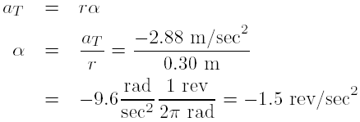

Slide 18

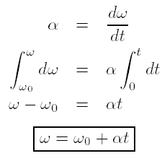
Equations of Rotational Motion
We will limit our discussion on the case of constant angular acceleration.

Slide 19
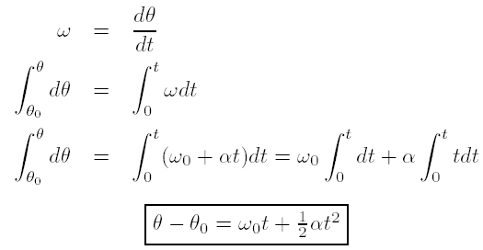

Slide 20
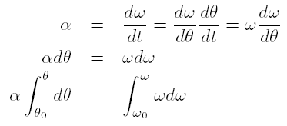
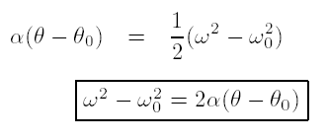

Slide 21
Example 7-3
A roulette wheel is given an initial rotational velocity of 2 rev/sec. It is observed to be rotating at 1.5 rev/sec ,5 sec after it was set in motion. (a) What is the angular deceleration (assumed constant) of the wheel? (b) How long will it take to stop? (c) How many revolutions will it make from start to finish?

Slide 22
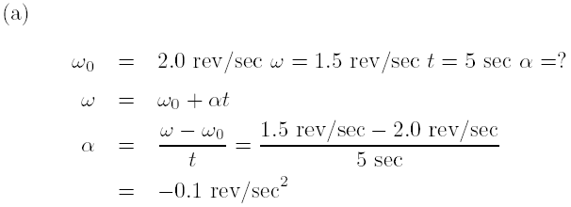
Sol

Slide 23

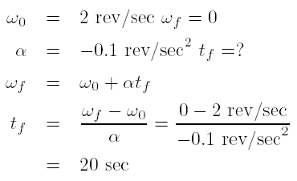
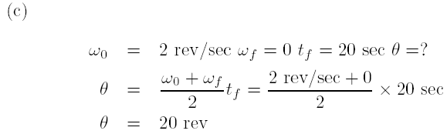

Slide 24

Radial Acceleration
See Fig. 7-3.
Because a velocity vector of a point on a circle is always tangent to the circle, it is perpendicular to the radius. For infinitesimal changes ¢t and thus ¢v?, there is an acceleration a_{R} inward along the radius called a radial acceleration a_{R} given by

Slide 25
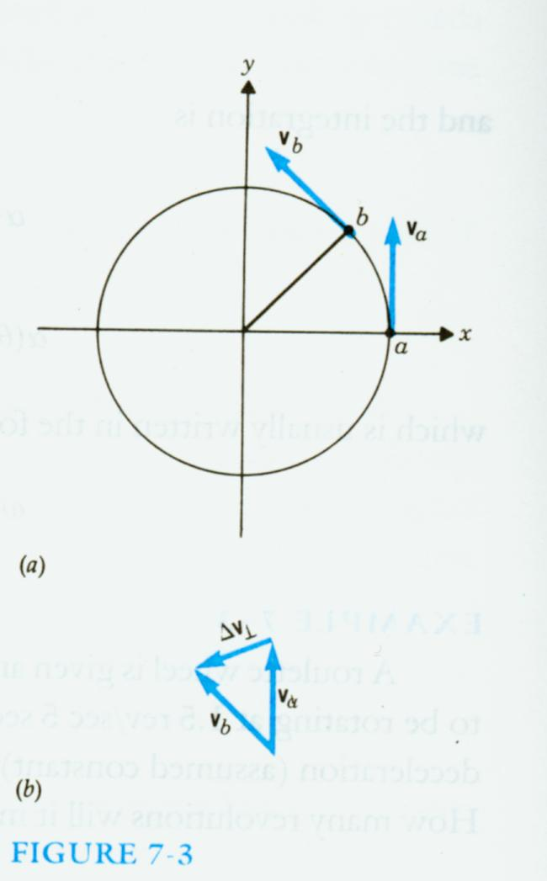

Slide 26

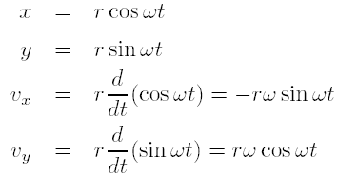
We now examine this radial acceleration analytically (see Fig. 7-4).
Let the marker rotate about the circle at a constant rotational velocity ω so that ¹

Slide 27
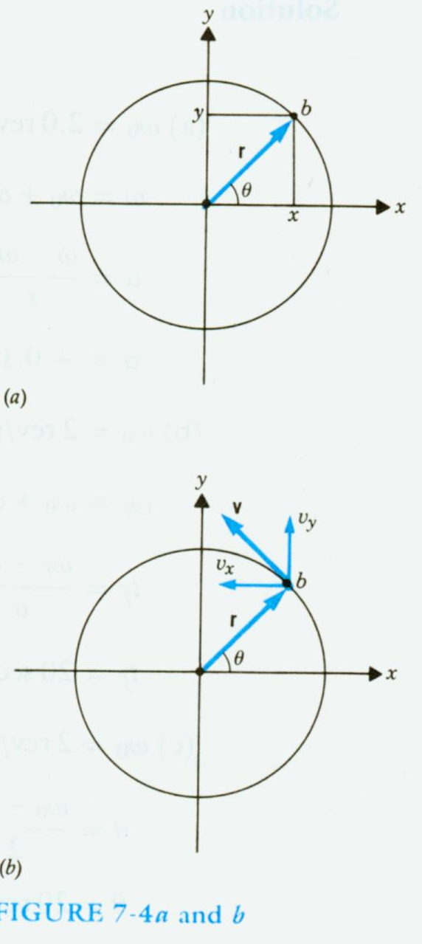

Slide 28
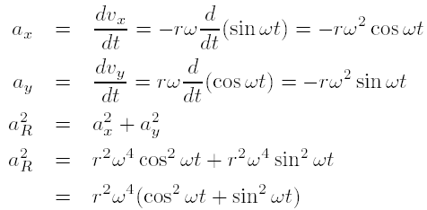

Slide 29
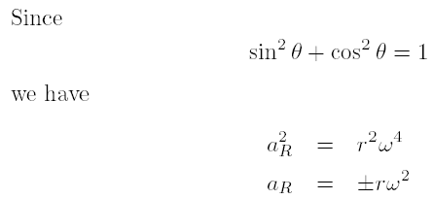
The direction of a_{R} is along the radius toward the center, that is, opposite to the vector direction of the radius (see Fig 7-5).

Slide 30
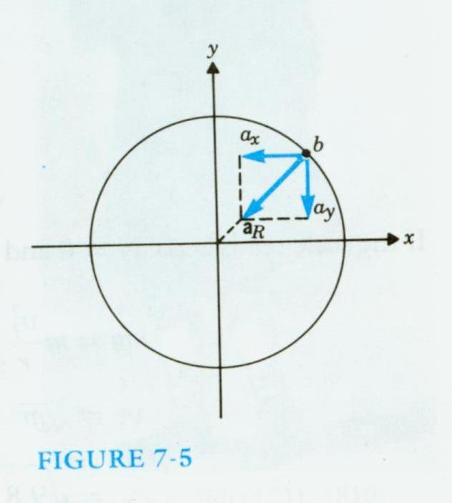

Slide 31
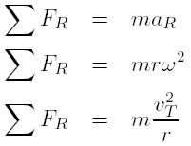
Centripetal Force
If there is an acceleration there must be a net force.
The particle cannot undergo circular motion unless there is a force along the radius directed inward toward the center. This force is called the centripetal force.
We indicate radial force by F_{R}.

Slide 32
In the solution of problems involving radial acceleration, two rules must be observed based on the derivations:
1. a_{R} has dimensions of m/sec² and therefore ω must have dimensions of rad/sec².
2. Radial forces directed toward the center of rotation are positive, whereas those directed away from the center are negative.

Slide 33
Example 7-4
A person whose weight is 600 N is riding a roller coaster. This person sits on a scale as the roller coaster passes over the top of a rise of radius 80 m. (a) What is the minimum speed of the car if the scale reads zero (the sensation of weightlessness is experienced)? (b) If the car increases its speed to 40 m/sec in descending to a dip with a radius of 80 m, what will the scale read? See Fig. 7-6.

Slide 34
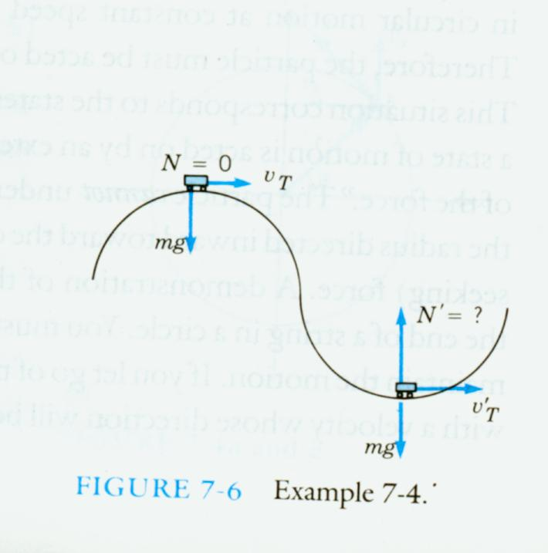

Slide 35
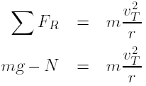
Sol
Let us consider the forces on the rider at the rise. The rider's weight, mg, is directed toward the center. The scale exerts a normal force N upward. N is the reading of the scale.

Slide 36
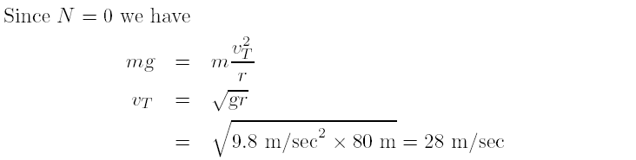

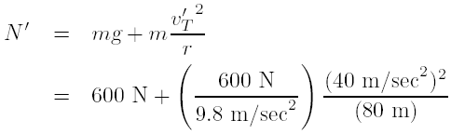

In the dip v’_{T} = 40 m/sec, mg is downward directed away from the
center whereas N’ now is upward toward the center.

Slide 37

Orbital Motion and Gravitation
Newton's law of gravitation: any two bodies are gravitationally attracted to each other by a force proportional to the product of their masses (m₁m₂) and inversely proportional to the square of the distance between them, r².
If we call the proportionality constant G, the universal gravitational constant,

Slide 38

The value of G is
The way to calculate the acceleration of gravity at the earth's surface, g.
1. m_{e} = the mass of the earth
m_{o} = the mass of an object near the surface
of the earth
m_{m} = the mass of the moon
r_{e} = the radius of the earth
r_{em} = the distance from the center of mass of
the earth to the center of mass of the
moon
m₀g = the force on an object at the surface of
earth

Slide 39



2.
3.The moon is also attracted to the earth
by the gravitational force

Slide 40

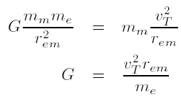
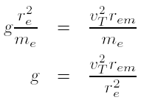
4. This force is the centripetal force
5.

Slide 41

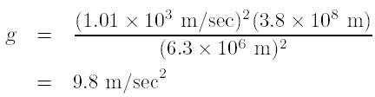
6.We have
V_{T} is the speed of the moon and
7.

Slide 42

Example 7-5
The radius of the earth is
and . Find the mass of the earth.
Sol : There are two ways to calculate the mass of the earth.

Slide 43
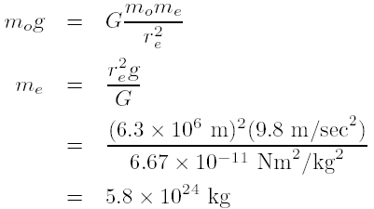
Sol
1.

Slide 44

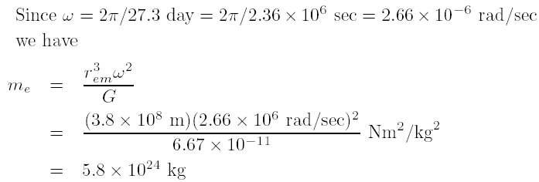
2. Since F_{R} = mrω² by applying this to the
motion of the moon around the earth
we have

Slide 45
Homework
7.3, 7.7, 7.11, 7.12, 7.13, 7.17, 7.18, 7.19, 7.20, 7.21.

Slide 46
Shell theorem on Gravitation
Newton solved the apple-Earth problem by solving an important theorem called the shell theorem:
  A uniform spherical shell of matter attracts a particle that is outside the shell as if all the shell's mass were concentrated at its center.
  A uniform shell of matter exerts no net gravitational force on a particle located inside it.
If the density of Earth were uniform, the gravitational force acting on a particle would be a maximum at Earth's surface.

Slide 47
Example s-1
Suppose a tunnel runs through Earth from pole to pole, as in Fig. s-1. Assume that Earth is a nonrotating, uniform sphere. Find the gravitational force on a particle of mass m dropped onto the tunnel when it reaches a distance r from Earth's center.

Slide 48
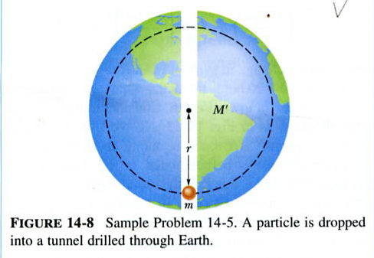
S-1

Slide 49

Sol
The force that acts on the particle is associated only with the mass M’ of Earth that lies within a sphere of radius r. The portion of Earth that lies outside this sphere does not exert any net force on the particle. Mass M’ is given by
in which V’ is the volume occupied by M’, and ½ is the assumed uniform density of Earth.

Slide 50
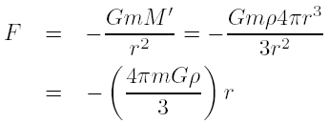
The force acting on the particle is then
We have inserted a minus sign to indicate that force F and the displacement r are in opposite direction, the former begin toward the center of Earth and the latter away from that point.

Slide 51
Example s-2
Consider a pulsar, a collapsed star of extremely high density, with a mass M equal to that of the Sun (1.98 × 10³⁰ kg), a radius R of only 12 km, and a rotational period T of 0.041 sec. At its equator, by what percentage does the free-fall acceleration g differ from the gravitational acceleration a_{g}?

Slide 52
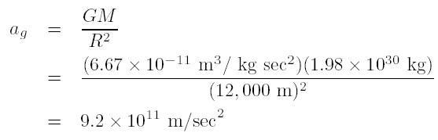
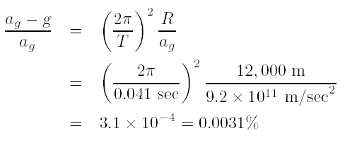
Sol
To find a_{g} on the surface of the pulsar, we have

Slide 53
Example s-3
An astronaut whose height h is 1.70 m float feet "down" in an orbiting space shuttle at a distance r = 6.77 X 10⁶ m from a black hole of mass M_{h} = 1.99 X 10³¹ kg (which is 10 times our sun's mass), what is the difference in the gravitational acceleration at her feet and head? The black hole has a surface (called the horizon of the black hole) of radius R_{h} = 2.95 X 10⁴ m. Nothing, not even light, can escape from the surface or any where inside it. Note that the astronaut is well outside the surface (at r = 229R_{h}).

Slide 54

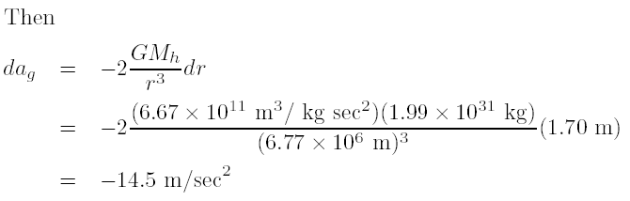
Sol
The gravitational acceleration at any distance from the center of the black hole is

Slide 55

Gravitational Potential Energy
As before, the gravitational potential energy decreases when the separation decreases.
We assume that the gravitational potential energy E_{p} is zero for r = , where r is the separation distance.
The potential energy is negative for any finite separation and becomes progressively more negative as the particles move closer together.
We take the gravitational potential energy of the two-particle system to be

Slide 56
Gravitational Potential Energy
-Proof
Let a baseball, starting from rest at a great (infinite) distance from Earth, fall toward point P, as in Fig. s-2. The potential energy of the baseball-Earth system is initially zero.
When the baseball reaches P, the potential energy is the negative of the work W done by the gravitational force as the baseball moves to P from its distant position.

Slide 57
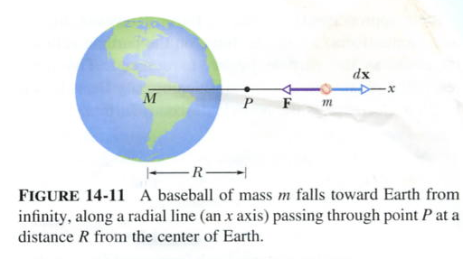
S-2

Slide 58
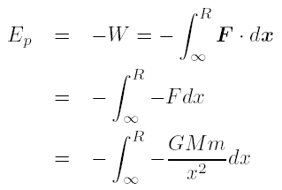
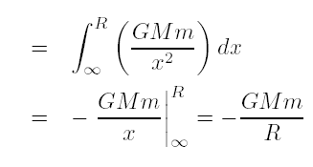
Thus

Slide 59
Escape Speed
There is a certain minimum initial speed that will cause a projectile to move upward forever, theoretically coming to rest only at infinity. This initial speed is called the escape speed.
Consider a projectile of mass m, leaving the surface of a planet with escape speed v. When the projectile reaches infinity, it stops and thus has no kinetic energy. It also has no potential energy because this is our zero-potential energy configuration.

Slide 60

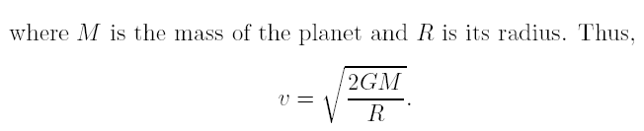
From the principle of conservation of energy, we have

Slide 61
Example s-4
An asteroid headed directly toward earth, has a speed of 12000 m/sec relative to the planet when it is at a distance of 10 Earth radii from Earth's center. Ignoring the effects of the terrestrial atmosphere on the asteroid, find the asteroid's speed when it reaches Earth's surface.
Sol: Because the mass of an asteroid is much less than that of Earth, we can assign the gravitational potential energy of the asteroid-Earth system to the asteroid alone, and we can neglect any change in the speed of Earth relative to the asteroid during the asteroid's fall.

Slide 62


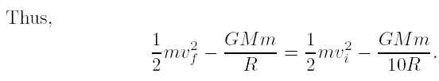
Thus,

Slide 63
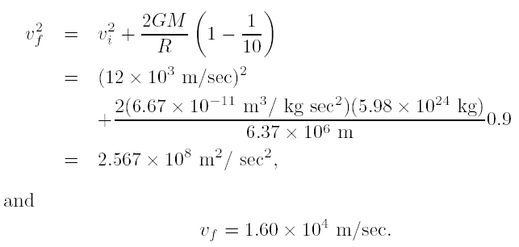

Slide 64
Kepler's Laws
The law of orbits: all planets move in elliptical orbits, with the Sun at one focus.
The law of areas: a line that connects a planet to the Sun sweeps out equal areas in equal times.
The law of periods: the square of the period of any planet is proportional to the cube of the semimajor axis of its orbit.

Slide 65

The law of orbits
The orbit in Fig. s-3 is described by given its semimajor axis a and its eccentricity e, the latter defined so that ea is the distance from the center of the ellipse to either focus F or F’.
The sum of the perihelion (nearest the Sun) distance R_{p} and the aphelion (farthest from the Sun) distance R_{a} is 2a.
The sum of the distance from any position in the orbit to two foci is 2a.
The equation of any position (x, y) in the orbit is

Slide 66
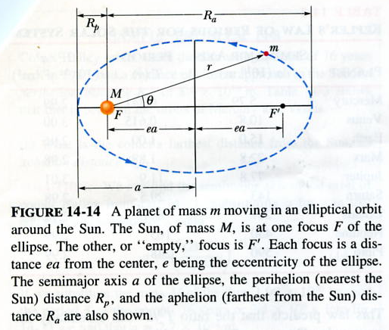
S-3

Slide 67
An eccentricity of zero corresponds to a circle, in which the two foci merge to a single central point.
The eccentricities of the planetary orbits are not large, so the orbits look circular.
The eccentricity of Earth's orbit is only 0.0167.

Slide 68
The Law of Areas
The planet will move most slowly when it is farthest from the Sun and most rapidly when it is nearest to the Sun.
The law of areas is a direct consequence of the idea that all of the forces are directed exactly toward the sun.

Slide 69

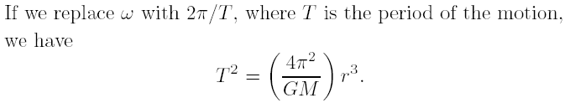
The Law of Periods
Consider a circular orbit with radius r. See Fig. s-4.
Applying Newton's second law, F = ma, to the orbiting planet in Fig. s-4 yield
the law holds also for elliptical orbits, provided we replace r with a, the semimajor axis of the ellipse.

Slide 70
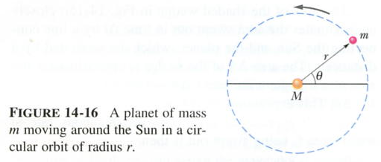
S-4

Slide 71




Example s-5
A satellite in circular orbit at an altitude h of 230 km above Earth's surface has a period T of 89 min. What mass of Earth follows from these data?
Sol: From Kepler's law of periods we have
The radius r of the satellite orbit is
in which R is the radius of Earth.

Slide 72
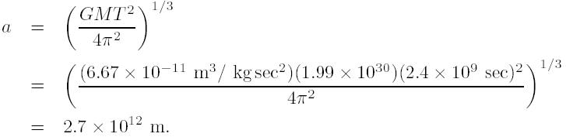
Example s-6
Comet Halley orbits about the Sun with a period of 76 years and, in 1986, had a distance of closest approach to the Sun, its perihelion distance R_{p}, of 8.9 £ 10¹⁰ m. (a) What is the comet's farthest distance from the Sun, its aphelion distance R_{a}? (b) What is the eccentricity of the orbit of comet Halley?
Sol:(a) From Kepler's law of period we have

Slide 73

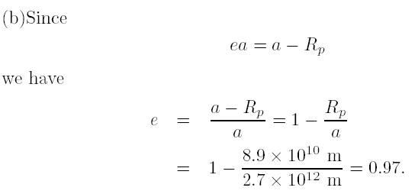

Slide 74

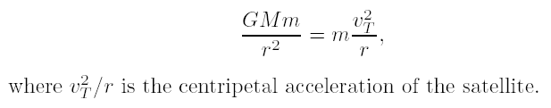
Satellites: Orbits and Energy
The mechanical energy E_{k} + E_{p} of the satellite remains constant.
We first assume that the orbit of the satellite is circular.
The potential energy is
where r is the radius of the orbit.
By Newton's second law,

Slide 75



The kinetic energy of a satellite is
The total mechanical energy is
For a satellite in an elliptical orbit of semimajor axis a, we have

