Slide 1
Chapter Eight
Rotational Dynamics

Slide 2
Rotational Dynamics
Previously, we developed the first principles of linear dynamics; now we adapt the principles of linear dynamics to rotating bodies.
Newton's laws, momentum, energy, and power all have equations equivalent to their linear counterparts.

Slide 3
Moment of Inertia and Torque
In Newton's second law, mass is the proportionality constant between force and acceleration. Newton called it the inertial mass.
This resistance to having the state of rotational motion changed is called the moment of inertia, with symbol I.

Slide 4
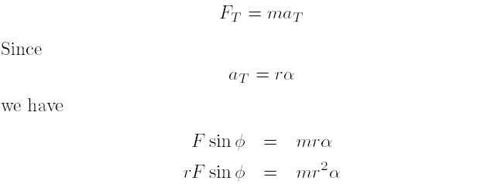

See Fig. 8-1. By Newton's second law,

Slide 5
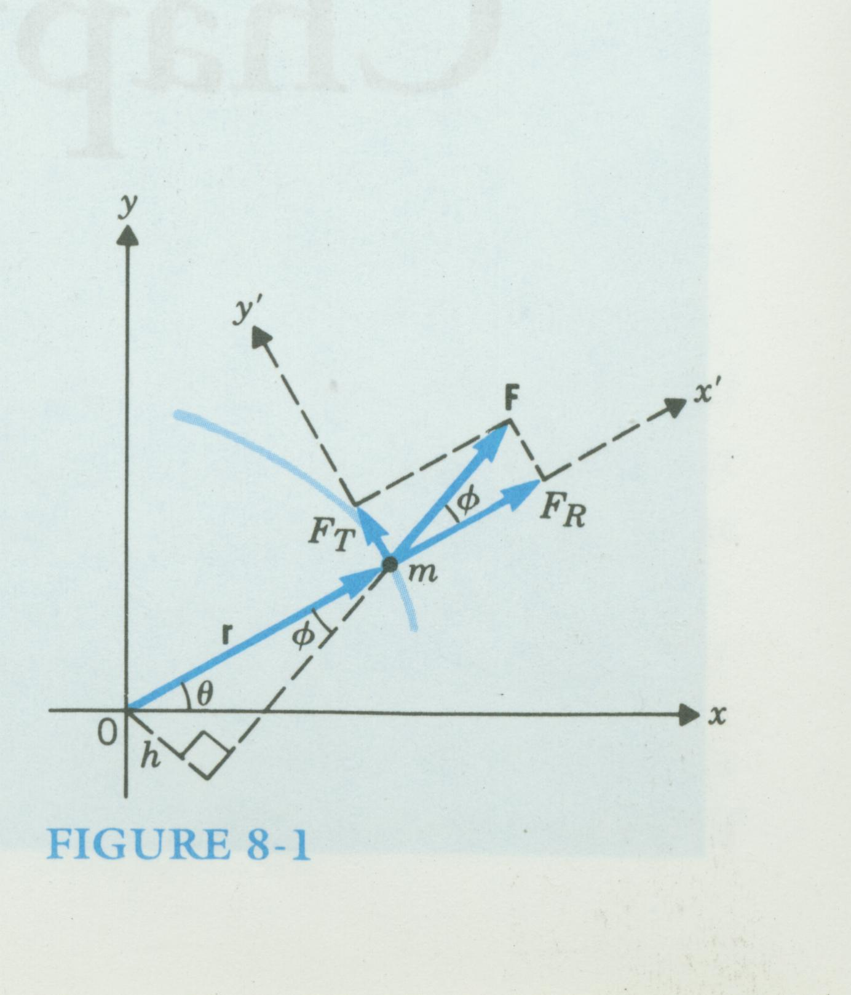

Slide 6


The quantity Fh = Fr sin ψ is called the torque produced by F, which is usually represented by τ .
The quantity mr² is called the moment of inertia, I, of a point mass.
Newton's second law for rotation:
It is conventional to define τ as the cross product of the position vector r and the force vector F, namely,

Slide 7

If there are a variety of masses at different distances from the pivot point, the moment of inertia of the assembly is the sum of their individual ones or
Unlike the translational inertia ( the mass), the rotational inertia (moment of inertia) of an object depends on the location of the mass relative to the axis of rotation and in general is different for different axes of rotation.

Slide 8
Example 8-1
A balance scale consisting of a weightless rod has a mass of 0.1 kg on the right side 0.2 m from the pivot point. See Fig. 8-2. (a) How far from the pivot point on the left must 0.4 kg be placed so that a balance is achieved? (b) If the 0.4-kg mass is suddenly removed, what is the instantaneous rotational acceleration of the rod? (c) What is the instantaneous tangential acceleration of the 0.1-kg mass when the 0.4-kg mass is removed?

Slide 9
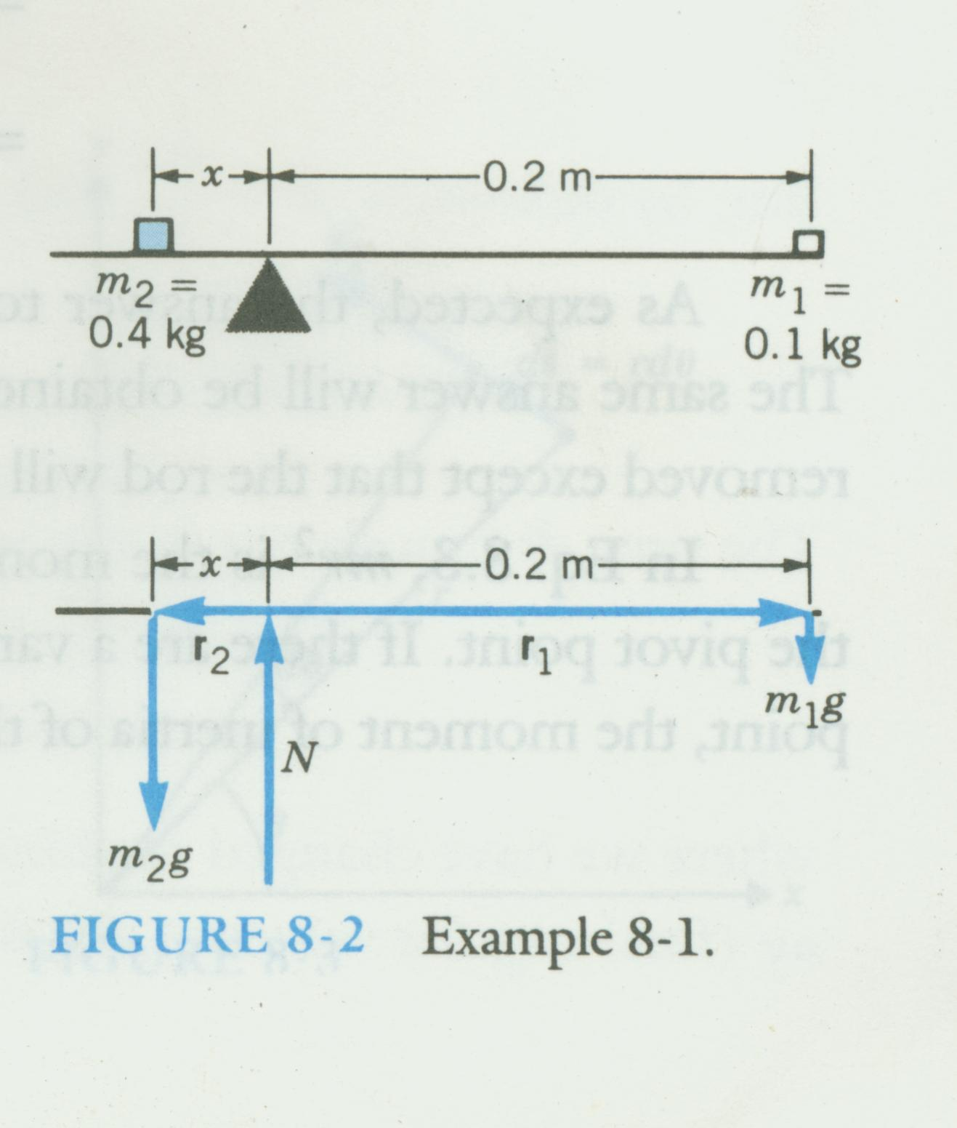

Slide 10

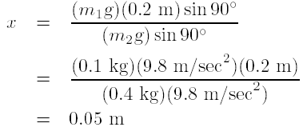
Sol
(a) Since α = 0, we have
Thus,

Slide 11
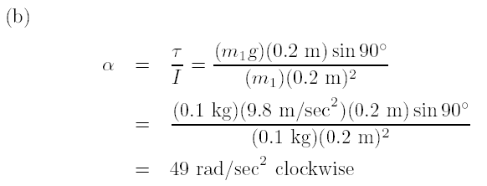


Slide 12



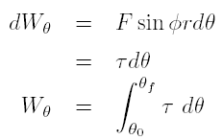
Rotational Kinetic Energy
The work down by F_{T} in this infinitesimal distance is dW, and
Since F_{T} and ds are in the same direction, we have
Since
We have
where θ₀ and θ_{f} are the initial and final angles, respectively.

Slide 13

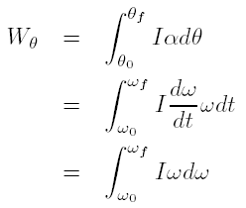
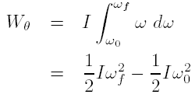
Since ¿ = I® we have
If the distance of the particle to the point of rotation does not change. then

Slide 14



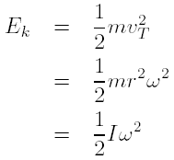
where the quantity is called the rotational kinetic energy,
A point on a rotating system has an instantaneous tangential velocity VT . Its kinetic energy is
Since

Slide 15
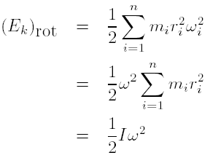

The rotation of a rigid body made up of discrete masses m_{i} . The rotational kinetic energy is
since the body is rigid, all point masses rotate with the same angular velocity regardless of their distance from the axis, i.e.,

Slide 16

A body can be rotating as it translates through space; its total kinetic energy is therefore the sum of translational and rotational and rotational kinetic energies
where v_{CM} is the translational velocity of the center of mass.

Slide 17
Example 8-2
A large wheel of radius 0.4 m and moment of inertia 1.2 kg-m², pivoted at the center, is free to rotate without friction. A rope is wound around it and a 2-kg weight is attached to the rope (see Fig. 8-4). when the weight has descended 1.5 m from its starting position
(a) what is its downward velocity?
(b) what is the rotational velocity of the wheel?

Slide 18
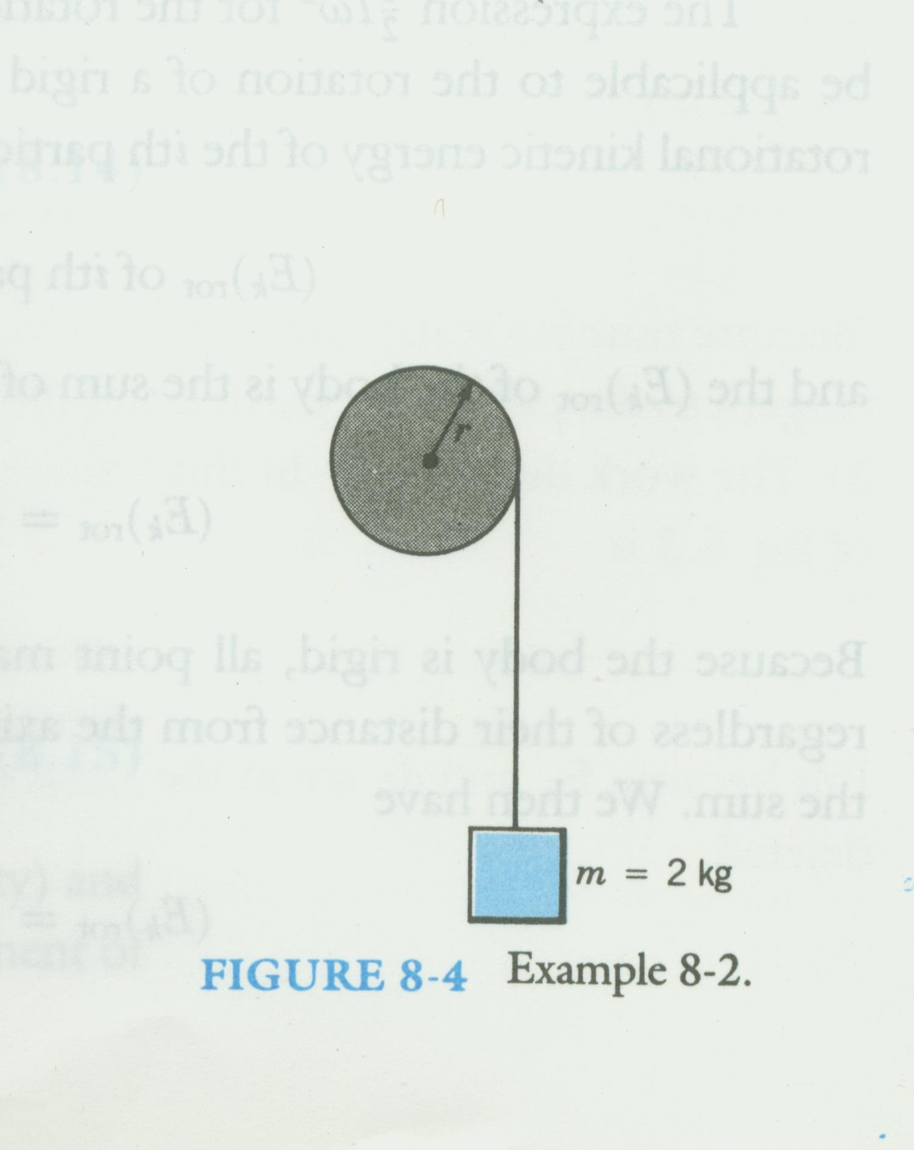

Slide 19
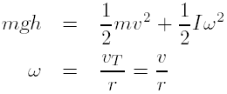
Sol
(a) We may solve this problem by the conservation of energy, equating the initial potential energy of the weight to its conversion to kinetic energy of the weight and of the wheel.

Slide 20
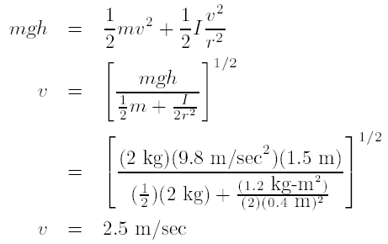

(b) The answer to part (a) shows that any point on the rim of the wheel has a tangential velocity of v_{T} = 2.5 m/sec.

Slide 21

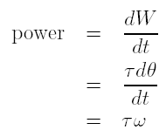
Power
The definition of power is work done per unit time.
The incremental amount of work done in moving the mass in Fig. 8-3 a
distance is

Slide 22
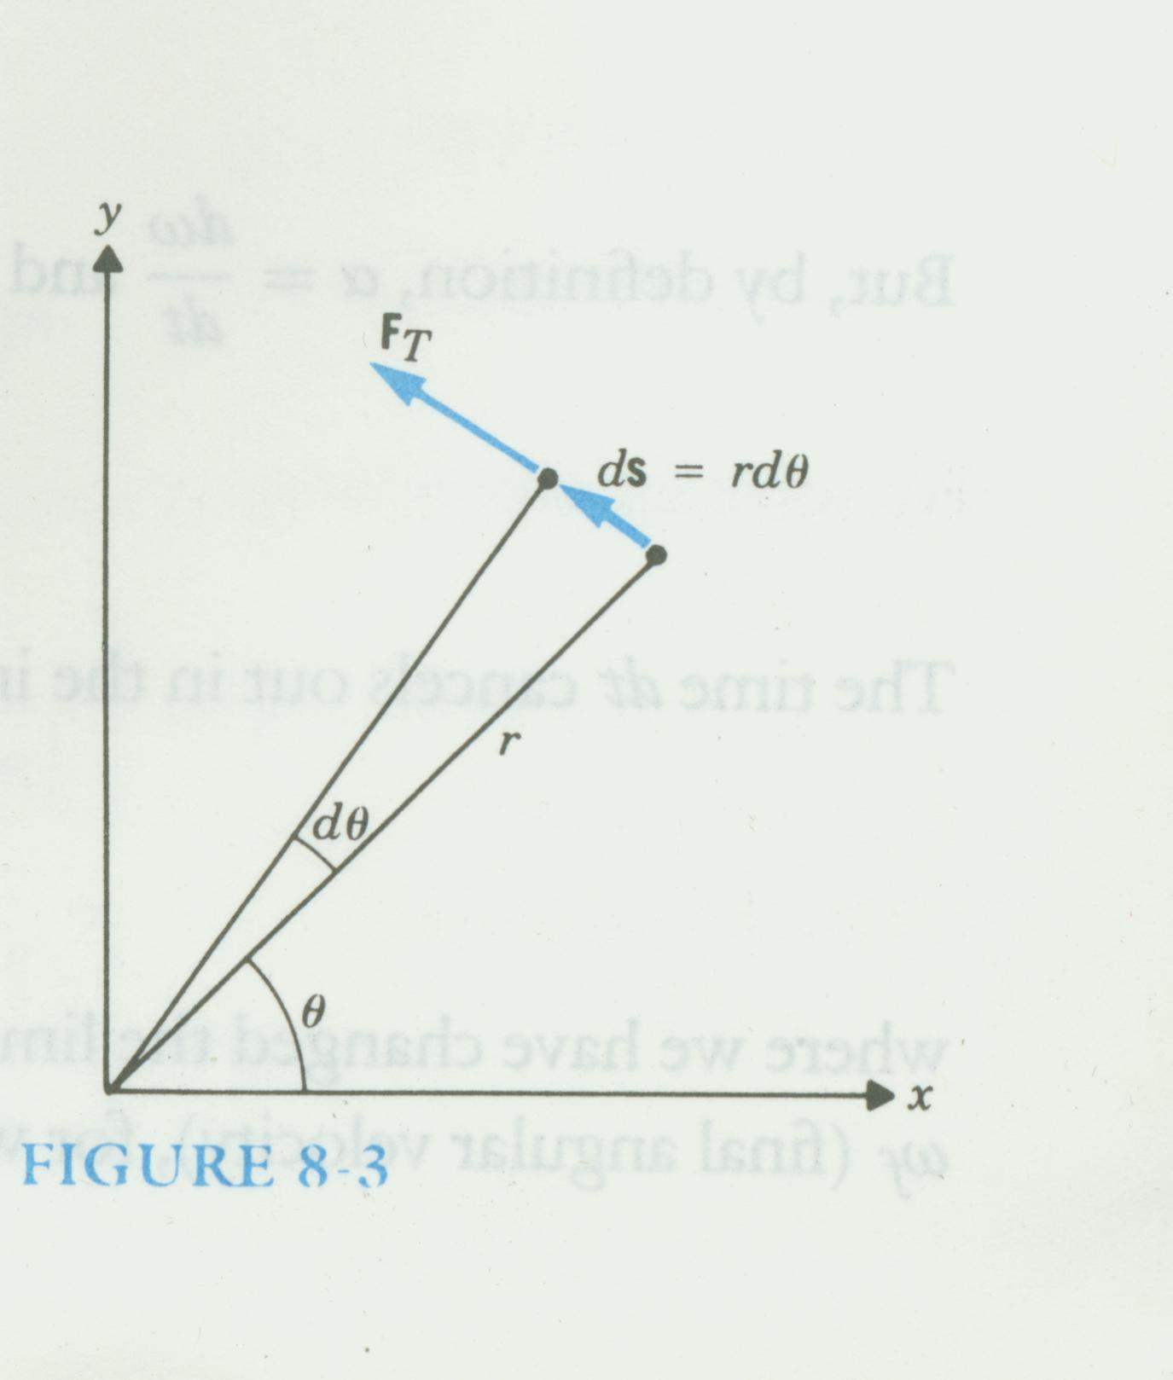

Slide 23
Example 8-3
A machine shop has a lathe wheel of 40-cm diameter driven by a belt that goes around the rim. If the linear speed of the belt is 2 m/sec and the wheel requires a tangential force of 50 N to turn it, how much power is required to operate the lathe?

Slide 24
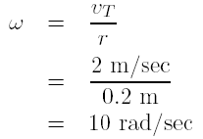


Sol
The rotational velocity is
The torque is

Slide 25
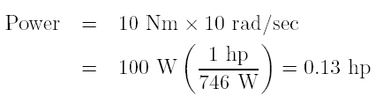
Thus

Slide 26
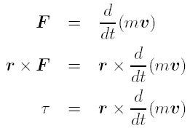
Angular Momentum
Consider, as shown in Fig. 8-5, a particle of mass m with momentum p = mv in the x-y plane. The position vector of m is r, which is not required to be a constant.

Slide 27
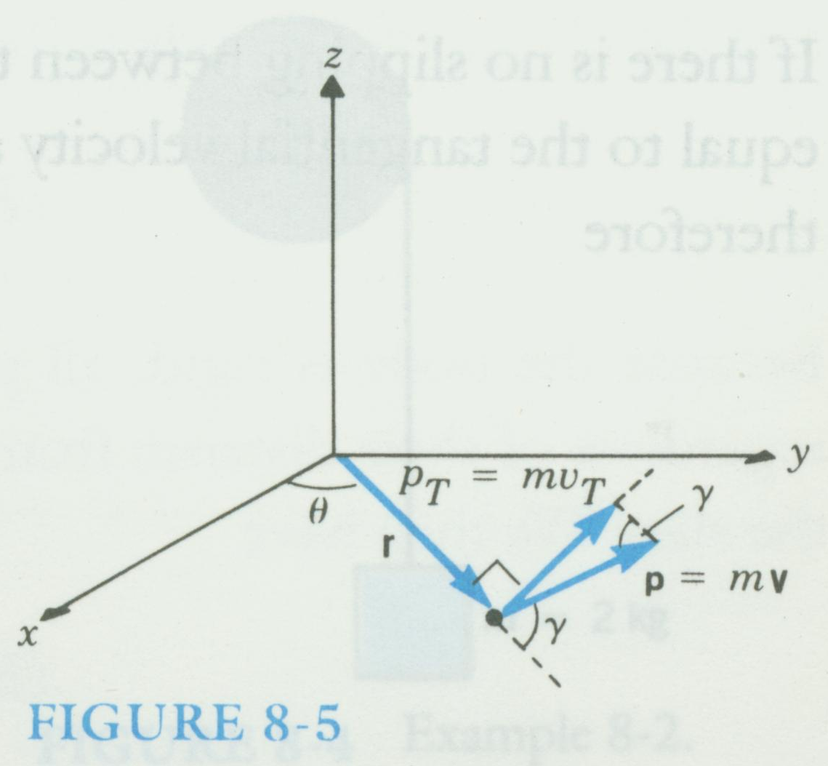

Slide 28
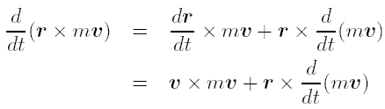



Note that
Since the cross product of two vectors in the same direction is zero,
There
Then

Slide 29



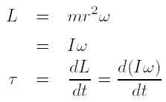
We call the angular momentum of the particle.
where γ is the angle between the radius vector r and the linear momentum mv (see Fig. 8-5). But mv sin γ = mv_{T} , and
Since v_{T} = rω and
therefore

Slide 30



Conservation of Angular Momentum
a
If we have a situation in which there is no net externally applied torque, then τ = 0. Thus
With no net external torque
This is known as the law of conservation of angular momentum.

Slide 31
Example 8-4
Suppose the body of an ice skater has a moment of inertia I = 4 kg-m² and her arms have a mass of 5 kg each with the center of mass at 0.4 m from her body. She starts to turn at 0.5 rev/sec on the point of her skate with her arms outstretched. She then pulls her arms inward so that their center of mass is at the axis of her body, r = 0. What will be her speed of rotation?

Slide 32
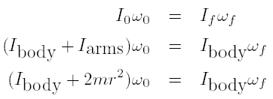
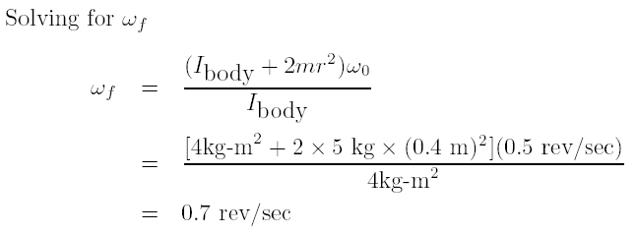
Sol

Slide 33
Homework
8.2, 8.5, 8.6, 8.7, 8.10, 8.11, 8.13, 8.14, 8.18, 8.19.

