Slide 1
Chapter Nine
Kinetic Theory of Gases and the
Concept of Temperature

Slide 2
Kinetic Theory of Gases and the Concept of Temperature
Heat is a form of energy.
The first law of thermodynamics is a broadened statement of the law of conservation of energy.

Slide 3

Molecular Weight
In this book we will consider only systems composed of identical atoms, or molecules such as oxygen (O₂) or nitrogen molecules (N₂).
A mole of a substance is that quantity which contains the same number of particles as there are atoms in 12 g of carbon-12.
Carbon-12 is said to have a mass of exactly 12 u per atom, where u is called an atomic mass unit and has the value

Slide 4
The mass of an atom (or molecule) in atomic mass units is called atomic weight (or molecular weight).
The mass, in grams, of a mole of a substance is numerically equal to the atomic weight ( or molecular weight) of the atoms of that substance, and it is referred to as the gram atomic weight (or gram molecular weight).

Slide 5

The mass of 1 mole of carbon-12 is 12 g/mole. The number of atoms in 1 mole of a substance is called Avogadro's number and has the value

Slide 6
We will use the symbol n ( called mole fraction) to represent the number of moles present.
If we denote M as the gram molecular weight of a substance and m as the mass of the amount present, then n = m/M, and, because M has NA atoms or molecules, the number of atoms or molecules present is nN_{A}.

Slide 7
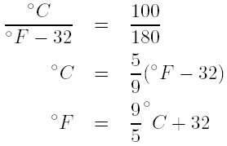
Thermometers
Fahrenheit scale: the melting point of pure ice is 32º and the boiling point of pure water at sea level is 212º.
Celsius scale: the melting point of pure ice is 0º and the boiling point of pure water at sea level is 100º. See Fig. 9-1.

Slide 8
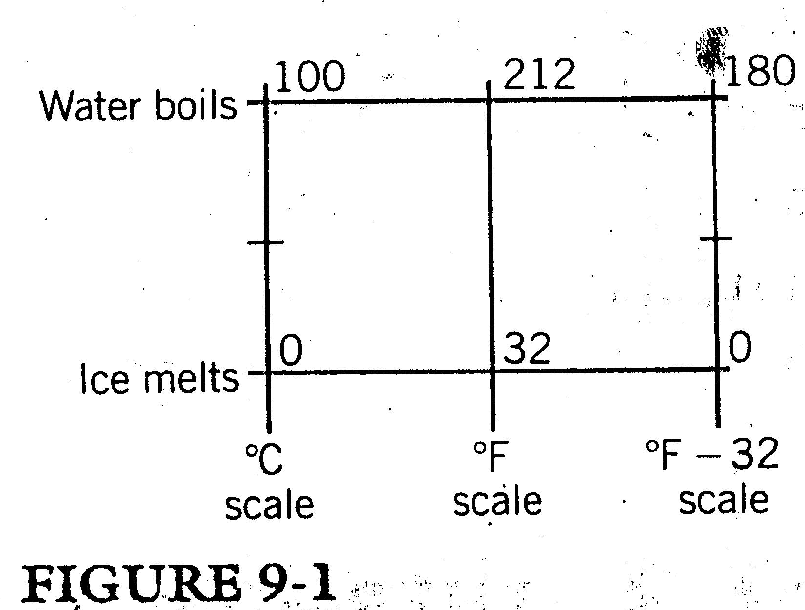

Slide 9
Ideal Gas Law and Absolute Temperature
The pressure, P, is the force perpendicular to a surface per unit surface area, or P = F=A.
The dimension of pressure is newton/meter² (N/m²) or pascal (Pa), where 1 Pa=1 N/m².
Atmospheric pressure at sea level is approximately 1.01 10⁵ N/m².
An idea gas is one that has no tendency to condense. This means that the atoms are infinitesimal in size and that there is no attractive force between them.

Slide 10


Idea gases do not exist.
If the quantity of gas remained constant,
where V is the volume of gas.
When equal volumes of the same gas are taken at the same temperature and pressure, R’ remains constant.
With the introduction of this term n the idea gas law is written as
where n is the number of moles and R is now the same for all gases.

Slide 11
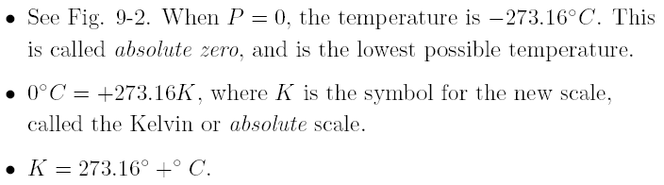


Slide 12
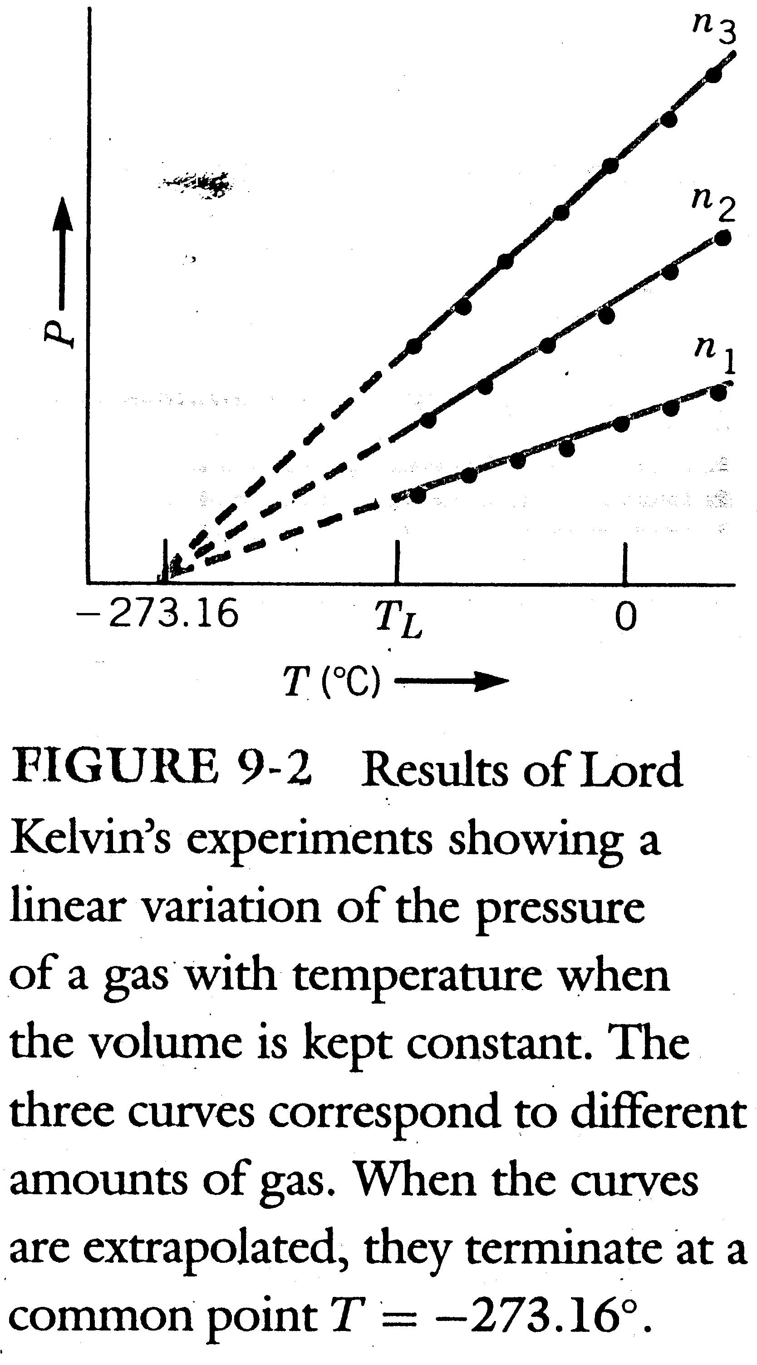

Slide 13
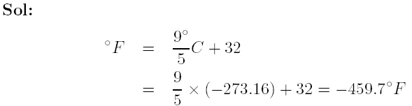
Example 9-1
What is the temperature of absolute zero on the Fahrenheit scale?

Slide 14
Example 9-2
In a typical experiment to determine the value of the gas constant R, 0.152 g of neon gas (atomic weight 20.2 g/mole) is introduced into a 100-cm3 flask that is closed and attached to a pressure gauge. It is found that when the flask is placed in a constant temperature bath at 50ºC the pressure of the gas is 2 atmospheres (atm). What value of R is obtained?

Slide 15
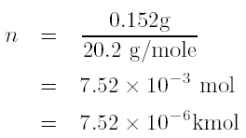
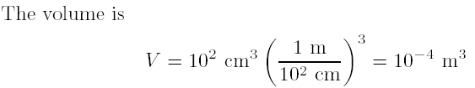
Sol
The mole fraction n is the ratio of the number of grams present to the atomic weight in grams.

Slide 16
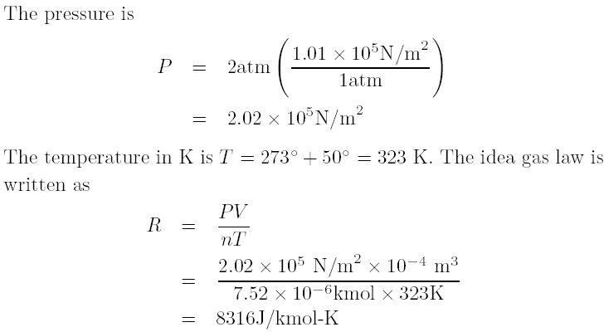

Slide 17
Example 9-3
In a diesel engine, no spark plug is required because the temperature is raised to the ignition point of the air-fuel mixture by compression. In a typical diesel engine the air intake is at 27ºC and at a pressure of 1 atm, and it is compressed to 1=15 of its original volume with its pressure becoming about 50 atm. What is the temperature of the air-fuel mixture in the cylinder in ºC.

Slide 18


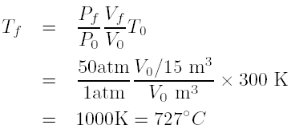
Sol
We note that
If the quantity of gas is kept constant, then nR is a constant. Thus,
In this Problem

Slide 19
Kinetic Theory of Gas Pressure
We will show how the concept of momentum conservation and the definition of pressure can be used to calculate the statistical behavior of a large number of atoms or molecules in a gas.
One of the assumptions in this calculation is that all collisions between atoms or molecules are perfectly elastic.
In an elastic collision of an atom with the container wall, the velocity component normal to the wall is reversed on collision with its magnitude unchanged, and the velocity component in the direction parallel to the surface of the wall is unchanged. See Fig. 9-3.

Slide 20
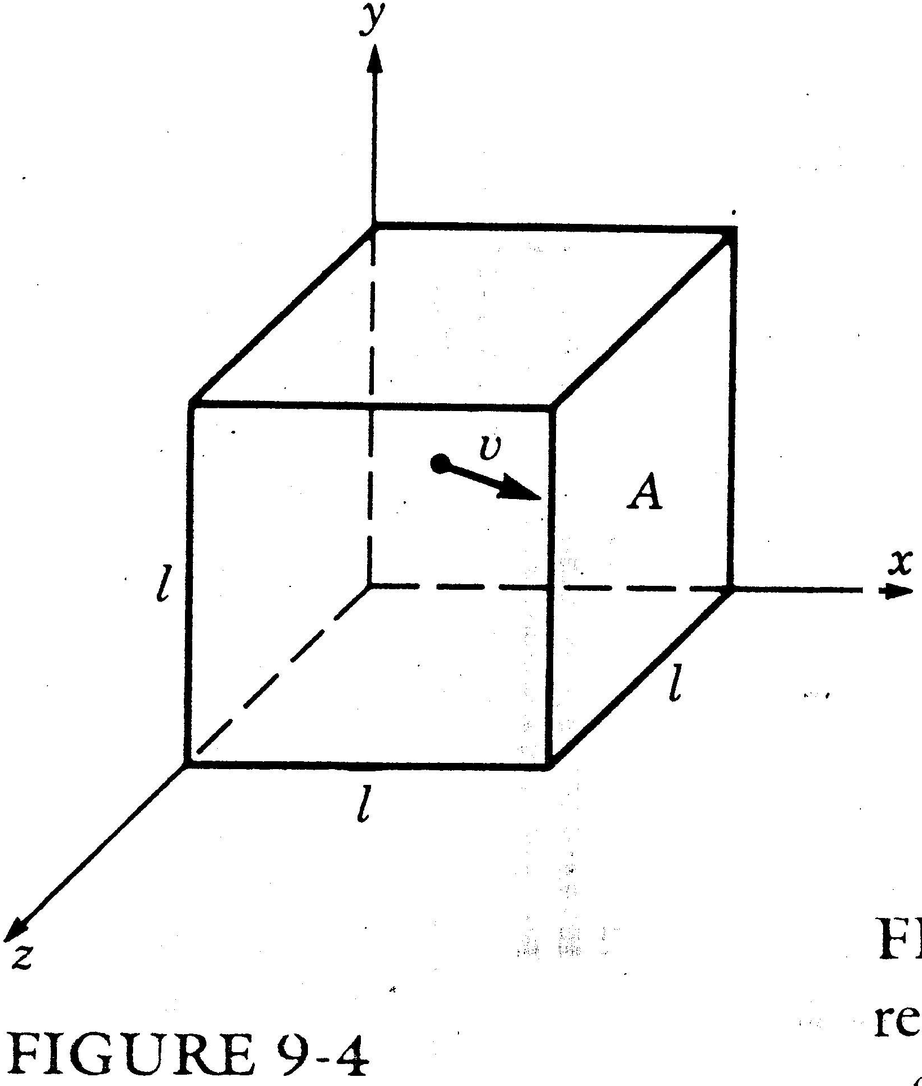

Slide 21
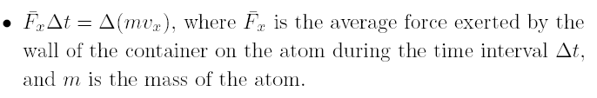
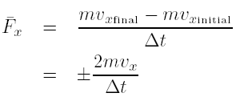

See Fig. 9-4. The area of a face is A = l² and a volume V = l³. Because the atom's velocity in the x direction remains constant in magnitude, the time for a round trip between opposite walls is

Slide 22
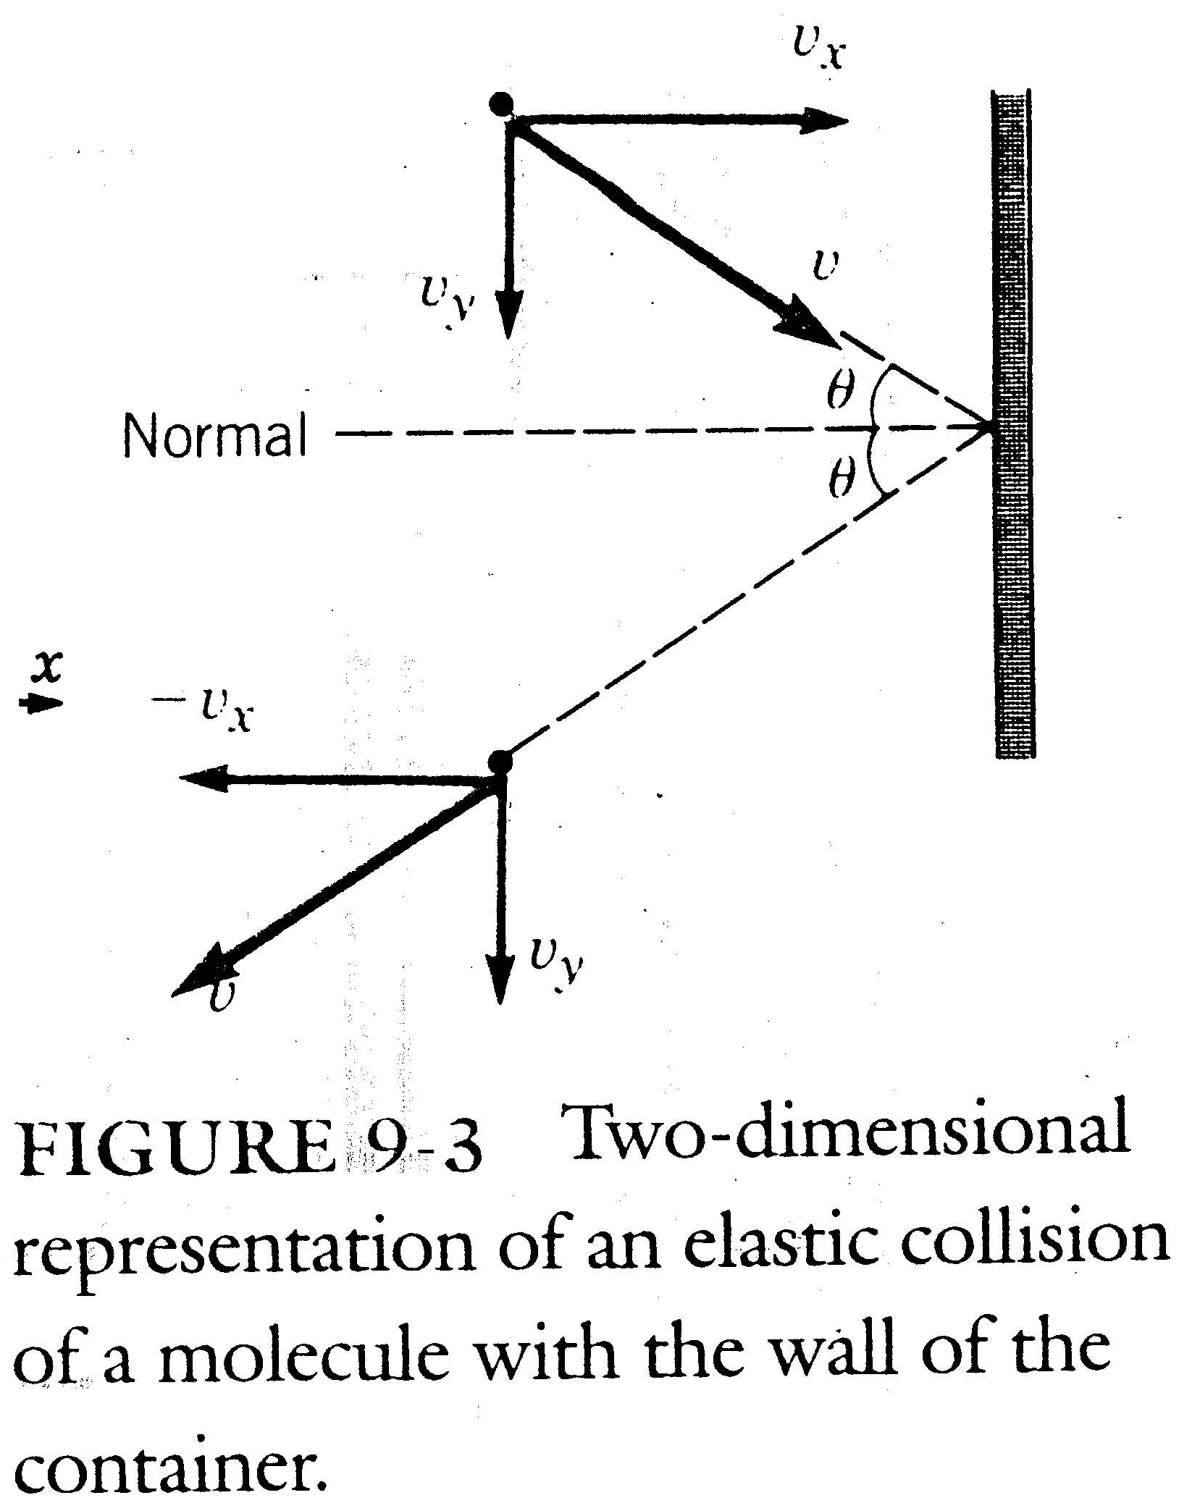

Slide 23

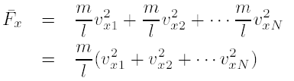

Then
The total average force on a wall due to the x motion of N atoms in the box is
Let the average of the squared individual x velocities be

Slide 24





Then
By the three-dimensional pythagorean theorem
or
But in a gas in equilibrium there is no preferred direction of motion; hence
and

Slide 25
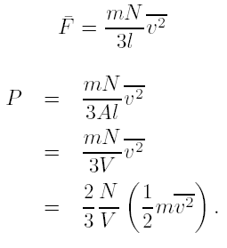
Thus

Slide 26


Kinetic Theory of Temperature
Since PV = nRT we have
where N is the number of molecules present in the box and n is the number of fraction of moles present.

Slide 27


Substituting n = N=N_{A} in the above equation gives

Slide 28

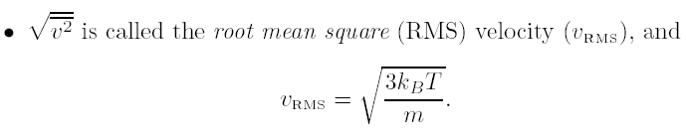
We have shown that temperature is simply proportional to the average kinetic energy E_{k} of the molecules, that is

Slide 29
Measurement of Heat
One calorie is the quantity of heat required to raise the temperature of 1 g of water by 1ºC.
See Fig. 9-5. The weight is allowed to fall at constant speed so that no changes in kinetic energy have to be considered, only changes on potential energy.
The specific heat c is defined as the amount of heat needed to raise the temperature of 1 g of a substance 1ºC. For water c = 1 cal/gºC.

Slide 30
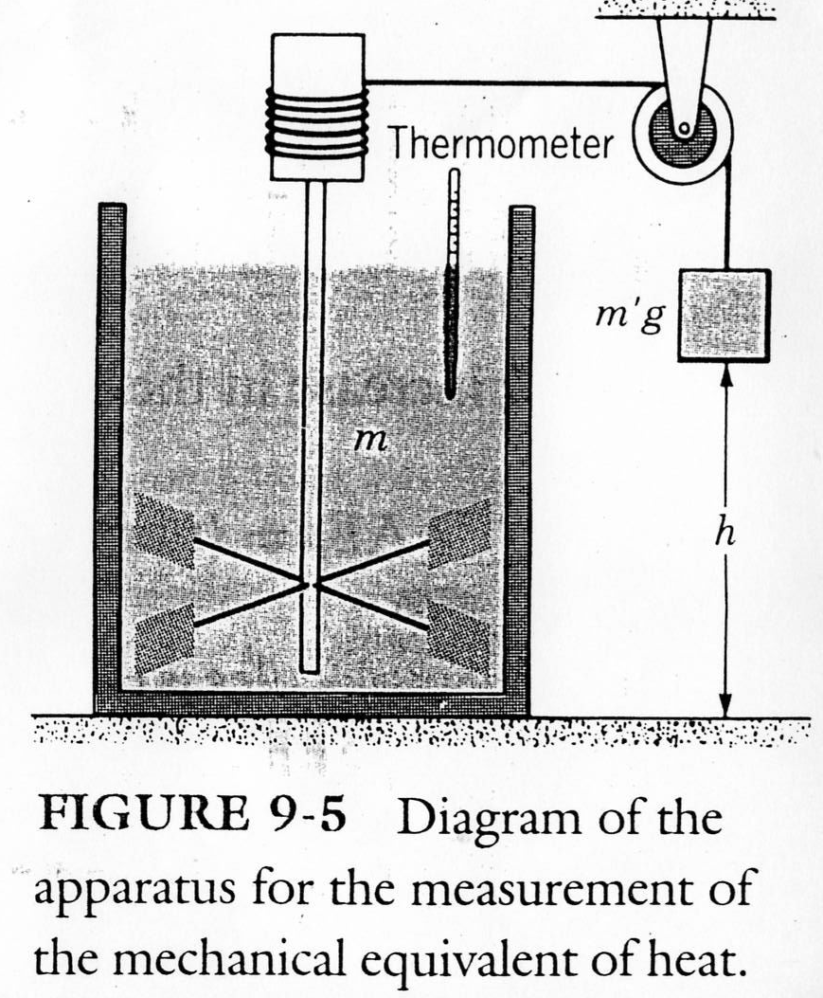

Slide 31

The quantity of heat ¢Q required to raise the temperature by ¢T of a mass m of a substance whose specific heat is c, is written as

Slide 32



We can equate this to the loss of potential energy,
of the falling weight m’g, that is
By experiment,
which is called the mechanical equivalent of heat.

Slide 33

Specific Heats of Gases
If we hold a quantity of gas at a constant volume so that it is can not do work by expanding, then all the heat Q goes into increasing the kinetic energy of the molecules, or

Slide 34

Since gases are compressible, we define a term C_{v} as the molar specific heat at constant volume; that is
where M is the mass of a mole of gas and c_{v} is the specific heat per gram at constant volume.

Slide 35

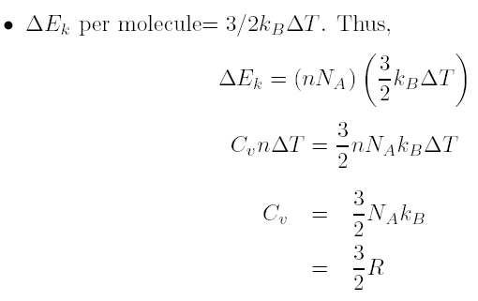
We have m = Mn, where m is the mass of gas. Thus

Slide 36
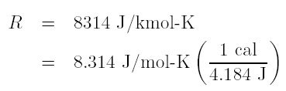


This value is expected to hold for all the rare gases that are monatomic, such as helium, neon, and argon.

Slide 37
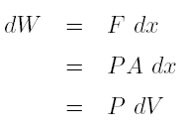
Work Done by a Gas
See Fig. 9-6.
By the definition of work, if the gas does work by expanding, the work done is positive, whereas if the gas is compressed by the force on the position, the work done by the gas is negative.

Slide 38
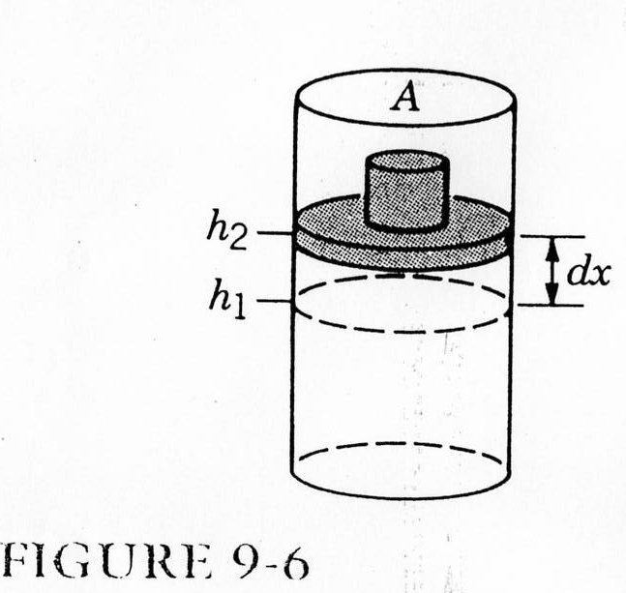

Slide 39




First Law of Thermodynamics
We have three factors relating energy and behavior of a gas:
1. Work done on or by a gas ¢W = P¢V .
2. The quantity of heat ¢Q that may be added or extracted from the gas.
3. The change in average kinetic energy of the molecules ¢Ek , which we usually call the change in internal energy ¢E.
First Law of Thermodynamics:

Slide 40

¢Q is taken as positive if heat enters the system and as negative if it leaves the system. The work, ¢W , is positive if it is done by the system, and negative if done on the system.

Slide 41
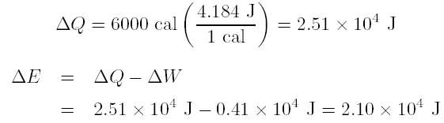
Example 9-5
Six thousand calories of heat are added to 2 moles of neon gas at 27ºC while it does 4100 J of work. (a) How much does the internal energy of the system increase? (b) What is the final temperature of the gas?
Sol: (a)

Slide 42


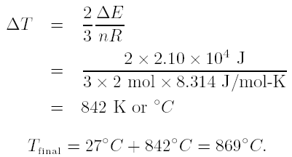
(b)
Therefore,

Slide 43
Homework
Homework: 9.4, 9.6, 9.7, 9.12, 9.14, 9.16, 9.17, 9.18, 9.19, 9.20.

