Slide 1
Introduction to Finite Field
Yunghsiang S. Han
Graduate Institute of Communication Engineering
National Taipei University
Modified from the lecture notes by Yuh-Ming Huang

Slide 2
Introduction to Finite Filed
Def 2.0 ( G , ＊ ) G: a set
A binary operation ＊ on G : a ＊ b ∈ G ∀a,b ∈ G
(G is closed under the operation ＊)
Def 2.1 Group : (G, ＊)
a＊(b＊c) = (a＊b) ＊c associative
∃ e ∈ G s.t. ∀ a ∈ G, a＊e = e＊a = a e: identity element of G
∀ a ∈ G, ∃ a’ ∈ G s.t. a＊a’ = a’＊a = e a’: inverse of a
Communicative group : (iv) ∀ a, b ∈ G, a＊b = b＊a
Thm 2.1 identity element is unique
pf: e’ = e’ ＊ e = e
Thm 2.2 inverse is unique
pf: suppose a’ & a’’ are inverse of a
a’ = a’＊e = a’＊(a＊a’’) = (a’＊a)＊a’’ = e＊a’’ = a’’

Slide 3


Examples: communicative group
( Z , + ) e = 0 i -i
( Q-{0} , ▪ ) e = 1 b/a a/b
( G={0,1} , ⊕ )
order of the group : the number of elements in a group
4. additive group
( G={0,1,2, ... ,m-1} , ) , where m ∈ Z⁺, i j ≡ i + j mod m
Infinite group
finite group
Q: (i) ( i j ) k = i ( j k )
(ii) e = 0
(iii) ∀ 0 < i < m m – i is an inverse of i
(iv) i j = j i

Slide 4

5. multiplicative group
( G = { 1,2,3, … ,p-1} , ) p : prime
i j ≡ i ▪ j mod p
Pf:
Let i ∈ G (<p) ∵ p is a prime ∴ (i , p) = 1
∴ ∃ a, b ∈ Z s.t. a▪i + b▪p = 1 & (a, p) = 1 (Euclid’s theorem)
⇒ a▪i = -b▪p + 1
if 0 < a < p i.e. a ∈ G ∴ a i = i a = 1
if a ∉ G, say a = q▪p + r ∵(a, p) = 1 ∴r ≠ 0
⇒ r ▪ i = -(b + q▪i)p + 1 ∴ r i = i r = 1
Q:
H is said to be a subgroup of G if
(i) H ⊂ G & H ≠ Ø
(ii) H is closed under the group operation of G & satisfies all
the conditions of a group
Q: Ref. pp. 29-31
e.g. G = ( Q, + )
H = ( Z, + )
⇒ Z is a subgroup of Q under the operation “+”

Slide 5
Def 2.2 Field : ( F, +, ▪ )
( F, + ) F is a communicative group under “+”
( F-{0}, ▪ ) F-{0} is a communicative group under “▪”
“▪” is distributive over “+”
i.e. a ▪ (b + c) = a ▪ b + a ▪ c ∀a, b, c ∈ F
Q: Does it imply (a + b) ▪ c = a ▪ c + b ▪ c
pf: ∵(a + b) ▪ c = c ▪ (a + b) = c ▪ a + c ▪ b = a ▪ c + b ▪ c
order of the field : # of elements in a field
finite field : order is finite
a – b ≡ a + (-b)
a ÷ b ≡ a ▪ b⁻¹
∀ a ∈ F, a ▪ 0 = 0 ▪ a = 0
pf: a = a ▪ 1 = a ▪ (1 + 0) = a + a ▪ 0
➔ -a + a = -a + a + a ▪ 0 ➔ 0 = 0 + a ▪ 0 = a ▪ 0
∀ a, b ∈ F & a, b ≠ 0 ⇒ a ▪ b ≠ 0
pf: if a ▪ b = 0
then (a⁻¹ ▪ a) ▪ b= a⁻¹ ▪ 0 ➔ b = 0 (→←)
-b : additive inverse of b
b⁻¹ : multiplicative inverse of b

Slide 6
(6) a ▪ b = 0 & a ≠ 0 imply that b = 0
(7) ∀ a, b ∈ F, –(a ▪ b) = (-a) ▪ b = a ▪ (-b)
pf: 0 = 0 ▪ b = (a + (-a)) ▪ b = a ▪ b + (-a) ▪ b
(8) For a ≠ 0, a ▪ b = a ▪ c imply that b = c
pf: 兩邊乘上a⁻¹ a⁻¹ ▪ (a ▪ b) = a⁻¹ ▪ (a ▪ c)
➔ (a⁻¹ ▪ a) ▪ b = (a⁻¹ ▪ a) ▪ c ➔ 1 ▪ b = 1 ▪ c ➔ b = c
Examples:
(R, +, ▪)
(F={0, 1}, , ) binary field GF(2)
(F={0, 1, 2, …, p-1}, , ) prime field GF(p) p : prime
* In a field, we can do the operations + - × ÷ in a manner similar to
ordinary arithmetic
4. extension field of GF(p) : GF(p^{m}) m ∈ Z⁺
Q: the order of any finite field is a power of a prime (answer later)
* finite fields are also called Galois fields

Slide 7
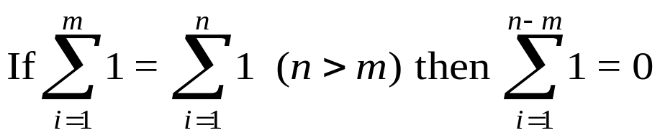
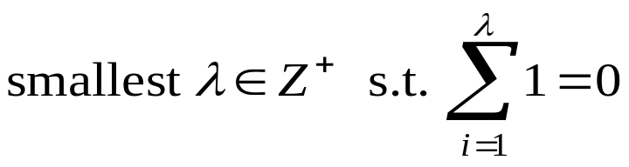
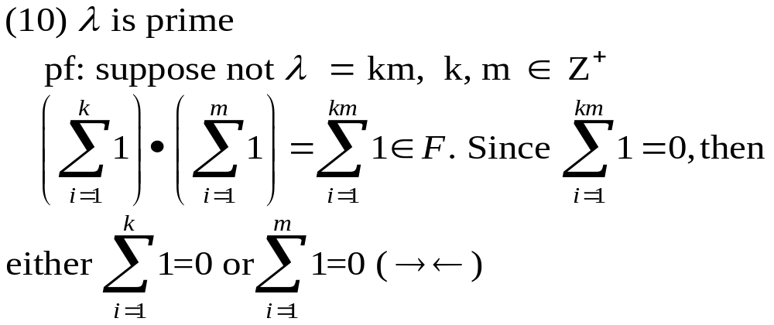
• Next, consider a finite field of q elements, GF(q).
(9) 1 : unit element in GF(q)
e.g. n = 4, m = 2
1+1+1+1 = 1+1
兩邊加 “1” 之 inverse “-1”
(-1+1)+1+1+1 = (-1+1)+1
0+1+1+1 = 0+1
1+1+1 = 1
…
1+1 = 0
Characteristic (λ) of the field GF(q) :
Q:
e.g. For GF(P), P:prime, λ= P

Slide 8
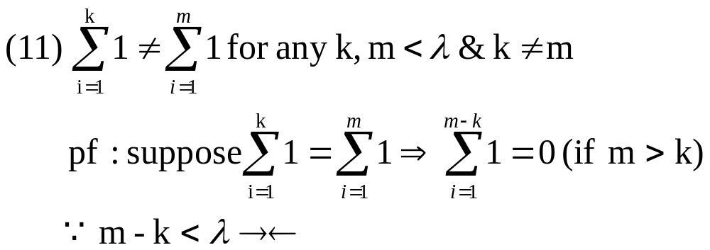
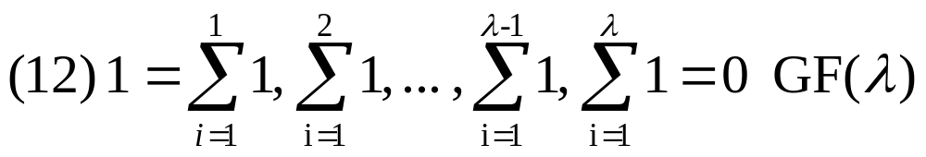
Q: GF(λ) is called a subfield of GF(q)
Since GF(λ) is a subset of GF(q) and it is finite
we only need to prove that GF(λ) is closed under operations defined
above. This is easy to see by the definitions of two operations.

Slide 9





(13) For any finite field GF(q) if λ ≠ q then q is a power of λ
pf: We have GF(λ) a subfield of GF(q). Let
; there are λ elements in GF(q) of the form . Since λ ≠ q , we choose not of the form . There are λ² elements in GF(q) of the form
. If q= λ², we are done. Otherwise we continue in this fashion and will exhaust all elements in GF(q).

Slide 10
• Let a be a nonzero element in GF(q).
a’ = a, a² = a▪a, a³ = a▪a▪a, … a: nonzero elements of GF(q)
Since finite field, so a^{k} = a^{m} suppose m > k
a^{-k}(≡ (a⁻¹) ^{k}) is the multiplicative inverse of a^{k}
[ (a⁻¹ ▪ a⁻¹) ▪ (a ▪ a) = a⁻¹ ▪ e ▪ a = a⁻¹ ▪ a = e ]
∴ 1 = a ^{m-k} [ a³ ▪ a⁻² = a ▪ a ▪ a ▪ a⁻¹ ▪ a⁻¹ = a = a³⁻² ]
order of the field element a : smallest Z⁺ n, s.t. a^{n} = 1.
Thm { a¹, a², …, a^{n-1}, a^{n} = 1 } : form a group
under the multiplication of GF(q)
Q: a^{i} ≠ a^{j}
pf:
(ii) unit element : 1
考慮 a^{i} ▪ a^{j}
i + j ≤ n a^{i} ▪ a^{j} = a^{i+j}
i + j > n, say i + j = n + r 0 < r ≤ n
a^{i} ▪ a^{j} = a^{i+j} = a^{n} ▪ a^{r} = a^{r}
(iii) For 1 ≤ i ≤ n a^{n-i} is the multiplicative inverse of a^{i}
closed
* A group is said to be cyclic if there exists an element in the group
whose powers constitute the whole group

Slide 11
Thm 2.4 a ∈ GF(q) & a ≠ zero element. Then a^{q-1} = 1
pf: let b₁ b₂ … b_{q-1} be the q-1 nonzero elements
∴ a ▪ b₁, a ▪ b₂, …, a ▪ b_{q-1} are nonzero & distinct
(a ▪ b₁) ▪ (a ▪ b₂)…(a ▪ b_{q-1}) = b₁ ▪ b₂ … ▪ b_{q-1}
a^{q-1} ▪ ( b₁ ▪ b₂ … ▪ b_{q-1} ) = b₁ ▪ b₂ … ▪ b_{q-1}
∵ ( b₁ ▪ b₂ … ▪ b_{q-1} ) ≠ 0 ➔ ∴ a^{q-1} = 1
If a ▪ b_{i} = a ▪ b_{j}
Then b_{i} = b_{j}
Thm 2.5 a ∈ GF(q) a ≠ 0 if n is the order of a, then n | q-1
pf: Suppose not q-1 = kn + r 0 < r < n
a^{q-1} = a^{kn+r} = a^{kn} ▪ a^{r} = (a^{n})^{k} ▪ a^{r}
∵ a^{q-1} = 1 & a^{n} = 1 ∴ a^{r} = 1
* ln GF(q), a nonzero element a is said to be primitive if the order of a
q-1
Thm: Every finite field has a primitive element
e.q. GF(7)
3¹ = 3, 3² = 2, 3³ = 6, 3⁴ = 4, 3⁵ = 5, 3⁶ = 1
3 : primitive element
4¹ = 4, 4² = 2, 4³ = 1 order of “4” is 3 ⇒
3| 7-1

Slide 12
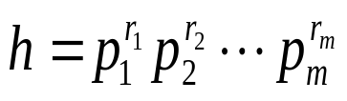
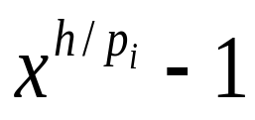
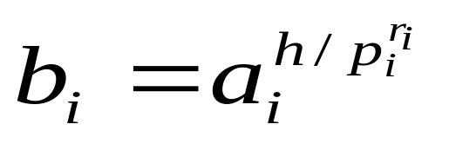
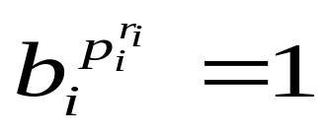
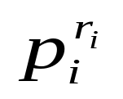
Pf: Assume that q>2. Let be the prime factor decomposition of h=q-1. For every i, the polynomial has at most h/p_{i} roots in GF(q). Hence, there is at least one nonzero element in GF(q) that are not roots of this polynomial. Let a_{i} be such an element and set
We have and the order of b_{i} is a divisor of .

Slide 13
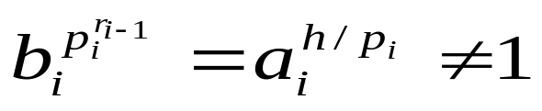


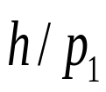
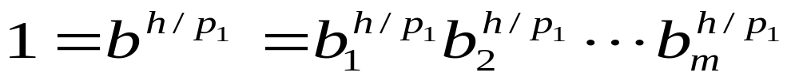
On the other hand,
And so the order of b_{i} is . We claim that the element has order h. Suppose that the order of b is a proper divisor of h and is therefore a divisor of at least one of the m integers , say of . Then we have

Slide 14
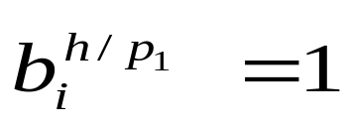
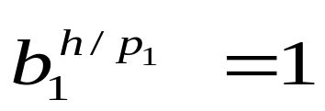
Now, for 1<i, divides , and hence . Therefore, . This implies that the order of b₁ must divide . Contradiction.
Then GF(q)-{0} is a finite cyclic group under multiplication. The number of primitive elements in GF(q) is ψ(q-1), where ψ is Euler’s function.

Slide 15
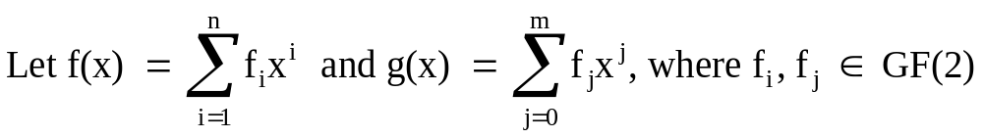

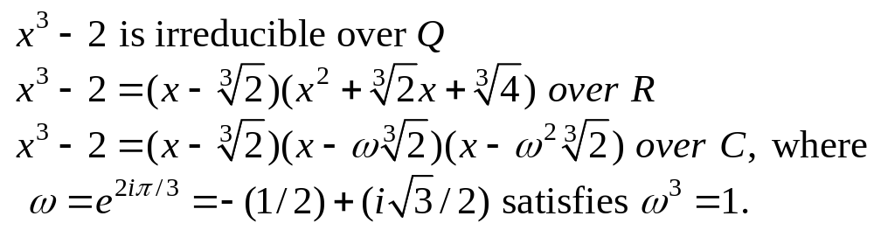
Binary Field Arithmetic
0
f(x) g(x) ≡ f(x)+g(x) modulo 2
f(x) g(x) ≡ f(x) ▪ g(x) modulo 2
(相加後係數再 mod 2)
(GF(2)[x], , )
or Z₂[x]
f(x) 0 = 0
f(x) said to be irreducible if it is not divisible by any polynomial over GF(2)
of degree less than n but greater than zero.
e.g. x² , x² ＋1, x² ＋x are reducible over GF(2)
x ＋ 1, x² ＋x+1, x³ ＋x+1 are irreducible over GF(2)
e.g.
non-binary field
e.g. x⁴+ 3x³+ 2x+4 = (x+4)³(x+1) over Z₅

Slide 16


Thm: In GF(2)[x], ∀m ≥ 1, ∃ an irreducible polynomial of degree m
pf: exercise
Thm 2.6 Any irreducible polynomial over GF(2) of degree m divides
pf: It will be easy to prove when we learn the construction of an extension
field.
e.g. x³ ＋ x + 1 | x⁷+1 i.e. x⁷+1 = (x⁴ +x² + x + 1)(x³ + x + 1)
*An irreducible polynomial p(x) of degree m is said to be primitive if the
smallest positive integer n for which p(x) divides x^{n} + 1 is n = 2^{m} - 1
e.g. x⁴ + x + 1 | x¹⁵ + 1 x⁴ + x³ + x² + x + 1 | x⁵ + 1
primitive
non-primitive
* For a given m, there may be more than one primitive polynomial of
degree m.

Slide 17
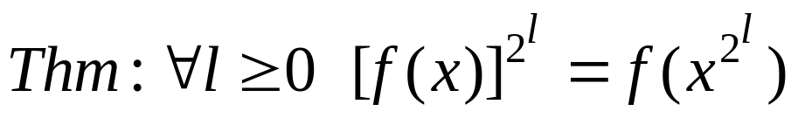
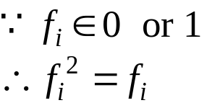
pf: f²(x) = (f₀ + f₁x + … + f_{n}x^{n})²
= [f₀ + (f₁x + f₂x² + … + f_{n}x^{n})]²
= f₀² + (f₁x + f₂x² + … + f_{n}x^{n})²
= f₀² + (f₁x)² + (f₂x²)² + … + (f_{n}x^{n})²
= f₀ + f₁(x²)¹ + f₂(x²)² + … + f_{n}(x²)^{n} = f(x²)
…

Slide 18
Construction of Galois Field GF(2^{m}), m > 1
Initially, we have two elements 0 and 1, from GF(2) and a new symbol α, and define a multiplication “▪ ’’ as follows
0▪0=0 0▪1=1▪0=0 1▪1=1
0▪α=α▪0=0 1▪α=α▪1=α
α²=α▪α α³=α▪α▪α … α^{j}=α▪α ▪ … ▪ α(j times)
F = {0, 1, α, α², …, α^{j}, …}
Let p(x) be a primitive polynomial of degree m over GF(2)
assume that p(α) = 0
∵ P(x) | x^{2m-1} +1 (by Thm 2.6)
∴ x^{2m-1} + 1 = q(x)p(x)
➔ α^{2m-1} + 1 =q(α)p(α) = q(α)▪0 = 0
➔ 兩邊加1之inverse(≡ -1=1) α^{2m-1} = 1 and α^{i} is not 1 for i< 2^{m}-1

Slide 19
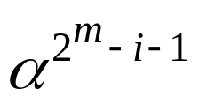
F* = { 0, 1(≡ α⁰), α, α², …, α^{2m-2}}
(A) Commutative group under “▪”
Closed
let 0 ≤ i, j < 2^{m} - 1
(i) i + j < 2^{m} – 1 α^{i}▪α^{j} = α^{i+j} ∈ F*
(ii) i + j ≥ 2^{m} – 1 i + j = (2^{m} – 1) + r 0 ≤ r < 2^{m}-1
∴ α^{i} ▪ α^{j} = α^{2m-1} ▪ α^{r} = α^{r} ∈ F*
(2) 1 : unit element
(3) “▪” is communicative & associative
(4) ∀ 0 < i < 2^{m-1}, is the multiplicative inverse of α^{i}
(F*-{0}, ▪) commutative group under “▪” with order 2^{m} – 1
Q: 證α^{i} ≠ α^{j} 0 ≤ i ≠ j < 2^{m} - 1

Slide 20
(B) Commutative group under “+”
For 0 ≤ i < 2^{m}-1, we have x^{i} = q_{i}(x)p(x) + a_{i}(x) ----- (*)
where a_{i}(x) = a_{i0} + a_{i1}x + a_{i2}x² + … + a_{i,m-1}x^{m-1}
∵ (x, p(x)) = 1 ∴ a_{i}(x) ≠ 0
* a_{i}(x) ≠ a_{j}(x) 0 ≤ i ≠ j < 2^{m} - 1
pf: suppose a_{i}(x) = a_{j}(x)
x^{i} + x^{j} = [q_{i}(x) + q_{j}(x)]p(x) + a_{i}(x) + a_{j}(x)
=0
∴ p(x) | x^{i} + x^{j} = x^{i}(1 + x^{j-i}) (assume j > i)
∵ (p(x), x^{i}) = 1 ∴ p(x) | 1 + x^{j-i} →← ∵ j – i < 2^{m} - 1
We have 2^{m}-1 distinct nonzero polynomials a_{i}(x) of degree m-1 or
less.
Replace x by α in equation (*), we have
α^{i} = a_{i}(α) = a_{i0} + a_{i1}α + a_{i2}α² + … + a_{i,m-1}α^{m-1}, 0≤ i ≤ 2^{m} - 2
0 用 zero polynomial 表示

Slide 21
(i) 0 + 0 = 0
Define (ii) 0 + α^{i} = α^{i} + 0 = α^{i}
(iii) α^{i} + α^{j} ∈ F*, 0 ≤i, j< 2^{m} - 1: 一般多項式相加，係數取module 2
(F*, +) commutative group under “+”
(C) polynomial multiplication satisfies distribution law
a(x) ▪[b(x)+c(x)] = [a(x) ▪b(x)]+ [a(x) ▪c(x)]
⇒ F* : a Galois field of 2^{m} element, GF(2^{m})

Slide 22
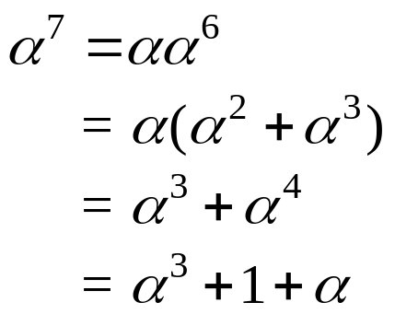
GF(2⁴), p(x) = 1 + x + x⁴ ( p(α) = 1 + α + α ⁴ = 0 )
Decimal representation
Power representation | Polynomial representation | 4-Tuple representation
0 | 0 | ( 0 0 0 0 ) 0
1 | 1 | ( 1 0 0 0 ) 8
α | α | ( 0 1 0 0 ) 4
α² | α² | ( 0 0 1 0 ) 2
α³ | α³ | ( 0 0 0 1 ) 1
α⁴ | 1+α | ( 1 1 0 0 ) 12
α⁵ | α+α² | ( 0 1 1 0 ) 6
α⁶ | α²+α³ | ( 0 0 1 1 ) 3
α⁷ | 1+α +α³ | ( 1 1 0 1 ) 13
α⁸ | 1+α² | ( 1 0 1 0 ) 10
α⁹ | α + α³ | ( 0 1 0 1 ) 5
α¹⁰ | 1+α+ α² | ( 1 1 1 0 ) 14
α¹¹ | α+ α²+ α³ | ( 0 1 1 1 ) 7
α¹² | 1+α + α²+ α³ | ( 1 1 1 1 ) 15
α¹³ | 1 + α²+ α³ | ( 1 0 1 1 ) 11
α¹⁴ | 1 + α³ | ( 1 0 0 1 ) 9
係數相加後mod 2
modulo
GF(2)[α]
α⁴+ α+1
α¹⁵ = 1

Slide 23
α α² α⁴ α⁸ α¹⁶ ≡ α
α³ α⁶ α¹² α²⁴ α⁴⁸ ≡ α³
≡ α⁹
Table 2.1 Representations of GF(2⁴). p(z) = z⁴ + z + 1
Exponential Notation | Polynomial Notation | Binary Notation | Decimal Notation | Minimal Polynomial
0 | 0 | 0000 | 0 | x
α⁰ | 1 | 0001 | 1 | x + 1
α¹ | z | 0010 | 2 | x⁴ + x + 1
α² | z² | 0100 | 4 | x⁴ + x + 1
α³ | z³ | 1000 | 8 | x⁴ + x³ + x² + x + 1
α⁴ | z + 1 | 0011 | 3 | x⁴ + x + 1
α⁵ | z² + z | 0110 | 6 | x² + x + 1
α⁶ | z³ + z² | 1100 | 12 | x⁴ + x³ + x² + x + 1
α⁷ | z³ + z + 1 | 1011 | 11 | x⁴ + x³ + 1
α⁸ | z² + 1 | 0101 | 5 | x⁴ + x + 1
α⁹ | z³ + z | 1010 | 10 | x⁴ + x³ + x² + x + 1
α¹⁰ | z² + z + 1 | 0111 | 7 | x² + x + 1
α¹¹ | z³ + z² + z + 1 | 1110 | 14 | x⁴ + x³ + 1
α¹² | z³ + z² + z + 1 | 1111 | 15 | x⁴ + x³ + x² + x + 1
α¹³ | z³ + z² + 1 | 1101 | 13 | x⁴ + x³ + 1
α¹⁴ | z³ + 1 | 1001 | 9 | x⁴ + x³ + 1
係數相加
相乘在數系
GF(2)上

Slide 24
GF(2)
+ 0 1 * 0 1
0 0 1 0 0 0
1 1 0 1 0 1
GF(3)
+ 0 1 2 * 0 1 2
0 0 1 2 0 0 0 0
1 2 0 1 0 1 2
2 0 1 2 0 2 1
GF(2)[α]
α²+ α+1
Primitive polynomial over GF(2)
GF(4)
+ 0 1 2 3 * 0 1 2 3
0 0 1 2 3 0 0 0 0 0
1 0 3 2 1 0 3 1 2
2 3 0 1 2 0 1 2 3
3 2 1 0 3 0 2 3 1
GF(2²), p(x) = 1 + x + x² ( p(α) = 1 + α + α ² = 0 )
0 0 00 0
1 10 2
α 01 1
α² 1+ α 11 3

Slide 25
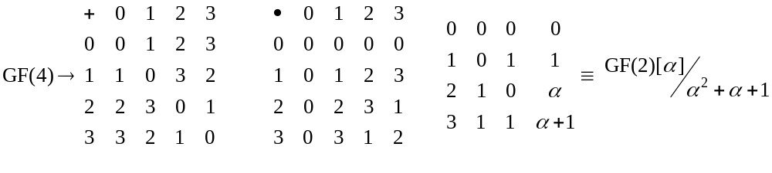
Primitive polynomial over GF(4)
GF(4²) ≡ GF(4)[z]/z²+z+2, p(z) = z²+z+2
Exponential Notation | Polynomial Notation | Binary Notation | Decimal Notation | Minimal Polynomial
0 | 0 | 00 | 0
α⁰ | 1 | 01 | 1 | x + 1
α¹ | z | 10 | 4 | x² + x + 2
α² | z + 2 | 12 | 6 | x² + x + 3
α³ | 3z + 2 | 32 | 14 | x² + 3x + 1
α⁴ | z + 1 | 11 | 5 | x² + x + 2
α⁵ | 2 | 02 | 2 | x + 2
α⁶ | 2z | 20 | 8 | x² +2x + 1
α⁷ | 2z + 3 | 23 | 11 | x² + 2x + 2
α⁸ | z + 3 | 13 | 7 | x² + x + 3
α⁹ | 2z + 2 | 22 | 10 | x² + 2x + 1
α¹⁰ | 3 | 03 | 3 | x + 3
α¹¹ | 3z | 30 | 12 | x² + 3x + 3
α¹² | 3z + 1 | 31 | 13 | x² + 3x + 1
α¹³ | 2z + 1 | 21 | 9 | x² + 2x + 2
α¹⁴ | 3z + 3 | 33 | 15 | x² + 3x + 3
係數相加
相乘在數系
GF(4)上
α = z
α¹⁵ = 1

Slide 26
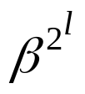
Basic properties of Galois Field GF(2^{m})
In GF(2) x⁴ + x³ + 1 : irreducible
In GF(2⁴) x⁴ + x³ + 1 = (x + α⁷)(x + α¹¹)(x + α¹³)(x + α¹⁴)
In R x² + 1無根
C x² + 1 有 ±i 根
Thm 2.7 f(x) ∈ GF(2)[x] let β be an element in an extension field of GF(2). If β is a root of f(x), then for any l ≥ 0, is also a root of f(x).
pf: f(β) = 0
∵ [f(x)] ^{2l} = f(x^{2l}) ∴ f(β^{2l}) = [f(β)]^{2l} = 0
• β^{2l} is called a conjugate of β
• In GF(2⁴), α⁷ (α⁷)² = α¹⁴ (α⁷)²² = α¹³ (α⁷)²³ = α¹¹ (α⁷)²⁴ = α⁷
• Let β ∈ GF(2^{m}) & β ≠ 0 By Thm 2.4 β^{2m-1} = 1
∴ β^{2m-1} + 1 = 0 i.e. β is a root of x^{2m-1} + 1
Thm 2.8 The 2^{m} - 1 nonzero element of GF(2^{m}) form all the roots of x^{2m-1} + 1
Cor. 2.8.1 The elements of GF(2^{m}) form all the roots of x^{2m} + x
(∵ 0 is the root of x)
φ(x) : minimal polynomial of β, the polynomial of smallest degree
over GF(2) s.t. φ(β) = 0
Q : φ(x) is unique

Slide 27
Thm 2.9 φ(x) is irreducible
pf : φ(x) = φ₁(x)φ₂(x) ∵ φ(β) = 0 ∴ either φ₁(β) = 0 or φ₂(β) = 0 (→←)
Thm 2.10 f(x) ∈ GF(2)[x] if β is also a root of f(x) then φ(x) | f(x)
pf : f(x) = a(x)φ(x) + r(x)
∵ f(β) = φ(β) = 0 ∴ r(β) = 0 ➔ if r(x) ≠ 0 (→←) ∴ r(x) = 0
Thm 2.11 φ(x) | x^{2m} + x
pf : By Cor 2.8.1 & Thm 2.10
⇒ (1) all the roots of φ(x) are from GF(2^{m})
( 2) what are the roots of φ(x) ?
Thm 2.12 Let f(x) be an irreducible polynomial over GF(2)
if f(β) = 0 then φ(x) = f(x)
pf : By Thm 2.10 φ(x) | f(x) ∵ φ(x)≠1 & f(x) is irreducible ∴ φ(x) = f(x)
By Thm 2.7 β, β², β²², …, β^{2l}, … are roots of φ(x)
Let e be the smallest integer, s.t. β^{2e} = β
Q : Then β²¹, β²², …, β^{2e-1} are all the distinct conjugates of β
∵ β^{2m} = β ∴ e ≤ m

Slide 28
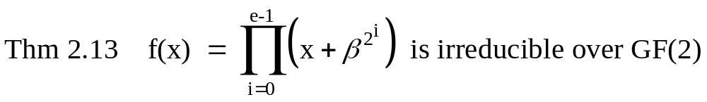
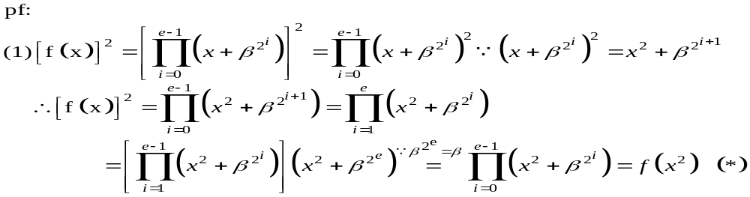
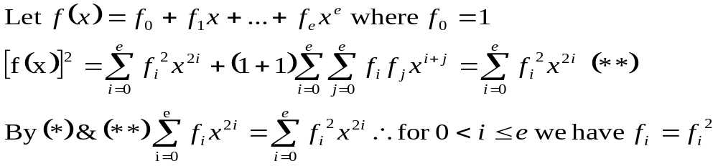
e
⇒ f_{i} = 0 or 1
∴ f(x) ∈ GF(2)
(2) suppose f(x) (=a(x)b(x)) is not irreducible over GF(2)
∵ f(β) = 0 ⇒ a(β) = 0 ⇒ a(x) has β β² … β^{2e-1} as roots
∴ deg[a(x)] = e & a(x)=f(x)
or b(β) = 0 ⇒ similarly, b(x) = f(x)
∴ f(x) must be irreducible

Slide 29
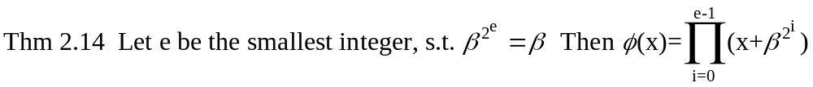
Pf : By Thm 2.12 & 2.13
Thm 2.15 Let e be the degree of φ(x).
Then e is the smallest integer s.t. β^{2e} = β, moreover e ≤ m
Pf: direct consequence of Thm 2.14.
Minimal polynomials of the elements in GF(2⁴) generated by p(x)=x⁴+x+1
Conjugate roots minimal polynomials
0 x
1 x+1
α, α², α⁴, α⁸ x⁴+ x +1
α³, α⁶, α⁹, α¹² x⁴+ x³+ x²+ x +1
α⁵, α¹⁰ x²+ x +1
α⁷, α¹¹, α¹³, α¹⁴ x⁴+ x³+ 1
e.g. X¹⁵-1= (x+1)(x²+x+1) (x⁴+x+1) (x⁴+x³+1) (x⁴+x³+x²+x+1) over GF(2)
X¹⁵-1= (x-α⁰) (x-α⁵)(x-α¹⁰) (x-α¹)(x-α²)(x-α⁴)(x-α⁸) over GF(2⁴)
α¹⁵ = 1 (x-α⁷)(x-α¹⁴)(x-α¹³)(x-α¹¹) (x-α³)(x-α⁶)(x-α¹²)(x-α⁹)

Slide 30
Q:
1. The degree of the minimal polynomial of any element in GF(2^{m}) divides m
2. In pp.18 (1) α^{i} ≠ α^{j}
(2) α is a primitive element
pf : if α^{i} = α^{j} , i ≠ j , j > i , 1 ≤ i, j < 2^{m} – 1
⇒ α^{j-i} = 1
ie. ∃ n = j – i < 2^{m} - 1 s.t. α^{n} + 1 = 0
⇒ x^{n} + 1 = q(x)p(x) + r(x) i.e. p(α) | α^{n} + 1
⇒ α^{n} + 1 = q(α)p(α) + r(α) i.e. p(x) | x^{n} + 1 (→←)
∵ α^{n} + 1 = 0 & p(α) = 0 ∴ r(α) = 0 ∵ p(x) is primitive
α以x替代
x以α替代
Q : primitive polynomial & minimal polynomial 關係?

Slide 31
For degree m primitive polynomial is not unique
For α, the minimal polynomial of α is unique
If α is primitive, the minimal polynomial of α is primitive
Q :
＊Let n be the order of α^{2l}, l > 0, by Thm 2.5, n | 2^{m} – 1 --- (1)
In GF(2^{m}) i.e. (α^{2l})^{n}= α^{n•2l} = 1
∵ α is a primitive element of GF(2^{m}), its order is 2^{m} – 1
∴ 2^{m} – 1 | n•2^{l} ∵ (2^{m} – 1, 2^{l}) = 1 ∴ 2^{m} – 1 | n --- (2) By (1)& (2) n = 2^{m} – 1
⇒ If α is primitive, then α^{2l} is primitive
Thm 2.16 If β is primitive in GF(2^{m}), all its conjugates β², β²², … are also primitive
See Table 2.1
Thm 2.17 If β is an element of order n in GF(2^{m}), all its conjugates have the same order n
Q:
See Table 2.1

