Slide 1
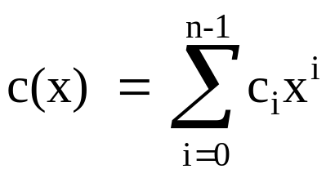
Ⅲ Cyclic Code
• shift registers with feedback connections
inherent algebraic structure → Algorithmic technique
• random-error correction
burst-error correction
Def : Cyclic Code (i) one linear code ( subset of GF(q)[x]/x^{n}-1 )
(n, k) (ii) x • c(x) mod x^{n}-1 ∈ C(x) if c(x) ∈ C(x)
Shift right i ≈
Shift left n-i
• v = (v₀, v₁, ..., v_{n-1}) : code vector
v⁽¹⁾ = (v_{n-1}, v₀, v₁, …, v_{n-2})
v^{(i)} = (v_{n-i}, v_{n-i+1}, …, v_{n-1}, v₀, v₁, …, v_{n-i-1})
• v(x) = v₀ + v₁x + … + v_{n-1}x^{n-1} : code polynomial
• v^{(i)}(x) = x^{i}v(x)/x^{n}-1

Slide 2
Def : generator polynomial : The nonzero monic code polynomial of
minimum degree in a cyclic code C
g(x) = g₀ + g₁x + … + g_{r-1}x^{r-1} + x^{r}
( note : multiply by a field element to make it monic )
• g(x) is unique
• In GF(2), g₀ = 1
We claim : r = n - k
For (n, k) cyclic code
Consider : g(x), xg(x), x²g(x), …, x^{n-r-1}g(x)
=
=
=
g⁽¹⁾(x)
g⁽²⁾(x)
g^{(n-r-1)}(x)
code polynomials
v(x) = u₀g(x) + u₁xg(x) + u₂x²g(x) + … + u_{n-r-1}x^{n-r-1}g(x)
= ( u₀ + u₁x + u₂x² + … + u_{n-r-1}x^{n-r-1} )g(x)
= u(x)g(x) is also a code polynomial
Note If r = n–k, deg u(x) = k-1 u(x) : information polynomial

Slide 3
Thm : Let g(x) = 1 + g₁(x) + … + g_{r-1}x^{r-1} + x^{r} be the generator polynomial
in an (n, k) cyclic code. A binary polynomial of degree n-1 or less
is a code polynomial iff it is a multiple of g(x).
Proof:
→ v(x) = a(x)g(x) + b(x) ∴ b(x) = v(x) + a(x)g(x) and deg b(x)<deg g(x)
← v(x) = (a₀+a₁x +…+a_{n-r-1}x^{n-r-1})g(x)= a₀g(x)+ a₁xg(x)+…+a_{n-r-1}x^{n-r-1}g(x)
# of binary polynomial with degree ≤ n-1 that are multiples of g(x) = 2^{n-r}
2^{n-r} = 2^{k} ➔ r = n-k
Thm : In an (n,k) cyclic code, there exists one and only one code
polynomial of degree n-k
g(x) = 1 + g₁x + g₂x² + … + g_{n-k-1}x^{n-k-1} + x^{n-k}
Every code polynomial is a multiple of g(x) and every binary polynomial of degree n-1 or less that is a multiple of g(x) is a code polynomial.
Q: g(x), xg(x), x²g(x), …, x^{k-1}g(x) are linear independent ?

Slide 4

Thm : g(x) | x^{n}+1 (x^{n}-1 )
pf: x^{n} – 1 = Q(x)g(x) + s(x) ← 兩邊 mod x^{n}-1
⇒ 0 = Q(x)g(x)/x^{n}-1 + s(x)
Q:
Thm : If g(x) is a polynomial of degree n-k and is a factor of x^{n}+1(x^{n}-1),
then g(x) generate an (n, k) cyclic code
pf: (1) v(x) = u₀ g(x) +u₁xg(x) +…+u_{k-1}x^{k-1}g(x)
= (u₀ +u₁x +…+u_{k-1}x^{k-1})g(x)= v₀+v₁x+…+v_{n-1}x^{n-1}
there exists 2^{k} code polynomials ⇒ (n,k) linear code
(2) If v(x) is a code polynomial, then xv(x) = v_{n-1}(x^{n}-1)+v⁽¹⁾(x)
⇒ v⁽¹⁾(x) is a multiple of g(x) ∴ v⁽¹⁾(x) is also a code polynomial

Slide 5
Q: For large n, x^{n}+1 may have many factors of degree n-k.
How to select g(x)?
Non-Systematic Encoding
⇒ v(x) = u(x)g(x)
x^{n-k}u(x) =a(x)g(x)+ t(x)
t(x)+ x^{n-k}u(x) = a(x)g(x)
& deg[t(x)+ x^{n-k}u(x)] ≤ n-1
∴ It’s a code polynomial
Systematic Encoding
v(x) = x^{n-k}u(x) + t(x)
where t(x) is chosen st. (i) deg t(x) < n-k
(ii) v(x)/g(x) = 0
∴ t(x) = - x^{n-k}u(x)/g(x)
≡ t₀ + t₁x + … + t_{n-k-1}x^{n-k-1}
v = (t₀, t₁, …, t_{n-k-1}, u₀, u₁, …,u_{k-1})
Q: t(x) physical mean?

Slide 6
TABLE 4.1 A (7, 4) CYCLIC CODE GENERATED BY g(x) = 1+x+x³
Messages
Code Vectors
Code polynomials
( 0 0 0 0 )
0 0 0 0 0 0 0
0 = 0•g(x)
( 1 0 0 0 )
1 1 0 1 0 0 0
1+x+x³ = 1•g(x)
( 0 1 0 0 )
0 1 1 0 1 0 0
x+x²+x⁴ = x•g(x)
( 1 1 0 0 )
1 0 1 1 1 0 0
1+x²+x³+x⁴ = (1+x)•g(x)
( 0 0 1 0 )
0 0 1 1 0 1 0
x²+x³+x⁵ = x²•g(x)
( 1 0 1 0 )
1 1 1 0 0 1 0
1+x+x²+x⁵ = (1+x²)•g(x)
non-systematic
( 0 1 1 0 )
0 1 0 1 1 1 0
x+x³+x⁴+x⁵ = (x+x²)•g(x)
( 1 1 1 0 )
1 0 0 0 1 1 0
1+x⁴+x⁵ = (1+x+x²)•g(x)
( 0 0 0 1 )
0 0 0 1 1 0 1
x³+x⁴+x⁶ = x³•g(x)
( 1 0 0 1 )
1 1 0 0 1 0 1
1+x+x⁴+x⁶ = x³•g(x)
( 0 1 0 1 )
0 1 1 1 0 0 1
x+x²+x³+x⁶ = (x+x³)•g(x)
( 1 1 0 1 )
1 0 1 0 0 0 1
1+x²+x⁶ = (1+x+x³)•g(x)
( 0 0 1 1 )
0 0 1 0 1 1 1
x²+x⁴+x⁵+x⁶ = (x²+x³)•g(x)
( 1 0 1 1 )
1 1 1 1 1 1 1
1+x+x²+x³+x⁴+x⁵+x⁶ = (1+x²+x⁴)•g(x)
( 0 1 1 1 )
0 1 0 0 0 1 1
x+x⁵+x⁶ = (x+x²+x³)•g(x)
( 1 1 1 1 )
1 0 0 1 0 1 1
1+x³+x⁵+x⁶ = (1+x+x²+x³)•g(x)

Slide 7
TABLE 4.1 A (7, 4) CYCLIC CODE GENERATED BY g(x) = 1+x+x³
Messages
Code Vectors
Code polynomials
( 0 0 0 0 )
0 0 0 0 0 0 0
0 = 0•g(x)
( 1 0 0 0 )
1 1 0 1 0 0 0
1+x+x³ = 1•g(x)
( 0 1 0 0 )
0 1 1 0 1 0 0
x+x²+x⁴ = x•g(x)
( 1 1 0 0 )
1 0 1 1 1 0 0
1+x²+x³+x⁴ = (1+x)•g(x)
( 0 0 1 0 )
1 1 1 0 0 1 0
1+x+x²+x⁵ = (1+x²)•g(x)
( 1 0 1 0 )
0 0 1 1 0 1 0
x²+ x³+x⁵ = x²•g(x)
systematic
( 0 1 1 0 )
1 0 0 0 1 1 0
1+x⁴+x⁵ = (1+x+x²)•g(x)
( 1 1 1 0 )
0 1 0 1 1 1 0
x+x³+x⁴+x⁵ = (x+x²)•g(x)
( 0 0 0 1 )
1 0 1 0 0 0 1
1+x²+x⁶ = (1+x+x³)•g(x)
X³(x²+1)
X³+x+1)
= x²
( 1 0 0 1 )
0 1 1 1 0 0 1
x+x²+x³+x⁶ = (x+x³ )•g(x)
( 0 1 0 1 )
1 1 0 0 1 0 1
1+x+x⁴+x⁶ = (1+x³)•g(x)
( 1 1 0 1 )
0 0 0 1 1 0 1
x³+x⁴+x⁶ = x³•g(x)
( 0 0 1 1 )
0 1 0 0 0 1 1
x+x⁵+x⁶ = (x+x²+x³)•g(x)
( 1 0 1 1 )
1 0 0 1 0 1 1
1+x³+x⁵+x⁶ = (1+x+x²+x³)•g(x)
( 0 1 1 1 )
0 0 1 0 1 1 1
x²+ x⁴+x⁵+x⁶ = (x²+x³)•g(x)
( 1 1 1 1 )
1 1 1 1 1 1 1
1+x+x²+x³+x⁴+x⁵+x⁶ = (1+x²+x⁵)•g(x)

Slide 8
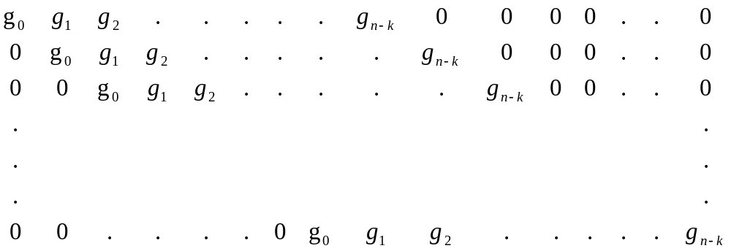
Generator & Parity-check Matrices
(一)
v = u • G
v(x) = (u₀ + u₁x + … + u_{k-1}x^{k-1})g(x)
Q: GH^{T}=0
G =
k x n
x^{n}+1 = g(x)h(x)
where h(x) = h₀ + h₁x + … + h_{k}x^{k} : parity polynomial
➔x^{k}h(x⁻¹) = h_{k} + h_{k-1}x + … + h₀x^{k}
Q:
∵ x^{k}h(x⁻¹) | x^{n}+1 ∴ x^{k}h(x⁻¹) generate an (n, n-k) cyclic code

Slide 9
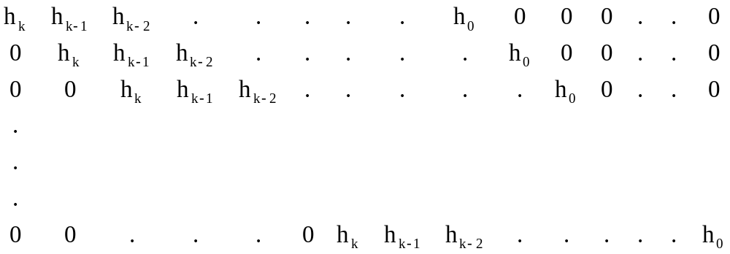
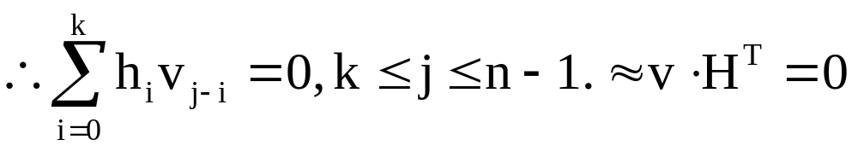
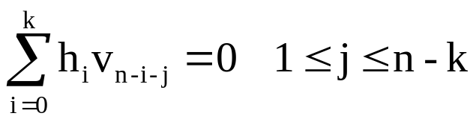
H =
(n-k) x n
Note If v(x) = a(x)g(x)
v(x)h(x) = a(x)g(x)h(x) = a(x)(x^{n}+1) = a(x) + x^{n}a(x)
∵ deg a(x) ≤ k-1
0 1 …k-1 n n+1 …n+k-1
deg = j 項係數

Slide 10
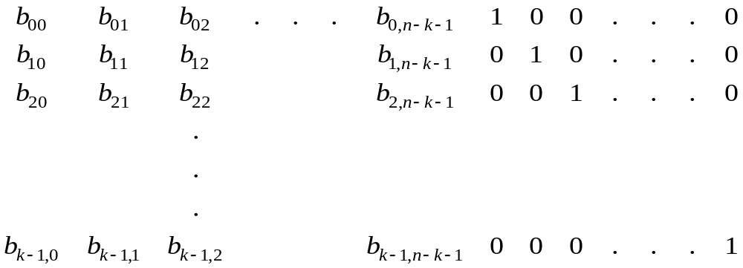
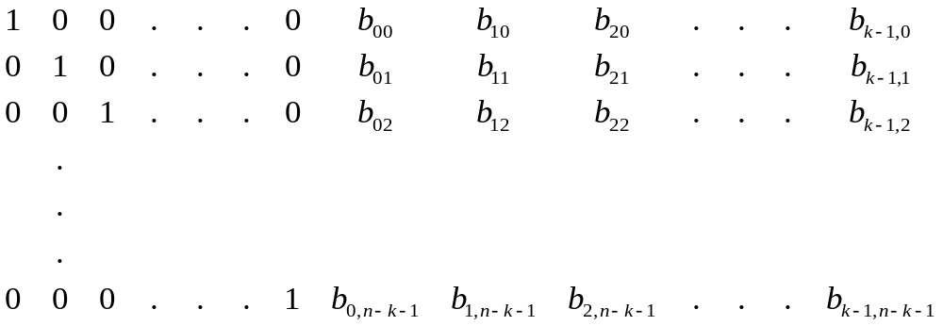
(二)
consider each i corresponding to an information place
x^{n-k+i} = a_{i}(x)g(x) + b_{i}(x) 0 ≤ i ≤ k-1 x^{n-k}, x^{n-k+1}, …, x^{n-1}
where b_{i}(x) = b_{i0} + b_{i1}x + … + b_{i,n-k-1}x^{n-k-1}
➔ b_{i}(x) + x^{n-k+i} are code polynomials
Q:
(1) linear independent?
(2) 與
x^{n-k}u(x)/g(x)之關係?
G =
k x n
(3) check VH^{T}=0
H =
(4) (一)G與(二)G之關係?
(n-k) x n

Slide 11
Ans (2)
x^{n-k}u(x) = u₀x^{n-k} + u₁x^{n-k+1} + … + u_{k-1}x^{n-1}
g(x) g(x)
= u₀b₀(x) + u₁b₁(x) + … + u_{k-1}b_{k-1}(x)
= t₀ + t₁x + … + t_{n-k-1}x^{n-k-1}
Ans (3)
V = (v₀,v₁,…,v_{n-k-1},v_{n-k},v_{n-k+1},…,v_{n-1})
= (t₀,t₁,…,t_{n-k-1},u₀,u₁,…,u_{k-1})
VH^{T}=V₀+ V_{n-k}b₀₀+ V_{n-k+1}b₁₀+…+ V_{n-1}b_{k-1,0}
= t₀+ u₀b₀₀+ u₁b₁₀+…+ u_{k-1}b_{k-1,0}

Slide 12
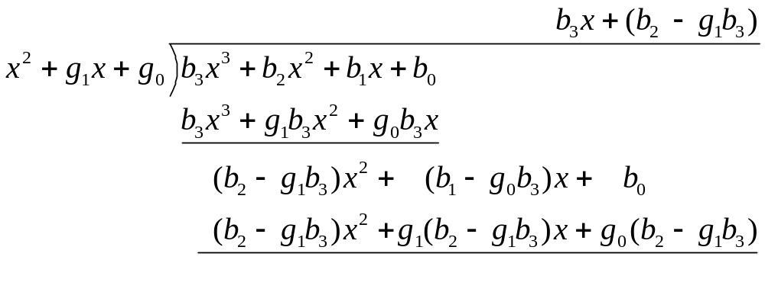
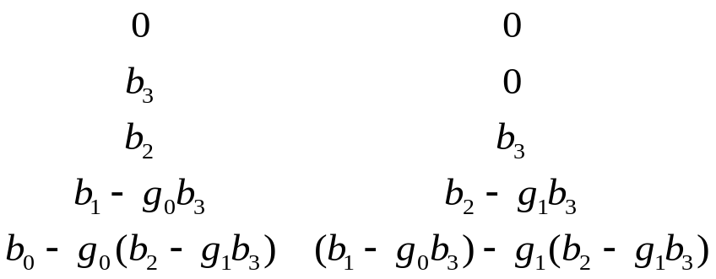
(一). b(x) mod g(x)
g(x) = x² + g₁x + g₀
b(x) = b₃x³ + b₂x² + b₁x + b₀
n-k = deg[g(x)] = 2
Ax + B (=s(x))
g₀
g₁
-1
b₀,b₁,b₂,b₃
b₃ 在第3clock 啟動前位於 -1 下方
i.e.就b₃x³ 單獨而言,在第4clock 後,registers內容為b₃x³ mod g(x)
G
=
=
B
A

Slide 13

(二).
x²b(x) mod g(x)
Q:
xb(x)/g(x)
(i) while complete the computation
b(x)/g(x) ≡ s(x)
(ii) G disable
(iii) one right shift
(iv) result = xs(x)/g(x)
xb(x) ≈ input 0, b₀, b₁, b₂ , b₃
(2) x²b(x)/g(x)
input 0, 0, b₀, b₁, b₂ , b₃
g₀
g₁
-1
b₀,b₁,b₂,b₃
就b₃x³ 單獨而言, 在第4 clock 結束後, registers內容為b₃x⁵ mod g(x). i.e. 相當於 (一), b₃由左方輸入但需 6個clock.
同理 for b₂, b₁, b₀

Slide 14
Encoding
< Method Ⅰ>
step (i) x^{n-k}u(x)
(ii) x^{n-k}u(x)/g(x) = b(x)
(iii) b(x) + x^{n-k}u(x)
Gate
g₁
g₂
g_{n-k-1}
b₀
b₁
b₂
…
b_{n-k-1}
Message X^{n-k}u(X)
Code word
n-k stage
Parity-check
digits
Figure 4.1 Encoding circuit for an (n, k) cyclic code with generator polynomial
g(X) = 1 + g₁X + g₂X² + … + g_{n-k-1}X^{n-k-1} + X^{n-k}

Slide 15
Example 4.5
Consider the (7, 4) cyclic code generated by g(X) = 1 + X + X³. The encoding circuit based on g(X) is shown in Figure 4.2. Suppose that the message u = (1 0 1 1) is to be encoded. As the message digits are shifted into the register, the contents in the register are as follows:
Input | Register contents
 | 0 0 0 (initial state)
1 | 1 1 0 (first shift)
1 | 1 0 1 (second shift)
0 | 1 0 0 (third shift)
1 | 1 0 0 (fourth shift)
After four shifts, the contents of the register are (1 0 0). Thus, the complete code vector is (1 0 0 1 0 1 1) and the code polynomial is 1 + X³ + X⁵ + X⁶.
Gate
(1 0 1 1)
Code word
Parity digits
Message X^{n-k}u(X)
Figure 4.2 Encoder for the (7, 4) cyclic code generated by g(X) = 1 + X + X³

Slide 16
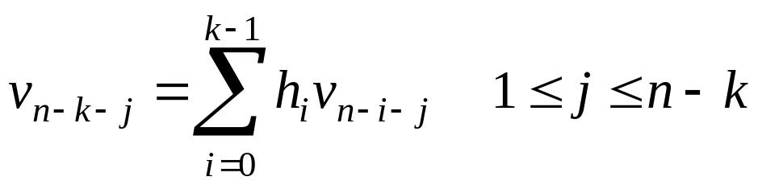
< Method Ⅱ>
--- (1)
⇒
given k information digits (v_{n-k}, v_{n-k+1}, …, v_{n-1}) = (u₀, u₁, … , u_{k-1})
By (1), to determine the n-k parity-check digits (v₀, v₁, … , v_{n-k-1})
v_{n-k-1} = h₀v_{n-1} + h₁v_{n-2} + … + h_{k-1}v_{n-k} = u_{k-1} + h₁u_{k-2} + … + h_{k-1}u₀
v_{n-k-2} = h₀v_{n-2} + h₁v_{n-3} + … + h_{k-1}v_{n-k-1} = u_{k-2} + h₁u_{k-3} + … + h_{k-2}u₀ + h_{k-1}v_{n-k-1}
+
+
+
+
Gate2
h_{k-1}
h_{k-2}
h₂
h₁
Gate1
•
u₀
u₁
•
• • •
•
U_{k-2}
U_{k-1}
° Output to channel
k stage
Figure 4.3 Encoding circuit for an (n, k) cyclic code based on the parity
polynomial h(x) = 1 + h₁X + h₂X² + …+ h_{k-1}X^{k-1}+X^{k}

Slide 17
h₀ = 1
Gate 2
Input
Gate 1
p
Output
Figure 4.4 Encoding circuit for the (7, 4) cyclic code based on its parity
polynomial h(x) = 1 + X + X² + X⁴
Suppose that the message to be encoded is (1 0 1 1).
Then v₃ = 1, v₄ = 0, v₅ = 1, v₆ = 1. The first parity-check digit is
v₂ = v₆ + v₅ + v₄ = 1 + 1 + 0 = 0
The second parity-check digit is
Q: 觀察 Method Ⅰ,Ⅱ 結果相同
v₁ = v₅ + v₄ + v₃ = 1 + 0 + 1 = 0
The third parity-check digit is
v₀ = v₄ + v₃ + v₂ = 0 + 1 + 0 = 1
Thus, the code vector that corresponds to the message (1 0 1 1) is
(1 0 0 1 0 1 1).

Slide 18
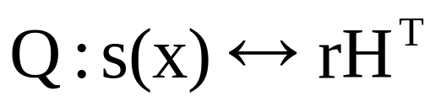

Syndrome Computation & Error Detection
< Type Ⅰ>
r(x) = r₀ + r₁x + … + r_{n-1}x^{n-1}
= a(x)•g(x) + s(x) deg s(x) ≤ n-k-1
s(x) = 0
r(x) is a code polynomial
syndrome
Gate
r(x)/g(x) ≈
g₁
g₂
g_{n-k-1}
s_{n-k-1}
r(X)
s₀
s₁
…
Received
vector
Figure 4.5 An (n-k)-stage syndrome circuit with input from the left end.

Slide 19
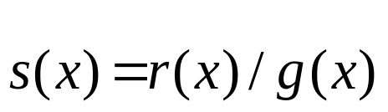
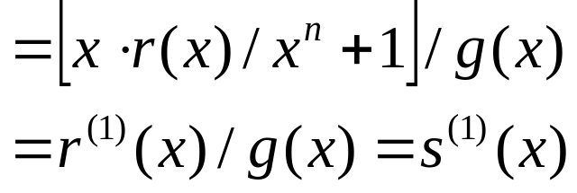
Thm : Let s(x) be the syndrome of a receive polynomial r(x)
Then s⁽¹⁾(x) ( = x• s(x)/g(x) ) is the syndrome of
r⁽¹⁾(x) (= x • r(x)/x^{n}+1)
pf:

Slide 20
Ref : pp. 10 & 11
r = (r₀, r₁, … ,r_{n-k-1}, r_{n-k}, … , r_{n-1}) = (t₀, t₁, … , t_{n-k-1}, u₀, u₁, … ,u_{k-1})
r•H^{T} = (s₀, s₁, … , s_{n-k-1})
s₀ = r₀ + r_{n-k}b₀₀ + r_{n-k+1}b₁₀ + … + r_{n-1}b_{k-1,0} = r₀ + t₀
s₁ = r₁ + r_{n-k}b₀₁ + r_{n-k+1}b₁₁ + … + r_{n-1}b_{k-1,1} = r₁ + t₁
…
s_{n-k-1} = r_{n-k-1} + r_{n-k}b_{0, n-k-1} + r_{n-k+1}b_{1, n-k-1} + … + r_{n-1}b_{k-1, n-k-1}
Syndrome is simply the vector sum of the received parity digits and the parity-check digits recomputed from the received information digits
∵ r(x) = r₀ + r₁x + … + r_{n-k-1}x^{n-k-1} + x^{n-k}•u(x)
u(x) = u₀ + u₁x + … + u_{k-1}x^{k-1}
∴ r(x)/g(x) = r₀ + r₁x + … + r_{n-k-1}x^{n-k-1} + x^{n-k}•u(x)/g(x)
=
t₀ + t₁x + … + t_{n-k-1}x^{n-k-1}
( r_{n-k}, r_{n-k+1}, … , r_{n-1} )G = ( t₀, t₁, … , t_{n-k-1}, r_{n-k}, r_{n-k+1}, r_{n-1} )

Slide 21
Example 4.7
A syndrome circuit for the (7, 4) cyclic code generated by g(X) = 1 + X + X³ is shown in Figure 4.6. Suppose that the receive vector is r = (0 0 1 0 1 1 0). The syndrome of r is s = (1 0 1). As the received vector is shifted into the circuit, the contents in the register are given in Table 4.3.
Gate
input
Gate
₁
₀
₁
Figure 4.6 Syndrome circuit for the (7, 4) cyclic code generated by g(X) = 1 + X + X³.
Shift | Input | Register contents
 |  | 0 0 0 (initial state)
1 | 0 | 0 0 0
2 | 1 | 1 0 0
3 | 1 | 1 1 0
4 | 0 | 0 1 1
5 | 1 | 0 1 1
6 | 0 | 1 1 1
7 | 0 | 1 0 1 (syndrome s)
8 | - | 1 0 0 (syndrome s⁽¹⁾)
9 | - | 0 1 0 (syndrome s⁽²⁾)
Table 4.3 CONTENTS OF THE SYNDROME REGISTER SHOWN IN FIGURE
4.6 WITH r = (0 0 1 0 1 1 0) AS INPUT

Slide 22
Gate
< Type Ⅱ>
x^{n-k}r(x)/g(x) ≈
g₁
g₂
g_{n-k-1}
s_{n-k-1}
s₀
s₁
…
r(X)
Figure 4.7 An (n-k)-stage syndrome circuit with
input from the right end.
Received vector
Cor : The contents of the registers form the syndrome s^{(n-k)}(x) of r^{(n-k)}(x),
which is the (n-k)^{th} cyclic shift of r(x)
Note :
x^{n-k}r(x)/g(x) = [x^{n-k}r(x)/x^{n}+1]/g(x) = r^{(n-k)}(x)/g(x) = s^{(n-k)}(x)
r(x) = v(x) + e(x)
∴ s(x) = r(x)/g(x) = e(x)/g(x)
x^{n-k}r(x)
= Q(x)(x^{n}+1) + R(x)
= Q(x)p(x)g(x) + q(x)g(x) + s(x)
= [Q(x)p(x) + q(x)]g(x) + s(x)

Slide 23
Decoding
syndrome
error pattern
correct
Meggitt decoder
received digits are decoded one at a time and
each digit is decoded with the same circuitry
<see next page>
Note : If Syndrome register ≠ 0’s at the end of decoding ( n shifts )
uncorrectable error pattern
syndrome
r(x)
r⁽¹⁾(x)
r₁(x)
r₁⁽¹⁾(x)
s(x)
s⁽¹⁾(x)
s₁(x)
s₁⁽¹⁾(x)
r₁(x) = r(x) + x^{n-1}
s₁(X) = s(x) + x^{n-1}/g(x)
s₁⁽¹⁾(x) = x•s₁(x)/g(x)
= xs(x)/g(x) + [x•x^{n-1}/g(x)]/g(x)
= xs(x)/g(x) + x^{n}/g(x) = s⁽¹⁾(x) + 1
x^{n}-1 = Q(x)g(x)
➔x^{n} = Q(x)g(x) + 1

Slide 24
< Type Ⅰ>
Gate
(r₀, r₁, … , r_{n-1})
Corrected
vector
=
r_{i}
r(X)
Buffer registers
Gate
Received
vector
Feedback connection
Gate
Gate
Syndrome register
s(x) --- r(x)
s⁽¹⁾(x) --- r⁽¹⁾(x)
e_{i}
Error pattern detection circuit
Gate
Syndrome modification
Figure 4.8 General cyclic code decoder with received polynomial r(X)
shifted into the syndrome register from the left end

Slide 25
Example 4.9
Consider the decoding of the (7, 4) cyclic code generated by g(X) = 1 + X + X³. This code has minimum distance 3 and is capable of correcting any single error over a block of seven digits. There are seven single-error patterns. These seven error patterns and the all-zero vector form all the coset leaders of the decoding table. Thus, they form all the correctable error patterns. Suppose that the received polynomial r(X) = r₀ + r₁X + r₂X² + r₃X³ + r₄X⁴ + r₅X₅ + r₆X⁶ is shifted into the syndrome register from the left end. The seven single-error patterns and their corresponding syndromes are listed in Table 4.4.
TABLE 4.4 ERROR PATTERNS AND THEIR SYNDROMES WITH THE RECEIVED POLYNOMIAL r(x) SHIFTED INTO THE SYNDROME REGISTER FROM THE LEFT END
Error pattern
e(X)
Syndrome
s(X)
Syndrome vector
(s₀, s₁, s₂)
e₆(X) = X⁶
e₅(X) = X⁵
e₄(X) = X⁴
e₃(X) = X³
e₂(X) = X²
e₁(X) = X¹
e₀(X) = X⁰
s(X) = 1 + X²
s(X) = 1 + X + X²
s(X) = X + X²
s(X) = 1 + X
s(X) = X²
s(X) = X
s(X) = 1
(1 0 1)
(1 1 1)
(0 1 1)
(1 1 0)
(0 0 1)
(0 1 0)
(1 0 0)

Slide 26
Buffer register
r(X)
r’(X)
Multiplexer
Input
Output
Gate
Gate
0
0
1
Gate
Figure 4.9 Decoding circuit for the (7, 4) cyclic code generated by
g(X) = 1 + X + X³.

Slide 27
Syndrome
register
Buffer register
Correction
Pointer
0
1
0
1
1
0
1
1
Initial
0
0
1
0
1st shift
1
1
0
1
1
0
1
1
0
1
0
2st shift
0
1
1
1
1
1
0
1
1
0
0
3rd shift
1
1
1
0
1
1
1
0
1
1

Slide 28
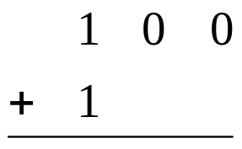
1
4th shift
1
0
1
1
0
1
1
1
0
1
0
Error corrected
0
1
0
1
1
1
0
5th shift
0
0
0
0
6th shift
0
0
0
0
0
1
0
1
1
1
0
Corrected word
7th shift
0
0
0
1
0
0
1
0
1
1
Figure 4.10 Error-correction process of the circuit shown in Figure 4.9

Slide 29
< Type Ⅱ>
s^{(n-k)}(x) : syndrome of r^{(n-k)}(x)
If e_{n-1} = 1 In r^{(n-k)}(x), the digit r_{n-1} is at the location x^{n-k-1}
r₁^{(n-k)}(x) = r^{(n-k)}(x) + x^{n-k-1}
➔ s₁^{(n-k)}(x) = s^{(n-k)}(x) + x^{n-k-1}
(r₀, r₁, … ,r_{n-1})
Gate
=
r_{i}
r(X)
Gate
Buffer register r(X)
Received
vector
Corrected
vector
Gate
Feedback connection
Note:
<Type I> circular shift 後考量
<Type II> circular shift 前考量
Gate
Syndrome register
(Syndrome
modification)
Gate
e_{i}
Error-pattern detection circuit
Figure 4.11 General cyclic code decoder with received polynomial r(X) shifted into the syndrome register from the right end.

Slide 30
Example 4.10
Again, we consider the decoding of the (7, 4) cyclic code generated by g(X) = 1 + X + X³. Suppose that the received polynomial r(X) is shifted into the syndrome register from the right end. The seven single-error patterns and their corresponding syndromes are listed in Table 4.5.
We see that only when e(X) = X⁶ occurs, the syndrome is (0 0 1) after the entire received polynomial r(X) has been shifted into the syndrome register. If the single error occurs at the location X^{i} with i ≠ 6, the syndrome in the register will not be (0 0 1) after the entire received polynomial r(X) has been shifted into the syndrome register. However, another 6 – i shifts, the syndrome register will contain (0 0 1). Based on this fact, we obtain another decoding circuit for the (7, 4) cyclic code generated by g(X) = 1 + X + X³, as shown in Figure 4.12. We see that the circuit shown in Figure 4.9 and the circuit shown in Figure 4.12 have the same complexity.

Slide 31
TABLE 4.5 ERROR PATTERNS AND THEIR SYNDROMES WITH THE RECEIVED POLYNOMIAL r(x) SHIFTED INTO THE SYNDROME REGISTER FROM THE RIGHT END
Error pattern
e(X)
Syndrome
s⁽³⁾(X)
Syndrome vector
(s₀, s₁, s₂)
e(X) = X⁶
e(X) = X⁵
e(X) = X⁴
e(X) = X³
e(X) = X²
e(X) = X¹
e(X) = X⁰
s⁽³⁾(X) = X²
s⁽³⁾(X) = X
s⁽³⁾(X) = 1
s⁽³⁾(X) = 1 + X²
s⁽³⁾(X) = 1 + X + X² s⁽³⁾(X) = X + X²
s⁽³⁾(X) = 1 + X
(0 0 1)
(0 1 0)
(1 0 0)
(1 0 1)
(1 1 1)
(0 1 1)
(1 1 0)

Slide 32
Buffer register
r(X)
r’(X)
Multiplexer
Input
Output
Gate
Gate
Gate
Figure 4.12 Decoding circuit for the (7, 4) cyclic code generated by
g(X) = 1 + X + X³.

