Slide 1
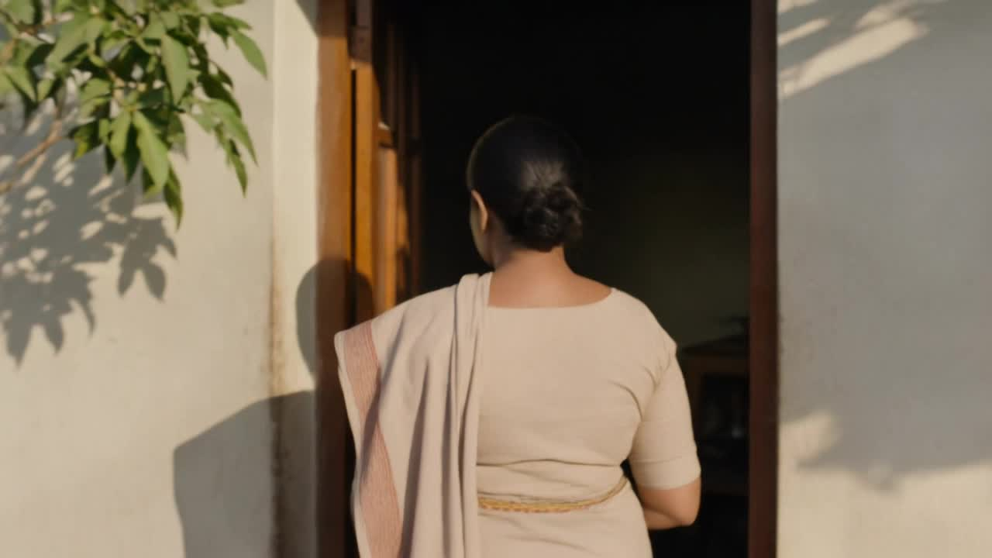
SHUMI
Website Design & Digital Experience
A global digital platform for women's empowerment
TEDCANLABS
September 2026
Notes:
PURPOSE — Open with scale and seriousness, not a logo on white.
KEY MESSAGE — SHUMI is a global platform, and this deck behaves like one from the first frame.
TRANSITION — Hold on the footage for a beat, then: 'Before we talk about pages, let's talk about the opportunity.'

Slide 2
01 — THE OPPORTUNITY
A website should
be more than
a website.
Women
Stories
Programmes
Events
Resources
Communities
SHUMI has the opportunity to build not a brochure, but a platform — one place where women, stories, programmes, events, resources, communities and partners connect to each other.
Partners
Opportunities
02
Notes:
PURPOSE — Reframe the brief from 'a website' to 'a platform'.
KEY MESSAGE — Eight content systems that currently live apart can reinforce each other.
TRANSITION — 'So what should that platform feel like?'

Slide 3

02 — THE VISION
Make SHUMI's mission
experienceable.
Create a digital experience that makes SHUMI's mission tangible — connecting women, communities, stories and opportunities across the world.
Global
Not generic
Human
People before jargon
Bold
Confident, not loud
Dynamic
Built to grow
03
Notes:
PURPOSE — State the vision in one line.
KEY MESSAGE — The mission should be felt, not read.
TRANSITION — 'Which leads to the idea the whole experience is built on.'

Slide 4
03 — THE CREATIVE IDEA
The world through her.
Not “women around the world” — that is a category. “The world through her” is a lens.
HER
→
HER STORY
→
HER COMMUNITY
→
HER OPPORTUNITY
→
HER IMPACT
→
THE WORLD
Every piece of content sits somewhere on this line. The design's job is to make the line visible.
04
Notes:
PURPOSE — Land the organising idea.
KEY MESSAGE — One woman's story is the near end of a chain that reaches the world. That is the architecture, not a tagline.
TRANSITION — 'Four principles fall out of that idea.'

Slide 5


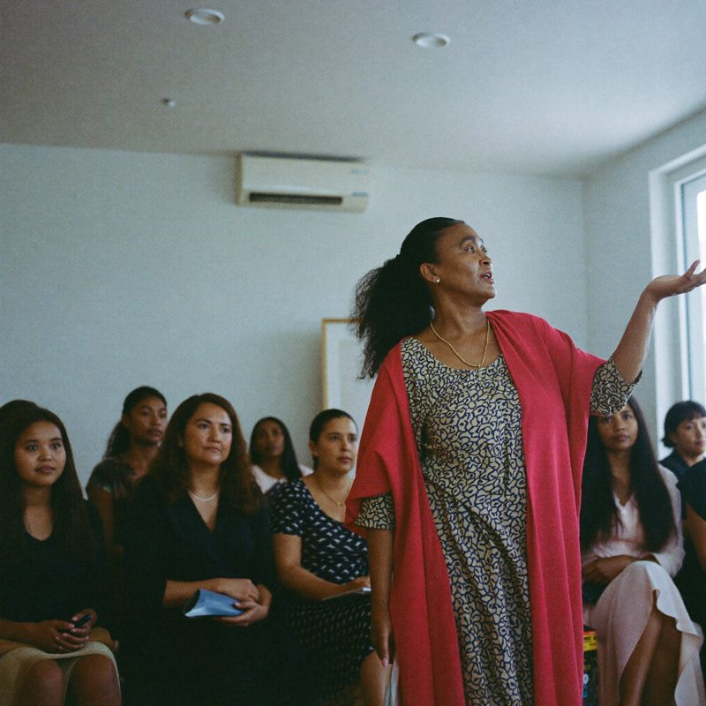

04 — DESIGN PRINCIPLES
Four principles.
01
Human first
Real people and authentic stories before organisational language.
02
Global by design
A worldwide perspective carried by specificity, never by landmarks.
03
Impact made visible
Turn impact into visual storytelling, not four tiles of numbers.
04
Designed for movement
An evolving platform, architected to grow without redesign.
05
Notes:
PURPOSE — Give the client four things to hold on to.
KEY MESSAGE — These principles govern every later decision in the deck.
TRANSITION — 'They came from studying what already works — and what does not.'

Slide 6
05 — THE REFERENCE LANDSCAPE
Inspired by principles. Not copied.
WHAT WE TAKE
Named events as destinations
An event with its own identity and URL converts far better than a row in a list.
Event-first architecture
Organised around “when can I come” — the right priority for an organisation that gathers people.
Attributed testimonials
Real names against real quotes. The credibility mechanism is right.
WHAT WE LEAVE
The statistics band
8000+ attendees, 250K+ viewers. SHUMI has no such figures, and inventing them is out of the question.
The press-logo marquee
A row of logos SHUMI has not earned is a lie with a design system around it.
Four competing typefaces
And a heading order running h1 → h3 → h4 → h2, which scrambles the page for screen readers.
Studied from the reference's actual markup — not from impression.
06
Notes:
PURPOSE — Show rigour, and pre-empt 'did you just copy their site?'.
KEY MESSAGE — We analysed the real code. We take the architecture and leave the credibility scaffolding SHUMI has not earned yet.
TRANSITION — 'From that, three genuinely different ways to build SHUMI.'

Slide 7

06 — THREE DIRECTIONS
Three ways to
experience SHUMI.
01
Editorial
The world's editorial voice for women.
02
Global
A network connecting women and opportunity.
03
Human
A platform built on real women's stories.
Genuinely different design philosophies — not one design in three palettes.
07
Notes:
PURPOSE — Set up the three concepts.
KEY MESSAGE — These are three different answers to what SHUMI is for, not three colourways.
TRANSITION — 'Concept one.'

Slide 8
07 — CONCEPT 7
Editorial SHUMI
Credibility through craft, not statistics.
SHUMI as a publication with a point of view. The only stance that lets a young organisation look serious today — with no numbers, no press and no partner logos.
Large editorial typography
Asymmetric, grid-breaking layouts
Full-bleed photography
Oversized pull quotes
Generous negative space
STRENGTH —
Degrades honestly. Works beautifully with nothing to prove.
WATCH —
Coldest of the three. Lives or dies on photographic quality.
08
Notes:
PURPOSE — Present Editorial SHUMI on its own terms.
KEY MESSAGE — Credibility through craft, not statistics.
TRANSITION — 'And the third.'

Slide 9
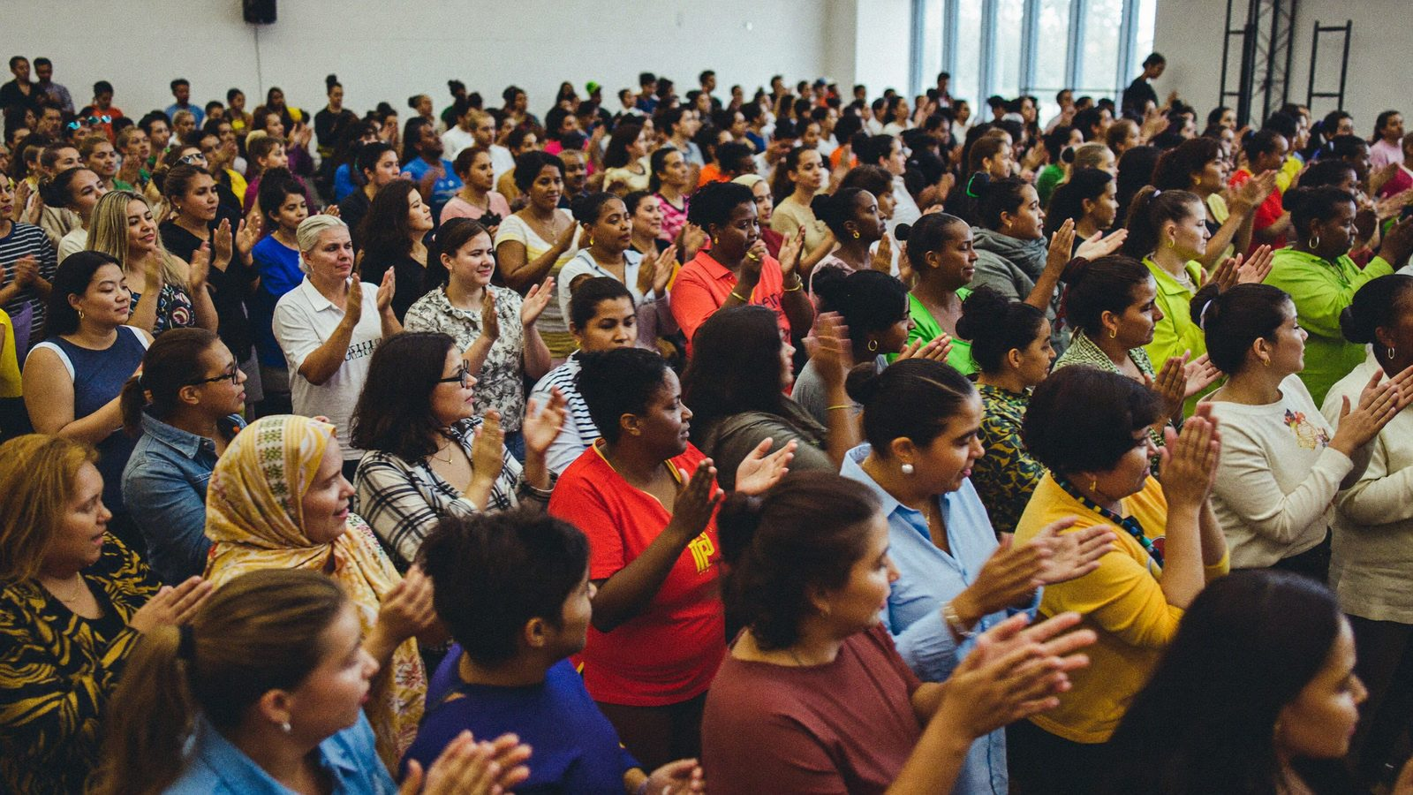
08 — CONCEPT 8
SHUMI Global
Geography as structure, not decoration.
SHUMI as a network. Country becomes metadata on every story and programme, so 'global' is a fact of the architecture rather than a claim in the copy.
Region and community storytelling
Filtered programme discovery
Impact metrics tied to stories
Location-led navigation
Dynamic transitions
STRENGTH —
Highest ceiling. The only direction that becomes a true platform.
WATCH —
Requires the most content. Looks worst when empty.
09
Notes:
PURPOSE — Present SHUMI Global on its own terms.
KEY MESSAGE — Geography as structure, not decoration.
TRANSITION — 'And the third.'

Slide 10

09 — CONCEPT 9
Human Connection
One woman, told properly.
SHUMI as a deeply human platform. Documentary portraits, personal quotes and an intimate visual rhythm — story-first rather than section-first.
Large documentary portraits
Personal quotes at scale
Organic, warm layouts
Story-first navigation
Soft, unhurried transitions
STRENGTH —
Highest warmth and conversion. Best mobile experience.
WATCH —
Least differentiated. Weakest at expressing 'global'.
10
Notes:
PURPOSE — Present Human Connection on its own terms.
KEY MESSAGE — One woman, told properly.
TRANSITION — 'So how do they compare?'

Slide 11
10 — COMPARISON
Scored, honestly.
Editorial
Global
Human
Premium feel
10
6
8
THE REAL FINDING
Three points across eleven categories is noise.
Weighted by what SHUMI needs next, each concept wins decisively — and the other two lose.
Fill the event → Human
Win credibility → Editorial
Build the platform → Global
So the choice is a strategy decision, not a taste decision.
Global identity
7
5
10
Warmth
4
10
5
Accessibility
8
10
6
Storytelling
9
8
7
Event conversion
6
9
8
Mobile UX
7
10
8
Scalability
7
6
10
Differentiation
9
5
8
Emotional impact
7
9
7
Long-term potential
8
6
10
Unweighted total
82
84
87
11
Notes:
PURPOSE — Show the comparison is real, not rigged for a favourite.
KEY MESSAGE — The totals are within three points. What matters is which priority SHUMI weights.
TRANSITION — 'Which is why we recommend combining them.'

Slide 12
11 — RECOMMENDATION
Editorial × Global Impact.
Editorial leads because it is the only stance that lets SHUMI look serious today. Global supplies the structure. Human supplies the heart.
70%
Premium editorial
Credibility through craft
20%
Global impact
Geography as architecture
10%
Human storytelling
The emotional centre
What we deliberately leave behind: the content debt. Counters, maps and filters are specified and switched off until SHUMI has something true to put in them.
12
Notes:
PURPOSE — Land the recommendation and its reasoning.
KEY MESSAGE — A balance, not a formula. And we hold back the parts that would look empty.
TRANSITION — 'Here is how that becomes a structure.'

Slide 13
12 — INFORMATION ARCHITECTURE
Built to grow.
HOME
About
Programs
Stories
Global
Events
Resources
Get Involved
Contact
Our Story
All Programs
Women
Regions
Upcoming
Articles
Donate
General
Mission & Vision
Program Detail
Communities
Communities
Event Detail
Reports
Partner
Service inquiries
Values
Filters
Impact
Global Impact
Past Events
Guides
Volunteer
Team
Media
Participate
GROWTH SLOTS —
Membership · Chapters · Regional hubs · Speakers · Vendors · Directory · Mentorship · Grants
Each maps onto a section that already exists. Adding one never forces a navigation redesign.
13
Notes:
PURPOSE — Show the structure is designed for 2028, not just launch.
KEY MESSAGE — Nine sections, and eight future features that already have a home.
TRANSITION — 'Now the homepage as a journey through that structure.'

Slide 14
13 — HOMEPAGE JOURNEY
A journey, not a stack of sections.
01
02
03
04
05
06
07
08
09
10
11
12
Hero
Introduction
Global impact
Stories
Programs
Global connection
Events
Resources
Partners
Get involved
Newsletter
Footer
Highlighted: the four beats that carry the argument.
THE TRANSITION RULE
Consecutive sections never share a ground colour or a layout shape. That rhythm is what stops twelve sections reading as twelve boxes.
14
Notes:
PURPOSE — Show the homepage is composed, not assembled.
KEY MESSAGE — Each section hands off to the next. The rhythm is designed.
TRANSITION — 'It opens here.'

Slide 15

14 — HERO EXPERIENCE
When women move forward,
the world moves with them.
SHUMI connects women across countries and generations.
EXPLORE SHUMI
MEET THE WOMEN
Composition briefed with the headline in mind — the type never needs a scrim to be legible.
15
Notes:
PURPOSE — Show the hero working, not described.
KEY MESSAGE — Headline is a creative direction, not approved copy. The negative space is a hard requirement.
TRANSITION — 'Then SHUMI introduces itself.'

Slide 16

15 — INTRODUCTION
A manifesto.
Not a paragraph.
The introduction is set as a large typographic statement, broken across lines and revealed as the visitor arrives. Short, declarative, in SHUMI's own voice.
“[SHUMI'S OWN WORDS — 25–40 words, to be written with SHUMI]”
Never fabricated. This slot stays visibly empty until SHUMI writes it.
16
Notes:
PURPOSE — Show restraint as a design decision.
KEY MESSAGE — We are not writing SHUMI's mission for them. The component is built; the words are theirs.
TRANSITION — 'Then impact — the part everyone gets wrong.'

Slide 17

16 — IMPACT EXPERIENCE
A number that hands you a person.
XX,XXX
Women reached
XX
Communities
XX
Countries
XX
Programmes
Then the chain continues.
A statistic that hands straight to one woman is worth more than four statistics in tiles. It also degrades gracefully — with the number still a placeholder, her story alone carries the section.
XX,XXX WOMEN
→
ONE WOMAN
→
HER COMMUNITY
→
THE WORLD
ALL FIGURES ARE PLACEHOLDERS.
No SHUMI statistic has been invented. These slots stay visibly empty until real numbers exist.
17
Notes:
PURPOSE — Show the impact mechanism and the honesty policy at once.
KEY MESSAGE — Impact is not four tiles. It is a chain from a number to a person.
TRANSITION — 'And the same chain runs outward, geographically.'

Slide 18
17 — GLOBAL EXPERIENCE
Explorable. Not a spinning globe.
WORLD
›
REGION
›
COMMUNITY
›
PROGRAM
›
WOMAN
›
STORY
FILTER BY REGION
WHY A LIST BEFORE A MAP
A typeset region index is honest at three countries and still works at sixty. A world map with four pins advertises how few pins there are — the opposite of the intended effect.
It is also keyboard-navigable and legible to a screen reader, which a map is not without significant extra work. The map becomes progressive enhancement, never the only way in.
Africa
Americas
Asia
Europe
Middle East
Oceania
[COUNTRIES SHUMI OPERATES IN — client to supply]
18
Notes:
PURPOSE — Pre-empt the client asking for an animated globe.
KEY MESSAGE — We can build the map. We recommend earning it first.
TRANSITION — 'Programmes work the same way.'

Slide 19



18 — PROGRAMME EXPERIENCE
Discovery that works at six, and at sixty.
All
Region
Theme
Type
Status
EDUCATION
[PROGRAM NAME]
[Region] · [Theme]
[Short description — client to supply]
Explore →
ECONOMIC
[PROGRAM NAME]
[Region] · [Theme]
[Short description — client to supply]
Explore →
LEADERSHIP
[PROGRAM NAME]
[Region] · [Theme]
[Short description — client to supply]
Explore →
COMMUNITY
[PROGRAM NAME]
[Region] · [Theme]
[Short description — client to supply]
Explore →
19
Notes:
PURPOSE — Show a scalable content system, not four hand-built pages.
KEY MESSAGE — One component, filtered. It looks right with three programmes and with thirty.
TRANSITION — 'The same discipline drives the most important system — stories.'

Slide 20

19 — STORIES EXPERIENCE
Her story is part of a larger story.
[WOMAN'S NAME]
[LOCATION] · [REGION]
“[Her quotation — real, short, attributed, and used with her permission.]”
[Short introduction — 40 to 60 words, client to supply]
READ HER STORY →
Every story carries region, theme and programme as metadata. That is what makes the global architecture real rather than claimed — and what lets one story link back up to its community, its region and the world.
20
Notes:
PURPOSE — This is the emotional centre of the deck. Slow down here.
KEY MESSAGE — One woman, told properly, beats six cards. And her record is structured so it connects outward.
TRANSITION — 'Stories bring people in. Events bring them together.'

Slide 21
20 — EVENTS EXPERIENCE
Events are experiences, not a calendar.
[DATE]
[EVENT NAME]
[LOCATION]
[Short description — client to supply]
REGISTER
ARCHITECTED FOR EVENTBRITE — NOT INTEGRATED TODAY
The ticket action is a slot behind a clean interface, so connecting Eventbrite later is configuration rather than a rebuild. We are not claiming an integration that does not exist. A post-event state is designed too, so the section never looks stale the morning after.
21
Notes:
PURPOSE — Named events as destinations — the one idea worth taking from the reference.
KEY MESSAGE — And an honest position on Eventbrite: architected for, not claimed.
TRANSITION — 'Once someone cares, they need a way in.'

Slide 22
21 — GET INVOLVED
Learn → Connect → Act.
Not six identical buttons. A progression ordered by commitment.
Donate
Partner
Participate
Volunteer
Attend
Share
Lowest effort. One tap.
Come to an event.
Give time.
Join a programme.
Organisational.
Highest commitment.
Height signals commitment. The page moves left to right from the easiest thing a visitor can do to the biggest — so nobody is asked to donate before they have been given a reason to.
22
Notes:
PURPOSE — Show conversion thinking, not a button row.
KEY MESSAGE — The ask escalates. Donation is the end of a journey, not the front door.
TRANSITION — 'And most of this happens on a phone.'

Slide 23
22 — MOBILE EXPERIENCE
Designed for the phone, not shrunk to fit.
Menu says the word “Menu”
Not a bare icon. Older users tap words.
Primary action in the lower third
Thumb reach is a layout constraint.
Art-directed crops per breakpoint
A 21:9 desktop hero becomes 4:5 on mobile.
Nothing depends on hover
Every menu opens on tap.
Scale relationships hold
Display steps 112px → 44px; the ratios survive.
Home
Story
Event
23
Notes:
PURPOSE — Mobile is where most visitors actually arrive.
KEY MESSAGE — These are decisions, not responsive defaults.
TRANSITION — 'Motion is the last layer of the experience.'

Slide 24
23 — MOTION SYSTEM
Motion with a job to do.
Image reveal
Mask wipe up, 600ms. Once, on first view.
Editorial statement
Line-by-line rise, 80ms stagger.
Impact figures
Count up 1200ms — and present as static text before any script runs.
Story rail
Horizontal momentum, keyboard operable.
Page transition
300ms cross-fade.
Hover
150ms colour only. Never scale, never lift.
FORBIDDEN
Bounce · spin · fly-in · auto-advancing carousels · scroll-jacking · parallax on text · anything that repeats on every scroll past.
prefers-reduced-motion disables all of it. Nothing is discoverable only through motion, and no information exists only inside an animation.
24
Notes:
PURPOSE — Show motion is governed, not sprinkled.
KEY MESSAGE — Six moments, each with a reason. And a reduced-motion path that actually works.
TRANSITION — 'Underneath all of it sits the content system.'

Slide 25
24 — CONTENT SYSTEM
SHUMI updates the site. Not a developer.
Story
Name · Location · Portrait · Quote · Body
Program
Name · Category · Impact · Status
Event
Name · Date · Location · Ticket URL
Resource
Title · Type · File · Description
Region
Name · Communities
Impact metric
Label · Value · Source · As-of date
Partner
Name · Logo · Consent flag
Team
Name · Role · Bio · Consent flag
TWO FIELDS THAT ARE NOT DECORATION
Impact metric carries Source and As-of date. Partner and Team carry a Consent flag.
These make it structurally awkward to publish a number nobody can stand behind, or to name a person or organisation that has not agreed. The content model enforces the honesty policy — rather than relying on whoever happens to be editing that day.
25
Notes:
PURPOSE — Show the CMS is designed, and that it protects SHUMI.
KEY MESSAGE — Nine entities, relational. Two fields exist specifically to prevent accidental fabrication.
TRANSITION — 'Briefly, what it runs on.'

Slide 26
25 — TECHNICAL FOUNDATION
Chosen for reasons, not résumé.
Next.js + TypeScript
Editorial sites live or die on image performance and SEO.
Headless CMS
The content model is relational; a page-based CMS cannot express it.
Tailwind + design tokens
Tokens map 1:1 to the system, so contrast rules survive handoff.
Art-directed images
AVIF/WebP, per breakpoint. Cinematic must not mean slow.
Accessibility built in
WCAG 2.1 AA measured, not assumed.
Eventbrite adapter
Behind a clean interface. Swappable, and not claimed as built.
TARGETS —
LCP under 2.5s on 4G · CLS under 0.1 · self-hosted fonts with metric-matched fallbacks · no autoplay with sound · semantic HTML, Article and Event schema.
26
Notes:
PURPOSE — Keep this short. The client is not buying a stack.
KEY MESSAGE — Every choice traces back to something in the experience.
TRANSITION — 'Here is how we would run it.'

Slide 27
26 — PROCESS
Seven steps.
01
02
03
04
05
06
07
›
›
›
›
›
›
Discover
Strategise
Wireframe
Design
Develop
Test
Launch
We do not skip the wireframe stage and we do not skip the concept comparison. Both already exist for SHUMI — this deck is the output of steps one to three.
27
Notes:
PURPOSE — Show process discipline.
KEY MESSAGE — Steps 1–3 are already done and in front of them.
TRANSITION — 'Which means the timeline starts from a running start.'

Slide 28
27 — TIMELINE
Seven to eleven weeks.
Discovery
1
UX / Wireframes
1–2 weeks
UI Design
2
Development
2–4 weeks
Content / Integrations
1–2 weeks
QA / Launch
1
THIS IS AN ESTIMATE.
It moves with content availability, feedback cycles and final scope — content is almost always the critical path, not development.
28
Notes:
PURPOSE — Be straight about the estimate.
KEY MESSAGE — Content availability drives the timeline more than build does.
TRANSITION — 'Here is exactly what you receive.'

Slide 29
28 — DELIVERABLES
What you receive.
Strategy
Design
Build
Launch
UX strategy
Final UI design
Website development
SEO foundation
Information architecture
Responsive design
CMS
Analytics
Three creative directions
Design system
Event architecture
Accessibility audit
Wireframes
Motion specification
Forms
QA, deployment & support
29
Notes:
PURPOSE — Make the scope concrete.
KEY MESSAGE — Sixteen deliverables across four stages.
TRANSITION — 'And what it costs.'

Slide 30
29 — INVESTMENT
Investment.
Strategy & UX
Discovery, IA, wireframes, three directions
$XX,XXX
UI / Visual design
Final design, responsive, design system
$XX,XXX
Development
Frontend build, performance, accessibility
$XX,XXX
CMS & integrations
Content model, forms, event architecture
$XX,XXX
Testing & launch
QA, deployment, launch support
$XX,XXX
Total
$XX,XXX
Figures are placeholders.
No pricing has been invented — these are filled in once scope is confirmed with SHUMI.
30
Notes:
PURPOSE — Present the shape of the investment without inventing a number.
KEY MESSAGE — Five workstreams. Pricing follows scope confirmation.
TRANSITION — 'A word on who is doing the work.'

Slide 31
30 — WHY TEDCANLABS
Four things, done together.
Strategy
We start with the argument, not the pages.
Design
Premium digital experiences that hold up beside anyone's.
Technology
Scalable implementation, built to be handed over.
Experience
Human-centred products, measured rather than assumed.
The quality of this document is the argument.
31
Notes:
PURPOSE — Keep it short and let the work speak.
KEY MESSAGE — Do not oversell here — the previous thirty slides are the credential.
TRANSITION — 'To close.'

Slide 32
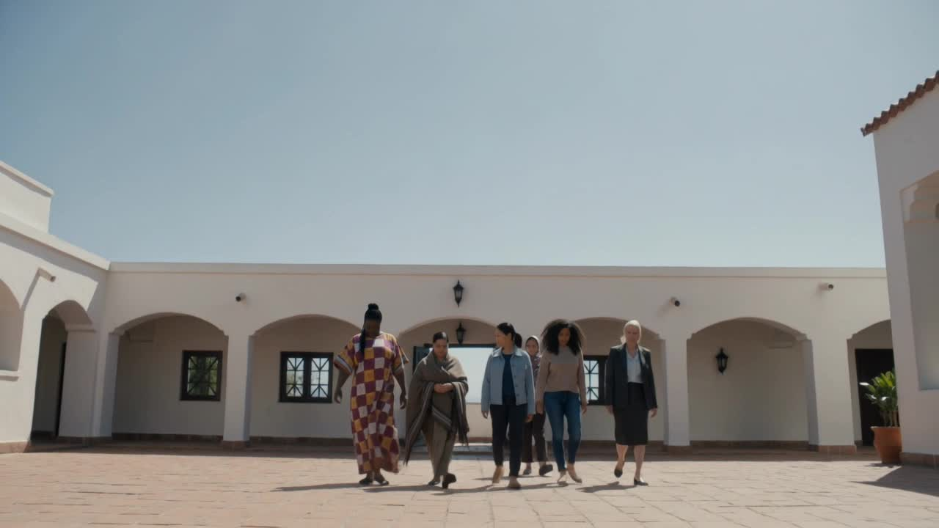
SHUMI deserves a digital experience
that reflects the scale of its mission.
A platform that does not simply tell people what SHUMI does — but lets them experience the women, stories, communities and impact behind the organisation.
Let's build SHUMI's digital future.
TEDCANLABS
32
Notes:
PURPOSE — Close on scale and a clear next step.
KEY MESSAGE — The ask is a decision on direction, not on budget.
TRANSITION — Stop talking. Let the room respond.

