Slide 1
Heart Disease: Classification Techniques

Slide 2
Introduction
The dataset used, Cleveland Heart Disease Dataset from the UCI was compiled by Robert Detrano, M.D., Ph.D using data from the V.A. Medical Centre, Long Beach and Cleveland Clinic Foundation. Individuals who are believed to be at risk of heart disease (through underlying conditions) can use this tool to spot how likely they are to suffer from heart disease. Individuals who are disease averse can use this tool to identify what steps they can take to reduce their likelihood of getting the disease.

Slide 3
Objective
The dataset used, Cleveland Heart Disease Dataset from the UCI was compiled by Robert Detrano, M.D., Ph.D using data from the V.A. Medical Centre, Long Beach and Cleveland Clinic Foundation. Individuals who are believed to be at risk of heart disease (through underlying conditions) can use this tool to spot how likely they are to suffer from heart disease. Individuals who are disease averse can use this tool to identify what steps they can take to reduce their likelihood of getting the disease.

Slide 4
Methodology
Data Analysis
Explore and explain the data.
Handle missing values.
Remove extraneous rows/columns.
Descriptive and inferential Statistics
Explore the data and make generalizations about which features are most closely linked to heart disease.
Machine Learning and Model Tuning
Logistic regression, K-nearest neighbours, classifier, support vector machine, decision tree classifier, random forest classifier and XGBoost classifier will be used to determine training accuracy.
Hyperparameter tuning will be used to yield a lower error.

Slide 5
Methodology
Data Analysis
Explore and explain the data.
Handle missing values.
Remove extraneous rows/columns.
Descriptive and inferential Statistics
Explore the data and make generalizations about which features are most closely linked to heart disease.
Machine Learning and Model Tuning
Logistic regression, K-nearest neighbours, classifier, support vector machine, decision tree classifier, random forest classifier and XGBoost classifier will be used to determine training accuracy.
Hyperparameter tuning will be used to yield a lower error.

Slide 6
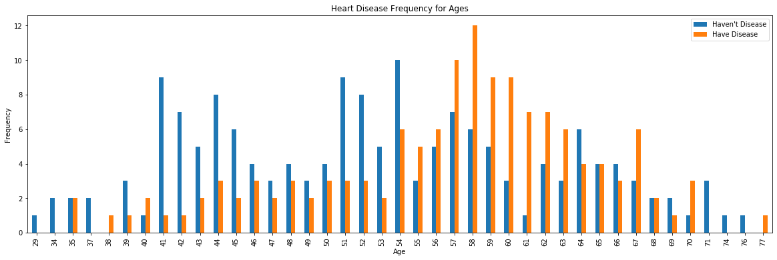
Data Analysis

Slide 7
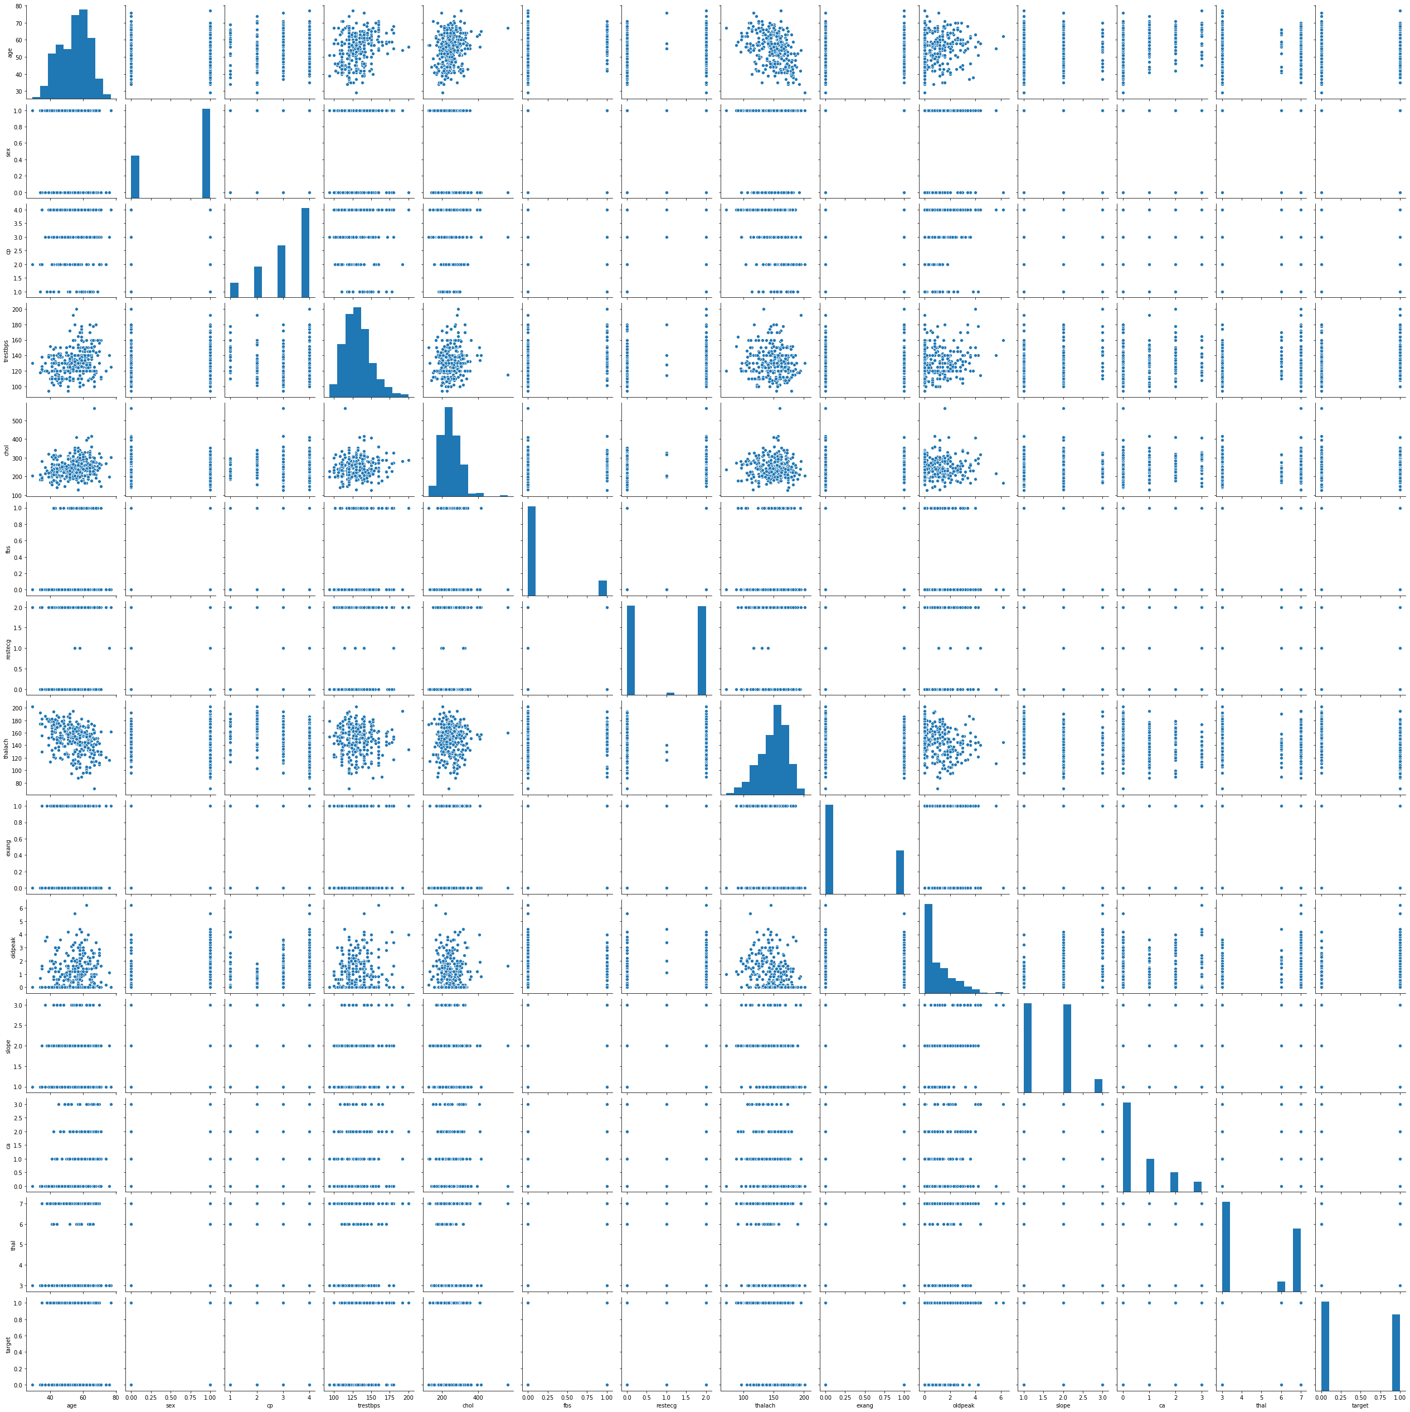
Correlation between Heart disease and its features

Slide 8
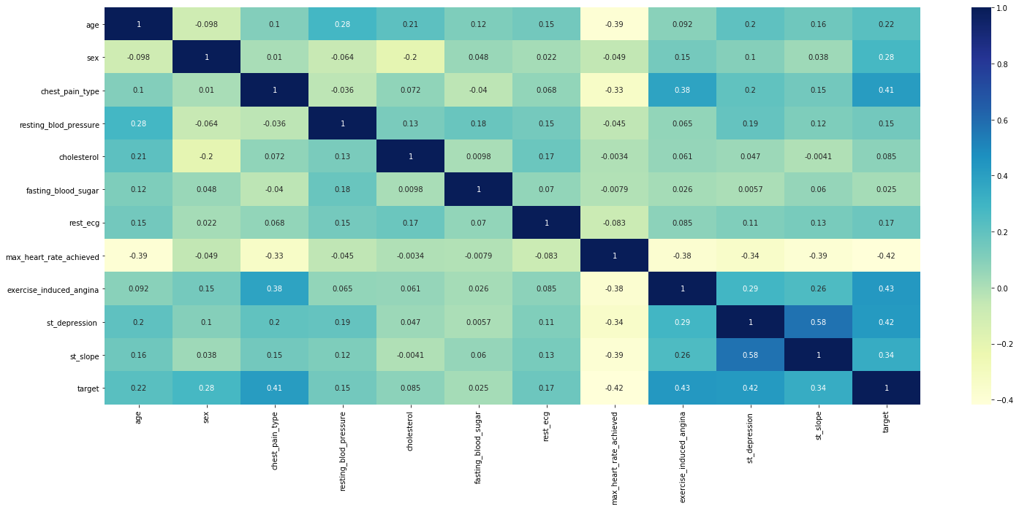
Correlation Matrix

Slide 9
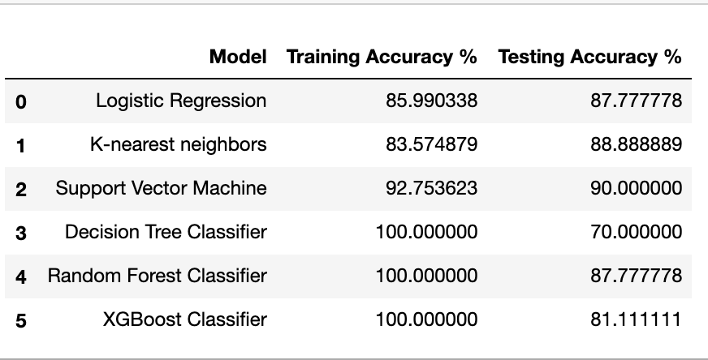
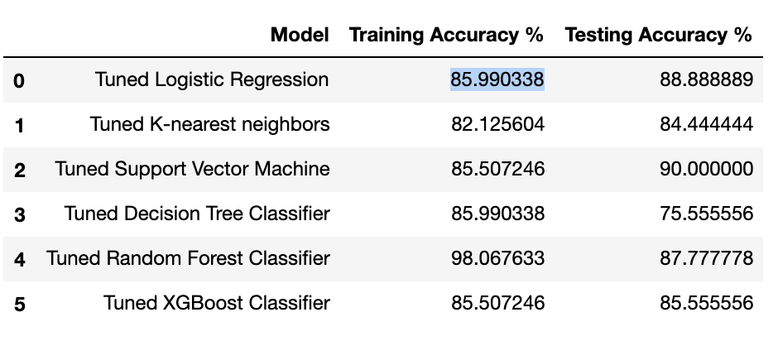
Before Tuning
Machine Learning Models
After Tuning

Slide 10
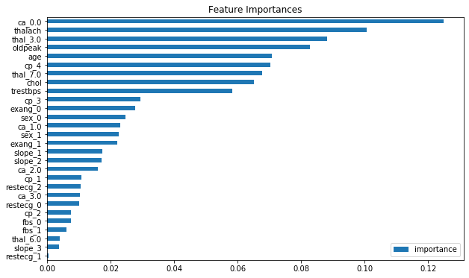
Feature Importance For Random Forrest

Slide 11
Conclusion
The machine learning models used show that SVM and random forest gave the best results.

