Slide 1
http://j.mp/pycontw2013review
Working in progress for a new slogan for
PyCon APAC 2014 in Taiwan

Slide 2
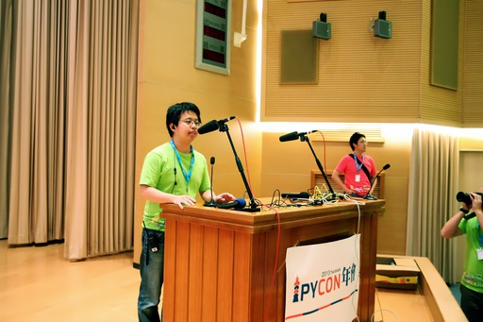
The New Chair Says
Tim Hsu (@TimYellow):
  More interactions.
  More talks.
  More project
  contributors/owners
  and hacking.
  More diversity.
I can leak some insider information:
  https://pycontw.hackpad.com/
  The team has been formed and started working (though quietly).

Slide 3
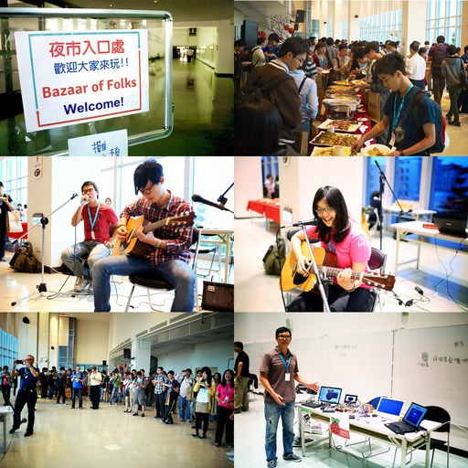
BoF Will Still Be “Bazaar of Folks”
The “night market (夜市)” is one honking great idea -- let's do more of that.
(The volunteers for organizing this have been identified. :)

Slide 4
Growth
PyCon APAC takes the lead to facilitate sharing and communication among Python programmers in this region.
The conferences help us to grow.
We enrich the conferences.
Developers, businesses, and users grow together as a community.
It's what we've seen in Taiwan, and what we hope to see in the whole APAC region.

